Slide 1

The Practice of Statistics for Business and Economics
Third Edition
David S. Moore
George P. McCabe
Layth C. Alwan
Bruce A. Craig
William M. Duckworth
© 2011 W.H. Freeman and Company

Slide 2
Producing Data:
Designing Samples
PSBE Chapter 3.1
© 2011 W.H. Freeman and Company

Slide 3
Objectives (PSBE Chapter 3.1)
Sampling designs
Observation versus experiment
Population versus sample
Sampling methods
Simple random samples
Stratified samples
Caution about sampling surveys

Slide 4
Obtaining data
Available data are data that were produced in the past for some other purpose but that may help answer a present question inexpensively. The library and the Internet are sources of available data.
  Government statistical offices are the primary source for demographic, economic, and social data (visit the Fed-Stats site at www.fedstats.gov).
Beware of drawing conclusions from our own experience or hearsay. Anecdotal evidence is based on haphazardly selected individual cases, which we tend to remember because they are unusual in some way. They also may not be representative of any larger group of cases.
Some questions require data produced specifically to answer them. This leads to designing observational or experimental studies.

Slide 5
Observation and experiment
Observational study: Record data on individuals without attempting to influence the responses.
Example: Watch the behavior of consumers looking at store displays, or the interaction between managers and employees.
Experimental study: Deliberately impose a treatment on individuals and record their responses. Influential factors can be controlled.
Example: To answer the question “Which TV ad will sell more toothpaste?” show each ad to a separate group of consumers and note whether they buy toothpaste.

Slide 6
Observational studies vs. experiments
Observational studies are essential sources of data on a variety of topics. However, when our goal is to understand cause and effect, experiments are the only source of fully convincing data.
Two variables are confounded when their effects on a response variable cannot be distinguished from each other.
Example: If we simply observe cell phone use and brain cancer, any effect of radiation on the occurrence of brain cancer is confounded with lurking variables such as age, occupation, and place of residence.
Well-designed experiments take steps to defeat confounding.

Slide 7
Population versus sample
Population: The entire group of individuals in which we are interested but can’t usually assess directly.
  Example: All humans, all working-age people in California, all crickets
A parameter is a number describing a characteristic of the population.
Sample: The part of the population we actually examine and for which we do have data.
  How well the sample represents the population depends on the sample design.
A statistic is a number describing a characteristic of a sample.
Population
Sample

Slide 8
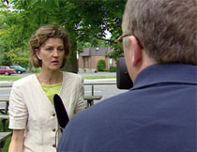
Sampling methods
Convenience sampling: Just ask whoever is around.
  Example: “Man on the street” survey (cheap, convenient, often quite opinionated or emotional → now very popular with TV “journalism”)
Which men, and on which street?
  Ask about corporate regulation or unemployment insurance “on the street” in New York or in some small town in Idaho and you would probably get completely different answers.
  Even within an area, answers would probably differ if you did the survey outside a high school or a restaurant.
Bias: Opinions limited to individuals present.

Slide 9

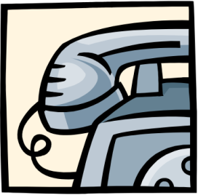
Voluntary response sampling:
Individuals choose to be involved. These samples are very susceptible to being biased because different people are motivated to respond or not. Often called “public opinion polls.” These are not considered valid or scientific.
Bias: Sample design systematically favors a particular outcome.
Ann Landers summarizing responses of readers
Seventy percent of (10,000) parents wrote in to say that having kids was not worth it—if they had to do it over again, they wouldn’t.
Bias: Most letters to newspapers are written by disgruntled people. A random sample showed that 91% of parents WOULD have kids again.

Slide 10
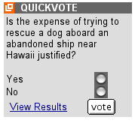
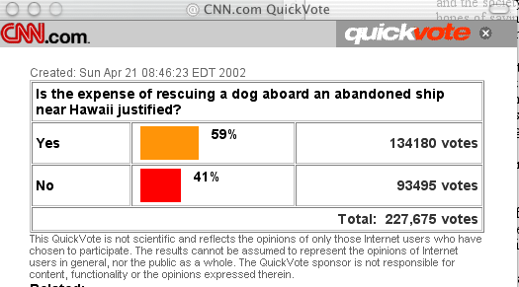
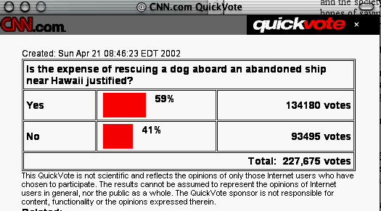
CNN on-line surveys:
Bias: People have to care enough about an issue to bother replying. This sample is probably a combination of people who hate “wasting the taxpayers money” and “animal lovers.”

Slide 11

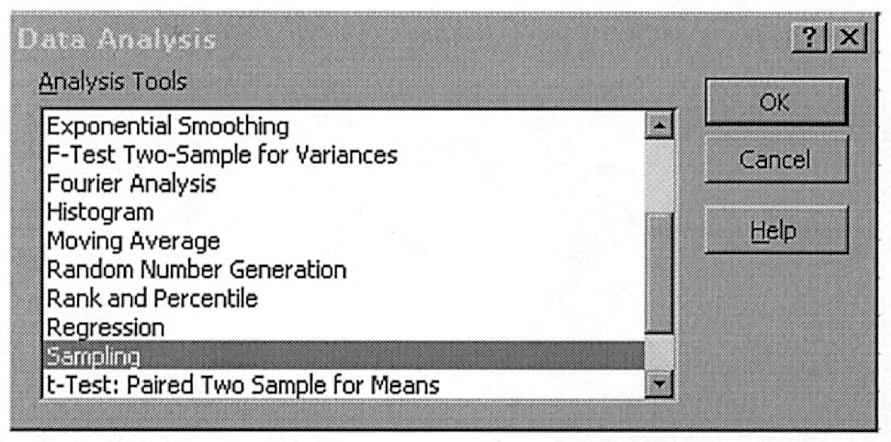
In contrast:
Probability or random sampling:
Individuals are randomly selected. No one group should be over-represented.
Sampling randomly gets rid of bias.
Random samples rely on the absolute objectivity of random numbers. There are tables and books of random digits available for random sampling.
Statistical software can
generate random digits
(e.g., Excel “=random()”).

Slide 12
Simple random samples
A Simple Random Sample (SRS) is made of randomly selected individuals. Each individual in the population has the same probability of being in the sample. All possible samples of size n have the same chance of being drawn.
The simplest way to use chance to select a sample is to place names in a hat (the population) and draw out a handful (the sample).

Slide 13
Stratified samples
There is a slightly more complex form of random sampling:
A stratified random sample is essentially a series of SRSs performed on subgroups of a given population. The subgroups are chosen to contain all the individuals with a certain characteristic. For example:
  Divide the shoppers at a mall into males and females.
  Divide the population of California by major ethnic group.
  Divide the counties in America as either urban or rural based on criteria of population density.
The SRS taken within each group in a stratified random sample need not be of the same size. For example:
  A stratified random sample of 100 male and 150 female shoppers
  A stratified random sample of a total of 100 Californians, representing proportionately the major ethnic groups

Slide 14
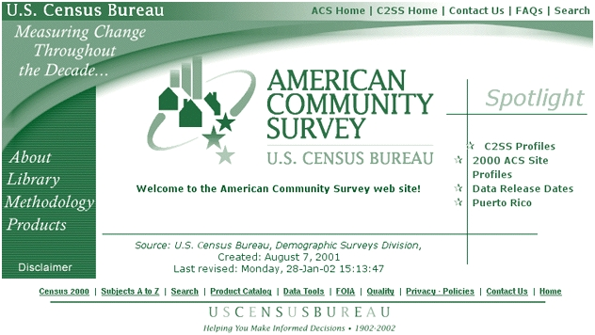
Multistage samples use multiple stages of stratification. They are often used by the government to obtain information about the U.S. population.
  Example: Sampling both urban and rural areas, people in different ethnic and income groups within the urban and rural areas, and then within those strata individuals of different ethnicities.
Data are obtained by taking an SRS for each substrata.
Statistical analysis for
multistage samples is more
complex than for an SRS.

Slide 15
Caution about sampling surveys
Nonresponse: People who feel they have something to hide or who don’t like their privacy being invaded probably won’t answer, yet they are part of the population.
Response bias: Fancy term for lying when you think you should not tell the truth, or forgetting. This is particularly important when the questions are very personal (e.g., “How much do you drink?”) or related to the past.
Wording effects: Questions worded like “Do you agree that it is awful that…” are prompting you to give a particular response.

Slide 16
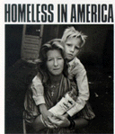
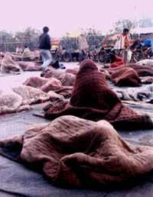
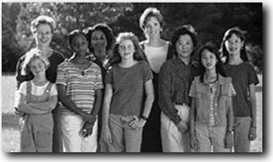

Undercoverage:
  Occurs when parts of the population are left out in the process of choosing the sample.
  Because the U.S. Census goes “house to house,” homeless people are not represented. Illegal immigrants also avoid being counted. Geographical districts with a lot of undercoverage tend to be poor ones. Representatives from richer areas typically strongly oppose statistical adjustment of the census.
Historically, clinical trials have avoided including women in their studies because of their periods and the chance of pregnancy. This means that medical treatments were not appropriately tested for women. This problem is slowly being recognized and addressed.

Slide 17
Caution about sampling surveys
To assess the opinion of shoppers at a mall on parking lot safety, a reporter interviews 15 shoppers he meets walking in the mall in the evening who are willing to give their opinion.
What is the sample here? What is the population? Why?
  All those shoppers walking in the mall in the evening
  All shoppers at malls with parking lot safety issues
  The 15 shoppers interviewed
  All shoppers approached by the reporter
Should you trust the results of this survey? Why or why not?

Slide 18
Caution about sampling surveys
An SRS of 1200 adult Americans is selected and asked: “In light of the huge national deficit, should the government at this time spend additional money to establish a national system of health insurance?” Thirty-nine percent of those responding answered yes.
→ What can you say about this survey?
  The sampling process is sound, but the wording is biased. The results probably understate the percentage of people who do favor a system of national health insurance.
Should you trust the results of this survey? Why or why not?

Slide 19
Capture–recapture sampling
Repeated sampling can be used to estimate the size N of a population (e.g., animals). Here is an example of capture-recapture sampling:
What is the number of a bird species (least flycatcher) migrating along a major route? Least flycatchers are caught in nets, tagged, and released. The following year, the birds are caught again and the numbers tagged versus not tagged recorded. The proportion of tagged birds in the sample should be a reasonable estimate of the proportion of tagged birds in the population.
 | Year 1 | Year 2
Sample size | 200 | 120
Number tagged |  | 12
If N is the unknown total number of least flycatchers, we should have approximately 12/120 = 200/N
➔ N = 200 ×120/12 = 2000
This works well if both samples are SRSs from the population and the population remains unchanged between samples. In practice, however, some of the birds tagged last year died before this year’s migration.

Slide 20
Producing Data:
Designing Experiments & Towards Inference
PSBE Chapters 3.2 and 3.3
© 2011 W.H. Freeman and Company

Slide 21
Objectives (PSBE Chapters 3.2 and 3.3)
Design of experiments and towards inference
Comparative experiments
Randomization
Completely randomized designs
Caution about experimentation
Matched pairs designs
Block designs
Sampling distributions
Bias and variability

Slide 22
Terminology
The individuals in an experiment are the experimental units. If they are human, we call them subjects.
In an experiment, we do something to the subject and measure the response. The “something” we do is called a treatment, or factor.
  The factor may be the administration of a drug.
  One group of people may be placed on a diet/exercise program for six months (treatment), and their blood pressure (response variable) would be compared with that of people who did not diet or exercise.

Slide 23
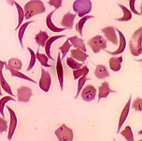
If the experiment involves giving two different doses of a drug, we say that we are testing two levels of the factor.
A response to a treatment is statistically significant if it is larger than you would expect by chance (due to random variation among the subjects). We will learn how to determine this later.
In a study of sickle cell anemia, 150 patients were given the drug hydroxyurea, and 150 were given a placebo (dummy pill). The researchers counted the episodes of pain in each subject. Identify:
The subjects
The factors / treatments
And the response variable
(patients, all 300)
(hydroxyurea and placebo)
(episodes of pain)

Slide 24
Comparative experiments
Experiments are comparative in nature: We compare the response to a treatment to:
  another treatment,
  no treatment (a control),
  a placebo
  or any combination of the above
A control is a situation when no treatment is administered. It serves as a reference mark for an actual treatment (e.g., a group of subjects does not receive any drug or pill of any kind).
A placebo is a fake treatment, such as a sugar pill. This is to test the hypothesis that the response to the actual treatment is due to the actual treatment and not to how the subject is being taken care of.

Slide 25
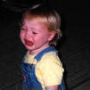

About the placebo effect
The “placebo effect” is an improvement in health due not to any treatment but only to the patient’s belief that he or she will improve.
  The “placebo effect” is not understood, but it is believed to have therapeutic results on up to a whopping 35% of patients.
  It can sometimes ease the symptoms of a variety of ills, from asthma to pain to high blood pressure, and even to heart attacks.
  An opposite, or “negative placebo effect,” has been observed when patients believe their health will get worse.
  The most famous, and maybe most powerful, placebo is the “kiss,” blow, or hug—whatever your technique.
Unfortunately, the effect gradually disappears
once children figure out that they sometimes
get better without help and vice versa.

Slide 26
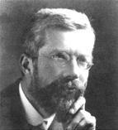
Designing “controlled” experiments
Sir Ronald Fisher—The “father of statistics”
He was sent to Rothamsted Agricultural Station in the United Kingdom to evaluate the success of various fertilizer treatments.
Fisher found the data from experiments going on for decades to be basically worthless because of poor experimental design.
  Fertilizer had been applied to a field one year and not in another in order to compare the yield of grain produced in the two years. BUT
    it may have rained more, or been sunnier, in different years.
    the seeds used may have differed between years as well.
  Or fertilizer was applied to one field and not to a nearby field in the same year. BUT
    the fields might have different soil, water, drainage, and history of previous use.
➔ Too many factors affecting the results were “uncontrolled.”

Slide 27
Fisher’s solution:
“Randomized comparative experiments”
In the same field and same year, apply fertilizer to randomly spaced plots within the field. Analyze plants from similarly treated plots together.
This minimizes the effect of variation within the field in drainage and soil composition on yield, as well as controlling for weather.
F |  | F |  | F |  |  | F | F |  |  | F
 |  | F | F | F | F |  | F | F | F |  | F
 | F |  | F |  |  |  |  | F | F |  | F
F | F |  | F |  |  | F |  | F | F | F | F
 | F |  |  | F |  | F | F | F
 |  |  | F | F |  |  | F |  |  |  | F

Slide 28
Randomization
One way to randomize an experiment is to rely on random digits to make choices in a neutral way. We can use a table of random digits (like Table B) or the random sampling function of a statistical software.
The process is the same as shown before when choosing employees.

Slide 29
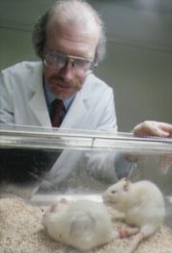
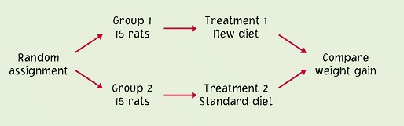
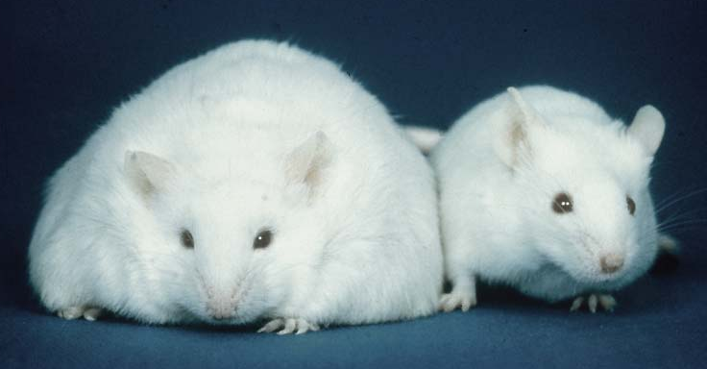
Completely randomized designs
Completely randomized experimental designs:
Individuals are randomly assigned to groups, then
the groups are randomly assigned to treatments.

Slide 30
Principles of experimental design
Three big ideas of design of experiments:
Control the effects of lurking variables on the response, most simply by comparing two or more treatments.
Randomize – use impersonal chance to assign subjects to treatments.
Replicate each treatment on enough subjects to reduce chance variation in the results.
Statistical Significance: An observed effect so large that it would rarely occur by chance is called statistically significant.

Slide 31
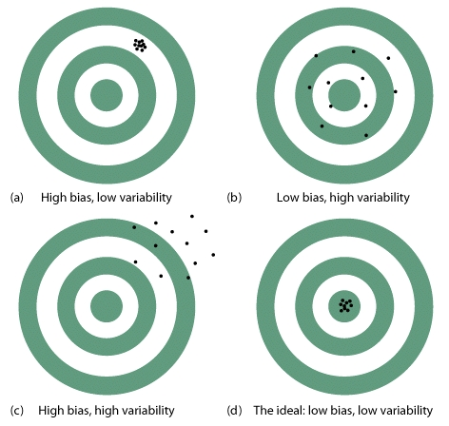
Caution about experimentation
The design of a study is biased if it systematically favors certain
outcomes.
The best way to exclude biases in an experiment is to randomize the design. Both the individuals and treatments are assigned randomly.

Slide 32
Other ways to remove bias:
A double-blind experiment is one in which neither the subjects nor the experimenter know which individuals got which treatment until the experiment is completed. The goal is to avoid forms of placebo effects and biases in interpretation.
The best way to make sure your conclusions are robust is to replicate your experiment—do it over. Replication ensures that particular results are not due to uncontrolled factors or errors of manipulation.

Slide 33
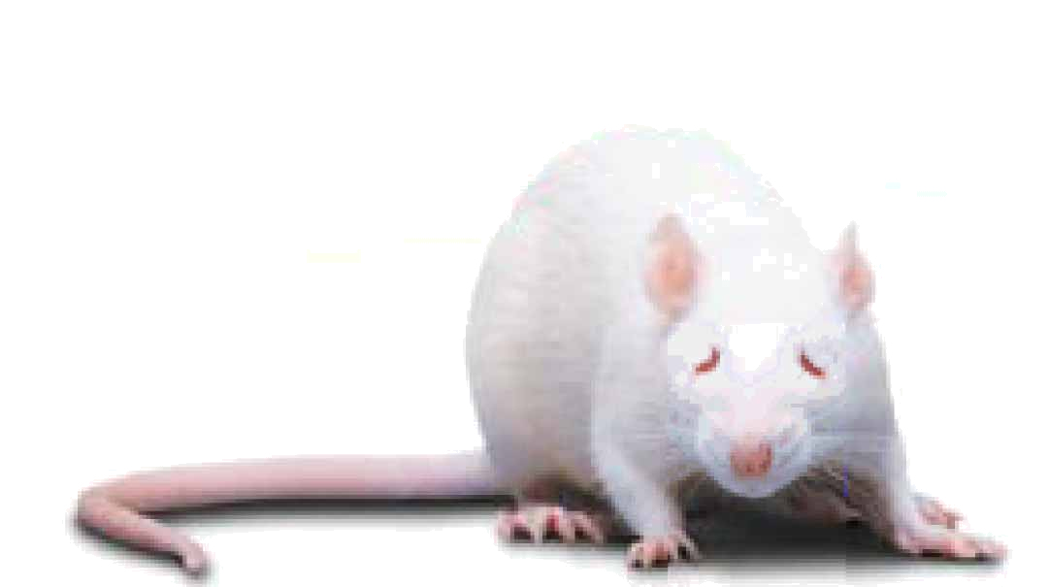
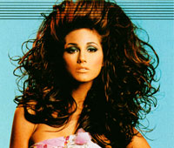
Lack of realism
Lack of realism is a serious weakness of experimentation. The subjects or treatments or setting of an experiment may not realistically duplicate the conditions we really want to study. In that case, we cannot generalize the conclusions of the experiment.
Is the treatment appropriate for the response you want to study?
Is studying the effects of eating red meat on cholesterol values in a group of middle aged men a realistic way to study factors affecting heart disease problems in humans?
What about studying the effects of hair spray
on rats to determine what will happen
to women with big hair?

Slide 34
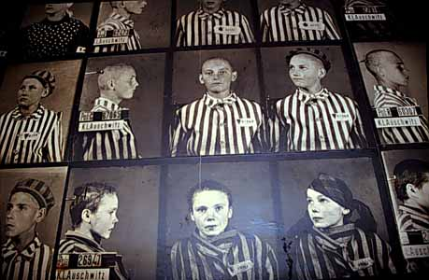
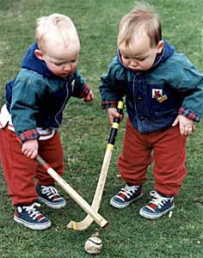
Matched pairs designs
Matched pairs: Choose pairs of subjects that are closely matched—e.g., same sex, height, weight, age, and race. Within each pair, randomly assign who will receive which treatment.
It is also possible to just use a single person, and give the two treatments to this person over time in random order. In this case, the “matched pair” is just the same person at different points in time.
The most closely
matched pair
studies use
identical twins.

Slide 35
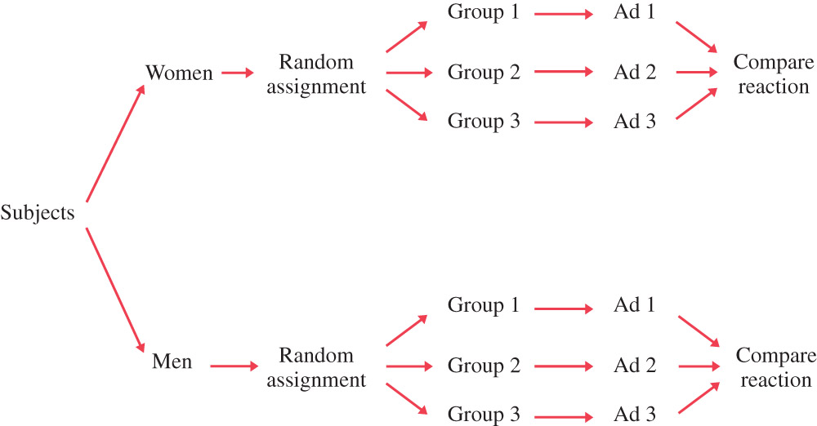
Block designs
In a block, or stratified, design, subjects are divided into groups, or blocks, prior to experiments to test hypotheses about differences between the groups.
The blocking, or stratification, here is by gender.

Slide 36
Toward statistical inference
The techniques of inferential statistics allow us to draw inferences or conclusions about a population in a sample.
  Your estimate of the population is only as good as your sampling design. → Work hard to eliminate biases.
  Your sample is only an estimate—and if you randomly sampled again you would probably get a somewhat different result.
  The bigger the sample the better.
Population
Sample

Slide 37
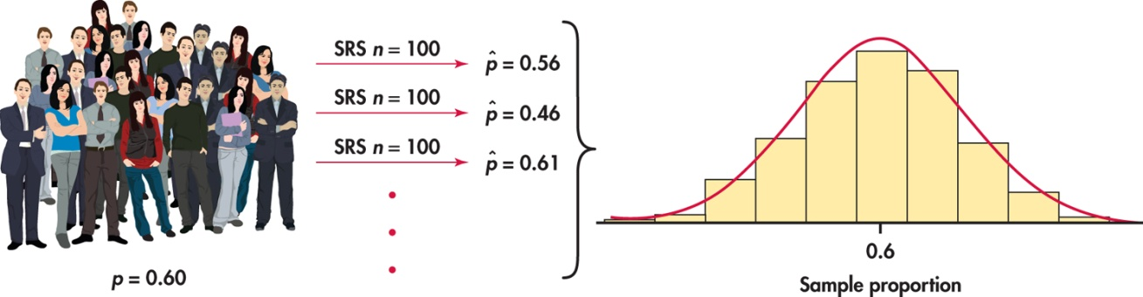
Sampling variability
Each time we take a random sample from a population, we are likely to get a different set of individuals and calculate a different statistic. This is called sampling variability.
The good news is that, if we take lots of random samples of the same size from a given population, the variation from sample to sample—the sampling distribution—will follow a predictable pattern. All of statistical inference is based on this knowledge.

Slide 38
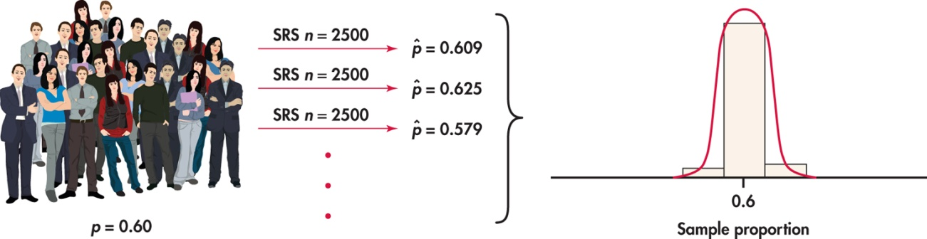
Sampling variability
Each time we take a random sample from a population, we are likely to get a different set of individuals and calculate a different statistic. This is called sampling variability.
If we increase the sample size, the statistic from the larger sample is less variable.

Slide 39
The variability of a statistic is described by the spread of its sampling distribution. This spread depends on the sampling design and the sample size n, with larger sample sizes leading to lower variability.
➔ Large random samples are almost always close estimates of the true population parameter. However, this only applies to random samples.
Remember the “QuickVote” online surveys. They are worthless no matter how many people participate because they use a voluntary sampling design and not random sampling.

Slide 40
Managing bias and variability
To reduce bias, use random sampling. The values of a statistic computed from an SRS neither consistently overestimate or underestimate the value of a population parameter.
To reduce the variability of a statistic from an SRS, use a larger sample. You can make the variability as small as you want by taking a large enough sample.
Population size doesn’t matter: The variability of a statistic from a random sample does not depend on the size of the population, as long as the population is at least 100 times larger than the sample.

Slide 41
Practical note
Large samples are not always attainable.
  Sometimes the cost, difficulty, or preciousness of what is studied limits drastically any possible sample size.
  Blood samples/biopsies: No more than a handful of repetitions acceptable. We often even make do with just one.
  Opinion polls have a limited sample size due to time and cost of operation. During election times though, sample sizes are increased for better accuracy.

Slide 42
Producing Data:
Data Ethics
PSBE Chapter 3.4
© 2011 W.H. Freeman and Company

Slide 43
Objectives (PSBE Chapter 3.4)
(self-study: please read the textbook)
Data Ethics
Institutional review boards
Informed consent
Confidentiality
Clinical trials
Behavioral and social science experiments

Slide 44
Institutional review boards
The organization that carries out the study must have an institutional review board that reviews all planned studies in advance in order to protect the subjects from possible harm.
The purpose of an institutional review board is “to protect the rights and welfare of human subjects (including patients) recruited to participate in research activities.”
The institutional review board:
      reviews the plan of study
      can require changes
      reviews the consent form
      monitors progress at least once a year

Slide 45
Informed consent
All subjects must give their informed consent before data are collected.
Subjects must be informed in advance about the nature of a study and any risk of harm it may bring.
Subjects must then consent in writing.
Who can’t give informed consent?
      prison inmates
      very young children
      people with mental disorders

Slide 46
Confidentiality
All individual data must be kept confidential. Only statistical summaries may be made public.
Confidentiality is not the same as anonymity. Anonymity prevents follow-up to improve non-response or inform subjects of results.
Separate the identity of the subjects from the rest of the data at once!
Example: Citizens are required to give information to the government (tax returns, social security contributions). Some people feel that individuals should be able to forbid any other use of their data, even with all identification removed.

Slide 47
Clinical trials
Clinical trials study the effectiveness of medical treatments on actual patients – these treatments can harm as well as heal.
Points for a discussion:
      Randomized comparative experiments are the only way to see the true effects of new treatments.
      Most benefits of clinical trials go to future patients. We must balance future benefits against present risks.
      The interests of the subject must always prevail over the interests of science and society.
In the 1930s, the Public Health Service Tuskegee study recruited 399 poor blacks with syphilis and 201 without the disease in order to observe how syphilis progressed without treatment. The Public Health Service prevented any treatment until word leaked out and forced an end to the study in the 1970s.

Slide 48
Behavioral and social science experiments
Many behavioral experiments rely on hiding the true purpose of the study.
Subjects would change their behavior if told in advance what investigators were looking for.
The “Ethical Principals” of the American Psychological Association require consent unless a study merely observes behavior in a public space.

