Slide 1
实用生物信息学小组汇报
占领生信高地的人
组长：燕思凡
组员：张铭旆 崔露莹 王永达 贾振国
指导：邹益
任务分工：文章理解（崔露莹，燕思凡）代码实现（贾振国）
PPT制作（王永达，张铭旆）

Slide 2

原文链接： https://www.nature.com/articles/s41564-019-0560-0

Slide 3
Part1 ARTICLE

Slide 4
Abstract
1. The term core microbiome describes microbes that are consistently present in a particular habitat. If the conditions
in that habitat are highly variable, core microbes may also be considered to be ecological generalists.
However, little is known about whether metabolic competition and microbial interactions influence the ability of some microbes to persist in the core microbiome while others cannot.
We investigated microbial communities at three sites in the guts of European seabass under four dietary conditions. We identified generalist core microbial populations in each gut site that are shared across fish, present under multiple diets and persistent over time.
We found that core microbes tend to show synergistic growth in co-culture, and low levels of predicted and validated metabolic competition.Within core microbial species, we found high levels of intraspecific variability and strain-specific habitat specialization.
Thus, both intraspecific variability and interspecific facilitation may contribute to the ecological stability of the animal core microbiome.

Slide 5
Main
From an ecological viewpoint, generalist species can be defined as taxa that inhabit different environments or environmental gradients; within these generalist species are members of the core microbiome—taxa with high occupancy that persist across multiple assemblages associated with a habitat (such as the gut).
Thus, the concept of the core microbiome considers persistent and sometimes highly abundant microbes in a microbial community that are also considered to be stable communities. Although research during the past few years has focused on understanding the role of these generalist microbiome members, their persistence across multiple hosts and habitats is not yet understood.
Microbial competition has recently been suggested to drive the stability of microbial communities in the ecosystem; however, mutualism or skewed interspecies interactions (amensalism or commensalism) have been observed in ecology to promote diversity and community stability. Moreover, alternative ecological theories, suggesting that generalist species are assemblages of more specialized individuals through increased variation among individuals, can also explain species persistence.
Here, using the fish gut as a model (European seabass), we aimed to identify such generalist core microbial populations that are widespread across multiple habitats and environmental conditions, and to elucidate the mechanisms that enable their patterns of persistence, such as the forces that stabilize them as populations and communities.
Our findings suggest that the persistence and coexistence of these core microbes are maintained through low competition and synergistic interactions, as well as intraspecies strain variability.

Slide 6
Results 1
Habitat filtering by gut part, and not diet, is the major driver shaping fish gut microbial communities.

Slide 7
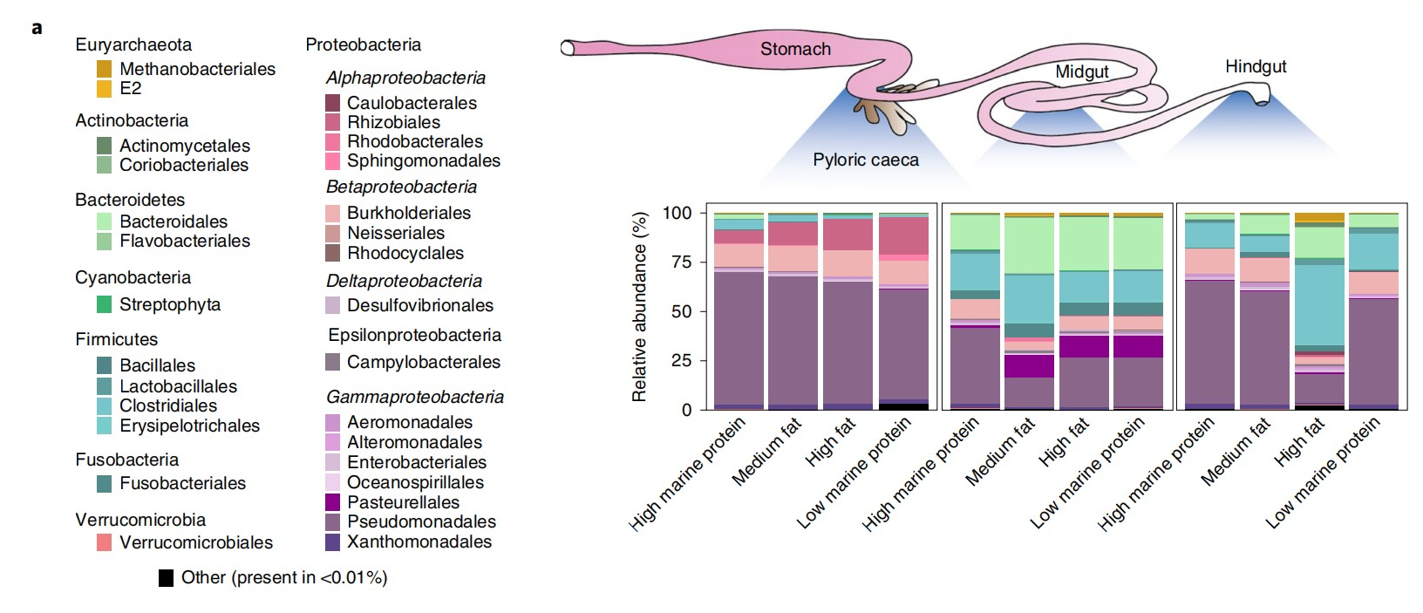
a, The relative abundance of the microbial communities at the order level found in different gut compartments (pyloric caeca, midgut and hindgut) of fish that were fed different diets.

Slide 8
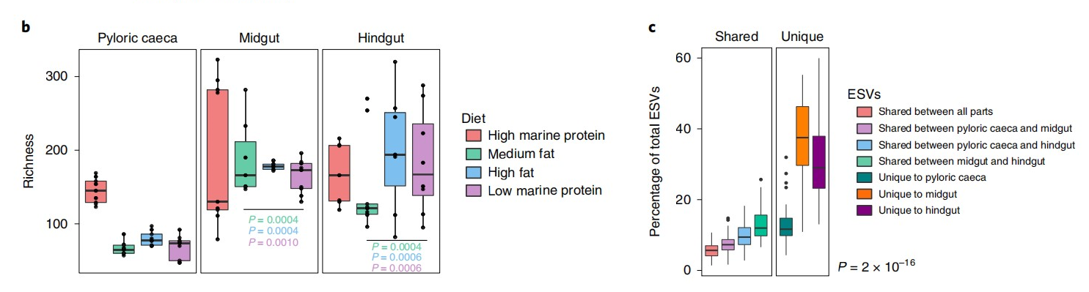
b, Microbial richness within the different gut compartments of fish fed different diets. P-values indicate significant difference from the pyloric caeca (paired two-sided Wilcoxon t-test, 95% CI). Data are shown as box plots (n = 9 fish individuals); the horizontal line indicates the median and the whiskers indicate the lowest and highest points within 1.5× the interquartile ranges of the lower or upper quartile, respectively. P values with different colours denote the values for each diet.

Slide 9
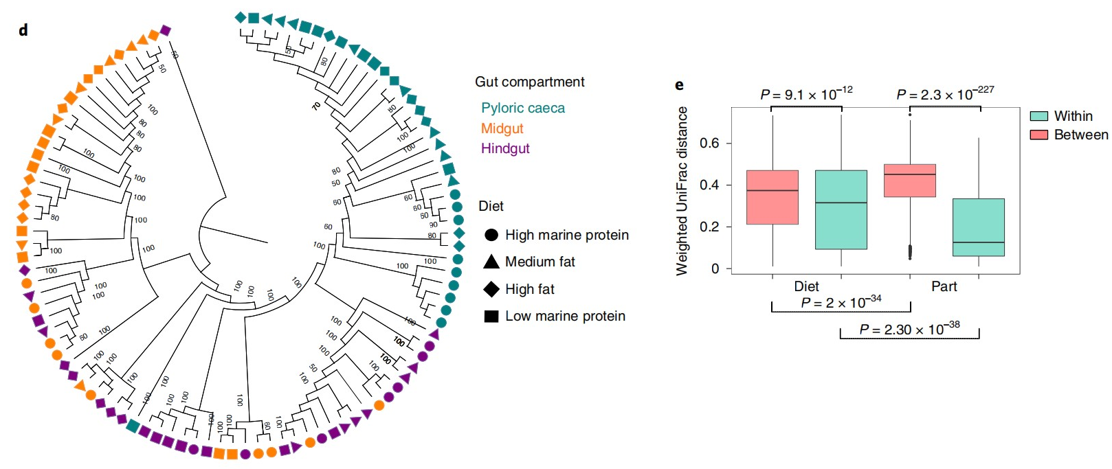
d. Hierarchical clustering dendrogram with jackknife support (numbers on the branches; only values above 50 are shown in the tree) using weighted UniFrac as a metric to compare similarity between different gut compartments. Shapes indicate different diets and colours indicate the different fish gut parts. e. Weighted UniFrac distance within and between samples originating from different gut parts or diets (two-sided Wilcoxon t-test, 95% CI; for within versus between gut parts, P < 0.0001). Box plots (n = 36 fish individuals) describe the data as in b.

Slide 10
Results 2
A core microbial community composed of 8 abundant generalist species persists across different habitats of diets and gut parts, and across different species of fish.different species of fish.

Slide 11
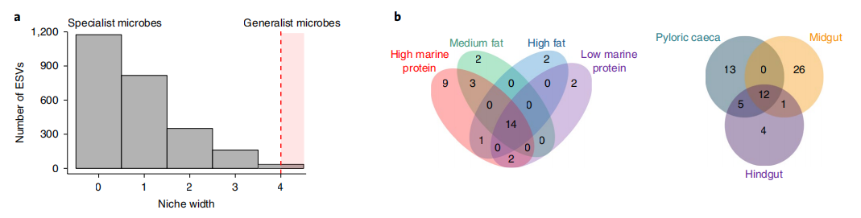
a.Niche width of the overall microbial communities calculated using Shannon index H′. Generalists are defined as microbes with the largest niche width (top 10th percentile), and specialists as microbes with the smallest niche width (bottom 10th percentile).
b. Venn diagram showing shared and unique ESVs between dietary treatments and gut parts (habitats), present in more than 90% of the samples for each specific habitat (see the ‘Shared and unique microbiomes’ section in the Methods). At the species level, 8 microbes that were shared among all diets and gut parts and fell into the generalist niche width were defined as core microbes (4 out of 12 ESVs belonged to the same species at 97% sequence identity).

Slide 12
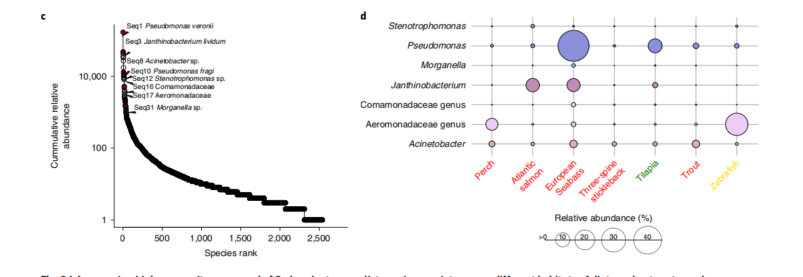
c.Rank-relative abundance plot of the overall microbial communities on a log scale. Red circles indicate the core microbes.
d. Balloon plot showing the abundance of the core generalist communities across different fish species at the genus level. Red, green and yellow text indicates carnivorous fish, herbivores and omnivores, respectively. Data are from the studies cited in Supplementary Table 15.

Slide 13
Results 3
Facilitation and positive interactions are prevalent among identified generalist core microbes.

Slide 14
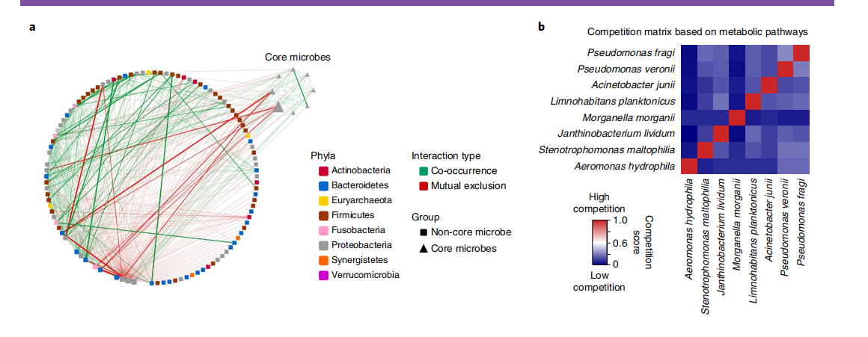
a, Network of co-occurring ESVs based on correlation analysis. Core microbes have strong positive correlations among them. A connection stands for a strong (1,000 most extreme values—negative or positive—based on of five methods of ensemble reference: Spearman, Pearson, mutual information, Bray–Curtis and Kullback–Leibler dissimilarity; default settings) and significant correlation (q< 0.05, after Benjamini–Hochberg correction; bootstrap, n= 100; permutations, n= 100). The size of each node is proportional to the relative abundance of the ESV. The edge thickness corresponds to the statistical significance (the P value) of the correlation—the thicker the edge, the lower the P value—whereas the edge transparency denotes the strength of the correlation (R). Green edges represent co_x0002_occurrence between two ESVs, red edges represent mutually excluded ESVs. Nodes are coloured by phylum taxonomy. Nodes of core microbes are indicated as triangles.
b, Competition matrix based on the analysis using NetCmpt (0, no competition; 1, competitive interactions). The matrix is not symmetrical as the pairwise interactions between the ESVs may differentially affect each of the microbes.

Slide 15
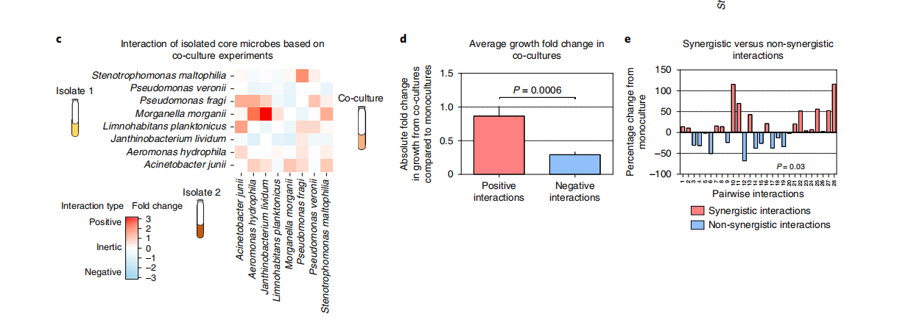
c, Pairwise co-cultivation of the core microbes in digested in vitro feed extract for 24 h (experimental design is provided in Supplementary Fig. 7). Colour intensity indicates fold-change increase (positive interaction; red) or decrease (negative interaction; blue) relative to single-microbe growth (monoculture).
d, Box plots showing the absolute fold change in 16S rRNA gene copies from co-cultures in comparison to the single cultures. Positive interactions originating from the co-cultures are shown in red and negative interactions are shown in blue. Statistical analysis was performed using two-sided Wilcoxon rank-sum tests, 95% CI. For the box plots (n= 8 core microbe in pairwise interactions), the horizontal line indicates the median and the whiskers indicate the lowest and highest points within 1.5×the interquartile ranges of the lower or upper quartile, respectively.
e, Synergistic interactions are calculated by analysing the total 16S rRNA gene copy number in the co-cultures compared with the sum of 16S rRNA gene copy numbers in each individual culture (see Methods; Supplementary Fig. 8). Bar plots represent the percentage change in growth (either positive or negative) of each co-culture compared with the monocultures, showing that synergistic interactions (pink, synergistic; blue, non-synergistic interactions) are prevalent in the core microbes. We found that the percentage change originating from positive and negative interactions was significant; the statistical analysis was performed using a Wilcoxon t-test.

Slide 16
Results 4
Generalist core species show higher strain variability, which is congruent with their habitat preferences.

Slide 17
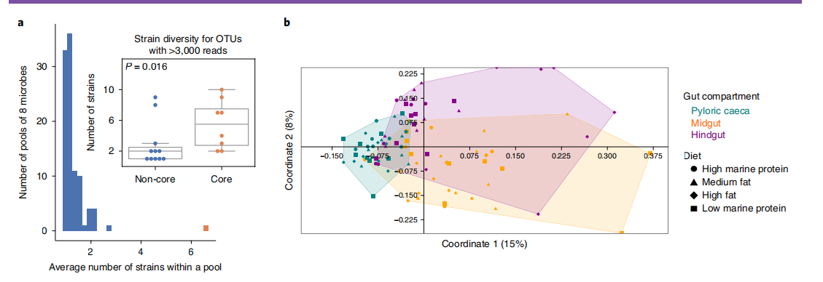
a, A histogram showing the strain richness within a species (97% sequence similarity clusters) comparing core versus randomly sampled non-core species (see the ‘Strain variation’ section in the Methods). Data are average strain richness in a pool of 8 microbes. The red bar shows the average number of strains of the core microbes; the blue bars denote the average number of strains of randomly selected pools of 8 microbes, iterated 100 times. Significance (P= 0.0099) was assessed using one-sided Mann–Whitney U-tests (95% CI). Inset: the box plots show the strain richness within a species (97% sequence similarity clusters) comparing core versus non-core species with more than 3,000 sequence read depth (see the ‘Strain variation’ section in the Methods). Significance (P= 0.016) was assessed using two-sided Mann–Whitney U-tests (95% CI). Data are shown as box plots; the horizontal line indicates the median of the sum of strains for all of the core species and the whiskers indicate the lowest and highest point within 1.5× the interquartile ranges of the lower or upper quartile, respectively. b, Principal coordinates analysis of samples (PERMANOVA, P= 0.001, 95% CI; n= 9 fish per diet and 3 parts per fish; see Methods) based on the presence–absence patterns of strains (Jaccard metric) originating from the core microbe cluster by gut part (colour) and diet (shape).

Slide 18
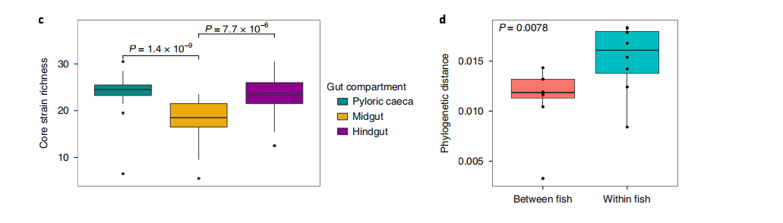
c, Strain richness originating from all of the core microbes across the gut parts (n= 51 total strains from 8 core microbes). Statistical analyses were performed using paired two-sided Wilcoxon rank-sum tests with Benjamini–Hochberg correction (P< 0.05, 95% CI). Box plots describe the data as the inset of a. d, The average phylogenetic distances of strains shared between fish and strains (n= 8 core microbes) within a fish. Statistical analyses were performed using paired two-sided Wilcoxon rank-sum tests (P= 0.0078, 95% CI). Box plots describe the data as the inset of a.

Slide 19
Part2 CODE

Slide 20
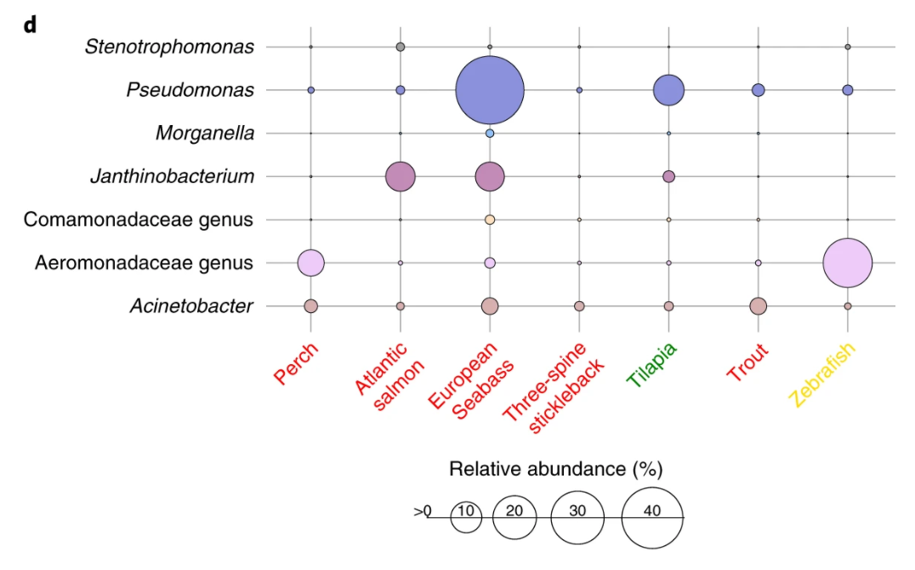
气泡图

Slide 21
气泡图
气泡图（bubble chart）：可用于展示三个变量之间的关系。它与散点图类似，绘制时将一个变量放在横轴，另一个变量放在纵轴，第三个变量则用气泡的大小来表示。
Balloon plot showing the abundance of the core generalist communities across different fish species at the genus level. Red, green and yellow text indicates carnivorous fish, herbivores and omnivores, respectively.

Slide 22
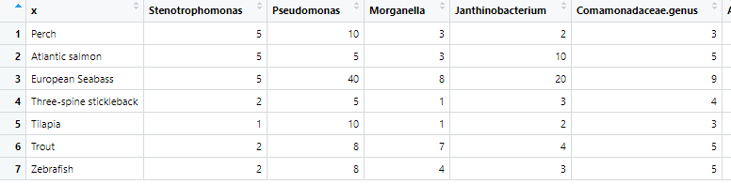
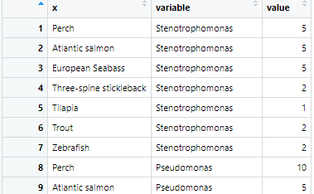
file.path <- file.choose()
file.path
df<-read.csv("bubbletest.csv",
header=T)
df1<-reshape2::melt(df)
导入数据
将长数据转化为宽数据

Slide 23
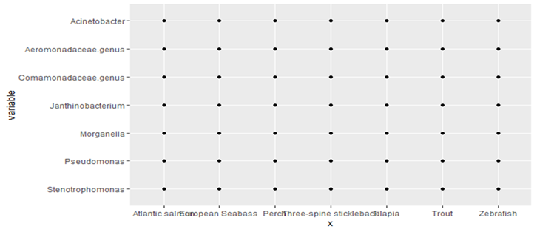
library(ggplot2)
ggplot(df1,aes(x=x,y=variable))+
geom_point(aes(color=value,size=value))+
theme(panel.background = element_blank(),
panel.grid = element_line(color=“black"),
axis.title = element_blank(),
axis.ticks = element_blnk(),
legend.position = "bottom",
axis.text.x=element_text(angle = 45,hjust = 1,
colour = c("red","red","red","red",
"green","red","yellow")))+
初始散点图
修改背景，标题，给x坐标添加颜色

Slide 24
guides(color=FALSE,
size=guide_legend(title.position = "top",
title.hjust = 0.5,
override.aes =
list(size=c(1,2,3,4))))+
labs(size="Relative abundance (%)")+
scale_color_viridis_c()+
scale_size_continuous(range = c(1,10))
去掉图例
对标题及气泡颜色大小进行调整

Slide 25
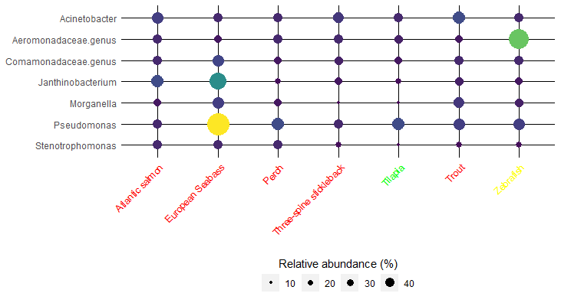

Slide 26
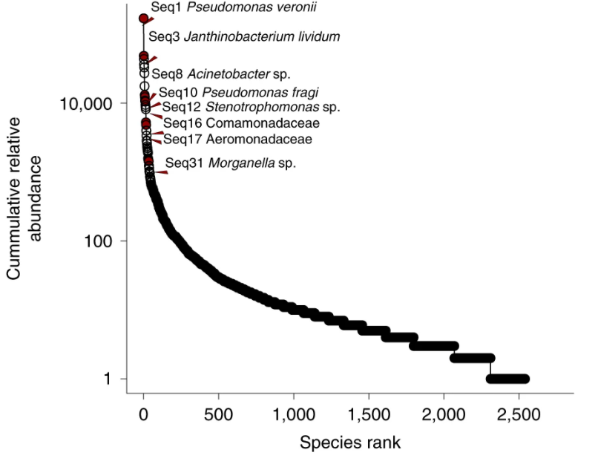
散点图
Rank-relative abundance plot of the overall microbial communities on a log scale. Red circles indicate the core microbes.

Slide 27
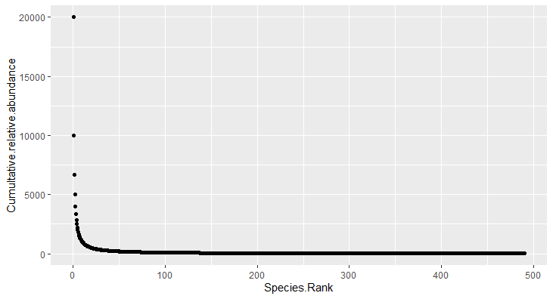
导入数据并获得初始图像
file.path <- file.choose()
file.path
df1<-read.csv("scatterplot.csv",header=T)
library(ggplot2)
ggplot(df1,aes(x=Species.Rank,y=Cumultative.relative.abundance))+
geom_point()

Slide 28
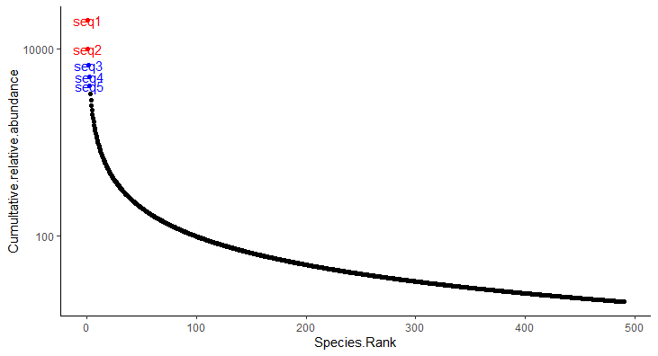
添加标签，颜色，调整坐标
ggplot(df1,aes(x=Species.Rank,y=Cumultative.relative.abundance，colour=color))+
scale_color_manual(values = c("black", "red", "blue"))+
scale_y_log10(breaks=c(100,10000), labels=c(100,10000))+
geom_text(aes(label=text_label））+
theme(panel.background = element_blank(),
axis.line = element_line())+
guides(color=FALSE)

Slide 29
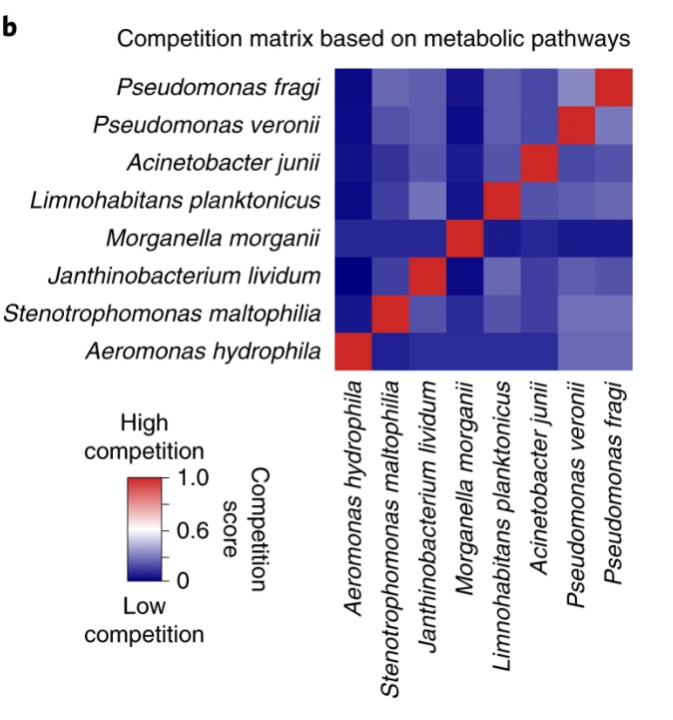
相关性矩阵热图
Competition matrix based on the analysis using NetCmpt (0, no competition; 1, competitive interactions). The matrix is not symmetrical as the pairwise interactions between the ESVs may differentially affect each of the microbes.

Slide 30
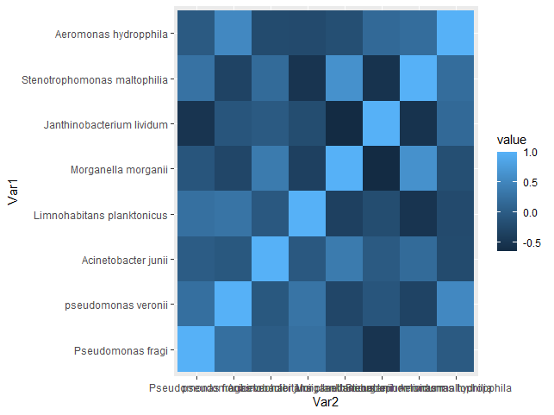
构建矩阵并获得初步图像
library(ggplot2)
library(ggplot2)
test1 <- matrix(runif(64,0,10)，nrow=8,ncol=8,dimnames=list(c("Pseudomonas fragi","pseudomonas veronii","Acinetobacter junii","Limnohabitans planktonicus","Morganella morganii","Janthinobacterium lividum","Stenotrophomonas maltophilia","Aeromonas hydropphila"),c("A","B","C","D","E","F","G","H")))
head(test1)
test2 <- round(cor(test1), 2)
head(test2)
library(reshape2)
test3 <- melt(test2)
head(test3)
ggplot(data = test3, aes(x=Var2, y=Var1, fill=value)) +
geom_tile()

Slide 31
调整颜色，进一步美化图像
ggplot(data =test3, aes(x=Var2, y=Var1, fill = value)) +
geom_tile(color = "white") +
scale_fill_gradient2(low = "blue", high = "red", mid = "white",
midpoint = 0, limit = c(-1, 1), space = "Lab",
name=“Competition score") +
theme_minimal() +
theme(axis.text.x = element_text(angle = 45, vjust = 1,
size = 12, hjust = 1)) +
coord_fixed()

Slide 32
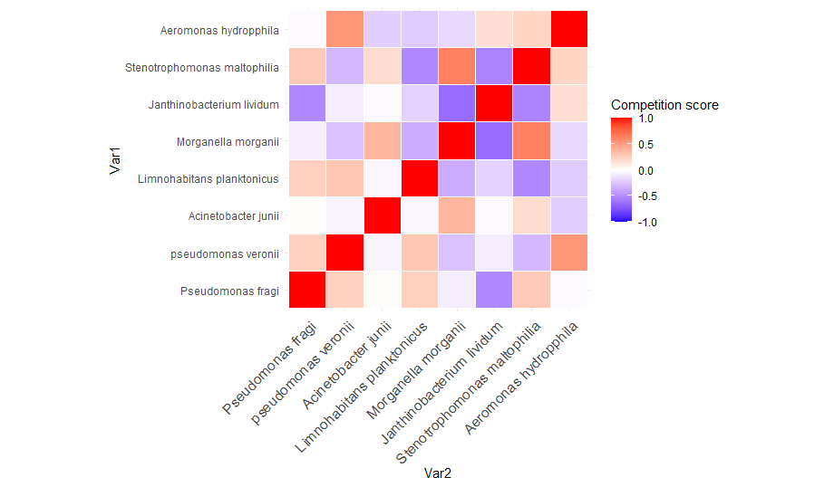

Slide 33
本组项目的代码、数据已托管于https://github.com/wangyongdalt/bioinformation-project

Slide 34
THANK YOU！

