Slide 1
GAME 3:
CLEANING UP
Need your help to clean below messy data no less than 50 times in 30 sec:
Missing value
Duplicates
Outliers
Play Game

Slide 2


times

Slide 3


Missing
data

Slide 4
Outlier

Slide 5

Duplicates

Slide 6
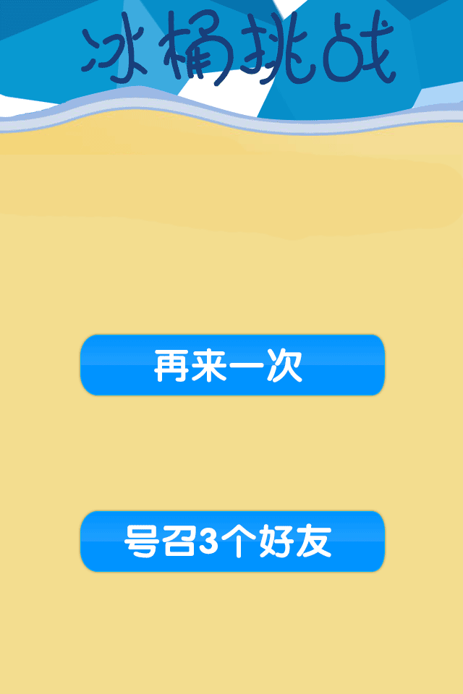
Play Again
Back to Menu

Slide 7
Outlier

Slide 8
Outlets

