Slide 1

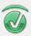
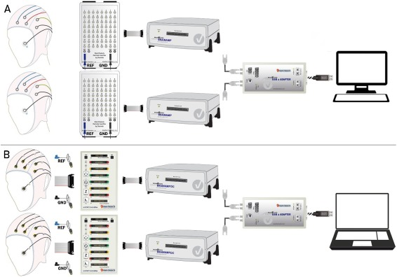
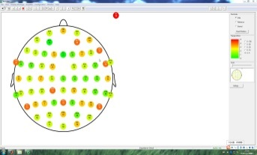
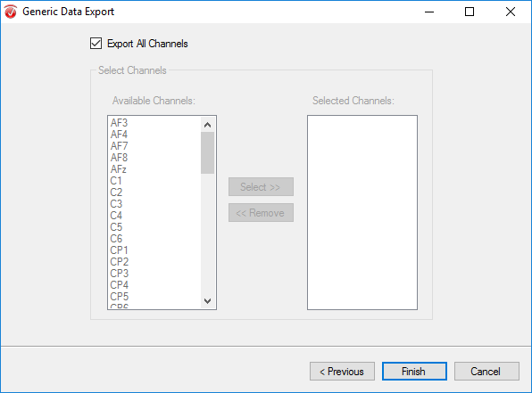
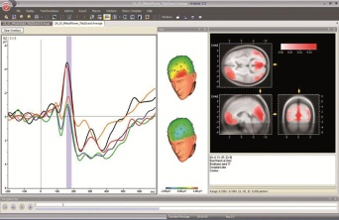

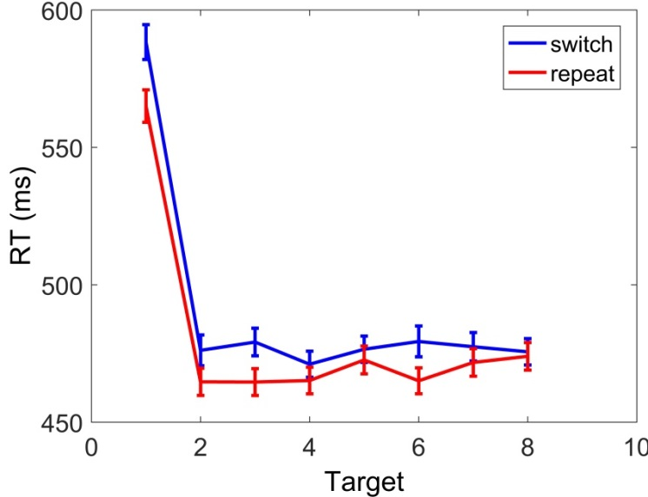
Stimuli & Recording
Hardware
Software
BrainVision Recorder 2.0
Recording
BrainVision Analyzer 2.0
Experimental design
Reaction times
cue
形状
or
颜色
Stimuli
target

Slide 2
Pre-processing workflow on the EEGLAB
File> Import data
>> Using EEGLAB function and plugins
>>> From Brain Vis. Rec. .vhdr file
Read raw eeg
Re-reference
Filter
Segmentation
Run ICA
Reject Artifact
Tools> Re-reference
>> Re-reference data to channel: FT9 FT10
Tools> Filter the data
>> Basic FIR filter: Pass band(2-49Hz)
Tools> Run ICA
>> ICA algorithm to use (click to select) : runica
Tools> SASICA
Tools> Extract epochs
>>Epoch limits [start, end] in seconds: -0.2 1

Slide 3
Pre-processing MATLAB script
Read raw eeg
>>PATHIN=‘**’; % the pathway of EEG data
>>cd PATHIN;%change current pathway
>>list=dir(‘*.vhdr’);% get the list of eeg file
>>EEG=pop_loadbv(PATHIN,list(s).name);% read s(th) eeg file
>>[ALLEEG EEG CURRENTSET] = pop_newset(ALLEEG, EEG,…
0,'setname','EEG_data','gui','off');% create new dataset
>>EEG=pop_chanedit(EEG, ‘lookup’,‘D:\MATLAB2016a\toolbox\eeglab\plugins\...
dipfit2.3\standard_BESA\standard-10-5-cap385.elp');% set channel location
Re-reference
>>EEG = pop_reref( EEG, [31 32] ); % set the average of FT9 and FT10 as new reference
>>[ALLEEG EEG CURRENTSET] = pop_newset(ALLEEG, EEG, 1,'gui','off');
% create new dataset
Filter
>>EEG = pop_eegfilt(EEG, lowfre,highfre,[], [0], 0, 0, 'fir1', 0);% pass band
>>[ALLEEG EEG CURRENTSET] = pop_newset(ALLEEG, EEG, 2,'gui','off');
Run ICA
>>EEG = pop_runica(EEG, 'extended',1,'interupt','on'); % run ICA
>>[ALLEEG EEG] = eeg_store(ALLEEG, EEG, CURRENTSET); %create new dataset

Slide 4
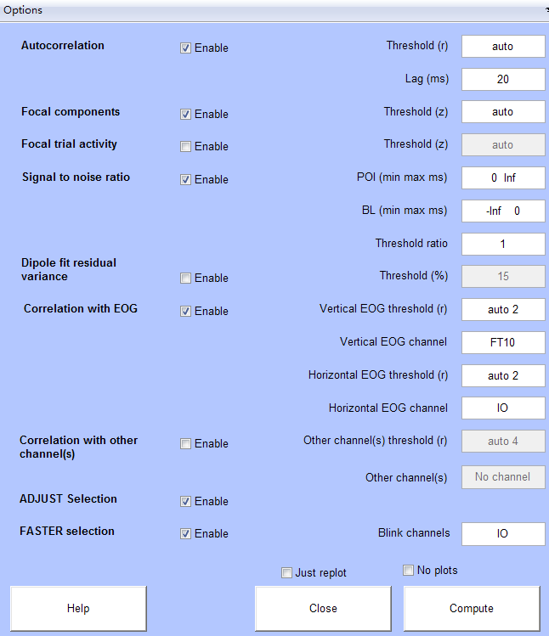
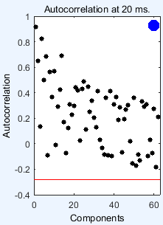
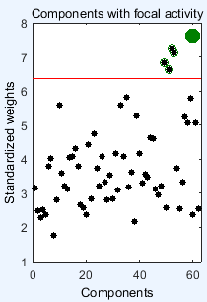
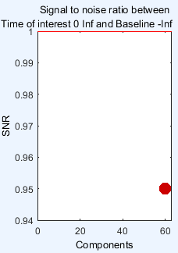
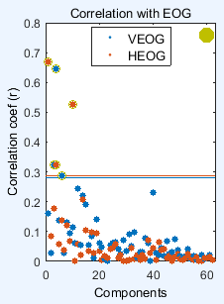
Reject Artifact by SASICA
Reject 4 component
Reject 0 component
Reject 0 component
Reject 5
component

Slide 5
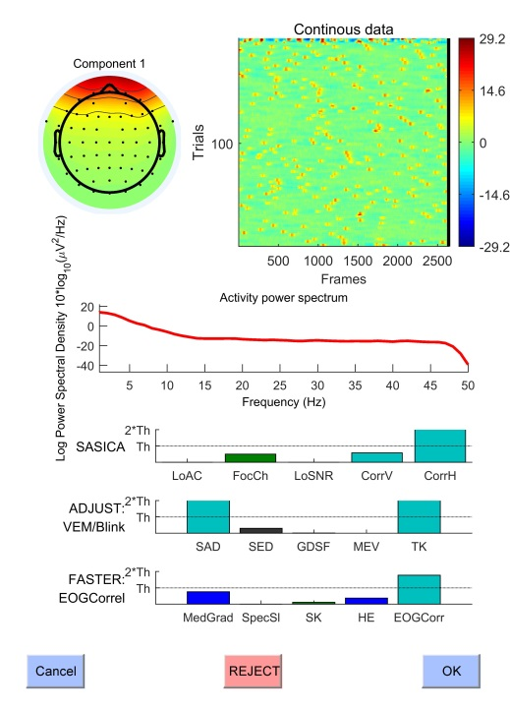
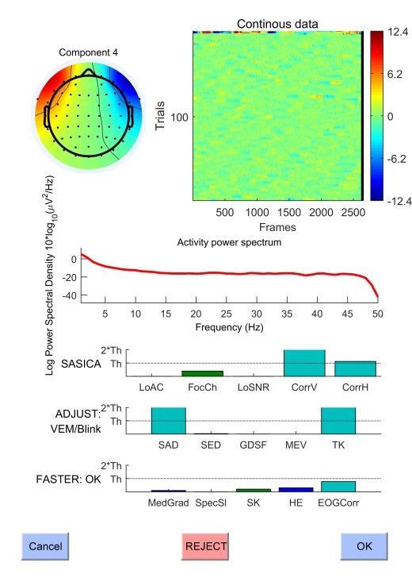
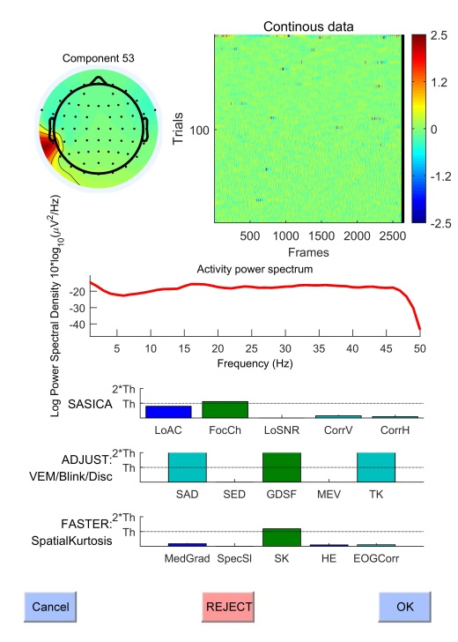
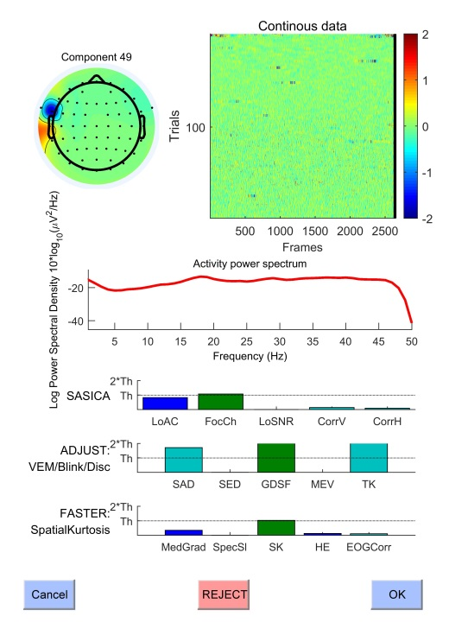
Reject Artifact by SASICA
Vertical eye movement
horizontal eye movement
Muscle movement
Other artifact

Slide 6
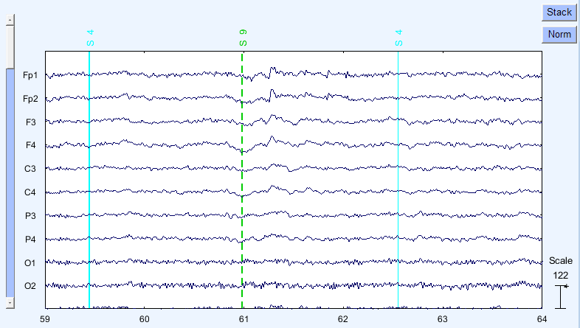
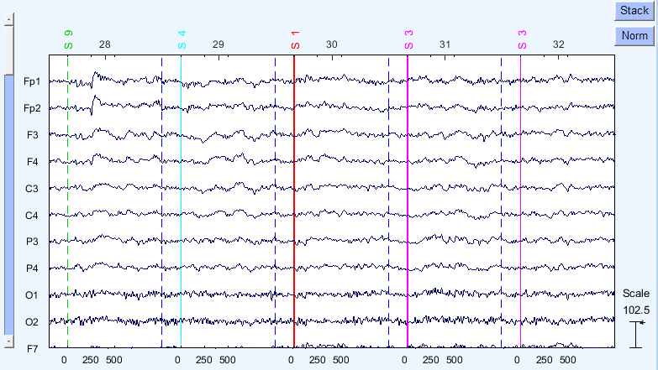
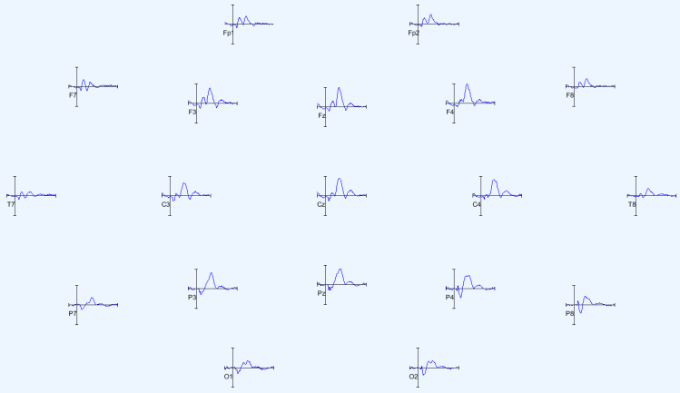
Segmentation
Workflow
EEG DATA
nbchan×pnts
segment
Epoch DATA
nbchan×pnts×trials
average
ERP DATA:
nbchan×pnts
script
>>EEG = pop_epoch( EEG,extract_events, [pretime postime], 'newname', …
'EEG_data', 'epochinfo', 'yes');% extract Epoch between pretime and postime
>>[ALLEEG EEG CURRENTSET] = pop_newset(ALLEEG, EEG, 1,'gui','off');
%create new data set
>>EEG = eeg_checkset( EEG );
>>EEG = pop_rmbase( EEG, [pretime*1000 0]); % baseline corrected
>>[ALLEEG EEG CURRENTSET] = pop_newset(ALLEEG, EEG, 2,'gui','off');
>>%create new dataset
>>EEG = pop_saveset( EEG, 'filename',[num2str(s),'.set'],'filepath',PATHOUT);
% save dataset

