Slide 1
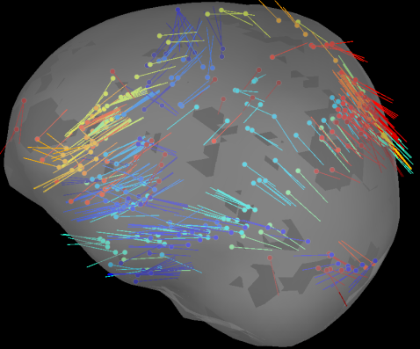
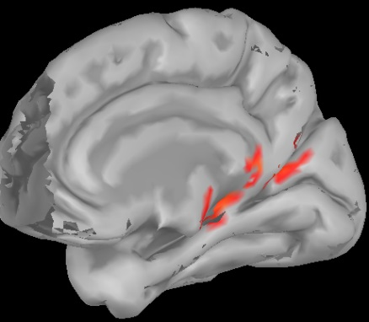
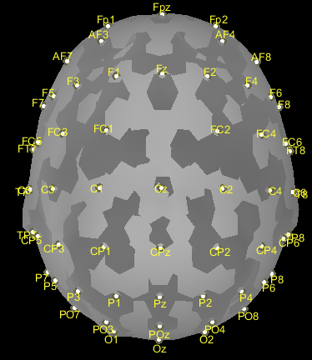
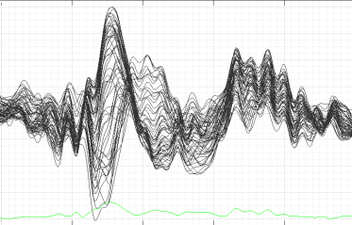
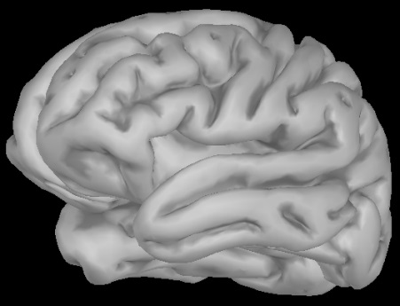
Brainstorm源分析
Dipole fitting method: 一个偶极子表示局部神经核团的突触后端的电活动, 既有大小又有方向。
Distributed models: 大量位置固定的偶极子 ,有大小无方向。
Source
Model
EEG
Channel
Position
Head Model
ERP
记录于头皮
的脑电数据
描述头部几何形状和组织电导率, 也叫Forward Model. 这里使用OpenMEEG BEM计算头模型.

Slide 2
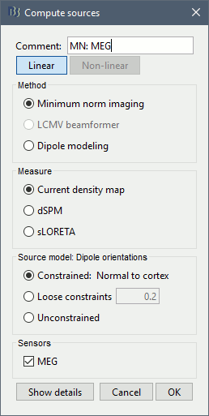
Brainstorm源分析
解剖和空间信息
功能数据(MEG/EEG)
Head
Model
Source
Model
Channel
Position
Processing of
functional data
Single sphere
Forward solution
Averaging & Noise covariance estimation
Overlapping spheres
OpenMEEG BEM
Inverse solution
visualization
源模型偶极子的指向：
1.Contrained: Normal to cortex--- Only for "surface" grids. At each grid point, we model only one dipole, oriented normally to the cortical surface.
2.Loose contraints---Only for "surface" grids, at each point in the surface grid the dipole direction is constrained to be normal to the local cortical surface.
3.Uncontrained---Either "surface" or "volume" grids. At each grid point, we leave undefined the assumed orientation of the source, such that three "elemental" dipoles are needed to model the source.
计算方法：
1.Current density map
2.dSPM---Implements dynamical Statistical Parametric Mapping
3.sLORETA---Standardized Low Resolution brain Electromagnetic TomogrAphy

Slide 3
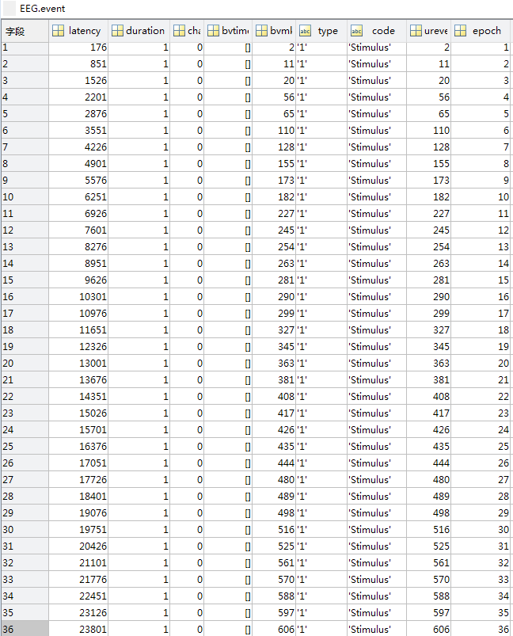
Brainstorm源分析
1. 文件路径设置
2. 输入文件格式
..> config
..>> elec_file.xyz %电极坐标文件
..> Epoch_data %输入文件路径
..>> sub1.set %输入文件
..>> sub2.set %输入文件
..> Source_data %输出文件路径
..>> @default_study
..>> @default_subject
..>> @inter
..>> sub1 % sub1.set的输出路径
..>>> @default_study
..>>> @intra
..>>> ERP_data %运算结果的输出路径
..>>> **.mat %源分析结果文件
..>> sub2 % sub1.set的输出路径
..>>> @default_study
..>>> @intra
..>>> ERP_data %运算结果的输出路径
..>>> **.mat %源分析结果文件
setname-----ERP_data
filename-----sub*.set
EEG.event

Slide 4
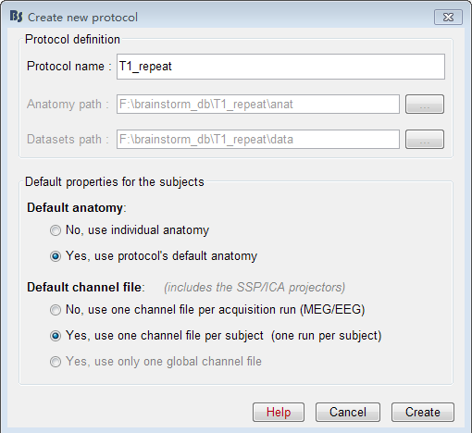
Brainstorm源分析
3. 创建protocol
4. 路径设置
File>>New protocol
clear;
close all;
PATHelec =‘***';
%电极文件的路径
PATHIN=‘***’;
%输入Epoch的路径
PATHOUT=‘***’;
%源分析输出路径
ProtocolInfo = bst_get(‘ProtocolInfo’);
%获取当前协议的信息
Path_bs=[ProtocolInfo.STUDIES filesep];
%获取当前协议的路径
elec_file=fullfile(PATHelec,‘elec_file.xyz’)
%读取电极文件
sFiles = [];%用于存放处理结果
处理协议名字
大脑结构像路径：
源分析输出路径
源分析数据路径：
源分析输出路径
大脑结构像选择
电极位置文件选择

Slide 5
Brainstorm源分析
5. 导入Epoch文件
6. 设置电极文件
sFiles = bst_process('CallProcess',
'process_import_channel',sFiles, [], ...
'channelfile', {elec_file, 'EEGLAB'}, ...
'usedefault', 1, ...
'channelalign', 0);
cd(PATHIN)
list=dir(‘*set’);
%获取PATHIN下Epoch文件的列表
len=length(list);
sFiles=bst_process('CallProcess',…
'process_import_data_epoch', ...
sFiles, [],'subjectname',subj{s}, ...
'condition', ‘ ', ...
'datafile',{{[PATHIN list(s).name ]},…
'EEG-EEGLAB'}, ...
'iepochs',[], ...
'eventtypes', 'type', ...
'createcond', 1, ...
'channelalign',0, ...
'usectfcomp', 0, ...
'usessp', 0, ...
'freq', [], ...
'baseline', []);
7.计算噪声(或数据)的协方差
sFiles = bst_process('CallProcess',
'process_noisecov', sFiles, [], ...
'baseline', [-0.35, 0], ...
'datatimewindow', [], ...
'sensortypes','', ...
'target', 1,'dcoffset',1, ...
'identity',0,'copycond',0, ...
'copysubj',0,'replacefile',1);
8. 求取ERP
sFiles = bst_process('CallProcess',
'process_average', sFiles, [], ...
'avgtype',1, 'avg_func',1, ...
'weighted',0, 'keepevents', 0);

Slide 6
Brainstorm源分析
9. 计算前向模型
10. 溯源分析
sFiles = bst_process('CallProcess',
'process_headmodel', sFiles, [], ...
'Comment', '', ...
'sourcespace', 1, ... % Cortex surface
'volumegrid', [], ...
'meg',2, ... % Single sphere
'eeg',3, ... % OpenMEEG BEM
'ecog',2, ... % OpenMEEG BEM
'seeg', 2, ... % OpenMEEG BEM
'openmeeg', struct(...
'BemFiles', {{}}, ...
'BemNames',{{'Scalp', 'Skull', 'Brain'}}, ...
'BemCond', [1, 0.0125, 1], ...
'BemSelect', [1, 1, 1], ...
'isAdjoint', 0, ...
'isAdaptative',1, 'isSplit',0, ...
'SplitLength', 4000));
sHeadModel =bst_get('HeadModelForStudy',
sFiles(1).iStudy);
sFiles = bst_process('CallProcess',
'process_inverse_2016',sFiles,[],...
'output', 2,
'inverse', struct(...
'Comment','dSPM: EEG', ...
'InverseMethod','minnorm', ...
'InverseMeasure','dspm', ...
'SourceOrient', {{'fixed'}}, ...
'Loose',0.2, ...
'UseDepth',1, ...
'WeightExp',0.5, ...
'WeightLimit', 10, ...
'NoiseMethod','reg', ...
'NoiseReg',0.1, ...
'SnrMethod','fixed', ...
'SnrRms',1e-06, ...
'SnrFixed',3, ...
'ComputeKernel', 1, ...
'DataTypes', {{'EEG'}}));

Slide 7
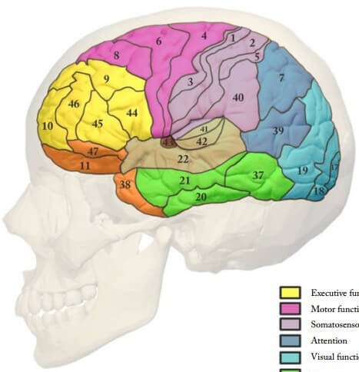
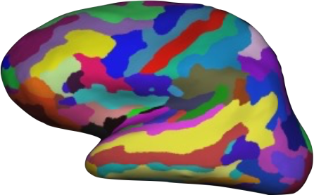
Brainstorm源分析
11. 提取深部脑区的时间序列
Brodmann
Area
Destrieux
% 这里选用Destrieux脑分区表示大
% 脑的ROI
sFiles = bst_process('CallProcess',
'process_extract_scout', ...
source_file, [], ...
'timewindow',[], ...
‘scouts’,{‘Destrieux’, …
{'G_Ins_lg_and_S_cent_ins R'}}, ...
'scoutfunc', 1,'isflip', 1, ...
'isnorm',0, ...
'concatenate',1,'save',1,...
'addrowcomment', 1, ...
'addfilecomment', 1);

Slide 8
Brainstorm链接分析
Non-directed
Directed
Correlation
Time domain
Bivariate Granger causality
Time-resolved correlation
Coherence
Phase transfer entropy
Phase locking value
Frequency domain
Amplitude envelope correlation
Time-resolved coherence
Bivariate Granger causality(spectral)

Slide 9
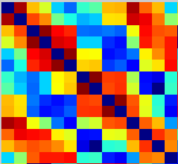

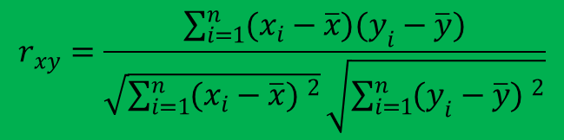
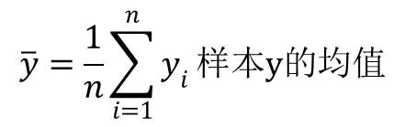
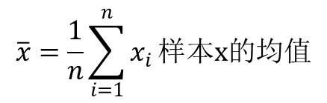

Brainstorm链接分析
FC1. Pearson correlation
动态相关
$$r_{xy}=\frac{\sum_{i=1}^{n}{(x_{i}−\overline{x})(y_{i}−\overline{y})}}{\sqrt{\sum_{i=1}^{n}{(x_{i}−\overline{x}) ^{2}}}\sqrt{\sum_{i=1}^{n}{(y_{i}−\overline{y}) ^{2}}}}$$
% Process: Time-resolved correlation NxN
sFiles = bst_process('CallProcess',
'process_corr1n_time', sFiles, [], ...
'timewindow', [-0.35, 0.998], ...
'dest_sensors', 'MEG, EEG', ...
‘includebad’, 1,‘win’,0.1, ... %窗宽100ms
‘overlap’, 50, ... %步长50ms
'scalarprod', 0, ...
'commenttag', '');
$$n是样本尺寸$$
$$x_{i},y_{i}第i个样本$$
$$\overline{x}=\frac{1}{n}\sum_{i=1}^{n}{x_{i}}样本x的均值$$
$$\overline{y}=\frac{1}{n}\sum_{i=1}^{n}{y_{i}}样本y的均值$$
静态相关
corr(F3,P3)反映了F3电极EEG和P3电极EEG的线性相关系数
%% Process: Correlation NxN
sFiles = bst_process('CallProcess',
'process_corr1n', sFiles, [], ...
'timewindow', [-0.35, 0.998], ...
'dest_sensors', 'MEG, EEG', ...
'includebad', 1, 'scalarprod', 0, ...
'outputmode', 1,'save', 1, ...
'addrowcomment', 1, ...
'addfilecomment', 1);

Slide 10
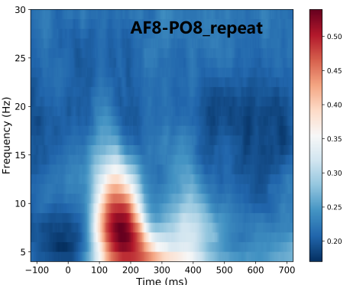
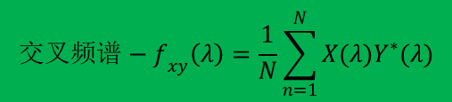


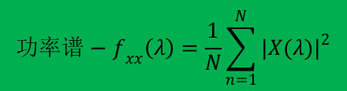
Brainstorm链接分析
FC2. coherence
动态相干
相干$−{Coh}_{xy}\left(λ\right)=\frac{{|f_{xy}(λ)|}^{2}}{f_{xx}(λ)f_{yy}(λ)}$
% Process: Time-resolved coherence NxN
sFiles = bst_process('CallProcess', 'process_cohere1n_time', sFiles, [], ...
'timewindow', [-0.35, 0.998], ...
'dest_sensors', 'MEG, EEG',
'includebad', 1, ...
'removeevoked', 0, 'win', 0.3,
'overlap', 50, 'cohmeasure', 1, ...
'maxfreqres', 12, 'maxfreq', 60, ...
'commenttag', '');
$${交叉频谱−f}_{xy}\left(λ\right)=\frac{1}{N}\sum_{n=1}^{N}{X(λ)Y^{∗}(λ)}$$
$${功率谱−f}_{xx}\left(λ\right)=\frac{1}{N}\sum_{n=1}^{N}{{|X(λ)|}^{2}}$$
$$X\left(λ\right)是序列x\left(t\right)的DFT$$
$$Y\left(λ\right)是序列y\left(t\right)的DFT$$
静态相干
%% Process: Coherence NxN
sFiles = bst_process('CallProcess',
'process_cohere1n', sFiles, [], ...
'timewindow', [-0.35, 0.998], ...
'dest_sensors', 'MEG, EEG', ...
'includebad',1, 'removeevoked', 0, ...
'cohmeasure', 1, 'maxfreqres', 2, ...
'maxfreq', 60, 'outputmode', 1,...
'save', 1, 'addrowcomment', 1, ...
'addfilecomment',1);
f1
表示时间段T和频率段F里的相干性
f2
fn
coherence(F3,P3,f)从频谱的角度反映了F3电极EEG和P3电极EEG在f频率段的同步特性

Slide 11
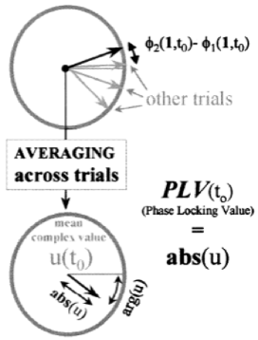
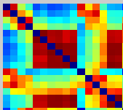

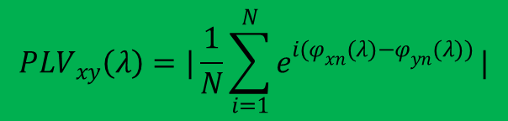

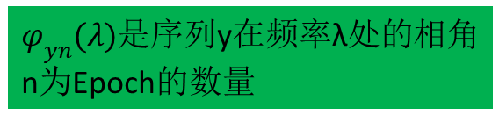
Brainstorm链接分析
FC3. Phase Locking Value
静态PLV
$${PLV}_{xy}\left(λ\right)=|\frac{1}{N}\sum_{i=1}^{N}{e^{i(φ_{xn}(λ)−φ_{yn}(λ))}}|$$
% Process: Phase locking value NxN
sFiles = bst_process('CallProcess',
'process_plv1n', sFiles, [], ...
'timewindow', [-0.35, 0.998], ...
'dest_sensors', 'MEG, EEG', ...
'includebad', 1, ...
'freqbands', {'delta', '2, 4', 'mean';
'theta', '5, 7', 'mean';
'alpha', '8, 12', 'mean';
'beta', '15, 29', 'mean';
'gamma1', '30, 59', 'mean'}, ...
'mirror', 0, 'keeptime', 0, ...
'plvmeasure', 2, 'outputmode', 1);
$φ_{xn}(λ)$是序列x在频率λ处的相角
$φ_{yn}(λ)$是序列y在频率λ处的相角
n为Epoch的数量
$$(φ_{xn}(λ)−φ_{yn}(λ))$$
PLV(F3,P3,f)从相位的角度更加严格地反映了F3电极EEG和P3电极EEG在λ频率段的同步特性

Slide 12
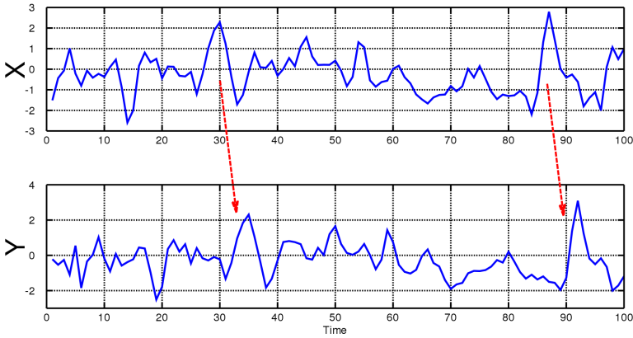
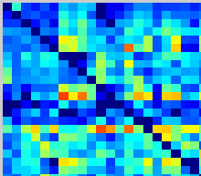
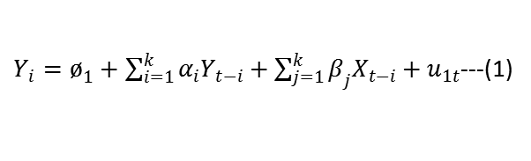
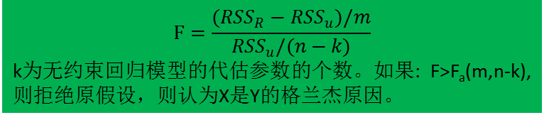
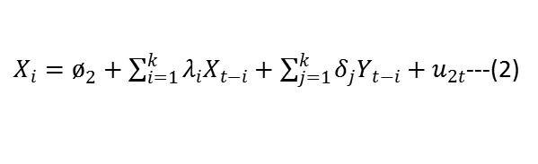
Brainstorm链接分析
FC4. Bivariate Granger causality
假设1---X对Y有单向影响: 式(1)X各项滞后项前的参数不为零。Y各滞后项前的参数整体为0 。
假设2---Y对X有单向影响:式(2)Y各项滞后项前的参数不为零。X各滞后项前的参数整体为0 。
假设3---Y与X有双向影响: 式(1)和(2)中X和Y各项滞后项前的参数不为零。
假设4---Y与X不存在影响: 式(1)和(2)中X和Y各项滞后项前的参数为零。
滞后期
格兰杰检验是通过受约束的F检验完成：
例如: 检验假设2，包含X滞后项的回归的残差平方为RSS_{U}，包含X滞后项的回归的残差平方为RSS_{R}，
$Y_{i}=ø_{1}+\sum_{i=1}^{k}{α_{i}Y_{t−i}}+\sum_{j=1}^{k}{β_{j}X_{t−i}}+u_{1t}$---(1)
$X_{i}=ø_{2}+\sum_{i=1}^{k}{λ_{i}X_{t−i}}+\sum_{j=1}^{k}{δ_{j}Y_{t−i}}+u_{2t}$---(2)
$$F=\frac{({RSS}_{R}−{RSS}_{u})/m}{{RSS}_{u}/(n−k)}$$
k为无约束回归模型的代估参数的个数。如果: F>F_{a}(m,n-k), 则拒绝原假设，则认为X是Y的格兰杰原因。
静态GC
%Process: Bivariate Granger causality NxN
sFiles = bst_process('CallProcess',
'process_granger1n', sFiles, [], ...
'timewindow', [-0.35, 0.998], ...
'dest_sensors', 'MEG, EEG', ...
'includebad', 1,'removeevoked',0, ...
'grangerorder',10,'outputmode',1,...
'save',1,'addrowcomment', 1, ...
'addfilecomment', 1);
GC反映了在认知过程中不同脑区之间的相互影响以及影响强度。
From
To

Slide 13
频域格兰杰计算流程
Time series data
Autoregressive
model estimation
Spectral estimation using Fourier
decomposition and multitapering
Model coefficients and residuals
Parametric approach
Cross-spectral
Density matrix
Non-parametric approach
Fourier transformation
of model coefficients
Factorization of spectral
density matrix
Noise covariance matrix spectral transfer function
Estimation of Granger causality
Granger causality

Slide 14
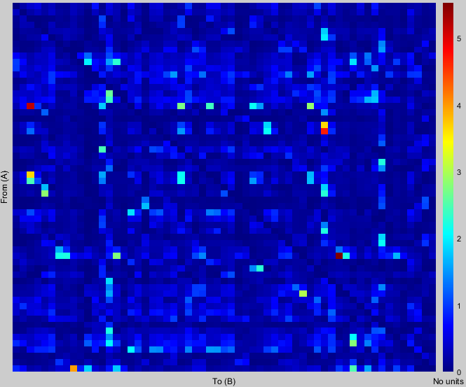
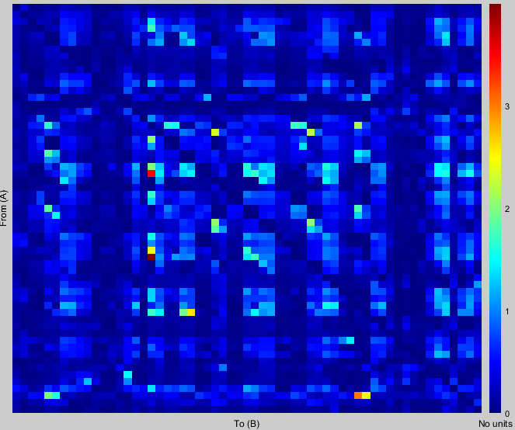
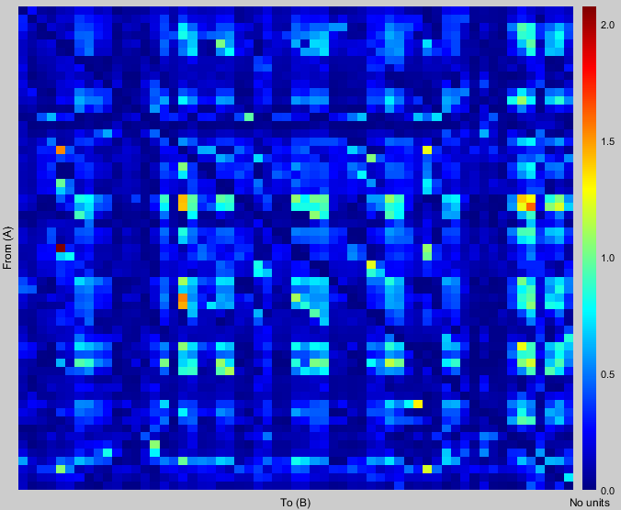




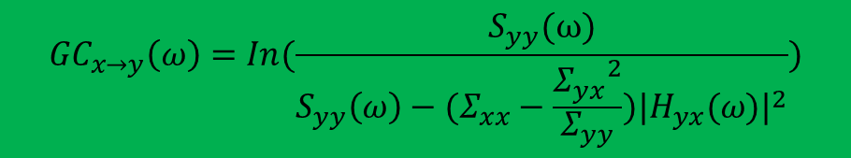
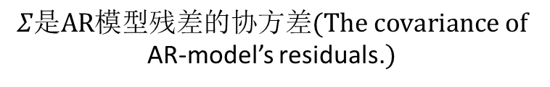

Brainstorm链接分析
FC5. Bivariate Granger causality(Spectral)
% Process: Bivariate Granger
% causality (spectral) NxN
sFiles = bst_process('CallProcess',
'process_spgranger1n', sFiles, [], ...
'timewindow', [-0.35, 0.998], ...
'dest_sensors', 'MEG, EEG', ...
'includebad', 1, 'removeevoked', 0, ...
'grangerorder', 10,'maxfreqres', 2, ...
'maxfreq', 100, 'outputmode', 1);
$${GC}_{x→y}\left(ω\right)=In(\frac{S_{yy}(ω)}{S_{yy}\left(ω\right)−(Σ_{xx}−\frac{{Σ_{yx}}^{2}}{Σ_{yy}}){|H_{yx}(ω)|}^{2}})$$
$$Σ是AR模型残差的协方差(The covariance of$$
AR-model’s residuals.$)$
$$H\left(ω\right)频域转换矩阵$$
$$S_{yx}\left(ω\right)=H_{yx}(ω)Σ_{yx}{H_{yx}}^{∗}$$
f1
$$S_{xy}是序列x和y的交叉谱$$
f2
$$S_{yy}\left(ω\right)是序列y的功率谱$$
fn
$$S_{xx}\left(ω\right)是序列x的功率谱$$
GC反映了在认知过程中不同脑区之间的相互影响以及影响强度。

Slide 15
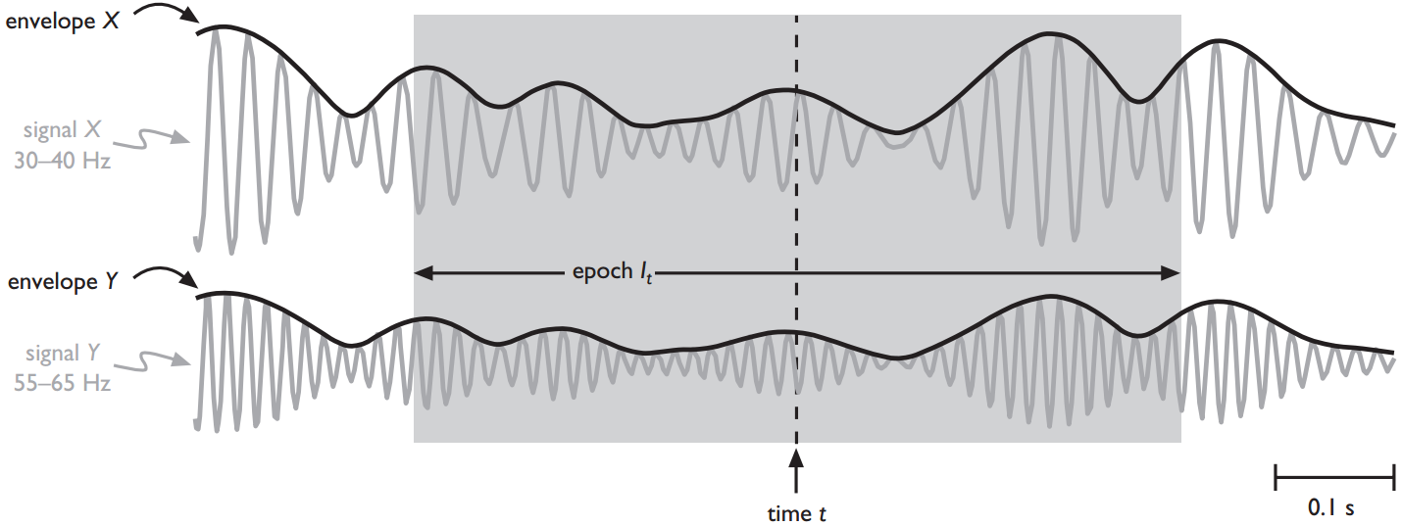

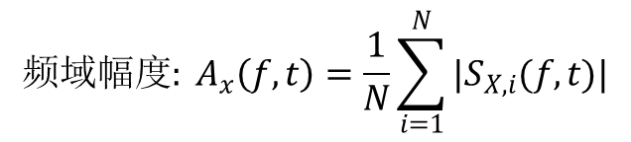
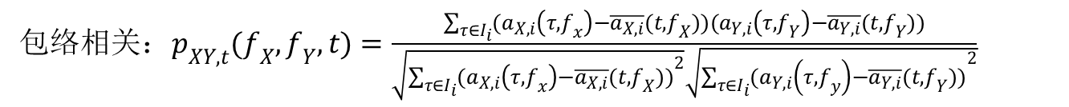

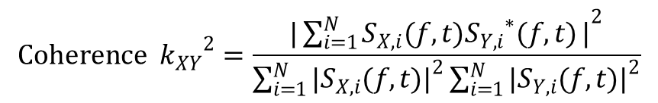
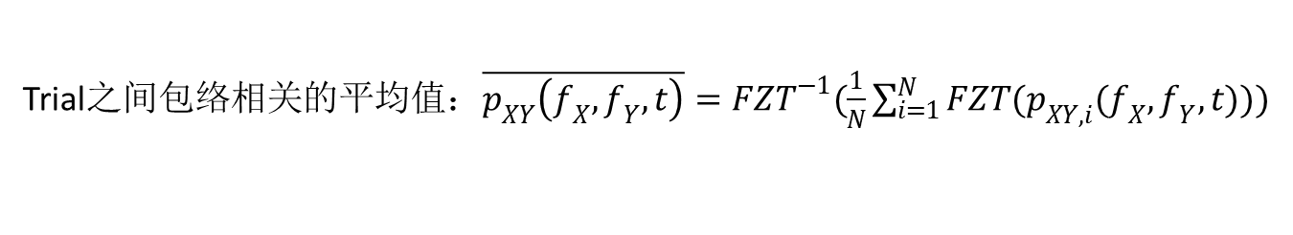
Brainstorm链接分析
FC6. Amplitude envelope correlation
$$频域幅度: A_{x}\left(f,t\right)=\frac{1}{N}\sum_{i=1}^{N}{|S_{X,i}(f,t)|}$$
$${时域幅度: a}_{x}\left(t,f_{x}\right)=|s_{x}\left(t,f_{x}\right)|$$
$$s_{x}\left(t,f_{x}\right)=F^{−1}(S_{X}(t,f_{x}))$$
$S_{X,i}\left(f,t\right)是电极X处第i个Epoch信号I_{i}的傅里叶变换，$N为Epoch的总数。
$$Coherence {k_{XY}}^{2}=\frac{{|\sum_{i=1}^{N}{S_{X,i}(f,t){S_{Y,i}}^{∗}(f,t)}|}^{2}}{\sum_{i=1}^{N}{{|S_{X,i}(f,t)|}^{2}}\sum_{i=1}^{N}{{|S_{Y,i}(f,t)|}^{2}}}$$
包络相关$：p_{XY,t}(f_{X},f_{Y},t)=\frac{\sum_{τ∈I_{i}}{(a_{X,i}\left(τ,f_{x}\right)−\overline{a_{X,i}}(t,f_{X}))(a_{Y,i}\left(τ,f_{Y}\right)−\overline{a_{Y,i}}(t,f_{Y}))}}{\sqrt{\sum_{τ∈I_{i}}{{(a_{X,i}\left(τ,f_{x}\right)−\overline{a_{X,i}}(t,f_{X}))}^{2}}}\sqrt{\sum_{τ∈I_{i}}{{(a_{Y,i}\left(τ,f_{y}\right)−\overline{a_{Y,i}}(t,f_{Y}))}^{2}}}}$
$$\overline{a_{X,i}}\left(t,f_{X}\right)和\overline{a_{Y,i}}\left(t,f_{Y}\right)是Epoch信号envelopes(包络)的均值$$
Trial之间包络相关的平均值：$\overline{p_{XY}\left(f_{X},f_{Y},t\right)}={FZT}^{−1}(\frac{1}{N}\sum_{i=1}^{N}{FZT(p_{XY,i}(f_{X},f_{Y},t))})$

Slide 16
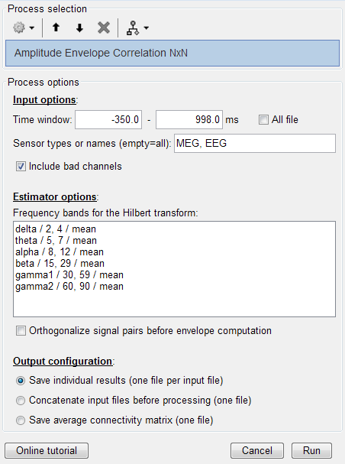
Brainstorm链接分析
FC6. Amplitude envelope correlation
AEC从包络的角度反映了认知过程中不同脑区之间的耦合关系。
% Process:
%Amplitude Envelope Correlation(NxN)
sFiles = bst_process('CallProcess',
'process_aec1n', sFiles, [], ...
'timewindow', [-0.35, 0.998], ...
'dest_sensors', 'MEG, EEG', ...
'includebad', 1, ...
'freqbands', {
'delta', '2, 4', 'mean';
'theta', '5, 8', 'mean';
'alpha', '9, 12', 'mean';
'beta', '15, 29', 'mean';
'gamma1', '30, 59', 'mean';
'gamma2', '60, 90', 'mean'}, ...
'isorth', 0,'outputmode', 1);

Slide 17
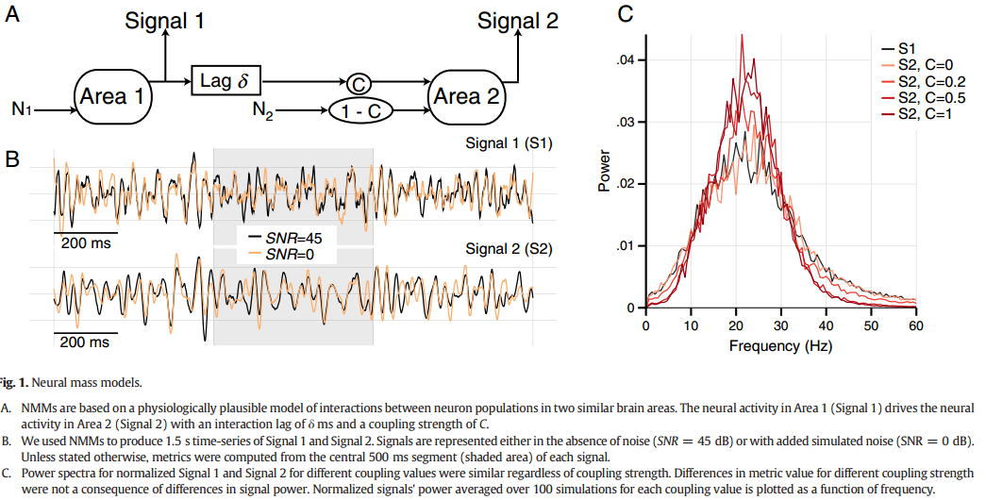
Brainstorm链接分析
Neural mass model parameters
A. NMMs are based on a physiologically plausible model of interactions between neuron populations in two similar brain areas. The neural activity in Area 1 (Signal 1) drives the neural activity in Area 2 (Signal 2) with an interaction lag of δ ms and a coupling strength of C.
C. Power spectra for normalized Signal 1 and Signal 2 for different coupling values were similar regardless of coupling strength.
Differences in metric value for different coupling strength were not a consequence of differences in signal power.
Normalized signals' power averaged over 100 simulations for each coupling value is plotted as a function of frequency.
B. We used NMMs to produce 1.5 s time-series of Signal 1 and Signal 2. Signals are represented either in the absence of noise (SNR = 45 dB) or with added simulated noise (SNR = 0 dB). Unless stated otherwise, metrics were computed from the central 500 ms segment (shaded area) of each signal.

Slide 18
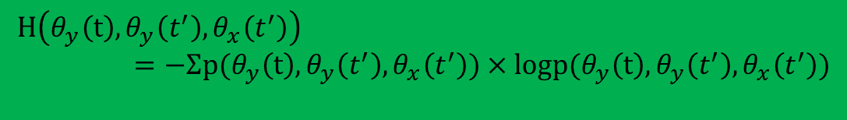


Brainstorm链接分析
FC7. Phase transfer entropy
$${Phase TE}_{X→Y}=H(θ_{y}\left(t\right),θ_{y}\left(t^{′}\right)+H\left(θ_{y}\left(t^{′}\right),θ_{x}\left(t^{′}\right)\right)−H\left(θ_{y}\left(t^{′}\right)\right)−H(θ_{y}\left(t\right),θ_{y}\left(t^{′}\right),θ_{x}(t^{′}))$$
在一给定的频段里，序列X(t)的瞬时相位时间序列θ(t)。
$$S\left(t\right)=A(t)×exp(iθ(t))$$
$S\left(t\right)$是原序列X(t)通过复杂滤波求得(比如小波变换,希尔伯特变换)
θ_{x}(t’)和θ_{y}(t’)是时间点t’ =t-δ的状态。即为θ_{x}(t’)= θ_{x}(t’ =t-δ), θ_{y}(t’)= θ_{y}(t’ =t-δ)
信息熵和联合熵
$$H\left(θ_{y}\left(t\right),θ_{y}\left(t^{′}\right)\right)=−Σp(θ_{y}\left(t\right),θ_{y}\left(t^{′}\right))×logp(θ_{y}\left(t\right),θ_{y}\left(t^{′}\right))$$
$$H\left(θ_{y}\left(t^{′}\right),θ_{x}\left(t^{′}\right)\right)=−Σp(θ_{y}\left(t^{′}\right),θ_{x}\left(t^{′}\right))×logp(θ_{y}\left(t^{′}\right),θ_{x}\left(t^{′}\right))$$
$$H\left(θ_{y}\left(t^{′}\right)\right)=−Σp(θ_{y}\left(t^{′}\right))×logp(θ_{y}\left(t^{′}\right))$$
$$H\left({θ_{y}\left(t\right),θ}_{y}\left(t^{′}\right),θ_{x}\left(t^{′}\right)\right)=−Σp({θ_{y}\left(t\right),θ}_{y}\left(t^{′}\right),θ_{x}\left(t^{′}\right))×logp({θ_{y}\left(t\right),θ}_{y}\left(t^{′}\right),θ_{x}\left(t^{′}\right))$$

Slide 19
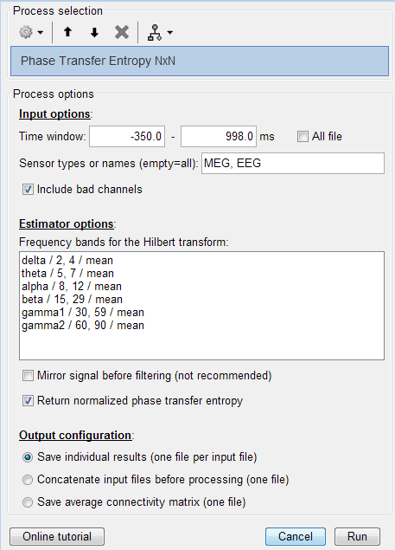
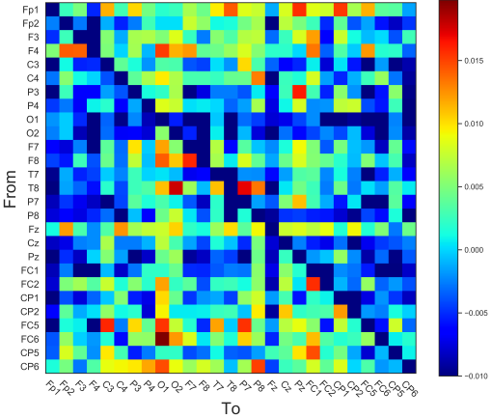
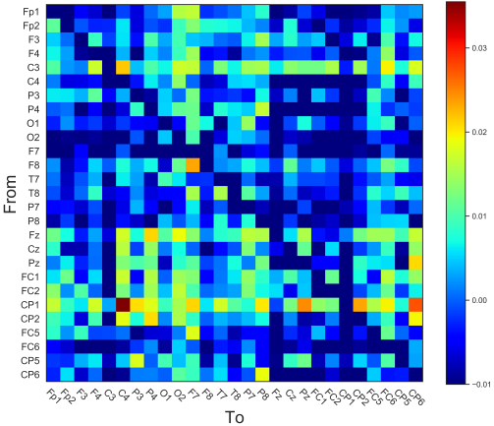
Brainstorm链接分析
FC7. Phase transfer entropy
PTE测量了认知过程中不同脑区之间
信息流动的方向和强弱，反映了认知
过程中不同脑区之间的耦合关系。
% Process: Phase Transfer Entropy NxN
sFiles = bst_process('CallProcess',
'process_pte1n', sFiles, [], ...
'timewindow', [-0.35, 0.998], ...
'dest_sensors', 'MEG, EEG', ...
'includebad', 1, ...
'freqbands', {'delta', '2, 4', 'mean';
'theta', '5, 8', 'mean'; 'alpha', '9, 12', 'mean';
'beta', '15, 29', 'mean';
'gamma1', '30, 49', 'mean';
'gamma2', '60, 90', 'mean'}, ...
'mirror', 0,'normalized', 1, ...
'outputmode', 1);
Theta_PTE
Alpha_PTE

