Slide 1
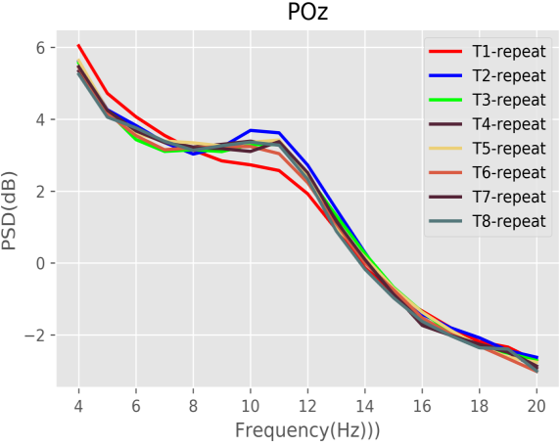
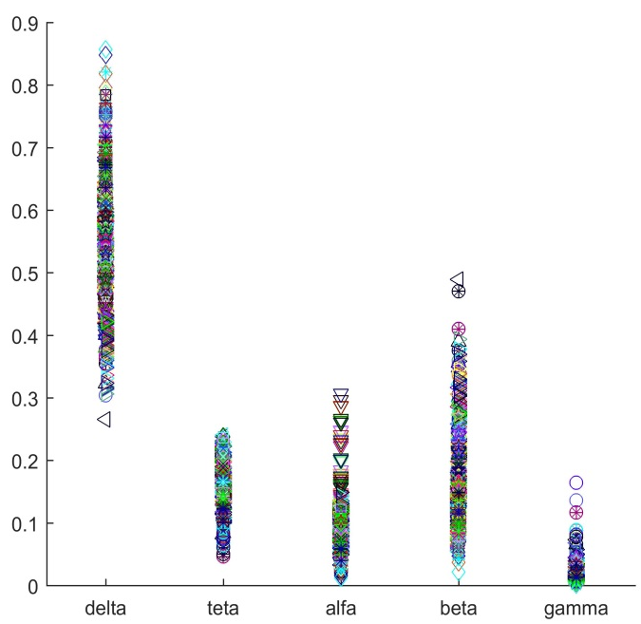

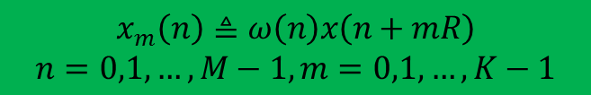
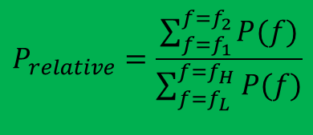
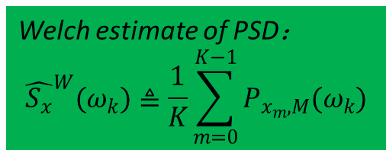
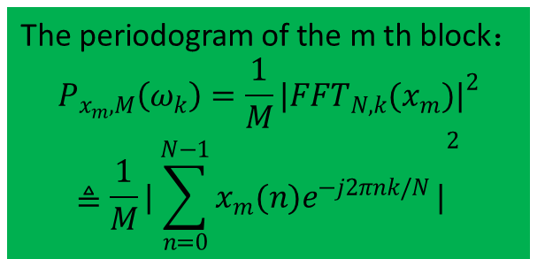
Power Spectral Density(PSD)
Welch's Method
The periodogram of the m th block：
$$P_{x_{m},M}\left(ω_{k}\right)=\frac{1}{M}{|{FFT}_{N,k}(x_{m})|}^{2}$$
$$≜\frac{1}{M}{|\sum_{n=0}^{N−1}{x_{m}(n)e^{−j2πnk/N}}|}^{2}$$
$$x_{m}\left(n\right)≜ω\left(n\right)x\left(n+mR\right)$$
$$n=0,1,…,M−1, m=0,1,…,K−1$$
The m th windowed, zero-padded frame from the signal x.
R is defined as the window hop size.
K denote the number of available frames.
Welch estimate of PSD：
$${\hat{S_{x}}}^{W}(ω_{k})≜\frac{1}{K}\sum_{m=0}^{K−1}{P_{x_{m},M}(ω_{k})}$$
The PSD results of each frequency band are normalized to obtain the relative PSD of one band to the whole frequency band.
Relative PSD
$$P_{relative}=\frac{\sum_{f=f_{1}}^{f=f_{2}}{P(f)}}{\sum_{f=f_{L}}^{f=f_{H}}{P(f)}}$$
$$P_{absolute}=\sum_{f=f_{L}}^{f=f_{H}}{P(f)}$$

Slide 2
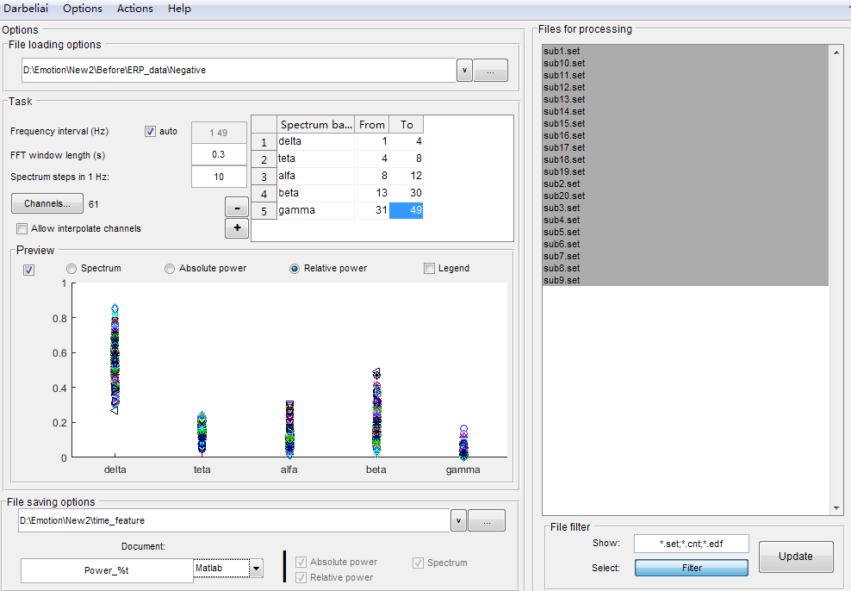
Relative PSD
黑色区域：文件列表
红色区域：文件输入 路径
绿色区域：文件输出
路径和输出参数设置。
绿色区域：
PSD的频谱范围
FFT的窗长
频率的步长
以及各个波段的
频率范围

Slide 3
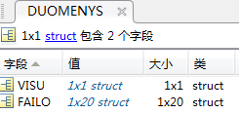
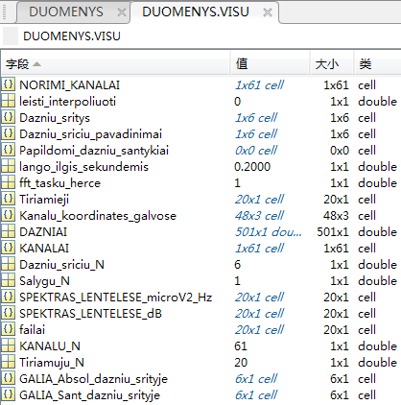
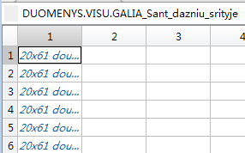
Power Spectral Density(PSD)
>> load('PSD.mat')
delta band
Spectrum
theta band
Alpha band
Absolute PSD
Beta band
Relative PSD
Gamma band

Slide 4
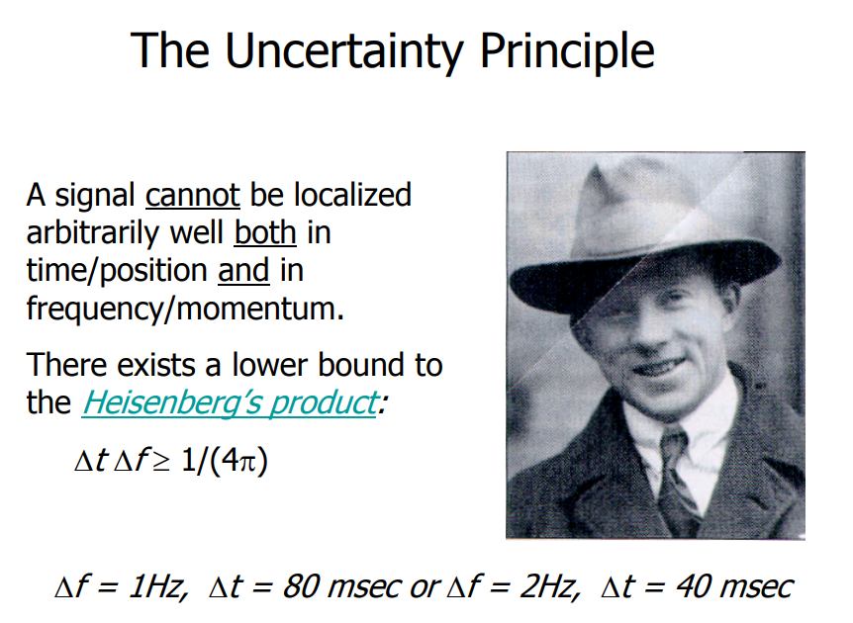

Slide 5
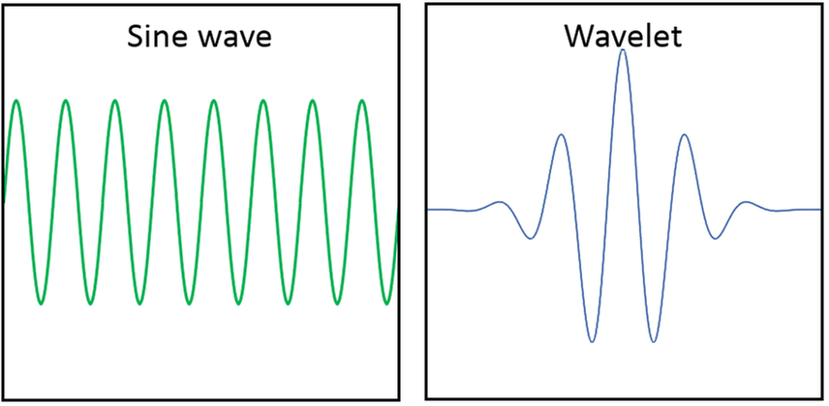
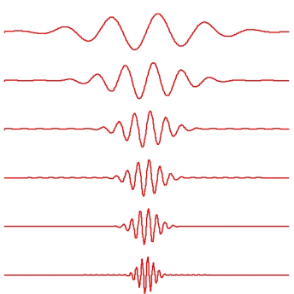
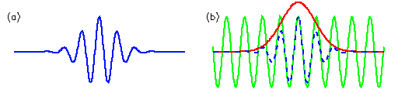



小波
$$e^{iωt}$$
求取最低频率
$$e^{−t^{2}/2}$$
$$ψ_{\left(t\right)}=e^{iωt}×e^{−t^{2}/2}$$
求取最高频率

Slide 6
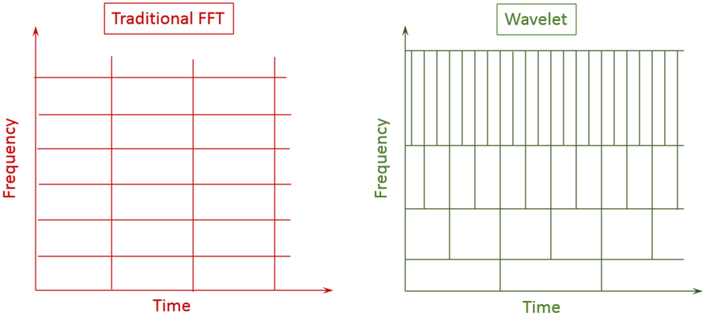
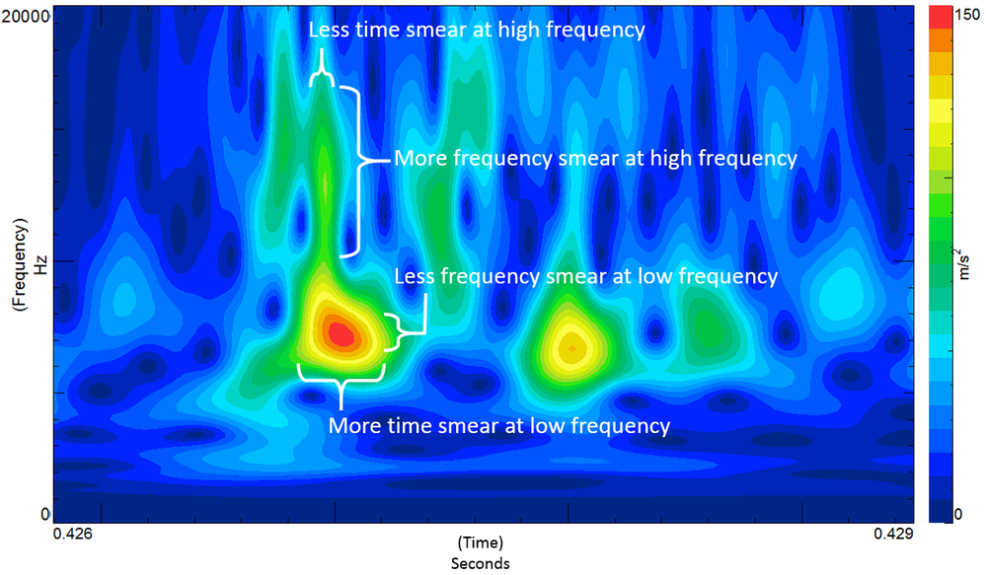
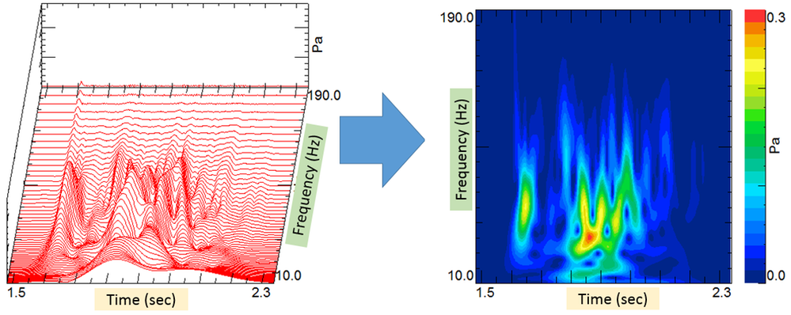
基于小波变换的时频分解
At lower frequencies, the data will be finer in the frequency domain, and more smeared in the time domain.
At higher frequencies, the data will be finer resolution in the time domain, and more smeared in the frequency domain.
At lower frequencies, octave bands are narrower, resulting in less smearing.
At high frequencies, octave bands are broader resulting in more smearing.
The change in time resolution is due to the stretching of the wavelets at low frequency and the shrinking of wavelets at high frequency.
smooth

Slide 7

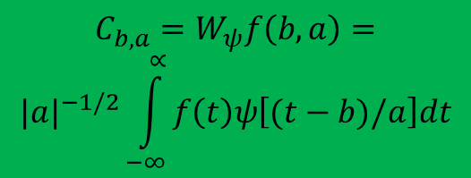

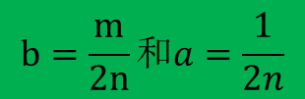
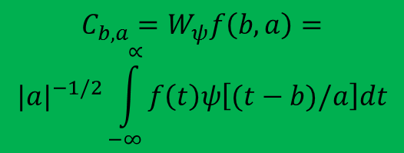
Wavelet Transform
连续小波变换
function [a,b,spec,freq]=dft(y)
%input: y--- 1-D序列
%output: spec—频谱
% freq--- 频率范围
% a--- 实部
% b--- 虚部
n=length(y);
t=2*pi*(0:n-1)/n;
f=2.0/n;
n2=floor(n/2);
for j=0:n2
cs=cos(j*t);
ss=sin(j*t);
a(j+1)=f*(cs*y);
b(j+1)=f*(ss*y);
spec(j+1)=f*(cs*y)+1i*f*(ss*y);
freq(j+1)=j;
end
a(1)=0.5*a(1);
a(n2+1)=0.5*a(n2+1);
b(1)=0.0;
b(n2+1)=0.0;
$$C_{b,a}=W_{ψ}f\left(b,a\right)=$$
$${|a|}^{−1/2}\int_{−∞}^{∝}{f\left(t\right)ψ\left[(t−b)/a\right]dt}$$
$ψ$[(t-b)/a]称为小波函数或小波，它是由函数$ψ($t)经过不同的时间尺度伸缩(a)
和不同的时间平移(b)得到。 $ψ($t)称为母小波(基本小波)。
离散小波变换
$$C_{b,a}=W_{ψ}f\left(b,a\right)=$$
$${|a|}^{−1/2}\int_{−∞}^{∝}{f\left(t\right)ψ\left[(t−b)/a\right]dt}$$
$$b=\frac{m}{2n}和a=\frac{1}{2n}$$
$$母小波：{ψ_{n}}^{m}\left(t\right)=2^{\frac{m}{2}}ψ(2^{m}t−n)$$

Slide 8
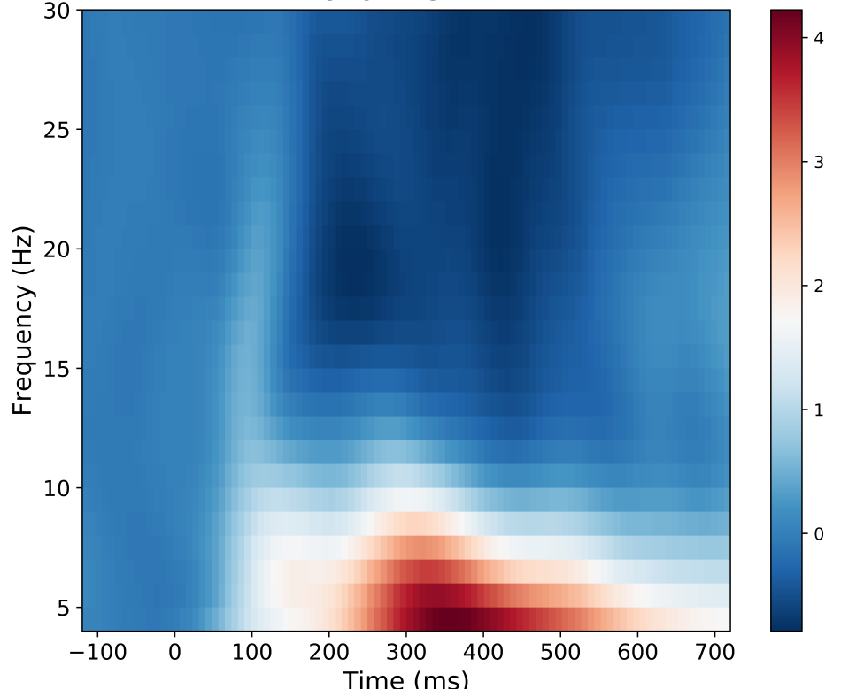
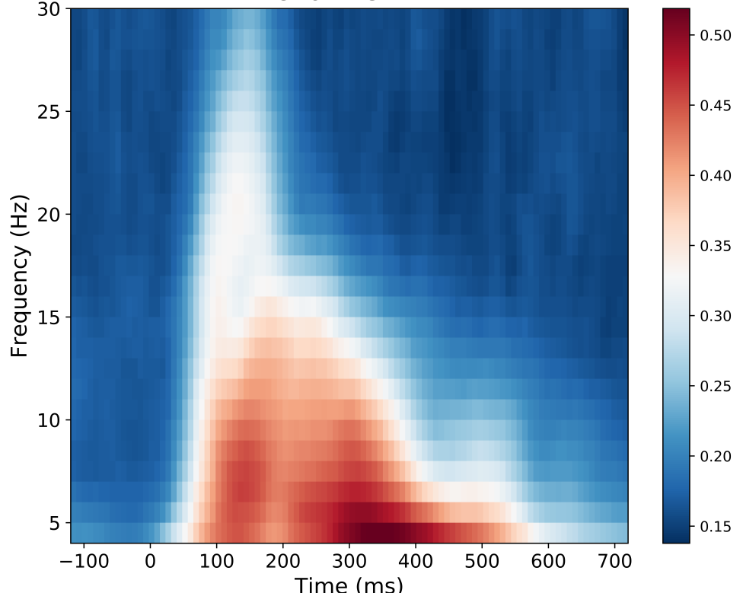
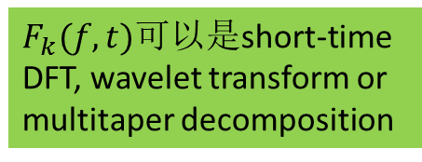
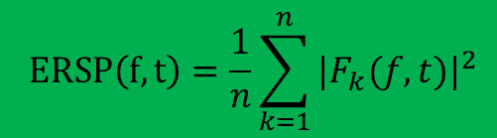
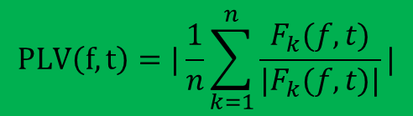
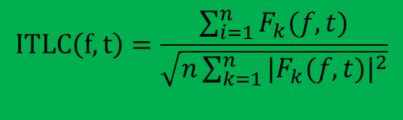
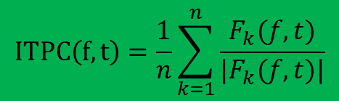
Time-frequency analysis
TF1. Event-Related Spectral Perturbation
TF2. Inter-trial phase(linear) coherence
$$ERSP\left(f,t\right)=\frac{1}{n}\sum_{k=1}^{n}{{|F_{k}(f,t)|}^{2}}$$
$$ITLC\left(f,t\right)=\frac{\sum_{i=1}^{n}{F_{k}(f,t)}}{\sqrt{n\sum_{k=1}^{n}{{|F_{k}(f,t)|}^{2}}}}$$
$F_{k}(f,t)$可以是short-time DFT, wavelet transform or multitaper decomposition
$$ITPC\left(f,t\right)=\frac{1}{n}\sum_{k=1}^{n}{\frac{F_{k}(f,t)}{|F_{k}(f,t)|}}$$
$$PLV\left(f,t\right)=|\frac{1}{n}\sum_{k=1}^{n}{\frac{F_{k}(f,t)}{|F_{k}(f,t)|}}|$$
ERSP
ITC

Slide 9
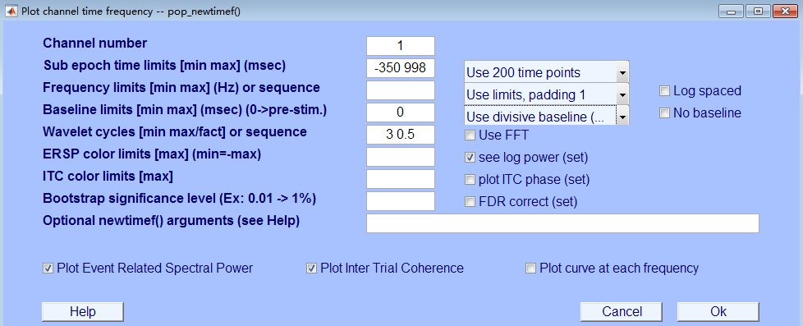
Time-frequency analysis
时域分辨率：时频分析的时间点数
可以是50,100,150,200,300,400
频域分辨率：可以是1,2,4
基线校正的方式：
Divisive baseline(DIV);
Standard deviation(STD)
Single trial DIV baseline
Singe trial STD baseline
[ersp,itc,~,times,freqs,~,~]=pop_newtimef(EEG, 1, elec,%电极序号
[pretime*1000 postiom*1000-2], %时频分析的时间段
[low_cycles high_cycles] , % 小波变换的周期范围
‘elocs’, EEG.chanlocs, %电极坐标
'chaninfo', EEG.chaninfo,
‘caption’, ‘P6’, ‘baseline’,[0], %基线校正的方法
‘freqs’, [low_fre high_fre], %时频分析的频率范围
'topovec', 1,
‘ntimesout’,time_counts, %时间点数
'plotersp', 'off', 'plotitc' , 'off', 'plotphase', 'off',
‘padratio’,frepad, %频率分辨率
'basenorm', 'on', 'trialbase', 'full');

Slide 10
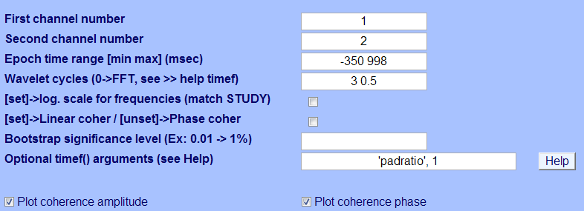
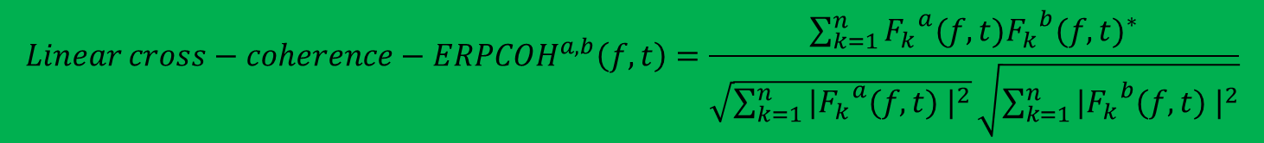
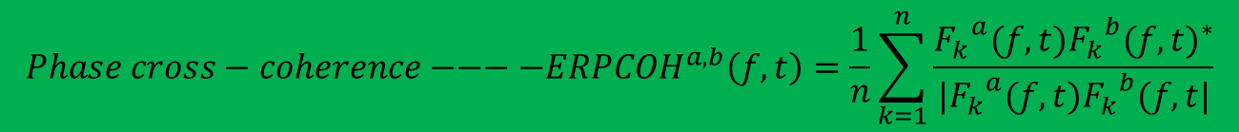
Time-frequency analysis
TF3. Cross-coherence
$${Phase cross−coherence−−−−ERPCOH}^{a,b}\left(f,t\right)=\frac{1}{n}\sum_{k=1}^{n}{\frac{{F_{k}}^{a}(f,t){{F_{k}}^{b}(f,t)}^{∗}}{|{F_{k}}^{a}(f,t){F_{k}}^{b}(f,t|}}$$
$${Linear cross−coherence−ERPCOH}^{a,b}\left(f,t\right)=\frac{\sum_{k=1}^{n}{{F_{k}}^{a}(f,t){{F_{k}}^{b}(f,t)}^{∗}}}{\sqrt{\sum_{k=1}^{n}{{|{F_{k}}^{a}(f,t) |}^{2}}}\sqrt{\sum_{k=1}^{n}{{|{F_{k}}^{b}(f,t) |}^{2}}}}$$

Slide 11
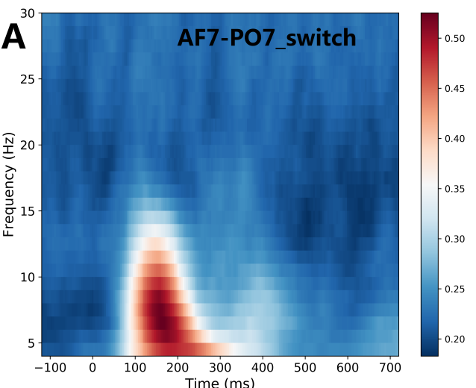
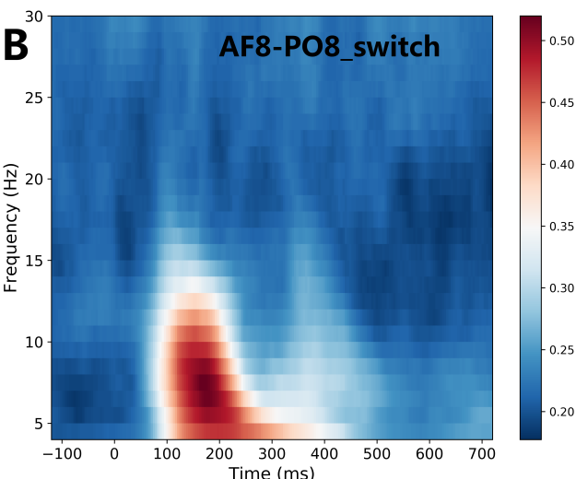
Time-frequency analysis
TF3. Cross-coherence
[coh,mcoh,timesout,freqsout,cohboot]=pop_newcrossf( EEG, 1,
elec,j,%求相干的两个电极
[pretime*1000 postiom*1000],%求相干的时间
[low_cycles high_cycles] ,%小波周期的范围
‘type’, ‘phasecoher’,%求取相位相干
'topovec', [elec,j],...
'elocs', EEG.chanlocs, 'chaninfo', EEG.chaninfo,
‘freqs’, [low_fre high_fre], %频率范围
'title','Channel Fp1-Fp2 Phase Coherence',
‘padratio’,frepad,%频率分辨率
'plotamp','off','plotphase','off');

