Slide 1
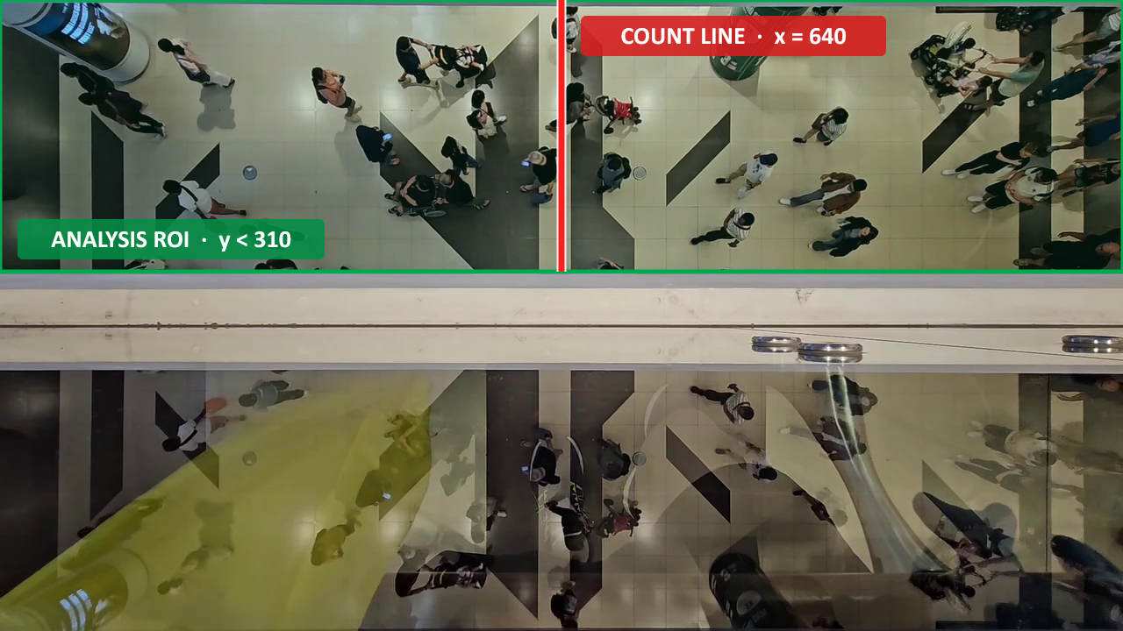
WANG YU · HTX DSAI TECHNICAL ASSESSMENT · TASK 4
Evidence-Driven Checkpoint
Simulation
PROBLEM STATEMENT
For peak and holiday periods, checkpoint leaders need to understand how traveler demand, staffing and queue/SOP choices interact to create bottlenecks and delays.
OBJECTIVE
Build an auditable traveller-level DES decision sandbox to compare operational scenarios and SOPs, quantifying queues, delays, clearance time and bottleneck shifts before implementation.
1280×720
748 frames
EVIDENCE
Supplied corridor video defines a bounded measurement window—not time-of-day demand
5,150 gate-passing AnyLogic runs + separate exact-gated queue replay
source frame (px)
24.923 s · ≈30 FPS
ROI 1280×310 px (y<310) · count line x=640
01 MEASURE
02 SIMULATE
03 DECIDE
Video → audited arrival anchor
Traveller-level DES
Stress-test → operational choices
Notes:
Slide 1 defines the supplied evidence and the measurement geometry; it deliberately does not present the accepted traveller count or arrival-rate output.
The supplied video is 1280×720 pixels, 748 frames and 24.922788889 seconds long. The recorded frame rate is 30.012692534 FPS, shown as approximately 30 FPS.
The analysis ROI is the full width and top 310 pixels: [0,0,1280,310], described as y<310. The vertical count line is x=640.
Accepted results—34 R→L / 12 L→R and the 1.364213 travellers/s short-window anchor—are presented on slide 2.
The 5,150 AnyLogic runs comprise 600 confirmatory, 2,700 capacity-surface, 450 service-variability, 1,000 peak-duration and 400 finite-buffer runs.
[Sources]
- TechnicalTestVideo-main/TestVidTask.mov
- _work/tracker_ab_yolo26m_20260727/botsort/run_summary.json
- docs/task1_measurement.md
- docs/task3_confirmatory_design.md
- docs/task3_capacity_response_surface_design.md
- docs/task3_service_variability_sensitivity_design.md
- docs/task3_peak_duration_sensitivity_design.md
- config/interstage_buffer_study.json
- results/analysis/interstage_buffer/validation.json
[/Sources]

Slide 2
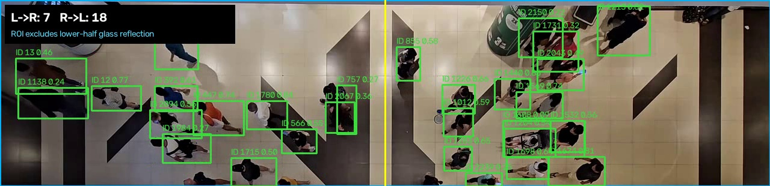
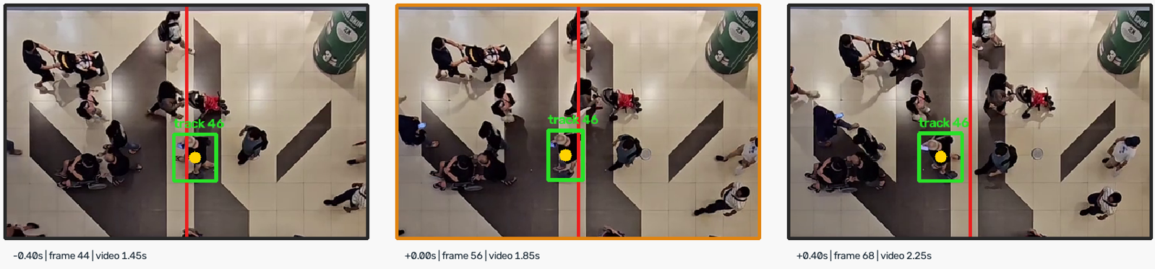
TASK 1 · DATA COLLECTION
AI inference turns video into an auditable flow anchor
VIDEO → YOLO26m ONNX DETECT → BoT-SORT TRACK → CROSSING LEDGER → FULL-VIDEO AUDIT → DES INPUT
Machine inference proposes candidates; human full-video review owns the accepted aggregate.
EXECUTED INFERENCE
METHOD SENSITIVITY
ACCEPTED INPUT
FULL-VIDEO HUMAN AUDIT
34
12
Detection:
YOLO26m ONNX · CPU inference · 748 frames processed
Tracking:
BoT-SORT · 24.923-s clip · ROI y<310 · count line x=640
At 14.9 s: 18 R→L / 7 L→R cumulative machine candidates
End of clip: 30 R→L / 8 L→R machine candidates
CANDIDATE COUNTS (R→L / L→R)
Detector / Hungarian
YOLOX-S 28/8 · YOLO 26s 38/14 · YOLO 26m 34/12
Tracker / YOLO26m ·
Hungarian. 34/12 · ByteTrack 27/9 · BoT-SORT 30/8
Method choice changes candidates
R→L candidates span 27–38 across tested methods.
accepted R→L
accepted L→R
1.364/s
R→L observed
arrival anchor
AI inference implemented
Pretrained detector + tracker generated a persisted candidate ledger.
SCOPE BOUNDARY
Metric speed/spacing excluded: no ground-plane calibration.
Party size excluded: no human-labelled membership.
WHY THIS PATH
YOLO26m: more small/occluded evidence than YOLOX-S;
fewer raw crossings than YOLO26s.
BoT-SORT: more R->L candidates than ByteTrack;
fewer obvious identity jumps than Hungarian.
Classical CV: retained as an independent audit channel.
Human review: sets the accepted 34/12; method spread is sensitivity evidence, not an accuracy estimate.
Human-in-the-loop acceptance
34 R→L / 12 L→R → 1.364213/s.
24.9-s clip only; not time-of-day demand.
Next Validation
Collect representative time-of-day clips and build a signed crossing-event ledger.
Select or fine-tune the production CV stack using precision/recall, ID switches, runtime, licence and security.
2
Notes:
Task 1 implements a basic AI inference pipeline for data collection: supplied video → YOLO26m ONNX person detections → BoT-SORT tracking → crossing ledger → full-video human audit → simulation input.
The screenshot is a literal ROI crop at 14.9 seconds from the executed run. It shows a running count of 18 R→L and 7 L→R at that frame.
The completed BoT-SORT machine candidate ledger contains 30 R→L and 8 L→R candidates. These are not ground truth.
Full-video human review accepts an aggregate of 34 R→L and 12 L→R. The 34 R→L events over 24.922788889 seconds yield the 1.364213 travellers/s short-window simulation anchor.
Detector sensitivity, holding Hungarian association fixed: YOLOX-S 28/8, YOLO26s 38/14, YOLO26m 34/12 (R→L/L→R).
Tracker sensitivity, holding the YOLO26m detection cache fixed: Hungarian 34/12, ByteTrack 27/9, BoT-SORT 30/8.
The exact aggregate match from YOLO26m plus Hungarian is not validation; it can contain compensating misses and duplicates. No signed human event-time ledger exists, so no model accuracy is claimed.
YOLO26m and the Ultralytics BoT-SORT implementation are retained as research/demo benchmarks. Production deployment requires appropriate licensing and security review; YOLOX-S plus Supervision ByteTrack is the licence-friendlier cross-check, not a fully production-cleared system.
GMC off： Global Motion Compensation
ReID off： Re-identification
[Sources]
- TechnicalTestVideo-main/TestVidTask.mov
- src/cv/yolo26_onnx.py
- src/cv/audit_crossings.py
- _work/tracker_ab_yolo26m_20260727/botsort/annotated_crossings.mp4
- _work/tracker_ab_yolo26m_20260727/botsort/crossing_ledger.csv
- _work/tracker_ab_yolo26m_20260727/botsort/run_summary.json
- data/derived/task1_final_aggregate.csv
- docs/task1_measurement.md
- docs/yolo26_detector_ab.md
- docs/yolo26m_tracker_sensitivity.md
- LICENSING.md
[/Sources]

Slide 3
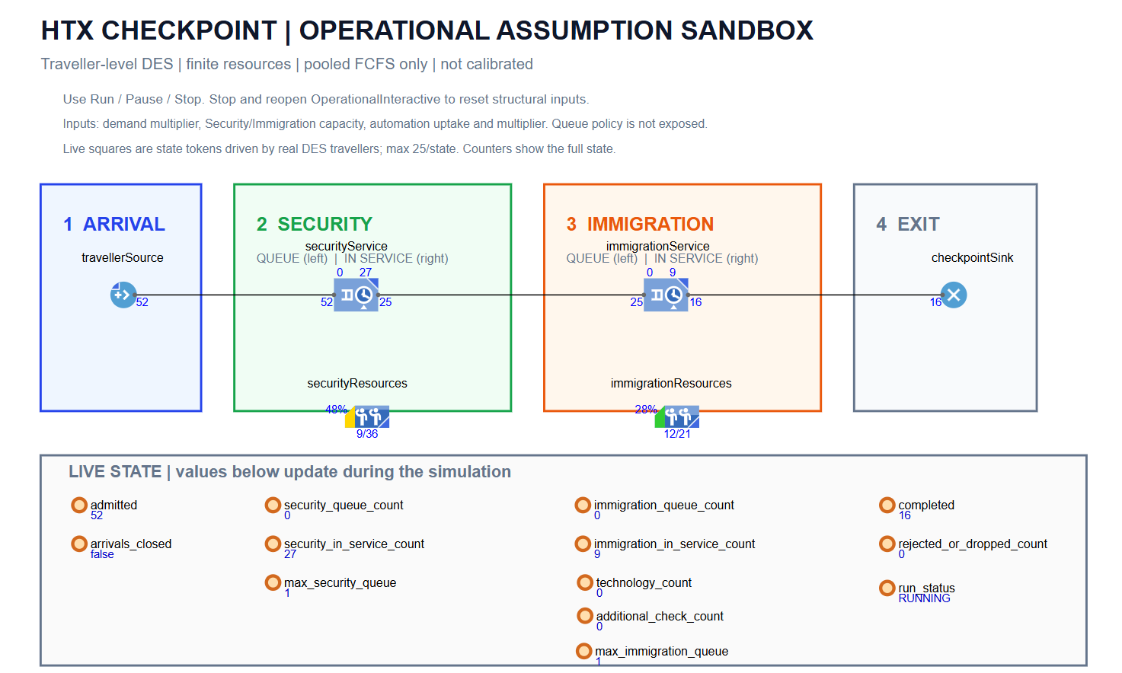
A traveller-level DES turns operational assumptions into auditable queue outcomes
OperationalInteractive | two finite-resource stages | pooled FCFS | full drain
1 ARRIVAL
2 SECURITY
Measured anchor: 1.364213 travelers/s
HPP timing and 300-s window are assumptions
Derived input: 36 finite homogeneous service positions
21.818-s service demand | pooled FCFS
3 IMMIGRATION
4 EXIT & MEASUREMENT
Derived input: 21 finite homogeneous service positions
13-s service demand | routing toggles are scenarios
Close arrivals at cutoff; drain every admitted traveler
Log queue waits, system time, utilization and clearance
EXTERNAL CONTEXT
• Security: 165 pax/h/lane, conservative bound of 165–200
→ service-time proxy = 3,600 / 165 = 21.818 s
• Immigration: 13 s/traveller, official SG bus-hall passport-clearance context
DESIGN RULE — ASSUMED
• Target utilisation (ρ ≤ 0.85)
• Retain ≥15% nominal capacity headroom
DERIVED REFERENCE CAPACITY
• Security: ceil(1.364213 × 21.818 / 0.85) = 36 concurrent service positions
• Immigration: ceil(1.364213 × 13 / 0.85) = 21 concurrent service positions
MEASURED
ASSUMED
CLAIM
34 R-to-L / 24.923 s = 1.364213/s
HPP timing | capacity | service demand | pooled FCFS | routing / SOP
Comparative evidence only - not a site forecast
Configuration-driven experiments | explicit random seeds | replicated runs | full-drain and validation gates
3
Notes:
Slide 3 exposes the implemented traveller-level DES and separates measured, externally contextualised and assumed inputs.
The 1.364213 travellers/s arrival anchor is the accepted 34 right-to-left crossings divided by the 24.922788889-second supplied clip. The stationary HPP timing and 300-second arrival window are modelling assumptions, not time-of-day calibration.
The Security proxy is 21.818181818 seconds, the reciprocal of the conservative 165 passengers/hour/lane external throughput context. It is not a measured local individual-service distribution.
The Immigration proxy is the named 13-second Singapore bus-hall passport-clearance context. It is a deterministic scenario input, not a measurement from the supplied corridor.
The target utilisation rho <= 0.85 is a design rule retaining at least 15% nominal headroom. Applying ceil(lambda times service demand divided by 0.85) yields the derived pooled reference capacities 36/21; these are not observed staffing.
The model implements two finite-resource stages, pooled FCFS, full drain and explicit logging. Routing, automation, service variability, capacity and arrival duration are controlled experimental assumptions.
[Sources]
- config/provenance_registry.csv
- config/parameter_registry.csv
- docs/task2_system_design.md
- docs/task3_results.md
- https://www.gao.gov/assets/a257263.html
- https://www.mha.gov.sg/media-room/newsroom/average-duration-to-process-travellers-at-bus-halls-of-land-checkpoints-using-qr-code-or-passport/
- results/analysis/capacity_response_surface/validation.json
- results/analysis/service_variability/validation.json
- results/analysis/peak_duration_sensitivity/validation.json
[/Sources]

Slide 4
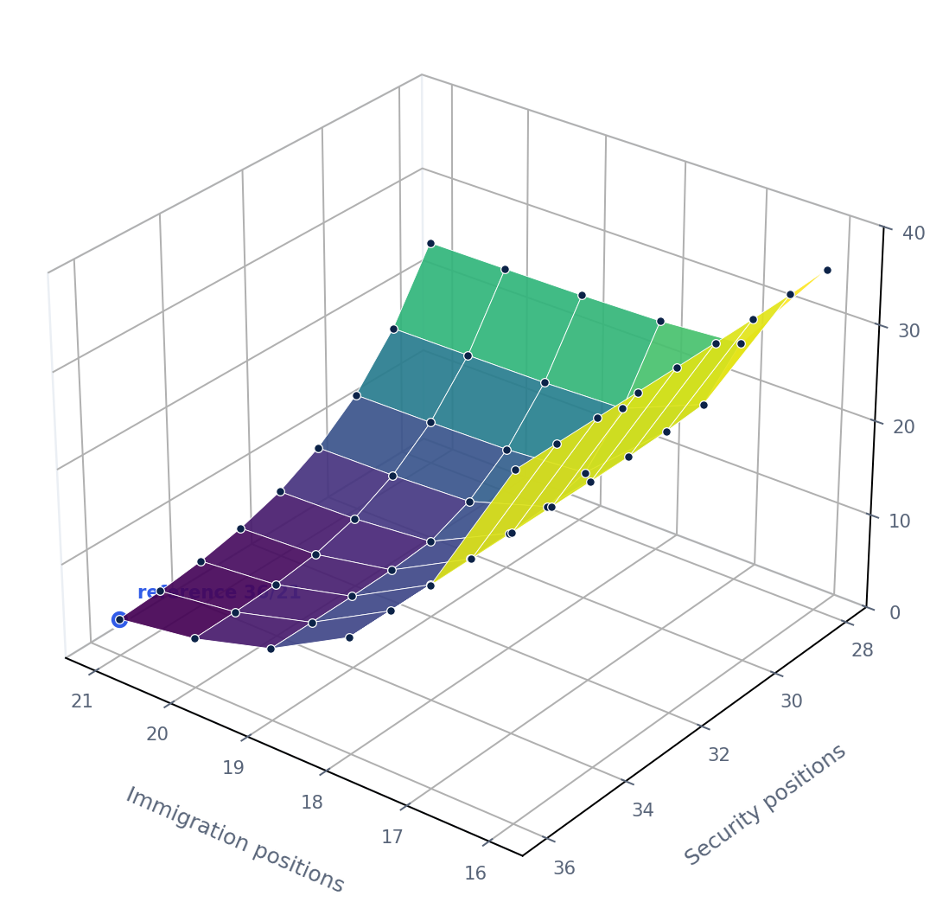
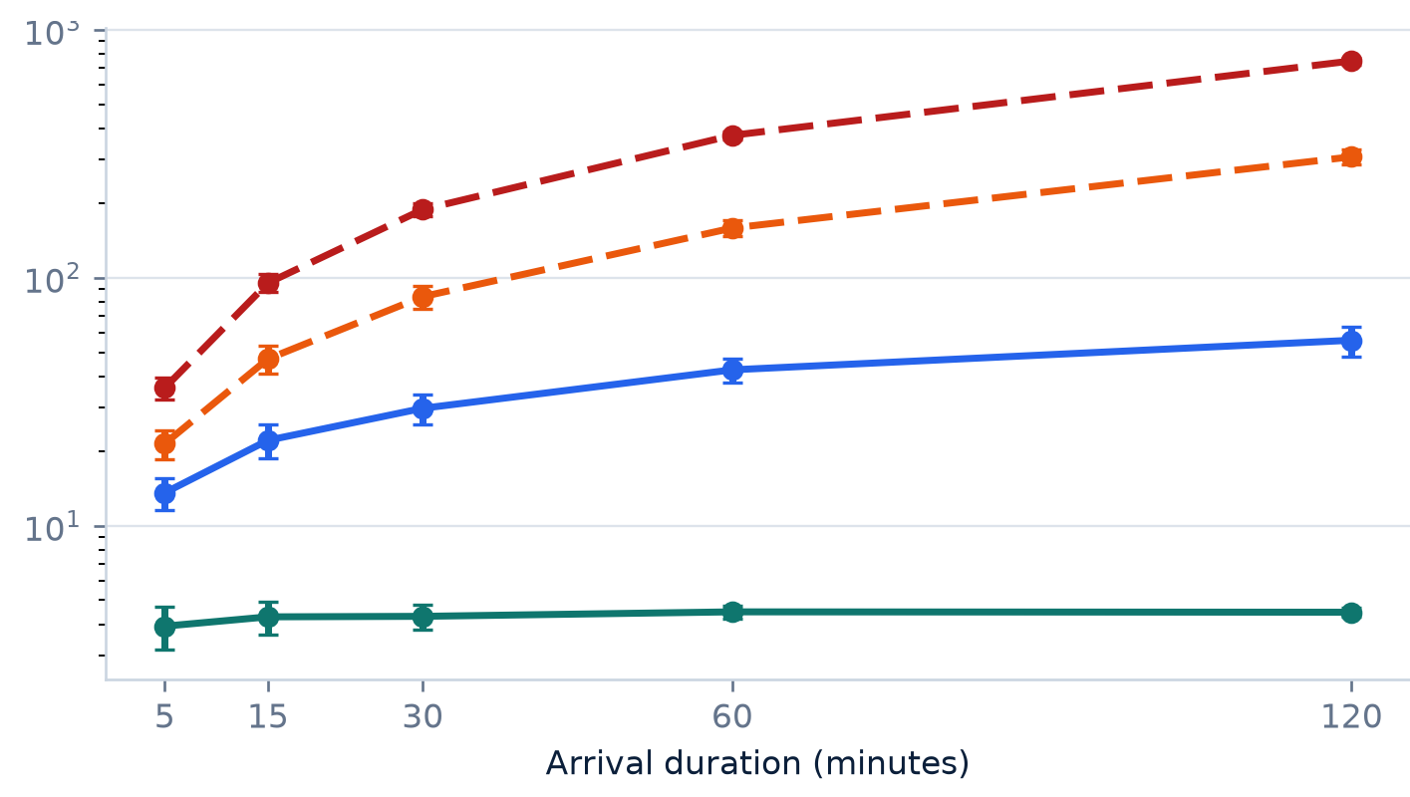
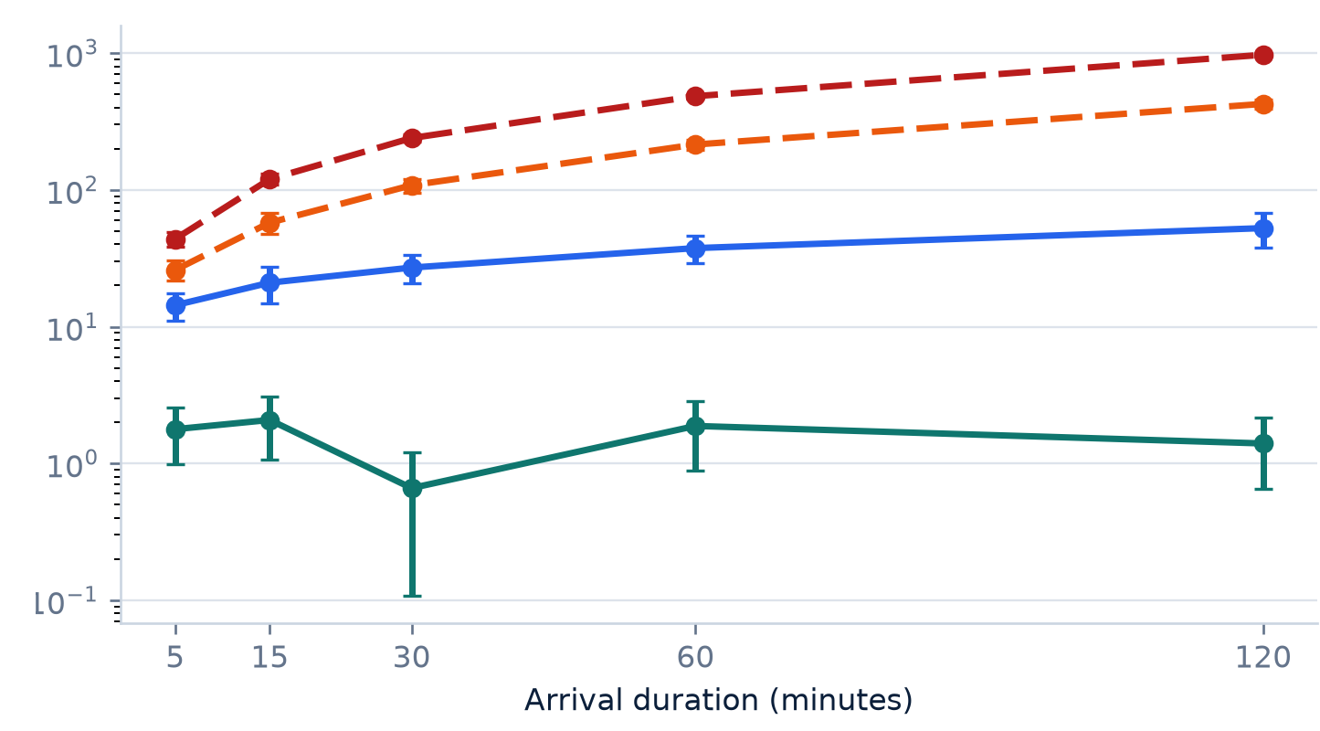
Capacity sets delay; finite space determines where congestion lands
Capacity: 54 × 50 | duration: 4 × 5 × 50 | finite buffer: 2 × 4 × 50 | replication means; 95% CIs shown where plotted
A
CAPACITY RESPONSE SURFACE
B
TRAVELLER P95 QUEUE-WAIT TAIL
C
QUEUE REMAINING AT CUTOFF
S36→28 | I21→16 | z = mean P95 wait (s)
36/21: HPP P95 3.93 s | ideal oracle 0 s
● 36/21 ρ=.845
● 30/18 ρ=.992
● 29/17 ρ=1.043
● 28/16 ρ=1.108
WHY | Locate the joint Security–Immigration capacity threshold.
WHY | Test whether each capacity configuration survives a longer peak.
WHY | Test recoverability after new arrivals are stopped.
EVIDENCE | 36/21 stays low; Immigration cuts drive the steepest P95 rise.
EVIDENCE | Near/over-capacity configurations accumulate tail wait; spare capacity stays stable.
EVIDENCE | Residual queues grow near/above capacity, delaying post-peak clearance.
D
WHY | DOES FINITE SPACE ADD DELAY OR RELOCATE CONGESTION?
MODEL CASE | Immigration bottleneck S36 / I16
6.66% → 1.01% → 0%
EVIDENCE | Security locking falls from 6.66% to 0% by B100.
Mean replication-level system-time P95 = 70.43 s at every B
EVIDENCE | B100 is non-binding; mean replication system-time P95 remains 70.43 s.
DECISION INSIGHT | Identify the active bottleneck; test long-peak recovery; measure interstage space before sizing a pilot.
EVIDENCE BOUNDARY | Capacity: 2,700 runs; duration: 1,000; finite buffer: 400. B is assumed; B5000 is a non-binding guard.
Stationary HPP, empty/idle, pooled FCFS, no loss, single path and full drain; comparative evidence—not a site forecast.
4
Notes:
Slide-reading logic:
A tests which capacity combinations cross the congestion threshold.
B tests how each capacity configuration responds as the peak lasts longer.
C tests whether work is cleared or remains at the arrival cutoff.
D tests whether finite interstage space changes traveller delay or relocates congestion upstream.
The 3D surface is built from 54 integer-capacity cells: Security 36 through 28 crossed with Immigration 21 through 16, with 50 replications per cell. The continuous surface only joins simulated cells as a visual guide.
The duration panels retain the executed experiment's Student-t 95% confidence intervals and log-scaled axes. Only 5, 15, 30, 60 and 120 minutes were simulated; connecting lines are visual guides.
The stable 36/21 reference remains bounded. The 30/18 case is below the rho=1 proxy but displays a long near-critical transient as exposure grows. The 29/17 and 28/16 cases exceed the rho=1 proxy and accumulate travellers over the finite arrival window.
The deterministic ideal comparator is a mechanism oracle, not a stochastic forecast: at 36/21 it yields zero wait while HPP arrivals yield a mean replication-level P95 total wait of 3.9288 seconds.
Finite-buffer experiment: 2 regimes × B={25,50,100,5000} × 50 replications = 400 gate-passing runs.
Under the Immigration bottleneck S36/I16, mean Security resource-time blocked is 6.6576% at B25, 1.0069% at B50 and 0% at B100/B5000. B25 and B50 therefore relocate waiting upstream and lock Security capacity.
The mean of replication-level system-time P95s is 70.4274 seconds at every B. All 50 paired replications have an exact P95 delta of 0.000 seconds. This invariance is conditional on the current no-loss, single-path, work-conserving, full-drain tandem assumptions.
The Security-bottleneck control S30/I21 has 0% blocked resource-time at every B. B100 exactly replays the non-binding B5000 comparator in 50/50 pairs in both regimes.
[Sources]
- docs/task3_capacity_response_surface_design.md
- results/analysis/capacity_response_surface/cell_estimates.csv
- results/analysis/capacity_response_surface/ideal_case_comparator.csv
- results/analysis/capacity_response_surface/validation.json
- docs/task3_peak_duration_sensitivity_design.md
- results/analysis/peak_duration_sensitivity/cell_estimates.csv
- results/analysis/peak_duration_sensitivity/validation.json
- results/analysis/interstage_buffer/analysis_manifest.json
- results/analysis/interstage_buffer/cell_estimates.csv
- results/analysis/interstage_buffer/replication_kpis.csv
- results/analysis/interstage_buffer/exact_replay_validation.json
- results/analysis/interstage_buffer/negative_control_invariance.json
- results/analysis/interstage_buffer/validation.json
[/Sources]

Slide 5
The sandbox locates the regime; site evidence selects the lever
SUMMARY | what the comparative experiments establish FUTURE WORK | what must be measured before a site pilot
FUTURE WORK PATH
1 INSTRUMENT
Demand · service · space
2 CALIBRATE
Distributions · policies
3 VALIDATE
Held-out periods · gates
4 PILOT & GOVERN
One lever · monitor
SUMMARY — WHAT THE EXPERIMENTS ESTABLISH
DATA REQUIRED BEFORE SITE PILOT
NOT YET OBSERVED
AUDITED INPUT
34/12 accepted; 1.364/s is a clip-level R→L anchor owned by human review.
1
Representative time-of-day arrivals + signed event ledger
5,150 gated runs isolate capacity, peak duration, service variability and finite space.
2
Observed staffing schedules, routing + queue policy
EXECUTED EVIDENCE
3
Stage service distributions, exceptions + automation
QUEUEING REGIME
Delay rises nonlinearly near capacity; rho > 1 accumulates residual backlog.
4
Physical queue capacity, walking + spillback boundaries
ROBUSTNESS LIMIT
Near/above capacity, longer peaks expand tail wait; finite space can relocate congestion upstream.
Production CV licence, security, privacy + drift monitoring
5
DECISION NOW | Advance to site calibration; pilot one lever only after the calibrated model reproduces held-out queues and bottleneck behaviour.
BOUNDARY | 36/21 is a derived pooled reference—not observed staffing. Comparative evidence assumes stationary HPP, pooled FCFS and no-loss/full drain; it is not a site forecast or production SOP.
5
Notes:
Closing logic:
The prototype establishes an auditable measurement-to-simulation pipeline and identifies conditional operating mechanisms.
It does not establish a field SLA, causal staffing effect, site forecast or production SOP.
The next gate is representative site instrumentation, calibration and held-out validation. A pilot should begin only after the calibrated model reproduces held-out queue and bottleneck behaviour, with service, recovery, cost, safety and physical-constraint KPIs.
Do not treat 36/21 as a staffing prescription.
[Sources]
- docs/task1_measurement.md
- docs/task2_system_design.md
- docs/task3_results.md
- docs/task3_peak_duration_sensitivity_design.md
- results/analysis/service_variability/validation.json
- results/analysis/peak_duration_sensitivity/validation.json
- results/analysis/interstage_buffer/analysis_manifest.json
- results/analysis/interstage_buffer/cell_estimates.csv
- LICENSING.md
[/Sources]

