Slide 1


081100M01002H 图像处理与分析 第五讲: 图像变换 (III) 图像的离散傅里叶变换，正交变换，距离变换
Lecture 5 October 10, 2019

Slide 2
关于课程助教的说明
本课程共有7位助教
- 窦昊，王晓莲，陈典浩，朱志华 (彭老师胡老师课题组) - 钟丽群，罗曜儒，游博 (杨老师课题组)
助教承担的工作包括： - 作业批改，成绩录入 - 答疑 - 准备参考答案 - 教学辅助

Slide 3
关于第一次作业的反馈 (I)
代码问题
问题一
最终结果展示有的用plot，有的用imshow。
直接给出中心位置，未使用size求图片尺寸。
问题二
average方法中未对数据作处理导致数据值超过255溢出。
method方法未写缺省代码。
其他
未提交代码或代码以TXT，WORD文档存储。
缺少主函数，缺少读取图像。
提交作业应包含图片，读取图片最好使用相对路径，以便验证。
作图无横纵坐标标题、图标题。
读图代码包含在函数中，只适合特定图片。

Slide 4
关于第一次作业的反馈 (II)
报告问题
- 报告写成一份即可，无需一个问题一个报告。
部分同学未提交报告或者只提供了txt文档，没有必要的代码运行说明和对结果的讨论和比较。 要求提供可执行代码和简要说明
其他
本次作业大部分同学使用matlab和python语言，极少数同学使用C++。是否应对编程语言有所限制？
要求使用MATLAB或者Python

Slide 5
关于第一次作业的反馈 (III)
关于评分标准的说明 - 评分标准 - 迟交报告处理 - 抄袭情况处理
作业批改由各位助教分担，个别相关问题可电子邮件联系 yangge@ucas.ac.cn

Slide 6
第三次编程小作业
第三次编程小作业已布置，发布时间是10月10日早上6:00。提交的截止时间是10月25日晚上11:00。

Slide 7
内容提要
图像的二维离散傅里叶变换的详细介绍
图像的二维离散傅里叶变换的计算
快速傅里叶变换的基本概念
一些常用的图像滤波算子
图像的正交变换
图像的距离变换
点扩散函数的基本概念
Notes:
As you will see again and again in the class, to understand bioimage informatics depends critically on understanding the biological background of bioimage informatics. This is because bioimage informatics is created to answer biological questions rather than for technological curiosity. If we do not understand the biological questions, we will not be able to understand bioimage informatics. So for this reason we need to build some background knowledge about biology, and specifically for this lecture about cell biology.
For the most part of this course, our discussion on biology will be on a level that will be quite comfortable for you.
After that I will give you some historical perspectives and talk about where does it come from. Then I will discuss the learning objectives that we plan to achieve in this class. And finally I will go through the course syllabus together with you and discuss some details.

Slide 8
图像的二维离散傅里叶变换的详细介绍
图像的二维离散傅里叶变换的计算
快速傅里叶变换的基本概念
一些常用的图像滤波算子
图像的正交变换
图像的距离变换
点扩散函数的基本概念
Notes:
As you will see again and again in the class, to understand bioimage informatics depends critically on understanding the biological background of bioimage informatics. This is because bioimage informatics is created to answer biological questions rather than for technological curiosity. If we do not understand the biological questions, we will not be able to understand bioimage informatics. So for this reason we need to build some background knowledge about biology, and specifically for this lecture about cell biology.
For the most part of this course, our discussion on biology will be on a level that will be quite comfortable for you.
After that I will give you some historical perspectives and talk about where does it come from. Then I will discuss the learning objectives that we plan to achieve in this class. And finally I will go through the course syllabus together with you and discuss some details.

Slide 9
关于复数的简要复习 (I)
复数的定义：R: 实部，I: 虚部
共轭复数
复数的极坐标和指数形式

Slide 10
关于复数的简要复习 (II)
共轭复数的极坐标和指数形式
共轭运算的乘法和加法分配律

Slide 11
关于复数的简要复习 (III)
以上结论同样适应于复函数

Slide 12
傅里叶级数与傅里叶变换 (I)
傅里叶级数
是周期为T的连续函数

Slide 13
傅里叶级数与傅里叶变换 (II)
傅里叶变换
是连续函数

Slide 14
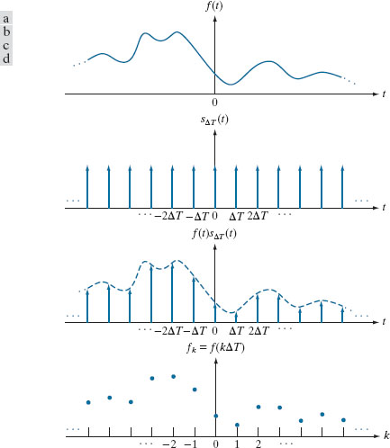
连续信号采样的数学表示
(a) 一个连续函数. (b) 采样脉冲序列. (c) 采样脉冲序列与连续函数的乘积. (d) 采样后的离散信号

Slide 15
卷积定理
时域或空间域的信号卷积对应于频域的变换乘积
时域或空间域的信号乘积应于频域的变换卷积

Slide 16
采样定理

Slide 17
一维离散傅里叶变换

Slide 18
一维离散傅里叶变换(1D-DFT)的定义

Slide 19
图像的二维离散傅里叶变换的详细介绍
图像的二维离散傅里叶变换的计算
快速傅里叶变换的基本概念
一些常用的图像滤波算子
图像的正交变换
图像的距离变换
点扩散函数的基本概念
Notes:
As you will see again and again in the class, to understand bioimage informatics depends critically on understanding the biological background of bioimage informatics. This is because bioimage informatics is created to answer biological questions rather than for technological curiosity. If we do not understand the biological questions, we will not be able to understand bioimage informatics. So for this reason we need to build some background knowledge about biology, and specifically for this lecture about cell biology.
For the most part of this course, our discussion on biology will be on a level that will be quite comfortable for you.
After that I will give you some historical perspectives and talk about where does it come from. Then I will discuss the learning objectives that we plan to achieve in this class. And finally I will go through the course syllabus together with you and discuss some details.

Slide 20
图像二维快速傅里叶变换(DFT)的计算 (I)
定义

Slide 21
图像二维快速傅里叶变换(DFT)的计算 (II)
计算正向变换
F(x,v) 是f(x,y)中一行的一维DFT
F(u,v) 是F(x,v)中一列的一维DFT

Slide 22
关于复数的简要复习 (II)
共轭复数的指数形式
共轭运算的乘法和加法分配律

Slide 23
图像二维快速傅里叶变换(DFT)的计算 (III)
计算逆向变换

Slide 24
图像二维快速傅里叶变换(DFT)的计算 (IV)
计算逆向变换步骤总结

Slide 25
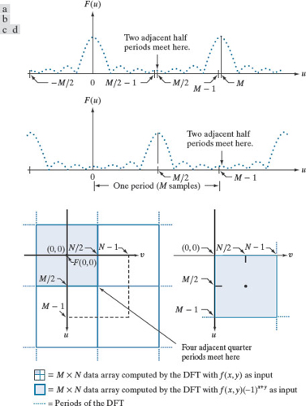
图像二维快速傅里叶变换(DFT)的计算 (V)
中心化傅里叶变换

Slide 26
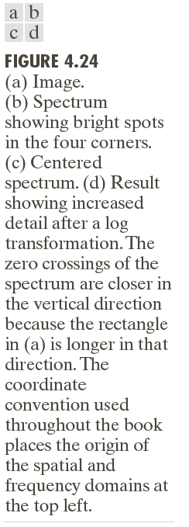
图像2D-DFT示例 (I)

Slide 27
图像的二维离散傅里叶变换的详细介绍
图像的二维离散傅里叶变换的计算
快速傅里叶变换的基本概念
一些常用的图像滤波算子
图像的正交变换
图像的距离变换
点扩散函数的基本概念
Notes:
As you will see again and again in the class, to understand bioimage informatics depends critically on understanding the biological background of bioimage informatics. This is because bioimage informatics is created to answer biological questions rather than for technological curiosity. If we do not understand the biological questions, we will not be able to understand bioimage informatics. So for this reason we need to build some background knowledge about biology, and specifically for this lecture about cell biology.
For the most part of this course, our discussion on biology will be on a level that will be quite comfortable for you.
After that I will give you some historical perspectives and talk about where does it come from. Then I will discuss the learning objectives that we plan to achieve in this class. And finally I will go through the course syllabus together with you and discuss some details.

Slide 28
图像二维快速傅里叶变换(DFT)的计算 (I)
定义

Slide 29
快速傅里叶变换的基本概念 (I)
直接计算 如果M=N=2048, (MN)²=1.76×10¹³
采用快速傅里叶变换的计算成本(一维)
计算成本~(MN)²

Slide 30
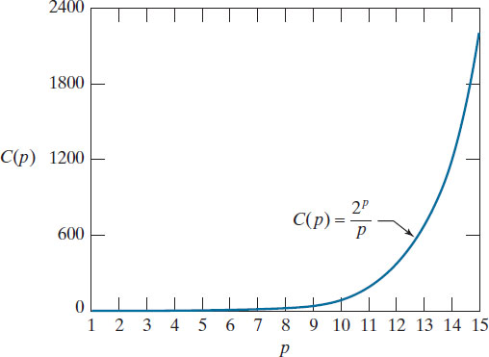
快速傅里叶变换的基本概念 (II)
Computational advantage of the FFT over a direct implementation of the 1-D DFT. The number of samples is M = 2^{p}. The computational
advantage increases rapidly as a function of p.

Slide 31
快速傅里叶变换的基本概念 (III)
卷积计算 图像大小 M×M, 卷积核大小 m×m

Slide 32
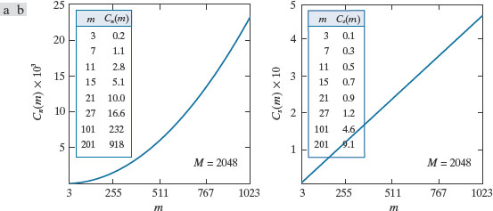
快速傅里叶变换的基本概念 (IV)
(a) Computational advantage of the FFT over nonseparable spatial kernels. (b) Advantage over separable kernels. The numbers for C(m) in the inset tables are not to be multiplied by the factors of 10 shown for the curves.

Slide 33
图像的二维离散傅里叶变换的详细介绍
图像的二维离散傅里叶变换的计算
快速傅里叶变换的基本概念
一些常用的图像滤波算子
图像的正交变换
图像的距离变换
点扩散函数的基本概念
Notes:
As you will see again and again in the class, to understand bioimage informatics depends critically on understanding the biological background of bioimage informatics. This is because bioimage informatics is created to answer biological questions rather than for technological curiosity. If we do not understand the biological questions, we will not be able to understand bioimage informatics. So for this reason we need to build some background knowledge about biology, and specifically for this lecture about cell biology.
For the most part of this course, our discussion on biology will be on a level that will be quite comfortable for you.
After that I will give you some historical perspectives and talk about where does it come from. Then I will discuss the learning objectives that we plan to achieve in this class. And finally I will go through the course syllabus together with you and discuss some details.

Slide 34
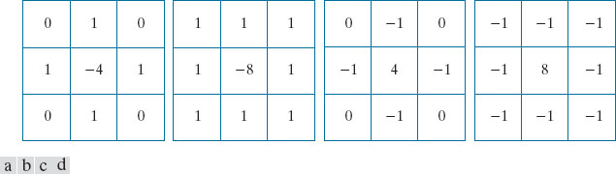
常用的滤波器算子：Laplacian算子
(a) Laplacian kernel used to implement Eq. (3-62). (b) Kernel used to implement an extension of this equation that includes the diagonal terms. (c) and (d) Two other Laplacian kernels.

Slide 35
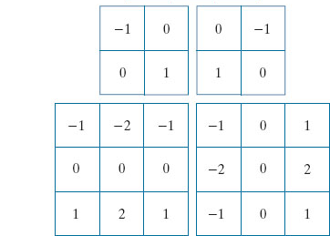
常用的滤波器算子：Roberts算子和Sobel算子
Roberts 算子
Sobel 算子
Sobel 算子

Slide 36
常用的滤波器算子：Prewitt算子和Scharr算子
Prewitt 算子
Sobel 算子

Slide 37
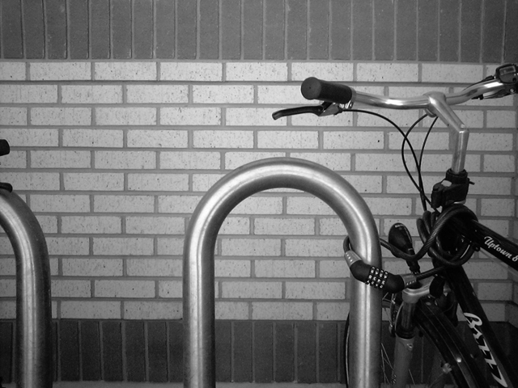
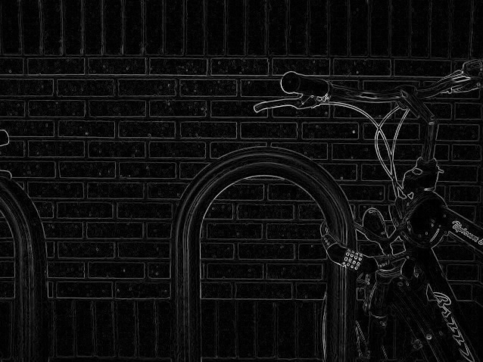
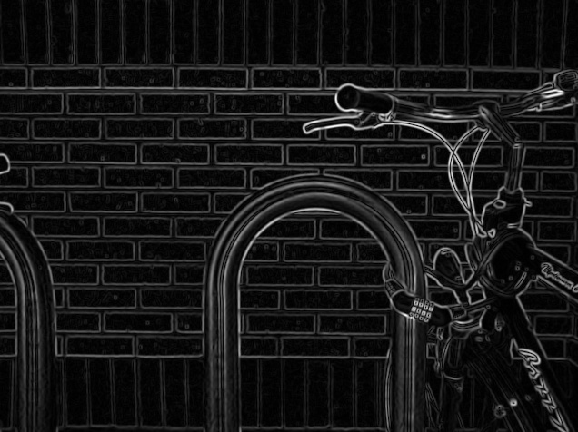
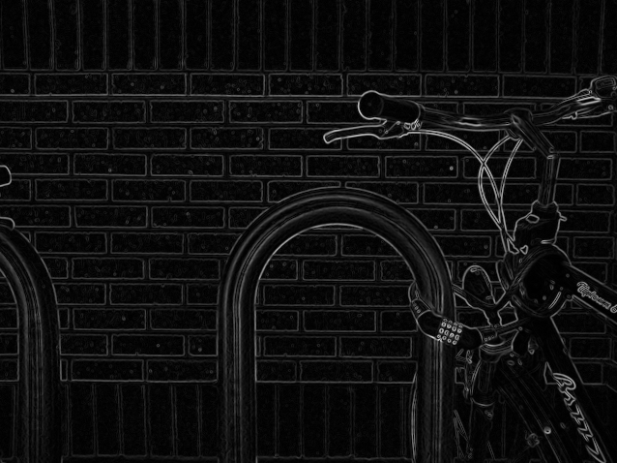
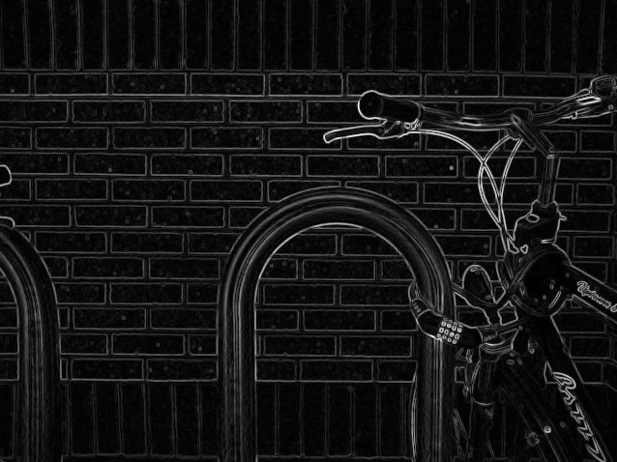
不同算子的比较
Source
Roberts
Sobel
Scharr
Prewitt
https://en.wikipedia.org/wiki/Roberts_cross

Slide 38
线性系统复习

Slide 39
线性代数复习

Slide 40
图像的二维离散傅里叶变换的详细介绍
图像的二维离散傅里叶变换的计算
快速傅里叶变换的基本概念
一些常用的图像滤波算子
图像的正交变换
图像的距离变换
点扩散函数的基本概念
Notes:
As you will see again and again in the class, to understand bioimage informatics depends critically on understanding the biological background of bioimage informatics. This is because bioimage informatics is created to answer biological questions rather than for technological curiosity. If we do not understand the biological questions, we will not be able to understand bioimage informatics. So for this reason we need to build some background knowledge about biology, and specifically for this lecture about cell biology.
For the most part of this course, our discussion on biology will be on a level that will be quite comfortable for you.
After that I will give you some historical perspectives and talk about where does it come from. Then I will discuss the learning objectives that we plan to achieve in this class. And finally I will go through the course syllabus together with you and discuss some details.

Slide 41
内积空间的基本概念
如果矢量空间V满足如下条件则是一个内积空间

Slide 42
内积空间的单位正交基

Slide 43
一维信号的正交变换
定义

Slide 44
一维信号的正交变换的矩阵形式

Slide 45
二维信号的正交变换的矩阵形式

Slide 46
图像的二维离散傅里叶变换的详细介绍
图像的二维离散傅里叶变换的计算
快速傅里叶变换的基本概念
一些常用的图像滤波算子
图像的正交变换
图像的距离变换
点扩散函数的基本概念
Notes:
As you will see again and again in the class, to understand bioimage informatics depends critically on understanding the biological background of bioimage informatics. This is because bioimage informatics is created to answer biological questions rather than for technological curiosity. If we do not understand the biological questions, we will not be able to understand bioimage informatics. So for this reason we need to build some background knowledge about biology, and specifically for this lecture about cell biology.
For the most part of this course, our discussion on biology will be on a level that will be quite comfortable for you.
After that I will give you some historical perspectives and talk about where does it come from. Then I will discuss the learning objectives that we plan to achieve in this class. And finally I will go through the course syllabus together with you and discuss some details.

Slide 47
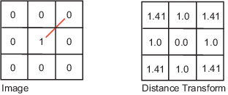
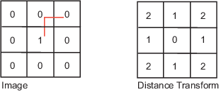


图像的距离变换 (I)
Euclidean
Citi block

Slide 48
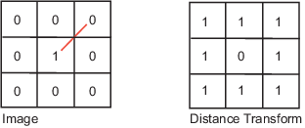
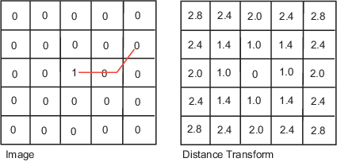
图像的距离变换 (II)
Chessboard
Quasi-enclidean
http://homepages.inf.ed.ac.uk/rbf/HIPR2/distance.htm

Slide 49
图像的二维离散傅里叶变换的详细介绍
图像的二维离散傅里叶变换的计算
快速傅里叶变换的基本概念
一些常用的图像滤波算子
图像的正交变换
图像的距离变换
点扩散函数的基本概念
Notes:
As you will see again and again in the class, to understand bioimage informatics depends critically on understanding the biological background of bioimage informatics. This is because bioimage informatics is created to answer biological questions rather than for technological curiosity. If we do not understand the biological questions, we will not be able to understand bioimage informatics. So for this reason we need to build some background knowledge about biology, and specifically for this lecture about cell biology.
For the most part of this course, our discussion on biology will be on a level that will be quite comfortable for you.
After that I will give you some historical perspectives and talk about where does it come from. Then I will discuss the learning objectives that we plan to achieve in this class. And finally I will go through the course syllabus together with you and discuss some details.

Slide 50
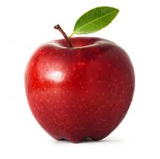
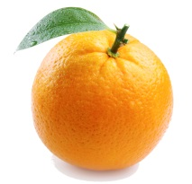
A Microscope as a Linear System
A light microscope can be considered as a linear system.
A linear system satisfies the following two conditions
- Homogeneity
- Additivity
Homogeneity
Additivity

Slide 51
How to Characterize a Linear System
A linear system can be characterized by
- Impulse response
- Frequency response
Impulse response of a microscope: point spread function
Frequency response of a microscope: optical transfer function

Slide 52
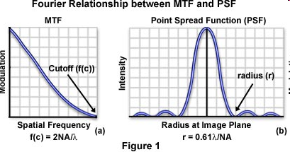
Airy Disk
Airy (after George Biddell Airy) disk is the diffraction pattern of a point feature under a circular aperture.
It has the following form
Detailed derivation is given in Born & Wolf, Principles of Optics, 7th ed., pp. 439-441.
J₁(x) is a Bessel function of the first kind.

Slide 53

Microscope Image Formation (I)
Microscope image formation can be modeled as a convolution with the PSF.
http://micro.magnet.fsu.edu/primer/java/mtf/airydisksize/index.html

Slide 54
Microscope Image Formation (II)
The impulse response of the microscope is called its point spread function (PSF).
The transfer function of a microscope is called its optical transfer function (OTF).
The PSF has the shape of an Airy Disk.

Slide 55
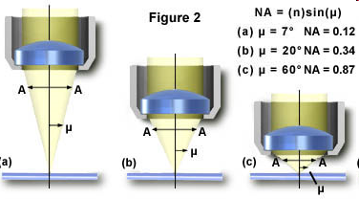
Numerical Aperture
Numerical aperture (NA) determines microscope resolution and light collection power.
n: refractive index of the medium between the lens and the specimen
μ: half of the angular aperture

Slide 56
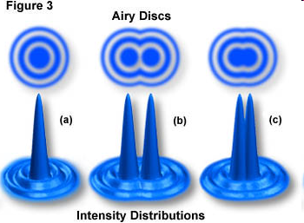
Different Definition of Light Microscopy Resolution Limit (Demo)
Rayleigh limit
Sparrow limit
http://www.microscopy.fsu.edu/primer/java/imageformation/rayleighdisks/index.html

Slide 57
Summary: High Resolution Microscopy
Size of cellular features are typically on the scale of a micron or smaller.
To resolve such features require
- Shorter wavelength (electron microscopy) - High numerical aperture (resolution) - High magnification (spatial sampling)

Slide 58
Questions?

