Slide 1


081100M01002H 图像处理与分析 第六讲: 图像变换 (IV) 图像的正交变换，距离变换
Lecture 6 October 17, 2019

Slide 2
内容提要
图像的正交变换
图像的距离变换
点扩散函数的基本概念
概率论基础 (复习)
Notes:
As you will see again and again in the class, to understand bioimage informatics depends critically on understanding the biological background of bioimage informatics. This is because bioimage informatics is created to answer biological questions rather than for technological curiosity. If we do not understand the biological questions, we will not be able to understand bioimage informatics. So for this reason we need to build some background knowledge about biology, and specifically for this lecture about cell biology.
For the most part of this course, our discussion on biology will be on a level that will be quite comfortable for you.
After that I will give you some historical perspectives and talk about where does it come from. Then I will discuss the learning objectives that we plan to achieve in this class. And finally I will go through the course syllabus together with you and discuss some details.

Slide 3
图像的正交变换
图像的距离变换
点扩散函数的基本概念
概率论基础 (复习)
Notes:
As you will see again and again in the class, to understand bioimage informatics depends critically on understanding the biological background of bioimage informatics. This is because bioimage informatics is created to answer biological questions rather than for technological curiosity. If we do not understand the biological questions, we will not be able to understand bioimage informatics. So for this reason we need to build some background knowledge about biology, and specifically for this lecture about cell biology.
For the most part of this course, our discussion on biology will be on a level that will be quite comfortable for you.
After that I will give you some historical perspectives and talk about where does it come from. Then I will discuss the learning objectives that we plan to achieve in this class. And finally I will go through the course syllabus together with you and discuss some details.

Slide 4
一维离散傅里叶变换(1D-DFT)的定义

Slide 5
二维离散傅里叶变换(2D-DFT)的定义

Slide 6
均值滤波器的频率域模型

Slide 7
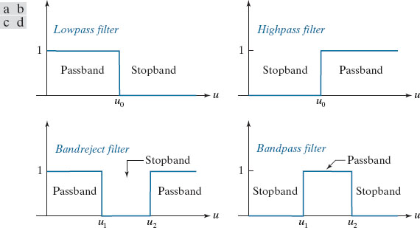
不同类型的频率域滤波器
Transfer functions of ideal 1-D filters in the frequency domain (u denotes frequency). (a) Lowpass filter. (b) Highpass filter. (c) Bandreject filter. (d) Bandpass filter. (As before, we show only positive frequencies for simplicity.)

Slide 8
代表性滤波器：高斯低通滤波器 GLPF

Slide 9
二维离散傅里叶变换(2D-DFT)的定义
一维和二维傅里叶变换是正交变换的一个特例，可以直接在时间/空间域获得直观的解释。这些解释具有重要意义。

Slide 10
矢量空间的基本概念 (I)
A vector space is defined as a nonempty set V of entities called vectors and associated scalars that satisfy the conditions outlined in A through C below. A vector space is real if the scalars are real numbers; it is complex if the scalars are complex numbers.
Condition A: There is in V an operation called vector addition, denoted x + y, that satisfies:
1. x + y = y + x for all vectors x and y in the space.
2. x + (y + z) = (x + y) + z for all x, y, and z.
3. There exists in V a unique vector, called the zero vector, and denoted 0, such that x + 0 = x and 0 + x = x for all vectors x.
4. For each vector x in V, there is a unique vector in V, called the negation of x, and denoted −x, such that x + (− x) = 0 and (− x) + x = 0.

Slide 11
矢量空间的基本概念 (II)
Condition B: There is in V an operation called multiplication by a scalar that associates with each scalar c and each vector x in V a unique vector called the product of c and x, denoted by cx and xc, and which satisfies:
1. c(dx) = (cd)x for all scalars c and d, and all vectors x.
2. (c + d)x = cx + dx for all scalars c and d, and all vectors x.
3. c(x + y) = cx + cy for all scalars c and all vectors x and y.
Condition C: 1x = x for all vectors x.

Slide 12
内积空间的基本概念
如果矢量空间V满足如下条件则是一个内积空间

Slide 13
内积空间的示例 I：欧几里得空间

Slide 14
内积空间示例II：积分内积空间
矢量空间 其中矢量是定义在 上的连续函数。

Slide 15
内积空间的基和单位正交基

Slide 16
双正交基和单位双正交基
一组矢量 和一种对偶矢量 称为双正交基/单位双正交基如果它们满足如下条件

Slide 17
一维傅里叶变换的内积与矩阵表示 (I)
正向变换核
逆向变换核

Slide 18
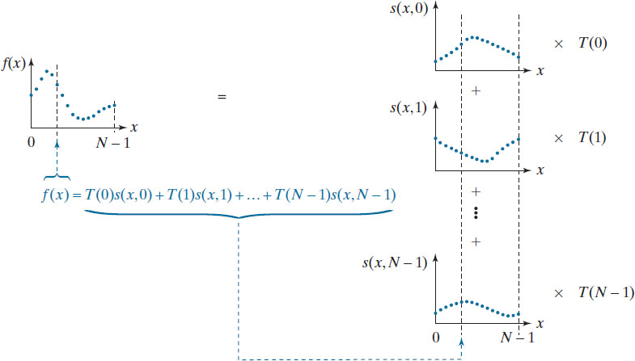
一维傅里叶变换的内积与矩阵表示 (II)

Slide 19
一维傅里叶变换的内积与矩阵表示 (III)

Slide 20
一维傅里叶变换的内积与矩阵表示 (IV)

Slide 21
一维傅里叶变换的内积与矩阵表示 (V)

Slide 22
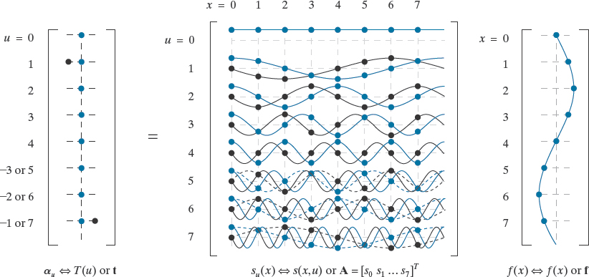
一维傅里叶变换的内积与矩阵表示 (VI)
Depicting the continuous Fourier series and 8-point DFT of f(x) = sin(2πx) as “matrix multiplications.” The real and imaginary parts of all complex quantities are shown in blue and black, respectively. Continuous and discrete functions are represented using lines and dots, respectively. Dashed lines are included to show that
effectively cutting the maximum frequency of the DFT in half. The negative indices to the left of t are for the Fourier series computation alone.

Slide 23
变换的直观解释
连续函数的相关函数

Slide 24
二维傅里叶变换的内积与矩阵表示 (I)

Slide 25
二维傅里叶变换的内积与矩阵表示 (II)

Slide 26
二维傅里叶变换的内积与矩阵表示 (III)

Slide 27
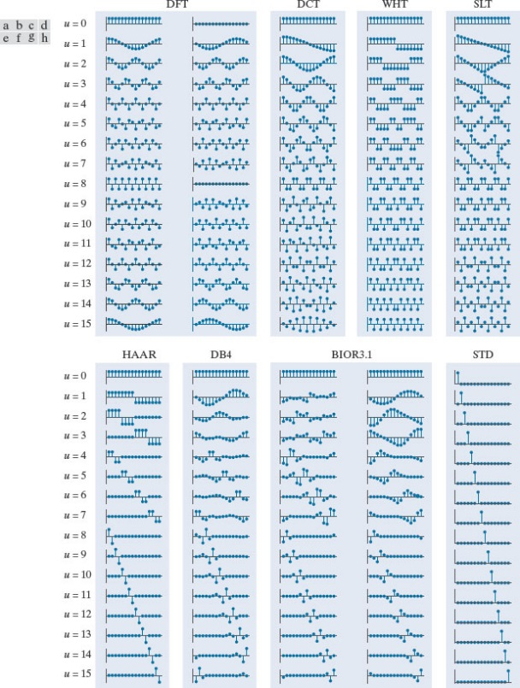
各种变换基总览
Basis vectors (for N = 16) of some commonly encountered transforms: (a) Fourier basis (real and imaginary parts), (b) discrete Cosine basis, (c) Walsh-Hadamard basis, (d) Slant basis, (e) Haar basis, (f) Daubechies basis, (g) Biorthogonal B-spline basis and its dual, and (h) the standard basis, which is included for reference only (i.e., not used as the basis of a transform).

Slide 28
各种变换基总览

Slide 29
基图像的基本概念

Slide 30
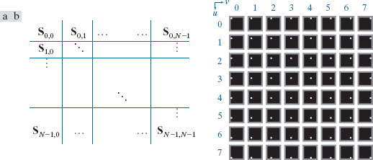
标准基变换
(a) Basis image organization and (b) a standard basis of size 8×8
For clarity, a gray border has been added around each basis image. The origin of each basis image (i.e., x = y = 0) is at its top left.

Slide 31
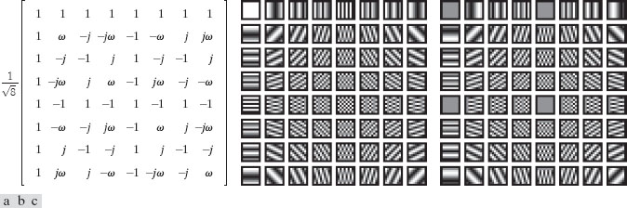
二维傅里叶变换的基图像
实部基图像
虚部基图像

Slide 32
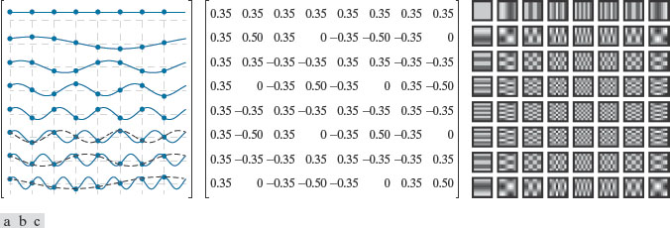
二维Hartley变换的基图像

Slide 33
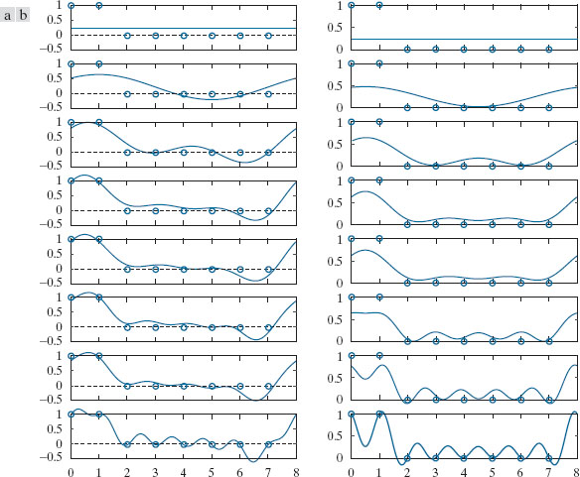
离散余弦变换

Slide 34
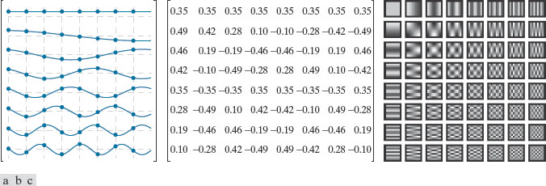
离散余弦变换

Slide 35
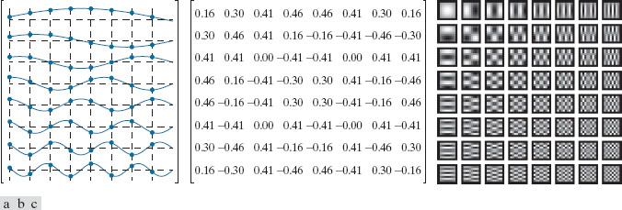
离散正弦变换

Slide 36
Walsh-Hadamard变换

Slide 37
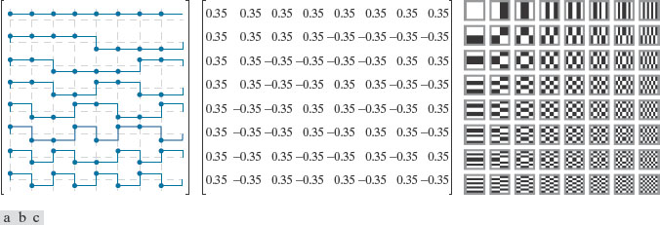
Walsh-Hadamard变换

Slide 38
Slant斜变换 (I)

Slide 39
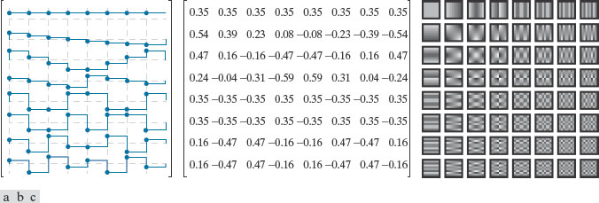
Slant变换 (II)

Slide 40
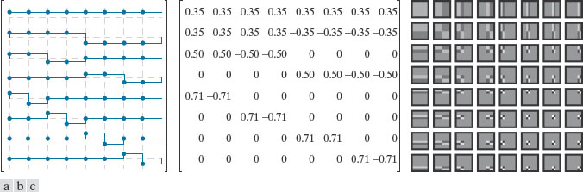
Haar变换的定义
已知的最早最简单的单位正交基

Slide 41
Haar变换

Slide 42
图像的正交变换
图像的距离变换
点扩散函数的基本概念
概率论基础 (复习)
Notes:
As you will see again and again in the class, to understand bioimage informatics depends critically on understanding the biological background of bioimage informatics. This is because bioimage informatics is created to answer biological questions rather than for technological curiosity. If we do not understand the biological questions, we will not be able to understand bioimage informatics. So for this reason we need to build some background knowledge about biology, and specifically for this lecture about cell biology.
For the most part of this course, our discussion on biology will be on a level that will be quite comfortable for you.
After that I will give you some historical perspectives and talk about where does it come from. Then I will discuss the learning objectives that we plan to achieve in this class. And finally I will go through the course syllabus together with you and discuss some details.

Slide 43
为什么要使用图像距离变换？
在比较二进制图像时，即使很局部的差别也会造成大的区别。
距离变换可以减缓图像特征的变化。
在计算机视觉中有广泛应用。

Slide 44
如何计算图像距离变换？
定义
在计算机图形学，机器人学与人工智能的应用中经常使用相距边界的最短距离。
在计算机视觉中，有时距离定义为相距某个特征的最短距离。

Slide 45
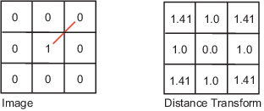
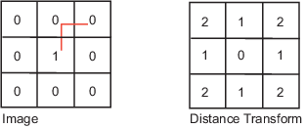
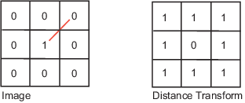
不同的距离定义 (I)
Euclidean
Citi block
Chessboard

Slide 46
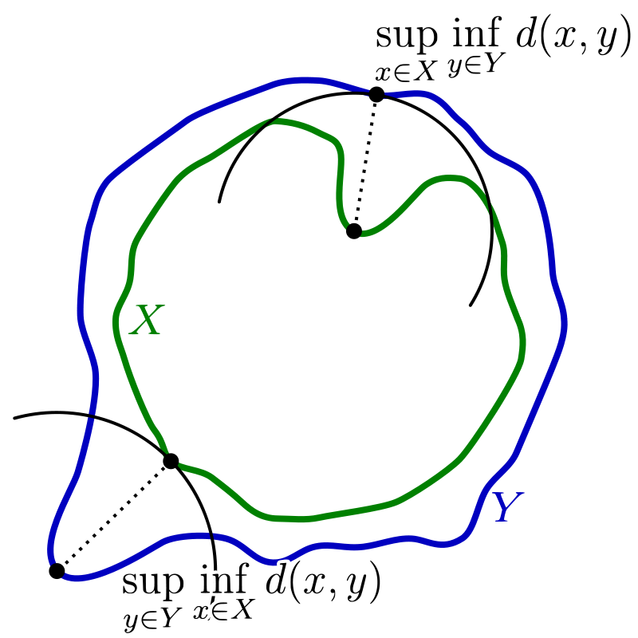
不同的距离定义 (II)
Hausdorff

Slide 47
图像的距离变换 (II)
Euclidean
City
Chessboard
https://www.cs.cornell.edu/courses/cs664/2008sp/handouts/cs664-7-dtrans.pdf

Slide 48
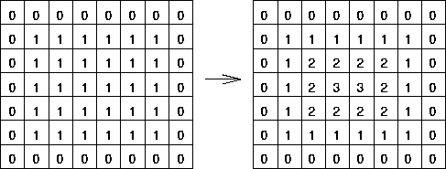
图像的距离变换 (II)
定义 距离为与最近边界的距离
https://homepages.inf.ed.ac.uk/rbf/HIPR2/distance.htm

Slide 49




距离变换结果示例 (I)
https://homepages.inf.ed.ac.uk/rbf/HIPR2/distance.htm

Slide 50


距离变换结果示例 (II)
https://homepages.inf.ed.ac.uk/rbf/HIPR2/distance.htm

Slide 51


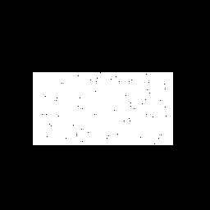

距离变换的局限性

Slide 52
图像的正交变换
图像的距离变换
点扩散函数的基本概念
概率论基础 (复习)
Notes:
As you will see again and again in the class, to understand bioimage informatics depends critically on understanding the biological background of bioimage informatics. This is because bioimage informatics is created to answer biological questions rather than for technological curiosity. If we do not understand the biological questions, we will not be able to understand bioimage informatics. So for this reason we need to build some background knowledge about biology, and specifically for this lecture about cell biology.
For the most part of this course, our discussion on biology will be on a level that will be quite comfortable for you.
After that I will give you some historical perspectives and talk about where does it come from. Then I will discuss the learning objectives that we plan to achieve in this class. And finally I will go through the course syllabus together with you and discuss some details.

Slide 53
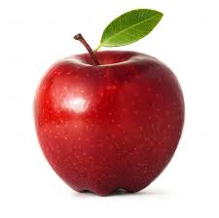
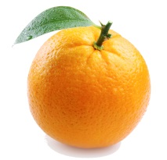
A Microscope as a Linear System
A light microscope can be considered as a linear system.
A linear system satisfies the following two conditions
- Homogeneity
- Additivity
Homogeneity
Additivity

Slide 54
How to Characterize a Linear System
A linear system can be characterized by
- Impulse response
- Frequency response
Impulse response of a microscope: point spread function
Frequency response of a microscope: optical transfer function

Slide 55
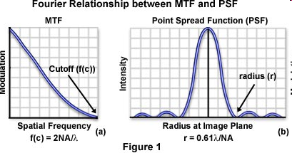
Airy Disk
Airy (after George Biddell Airy) disk is the diffraction pattern of a point feature under a circular aperture.
It has the following form
Detailed derivation is given in Born & Wolf, Principles of Optics, 7th ed., pp. 439-441.
J₁(x) is a Bessel function of the first kind.

Slide 56

Microscope Image Formation (I)
Microscope image formation can be modeled as a convolution with the PSF.
http://micro.magnet.fsu.edu/primer/java/mtf/airydisksize/index.html

Slide 57
Microscope Image Formation (II)
The impulse response of the microscope is called its point spread function (PSF).
The transfer function of a microscope is called its optical transfer function (OTF).
The PSF has the shape of an Airy Disk.

Slide 58
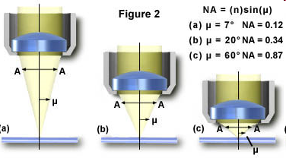
Numerical Aperture
Numerical aperture (NA) determines microscope resolution and light collection power.
n: refractive index of the medium between the lens and the specimen
μ: half of the angular aperture

Slide 59
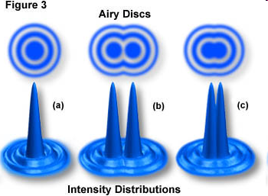
Different Definition of Light Microscopy Resolution Limit (Demo)
Rayleigh limit
Sparrow limit
http://www.microscopy.fsu.edu/primer/java/imageformation/rayleighdisks/index.html

Slide 60
Summary: High Resolution Microscopy
Size of cellular features are typically on the scale of a micron or smaller.
To resolve such features require
- Shorter wavelength (electron microscopy) - High numerical aperture (resolution) - High magnification (spatial sampling)

Slide 61
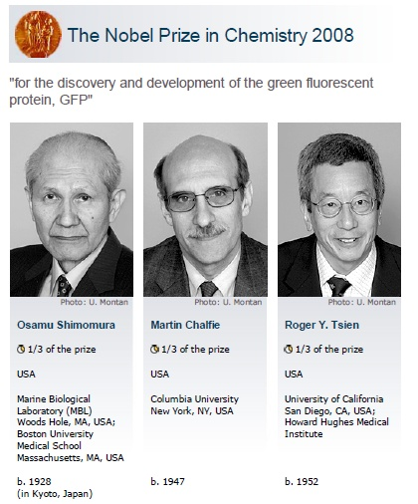
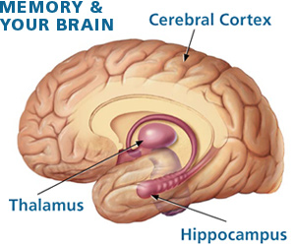
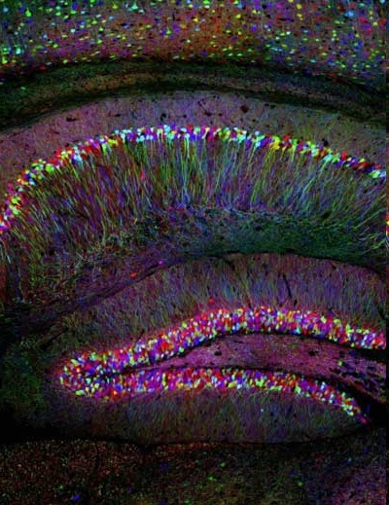
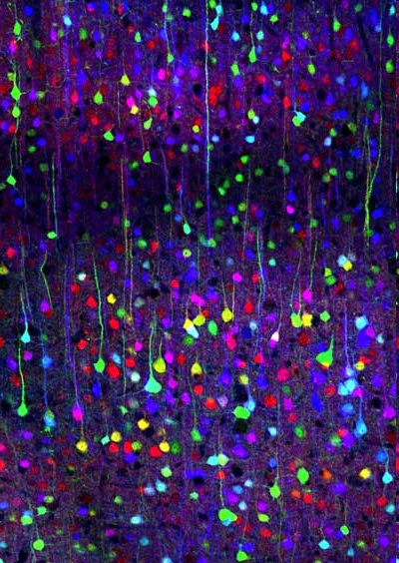
Introducing Fluorescence Microscopy Images
Livet J, Weissman TA, Kang H, et al. Nature 450: 56–62, 2007
10

Slide 62
图像的正交变换
图像的距离变换
点扩散函数的基本概念
概率论基础 (复习)
Notes:
As you will see again and again in the class, to understand bioimage informatics depends critically on understanding the biological background of bioimage informatics. This is because bioimage informatics is created to answer biological questions rather than for technological curiosity. If we do not understand the biological questions, we will not be able to understand bioimage informatics. So for this reason we need to build some background knowledge about biology, and specifically for this lecture about cell biology.
For the most part of this course, our discussion on biology will be on a level that will be quite comfortable for you.
After that I will give you some historical perspectives and talk about where does it come from. Then I will discuss the learning objectives that we plan to achieve in this class. And finally I will go through the course syllabus together with you and discuss some details.

Slide 63
概率论复习

