Slide 1


Board Game
By Wang Yuchen
Wiley Edge Project Week 1
Build in python

Slide 2


Game Intro
The game is a turn-based game, two players roll the dice one by one(dice range(1-3))
Both players start off from the initial start point. If one player steps on the other player’s property. The second player would get kicked back to it’s initial start point immediately.
Winning condition: if a player step exactly on the initial point after one round movement. Then this player will be considered as the winner, game over!
If a player step over the start point, then this movement wouldn’t happen. The player stay idle.

Slide 3
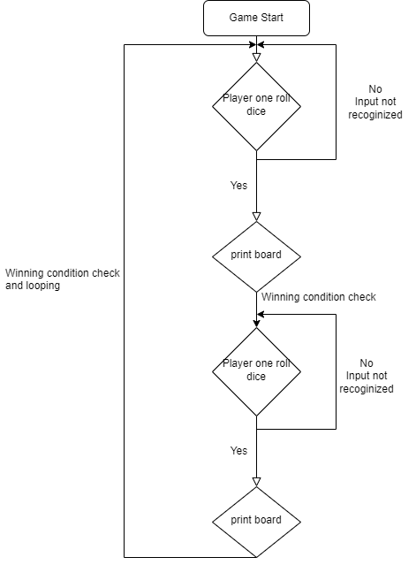
Flow chart
Describe how the program runs

Slide 4
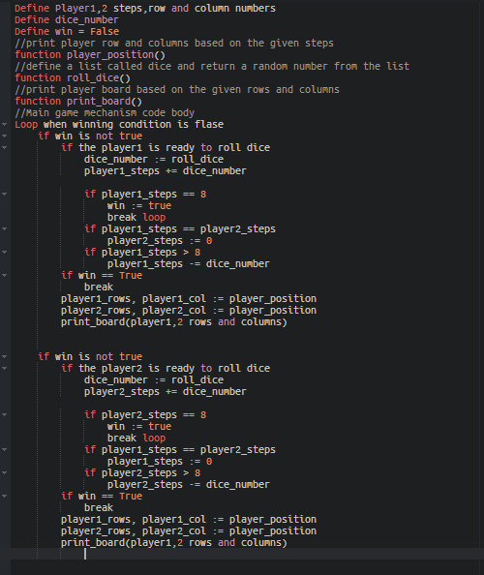
Pseudocode

Slide 5
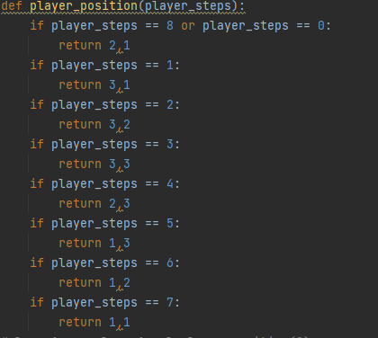
Player Position function
Determine the row and column of the player by the given steps

Slide 6
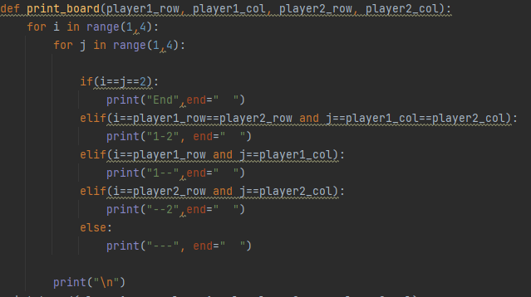
Print board function

Slide 7
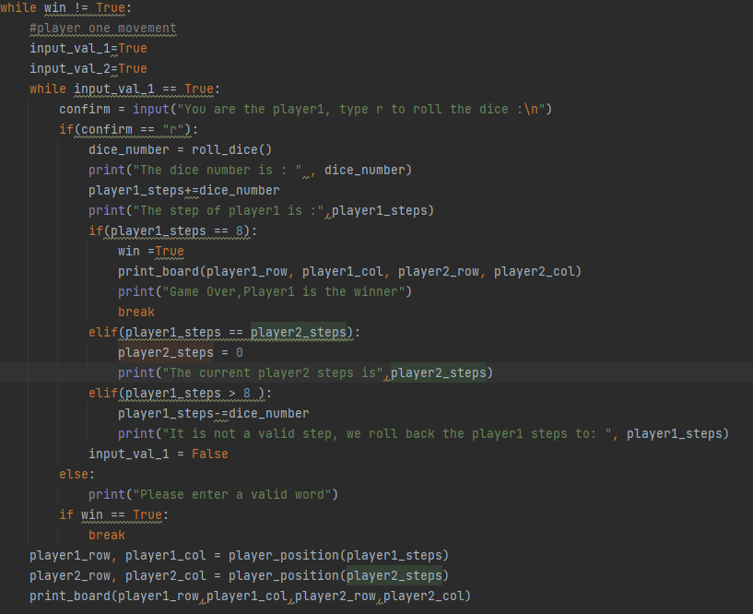
Main code to move the player one
Pretty similar for the movement of player two

Slide 8
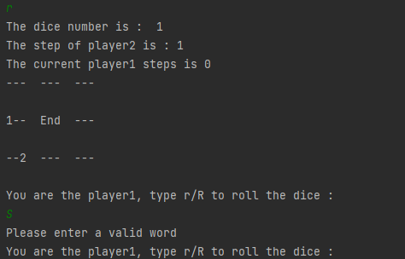
Sample output

