Slide 1
Reproducing GenericAgent's
long-horizon claims
with a different backbone, and the authors' own graders
arXiv:2604.17091 · lsdefine/GenericAgent@a9a36b4
Student： Zihan Wang ID: 1155267768
FTEC5660 · Reproducibility Work · Oct 2026
1 / 13

Slide 2
01 · THE TARGET
One table row in a technical report
Table 4 claims a minimal agent matches Claude Code at a third of the tokens.
100%
188,829
35%
success on 5 long-horizon tasks
total tokens, all five tasks
of Claude Code's token cost
So: keep everything except the model — does the 100% survive?
Source: technical report §4.2, Table 4.
FTEC5660 · Reproducibility Work
2 / 13

Slide 3
02 · THE SYSTEM
How GenericAgent works
One loop
Nine atomic tools
Self-evolving
Perceive the state, pick one tool, write the result into memory.
code_run, file read/write/patch, web_scan, web_execute_js, ask_user, two memory tools.
Every solved task is distilled into a reusable skill.
Runs headless on a laptop: no GPU, no Docker.
“Don't preload skills — evolve them.”
The framework ships a loop; capability is supposed to accumulate from use.
FTEC5660 · Reproducibility Work
3 / 13

Slide 4
03 · SCOPE
Three of the five tasks
TEB-13 · SQL copilot
TEB-14 · report
TEB-12 · slides
query.sql, result.csv, analysis.md
Local data, easy to isolate
report, chart csv, summary, 2 figures
Many artefacts, real analysis
presentation.pptx + notes
Document generation, long horizon
Dropped: procurement and reproduction-feasibility — they need live pricing pages and a real browser session.
Tasks and graders taken verbatim from the authors' evaluation repo.
FTEC5660 · Reproducibility Work
4 / 13

Slide 5
04 · METHOD
Four things I controlled
Fresh repo per trial
no memory, no scratch files, no cross-trial state
Upstream code untouched
one 60-line plugin reads the framework's own hooks
Authors' graders, unmodified
every mandatory check enforced
Backbone = the variable
Claude Sonnet 4.6 → DeepSeek-v4-pro, disclosed everywhere
FTEC5660 · Reproducibility Work
5 / 13

Slide 6
05 · METRICS
What I measure, and one trap
Success = the grader's task_success, all checks enforced.
Tokens = every request's prompt + completion, summed.
Fresh tokens = the same, minus prompt-cache hits.
The trap: the paper never defines 'accounted tokens'.
With caching, the two readings differ 4–10×, so I report both and compare neither loosely.
FTEC5660 · Reproducibility Work
6 / 13

Slide 7
06 · RESULTS
Baseline: three of six trials pass
Task | Trial 1 | Trial 2 | Tokens | Requests | Time (s)
TEB-13 SQL | 1.000 ✓ | 1.000 ✓ | 232k / 698k | 14 / 21 | 219 / 759
TEB-14 report | 0.778 ✗ | 0.778 ✗ | 353k / 317k | 16 / 15 | 332 / 293
TEB-12 slides | 0.000 ✗ | 1.000 ✓ | 1.52M / 0.94M | 49 / 29 | 713 / 602
Paper, same table, Claude Sonnet 4.6: 100% · 188,829 tokens · 11.0 requests · 220.8 s.
FTEC5660 · Reproducibility Work
7 / 13

Slide 8
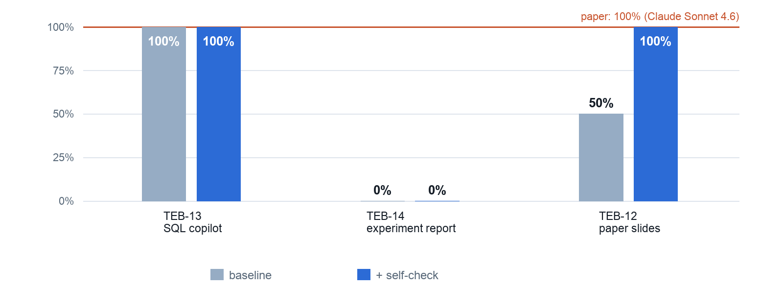
06 · RESULTS
The gap, in one picture
Paper = red line. Two tasks now pass every trial; TEB-14 passes none.

Slide 9
07 · FAILURES
Both failures are packaging, not reasoning
F1 · wrong file name
F2 · spec conflict
TEB-12 trial 1 saved a valid deck as DAPO_paper_share.pptx.
The grader found no artefact → 0.0.
Trial 2 used the required name → 9/9.
Prompt: 'at least six columns'.
Grader: exactly six, in order.
Three of four runs added one → fail.
The self-check fixed the file name, and the header once.
It never fixed length — the model estimates characters instead of counting them.
FTEC5660 · Reproducibility Work
9 / 13

Slide 10
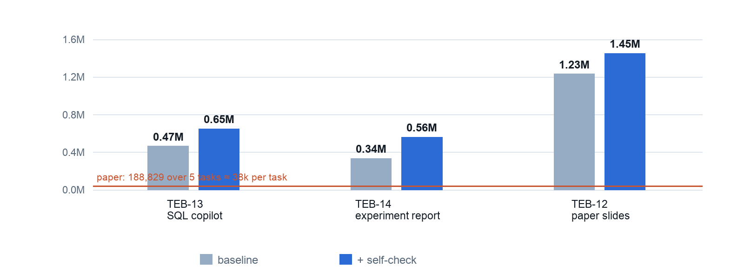
08 · TOKENS
Why the token totals are not comparable
Every turn resends the whole context; 82–90% of prompt tokens are cache hits.

Slide 11
09 · MODIFICATION
One block of system prompt
Appended to assets/sys_prompt.txt
No code, no tool, no grader touched.
Before finishing, the agent must:
— open every artefact with the right library
— count pages, characters, columns against limits
— re-check file names and what 'last' refers to
Disclosure
Written after inspecting the baseline failures. An error-driven fix, not a pre-registered hypothesis — and reported as such.
It changes what “done” means — not how the agent works.
FTEC5660 · Reproducibility Work
11 / 13

Slide 12
10 · EFFECT
50% → 67%, for 31% more tokens
Task | Baseline | + self-check | Δ tokens | Δ time
TEB-13 SQL | 100% | 100% | +40% | −22%
TEB-14 report | 0% | 0% | +67% | +26%
TEB-12 slides | 50% | 100% | +18% | −2%
Overall (n=6) | 50% | 67% | +31% | −3%
It converts the one locally checkable failure — and only that one.
With the smaller model it also saved 51% of tokens; with v4-pro it costs 31% more.
FTEC5660 · Reproducibility Work
12 / 13

Slide 13
11 · TAKEAWAYS
What reproduces, what does not
Competence
The number
The bottleneck
Nine atomic tools are enough for multi-step, artefact-producing work.
Every failing run still produced a correct analysis.
100% does not reproduce as a property of the agent.
It moves with the backbone: 50% here, 17% with a smaller model.
File names, headers, length budgets, 'must be last'.
One of the two families is a spec conflict.
Before calling a number unreproducible, check whether the task text and the grader agree.
FTEC5660 · Reproducibility Work
13 / 13

