Slide 1
Project Charter DC-Team 8
Contents
1. Background & project purpose
2.
3. Scope Statement and Budget
4.
5.
Qifan Cui
Keke Su
Leo Liu
Archana Govindarajulu
Zanning Wang

Slide 2

3. Scope statement &Budget

Slide 3
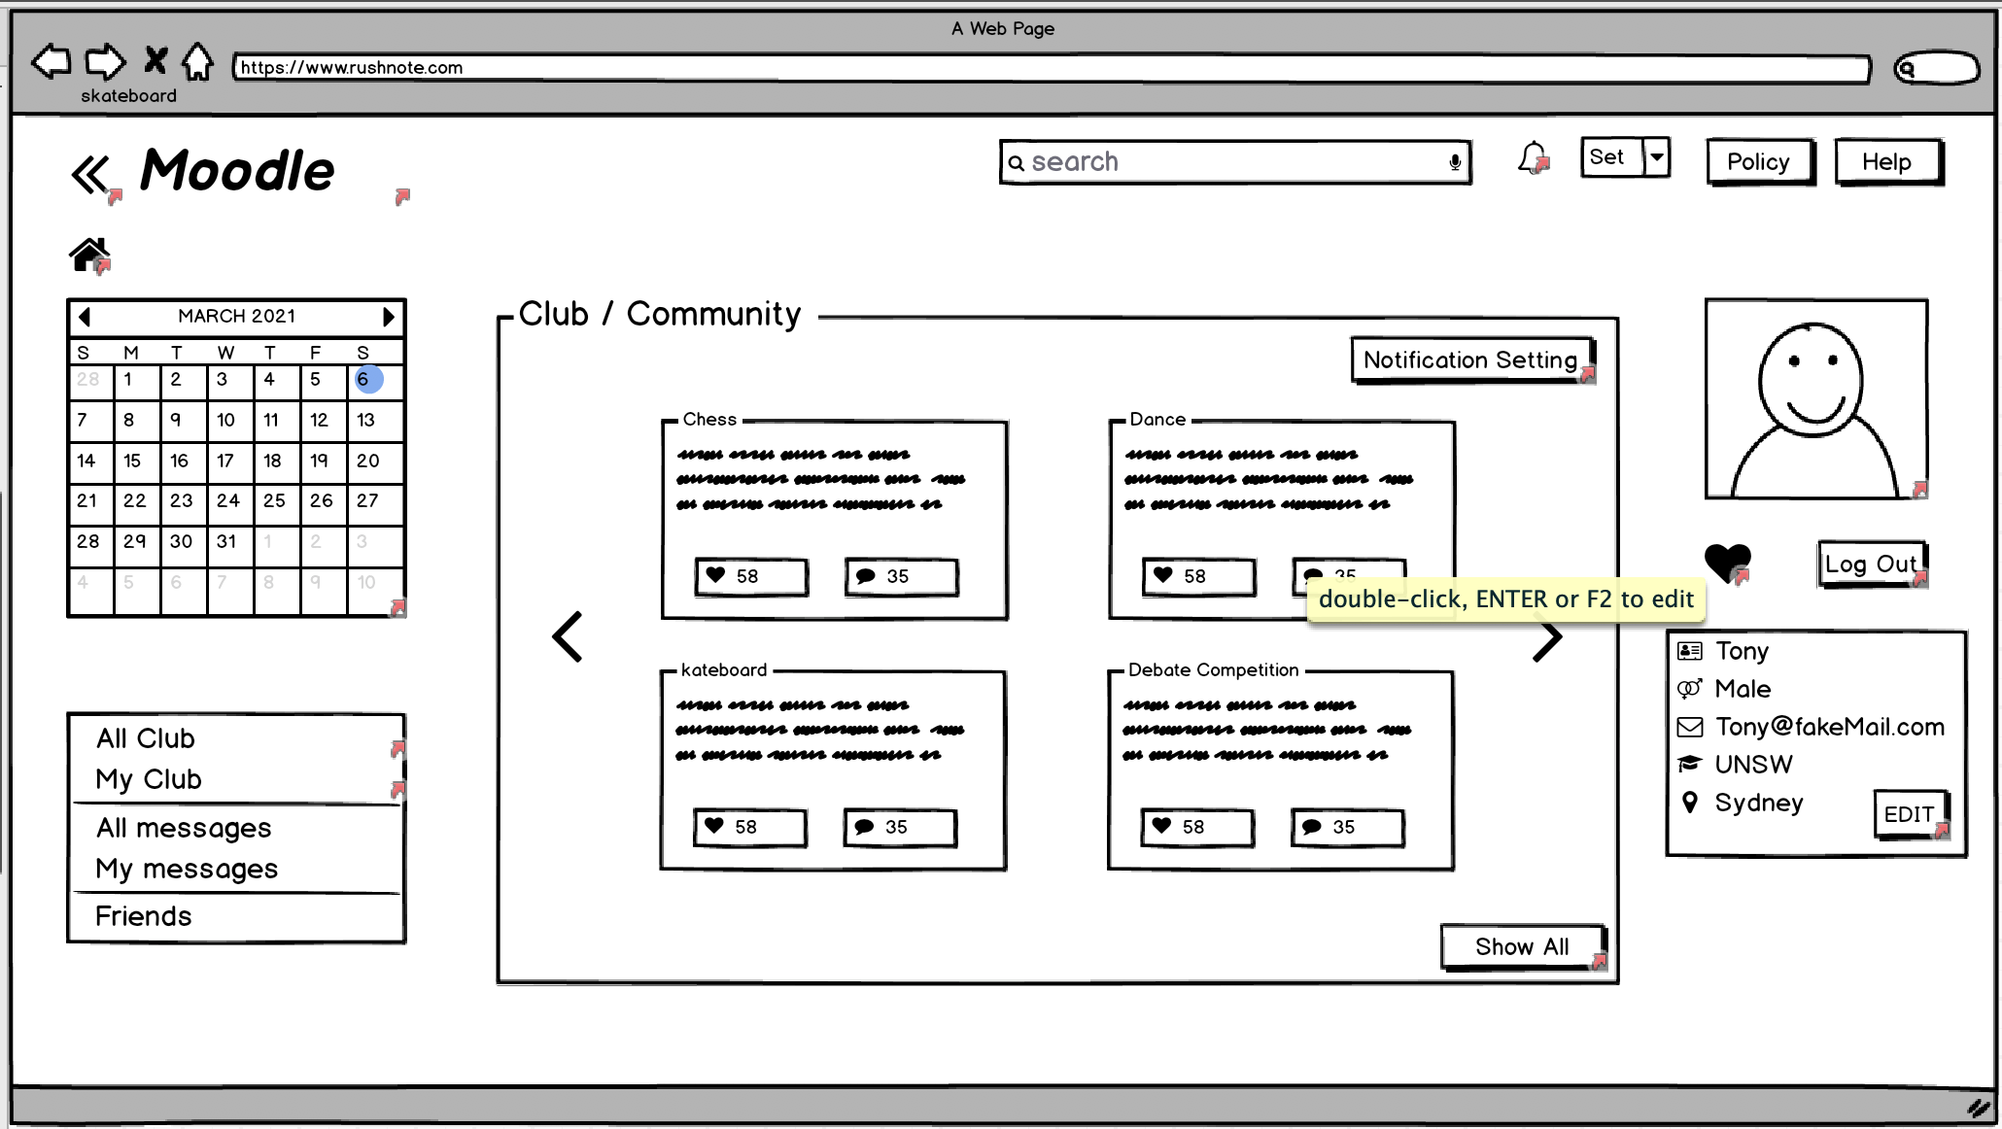
User Interface Design
This is one of our user interface, we intended to build more features such as :
More concise graphical interface
Recommend activities and clubs through machine learning
Real-time reminder of upcoming events

Slide 4
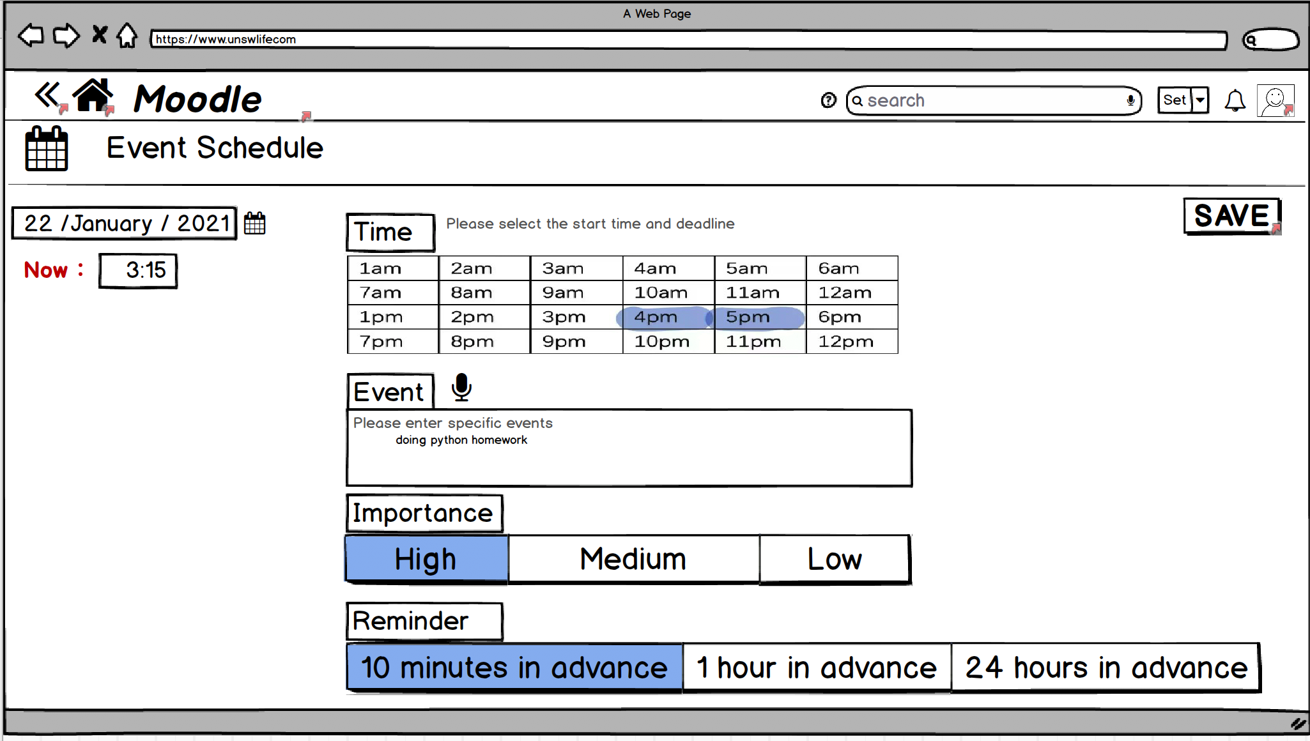
Administrator Interface Design
This is one of our administrator interface, we intended to build more features such as :
public and private channels
More easily to add new activities
Statistics interface

Slide 5
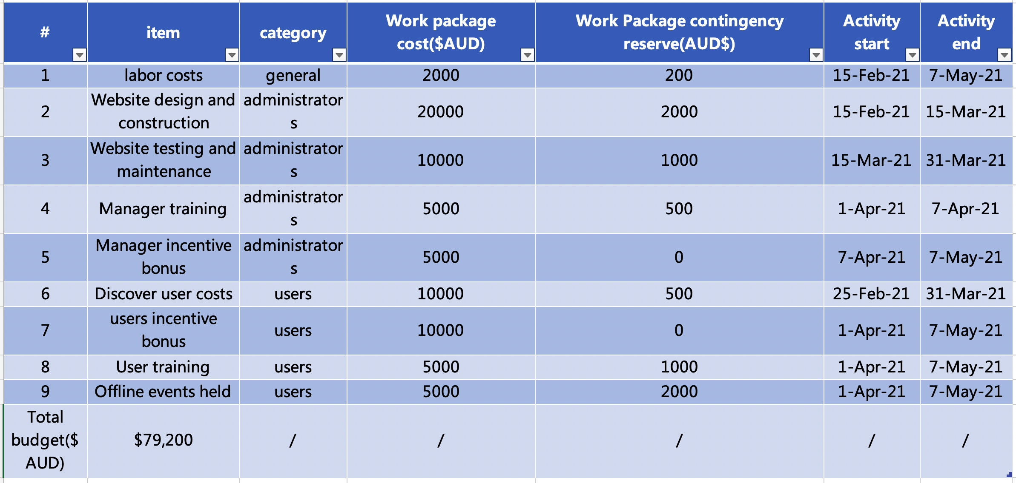
Budget

