Slide 1
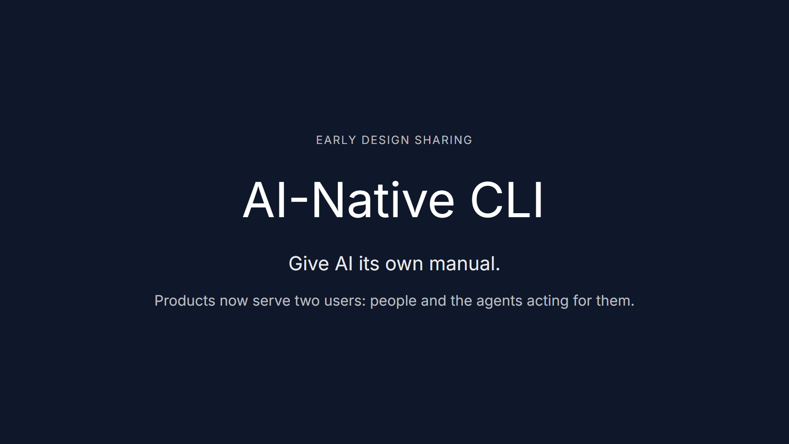
Notes:
Hi everyone. I want to share one simple idea today. The products we build now serve two users: the person at the keyboard, and the AI acting on that person's behalf. We already write a manual for the first user. I think we should write one for the second.

Slide 2
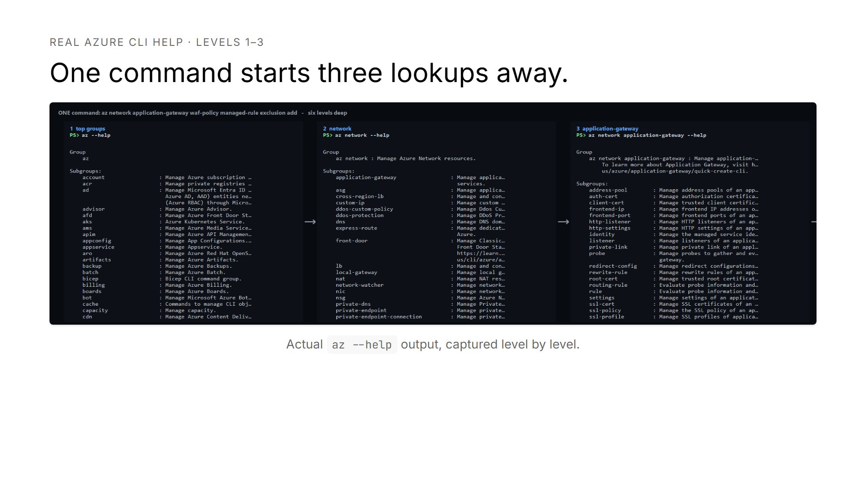
Notes:
This is real Azure CLI help. To find one application gateway command, the model must first inspect the top level, then network, then application gateway.

Slide 3
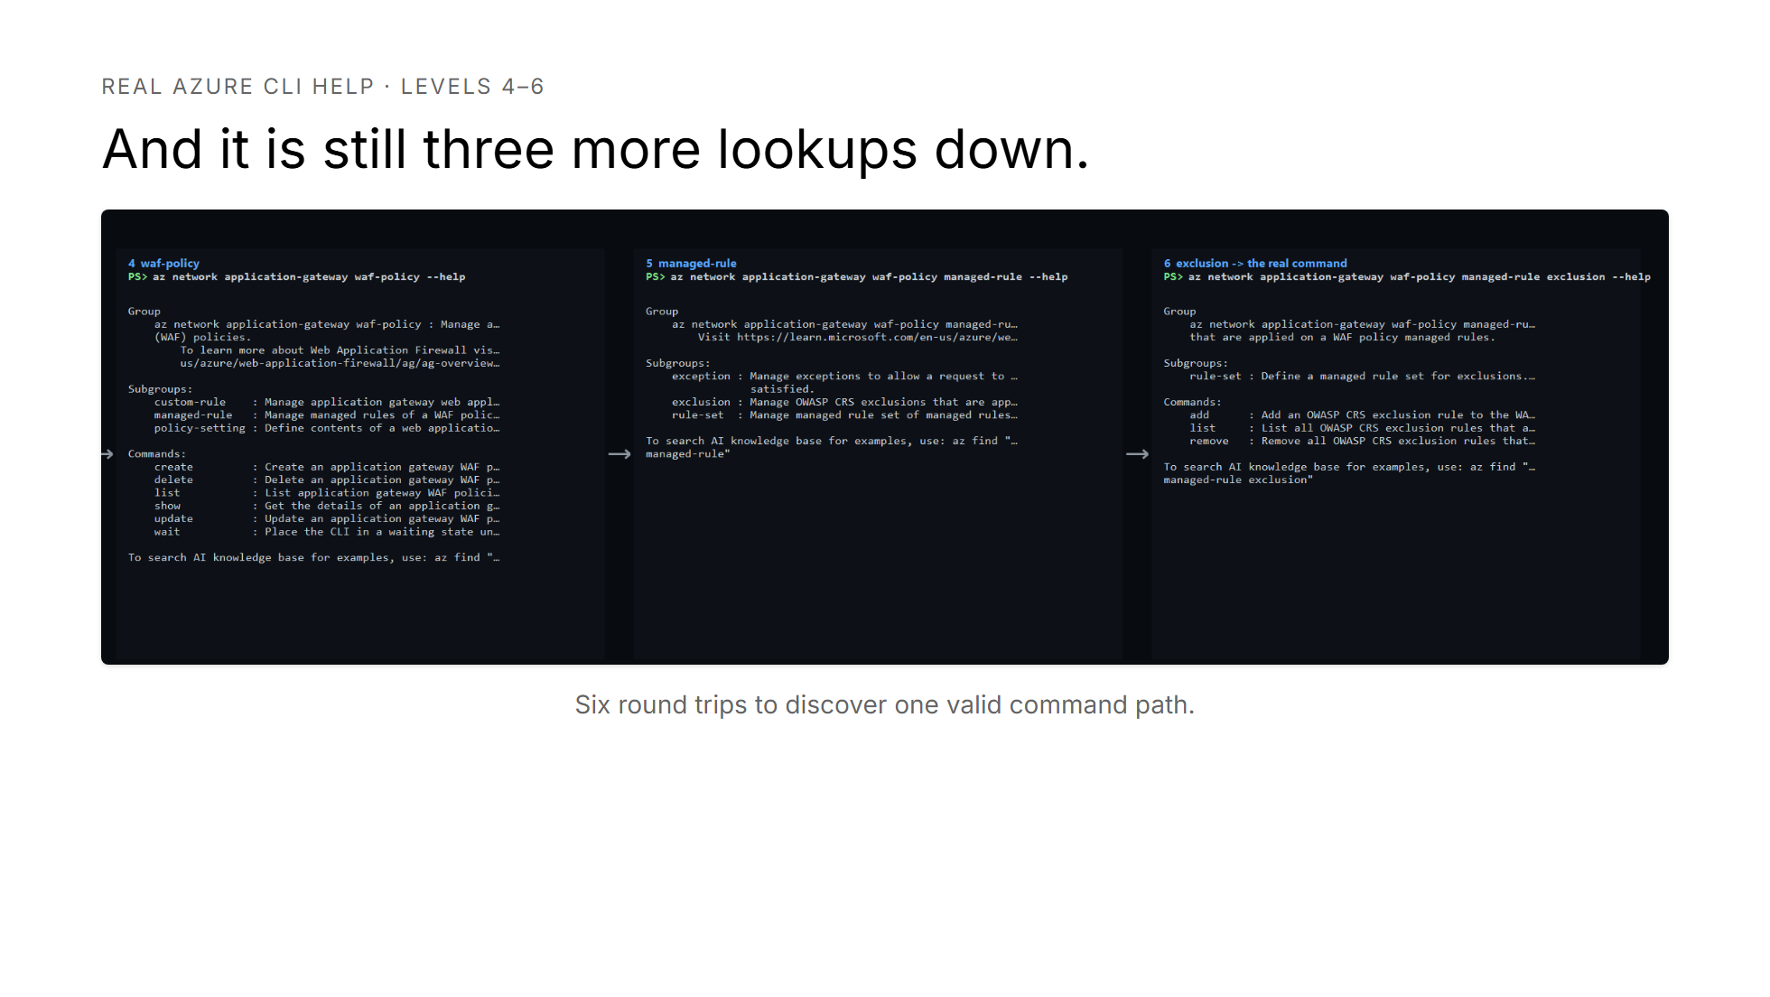
Notes:
From there it still has to inspect WAF policy, managed rule, and exclusion before the add command finally appears. That is six round trips to discover one path. A small typo can stop the search before it gets there.

Slide 4
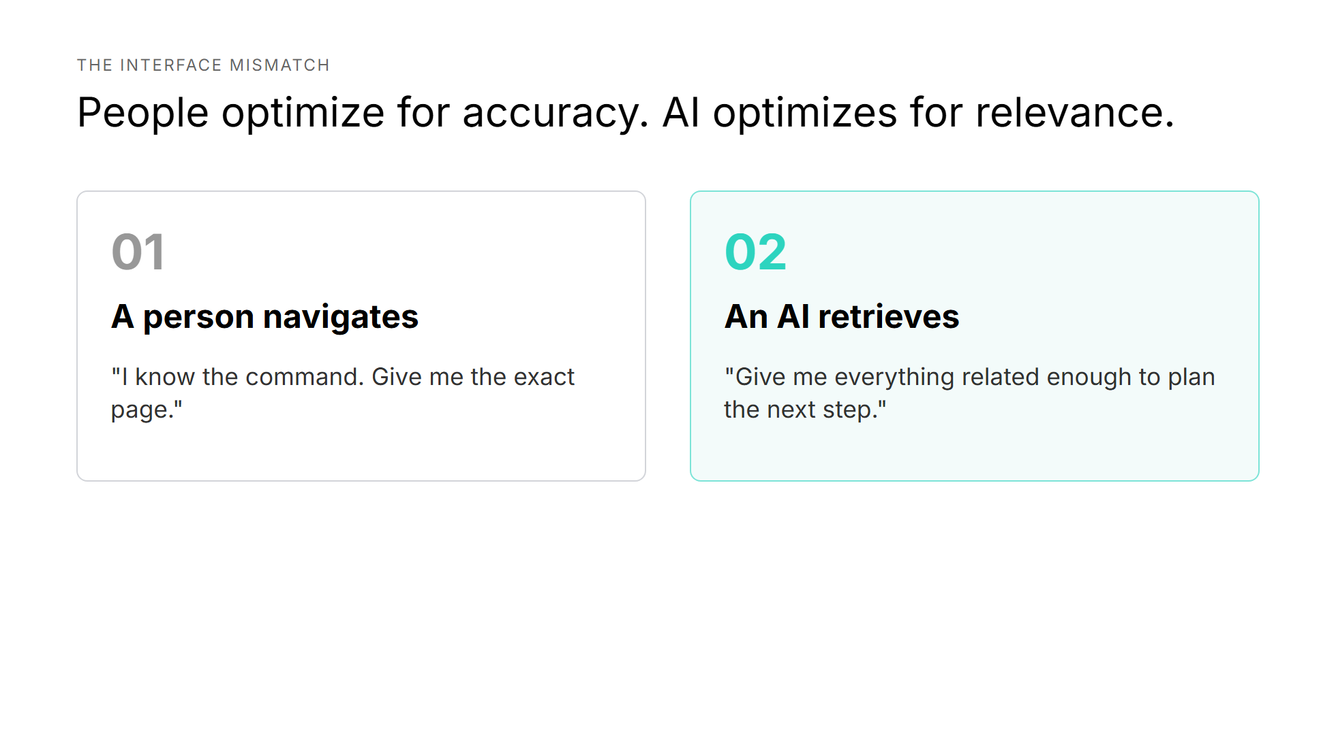
Notes:
A person usually knows where they want to go. They want the exact page. An AI is planning its next step. It needs the nearby context too, so it can compare options and recover from a wrong guess.

Slide 5
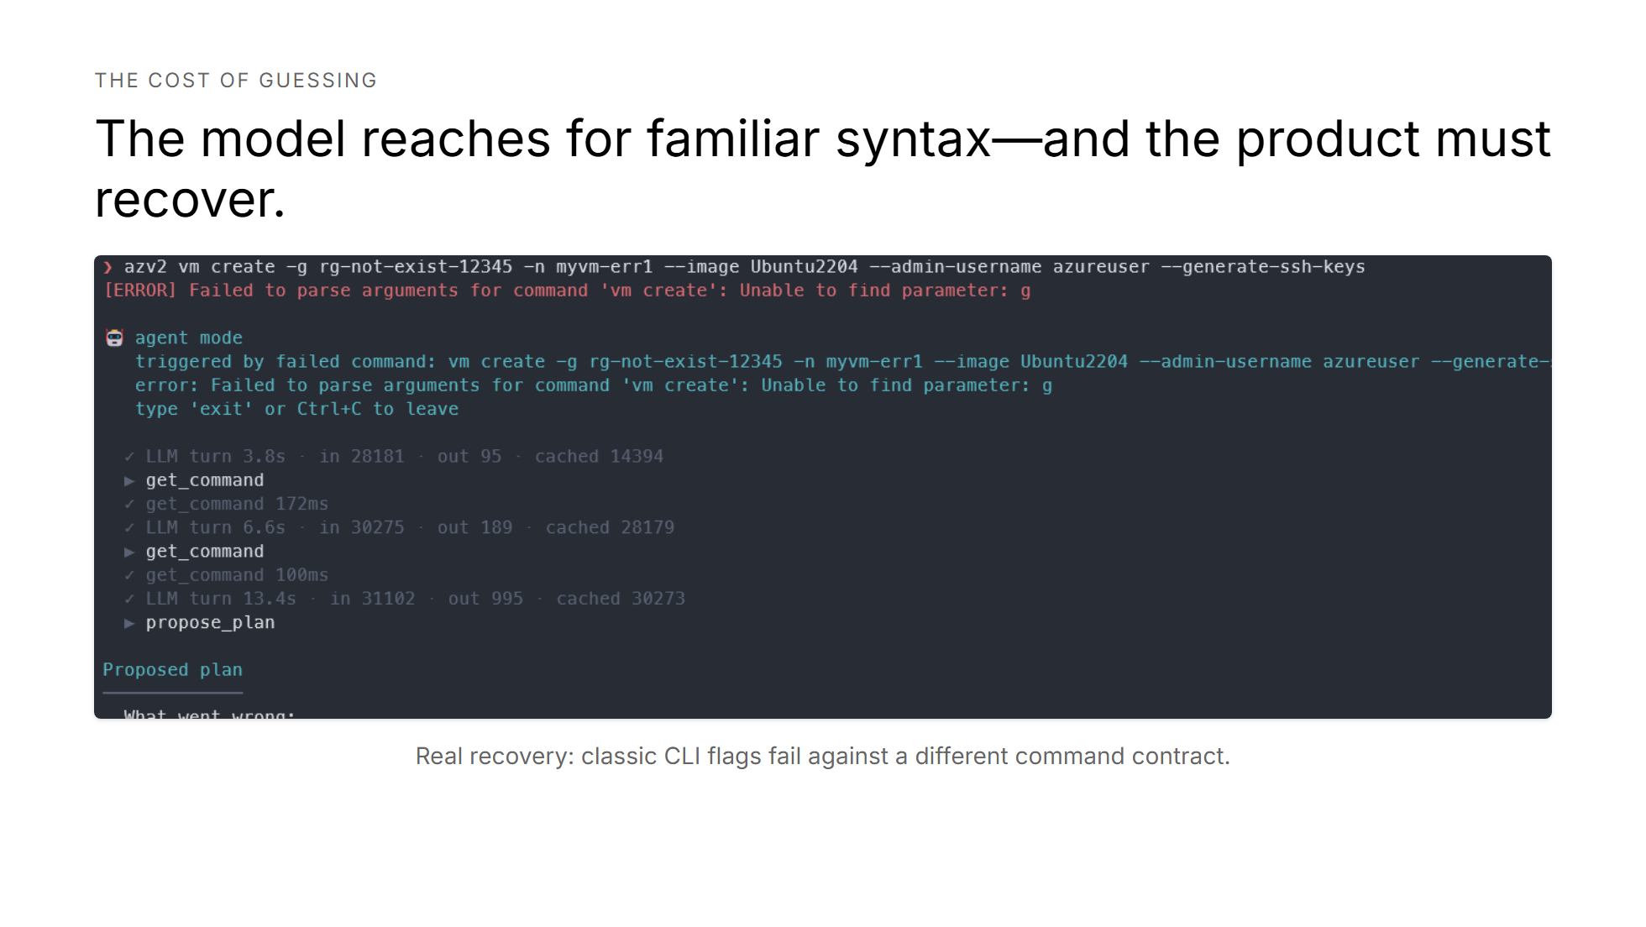
Notes:
Here is the failure mode in practice. The model used familiar Azure CLI flags against a different command contract, and the command failed immediately. The agent then had to inspect the real contract, explain every mismatch, and rebuild the plan. Useful recovery, but avoidable work.

Slide 6
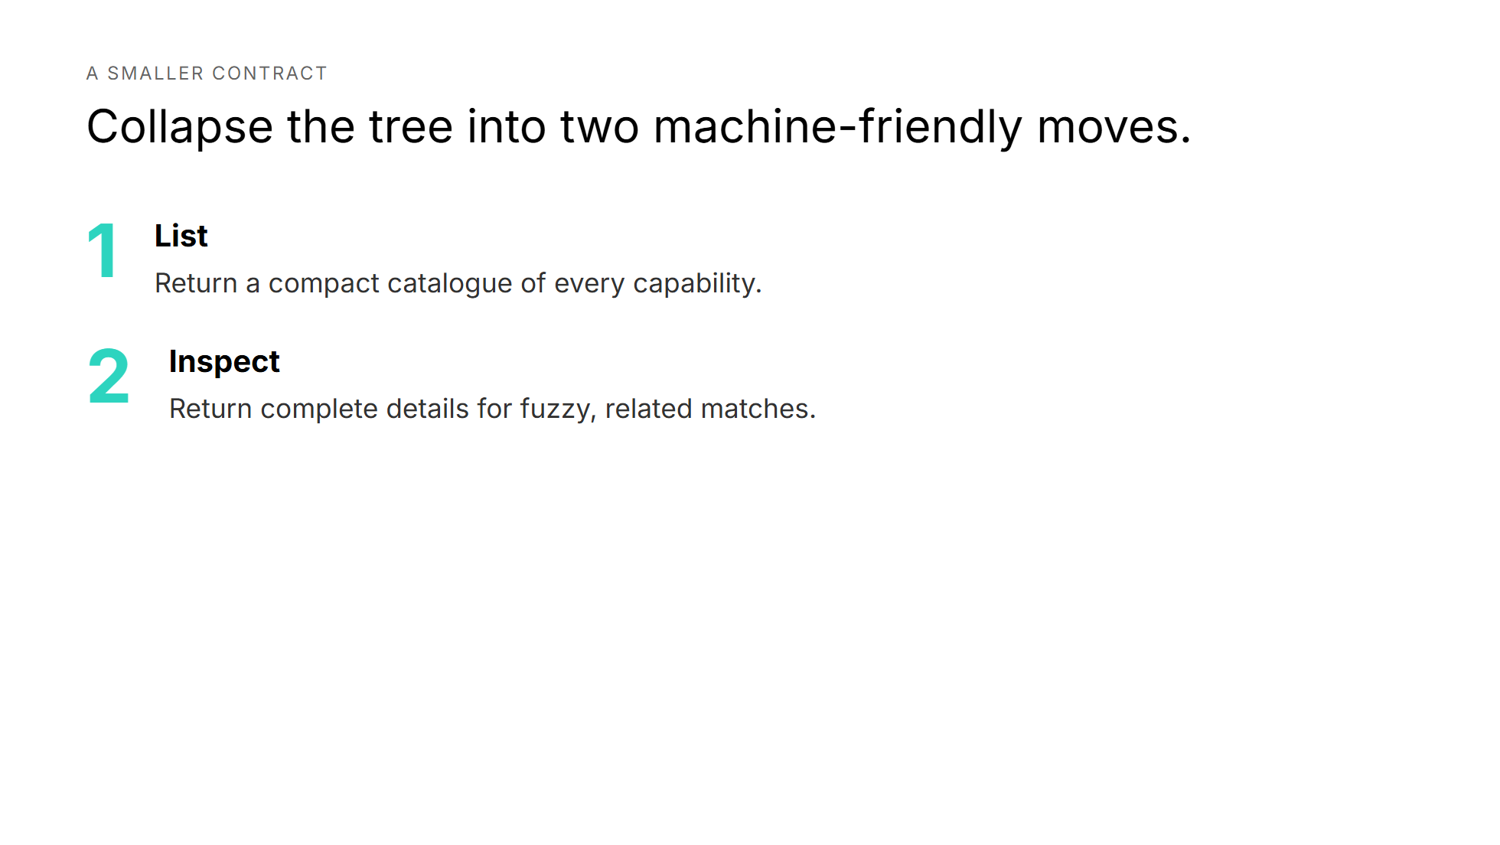
Notes:
The first move is list: give the model a compact catalogue of every capability. The second move is inspect: return complete details for fuzzy, related matches. That gives the model enough context with far fewer round trips.

Slide 7
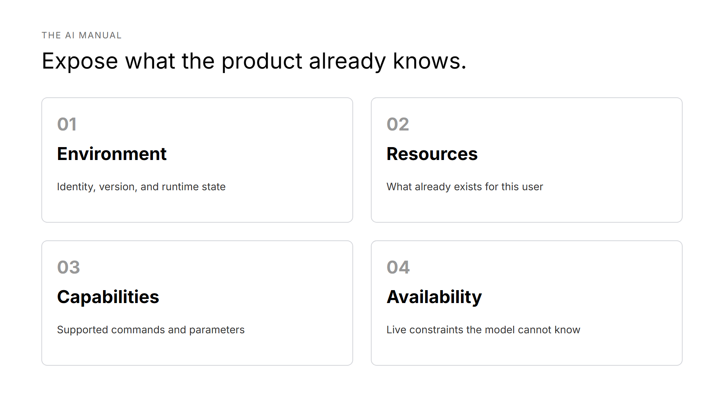
Notes:
The AI manual does not need to be a new documentation project. Most products already know the environment, existing resources, supported capabilities, and live availability constraints. The opportunity is to expose that knowledge through stable, structured tools.

Slide 8
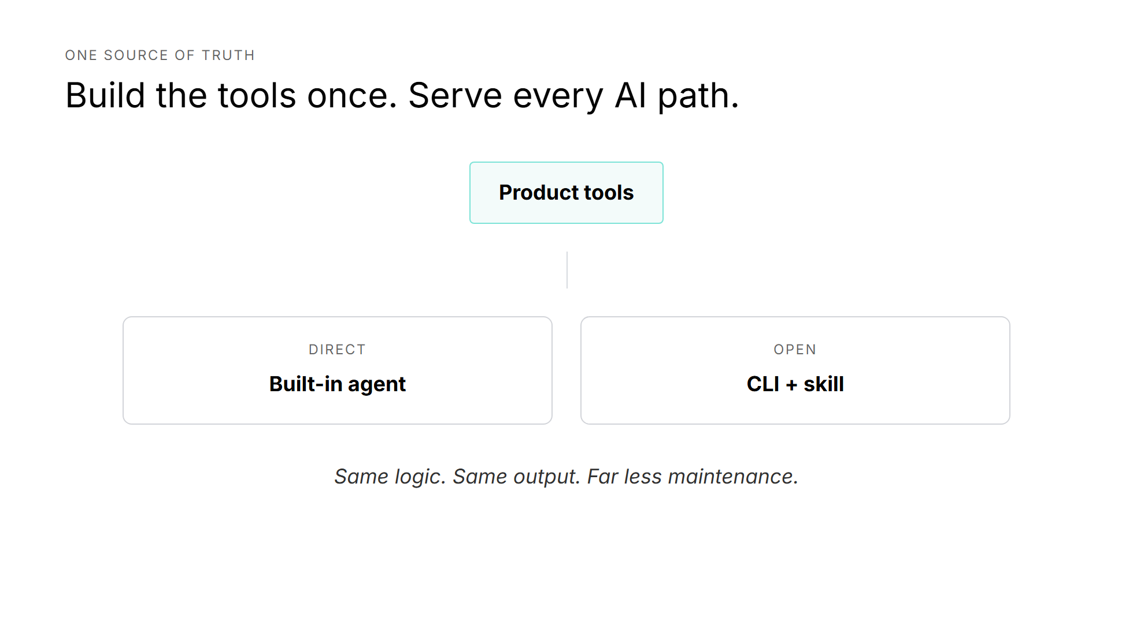
Notes:
A built-in agent can call the tools directly. An external agent can reach the same tools through a CLI and a skill. Both paths use the same logic and the same output contract. That keeps maintenance low.

Slide 9
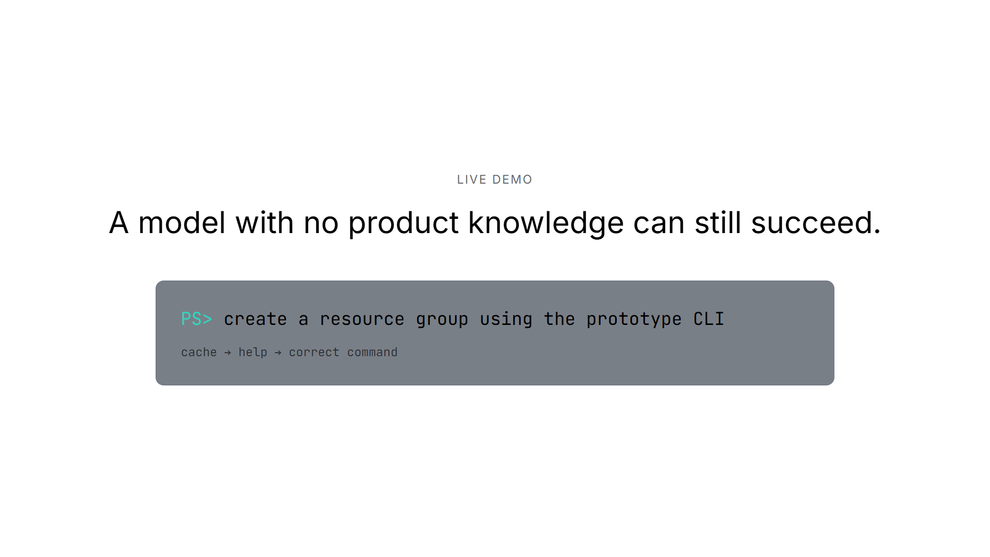
Notes:
I have given the coding agent a small skill that points it to these product tools. Watch the sequence. It checks what exists, reads the real command contract, and then builds the command from current facts instead of training data.

Slide 10
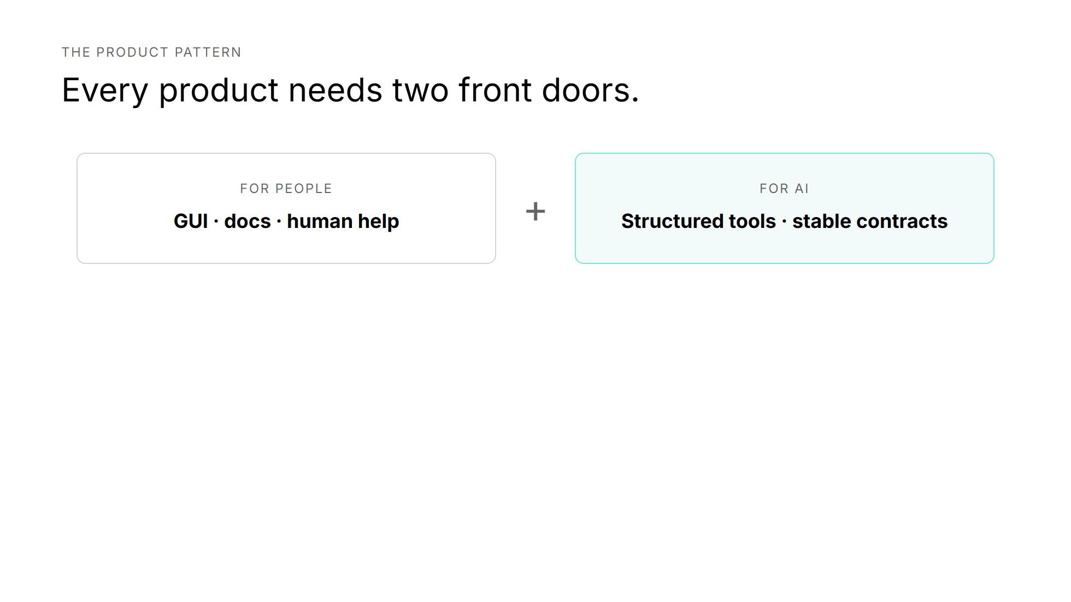
Notes:
Keep the interface for people: the graphical experience, documentation, and human-readable help. Add an interface for AI: structured tools, stable schemas, and errors a model can act on.

Slide 11
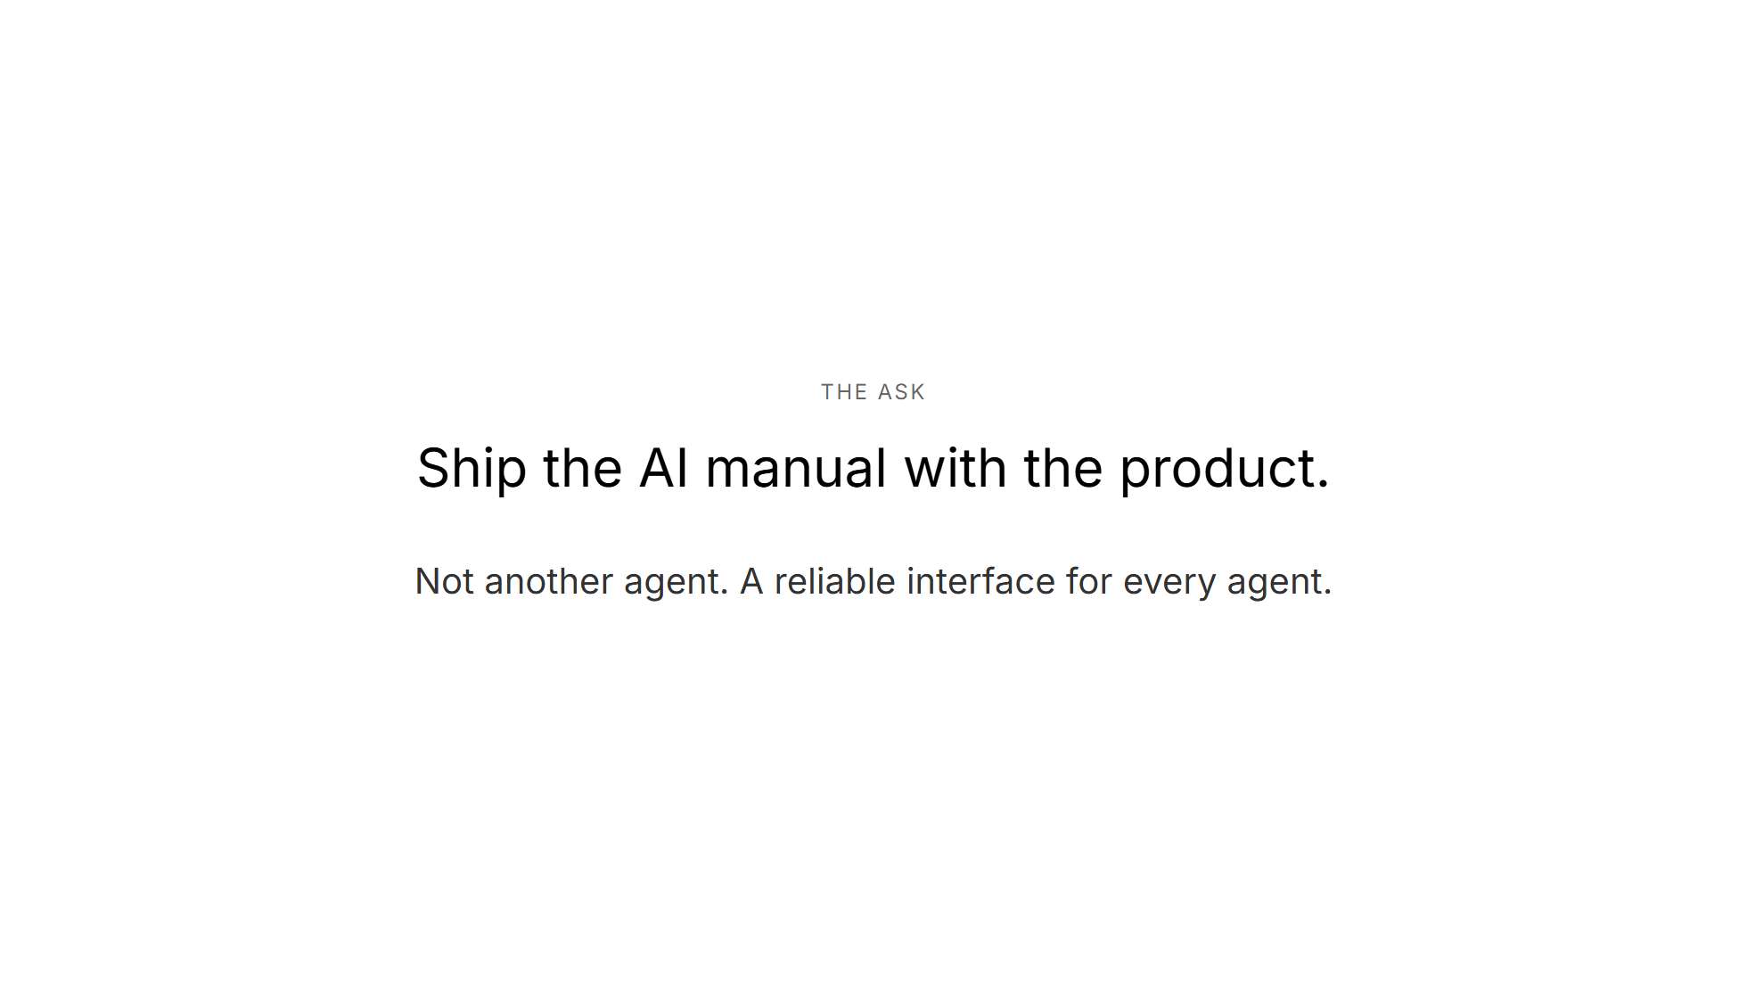
Notes:
This is not a proposal to build another agent. It is a proposal to give every agent a reliable way to understand and operate the product. My ask is simple: when we ship a product interface for people, ship its AI manual too.

