Slide 2











$$H_{1}$$
$$\text{ReLU}$$
t
$$H_{2}$$
$$\text{ReLU}$$
$$S_{t}$$
$$O_{1}$$
$$tanh$$
$$A_{t}$$
……
$$V_{t}$$
$$H_{10}$$
$$\text{ReLU}$$

Slide 3








$$H_{1}$$
$$\text{ReLU}$$
t
$$H_{2}$$
$$\text{ReLU}$$
$$S_{t}$$
……
$$V_{t}$$
$$H_{10}$$
$$\text{ReLU}$$
$$O_{1}$$
$$Q_{t}$$
$$H_{11}$$
$$\text{ReLU}$$
$$H_{12}$$
$$\text{ReLU}$$
$$A_{t}$$
……
$$H_{20}$$
$$\text{ReLU}$$

Slide 4
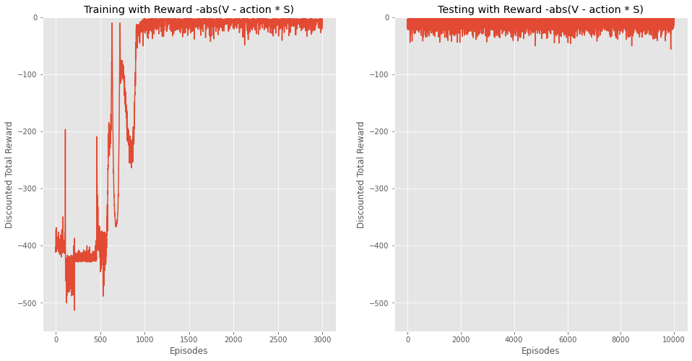
DDPG: mean -8.2457319987042
Std 6.4800464539652

Slide 5
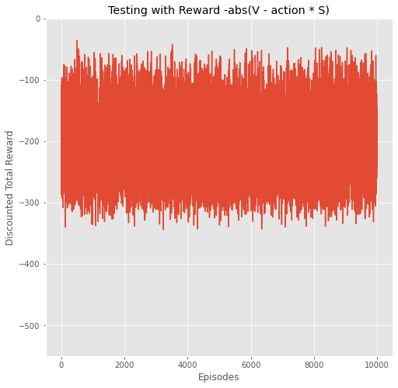
Delta hedging
Mean: -201.165440613374
Std: 60.0674860858

Slide 6
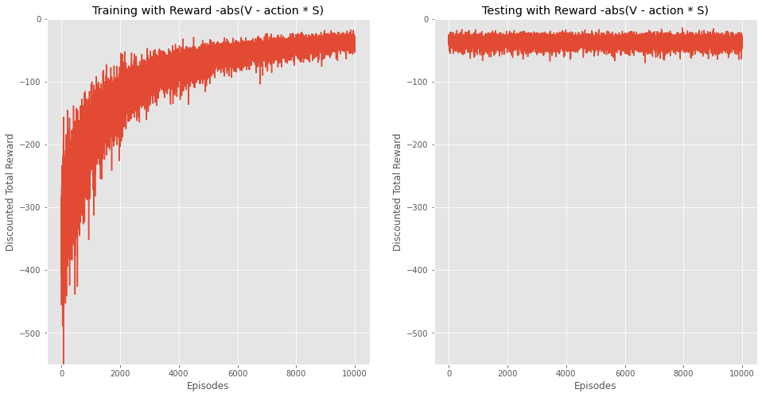
PG linear gaussian
Mean:-36.303624385
Std: 7.257154629085375

