Slide 1


RecoDS
Tuan Van
Jack Herbert
Anthony Vigil
Beau Crawford

Slide 2
Overview
What is RecoDS?
  Data Structure Recognition of:
    Arrays
    Linked Lists
    Trees
    Combinations

Slide 3
Motivation
Why do Diagram Recognition?
  More effective teaching methods
    Clarification of understanding/misunderstanding
    Saved examples of misunderstandings

Slide 4
Presentation Outline
Component Recognition

Slide 5
Presentation Outline
Component Recognition
Data Structure Recognition

Slide 6
Presentation Outline
Component Recognition
Data Structure Recognition
Data Structure Rendering

Slide 7
Presentation Outline
Component Recognition
Data Structure Recognition
Data Structure Rendering
Interactive Demo

Slide 8
Presentation Outline
Component Recognition
Data Structure Recognition
Data Structure Rendering
Interactive Demo
Advanced Functionality

Slide 9
Presentation Outline
Component Recognition
Data Structure Recognition
Data Structure Rendering
Interactive Demo
Advanced Functionality
Advanced Demo

Slide 10
Presentation Outline
Component Recognition
Data Structure Recognition
Data Structure Rendering
Interactive Demo
Advanced Functionality
Advanced Demo
Challenges

Slide 11

Component Recognition
Arrays
  Array Head Cell:
  Array Next Cell:

Slide 12
Component Recognition
Linked List
  Linked List Node:
  Linked List Pointer:

Slide 13
Component Recognition
Trees
  Tree Node:
  Tree Edge:

Slide 14
Component Recognition
Connecting Data Structures
  Pointers:

Slide 15
Component Recognition
Algorithm
  Finds Feature points (corners)
    Speed
    Curvature
  Relative angles between feature points
  Component probabilities

Slide 16

Data Structure Recognition
Arrays
  Our recognition is based on Arrays being drawn one component at a time
  Example:

Slide 17
Data Structure Recognition
Linked Lists
  Our recognition is based on Linked Lists being drawn one component at a time
  Consist of Linked List Nodes and Linked List Pointers
  Example:

Slide 18
Data Structure Recognition
Trees
  Our recognition is based on Trees being
  drawn one component at a time
  Trees Consist of Tree Nodes and Edges
  Tree nodes and edges can be drawn in any order
Example:

Slide 19
Data Structure Rendering
Width of nodes is dictated by size of text
contained within node
Short String Example:
Long String Example:

Slide 20
Data Structures
Questions??

Slide 21
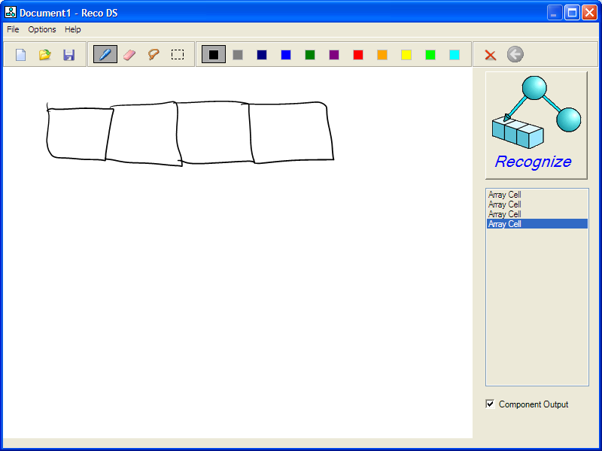
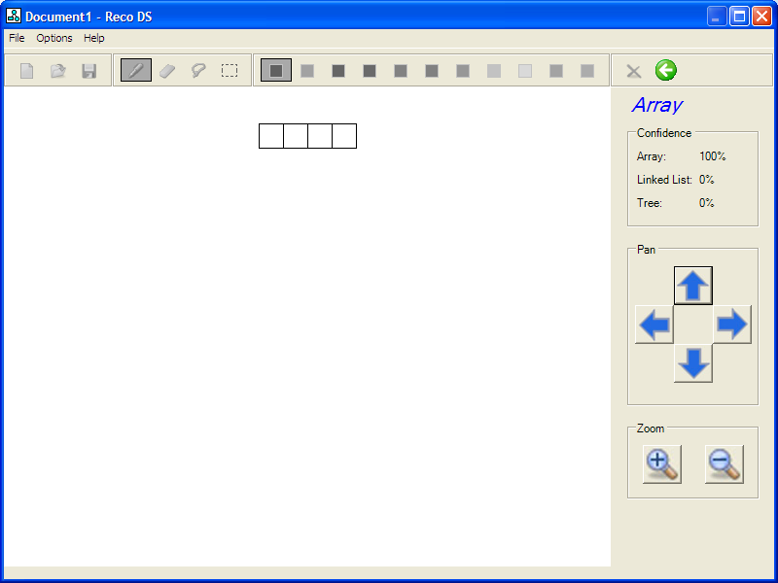
Interactive Demo
Demo

Slide 22
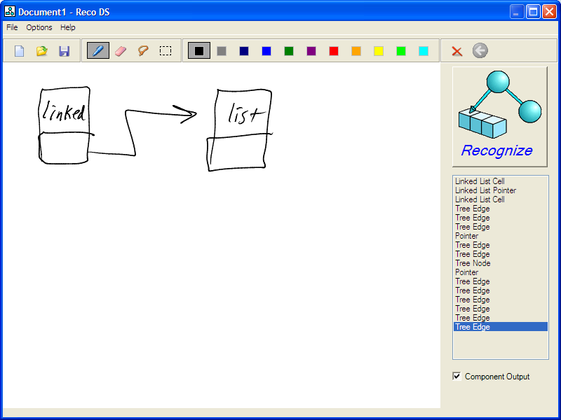
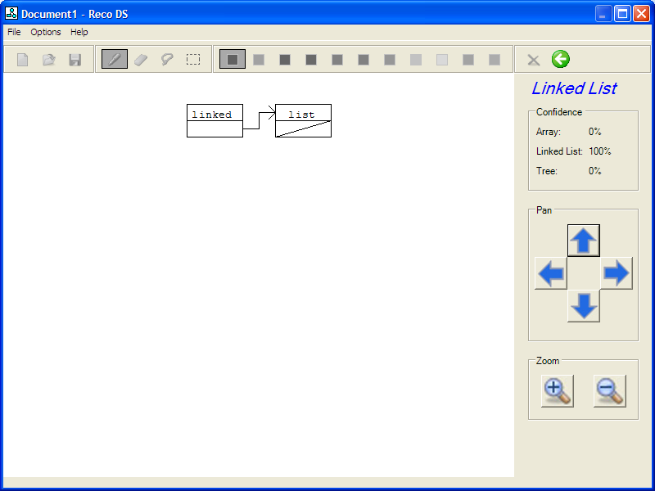
Interactive Demo
Demo

Slide 23
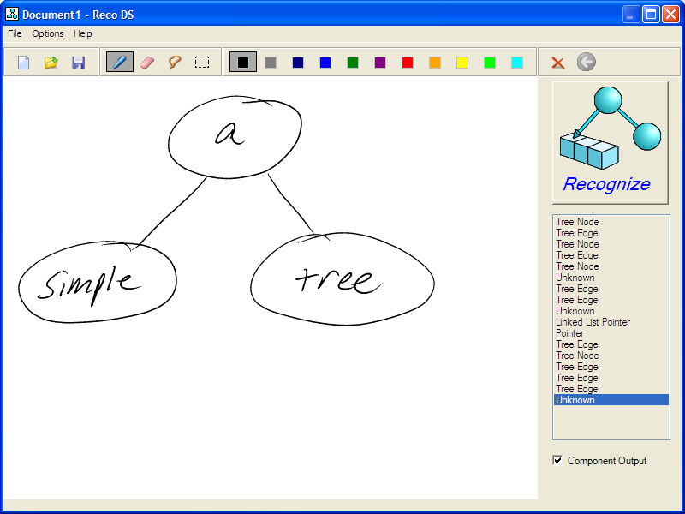
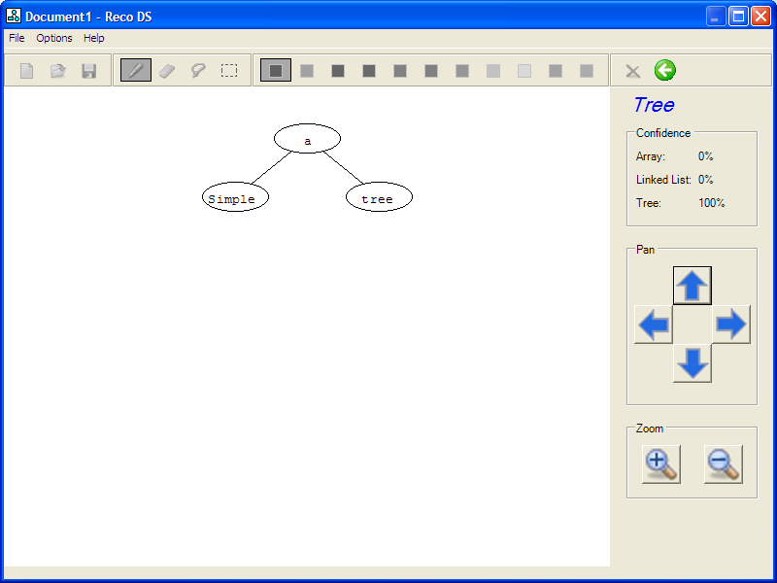
Interactive Demo
Demo

Slide 24
Advanced Functionality
Child data structures
Multi-stroke Recognition
  Arrays
  Linked Lists

Slide 25
Advanced Functionality
New File
Opening Files
Saving Files
Erasing Strokes
Selecting data structure(s) to recognize
  Lasso
  Selection box

Slide 26
Advanced Functionality
Moving data structures
Online Help
Viewing Options
  Panning
  Zooming

Slide 27
Advanced Functionality
Questions??

Slide 28
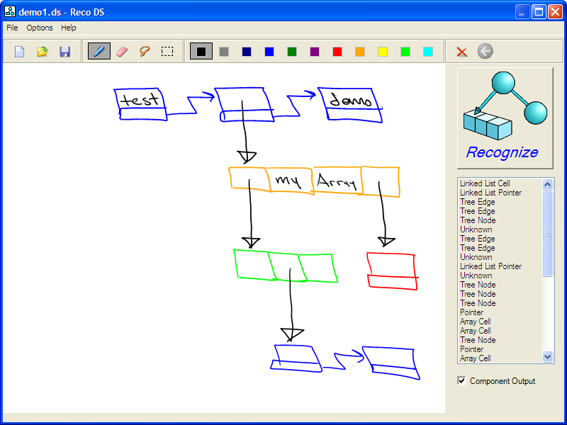
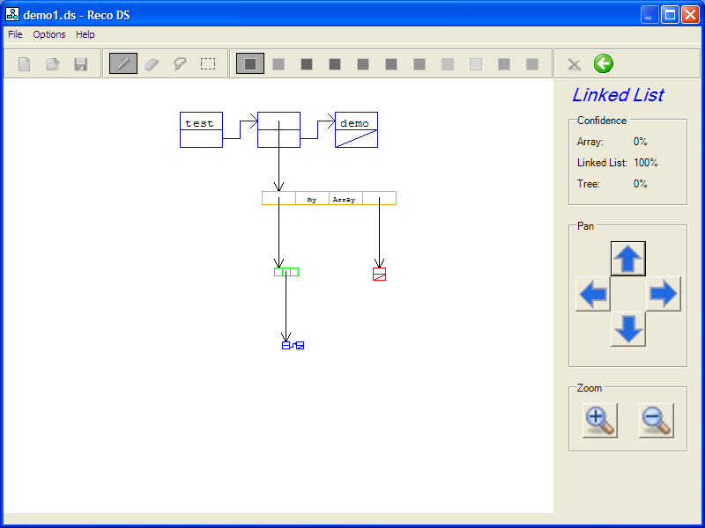
Advanced Demo
Demo

Slide 29
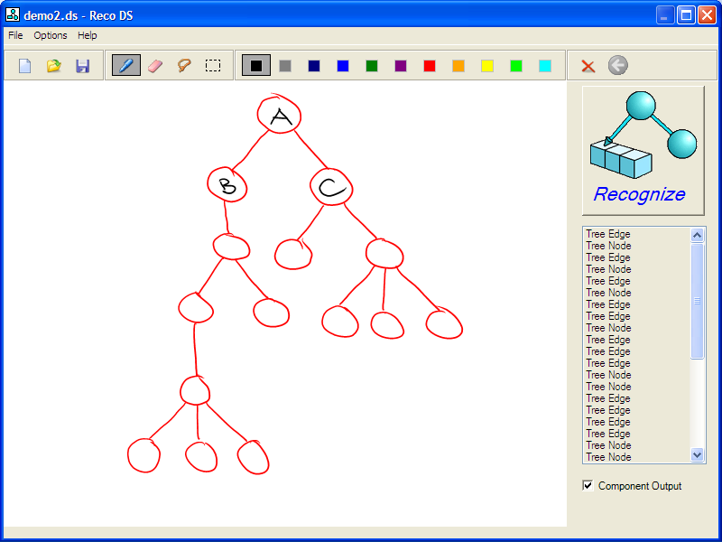
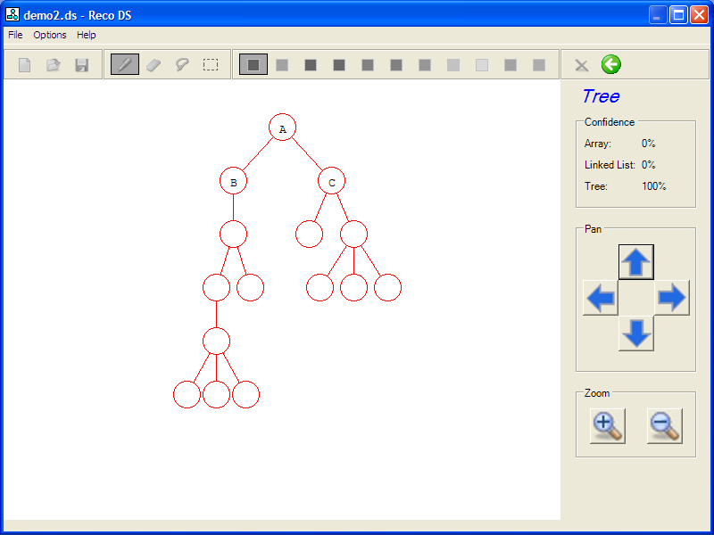
Advanced Demo
Demo

Slide 30
Tradeoffs
User Learning vs. Machine Learning

Slide 31
Challenges
Limited experience with
  C#
  Tablet PC platform
Exploratory work

Slide 32
Questions??

