Slide 1
OpenShift Serverless
Unified Multi-Cloud Serverless Platform
Cathay Technical Proposal | Validated on Live Infrastructure
Validated on ROSA HCP 4.20.21
2026-05-13 | Red Hat Adoption Team

Slide 2
Agenda
01
Multi-Cloud Serverless Challenge
N clouds x M functions = NxM independent CI/CD pipelines
02
OpenShift Serverless Solution
Knative Serving + Eventing + Functions — unified architecture
03
Validated Comparison
Knative vs Lambda: performance, complexity, and cost benchmarks
04
Workflow Orchestration
SonataFlow vs AWS Step Functions — live comparison
05
Enterprise Capabilities
Unified CI/CD, multi-cloud portability, event-driven architecture
06
Implementation Roadmap
8-week phased rollout plan with success criteria
OpenShift Serverless — Unified Multi-Cloud Serverless Platform
2

Slide 3
CHALLENGE
Multi-Cloud Serverless Challenge
N clouds x M functions = NxM independent CI/CD pipelines
Each cloud requires its own CI/CD pipeline
AWS Lambda: SAM/CDK + IAM + API Gateway
Azure Functions: func CLI + bindings + triggers
Alibaba Cloud / GCP: separate deployment tools & SDKs
Operational overhead scales linearly with cloud count
NxM pipelines = NxM maintenance cost
Every change must be replicated across multiple platforms
Deep vendor lock-in
Proprietary SDKs, trigger models, and deployment tools
Migration cost grows over time
Func 1
Func 2
Func M
AWS
CI/CD
CI/CD
CI/CD
Azure
CI/CD
CI/CD
CI/CD
GCP
CI/CD
CI/CD
CI/CD
3 clouds x 50 functions = 150 pipelines
OpenShift Serverless — Unified Multi-Cloud Serverless Platform
3

Slide 4
Current State vs. Target State
From NxM pipelines to 1xM pipelines — architecture transformation
Current State
Target State
AWS Lambda (multiple functions)
CI/CD for AWS (SAM/CDK)
Unified CI/CD Pipeline (Tekton + ArgoCD)
Azure Functions (planned)
CI/CD for Azure (func CLI)
Migrate
Container Image (OCI) + Knative YAML
ROSA (AWS)
ARO (Azure)
OCP (Ali/GCP)
N clouds x M functions = NxM pipelines
1 pipeline x M functions = M pipelines (cloud-agnostic)
OpenShift Serverless — Unified Multi-Cloud Serverless Platform
4

Slide 5
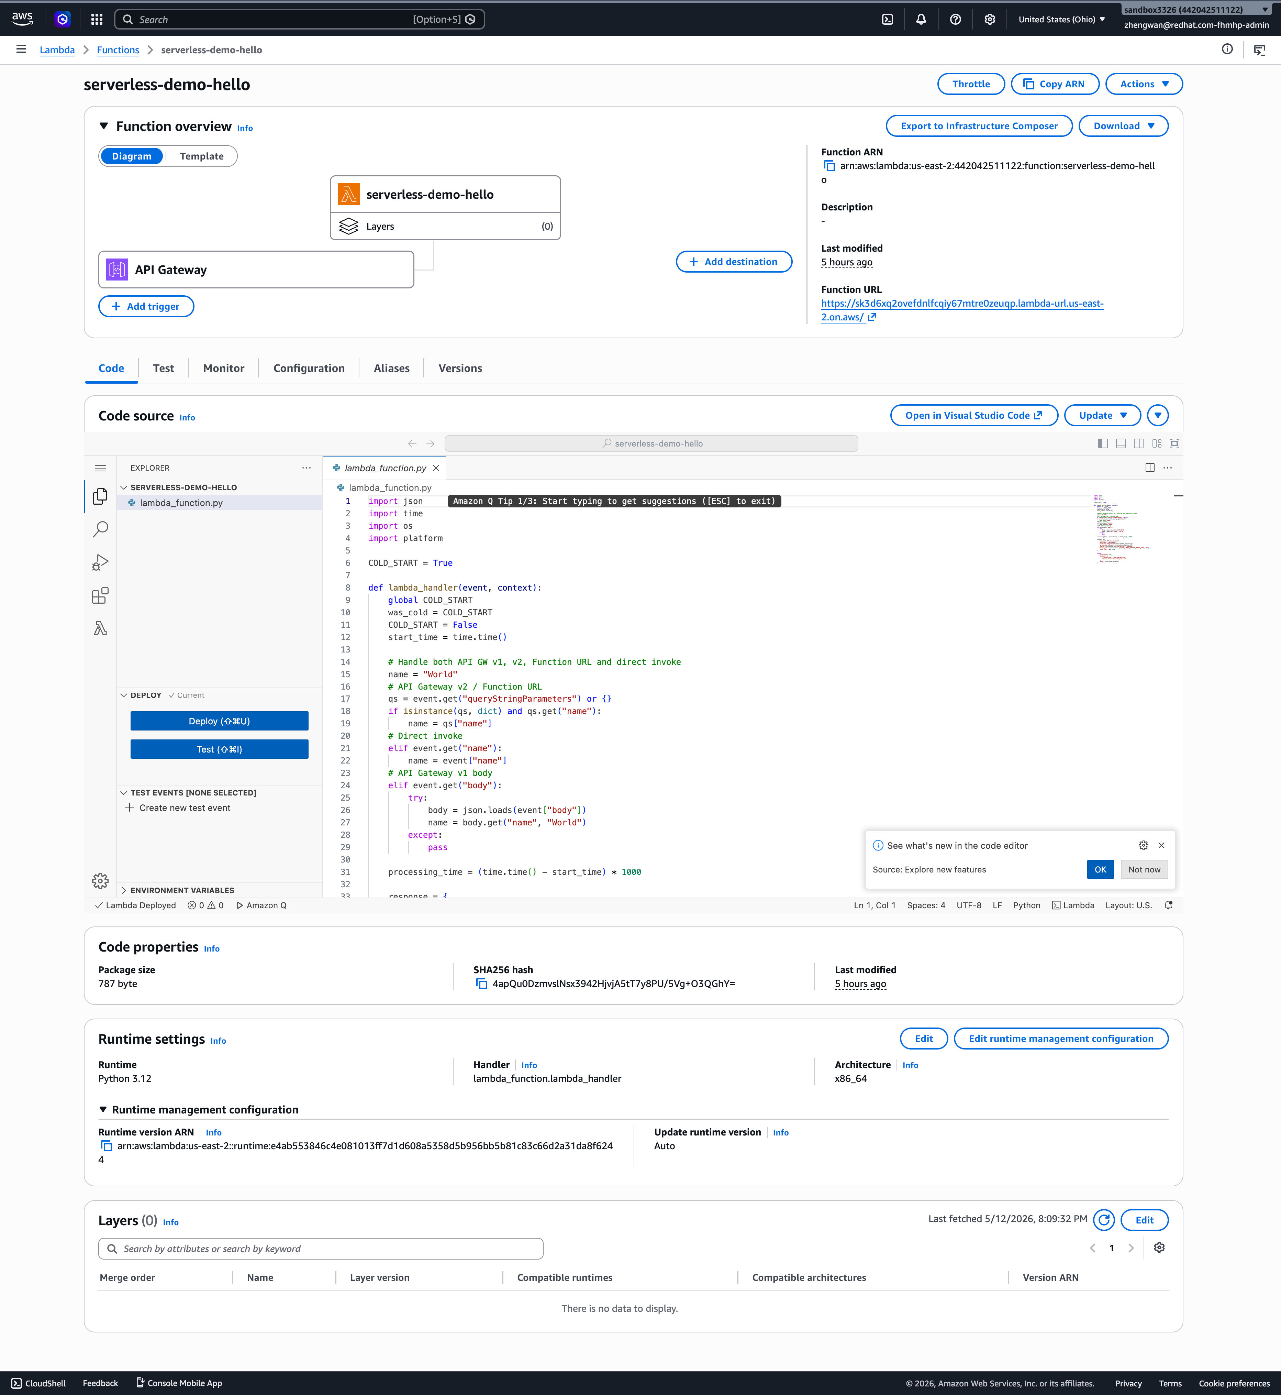
VALIDATION
Test Environment
All data from end-to-end testing on live infrastructure
Component | Details
ROSA Cluster | rosa-fhmhp, Hosted CP, OCP 4.20.21, K8s v1.33.10
Worker Nodes | 2x m6a.xlarge, us-east-2a
AWS Region | us-east-2 (Ohio)
Serverless Operator | v1.37.1 (Knative 1.17)
Serverless Logic Operator | v1.37.2 (GA, stable channel)
AWS Lambda Runtime | Python 3.12.13
Comparison Method | Same region, same network, same business logic
OpenShift Serverless — Unified Multi-Cloud Serverless Platform
5

Slide 6
Performance: Knative Serving vs AWS Lambda
Same business logic, same AWS region, end-to-end measured data
Metric | AWS Lambda | OpenShift Serverless (Knative) | Notes
Cold Start Latency | ~292ms | ~1.67s | Lambda cold start is faster (no pod spin-up)
Warm Request Latency | ~44-55ms | ~28-30ms | Knative is faster (in-cluster network)
Scale-to-Zero | Auto (~15min) | Auto (~90s, configurable) | Knative scales down faster
Deployment Complexity | 11 CLI commands 3 AWS services | 1 oc apply 1 YAML | Knative greatly simplified
Multi-Cloud Support | AWS only | ROSA / ARO / OCP (any cloud) | Knative is portable
CI/CD Pipelines | Separate per cloud | One pipeline for all clusters | Ops cost N to 1
Warm latency: Knative 40% faster than Lambda | Deployment complexity reduced 90% | CI/CD pipelines: N to 1
OpenShift Serverless — Unified Multi-Cloud Serverless Platform
6

Slide 7
Deployment Complexity: 11 Steps vs 1
Full steps required to create a simple HTTP function with an exposed endpoint
AWS Lambda
OpenShift Serverless
11 CLI commands | 3 AWS services
1 command | 1 API
1. Write function code + ZIP package
oc apply -f knative-service.yaml
2. Create IAM Trust Policy JSON
3. aws iam create-role
4. aws iam attach-role-policy
✓ Route auto-generated (HTTPS)
5. aws lambda create-function
✓ TLS certificate auto-configured
6. aws lambda wait function-active
✓ Autoscaling policy via annotations
7. aws apigatewayv2 create-api
✓ No IAM, API Gateway, or permission setup
8. aws lambda add-permission
✓ No activation wait — ready in ~10s
9. aws apigatewayv2 create-integration
10. aws apigatewayv2 create-route
11. aws apigatewayv2 create-stage
IAM + Lambda + API Gateway
OpenShift Serverless — Unified Multi-Cloud Serverless Platform
7

Slide 8
Developer Experience: kn func vs Lambda
"Just write code, forget about containers" — Lambda-equivalent workflow
Step | AWS Lambda | kn func (Knative Functions)
Scaffold | sam init | kn func create -l python
Write Code | lambda_handler(event, context) | Function.handle(scope, receive, send)
Build | sam build / zip package | kn func build (S2I, no Dockerfile)
Deploy | sam deploy + IAM + API GW | kn service create --image ...
Dockerfile | Not needed | Not needed (S2I auto-build)
SDK Dependency | AWS SDK, boto3 | None (standard HTTP/ASGI)
Languages | Python/Node/Go/Java/... | Python/Node/Go/Quarkus/Rust/TS
Warm Latency | ~44-55ms | ~28-31ms
Multi-Cloud | AWS only | Any OCP cluster
Also supports standard Dockerfile builds — same runtime, compatible with existing CI/CD pipelines
OpenShift Serverless — Unified Multi-Cloud Serverless Platform
8

Slide 9
Scale-to-Zero: Automatic Cost Optimization
No traffic: Pods→0, Nodes→0, Compute cost→$0
No Traffic
Request rate = 0
Knative Scale-to-Zero Pods = 0
Machine Pool Nodes = 0 (auto scale-down)
Cost = $0
Traffic Arrives
Request arrives
Activator buffers request
Cluster auto-scales adds node
Knative Pod starts
Request served (cold start ~1.5s)
Scale-to-Zero Timeline
15-30s grace (pods still running)
60s stable window (pods terminate)
Node idle 10m (nodes removed)
Compute cost $0
OpenShift Serverless — Unified Multi-Cloud Serverless Platform
9

Slide 10
COST
Cost Comparison Model
Monthly cost estimates for a 50-function workload
Factor | AWS Lambda | Knative on ROSA (Spot)
Invocation Cost | $0.20/million requests | $0 (included in compute)
Compute (128MB, 1s) | $0.0000021/request | Scale-to-zero = $0 when idle
Warm-Up Cost | Provisioned Concurrency $$ | minScale=0, no idle cost
Data Transfer | Cross-service charges | In-cluster = free
Multi-Cloud Overhead | N/A (single cloud) | Same image, same YAML
CI/CD Pipeline Cost | Separate per cloud $$ | One pipeline for all
Node Idle Cost | N/A | $0 (auto scale-down removes nodes)
Traffic Scenario | AWS Lambda | Knative on ROSA (Spot) | Savings
Low (intermittent) | $200-500/mo | ~$0 (fully scaled to zero) | 100%
Medium | $500-2000+/mo | $200-600/mo | 60-70%
Across 3 clouds | 3x cost | 1x CI/CD + 3x OCP compute | 50%+
Note: For sustained high-throughput functions, Lambda may be more cost-effective. Knative excels for bursty/intermittent workloads and multi-cloud scenarios.
OpenShift Serverless — Unified Multi-Cloud Serverless Platform
10

Slide 11
Event-Driven Architecture: Knative Eventing
Unified event model — replaces CloudWatch Events / SQS / S3 triggers
Mode 1: Direct Sink
Mode 2: Channel + Sub
Mode 3: Broker + Trigger
PingSource → Service Point-to-point, zero middleware
Source → Channel → Service A/B Fan-out, ordered delivery
Multi Source → Broker → Multi Service Attribute-based routing
Current Demo
Medium
Production
Lambda Trigger | Knative Equivalent | Delivery Mode
CloudWatch Events / EventBridge | PingSource (cron schedule) | Direct Sink
SQS trigger | KafkaSource + AMQ Streams | Channel / Broker
S3 event | SinkBinding via Eventing | Broker + Trigger
API Gateway | Knative Route (auto-created) | HTTP direct
SNS | Knative Channel + Subscription | Channel
Design philosophy: Zero middleware for simple cases (Direct Sink); add Channel/Broker + Kafka only when needed
OpenShift Serverless — Unified Multi-Cloud Serverless Platform
11

Slide 12
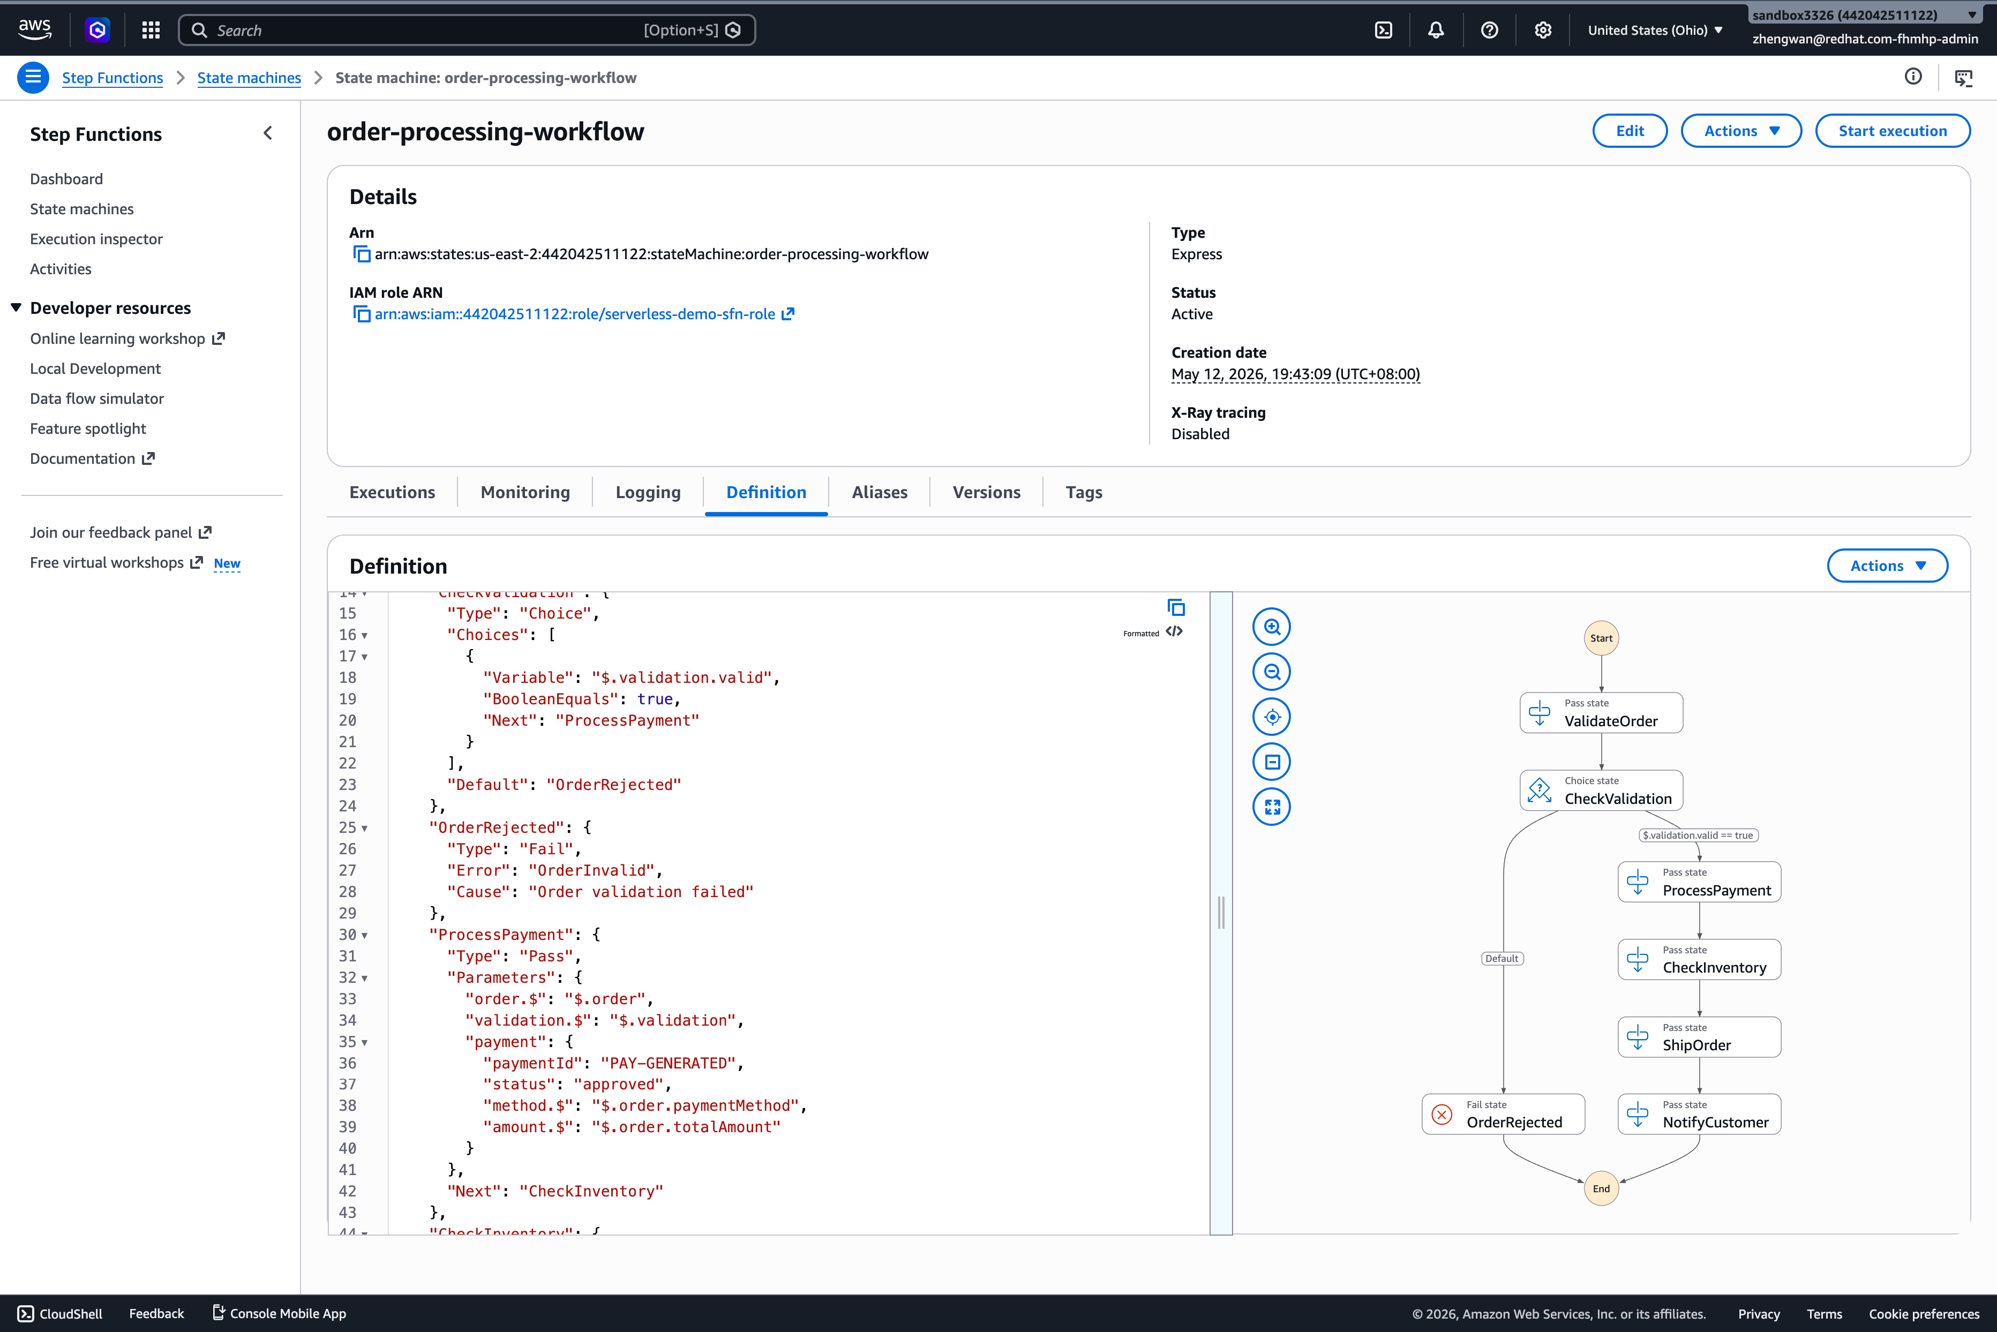
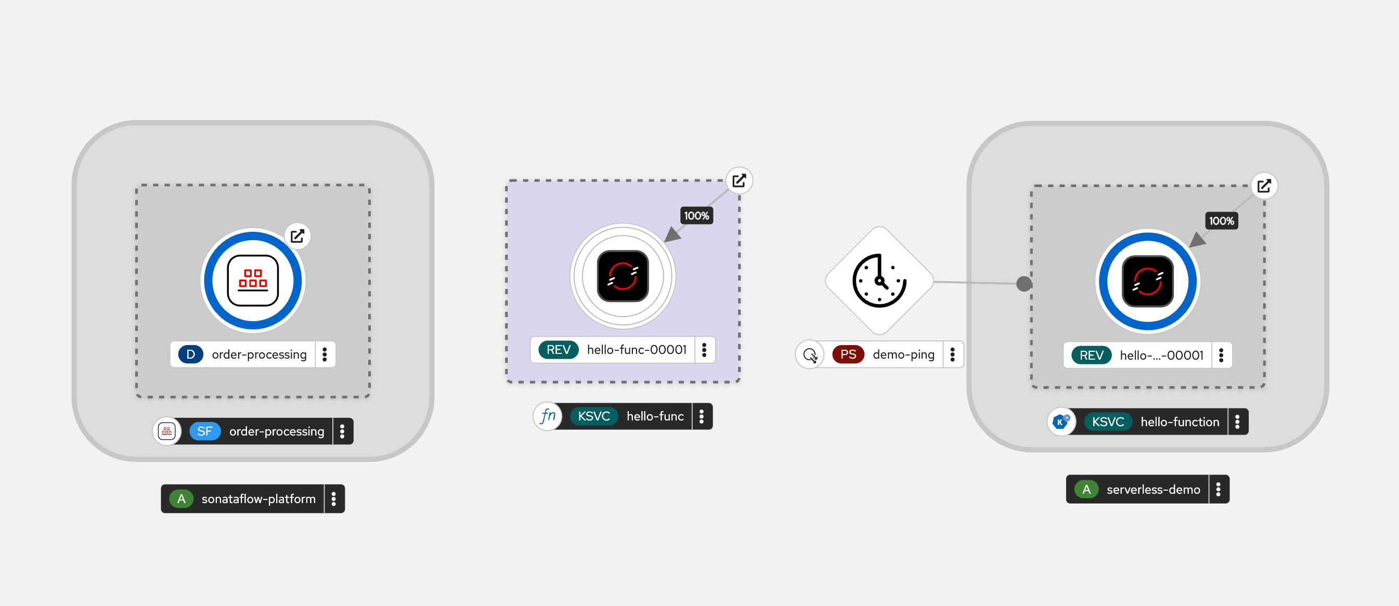
KEY REQUIREMENT
Workflow Orchestration: SonataFlow
Replaces AWS Step Functions — built on CNCF Serverless Workflow open standard
Order Processing Workflow — Live Demo
Receive Order
Validate Order
Process Payment
Check Inventory
Ship Order
Notify Customer
CNCF Serverless Workflow Spec
Open standard, not proprietary ASL — workflow definitions are runtime-portable
Kubernetes Native (CRD)
Workflow definitions are K8s CRs — seamless GitOps and CI/CD integration
jq Expression Engine
More powerful data transformation than ASL's JSONPath (Turing-complete)
Built-in Dev Tools
SwaggerUI + DevUI out of the box, no additional configuration
Consistent Multi-Cloud Deploy
Same SonataFlow YAML deploys to ROSA, ARO, or any OCP cluster
OpenShift Serverless — Unified Multi-Cloud Serverless Platform
12

Slide 13
SonataFlow vs AWS Step Functions
Same order-processing workflow, live comparison data
Dimension | AWS Step Functions | SonataFlow on ROSA
Workflow Execution Latency | ~2ms (Express) | ~46ms (warm request)
First Request | ~962ms (incl. CLI overhead) | ~220ms
Workflow Spec | ASL (AWS proprietary) | CNCF Serverless Workflow (open standard)
Expression Language | JSONPath + limited intrinsics | jq (full-featured, Turing-complete)
Deployment | aws sfn create-state-machine | oc apply -f sonataflow.yaml
Multi-Cloud Portable | AWS only | Any OCP cluster
K8s Native | No | Yes (CRD + Operator)
Human Approval | Activity Task + SQS | Built-in Callback State
Cost Model | Per state transition | Included in OCP compute
Visual Editor | Workflow Studio (built-in) | VS Code extension + Web Tools
GitOps Friendly | Console edits bypass Git | YAML CRD + Git version control
Vendor Lock-in | High (ASL proprietary) | Low (CNCF standard)
Design philosophy: AWS favors Console-first | SonataFlow favors Code-first + GitOps
OpenShift Serverless — Unified Multi-Cloud Serverless Platform
13

Slide 14
Unified CI/CD: Tekton + ArgoCD
One pipeline for all OCP clusters — Git Push → Build → Deploy, fully automated
Git Push
Git Repo (GitHub/GitLab)
Tekton EventListener (webhook)
GitOps Repo Structure
base/
knative-service-template.yaml
overlays/
rosa-prod/ (scale, registry)
Clone Source
Build & Push Image
Deploy via GitOps (ArgoCD)
aro-prod/ (registry override)
ocp-ali/ (registry override)
argocd/
rosa-prod-app.yaml
aro-prod-app.yaml
ROSA (AWS) Knative Svc
ARO (Azure) Knative Svc
OCP (Ali/GCP) Knative Svc
Only differences: Registry URL + DNS + load balancer type — handled by Kustomize Overlays
OpenShift Serverless — Unified Multi-Cloud Serverless Platform
14

Slide 15
Multi-Cloud Portability
Same container image + same Knative YAML → any OCP cluster
Container Image (OCI) + Knative Service YAML
ROSA (AWS)
ARO (Azure)
OCP (Ali/GCP)
Registry: Quay.io/ECR Ingress: Kourier + NLB Spot instance support
Registry: ACR/Quay.io Ingress: Kourier + ALB On-demand/reserved
Registry: Harbor/Quay Ingress: Kourier + LB Self-managed, flexible
Lambda → Knative Concept Mapping
AWS Lambda Concept | Knative / OpenShift Equivalent
Lambda Function | Knative Service (ksvc)
API Gateway trigger | Knative Route (auto-created)
SQS trigger | KafkaSource + AMQ Streams
EventBridge Schedule | PingSource
Env variables | ConfigMap / Secret
Versioning / Alias | Knative Revisions + Traffic Splitting
SAM template | Knative YAML + Tekton Pipeline
OpenShift Serverless — Unified Multi-Cloud Serverless Platform
15

Slide 16
ROADMAP
Implementation Roadmap
8-week phased rollout plan
W1
W2
W3
W4
W5
W6
W7
W8
W9
Phase 1: Install Serverless Operator
Install Serverless Operator
Week 1-2
Phase 2: Dedicated Machine Pool
Dedicated Machine Pool
Week 2-3
Phase 3: Lambda Migration (Pilot)
Lambda Migration (Pilot)
Week 3-5
Phase 4: Unified CI/CD Pipeline
Unified CI/CD Pipeline
Week 4-6
Phase 5: Event Source Integration
Event Source Integration
Week 5-7
Phase 6: Cost Optimization
Cost Optimization
Week 6-7
Phase 7: Multi-Cloud Validation
Multi-Cloud Validation
Week 7-8
Estimated total duration: 6-8 weeks
Phase 8: Workflow Orchestration
Workflow Orchestration
Week 7-9
OpenShift Serverless — Unified Multi-Cloud Serverless Platform
16

Slide 17
Success Criteria
Measurable acceptance metrics
Criterion | Measurement | Test Status
Unified CI/CD | Single Tekton Pipeline deploys to all target clouds | Design ready
Scale-to-Zero | Pod count drops to 0, nodes removed | Validated ✓
Cost Reduction | Cost reduced ≥30% vs equivalent Lambda | Model validated
Cold Start < 10s | P95 cold start latency under 10 seconds | Measured 1.67s ✓
Multi-Cloud Portable | Same function image + YAML deploys to ROSA and ARO | Architecture ready
Migration Coverage | ≥3 Lambda functions migrated as proof of concept | Pending
Ops Readiness | Monitoring dashboards, alerts, and runbook delivered | Docs ready
Workflow Orchestration | SonataFlow replaces Step Functions POC | Validated ✓
OpenShift Serverless — Unified Multi-Cloud Serverless Platform
17

Slide 18
Key Takeaways
1
Warm request latency: Knative 40% faster than Lambda
Measured: Knative ~28-30ms vs Lambda ~44-55ms — zero overhead from in-cluster networking
2
Deployment complexity reduced from 11 steps to 1
No IAM, API Gateway, or permission setup — one declarative YAML deployment
3
CI/CD pipelines reduced from N to 1
Tekton + ArgoCD + Kustomize Overlays → one pipeline for all clouds
4
Scale-to-Zero delivers true pay-per-use
No traffic → Pods scale to zero → Nodes removed → Compute cost $0
5
Built on open standards, eliminating vendor lock-in
Knative (CNCF) + CNCF Serverless Workflow + OCI container standards
Next step: Launch Phase 1 — install OpenShift Serverless on existing ROSA cluster, complete first pilot function migration within 2 weeks
OpenShift Serverless — Unified Multi-Cloud Serverless Platform
18

Slide 19
Thank You
Q & A
Red Hat Adoption Team | 2026-05-13
Test Environment: ROSA HCP 4.20.21 (us-east-2) Documentation: solution.md + steps.md (full commands and output)

