Slide 1
High-level System Overview
Simply speaking, it executes the following steps:
Data Ingestion: Every two months, we will get the user list that was sent for a specific campaign. We will also have the result of whether the email was opened. We also have a general metadata for these campaigns, what was the title, what was the open rate, etc.
Error Handling: We do quality check. We got rid of the record in which there was a sending error, because in such case user would never open the email. These records are useless for model training.
Feature Extraction: We do feature extraction for raw data. We extract time-related features, such as whether a user has received an email in the past 7 days, or what is its previous history open rate for email of this category.
Training and Forecasting: We train the data using random forest and logistic regression. The trained model would be stored and used for new request for the campaigns after.

Slide 2
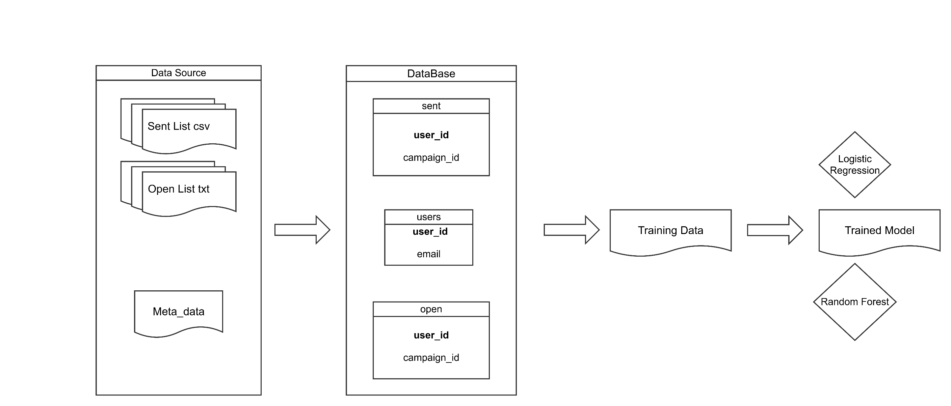
High-level Diagram

Slide 3

1 - Data Ingestion
Sent Data: 1.6億 rows of data in 2 months
Opened Data: 0.5億 rows of data in 2 months
Meta_Data: 452 rows of campaign information in 2 months

Slide 4
1 - Data Ingestion
Previous Method:
Use Pandas + CSV/TSV to store users, opened_fact, sent_fact.
Pandas merge is time costly
CSV is slow and large
Proposed Method:
Use Parquet + Duckdb(or Posgre?) to create users, campaigns and emails.
Use partquet to replace csv allows for faster reads, smaller size and typed columns
Duckdb has a faster merge speed.
Email table would incorporate both sent and open information; this is logically more sensible. Each send action should have a result.

Slide 5
2 – Error Handling
After we build the database, there are error cases that need to be handled.
Error report is updated in a monthly basis. It continues to increase with new report from every month. The error report only contains the email address that has sending failure. No exact date.
Because those users who did encounters sent error would of course not open the mail, leaving them in the training set would reduce model’s accuracy.
How do we get error in each month?
At month 11:
At month 12:
Error: 1-11
Error: 1-10
Error: 11
Anti Join
Error: 1-12
Error: 1-11
Error: 12
Anti Join

Slide 6
2 – Error Handling
Previous Method:
After getting a map of error email list to the month, they would do a join on the record data based on user id and error id, then get rid of the send record in which the campaign happens inside the error period. This step is complex and has a bug, which causes the project to run slower, and duplicate rows in the final training data.
Proposed Method:
I would do the same thing but in SQL query. In this step, the original project’s idea has no problem. But using query would make things much faster.
Possible Consideration:
What is the reason for the error? If the user blocked the email from Rakuten Bank, not only their record for that month should be deleted, their record after that month should also be deleted. If it was due to system error, then the current method is correct.

Slide 7
3 – Feature Processing
In the original project, after the feature processing, the training data looks like this:
This is only a part of the features, but I think these are the most important ones. Notice that there are two computation-heavy features: sent_within_7days and product_open_rate.
All the campaign-related features can be generated in the campaign table, then joined with email table. But sent_within_7days records whether the customer has received an email in the past 7 days on the day he received email. Therefore, we must sort by users, then calculate this feature.
Another feature is product_open_rate. This requires a groupby command by users and business unit, then calculate the average open rate. This is also time consuming.

Slide 8
3 – Feature Processing
Previous Method:
Both calculated using pandas. The sort was done for the feature extraction, so it is good practice.
Proposed Method:
I would do the exactly same thing, but in sql.
Possible Consideration:
In MDAS, we have other features corresponding to the user information. If we add these features as well, this might have a positive effect on the final model accuracy. However, this would reduce speed.

Slide 9

4 – Training and Forecasting
Training Data
Hyperparameter Optimization
Best Model
Forecast customer’s preference for a category
Score
Using the extracted features, we prepare the training dataset. We then use hyperparameter optimization to train the best model, then use the best model to predict customer’s preference for a category.

Slide 10

4 – Training and Forecasting
I think this scoring method omits the campaign data. During training, we have the exact campaign data, such as what is its title, how much “!” mark is inside the email etc.
If we can have these features for the future campaigns, we can just predict for each feature campaign instead for just giving historical scoring for those categories of campaign.

Slide 11
4 – Training and Forecasting
Speed:
The training causes a lot of time. To save time, we can try the following:
Reduce the grid search space / Random Search
Reduce the training size: We do not rely on collaborative filtering; we can use 1/10 of the original training set.
Change the model. Random forest can take a long time compared to LightGBM and even XGBoost.
Forecast Quality:
The final score for each user is solely based on the most recent campaign for that category. We can incorporate the future campaign features into the pipeline
Cold Start problem: For those new users, because they have no open record, they are very likely to be given a low score. Therefore, for the sake of potential customers, we should intentionally mix new users with the older users that has high open possibility.

Slide 12
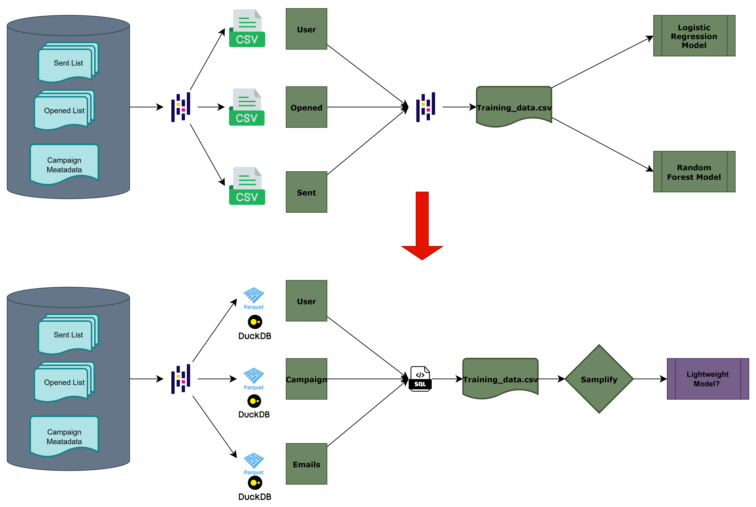
A general approach

Slide 13
All the change points considered
Must do:
Write all the sql query and py files into a sh file, so that there is no human input needed
Change the csv format to parquet format to reduce storage space
Use sql query to do all the feature engineering steps to speed up processing
Use less training data to speed up model training
Potential:
Deal with error by identifying the root cause
Combine customer features from MDAS
User better model
Deal with Cold Start Problem by incorporating new users intentionally
Incorporate the future campaigns feature into scoring process, instead of just use customer’s open possibility for the latest campaign in a category

Slide 14

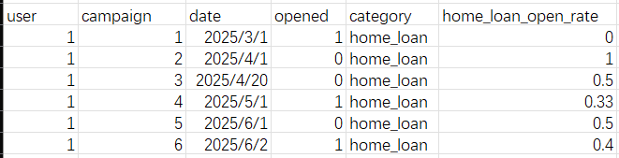
Why should we incorporate one more month？
If you check the tables below, you will notice that, home_loan_open_rate will always be 0 for the first record. This is like the cold start problem we talked about before.
Use 2 months for training
Use 4 months, but still use 2 months for training

