Slide 1


如何撰写学术论文
蔡宏民 博士、教授
华南理工大学计算机科学与工程学院

Slide 2
1
1
写在前面
2
论文写作的原则、要素与要点
目录
3
投稿要点
4
结语

Slide 3
Part
1
写在前面

Slide 4
写在前面
一、区分研究和论文写作
研究是要发现和解决新问题，而写论文是要把研究过程和成果公之于众。研究和论文写作是两项工作，各有各的要求。只是在一般情况下，人们一边做研究一边写论文，没有意识到它们是两项工作而已。此次讲课的内容侧重点在论文写作方面的要求和规范。
首先，写论文本身有很多好处，例如提高思考问题的能力、解决问题的能力、资料收集能力、信息筛选能力、语言组织能力，不仅促进个人学习和成长，还能传递知识、帮助他人，等等。
当然，这也是现实的需要，因为现在攻读华南理工大学计算机科学学院硕士学位，无论是专硕还是学硕，毕业要求都是要发表一篇SCI论文。
二、为什么写论文?

Slide 5


写在前面
三、在论文写作时，我校研究生存在各种问题：
逻辑混乱，关键术语的定义经常发生漂移，一个术语在前文是一个含义，在后文是另一个含义；
因为大部分研究生在高中和本科阶段缺乏论文写作方面的系统训练！
不知如何论证，往往机械地堆砌材料，论点和证据两层皮
文字表达能力低下，语句不通，错别字、语法错误随处可见；
不知何为抄袭，不仅抄别人论文，而且抄自己论文。
怕写论文，一写论文就不知如何下手
造成这种局面的原因是什么？

Slide 6
Part
2
论文写作的原则、要素
与要点

Slide 7

“I don’t care what you think”, George said,
“my paper is dynamic and stimulating.”

Slide 8
写作原则
科学研究发展到了今天，已经形成了一整套严密的规范。总体而言，论文写作需要遵循以下几个原则：
1.可阅读：论文应该结构完整、文字流畅、插图充分，让人读得懂，愿意读。
2.可验证：一篇论文解决了一个新问题，其结论需要接受读者的检验。所以论文应该是问题、方法、
思路和观点表述清晰，资料和数据真实充分。读者可以顺着论文的思路，可以检验观点
是否可以成立。
3.可追溯：现在论文都要求有注释，这是为了说明资料来源。一个严谨的审稿者和编辑会查阅这些
注释，看作者是否准确地转达了所引论文的原意。而作者也通过充分、准确的注释，避
免剽窃之嫌。
4.可检索：写论文是为了让同行读的，但是现在每年发表的论文成千上万，大多数读者需要通过文
献检索来寻找自己需要的论文。一位研究者要让读者发现自己的论文，就要在内容提要
和关键词上下功夫。

Slide 9
Components of a Paper

Slide 10
Title
Describes the paper’s content clearly and precisely including keywords
Is the advertisement for the article
Do not use abbreviations and jargon
Search engines/indexing databases depend on the accuracy of the title - since they use the keywords to identify relevant articles

Slide 11
The abstract
I usually write the abstract last !
Used by program committee members to decide which papers to read !
Four sentences [Kent Beck]
1. State the problem
2. Say why it’s an interesting problem
3. Say what your solution achieves
4. Say what follows from your solution

Slide 12
Example
Many papers are badly written and hard to understand
This is a pity, because their good ideas may go unappreciated
Following simple guidelines can dramatically improve the quality of your papers .
Your work will be used more, and the feedback you get from others will in turn improve your research

Slide 13
论文要素
内容提要：
（1）作者要解决什么问题；
（2）为什么选这个题目；
（3）用什么方法（或用什么资料）；
（4）得到了什么结论；
篇幅不能太短，短了不能写足上述要素；当然也不能太长，长了就 啰嗦

Slide 14
Introduction
Clearly state the:
Problem being investigated
Background that explains the problem
Reasons for conducting the research
Summarize relevant research to provide context
State how your work differs from published work
Identify the questions you are answering
Explain what other findings, if any, you are challenging or extending
Briefly describe the experiment, hypothesis(es), research question(s); general experimental design or method

Slide 15
The introduction (1 page)
1. Describe the problem
2. State your contributions
...and that is all
ONE PAGE!

Slide 16
State your contributions
Write the list of contributions first !
The list of contributions drives the entire paper: the paper substantiates the claims you have made !
Reader thinks “gosh, if they can really deliver this, that’s be exciting; I’d better read on”

Slide 17
Methods
Provide the reader enough details so they can understand and replicate your research
Explain how you studied the problem, identify the procedures you followed, and order these chronologically where possible
Explain new methodology in detail; otherwise name the method and cite the previously published work
Include the frequency of observations, what types of data were recorded, etc.
Be precise in describing measurements and include errors of measurement or research design limits

Slide 18
Results
Objectively present your findings, and explain what was found
Show that your new results are contributing to the body of scientific knowledge
Follow a logical sequence based on the tables and figures presenting the findings to answer the question or hypothesis
Figures should have a brief description (a legend), providing the reader sufficient information to know how the data were produced

Slide 19
Discussion/Conclusion
Describe what your results mean in context of what was already known about the subject
Indicate how the results relate to expectations and to the literature previously cited
Explain how the research has moved the body of scientific knowledge forward
Do not extend your conclusions beyond what is directly supported by your results - avoid undue speculation
Outline the next steps for further study

Slide 20
References
Whenever you draw upon previously published work, you must acknowledge the source
Any information not from your experiment and not ‘common knowledge’ should be recognized by a citation
How references are presented varies considerably - refer to notes for authors for the specific journal
Avoid references that are difficult to find
Avoid listing related references that were not important to the study

Slide 21
Key point 1: credit is not like money
Giving credit to others does not diminish the credit you get from your paper
Warmly acknowledge people who have helped you
Be generous to the competition. “In his inspiring paper [Foo98] Foogle shows.... We develop his foundation in the following ways...” "
Acknowledge weaknesses in your approach

Slide 22
Credit is not like money
Failing to give credit to others can kill your paper
If you imply that an idea is yours, and the referee knows it is not, then either
You don’t know that it’s an old idea (bad)
You do know, but are pretending it’s yours (very bad)

Slide 23
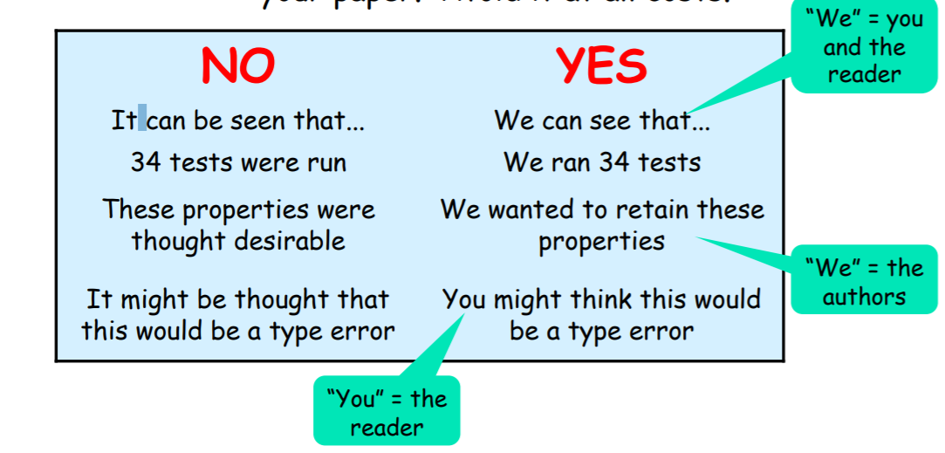
Key point 2: Use the active voice
The passive voice is “respectable” but it DEADENS your paper. Avoid it at all costs

Slide 24
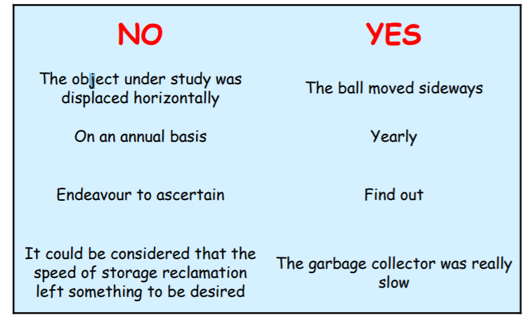
Key point 3: Use simple, direct language

Slide 25
Key point 4: Importance goes first
State the most important word first, then the second most important

Slide 26
Key point 5: Avoid long sentence
A sentence with fixed number of words (the favorite is 29) past which a sentence is too hard to read.

Slide 27
Part
3
投稿要点

Slide 28
Article Submission
Select your journal carefully
Read the aims and scope
Think about your target audience and the level of your work – do you have a realistic chance of being accepted?
Follow the guidelines in the notes for authors and include everything they ask – it makes the editor’s job easier…
Articles should not be submitted to more than one journal at a time
See: Instructions to Authors in Health Sciences
http://mulford.mco.edu/instr/

Slide 29
Online Submission
Many publishers now offer a completely electronic submission process
Article is submitted online and all of the review procedure also happens online
Speeds up the editorial process
Is invaluable for authors in low-income countries

Slide 30
Author Priorities for Journal Selection (Elsevier)
Key (Determining) factors
Impact Factor
Reputation
Access to the target audience
Overall editorial standard
Publication speed
International coverage
Open Access or HINARI participating publisher
Marginal (Qualifying) factors
Experience as a referee
Track record
Quality and colour illustrations
Service elements

Slide 31
Author Priorities for Journal Selection (INASP)
Quality / prestige
Collection / specialisation
Habit / previous publication
Speed / time delay

Slide 32
Part
4
结语

Slide 33
结语
综上所述，论文是一个非常复杂的工程。
写作一篇论文需要遵循可阅读、可检验、可追溯和可检索四条原则。
作者需要明白论文的结构，清楚各个要素即内容提要、关键词、前言、正文、结语、插图和参考文献的功能，写好每个要素。
此外，论文还要注意术语的延续性、体悟读者的需要、避免抄袭、使用平实语言和发掘论文价值。
所有这些都需要一个研究者接受长期的、反复的论文写作训练。

Slide 34
谢谢各位！
蔡宏民 博士、教授
华南理工大学计算机科学与工程学院

