Slide 1
0610

Slide 2
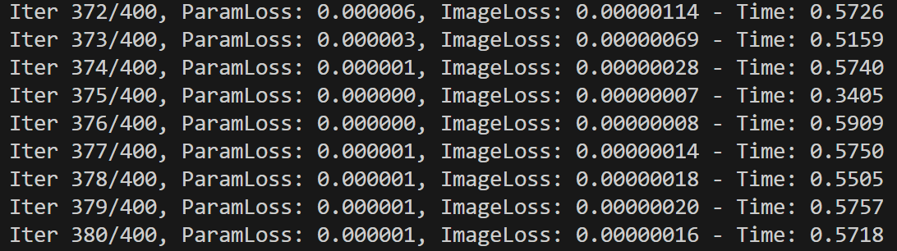
Adam:

Slide 3
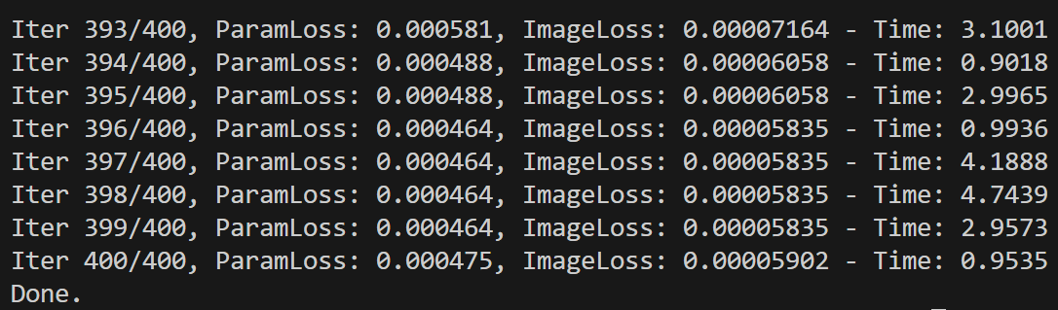
Newton & quasi-newton
lbfgs:

Slide 4

Approximating with taylor expansion
Second order: h$\left(x\right)=\frac{1}{2}{\left(x−θ\right)}^{T}B\left(x−θ\right)+{\left(x−θ\right)}^{T}∇g\left(θ\right)+g\left(θ\right)$
B = hessian of g at $θ$
Surrogate: $min l\left(θ,ϕ\right)=\int_{Θ}{λ\left(ρ,θ\right){\left(g\left(ρ\right)−h\left(ρ,ϕ\right)\right)}^{2}\text{d}ρ}$

Slide 5
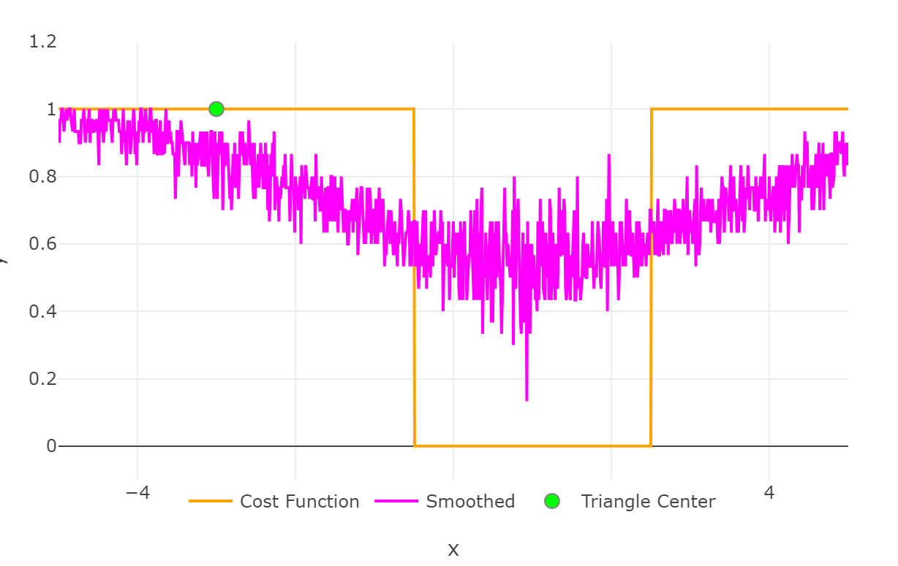

Slide 6
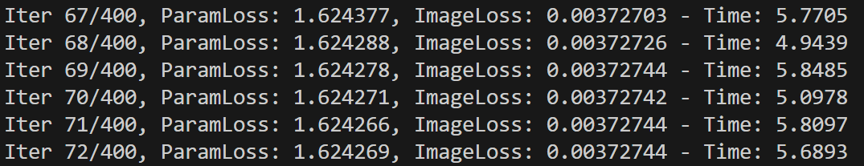
Conjugate gradients
A-orthogonal steepest descent
Line search also with Taylor expansion

Slide 7
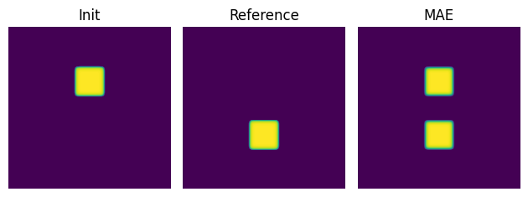
Box example

Slide 8
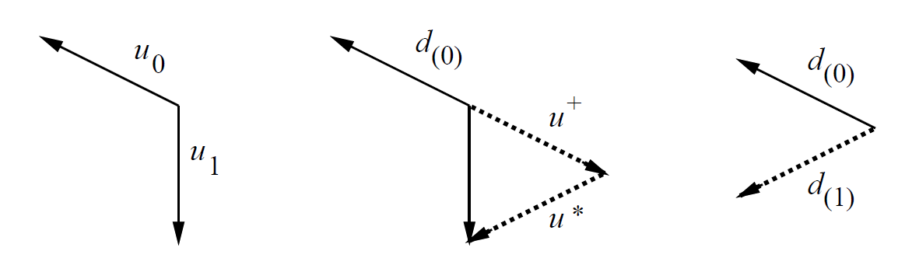
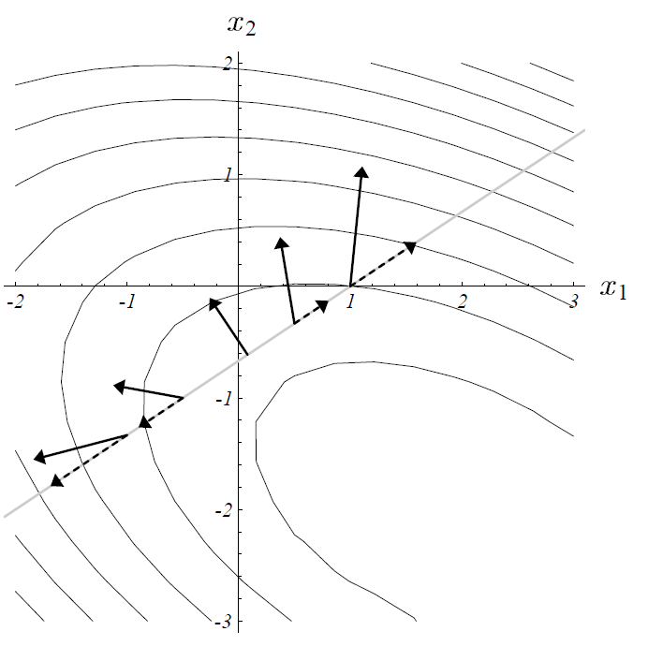
Conjugate gradients
Update Descent direction
Line search

Slide 9
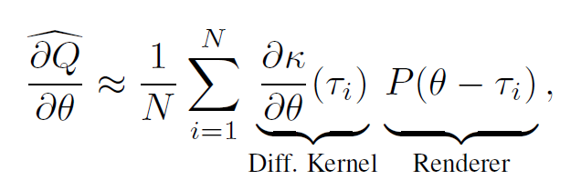

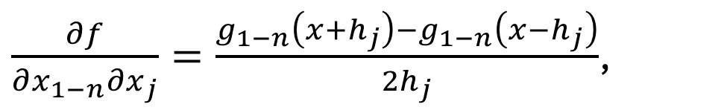
Finite difference hessian vs true hessian
$\frac{∂f}{∂x_{1−n}∂x_{j}}=\frac{g_{1−n}\left(x+h_{j}\right)−g_{1−n}\left(x−h_{j}\right)}{2h_{j}}$,
SmoothFn is already gradient in the forward pass.
So only one method can be used to approximate the hessian
Need to convolve with hessian of the gaussian.
$$=\frac{1}{N}\sum_{i=1}^{N}{\frac{∂^{2}k}{∂θ_{1}∂θ_{2}}\left(τ_{i}\right)P\left(θ−τ_{i}\right)}$$

Slide 10
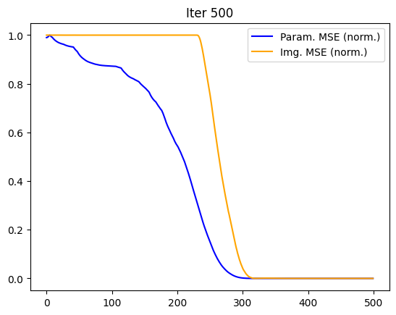
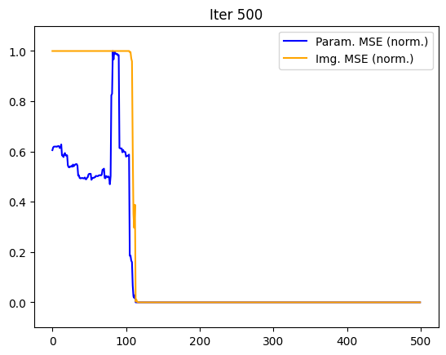
Converge speed

Slide 11
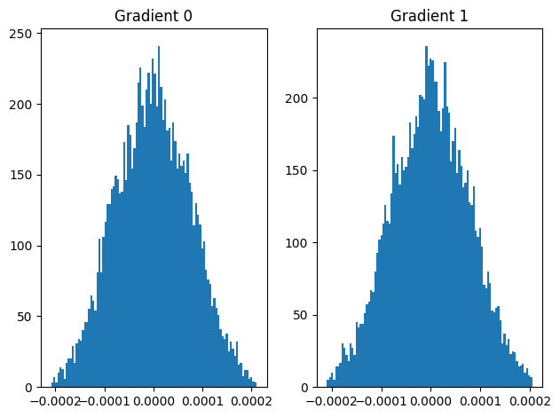
Sampled gradients

Slide 12
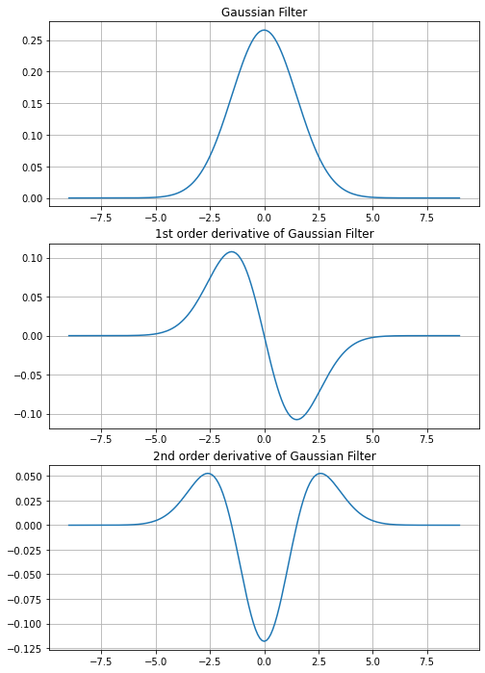
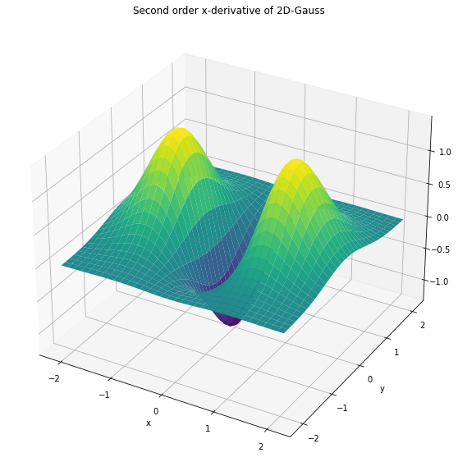
Convolving with second order derivative of gaussian
Currently convolving the loss with 1d Gaussian, so only make sense for second order derivative but not hessian.
Trying convolving with 2d Gaussian? Sampling size maybe squared. Since we need the hessian for line search(not axial)

Slide 13
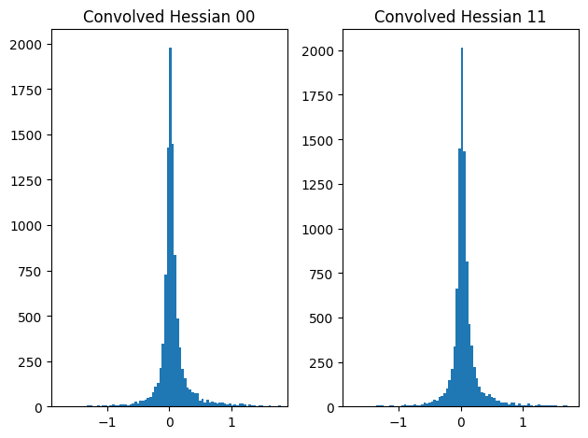
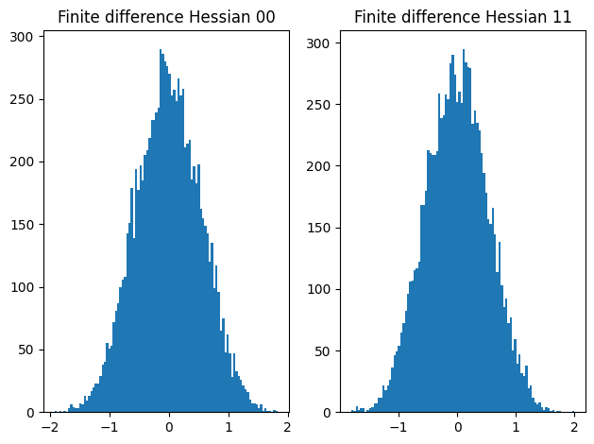
Current hessian - diagonal

Slide 14
Others
Variance reduction
Preconditioning
PR beta update
Derivative free quasi-newton

Slide 15
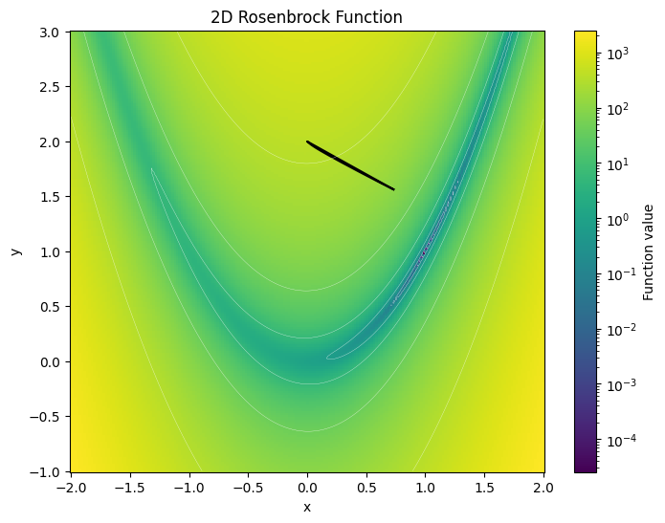

Simple toy problem convergence
500 iteration in Adam
300 iteration with CG(converged)

Slide 16
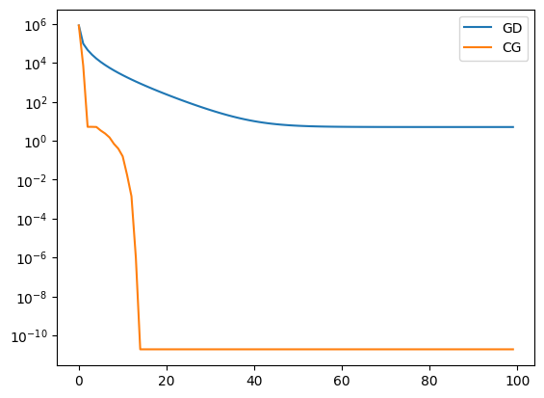
convergence

Slide 17
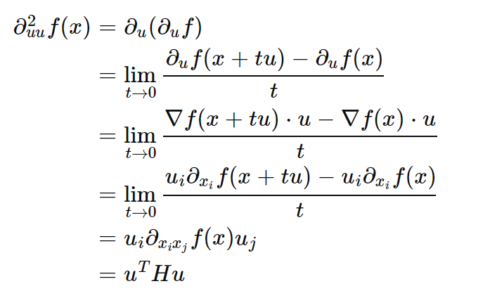
Avoiding the hessian
Directional derivative

Slide 18
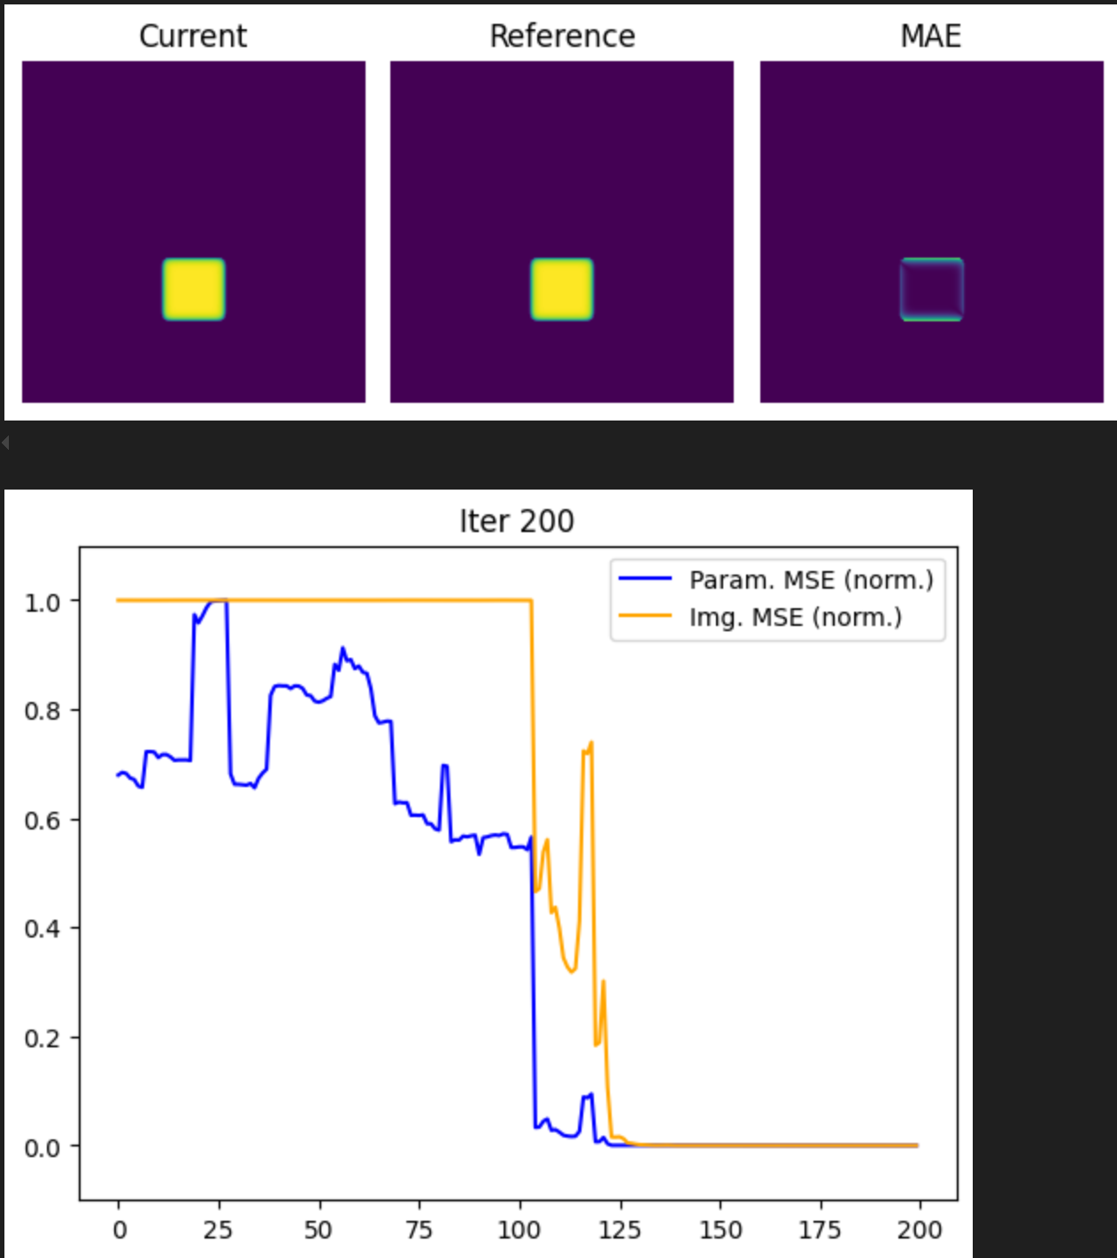
Second order with no blur kernel

Slide 19
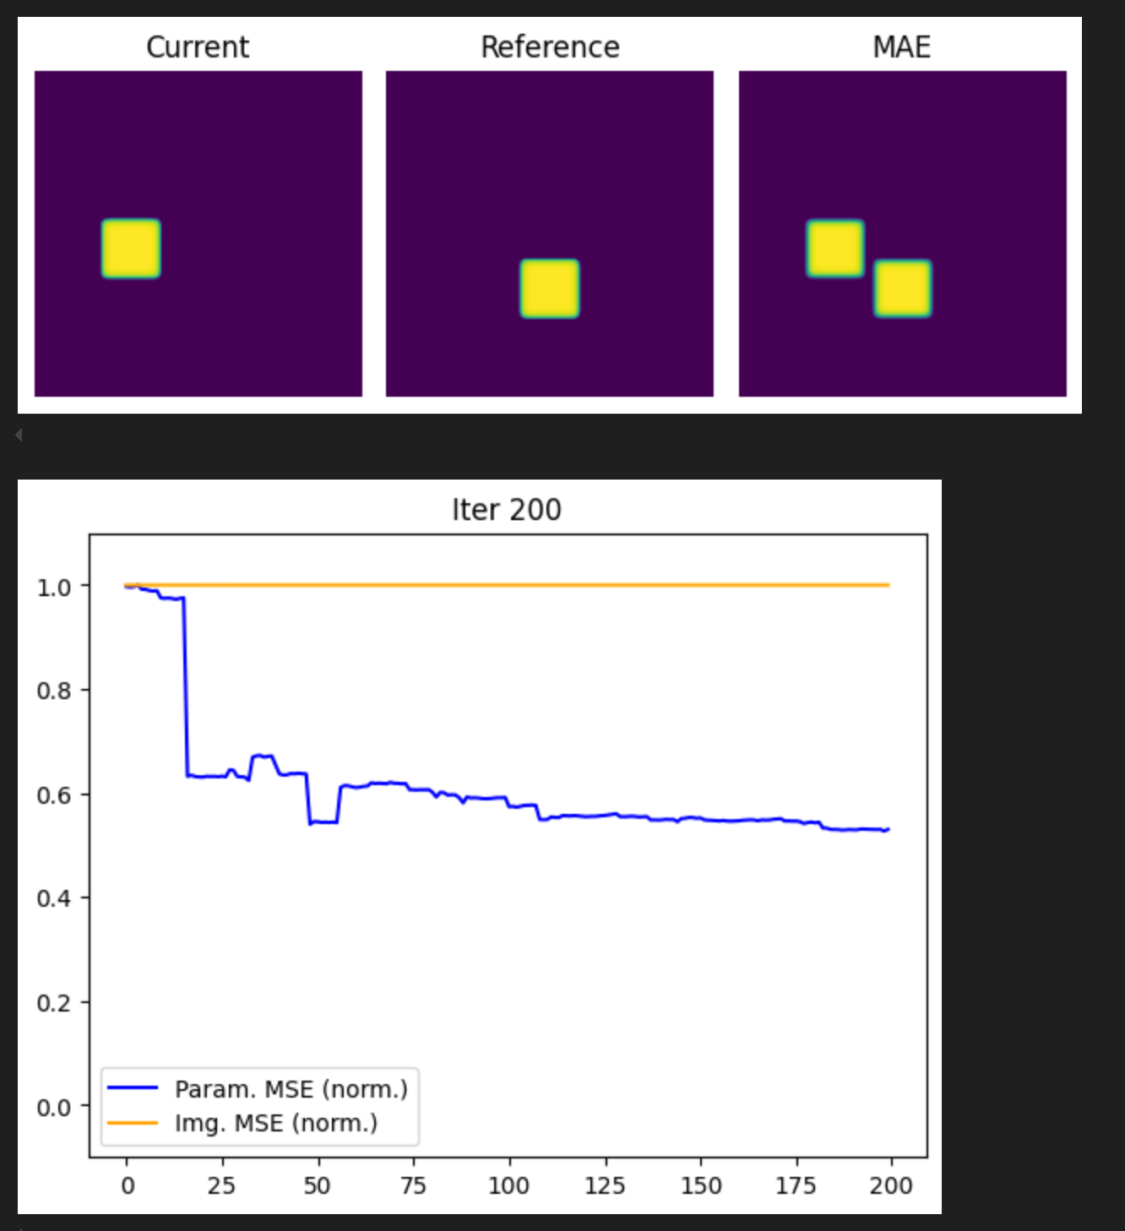
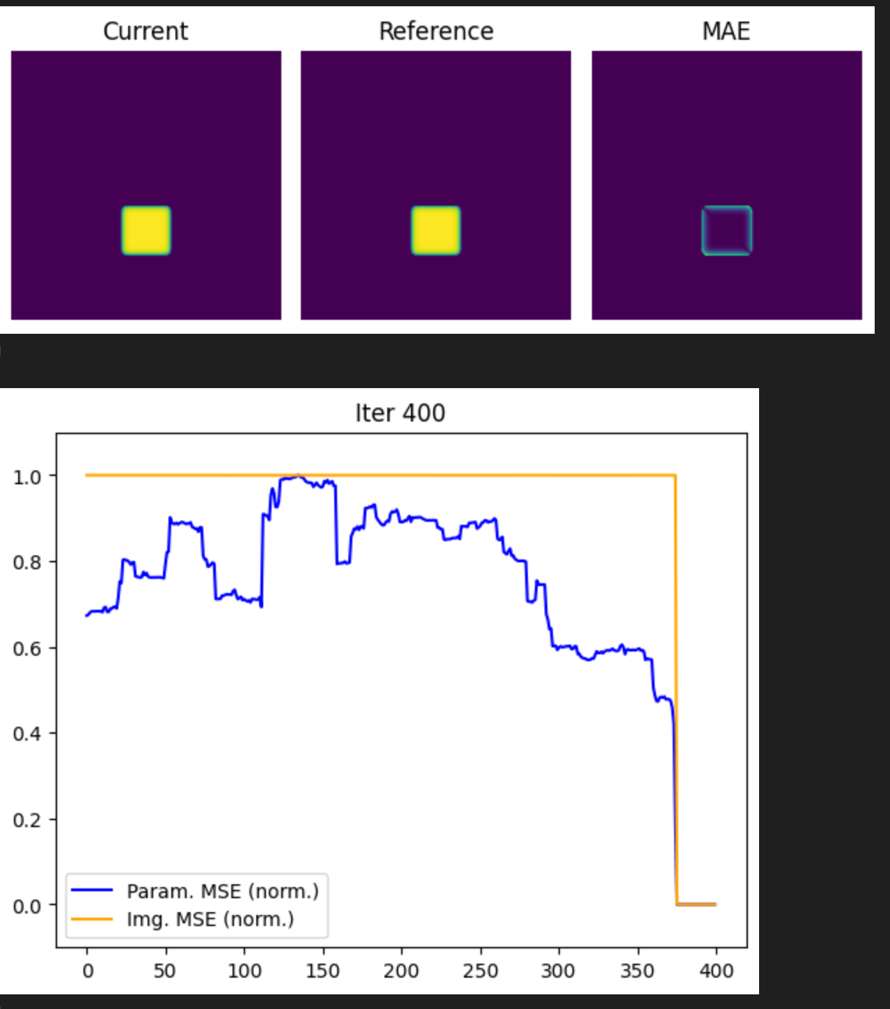
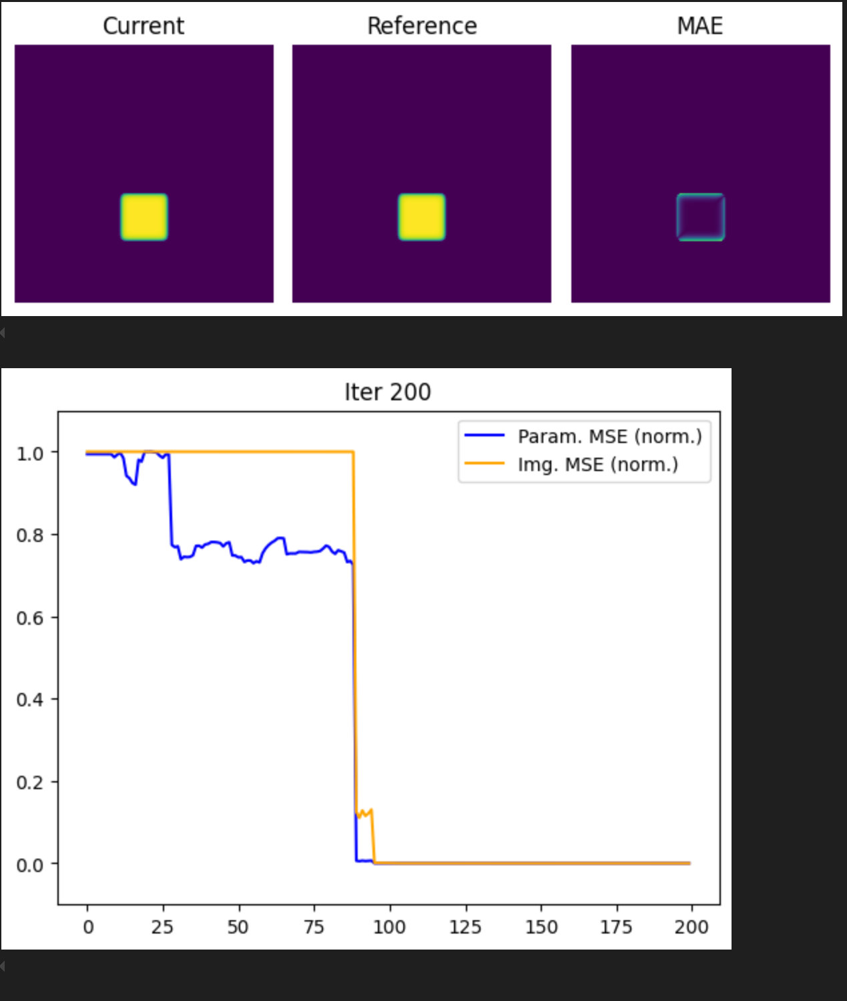
Different starting points

