Slide 1

Research Paper
Transfer Learning for Meta-analysis
Under Covariate Shift
Placebo-anchored proxy-gold learning for target-specific treatment effects
Zilong Wang, Ali Abdeen, Turgay Ayer | Georgia Institute of Technology
0:00-0:30

Slide 2
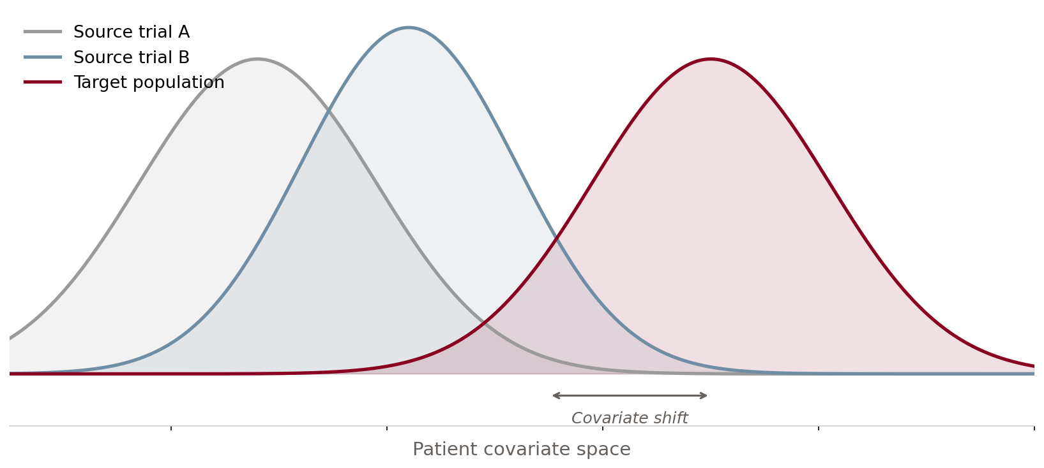
Clinical trial evidence rarely lands in the target population
The decision target is patient-level and local; the available evidence is multi-site and shifted.
01
02
03
Different enrolled patients
Different baseline risk
Patient-level decisions
RCT sites can differ by eligibility, geography, baseline risk, and case mix. Pooling can estimate the wrong population.
A shared comparator is not automatically exchangeable once covariates and residual risk drift across studies.
Decision makers need CATEs, targeting, regret, and calibration - not only a network-wide average effect.
0:31-1:45
IEEE ICHI 2026
Minneapolis, MN • June 1–3, 2026

Slide 3
The gap: standard transport needs conditions the target lacks
The hard case is weakly connected or disconnected target evidence under covariate shift.
Common assumption
Failure mode in this talk
Network connectivity
Disconnected target
Target trial connects through a shared comparator arm.
Target may have placebo only for the treatment of interest.
Comparator exchangeability
Residual baseline drift
Placebo arms are comparable after measured adjustment.
Measured shift plus site-specific risk makes direct transfer biased.
Average effect is enough
Individualized decisions
NMA or transport reports a marginal target estimand.
The task is calibrated patient-level CATE and targeting.
1:45-3:00
IEEE ICHI 2026
Minneapolis, MN • June 1–3, 2026

Slide 4
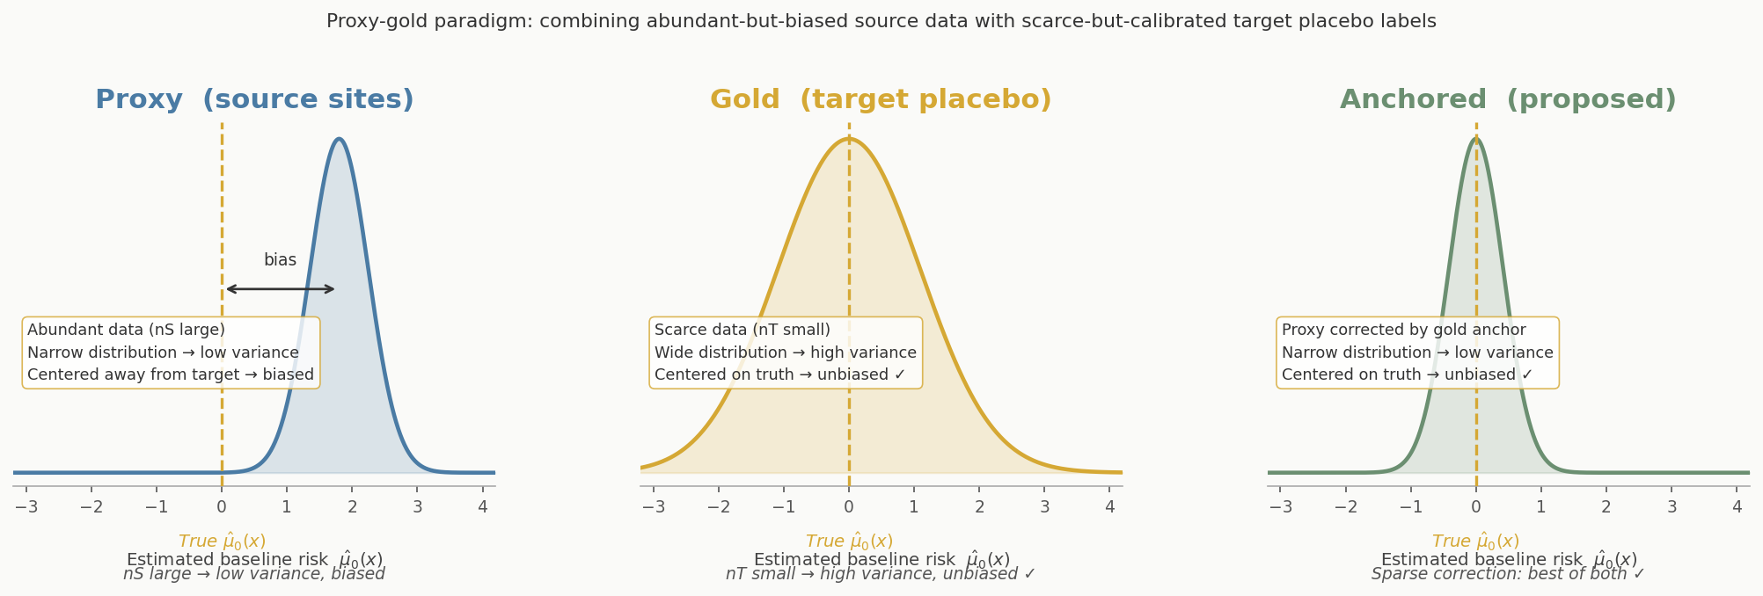
Core idea: target placebo is the gold calibration signal
Source data is abundant but miscalibrated for the target; target placebo is scarce but perfectly calibrated — sparse correction bridges the two.
3:00-4:15
IEEE ICHI 2026
Minneapolis, MN • June 1–3, 2026

Slide 5




Estimator pipeline: anchor first, orthogonalize second
Two layers do the work: sparse baseline anchoring first, then doubly robust CATE learning.
1 Source proxy
2 Target anchor
3 Sparse correction
4 DR learner
->
->
->
Fit source outcome models from abundant source IPD.
Target placebo outcomes provide gold residual labels.
Debias target baseline risk with a low-complexity correction.
Fit τ̂(x) = E[ψ | x] for targeting and regret.
Bastani/Tian-Feng supply the sparse anchor; Kennedy supplies the orthogonal DR learner.

Slide 6
Estimator pipeline — equations from §3
(candidate 5b)
01
Fit source models
K source RCTs via glmtrans. e(x) known by design (A2).
μ̂₀⁺ (x), μ̂₁⁺ (x) k=1,…,K § 3.1
02
Anchor baseline
LASSO on target placebo residuals; corrects bias.
δ̂ → μ̂₀ᵃⁿᶜʰᵒʳ § 3.2 Eq. (4)
03
Build pseudo-outcomes
DR pseudo-outcome ψᵢ; cross-fitting (Proposed-CF).
ψᵢ (Kennedy 2023) Eq. (5)
04
Estimate CATE
τ̂(x) = argmin Σᵢ (ψᵢ − f(Xᵢ))²
Regress ψᵢ on covariates. Thm 1: n₀⁻½ rate (connected).
f ∈ {random forest, lasso, …}
τ̂(x) Thm. 1, 2 § 3.3
4:15–6:00 [5b]
IEEE ICHI 2026
Minneapolis, MN • June 1–3, 2026

Slide 7


Two target regimes, two interpretations
Connected target
Disconnected target
Key distinction
Connected target
Connected target
Disconnected target
Disconnected target
Key distinction
Key distinction
Target has treated and placebo outcomes. The estimator targets an identified target-site CATE and admits a Neyman-orthogonal expansion.
Target has placebo only. The output is a screen-then-transport working-model estimate under explicit A6 transport assumptions.
Theorem 1 gives √n₀ guarantees on an identified estimand. Theorem 2 decomposes error into estimation + structural transport bias ε_τ. These are not interchangeable — label them separately.
Target has treated and placebo outcomes.
Claim: identified target-site CATE.
Guarantee: Theorem 1 gives a Neyman-orthogonal expansion:
Target has treated and placebo outcomes.
Claim: identified target-site CATE.
Guarantee: Theorem 1 gives a Neyman-orthogonal expansion:
Target has placebo outcomes only.
Claim: screen-then-transport working-model estimate.
Guarantee: Theorem 2 separates error sources:
Target has placebo outcomes only.
Claim: screen-then-transport working-model estimate.
Guarantee: Theorem 2 separates error sources:
These are different claims.
Connected = identified CATE.
Disconnected = useful ranking and scenario analysis under explicit A6 transport assumptions.
These are different claims.
Connected = identified CATE.
Disconnected = useful ranking and scenario analysis under explicit A6 transport assumptions.
6:01-7:15
6:01-7:15
6:01-7:15
IEEE ICHI 2026
Minneapolis, MN • June 1–3, 2026

Slide 8
Evaluation setup
Evaluation spans scarce target evidence, covariate shift, and two target-data regimes.
REGIMES
COMPARATORS
METRICS
Two target settings
What transfer is compared against
What counts as success
Connected: target has treated and placebo outcomes.
Disconnected: target has placebo only, so treated effects are transported under A6.
TargetOnly tests no transfer.
ProxyOnly tests source transfer without anchoring.
AnchorOnly isolates target-placebo correction.
Transport baselines test weighting/outcome-model transfer.
Accuracy: PEHE and ATE error.
Targeting: Spearman and policy regret.
Trust: CATE calibration slope, R2, and ECE.
Anchoring, source scaling, and disconnected transport are evaluated separately.
7:15-8:30

Slide 9
Connected targets: transfer helps when labels are scarce
In connected targets, target-placebo anchoring helps most when target labels are scarce and p is large.
PEHE at target budget m0=150, m1=100 (lower is better)
p=20
TargetOnly
2.60
TAKEAWAY
Proposed-CF
0.50
This is the deployment case
The method is not just better on average. Its biggest gains appear where target IPD is expensive: small target trial, high dimension, shifted sources.
p=50
TargetOnly
4.75
Proposed
0.73
p=100
TargetOnly
7.57
Proposed
1.71
8:30-10:00

Slide 10
Why the method helps: anchor, then learn CATEs
The gain is not generic pooling; it comes from anchoring source models to target placebo and then learning CATEs.
TargetOnly
ProxyOnly
AnchorOnly
Proposed / Proposed-CF
no transfer
transfer without anchor
target placebo correction
anchor + DR learner
High variance when target treated labels are scarce.
Low variance but biased under covariate shift.
Shows the baseline calibration contribution.
Adds orthogonal CATE learning and calibration.
Average ranks summarize the pattern after the finite-sample gain is visible.
10:00-11:15

Slide 11
Robustness: source diversity helps; violations degrade smoothly
The method scales with source diversity and degrades smoothly when the sparse-shift approximation weakens.
SOURCE SCALING
A5 SENSITIVITY
LIMIT
More source sites help when target data are scarce
Violations hurt, but not catastrophically
Sparse proxy-gold shifts matter
Across C=2 to 50 source sites, Proposed stays around PEHE 0.84 -> 0.66 at m0=150, m1=100, while TargetOnly remains near 5.
The useful signal is source diversity plus target anchoring.
When sparse linear shift holds, Proposed-CF is about 0.38 PEHE.
As sparsity and nonlinearity increase, PEHE rises gradually rather than collapsing.
The strongest gains occur in the intended sparse proxy-gold regime.
Dense or highly nonlinear corrections reduce performance.
11:15-12:30

Slide 12
IHDP benchmark: real covariate shift tells the same story
Real covariate shift tells the same story, while disconnected targets must stay labeled as transport.
CONNECTED IHDP
DISCONNECTED IHDP
Proposed is strongest under real covariate shift
Useful ranking, not target identification
IHDP uses real baseline covariates and semi-synthetic outcomes.
Example at m0=25, m1=100:
Proposed PEHE 1.57 vs OM-Transport 2.05 vs TargetOnly 3.09.
With m1=0, Proposed-B is competitive on PEHE and strong on ranking.
Example at m0=25:
Proposed-B PEHE 2.11 vs transport/proxy baselines 2.28-2.82.
Assumption: A6 transport.
Connected estimates identified CATEs; disconnected analyses are transport-based.
12:30-13:45

Slide 13

Takeaways
Questions?
Zilong Wang
Georgia Institute of Technology
zwang937@gatech.edu
Anchor to target placebo.
Separate identified from
transported claims.
Evaluate decisions, not only error.
13:46-15:00
13:46-15:00
13:46-15:00

