Slide 1

Research Paper
Transfer Learning for Meta-analysis
Under Covariate Shift
Placebo-anchored proxy-gold learning for target-specific treatment effects
Zilong Wang, Ali Abdeen, Turgay Ayer | Georgia Institute of Technology
0:00-0:30

Slide 2
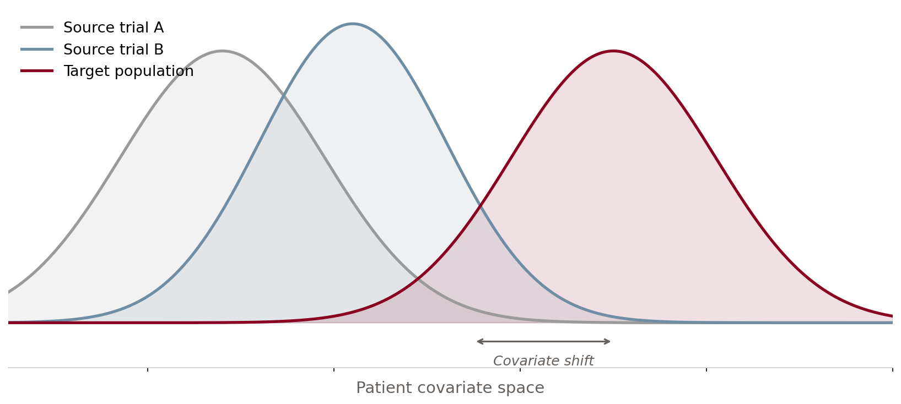
Clinical trial evidence rarely lands in the target population
The decision target is patient-level and local; the available evidence is multi-site and shifted.
01
02
03
Different enrolled patients
Different baseline risk
Patient-level decisions
RCT sites can differ by eligibility, geography, baseline risk, and case mix. Pooling can estimate the wrong population.
A shared comparator is not automatically exchangeable once covariates and residual risk drift across studies.
Decision makers need CATEs, targeting, regret, and calibration - not only a network-wide average effect.
0:31-1:45
IEEE ICHI 2026
Minneapolis, MN • June 1–3, 2026

Slide 3
The gap: standard transport needs conditions the target lacks
The hard case is weakly connected or disconnected target evidence under covariate shift.
Common assumption
Failure mode in this talk
Network connectivity
Disconnected target
Target trial connects through a shared comparator arm.
Target may have placebo only for the treatment of interest.
Comparator exchangeability
Residual baseline drift
Placebo arms are comparable after measured adjustment.
Measured shift plus site-specific risk makes direct transfer biased.
Average effect is enough
Individualized decisions
NMA or transport reports a marginal target estimand.
The task is calibrated patient-level CATE and targeting.
1:45-3:00
IEEE ICHI 2026
Minneapolis, MN • June 1–3, 2026

Slide 4
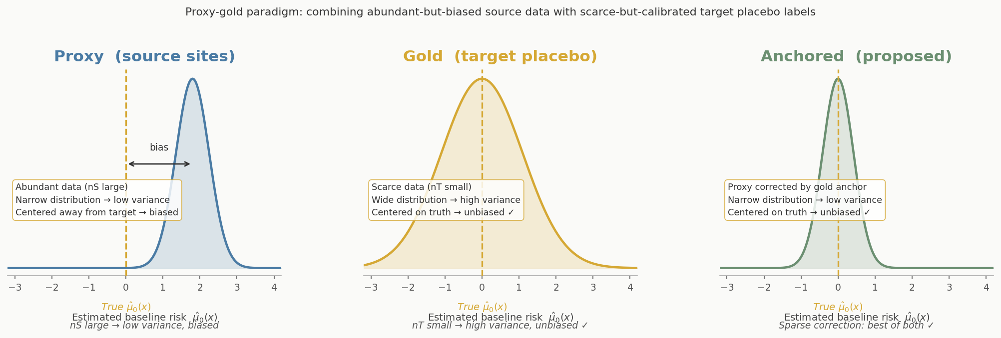
Core idea: target placebo is the gold calibration signal
Source data is abundant but miscalibrated for the target; target placebo is scarce but perfectly calibrated — sparse correction bridges the two.
3:00-4:15
IEEE ICHI 2026
Minneapolis, MN • June 1–3, 2026

Slide 5
Estimator pipeline: anchor first, orthogonalize second
01
02
03
04
Fit source models
Anchor baseline
Build pseudo-outcomes
Estimate CATE
Learn mu0 and mu1 from source IPD; randomized propensities are known.
Use target placebo gold labels to correct target baseline risk.
Form DR pseudo-outcomes with cross-fitting when target treated data exist.
Predict tau(x), evaluate ranking, calibration, and treatment policy regret.
4:15-6:00
IEEE ICHI 2026
Minneapolis, MN • June 1–3, 2026

Slide 6
Two target regimes, two interpretations
Connected target
Disconnected target
Key distinction
Target has treated and placebo outcomes. The estimator targets an identified target-site CATE and admits a Neyman-orthogonal expansion.
Target has placebo only. The output is a screen-then-transport working-model estimate under explicit A6 transport assumptions.
Theorem 1 gives √n₀ guarantees on an identified estimand. Theorem 2 decomposes error into estimation + structural transport bias ε_τ. These are not interchangeable — label them separately.
6:01-7:15
IEEE ICHI 2026
Minneapolis, MN • June 1–3, 2026

Slide 7
Evaluation: accuracy, targeting, regret, and calibration
01
02
03
04
Synthetic RCTs
Ablations
Stress tests
IHDP benchmark
Controlled covariate shift, known potential outcomes, 100 Monte Carlo replicates.
Compare TargetOnly, ProxyOnly, AnchorOnly, transport baselines, Proposed variants.
Sweep target budget, dimension, number of sources, sparsity, and nonlinearity.
Real covariate distributions with semi-synthetic outcomes over 50 realizations.
7:15-8:30
IEEE ICHI 2026
Minneapolis, MN • June 1–3, 2026

Slide 8
Synthetic summary: proposed methods dominate the ranking table
Across synthetic sweeps, Proposed is rank 1 on PEHE, ATE, Spearman, and regret; Proposed-CF leads calibration.
Average rank across performance metrics (lower is better)
Proposed
1.3
Proposed avg rank
Proposed-CF
1.8
1.3
Proposed-B†
3.3
PEHE/ATE/rank/regret
OM-Transport
4.2
IPW-Transport
5.0
Proposed-CF
1.3
TargetOnly
6.0
ECE rank (calibration)
ProxyOnly
8.5
† AnchorOnly (avg rank ≈6.5, ablation) and EntropyBal (≈5.5) omitted for space — full 9-method comparison in Table I
8:30-10:00
IEEE ICHI 2026
Minneapolis, MN • June 1–3, 2026

Slide 9
Small target samples are where transfer pays off
When p is large and target labels are scarce, target-only learning deteriorates while anchored transfer stays usable.
p=100, target 150/100
p=50, target 150/100
p=20, target 150/100
7.57 -> 1.71
4.75 -> 0.73
2.60 -> 0.50
TargetOnly PEHE to Proposed
TargetOnly PEHE to Proposed
TargetOnly PEHE to Proposed-CF
10:00-11:15
IEEE ICHI 2026
Minneapolis, MN • June 1–3, 2026

Slide 10
Disconnected targets: useful, but label the assumption
With m1=0, Proposed-B is best or near-best on PEHE, but the estimand is transported rather than identified.
Disconnected PEHE, target placebo only (m0=50)
ProxyOnly
A6
Proposed-B
Screen-then-transport
Use target placebo to detect compatible sources, then transport source CATEs. This supports scenario analysis, not nonparametric identification.
p=10
p=20
p=50
p=100
11:15-12:30
IEEE ICHI 2026
Minneapolis, MN • June 1–3, 2026

Slide 11
IHDP benchmark: real covariate shift tells the same story
On real IHDP covariates with known counterfactuals, the method remains best or competitive across connected and disconnected regimes.
Connected
Disconnected
Proposed is best in 9/9 PEHE cells
Lowest PEHE at all placebo budgets
Example: at m0=25, m1=100, PEHE is 1.57 for Proposed vs 2.05 for OM-Transport and 3.09 for TargetOnly.
At m0=25, PEHE is 2.11 for Proposed-B vs 2.28-2.82 for transport/proxy baselines. Interpret under the working transport condition.
12:30-13:45
IEEE ICHI 2026
Minneapolis, MN • June 1–3, 2026

Slide 12

Takeaways
Questions?
Zilong Wang
Georgia Institute of Technology
zwang937@gatech.edu
Anchor to the target placebo arm.
Separate identified from transported claims.
Evaluate decisions, not only error.
13:46-15:00

