Slide 1
House Price Predication
—— Zining Wang, Wenxuan Wang and Wenda Zheng

Slide 2
Motivation and objective
Everyone has a dream house in mind!
Tradeoffs between certain criteria and house prices
Avoid over-estimated house
How to predict the actual value of the house
Convenient without field investigation

Slide 3
Goal: Predicting House price according to different conditions.

Slide 4
Data Description
79 house attributes
include structural attributes (e.g. the area of first floor), location attributes (e.g. whether the house is adjacent to railroads), and some overall quality ratings.
Training data & Testing data

Slide 5
Data preprocessing
Discard attributes that have lots of missing values
Adjust house price based on CPI index, choose Dec.2010 as base year

Slide 6
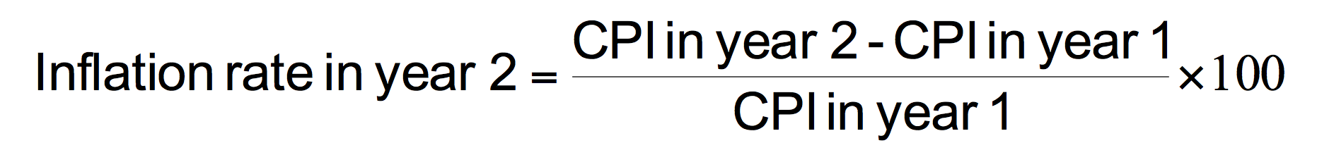
• Consumer price index (CPI)
– Measure of the overall level of prices
– Measure of the overall cost of goods and services
– Bought by a typical consumer

Slide 7
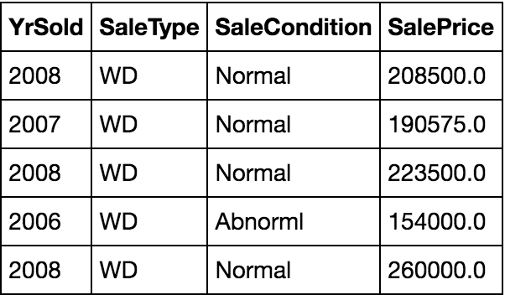
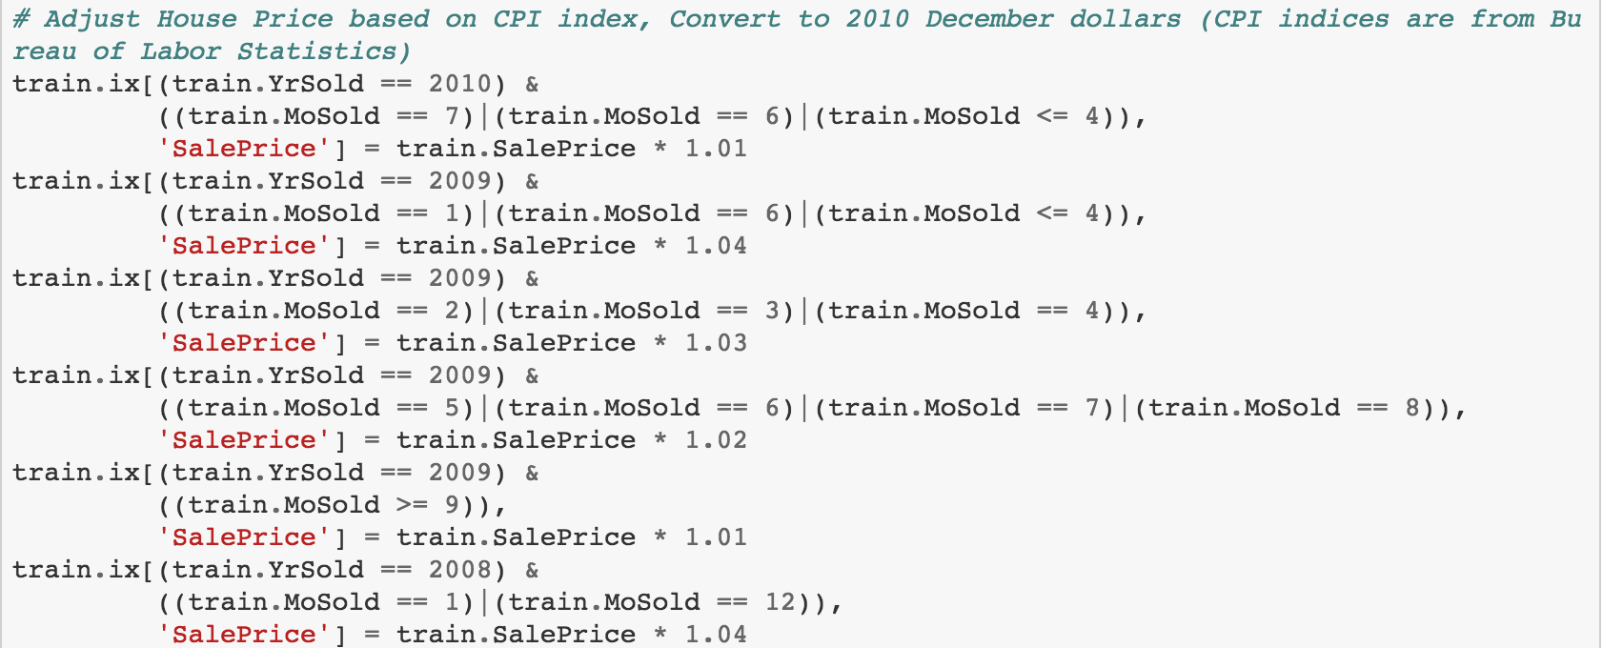
Adjusting price based on CPI Index

Slide 8
Data preprocessing (Other Techniques)
int to string
NA to another kind
NA to 0.0
Mean/Mode imputation
Drop
...

Slide 9
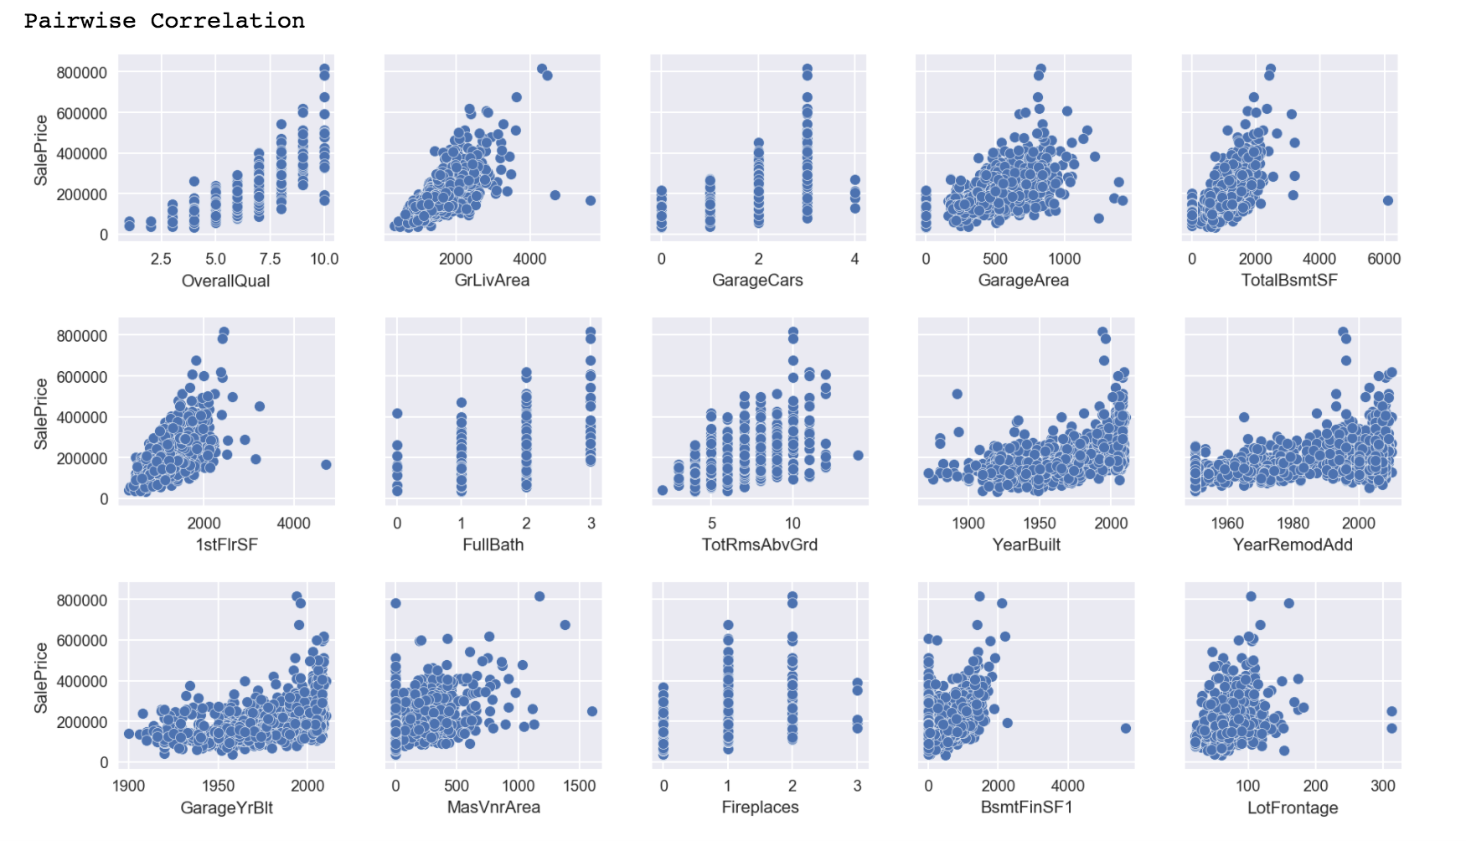
9

Slide 10
XGBoost (Extreme Gradient Boosting)
based on the boosting tree model
Uses gradient descent and boosting method to overcome incorrectly classified subsets over each iteration, until some stopping criterion is met
Existing Python packages for XGBoost

Slide 12
Result of every single step

Slide 13
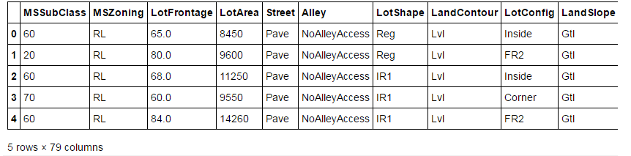
First 5 rows of input after cleaning

Slide 14
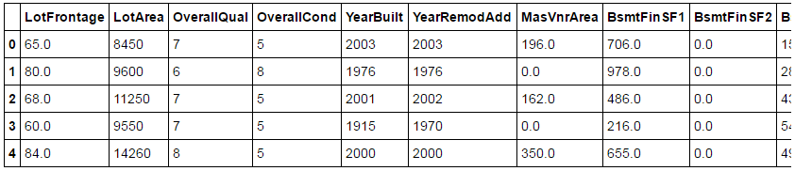
Replacing Dummy Variables

Slide 15
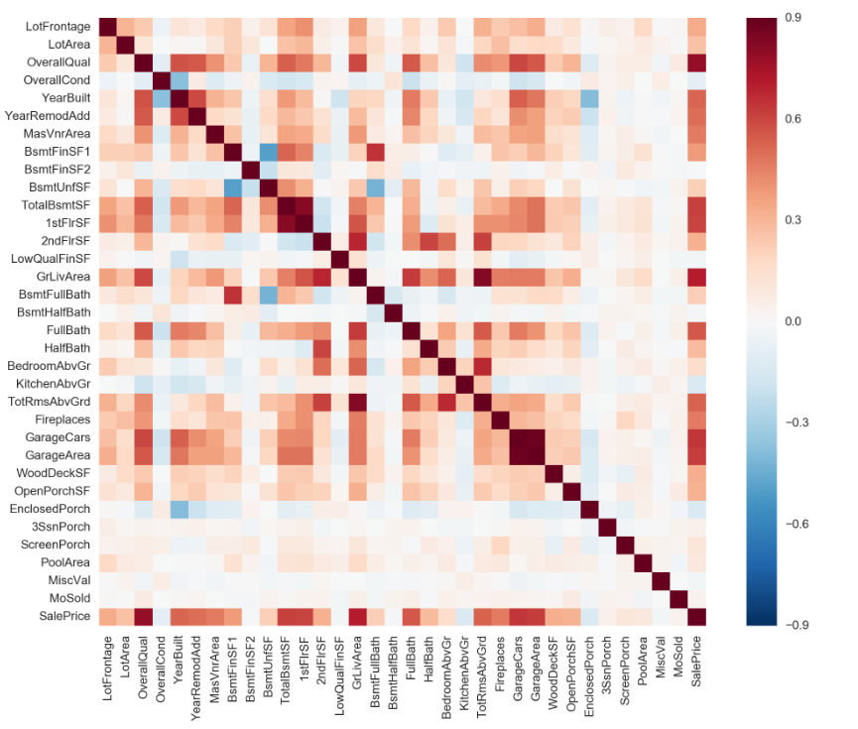
Correlation Heatmap

Slide 16
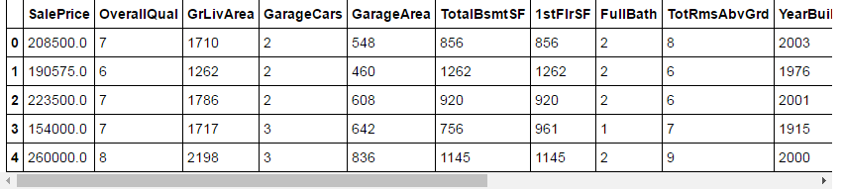
Fifteen most important attributes

Slide 17
Related work and method
Regularized linear regression
XGBoost (Extreme Gradient Boosting)

Slide 18
Regularized Linear Regression
In our dataset, 79 house attributes are used as independent variables, and house sales price is the dependent variable.
Served as the baseline model for our project
Adding a regularized term to control the complexity of the regression model. E.g. Ridge or Lasso regularization

Slide 19
Future work

Slide 20
Thank you!!

