Slide 1
13mm
9mm
10.5mm
12mm
8mm
11mm
B GND A
2mm
POWER
5.8mm
D=7mm
26mm
13mm
13mm
3mm
3.5mm
3mm
LED
REMOTE
LED
5.8mm
D=2mm
D=2mm

Slide 2
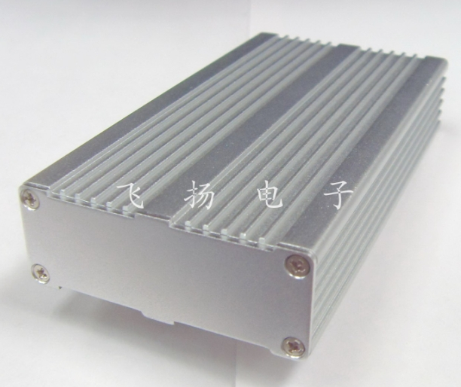

Slide 3
