Slide 1
DAOmap: a depth-optimal area optimization mapping algorithm for FPGA designs
Wan Haochuan

Slide 2
Introduction
There are four categories of technology mapping algorithms for LUT-based FPGA designs:
Area Minimization. These algorithms include Chortle-crf, MIS-pga, XMap, VisMap, TechMap, and Praetor. It is an NP-hard problem to solve for general circuits as DAG's (directed acyclic graphs).
Delay Minimization. These algorithms include Chortle-d, MIS-pga-delay, TechMap-L, DAG-map, FlowMap, EdgeMap, and Seq. MapII. FlowMap is the first algorithm to guarantee a depth-optimal mapping solution in polynomial time under the unit delay model. EdgeMap presents a non-trivial generalization of FlowMap and achieves optimal delay using the general delay model, where each interconnection edge has a weight representing the delay of the interconnection.
Power Minimization. These algorithms include mapping algorithms in and, PowerMap, PowerMinMap, Emap, and DVrnap. Min-power mapping is also a NP-hard problem to solve.
Delay and Area Minimization. The algorithms in this category are particularly interesting because they minimize both delay and area of the FPGA design. The major works include FlowMap-r and CutMap, where no logic resynthesis/restructuring is performed. Other works, such as BoolMap, FlowSYN and the work in, consider logic resynthesis during mapping.

Slide 3
DAOmap
DAOmap is Depth-optimal Area Optimization of FPGA designs.
Methods:
Adopt a cut-enumeration-based method that consists of cut generation and cut selection.
Cut generation traverses the network from primary inputs (PIs) to primary outputs (POs), and combines subcuts on the fanin nodes of the target node to generate all the cuts on the target node (each cut represents one possible LUT implementation rooted on the target node).
After all the cuts are generated, traverse the network from POs to PIs and select cuts to produce the LUT mapping result.
Difficults:
A binate-covering algorithm will give an optimal solution but with exponential complexity. To design effective heuristics to select cuts, have to consider the global view of the area optimization because early selections of cuts will have a strong impact on the future selections of cuts during the traversal from POs to PIs.
Through the mapping procedure, node duplication cannot be avoided if the optimal mapping depth is to be guaranteed. Actually, how to handle the different duplication scenarios makes the min-area FPGA mapping problem NP-hard.

Slide 4
DAOmap
DAOmap is Depth-optimal Area Optimization of FPGA designs.
Solutions:
Consider the potential duplications during the cut generation procedure so the mapping solutions encoded in the cuts consider duplication costs. This will help the cut selection procedure to make the right decisions to cover the circuit with less node duplications from a global optimization point of view.
After the timing constraint is determined (the longest optimal mapping delay of the network), relax the non-critical paths by searching the solution space considering both local and global optimality information to minimize the mapping area.
Carry out an iterative cut selection procedure that further explores and perturbs the solution space to improve solution quality.

Slide 5
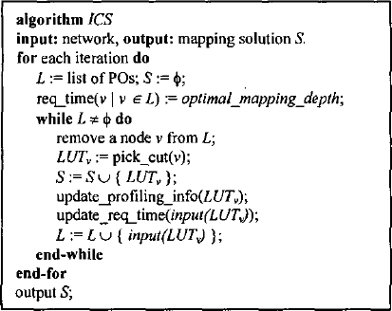
Algorithm description
This paper designed an iterative cut selection process, which generates the final mapping result based on previous cut selection iterations. The previous iteration can be seen as a temporary mapping that provides guidance for the next iteration. This iterative process provides more opportunities to reduce duplication. It is intertwined with local cost adjustment techniques. The left figure provides a high-level description of the algorithm.

Slide 6
Algorithm description
Early iterations will provide summary information for subsequent iterations. The analysis information includes the LUT roots (updated by the list L), which are the LUT root nodes (LUT output) selected for LUTv’s in the mapping solution S of the previous iteration. It also includes a list of nodes that were repeated in the previous iteration. When more than one LUT covers the node, a duplicate node can be found. The analysis information is collected in update_profiling_info. The pick_cut subroutine will use profiling data and some other conditions to update the cost of each cut rooted with v in the current iteration. update_req_time will update the time required for the input node of the selected LUTv by the following formula:
Reqi=MIN (Reqv−1)
i∈input(LUTv) for all v
If Reqi is the necessary time for signal i, it may have multiple fan-out nodes. Before determining the Reqi value, the time Reqv's required for fan-out has been determined according to the topology sequence.

Slide 7
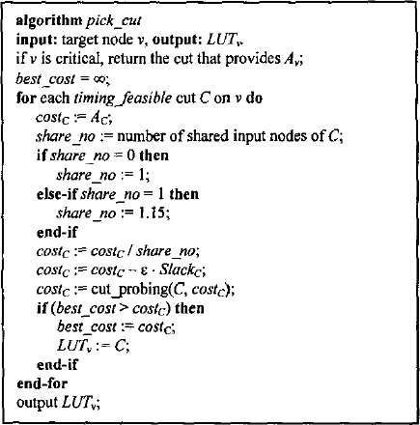
Algorithm description
All local adjustment techniques are implemented in subroutine conversion, and its high-level description is shown in Figure 5. share_no is the number of inputs shared with the C of the existing LUT. The new cost is the old cost divided by the inventory code. When share_no is 1, set it to 1.15 (obtained through empirical research) to calculate the sharing effect. The direct effect of sharing the input with another LUT is that the target cut can ignore part of the input. The division is achieved by weighing the cost savings of each shared input. This is a local operation focused on edge reduction. Use the term ε⋅Slackc to calculate the relaxation distribution effect. The cost adjustment through cutting detection is performed in the subroutine cut_probing.

Slide 8
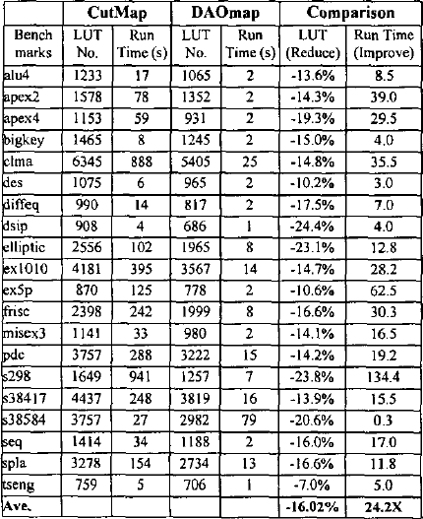
Result
The left table shows that in terms of the number of LUTs, DAOmap is 16.02% better than CutMap on average, and when both use 5-LUT mapping, it runs 24.2 times faster. For DAOmap and CutMap, the mapping depth of each datum is the same, so it is not shown. They also mapped 4-LUT and 6-LUT. Using 4-LUT, the area of DAOmap is increased by 13.98%, and the speed is increased by 13.2 times. Using 6-LUT, the area of DAOmap has increased by 12.44% and the speed has increased by 4.7 times. In this case, since the amount of shear generated by each node is relatively large when K = 6, the runtime reduction is small

Slide 9
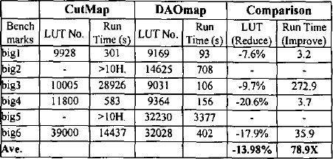
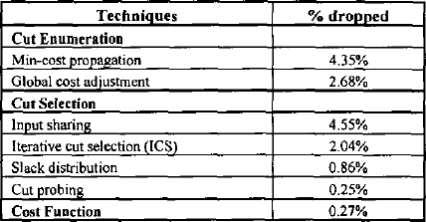
Result
The above table shows the results (the no-x switch of CutMap, neither of which is packaged). For two of these benchmarks, CutMap could not complete the mapping after 10 hours. And can observe that DAOmap always gets better results. In particular, even if the two cases of CutMap delay are not calculated, the improvement in running time is close to two orders of magnitude. This shows the efficiency of the algorithm based on cut enumeration and its good scaling function for millions of FPGA designs.
To show the effectiveness of our mapping algorithm and provide some insights into the most important factors for minimizing area, they conducted experiments to evaluate the various techniques described in this article. The below table shows the results. Remove each technology separately from the mapping process to evaluate how the quality of the result is reduced compared to the process that includes each technology. The larger the percentage drop, the more effective this technique is for reducing the area.

Slide 10
Conclusion
In this article propose a technology mapping algorithm DAOmap for FPGA architecture to minimize chip area under timing constraints. Their method closely monitors various node replication schemes in both the cut enumeration phase and the cut selection phase. They designed a novel heuristic method, taking into account both local and global optimization information in order to accurately capture the mapping cost. Their work framework provides greater flexibility and excellent efficiency for FPGA area optimization, and ensures the best mapping depth under the unit delay model. They have evaluated these novel technologies in a systematic manner and provided insights on the most important factors of technology mapping based on enumerated examples. Experimental results show that DAOmap has produced significant quality and runtime improvements. Compared with the latest depth-optimized area minimization mapping algorithm CutMap, the area of ​​DAOmap has increased by 16.02%. When using 5_LUT to map these two algorithms to FPGA, the average running speed is increased by 24.2 times.

