Slide 1
A 12.1 TOPS/W Quantized Network Acceleration Processor With Effective-Weight-Based Convolution and Error-Compensation-Based Prediction
Huiyu Mo, Wenping Zhu, Wenjing Hu, Qiang Li, Ang Li,
Shouyi Yin, Shaojun Wei and Leibo Liu
Reporter: Wan Haochuan and Li Antong

Slide 2
Contents
Introduction
Main contributions
Effective-Weight-Based convolution
Error-Compensation-Based prediction method
Pipeline for the residual block
Implementation and evaluation
Conclusions

Slide 3
Introduction
Introduction
Main contributions
Effective-Weight-Based convolution
Error-Compensation-Based prediction method
Pipeline for the residual block
Implementation and evaluation
Conclusions

Slide 4
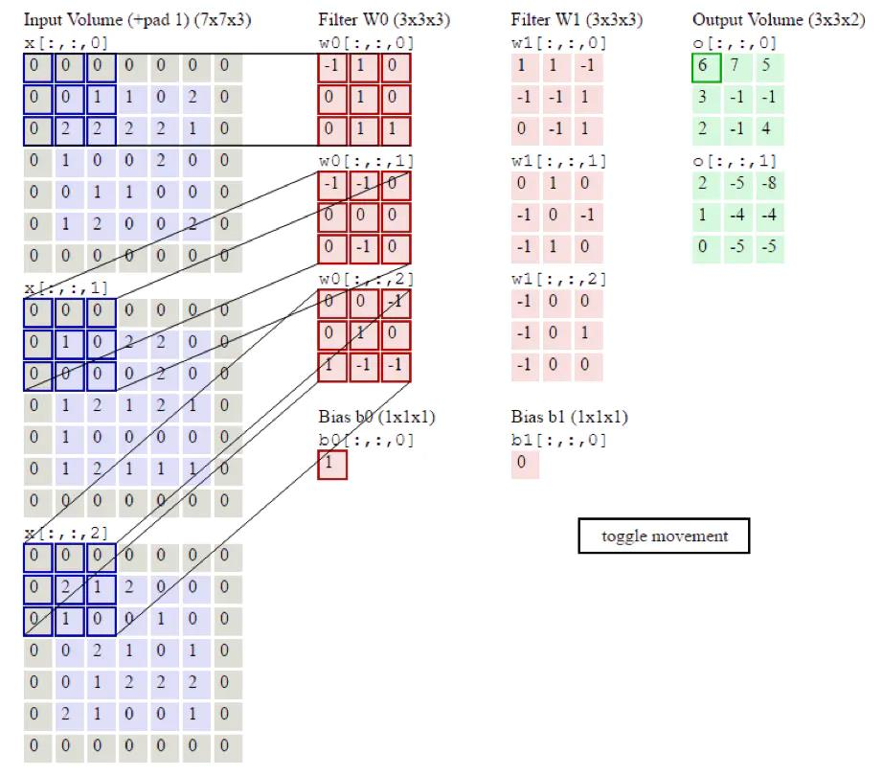
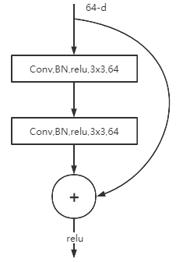
Introduction
CNN operation & residual network

Slide 5
Main contributions
Introduction
Main contributions
Effective-Weight-Based convolution
Error-Compensation-Based prediction method
Pipeline for the residual block
Implementation and evaluation
Conclusions

Slide 6
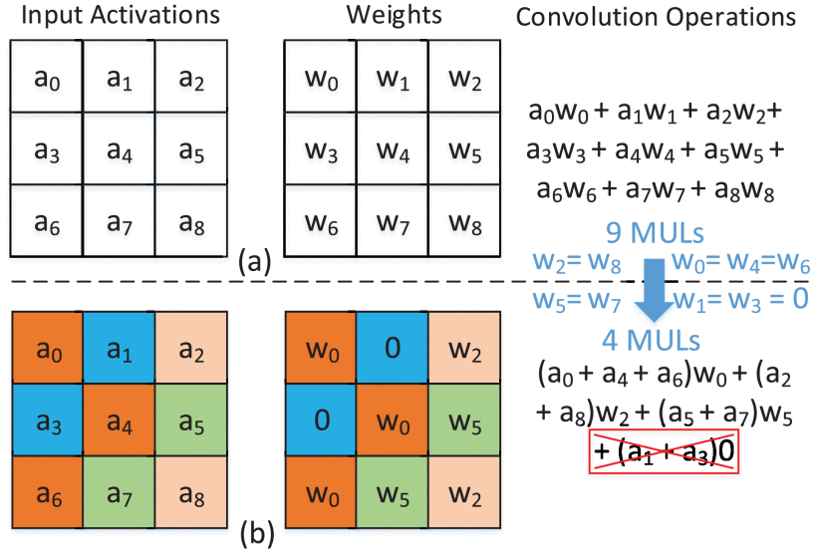
Main contributions
Effective-Weight-Based convolution
EWC is proposed to avoid a large number of multiplications caused by the repetition of quantized weights.

Slide 7
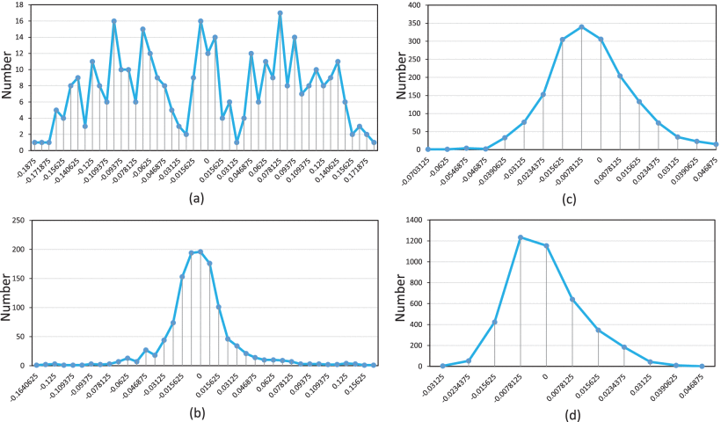
Main contributions
Effective-Weight-Based convolution

Slide 8
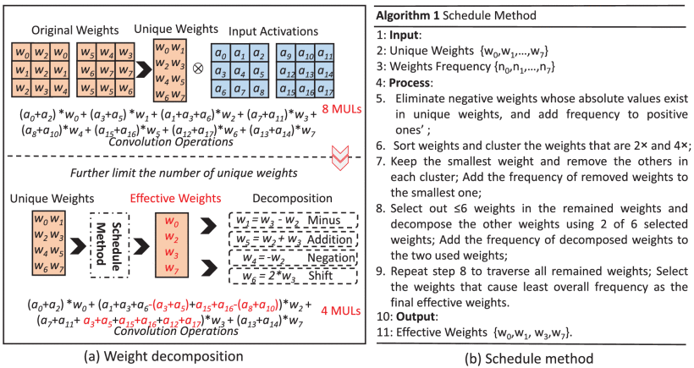
Main contributions
Effective-Weight-Based convolution

Slide 9
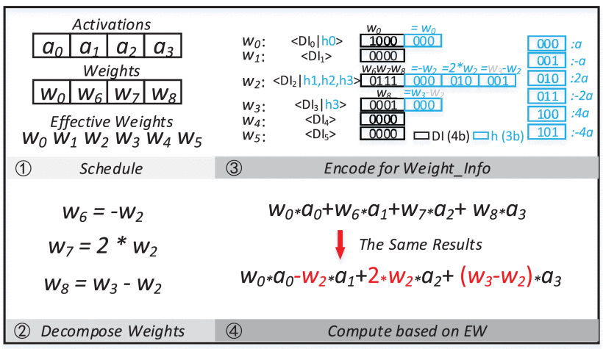
Main contributions
Effective-Weight-Based convolution

Slide 10
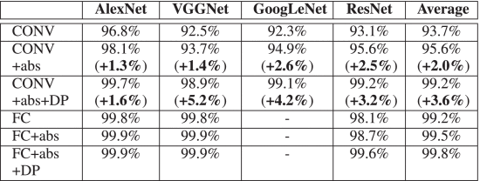
Main contributions
Effective-Weight-Based convolution

Slide 11
Main contributions
Error-Compensation-Based prediction method
ECP is proposed to eliminate unnecessary ILBs CONV operations caused by the ReLU function.
A specific compensation strategy is designed to use values to further accelerate CNN improve hardware utilization with ignorable accuracy loss.

Slide 12
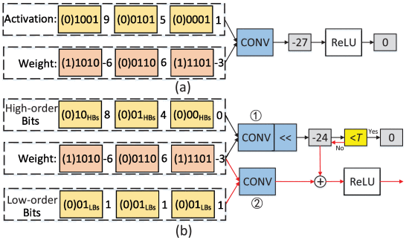
Main contributions
Error-Compensation-Based prediction method

Slide 13
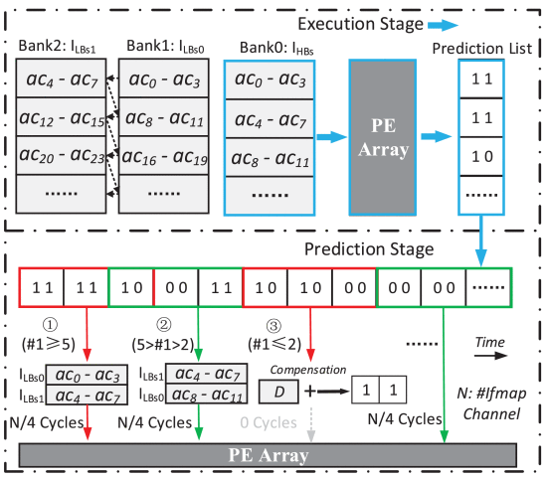
Main contributions
Error-Compensation-Based prediction method

Slide 14

Main contributions
Error-Compensation-Based prediction method

Slide 15
Main contributions
Pipeline for the residual block
The RP model is proposed to support residual blocks with less off-chip memory access, which achieves higher hardware utilization than previous pipeline modes.

Slide 16
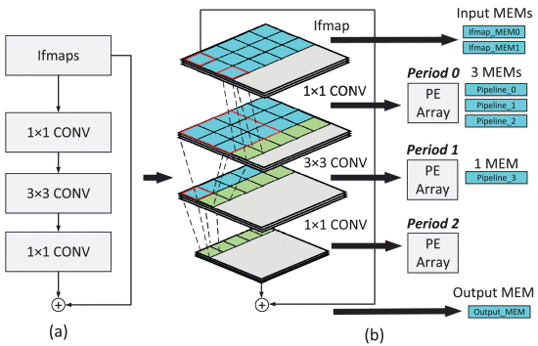
Main contributions
Pipeline for the residual block

Slide 17
Implementation and evaluation
Introduction
Main contributions
Effective-Weight-Based convolution
Error-Compensation-Based prediction method
Pipeline for the residual block
Implementation and evaluation
Conclusions

Slide 18
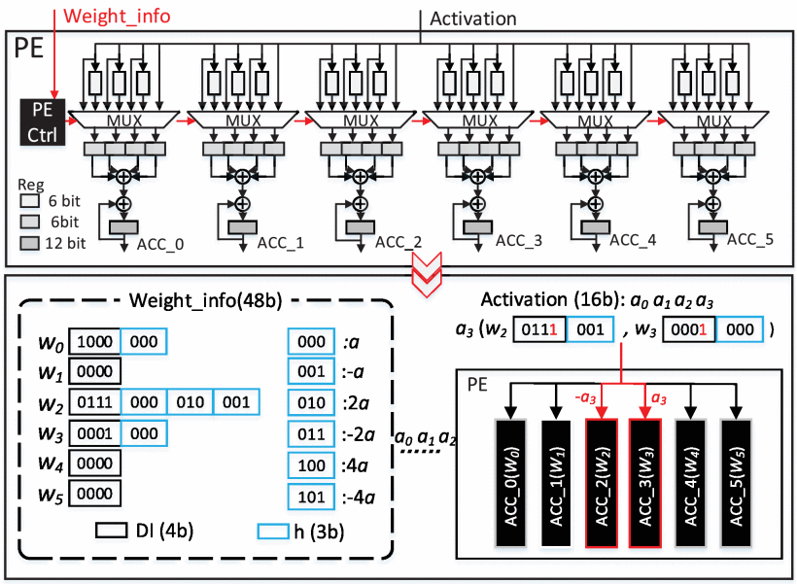
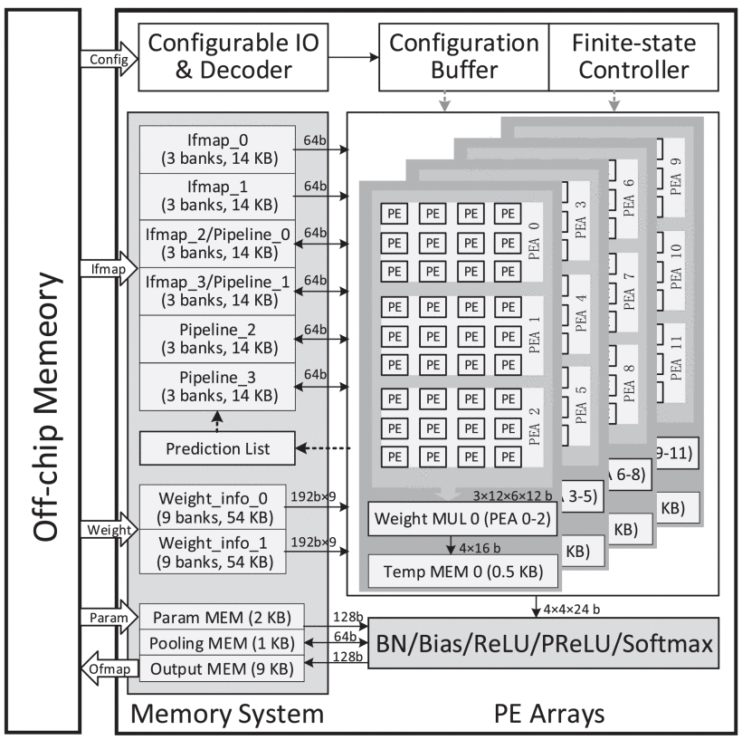
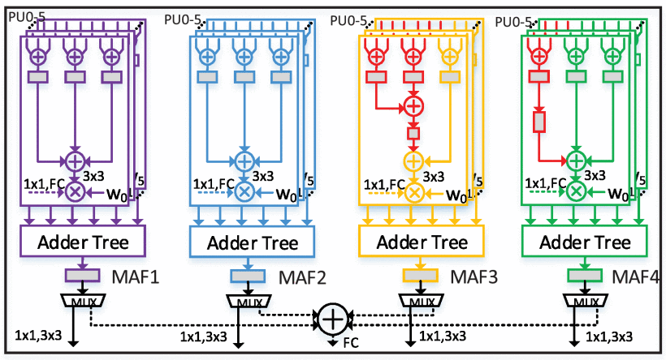
Implementation and evaluation

Slide 19
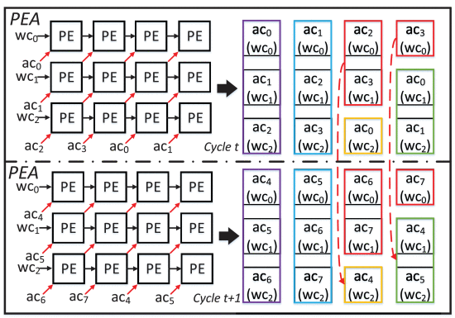
Implementation and evaluation
Row stationary dataflow like Eyeriss

Slide 20
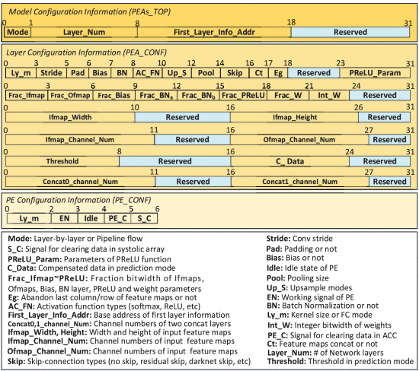
Implementation and evaluation

Slide 21
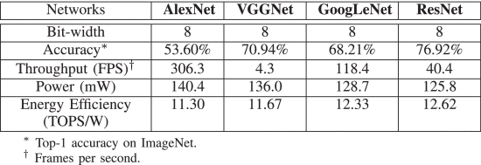
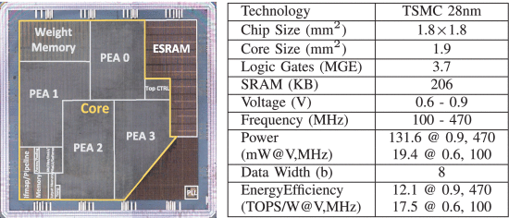
Implementation and evaluation
Notes:
基于TSMC 28 nm工艺，QNAP内核面积为1.9mm2，在电压为0.6~0.9 V，对应工作频率为100-470 MHz条件下，功耗仅为19.4-131.6 mW（如图6所示）。

Slide 22
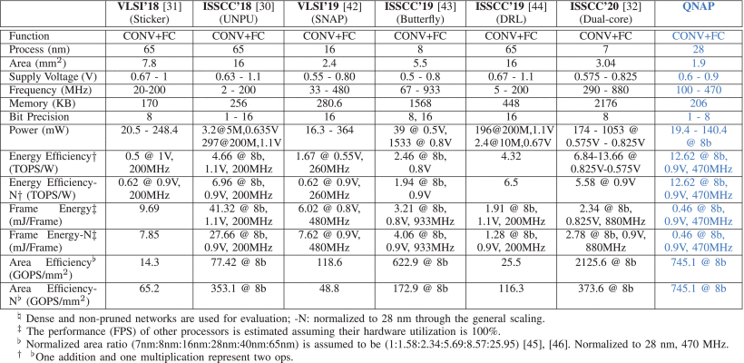
Implementation and evaluation
Notes:
以8 bit量化的AlexNet/VGGNet/GoogLeNet/ResNet作为基准网络，QNAP在470 MHz, 0.9V条件下，实现了12.1 TOPS/W的能效，为当前最优处理器平均性能的3.56倍。

Slide 23
Conclusions
Introduction
Main contributions
Effective-Weight-Based convolution
Error-Compensation-Based prediction method
Pipeline for the residual block
Implementation and evaluation
Conclusions

Slide 24
Conclusions
EWC is proposed to eliminate most of the multiplications caused by repetitive quantized weights with no more than 6 EWs.
ECP is presented to further reduce addition operations by removing the potential redundant operations caused by the ReLU function.
The RP mode is presented to achieve memory-efficient pipelined processing of residual blocks with nearly full hardware utilization.

Slide 25

Thanks

