Slide 1

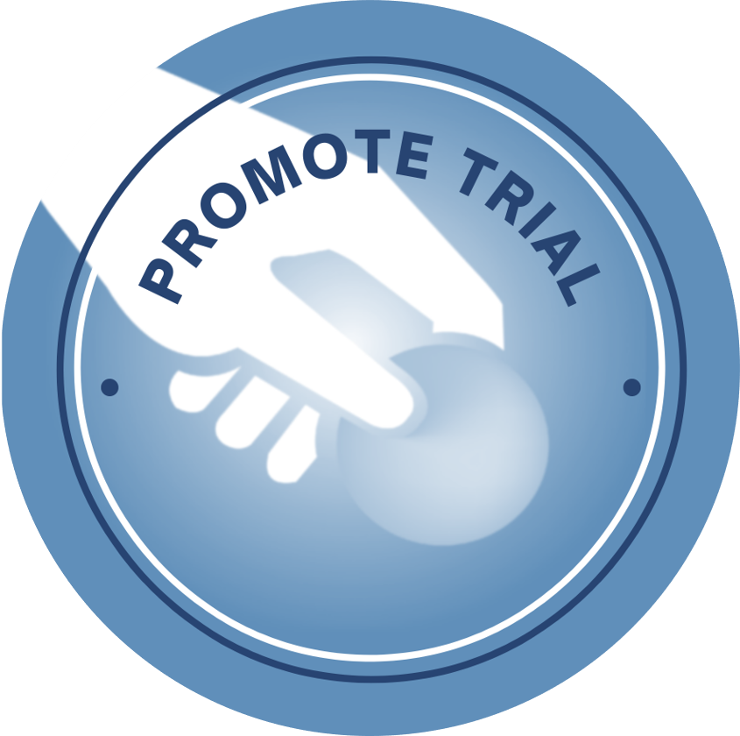
GUIDELINES FOR STROKE MANAGEMENT [Date]
CLINICAL AUDIT RESULTS

Slide 2
Patient 1: [n] indicators Patient 2: [n] indicators

Slide 3
Team Adherence to Audit Criteria

Slide 4
Overall Adherence to date

Slide 5
Focused Discussion:
✓ Things we did well:
✓ Things we will work on together as a team this week:
Notes:
How is the documentation template going? Suggestions for this week?

Slide 6
Chapter 5 of 8: Rehabilitation
AMOUNT OF REHABILITATION
STRONG RECOMMENDATION
For stroke survivors, rehabilitation should be structured to provide as much scheduled therapy (occupational therapy and physiotherapy) as possible (Lohse et al. 2014; Schneider et al. 2016; Veerbeek et al. 2014)
Notes:
SMD 0.39, 95% CI 0.07 to 0.71, I2=66%)). When the experimental group received at least double the amount of therapy time, the effect size increased and statistical heterogeneity decreased (SMD 0.59, 95% CI 0.23 to 0.94, I2=44%).

Slide 7
Chapter 5 of 8: Rehabilitation
AMOUNT OF REHABILITATION
WEAK RECOMMENDATION
A minimum of three hours a day of scheduled therapy (UL and LL) is recommended, ensuring at least two hours of active task practice occurs during this time (Lohse et al. 2014; Schneider et al. 2016) Therefore, if client has UL and LL issues, recommend a minimum of 90minutes per day is dedicated to the UL
Notes:
SMD 0.39, 95% CI 0.07 to 0.71

Slide 8
Chapter 5 of 8: Rehabilitation
AMOUNT OF REHABILITATION
STRONG RECOMMENDATION
For stroke survivors, group circuit class therapy should be used to increase scheduled therapy time (English et al. 2015)
Notes:
Providing therapy in group circuit classes was highly effective at increasing the time (mean difference for total therapy time 22.2 hours, 95% CI 19.1 to 25.3 compared to usual care 5 days a week) (English et al 2014 [37]).

Slide 9
Chapter 5 of 8: Rehabilitation
ARM ACTIVITY
STRONG RECOMMENDATION
For stroke survivors with some active wrist and finger extension, intensive constraint-induced movement therapy (minimum 2 hours of active therapy per day for 2 weeks, plus restraint for at least 6 hours a day) should be provided to improve arm and hand use (Corbetta et al. 2015)
Notes:
Overall there was a moderate effect size (SMD 0.56, 95%CI 0.30 to 0.81; high heterogeneity I²=79.8%). Liu et al (2017)[252] included 16 trials in acute and sub-acute phase. Pooling 6 studies resulted in significant improvement in the Action Research Arm Test (MD 8.35, 95%CI 1.98 to 14.71; extremely high heterogeneity I²=94.1%). Motor Activity Log quality of movement was also significantly higher (MD 0.81, 95%CI 0.33 to 1.29; 4 studies; moderate heterogeniety I²=56.7%).

Slide 10
Chapter 5 of 8: Rehabilitation
WEAKNESS
STRONG RECOMMENDATION
For stroke survivors with reduced strength in their arms or legs, progressive resistance training should be provided to improve strength (Dorsch et al. 2018)
Notes:
The results show that PRT has a large effect on improving strength compared to no intervention or placebo (SMD 0.98 (95% CI 0.67 to 1.29) but the effect on activity was unclear (SMD 0.42, 95% CI –0.08 to 0.91, I² = 54%).

Slide 11
Chapter 5 of 8: Rehabilitation
WEAKNESS
WEAK RECOMMENDATION
For stroke survivors with reduced strength in their arms (particularly for those with less than antigravity strength), electrical stimulation may be used (de Sousa et al. 2018; Nascimento et al. 2014)
Notes:
Very weak participants (8/11 trials) with an effect size of 0.40 (95% CI 0.17 to 0.65)
weak participants (3/11 trials) with an effect size of 0.66 (95% CI 0.21 to 1.11).
When the trials were grouped according to the time after stroke, electrical stimulation increased the strength in sub-acute participants (6/11 trials) with an effect size of 0.55 (95% CI 0.28 to 0.81), while in chronic participants (5/11 trials) the effect size was 0.33 (95% CI −0.02 to 0.69).

Slide 12
Chapter 5 of 8: Rehabilitation
ARM ACTIVITY
WEAK RECOMMENDATION
For stroke survivors with mild to moderate weakness, mirror therapy may be used as an adjunct to routine therapy to improve arm function after stroke (Thieme et al. 2018)
Notes:
Mirror therapy significantly improved arm motor function (SMD 0.46, 95%CI 0.23 to 0.69; 31 studies, n=1048; moderate certainty evidence).

Slide 13
Chapter 5 of 8: Rehabilitation
ARM ACTIVITY
WEAK RECOMMENDATION
For stroke survivors with at least some voluntary movement of the arm and hand, repetitive task-specific training may be used to improve arm and hand function. (French et al. 2016)
Notes:
SMD 0.92, 95% CI 0.58 - 1.26

Slide 14
Chapter 5 of 8: Rehabilitation
ARM ACTIVITY
WEAK RECOMMENDATION
For stroke survivors with mild to severe arm or hand weakness, electrical stimulation in conjunction with motor training may be used to improve upper limb function. (Howlett et al. 2015; Yang et al. 2019 [266])
Notes:
Meta-analysis of upper-limb activity measures showed a large and significant benefit of electrical stimulation in addition to motor training when compared to either no therapy or motor training alone (SMD 0.69, 95% CI 0.33 to 1.05).
Electrical stimulation had moderate to large effects both immediately after treatment and at follow up on arm activity (Action Research Arm Test post treatment SMD 0.70, 95%CI 0.39 to 1.02; 10 studies, n=411; moderate heterogeneity I²=56%). At follow up SMD 0.93, 95%CI 0.34 to 1.52; 8 studies, n=289; high heterogeneity I²=81%). But it appears the included studies were a mix of active and passive approaches.

Slide 15
Chapter 5 of 8: Rehabilitation
ARM ACTIVITY
WEAK RECOMMENDATION
For stroke survivors with mild to moderate weakness of their arm, mental practice in conjunction with active motor training may be used to improve arm function (Barcley-Goddard et al. 2020; Borges et al. 2018).
Notes:
SMD 0.66, 95%CI 0.39 to 0.94.

