Slide 1

Introduction to the Terminal, GitHub, and VSCode
Full stack Skills Bootcamp

Slide 2


Introduction to the Terminal, GitHub, and VSCode
Lesson Overview:
This lesson will introduce us to the terminal, basic terminal commands, GitHub, and how to use GitHub with VSCode.
By the end of the lesson, we will understand how to navigate the file system via the terminal, use GitHub to manage repositories, and integrate GitHub with VSCode for an efficient development workflow.

Slide 3
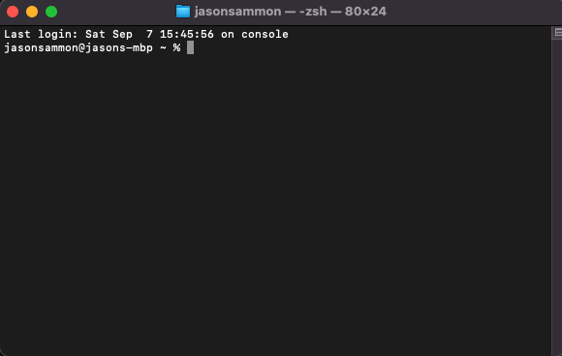
What is the Terminal?
Definition: The terminal is a text-based interface used to interact with the computer’s file system and run commands.
Uses: Navigate directories, create/delete files, run scripts, and control your environment.
Key Point: Understanding the terminal is fundamental to working with version control systems like Git and programming in general.

Slide 4
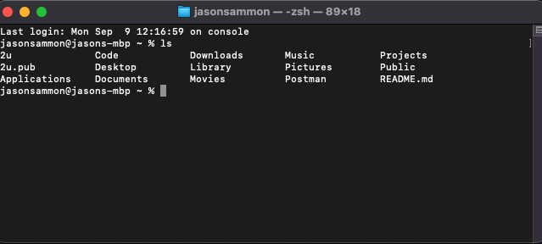
Basic Terminal Commands
ls – Lists files and directories in the current directory. Example: ls
mkdir – Creates a new directory Example: mkdir project-folder
touch – Creates a new, empty file. Example: touch index. Html
cd – Changes the current directory. Example: cd project-folder

Slide 5
Demo of Basic Commands
Live demo of using ls, mkdir, touch, and cd commands.
Example workflow:
List files in a folder: ls
Create a folder: mkdir demo
Navigate into the folder: cd demo
Create a file: touch hello.txt
Verify the file was created: ls demo….

Slide 6
Introduction to GitHub and Version Control
Learning Objective: You will understand what GitHub is, why it is useful, and how to create, clone, commit, and push changes to a repository.

Slide 7
What is GitHub?
Definition: GitHub is a cloud-based platform for version control using Git.
Uses: Collaborating on projects, tracking changes to code, and backing up projects online.
Key Point: GitHub enables teams to work on code together while keeping track of every change.

Slide 8
Git Workflow Overview
Git: The version control system used to track changes.
Repository (repo): A storage space where the project files live.
Local vs Remote Repo:
Local repo is on your machine.
Remote repo is on GitHub.

Slide 9
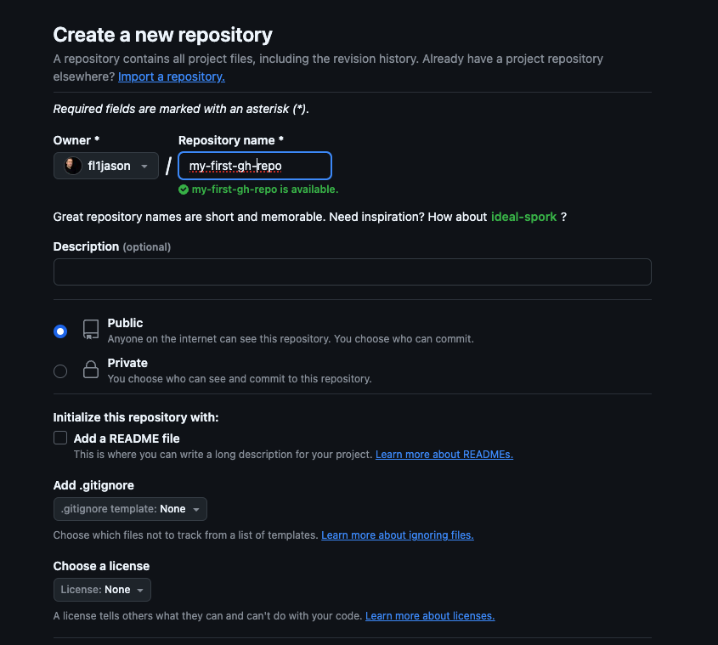
Creating a Repository on GitHub
Steps to create a new repository:
Go to GitHub and log in.
Click the “New” button to create a new repo.
Name the repository and choose its visibility (public/private).
Click "Create Repository".

Slide 10
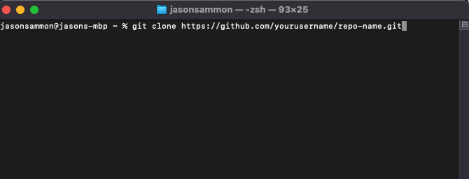
Cloning a Repository Locally
After creating a repository, you can clone it to your local machine: Example command: git clone https://github.com/yourusername/repo-name.git
Cloning downloads the entire project to the local machine.

Slide 11
Creating a README.md File
A README.md describes the project and its usage. Command to create a README.md file using the terminal: touch README.md
Add content using a text editor or VSCode. code .

Slide 12
Committing and Pushing Changes
Commit: Save a snapshot of changes. Command: git add . (to stage changes) git commit -m "Add README.md"
Push: Send changes to the remote GitHub repository. Command: git push
Key Point: Committing and pushing ensure your changes are safely stored on GitHub.

Slide 13
Demo: GitHub Workflow
Now we’ll walk through creating a repo on GitHub, cloning it, adding a README.md, committing the changes, and pushing to GitHub.
Create a repository.
Clone it locally.
Create a README.md file.
Add content, commit, and push. Demo…

Slide 14
Using GitHub with VSCode
Learning Objective: We will learn how to integrate GitHub with Visual Studio Code (VSCode) for a streamlined development workflow.

Slide 15
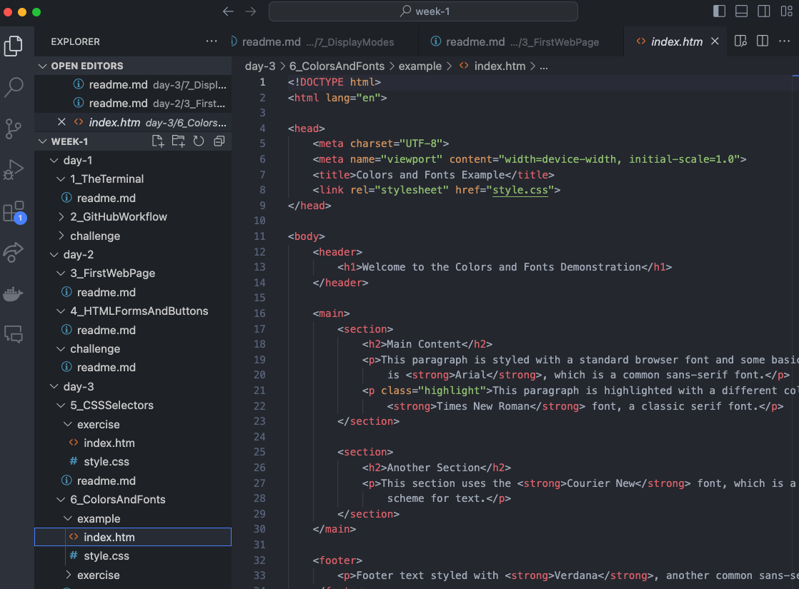
Introduction to VSCode
VSCode is a popular code editor that integrates with Git and GitHub.
Features: Git integration, terminal access, and powerful extensions.

Slide 16
Setting Up GitHub in VSCode
Installing Git and ensuring it's configured in VSCode.
Git needs to be installed on the machine.
VSCode automatically detects Git repositories.
Open a cloned GitHub repo in VSCode:
Use the terminal or file explorer to open the folder in VSCode.
Navigate to the terminal in VSCode with Ctrl + ` or from the menu.

Slide 17
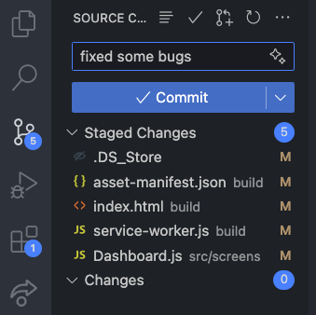
Git Commands in VSCode
VSCode provides a graphical interface for Git commands:
Staging Changes: You can select files and stage them by clicking the "+" icon next to each file.
Committing: Write a commit message in the text box and click the checkmark to commit.
Pushing: Click the "Push" button to send changes to GitHub.

Slide 18
Demo: VSCode GitHub Workflow
Making a change to a file (e.g., editing README.md).
Staging, committing, and pushing the change—all within VSCode’s interface.

Slide 19
Conclusion and Q&A
Navigating the terminal and using basic commands.
Creating and managing repositories on GitHub.
Using GitHub efficiently with VSCode.

Slide 20
Questions?

