Slide 1

Introduction to CSS Box Model, Borders, and Variables
Full stack Skills Bootcamp

Slide 2
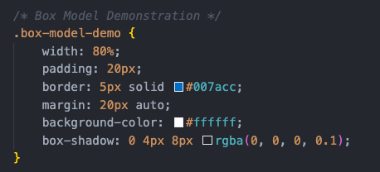
Introduction to CSS Box Model, Borders, and Variables
Lesson Overview:
In this lesson, we will be introduced to CSS Box Model, CSS Borders, border-radius, Box-shadow, CSS Variables and Examples and Real-World Use Cases

Slide 3
Introduction to CSS Box Model
Definition: The CSS Box Model is a fundamental concept for understanding how elements are structured and rendered in the browser..
It consists of:
Content: The actual content (text, images, etc.)
Padding: Space between the content and the border
Border: The line surrounding the padding (optional)
Margin: Space outside the border that separates elements from others

Slide 4
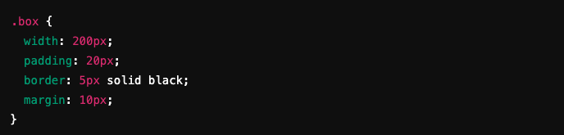
CSS Box Model Example
Content: 200px width
Padding: 20px
Border: 5px solid
Margin: 10px
Total width: width + padding + border + margin = 200 + 20 + 5 + 10 = 235px

Slide 5
CSS Borders: Basic Properties
Borders define the edges of an element.
Properties:
border-width: Specifies the thickness (e.g., 2px)
border-style: Defines the style (e.g., solid, dashed, dotted)
border-color: Sets the color (e.g., red, #333)
Borders can be applied to each side (border-top, border-right, etc.) or as shorthand.

Slide 6

CSS Selectors: Universal, Element, Class, and ID
Result: A blue solid border with 3px thickness. Demo …

Slide 7

CSS Border-Radius
Border-radius rounds the corners of an element.
Can be applied to individual corners (border-top-left-radius, etc.) or all corners.
Syntax:
Result: Rounded corners with a radius of 10px.

Slide 8
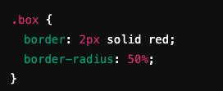
CSS Border-Radius Examples
Result: A perfect circle if applied to a square element.
Also possible to specify different radii for each corner (e.g., border-radius: 10px 20px 30px 40px;).

Slide 9

CSS Box-Shadow
Adds a shadow to an element, creating a 3D effect.
Parameters: Horizontal offset (5px)
Vertical offset (5px)
Blur radius (15px)
Color (RGBA for transparency)

Slide 10
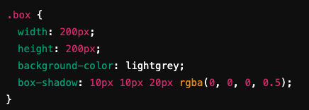
Box-Shadow Example
Result: A grey box with a shadow that offsets by 10px on both axes, with a 20px blur.

Slide 11
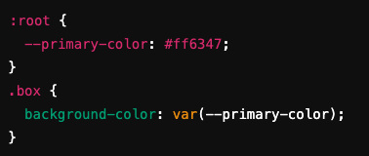
CSS Variables (Custom Properties)
CSS Variables allow you to store values in variables for reuse throughout your stylesheet.
Benefits:
Centralized management of values (colors, spacing, etc.).
Easier to implement changes across large stylesheets.

Slide 12
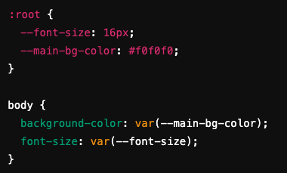
Using CSS Variables
Variables are defined in the :root selector (global scope).
Accessed using var(--variable-name).

Slide 13
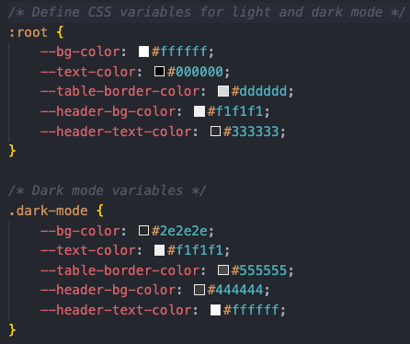
Example: Dark Mode with CSS Variables
Use CSS variables to easily switch themes:

Slide 14
Real world use cases
Theming and Design Consistency: CSS variables are ideal for defining colors, fonts, spacing, and other design properties in one place.
This ensures consistency across a website or app. For example, if you define a primary color as a
variable, updating it in one location will automatically apply the change everywhere it's used.

Slide 15
Recap
CSS Box Model
The Box Model defines how elements are structured on a webpage. Every element is essentially a box made up of four parts:
Content: The actual content inside the element.
Padding: Space between the content and the border.
Border: The edge surrounding the padding.
Margin: Space outside the border, separating the element from others.
We learned how to use properties like padding, border, and margin to control the layout and spacing of elements.
MDN Web Docs – CSS Box Model: https://developer.mozilla.org/en-US/docs/Learn/CSS/Building_blocks/The_box_model
CSS-Tricks – CSS Box Model: https://css-tricks.com/the-css-box-model/

Slide 16
Recap
Border Styling
We explored different ways to style borders in CSS. Key properties include:
border-width: Sets the thickness of the border.
border-style: Defines the type of border (e.g., solid, dashed, dotted).
border-color: Sets the color of the border.
MDN Web Docs – Border Styling: https://developer.mozilla.org/en-US/docs/Web/CSS/border-style CSS-Tricks – Border Styling: https://css-tricks.com/almanac/properties/b/border/

Slide 17
Recap
CSS Variables
CSS Variables, also known as custom properties, allow you to define reusable values in your stylesheets.
This helps maintain consistency and makes future changes easier.
MDN Web Docs – CSS Variables: https://developer.mozilla.org/en-US/docs/Web/CSS/Using_CSS_custom_properties CSS-Tricks – CSS Variables: https://css-tricks.com/a-complete-guide-to-custom-properties/

Slide 18
Questions?

