Slide 1


GBME Grad Basic Stats | Spring 2019
Lecture 05 | 040219
Lecture 05
Sampling
(Ch. 7)
CHOONG-WAN WOO | COCOAN lab | http://cocoanlab.github.io

Slide 2
Lecture 05
Sampling
Idea 1: Examine a part of the whole
  Why do we need sampling? To save time, money, effort, etc.
  Population: the entire group of individuals
  Sample: a smaller group of individuals, selected from the population
  It is difficult to ensure the sample represents the population, and how we select the sample is critical to ensure that the sample is representative of the entire population
  Bias: over- or under-represent some characteristics of the population
    “biased”: values from the samples are systematically different from the population values (parameters)
    “unbiased”: in the long run, we expect them to have the same values as the population parameters
CHOONG-WAN WOO | COCOAN lab | http://cocoanlab.github.io

Slide 3
Lecture 05
Sampling
Idea 1: Examine a part of the whole
Idea 2: Randomize
  To make sure the sampling is not biased
  Simple random sampling: Each subject has an equal chance of being selected
  Stratified random sampling
    Strata: the population is first divided into homogeneous groups (e.g., male and female)
    Then, simple random sampling within each stratum before the results are combined.
      E.g., 60% men and 40% women in the campus: randomly sample 60 men and 40 women for 100 subjects
  Other sampling methods: cluster sampling, multistage sampling, systematic sampling
CHOONG-WAN WOO | COCOAN lab | http://cocoanlab.github.io

Slide 4
Lecture 05
Sampling
Idea 1: Examine a part of the whole
Idea 2: Randomize
Idea 3: Sample size matters
  Important thing is not the fraction of the population, but the sample size.
  Census: examine the entire population
    It is difficult to complete a census
    More noisy
    They do not stand still
CHOONG-WAN WOO | COCOAN lab | http://cocoanlab.github.io

Slide 5
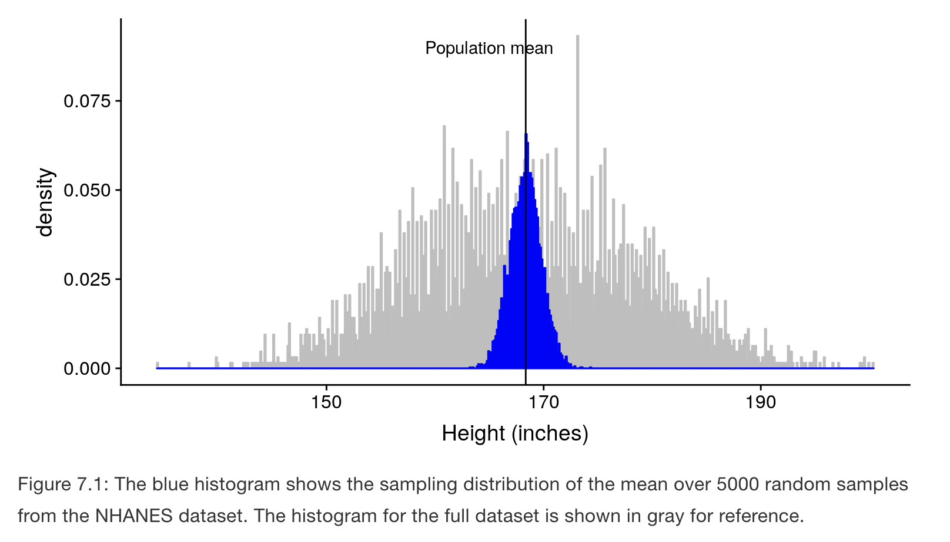
Lecture 05
Sampling error
Sampling error: The statistic from each sample differs slightly from the population parameter
Sampling distribution: The distribution of our statistic across samples
Example of NHANES dataset
  Population distribution (gray histogram)
    the population mean of height = 168.35
    the population standard deviation = 10.16
  Sampling distribution (blue)
    50 individuals for each sample
    5,000 samples
    Blue histogram: the distribution of the mean
    the mean of the sampling distribution = 168.33
    the standard deviation of sample means = 1.43
  Mean is almost same: 168.35 vs. 168.33
  But standard deviation is different: 10.16 vs. 1.43, why?
CHOONG-WAN WOO | COCOAN lab | http://cocoanlab.github.io

Slide 6
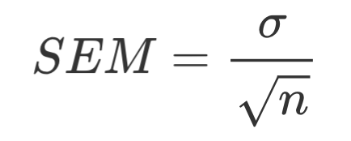
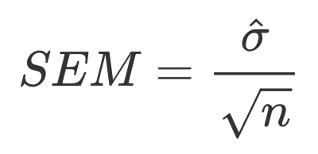
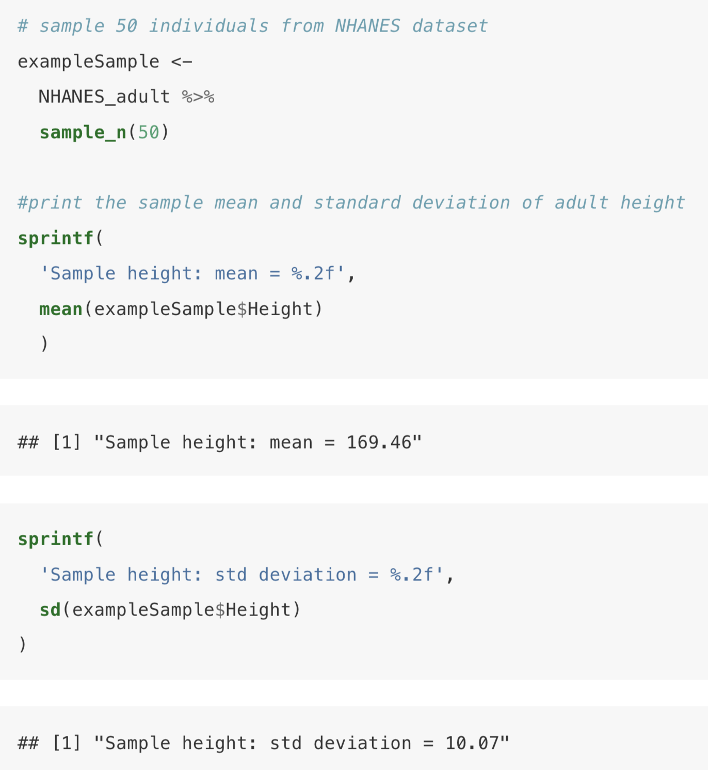
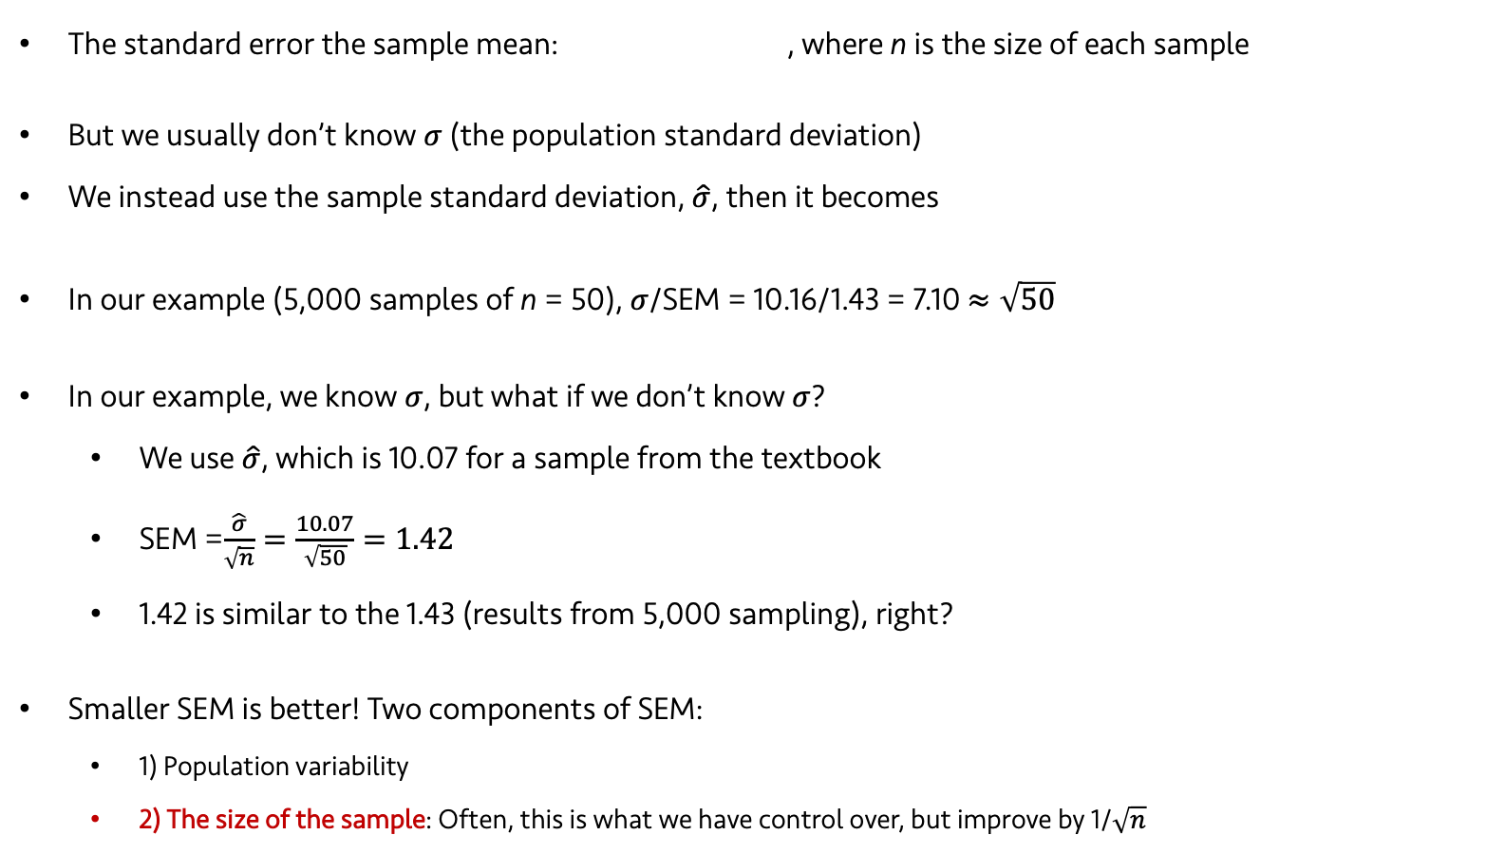
Lecture 05
Standard error of the mean
The standard error the sample mean: , where n is the size of each sample
But we usually don’t know $σ$ (the population standard deviation)
We instead use the sample standard deviation, $\hat{σ}$, then it becomes
In our example (5,000 samples of n = 50), $σ$/SEM = 10.16/1.43 = 7.10 $≈\sqrt{50}$
In our example, we know $σ$, but what if we don’t know $σ$?
  We use $\hat{σ}$, which is 10.07 for a sample from the textbook
  SEM =$\frac{\hat{σ}}{\sqrt{n}}=\frac{10.07}{\sqrt{50}}=1.42$
  1.42 is similar to the 1.43 (results from 5,000 sampling), right?
Smaller SEM is better! Two components of SEM:
  1) Population variability
  2) The size of the sample: Often, this is what we have control over, but improve by 1/$\sqrt{n}$
CHOONG-WAN WOO | COCOAN lab | http://cocoanlab.github.io

Slide 7
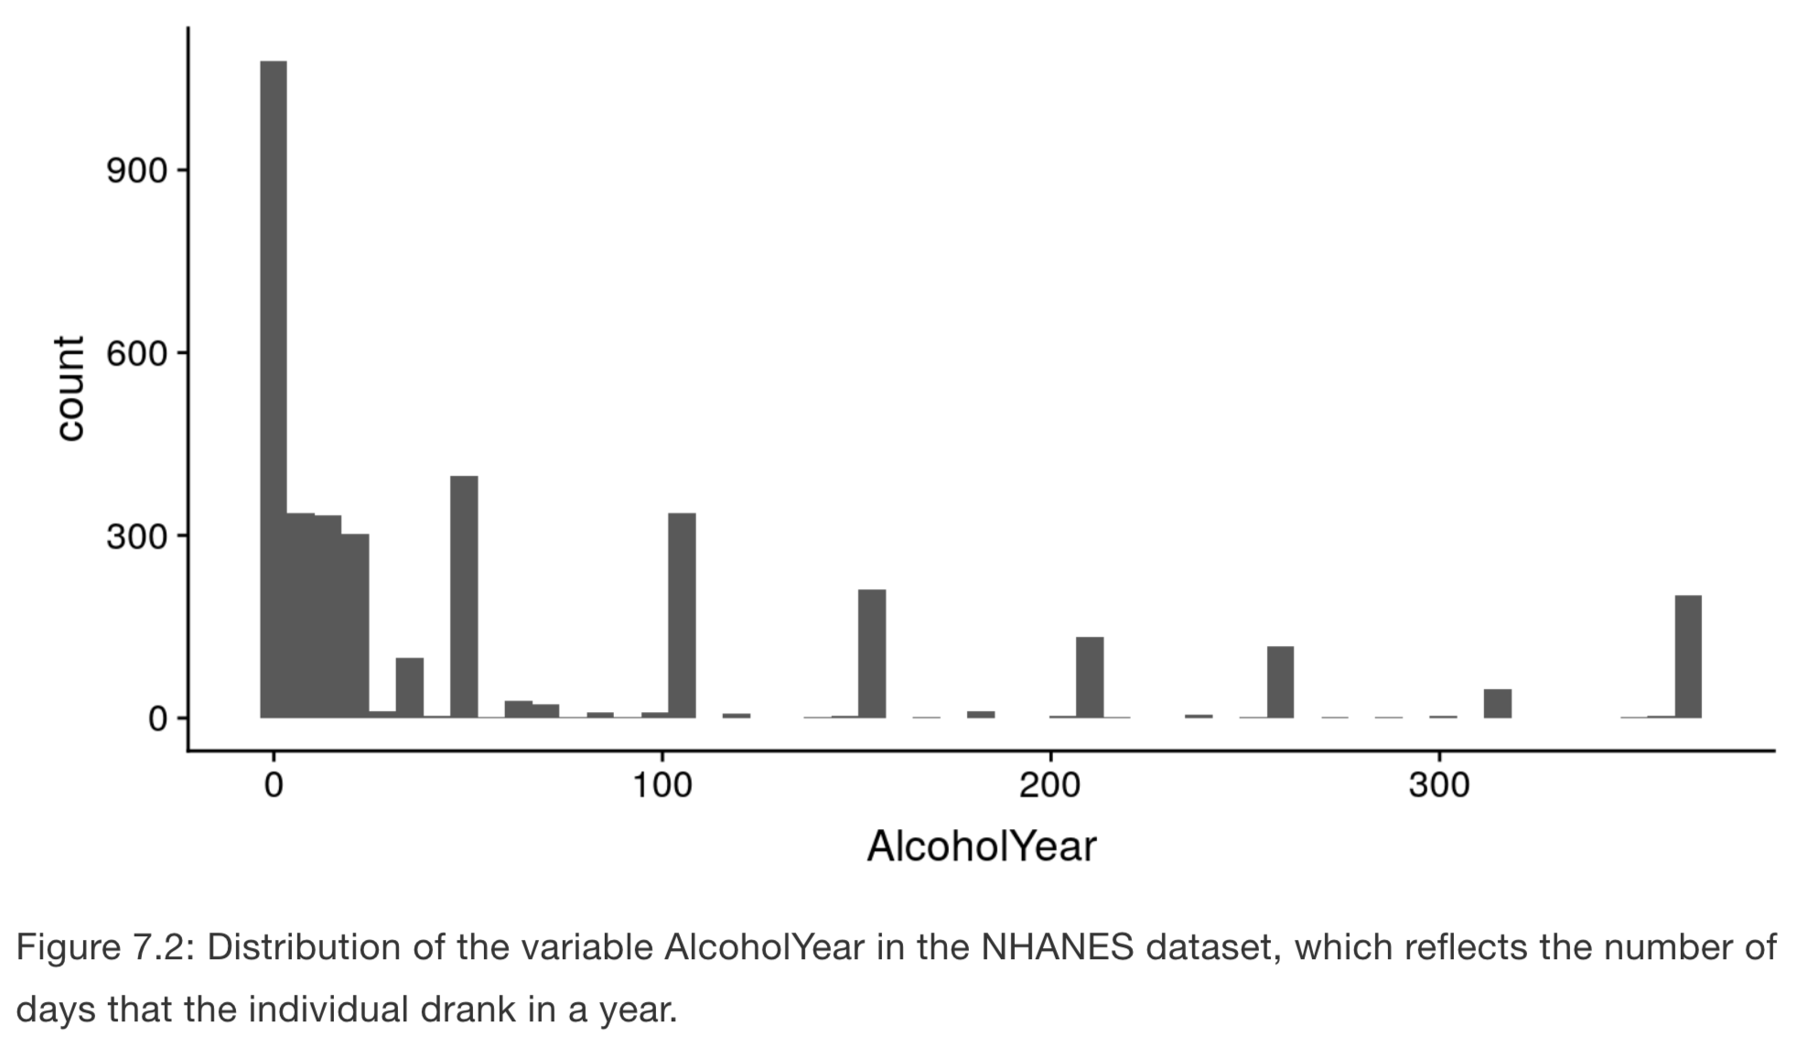
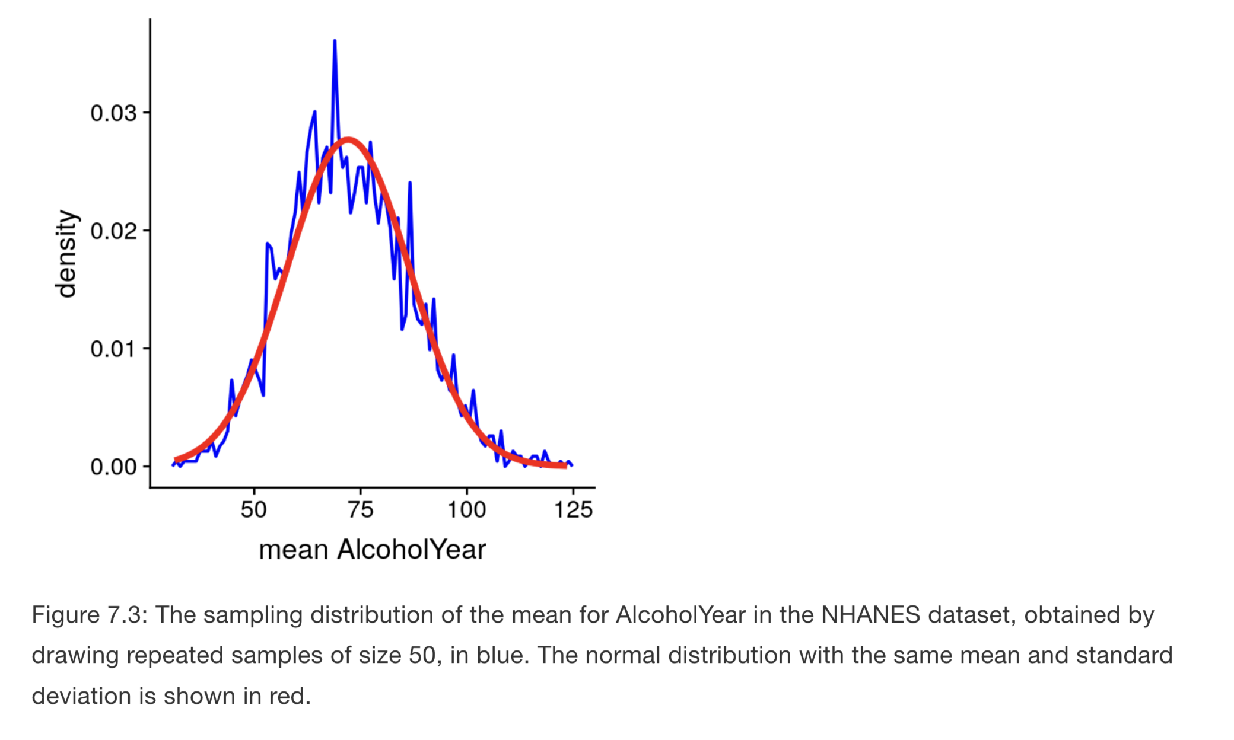
Lecture 05
Central Limit Theorem
As sample size get larger, the sampling distribution of the mean will become normally distributed
Even if the data within each sample are not normally distributed
CHOONG-WAN WOO | COCOAN lab | http://cocoanlab.github.io

Slide 8
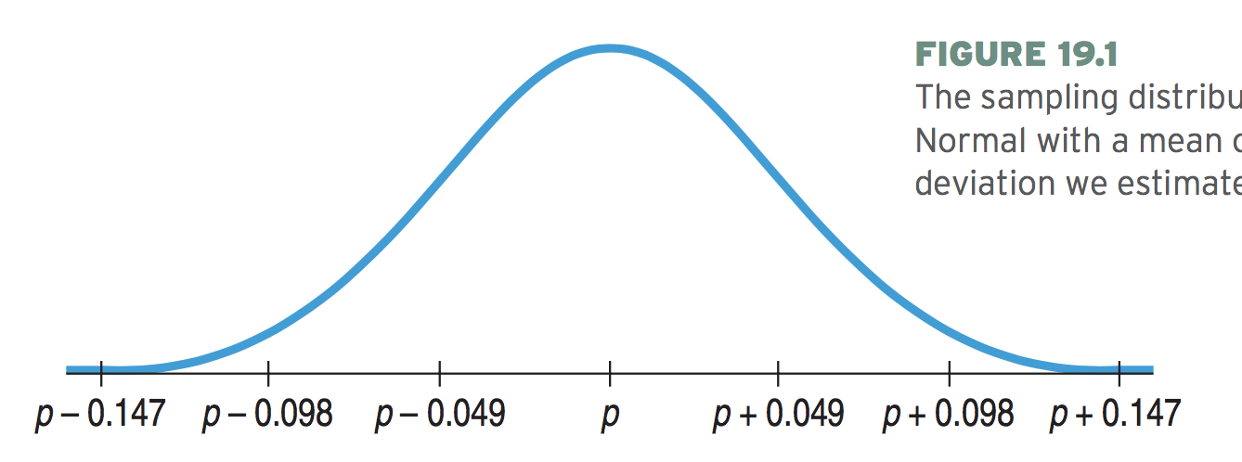



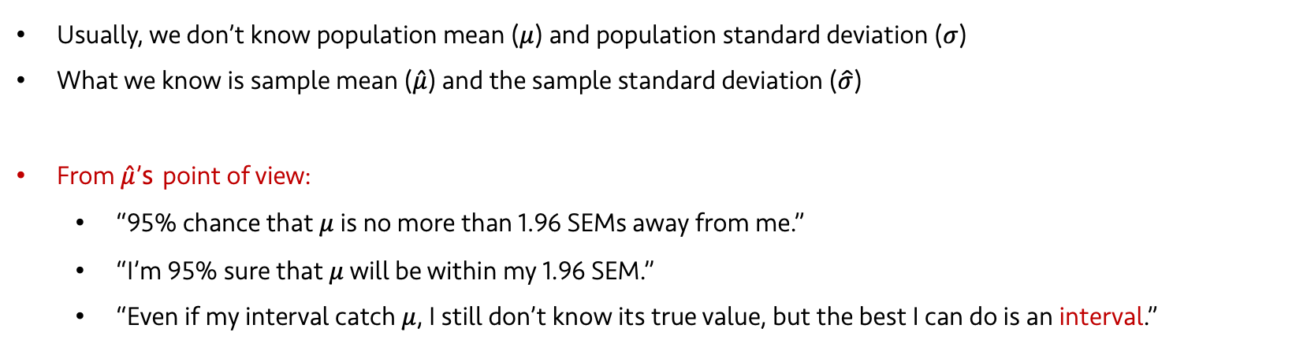





Lecture 12 | 102918
Confidence Interval
Usually, we don’t know population mean ($μ$) and population standard deviation ($σ$)
What we know is sample mean ($\hat{μ}$) and the sample standard deviation ($\hat{σ}$)
From $\hat{μ}$’s point of view:
  “95% chance that $μ$ is no more than 1.96 SEMs away from me.”
  “I’m 95% sure that $μ$ will be within my 1.96 SEM.”
  “Even if my interval catch $μ$, I still don’t know its true value, but the best I can do is an interval.”
1.96 SEM
= 95% chance
$$\hat{μ}$$
$μ$-3SEM
$μ$-2SEM
$μ$-SEM
$$μ$$
$μ$+SEM
$μ$+2SEM
$μ$+3SEM
~95%
CHOONG-WAN WOO | COCOAN lab | http://cocoanlab.github.io

Slide 9







Lecture 12 | 102918
Confidence Interval
$μ$-3SEM
$μ$-2SEM
$μ$-SEM
$$μ$$
$μ$+SEM
$μ$+2SEM
$μ$+3SEM
$$\hat{μ}$$
CHOONG-WAN WOO | COCOAN lab | http://cocoanlab.github.io

Slide 10
Lecture 12 | 102918
Confidence Interval
Each sample mean and standard deviation can be used to make a confidence interval.
The Central Limit Theorem assures us that (in the long run) 95% of the intervals cover the true value, and only 5% are wrong.
Our confidence (and our uncertainty) is about the interval, not the true parameter.
CHOONG-WAN WOO | COCOAN lab | http://cocoanlab.github.io

Slide 11
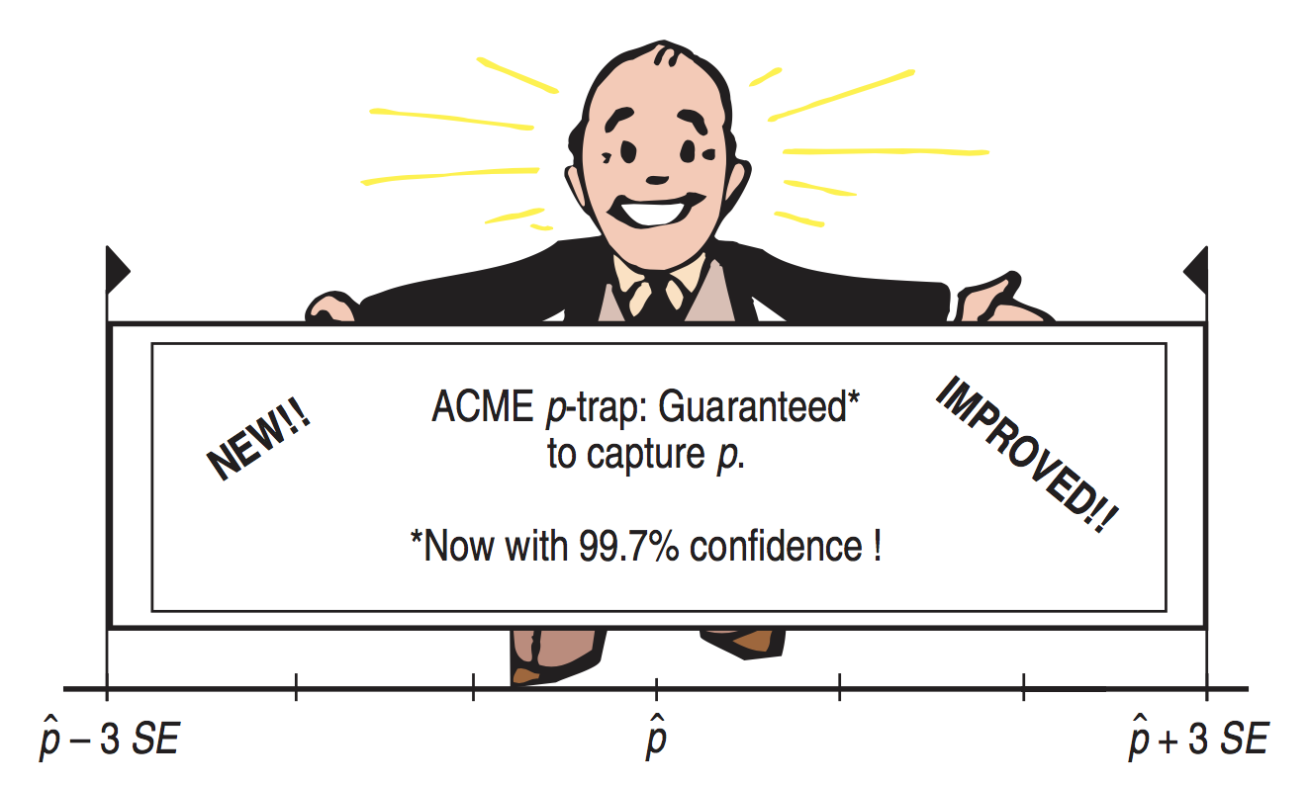
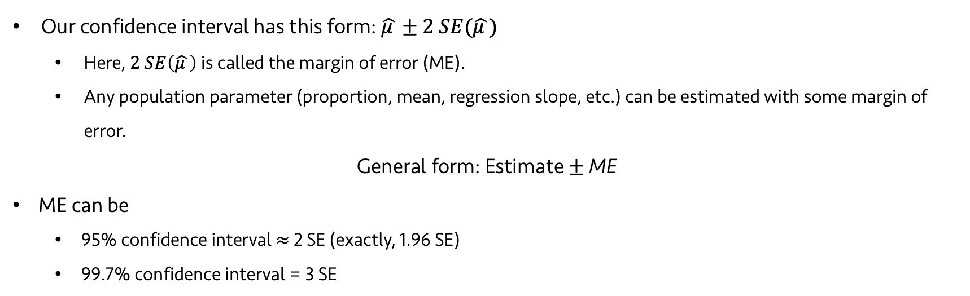
Lecture 12 | 102918
Certainty vs. Precision
Our confidence interval has this form: $\hat{μ }±2 SE(\hat{μ })$
  Here, $2 SE\left(\hat{μ }\right)$ is called the margin of error (ME).
  Any population parameter (proportion, mean, regression slope, etc.) can be estimated with some margin of error.
General form: Estimate $±$ ME
ME can be
  95% confidence interval $≈$ 2 SE (exactly, 1.96 SE)
  99.7% confidence interval = 3 SE
CHOONG-WAN WOO | COCOAN lab | http://cocoanlab.github.io

Slide 12
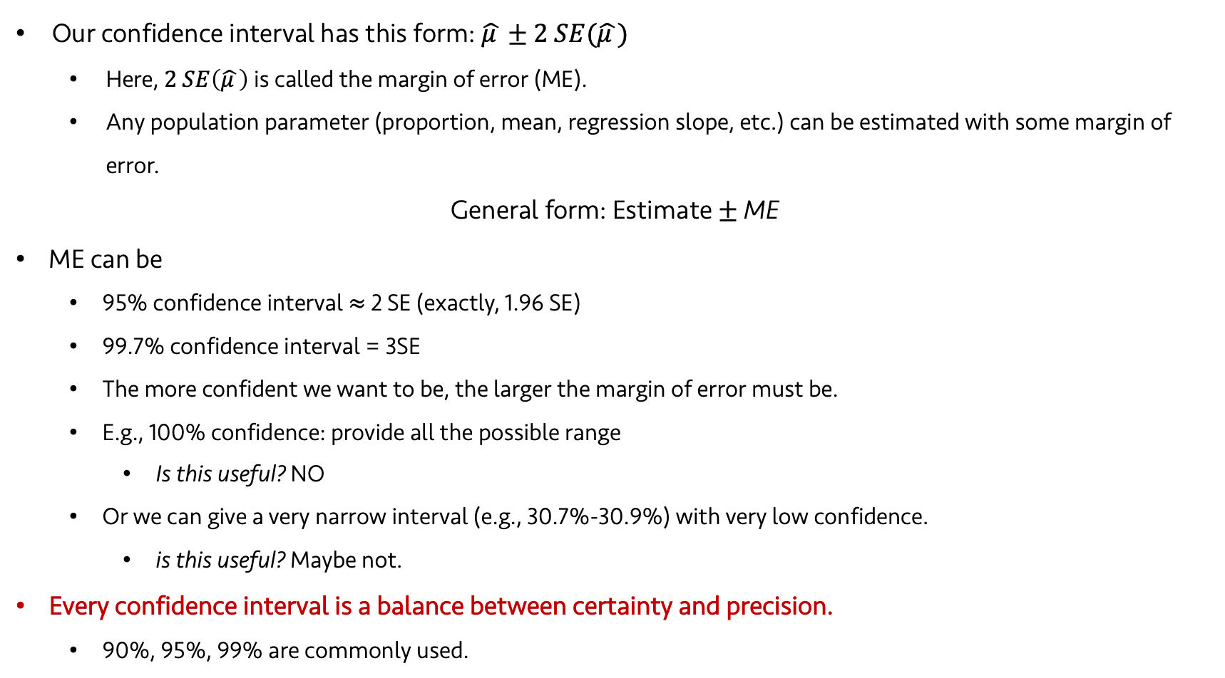
Lecture 12 | 102918
Certainty vs. Precision
Our confidence interval has this form: $\hat{μ }±2 SE(\hat{μ })$
  Here, $2 SE\left(\hat{μ }\right)$ is called the margin of error (ME).
  Any population parameter (proportion, mean, regression slope, etc.) can be estimated with some margin of error.
General form: Estimate $±$ ME
ME can be
  95% confidence interval $≈$ 2 SE (exactly, 1.96 SE)
  99.7% confidence interval = 3SE
  The more confident we want to be, the larger the margin of error must be.
  E.g., 100% confidence: provide all the possible range
    Is this useful? NO
  Or we can give a very narrow interval (e.g., 30.7%-30.9%) with very low confidence.
    is this useful? Maybe not.
Every confidence interval is a balance between certainty and precision.
  90%, 95%, 99% are commonly used.

Slide 13
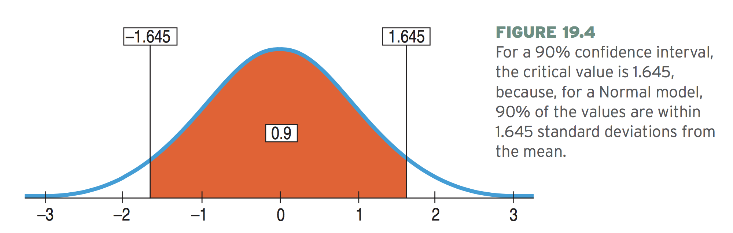
Lecture 12 | 102918
Critical values
Critical value = the number of SEs (e.g., 2 in 2SEs)
Denoted as z*
For 95% confidence interval, the precise critical value is z* = 1.96
For 99% confidence interval, the precise critical value is z* = 2.58

