Slide 1


Biostats and Big Data 2
Lecture 20
Lecture 20
Logistic regression
CHOONG-WAN WOO | COCOAN lab | http://cocoanlab.github.io

Slide 2
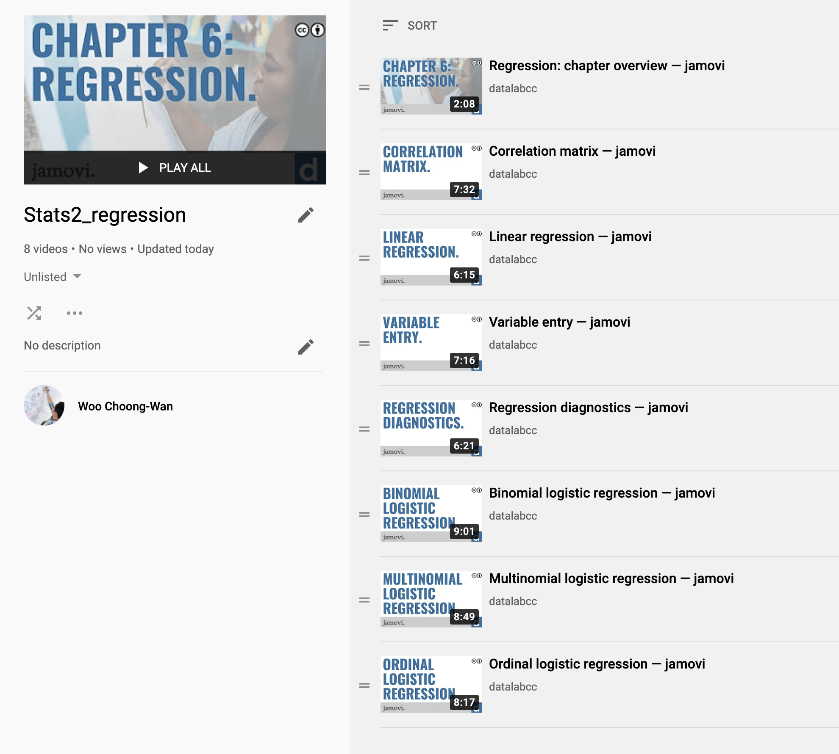
Lecture 20
Regression with JAMOVI
https://www.youtube.com/playlist?list=PLXCuLG6zw7mKEkaaVzzoUWjQdCGjhksmP
CHOONG-WAN WOO | COCOAN lab | http://cocoanlab.github.io

Slide 3
Lecture 20
Analysis methods for modeling relationships
Independent Variable
(Predictors)
Dependent Variable
Analysis
Correlation
continuous
General Linear Model
Regression
continuous
T-test
categorical
ANOVA
continuous
Logistic regression
categorical
categorical
Chi square
Slide from Tor Wager
CHOONG-WAN WOO | COCOAN lab | http://cocoanlab.github.io

Slide 4
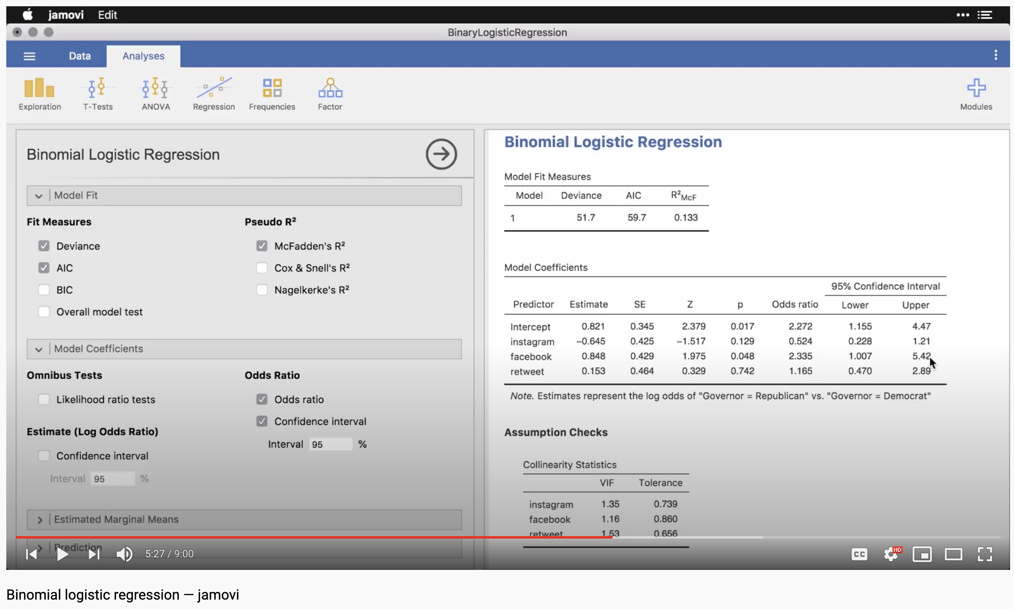
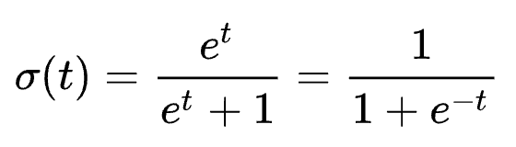

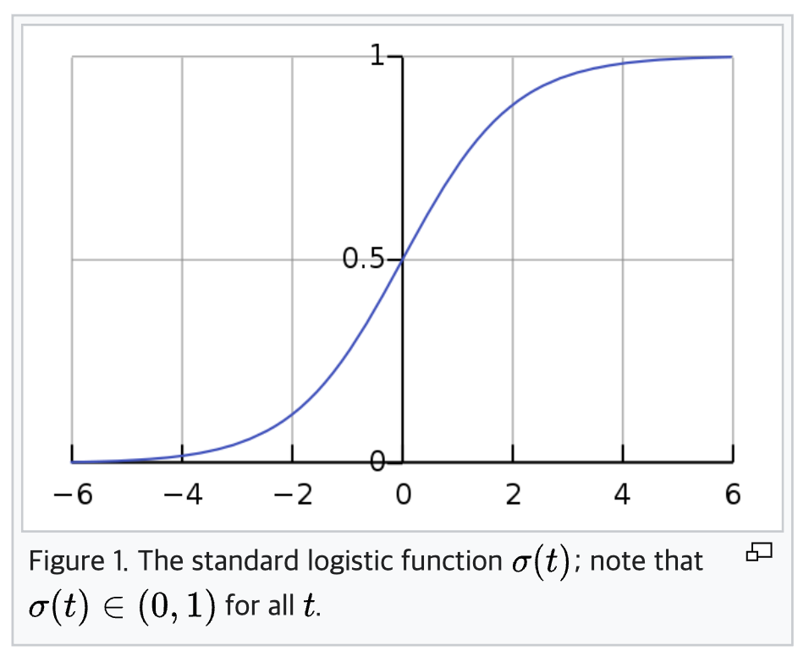
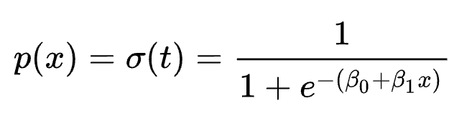
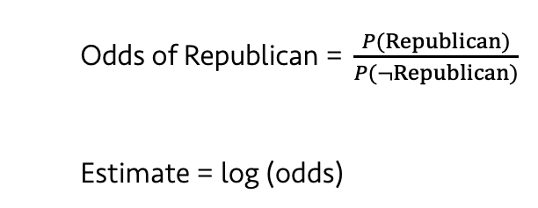
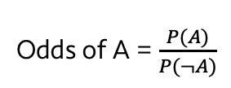
Lecture 20
Odds ratio in the logistic regression context
Odds of A = $\frac{P(A)}{P(¬A)}$
Odds of Republican = $\frac{P(Republican)}{P(¬Republican)}$
Estimate = log (odds)
CHOONG-WAN WOO | COCOAN lab | http://cocoanlab.github.io

