Slide 1


Biostats and Big Data 2
Lecture 10
Lecture 10
T-test
CHOONG-WAN WOO | COCOAN lab | http://cocoanlab.github.io

Slide 2
Lecture 10
What we learned…
Sampling distribution
Standard error of the mean
Confidence interval
CHOONG-WAN WOO | COCOAN lab | http://cocoanlab.github.io

Slide 3
Lecture 10
Hypothesis testing?
Before we learn the JAMOVI implementations of t-test, it would be good to review the logic of hypothesis testing.
CHOONG-WAN WOO | COCOAN lab | http://cocoanlab.github.io

Slide 4
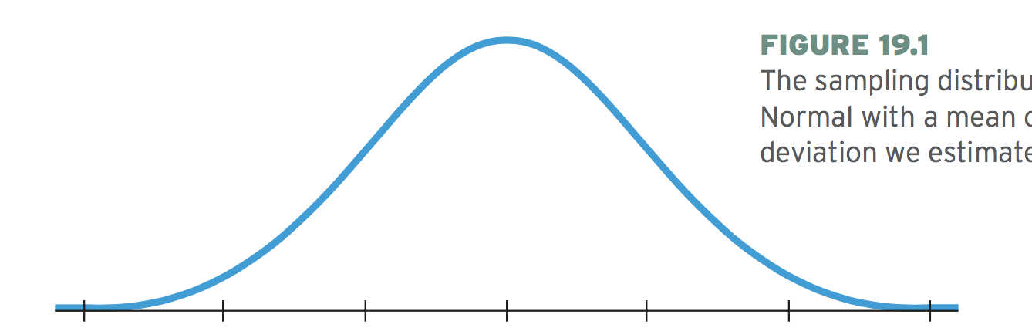
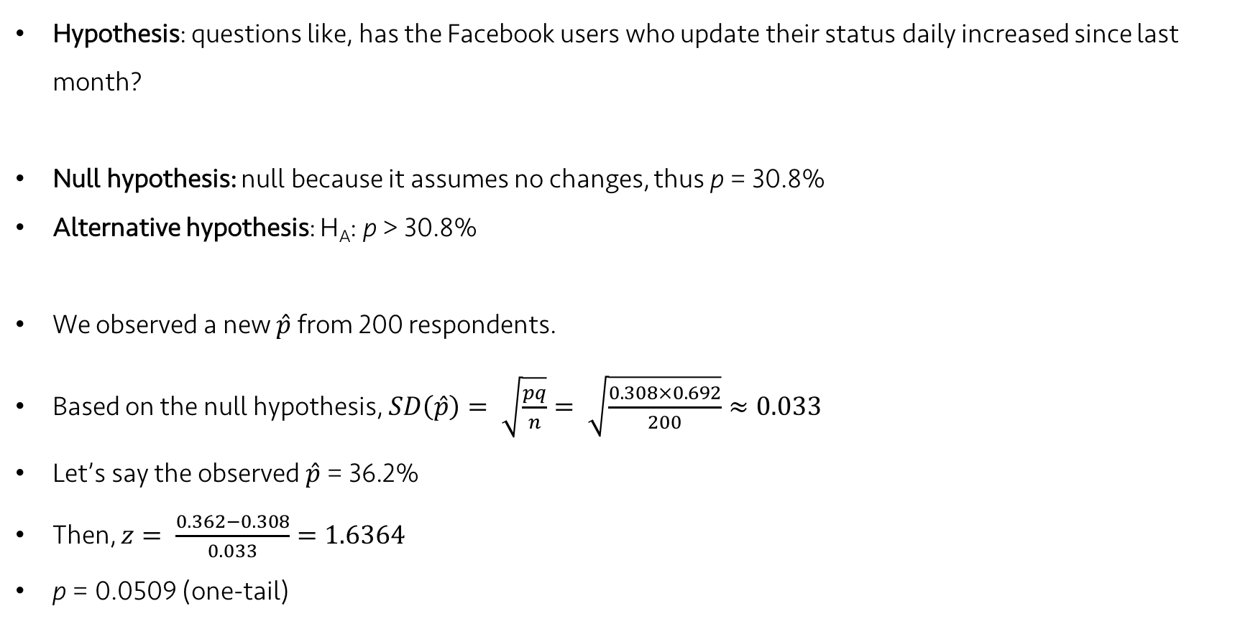
Lecture 16
Hypotheses
Hypothesis: questions like, has the Facebook users who update their status daily increased since last month?
Null hypothesis: null because it assumes no changes, thus p = 30.8%
Alternative hypothesis: H_{A}: p > 30.8%
We observed a new $\hat{p}$ from 200 respondents.
Based on the null hypothesis, $SD\left(\hat{p}\right)= \sqrt{\frac{pq}{n}}= \sqrt{\frac{0.308×0.692}{200}}≈0.033$
Let’s say the observed $\hat{p}$ = 36.2%
Then, $z= \frac{0.362−0.308}{0.033}=1.6364$
p = 0.0509 (one-tail)
0.362
p = 0.0509
0.308
-0.066
0.308
-0.033
0.308
0.308
+0.033
0.308
+0.066
CHOONG-WAN WOO | COCOAN lab | http://cocoanlab.github.io

Slide 5
Lecture 16
A Trial as a “Null Hypothesis Statistical Test” (NHST)
It’s the logic of jury trials.
The null hypothesis is that the defendant is innocent
Judge the evidence
Juries ask “Could these evidence plausibly have happened by chance if the defendant were in fact innocent?”
Make a decision
In hypothesis testing:
We quantify “how surprising the evidence would be if the null hypothesis were true.”
CHOONG-WAN WOO | COCOAN lab | http://cocoanlab.github.io

Slide 6
Lecture 18
What’s P-value?
P-value = P(Data | H₀), not P(H₀ | Data)
The conditional probability of getting the data given that the null hypothesis is true
NOT the probability that the null hypothesis is true
NOT the conditional probability that the null hypothesis is true given the data
P-value = 0.03
does NOT mean “there is a 3% chance that the null hypothesis is true”.
does mean “given the null hypothesis, there’s a 3% chance of observing the observed statistic value.
CHOONG-WAN WOO | COCOAN lab | http://cocoanlab.github.io

Slide 7
Lecture 18
Small P-value
First, yay!
It means the result we just observed is unlikely to occur if the null hypothesis is true.
does NOT mean that the null hypothesis is “less true”.
How small the P-value should be?
depends on a lot of things, e.g., your prior belief in the null hypothesis, your trust in your data, in the experimental method, in the survey protocol, etc.
P-value serve as a measure of the strength of the evidence against the null hypothesis
should NEVER serve as a hard and fast rule for decisions.
YOU have to take the responsibility for the decision on yourself.
CHOONG-WAN WOO | COCOAN lab | http://cocoanlab.github.io

Slide 8
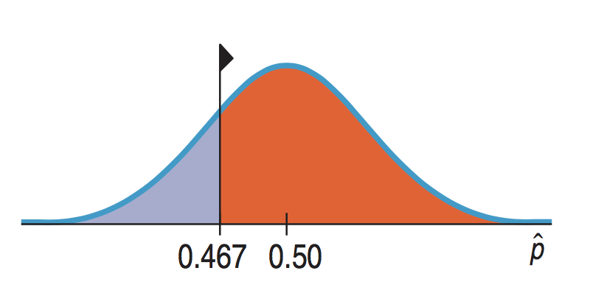
Lecture 18
High P-value
No evidence for rejecting H₀
We cannot reject the null hypothesis.
For one-sided test, if P-value is higher than 0.5, you know that your test statistic is on the “wrong” side.
High P-values mean
What we’ve observed is not surprising.
We have no reason to reject our null hypothesis.
Does NOT prove that the null hypothesis is true
Do NOT say that you “accept the null hypothesis”.
You should say that “the data have failed to provide sufficient evidence to reject the null hypothesis”.
CHOONG-WAN WOO | COCOAN lab | http://cocoanlab.github.io

Slide 9
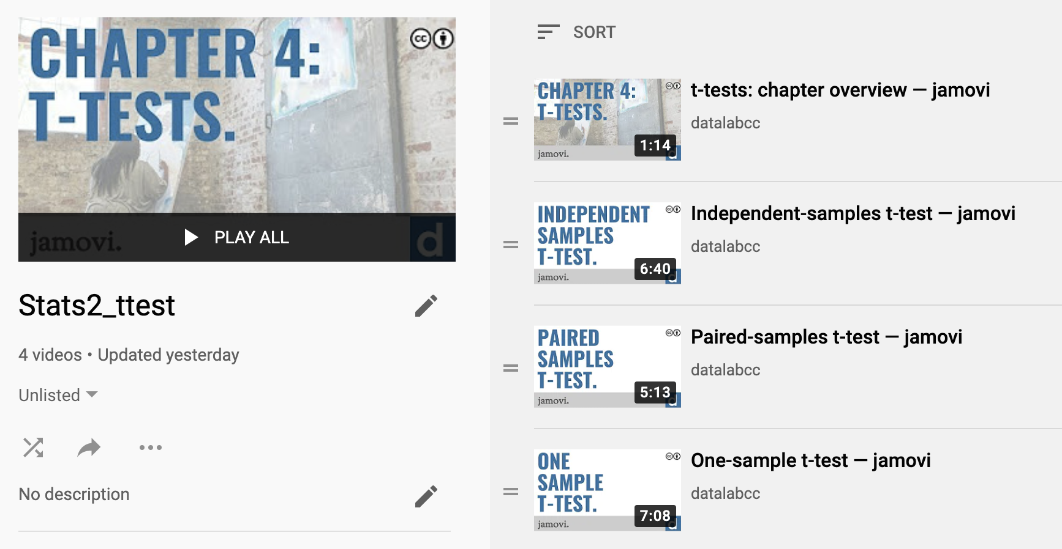
Lecture 10
T-tests
https://www.youtube.com/playlist?list=PLXCuLG6zw7mL5v44qpj4VuvcV22YyNc8x
One sample t-test
Paired t-test
Two samples t-test
CHOONG-WAN WOO | COCOAN lab | http://cocoanlab.github.io

Slide 10
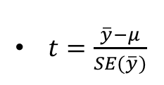
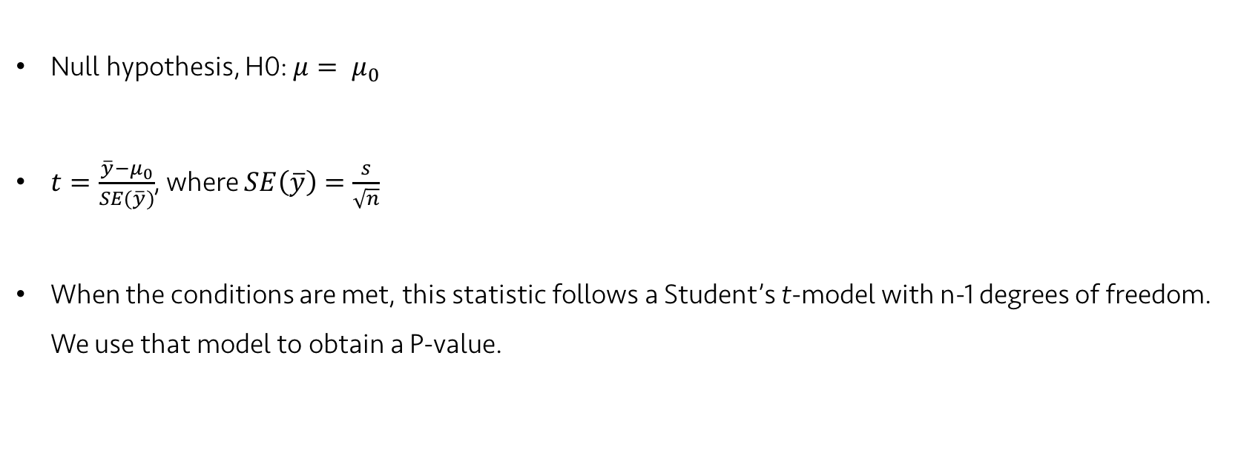
Lecture 17
One sample t-test for the mean
Null hypothesis, H0: $μ= μ_{0}$
$t=\frac{\overline{y}−μ_{0}}{SE(\overline{y})}$, where $SE\left(\overline{y}\right)=\frac{s}{\sqrt{n}}$
When the conditions are met, this statistic follows a Student’s t-model with n-1 degrees of freedom. We use that model to obtain a P-value.
$t=\frac{\overline{y}−μ}{SE(\overline{y})}$
CHOONG-WAN WOO | COCOAN lab | http://cocoanlab.github.io

Slide 11
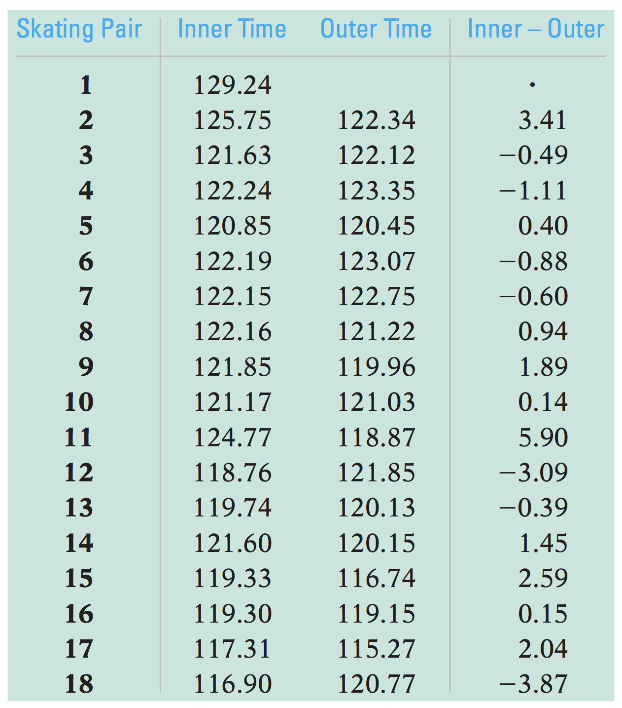
Lecture 20
Paired t-test
Two-sample t-test?
NO. The races are run in pairs, so the columns are not independent.
Instead, we should focus on the difference between each pair.
It’s not a problem, paired data provides an opportunity!
We need to take advantage of the paired data structure.
“Paired” t-test:
Use pairwise differences!
Ignore original two columns
One-sample t-test on the pairwise differences
CHOONG-WAN WOO | COCOAN lab | http://cocoanlab.github.io

Slide 12
Lecture 20
Assumptions and conditions
Paired data assumption
You should not use methods for paired data on independent data.
Or methods for independent data (e.g., two-sample t-test) should not be used on paired data.
Independence assumption
The differences for pairs should be independent of each other.
Conditions
Randomization condition
10% condition
Normal population assumption
The population of differences should follows a Normal model.
Each group doesn’t need to follow a Normal model.
CHOONG-WAN WOO | COCOAN lab | http://cocoanlab.github.io

Slide 13
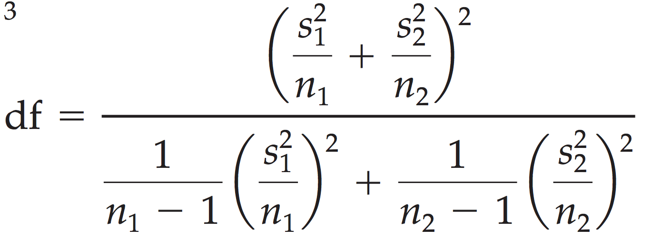

Lecture 19
Two-Sample t-test
$H_{0}:μ_{1}−μ_{2}=Δ_{0}$
many times $Δ_{0}$ = 0
$t= \frac{\left({\overline{y}}_{1}−{\overline{y}}_{2}\right)−Δ_{0}}{SE\left({\overline{y}}_{1}−{\overline{y}}_{2}\right)}$
$SE\left({\overline{y}}_{1}−{\overline{y}}_{2}\right)=\sqrt{\frac{s_{1}^{2}}{n_{1}}+\frac{s_{2}^{2}}{n_{2}}}$
When the conditions are met and the null hypothesis is true, the statistic can be closely modeled by a Student’s t-model with a number of degrees of freedom (adjusted). We use that model to obtain P-value.
CHOONG-WAN WOO | COCOAN lab | http://cocoanlab.github.io

Slide 14
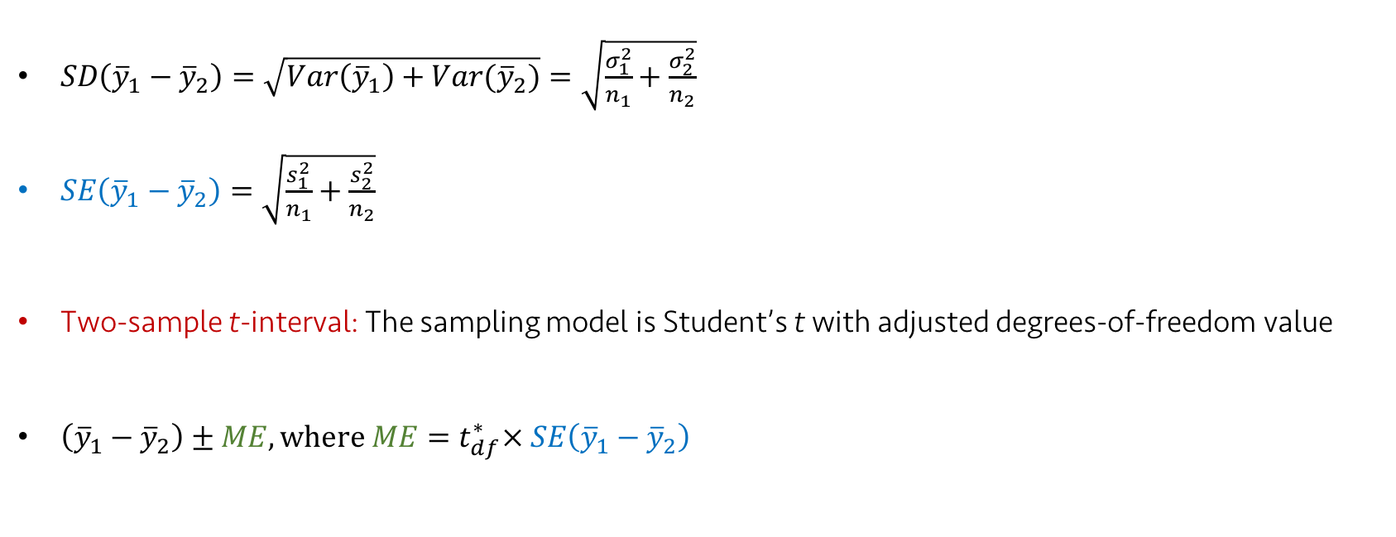
Lecture 19
Confidence Interval for the Difference between two means
$SD\left({\overline{y}}_{1}−{\overline{y}}_{2}\right)=\sqrt{Var\left({\overline{y}}_{1}\right)+Var({\overline{y}}_{2})}=\sqrt{\frac{σ_{1}^{2}}{n_{1}}+\frac{σ_{2}^{2}}{n_{2}}}$
$SE\left({\overline{y}}_{1}−{\overline{y}}_{2}\right)=\sqrt{\frac{s_{1}^{2}}{n_{1}}+\frac{s_{2}^{2}}{n_{2}}}$
Two-sample t-interval: The sampling model is Student’s t with adjusted degrees-of-freedom value
$\left({\overline{y}}_{1}−{\overline{y}}_{2}\right)±ME, where ME=t_{df}^{∗}× SE\left({\overline{y}}_{1}−{\overline{y}}_{2}\right)$
CHOONG-WAN WOO | COCOAN lab | http://cocoanlab.github.io

