Slide 1


GBME Probability and Statistics
Lecture 21
Lecture 21
Comparing counts (Chi-square test)
CHOONG-WAN WOO | COCOAN lab | http://cocoanlab.github.io

Slide 2
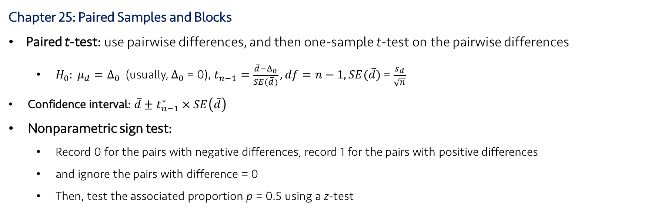
Lecture 21
Review: Key Points
Chapter 25: Paired Samples and Blocks
Paired t-test: use pairwise differences, and then one-sample t-test on the pairwise differences
$H_{0}: μ_{d}=Δ_{0}$ (usually, $Δ_{0}$ = 0), $t_{n−1}=\frac{\overline{d}−Δ_{0}}{SE(\overline{d})}, df=n−1, SE(\overline{d})$ = $\frac{s_{d}}{\sqrt{n}}$
Confidence interval: $\overline{d}±t_{n−1}^{∗} × SE\left(\overline{d}\right)$
Nonparametric sign test:
Record 0 for the pairs with negative differences, record 1 for the pairs with positive differences
and ignore the pairs with difference = 0
Then, test the associated proportion p = 0.5 using a z-test
CHOONG-WAN WOO | COCOAN lab | http://cocoanlab.github.io

Slide 3
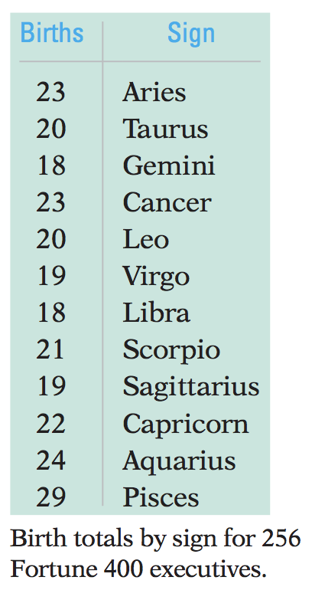
Lecture 21
Counts
Example: zodiac signs of 256 heads of the largest 400 companies
If the zodiac signs cannot predict the future, we should expect 1/12 counts for each category.
How closely do the observed numbers of births per sign fit this simple “null” model?
“Goodness-of-fit” test
CHOONG-WAN WOO | COCOAN lab | http://cocoanlab.github.io

Slide 4
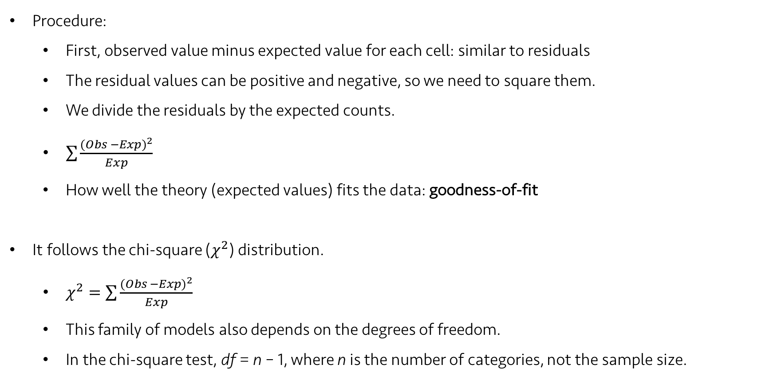
Lecture 21
Goodness-of-fit tests
Procedure:
First, observed value minus expected value for each cell: similar to residuals
The residual values can be positive and negative, so we need to square them.
We divide the residuals by the expected counts.
$\sum{\frac{{(Obs −Exp)}^{2}}{Exp}}$
How well the theory (expected values) fits the data: goodness-of-fit
It follows the chi-square ($χ^{2}$) distribution.
$χ^{2}=\sum{\frac{{(Obs −Exp)}^{2}}{Exp}}$
This family of models also depends on the degrees of freedom.
In the chi-square test, df = n – 1, where n is the number of categories, not the sample size.
CHOONG-WAN WOO | COCOAN lab | http://cocoanlab.github.io

Slide 5
Lecture 21
Assumptions and Conditions
Counted Data Condition
The data must be counts for the categories of a categorical variable.
Independence Assumption
The counts in the cells should be independent of each other.
Sample Size Assumption
Expected cell frequency condition:
The expected counts for each cell should be at least 5.
CHOONG-WAN WOO | COCOAN lab | http://cocoanlab.github.io

Slide 6
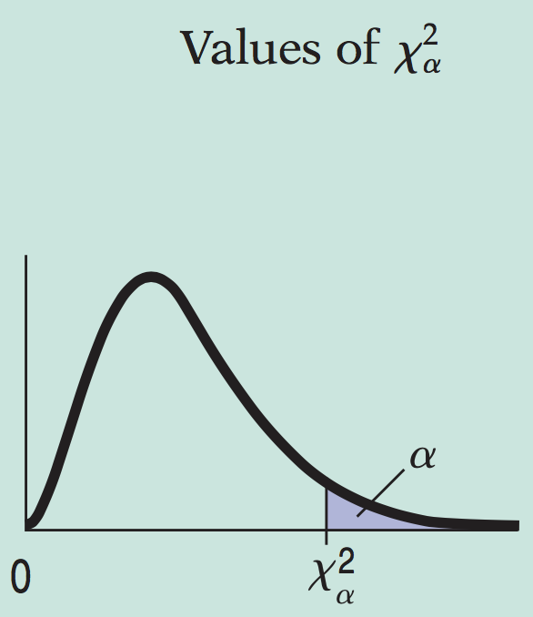
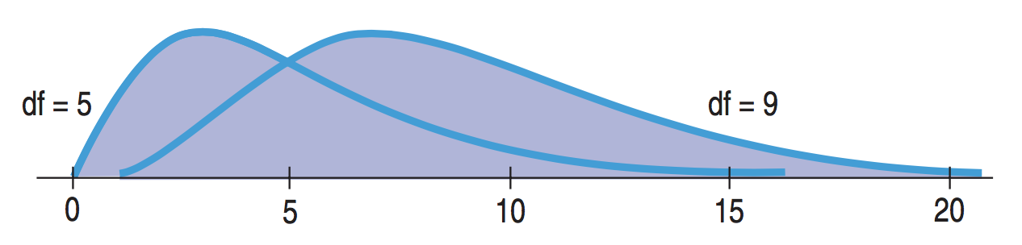
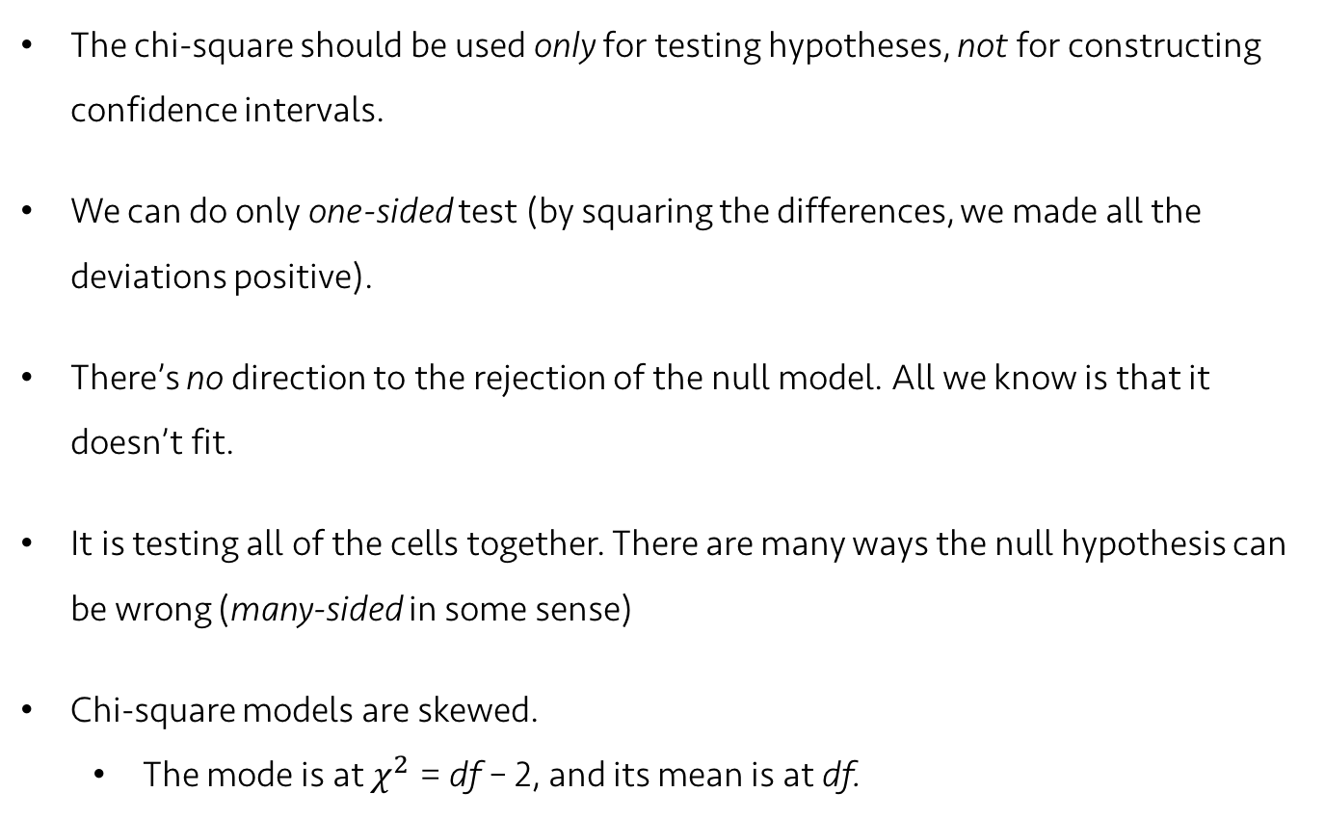
Lecture 21
Chi-Square P-values
The chi-square should be used only for testing hypotheses, not for constructing confidence intervals.
We can do only one-sided test (by squaring the differences, we made all the deviations positive).
There’s no direction to the rejection of the null model. All we know is that it doesn’t fit.
It is testing all of the cells together. There are many ways the null hypothesis can be wrong (many-sided in some sense)
Chi-square models are skewed.
The mode is at $χ^{2}$ = df – 2, and its mean is at df.
Mode: 3
Mode: 7
CHOONG-WAN WOO | COCOAN lab | http://cocoanlab.github.io

Slide 7
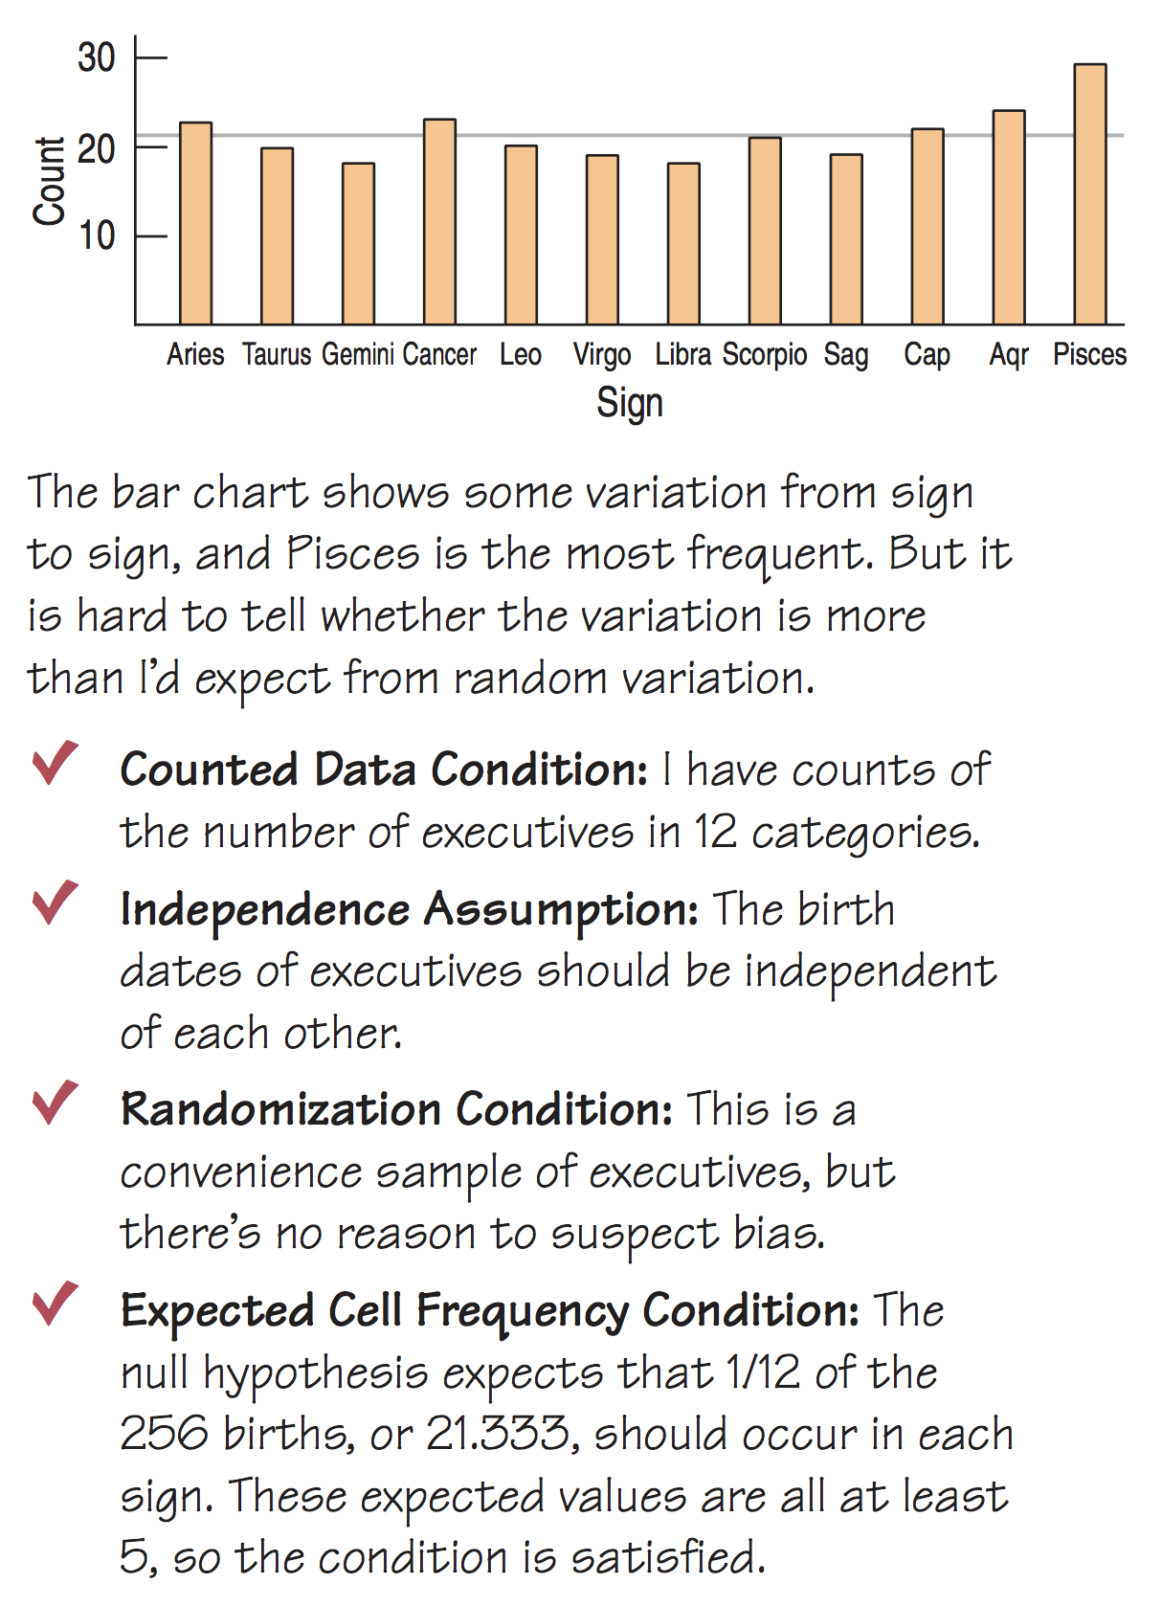
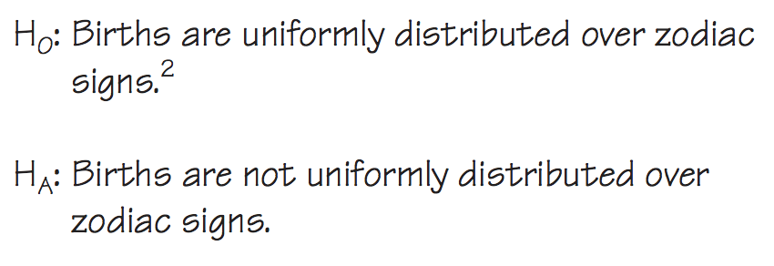
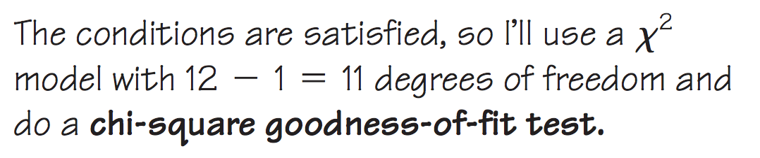
Lecture 21
The example of zodiac sign
CHOONG-WAN WOO | COCOAN lab | http://cocoanlab.github.io

Slide 8
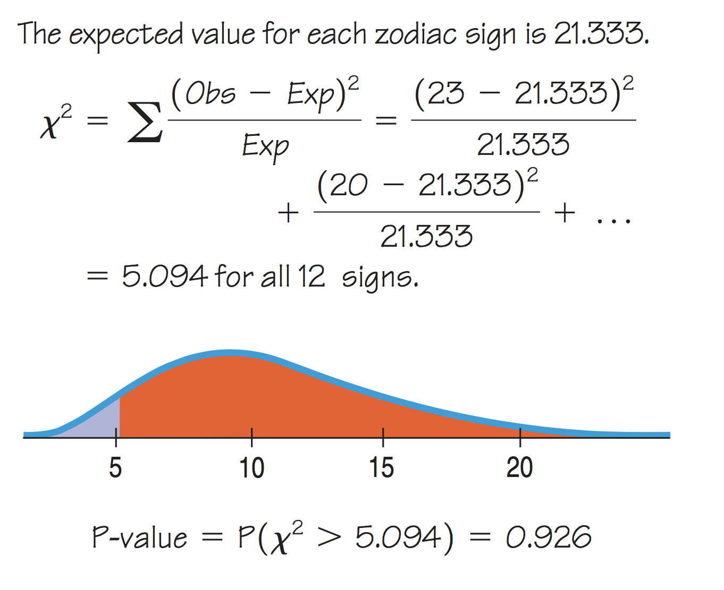
Lecture 21
The example of zodiac sign
CHOONG-WAN WOO | COCOAN lab | http://cocoanlab.github.io

Slide 9
Lecture 21
Trouble with Goodness-of-fit tests
Goodness-of-fit: How well does the theory fit the data?
The only null hypothesis available (H₀: the theory is true)
We can only reject or fail to reject the null hypothesis.
We can never confirm the theory is true.
It is also difficult to know what is the alternative.
The theory can be wrong in many ways.
Thus, there is no way to prove that a favored model is true, with goodness-of-fit tests.
Alternative: model comparison
CHOONG-WAN WOO | COCOAN lab | http://cocoanlab.github.io

Slide 10
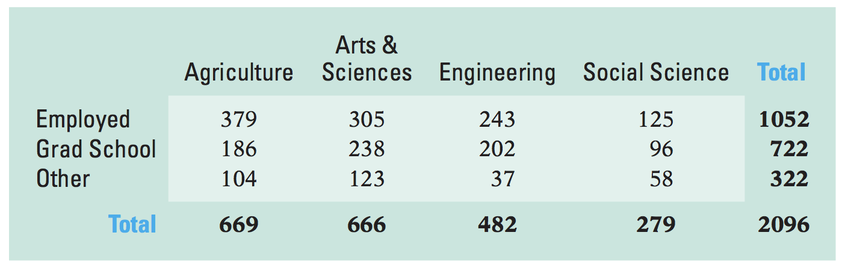
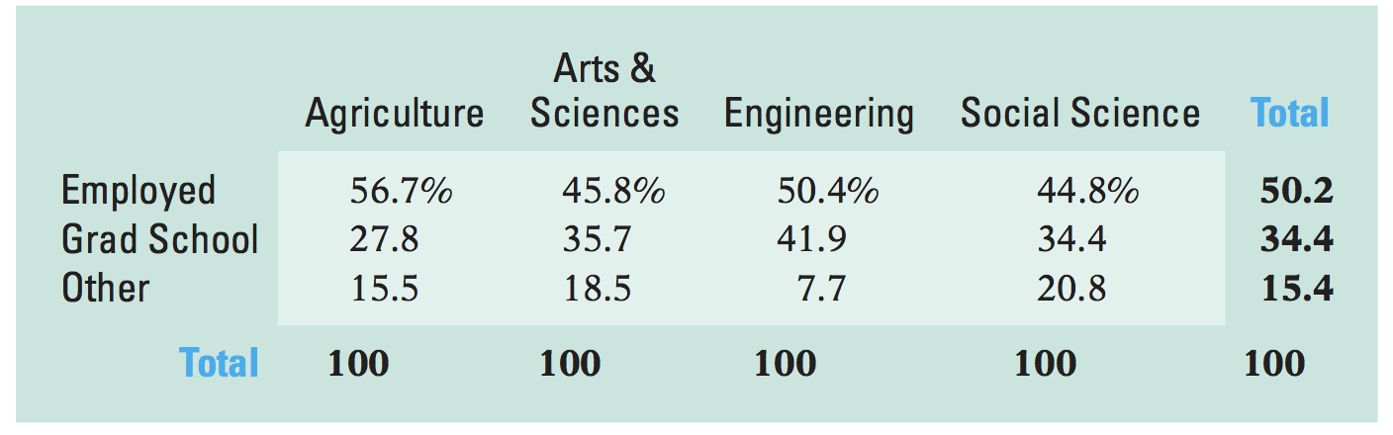
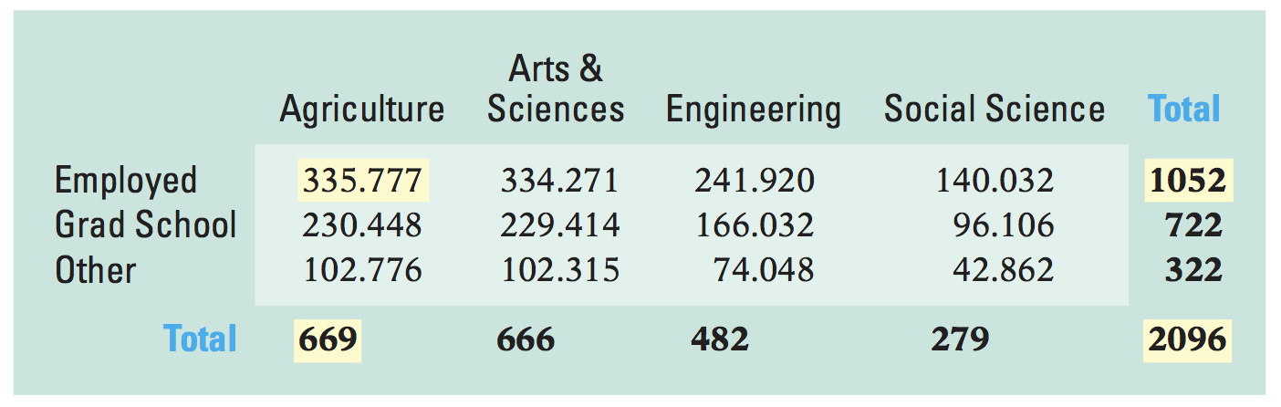
Lecture 21
Chi-square test of Homogeneity
Testing whether the proportions are same across multiple groups
two-way table
Post-graduation activities of the class of 2006 for several colleges of a large university
Percentage
Expected values for the ‘06 graduates
CHOONG-WAN WOO | COCOAN lab | http://cocoanlab.github.io

Slide 11
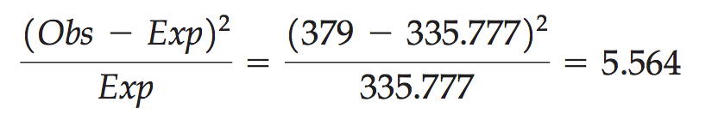

Lecture 21
Chi-square test of Homogeneity
$χ^{2}=\sum{\frac{{(Obs −Exp)}^{2}}{Exp}}$
The example of the agriculture school
And summing these across all the schools,
$χ^{2}=\sum{\frac{{(Obs −Exp)}^{2}}{Exp}}=54.51$
Degrees of freedom:
$(R−1)(C−1)$, where R: the number of rows, C: the number of columns
CHOONG-WAN WOO | COCOAN lab | http://cocoanlab.github.io

Slide 12
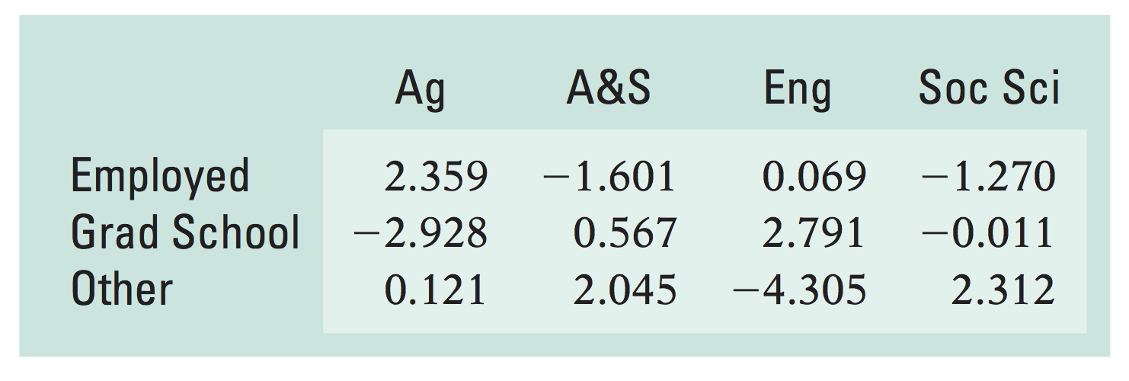
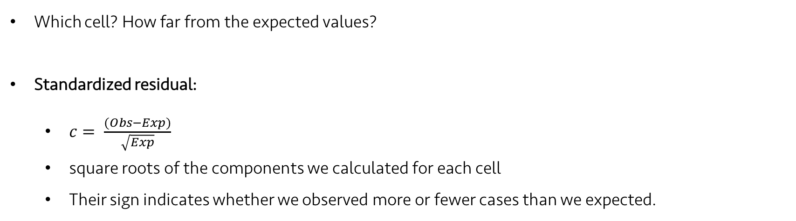
Lecture 21
Examining the Residuals
Which cell? How far from the expected values?
Standardized residual:
$c= \frac{(Obs−Exp)}{\sqrt{Exp}}$
square roots of the components we calculated for each cell
Their sign indicates whether we observed more or fewer cases than we expected.
CHOONG-WAN WOO | COCOAN lab | http://cocoanlab.github.io

Slide 13
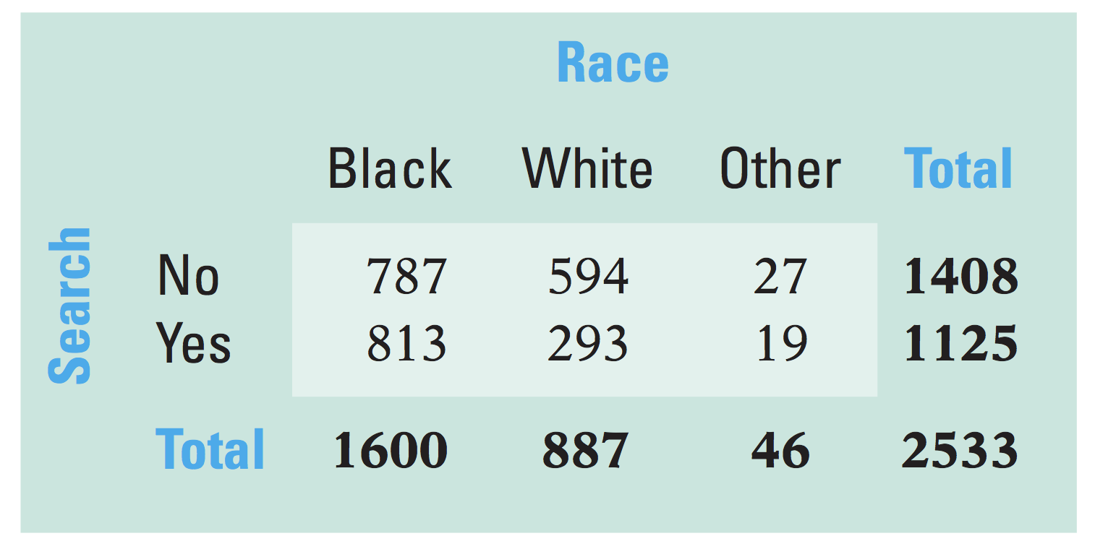
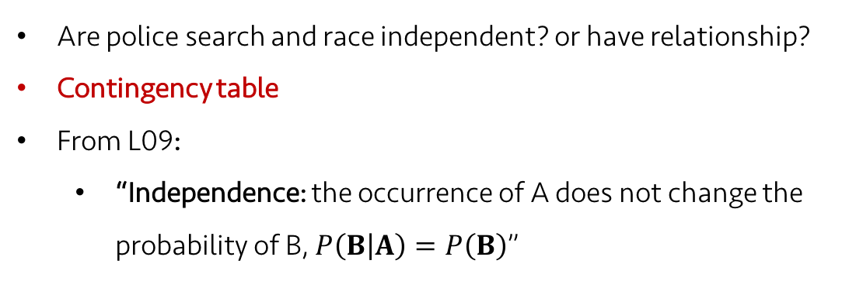
Lecture 21
Chi-square test of independence
Race effects on police vehicle search
Are police search and race independent? or have relationship?
Contingency table
From L09:
“Independence: the occurrence of A does not change the probability of B, $P\left(B | A\right)=P\left(B\right)$”
The calculation is identical to the homogeneity test.
What’s different?
Independence test: Two categorical variables measured on a single population
Homogeneity test: a single categorical variable independently measured on two or more populations
Independence test’s question: “Are the variables independent?”
Homogeneity test: “Are the groups homogeneous?”
CHOONG-WAN WOO | COCOAN lab | http://cocoanlab.github.io

Slide 14
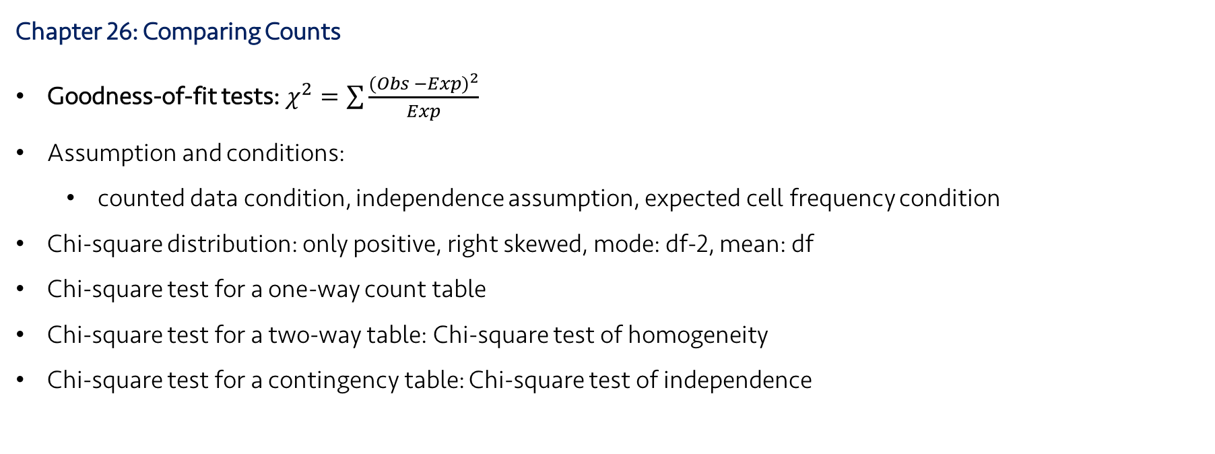
Lecture 21
Review: Key Points
Chapter 26: Comparing Counts
Goodness-of-fit tests: $χ^{2}=\sum{\frac{{(Obs −Exp)}^{2}}{Exp}}$
Assumption and conditions:
counted data condition, independence assumption, expected cell frequency condition
Chi-square distribution: only positive, right skewed, mode: df-2, mean: df
Chi-square test for a one-way count table
Chi-square test for a two-way table: Chi-square test of homogeneity
Chi-square test for a contingency table: Chi-square test of independence
CHOONG-WAN WOO | COCOAN lab | http://cocoanlab.github.io

