Slide 1


GBME Probability and Statistics
Lecture 04
Lecture 04
Comparing distributions, Normal model
CHOONG-WAN WOO | COCOAN lab | http://cocoanlab.github.io

Slide 2
From Lecture 03
Key Points
Chapter 3: Displaying categorical data
Bar chart for categorical data
Pie chart for proportions of whole
Faithful reporting and the area principle
Contingency tables
Simpson’s paradox
Chapter 4: Displaying quantitative data
Histograms, Stem-leaf, dot plots
Shape (mode, symmetrical)
Center (median, mean)
Spread (range, IQR, variance, standard deviation)
Box plots
CHOONG-WAN WOO | COCOAN lab | http://cocoanlab.github.io

Slide 3
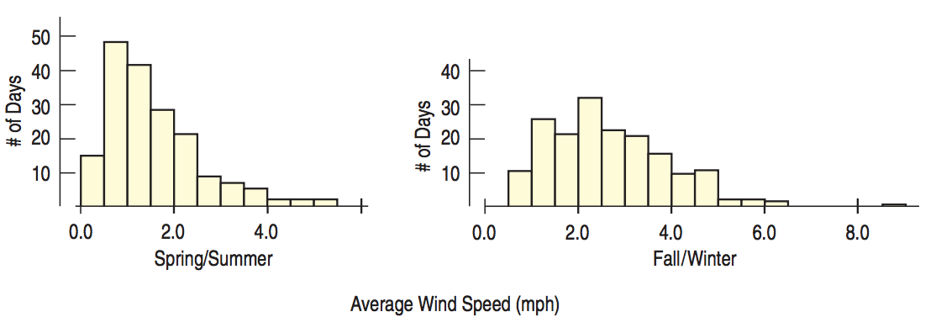
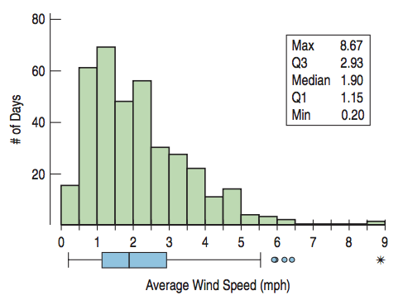
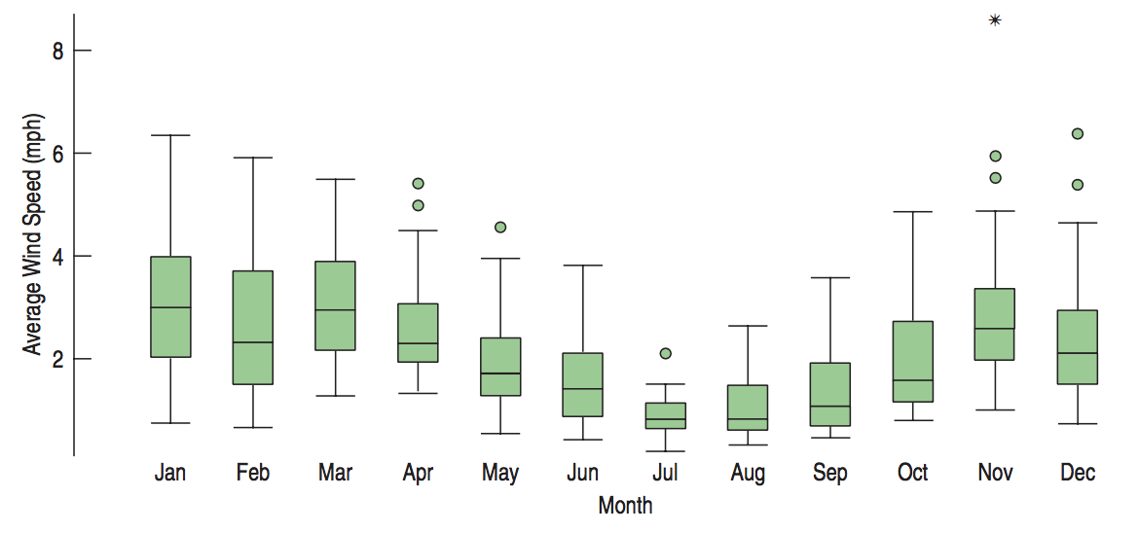
Lecture 04
Comparing Groups with Histogram and Boxplots
Data:
When: Days during 2011
What: Average daily wind speed (mph)
Where: Hopkins Forest in western Massachusetts
Why: Long-term observations to study ecology and climate
Outliers are context dependent!
CHOONG-WAN WOO | COCOAN lab | http://cocoanlab.github.io

Slide 4
Lecture 04
Outliers
Outliers may be the most important values.
Or they may be just errors.
What to do with them?
Correct them if possible
Report summaries and analyses with and without the outliers (readers can decide)
Some statistical methods: down-weight them (e.g., robust regression), smoothing, etc.
Never do:
Leave them in place and proceed as if nothing were unusual
Omit an outlier from the analysis without comment
CHOONG-WAN WOO | COCOAN lab | http://cocoanlab.github.io

Slide 5
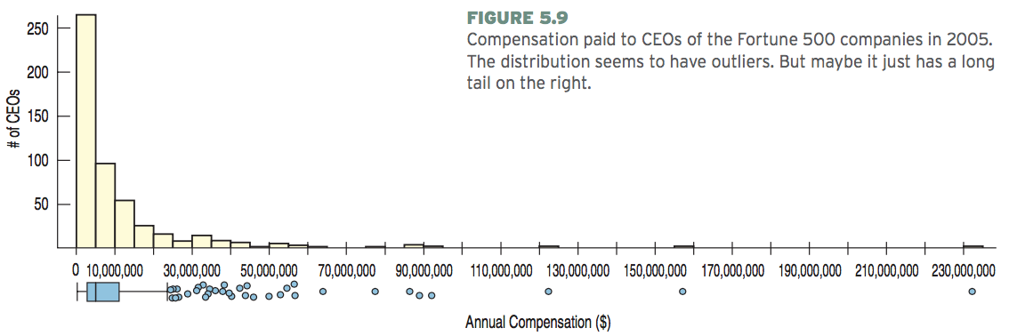
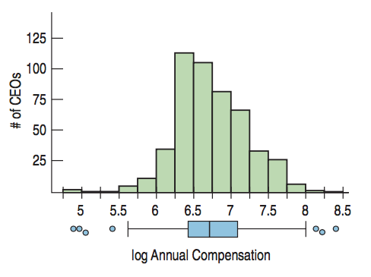
Lecture 04
Re-expressing Data
To improve symmetry:
Logarithms of 2005 CEO compensations
Very common in physio data preprocessing
E.g., logarithm, square root (normalization)
CHOONG-WAN WOO | COCOAN lab | http://cocoanlab.github.io

Slide 6
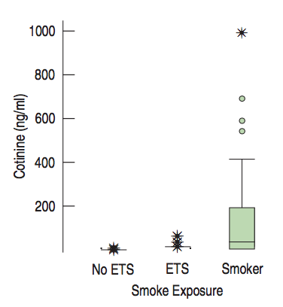
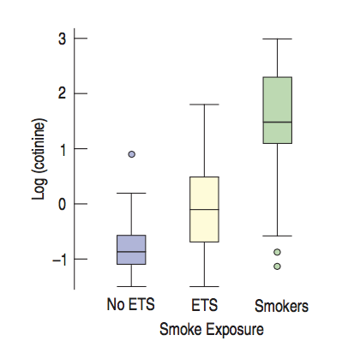
Lecture 04
Re-expressing Data
To equalize spread across groups
Log-transform
*ETS: exposed to smoke
Normalization is one of the key elements of recent successes of artificial intelligence (machine learning)
CHOONG-WAN WOO | COCOAN lab | http://cocoanlab.github.io

Slide 7
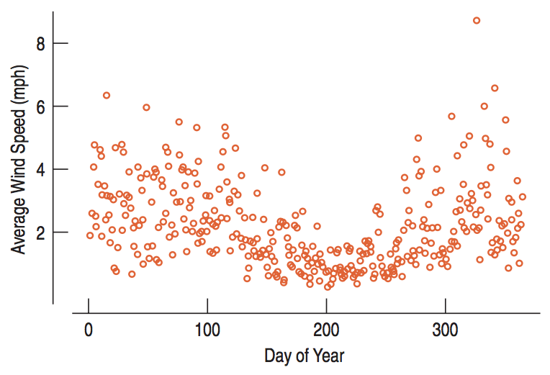
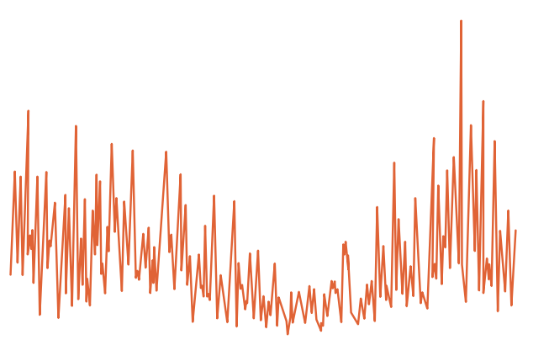
Lecture 04
Timeplots
Values against time: timeplot, time-series data (e.g., neural activity data, stock market, bio-sensor…)
CHOONG-WAN WOO | COCOAN lab | http://cocoanlab.github.io

Slide 8
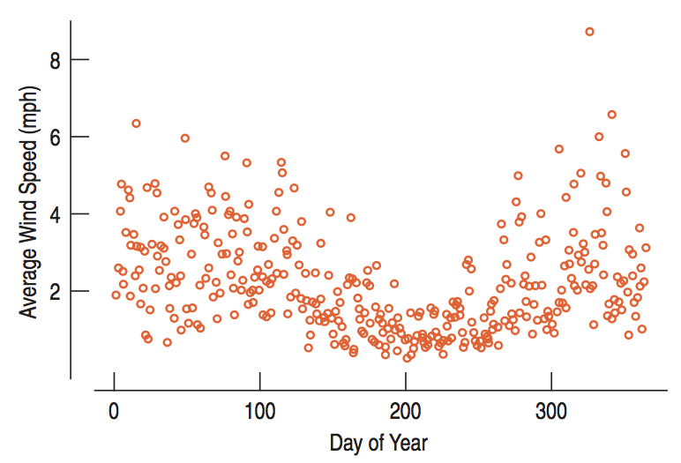
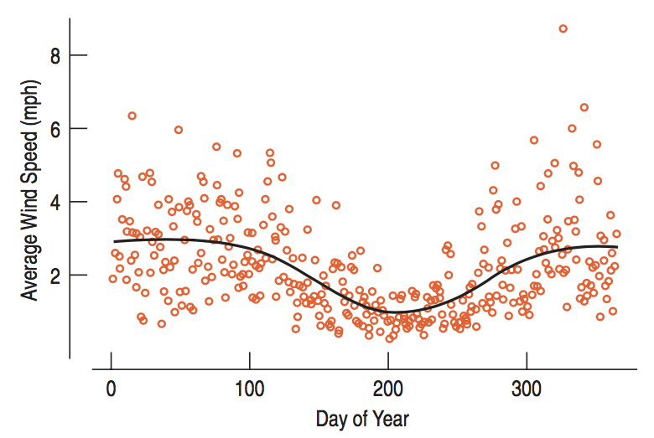
Lecture 04
Smoothing timeplots
Lowess (locally weighted scatterplot smoothing)
Moving average
CHOONG-WAN WOO | COCOAN lab | http://cocoanlab.github.io

Slide 9
Lecture 04
Key Points
Chapter 5: Comparing distributions: considerations
Outliers are context dependent
Re-expressing data (log, sqrt)
to improve symmetry
to equalize spread
Timeplots
Moving-averages, smoothing
CHOONG-WAN WOO | COCOAN lab | http://cocoanlab.github.io

Slide 10
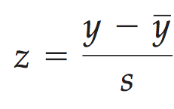
Lecture 04
z-Scores
To compare different values in different units,
the values should be standardized!
z-scores: mean = 0, standard deviation = 1
standardized values
= using standard deviation as a ruler!
Two elements: shifting and scaling
CHOONG-WAN WOO | COCOAN lab | http://cocoanlab.github.io

Slide 11
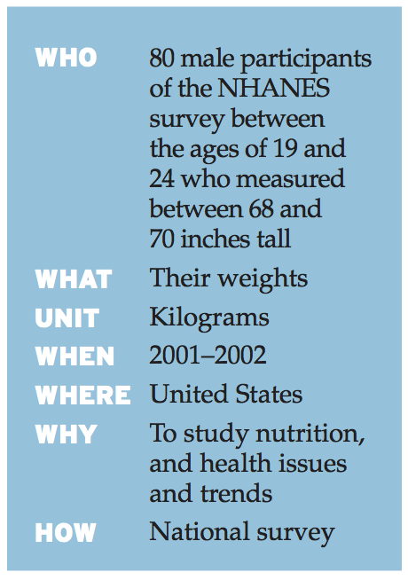
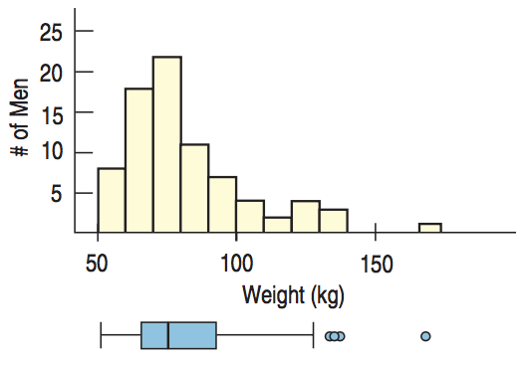
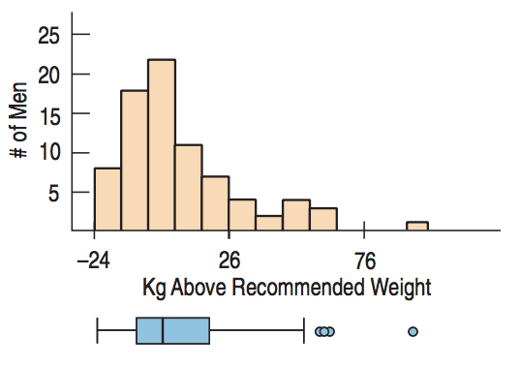
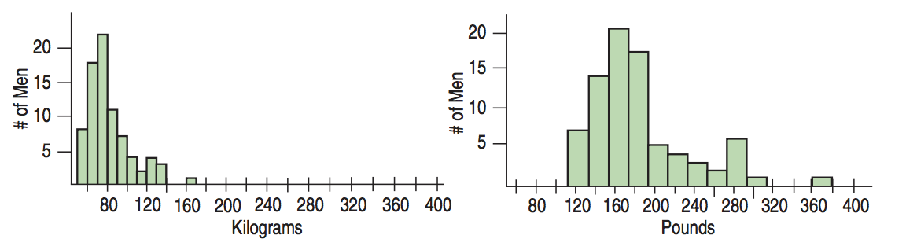
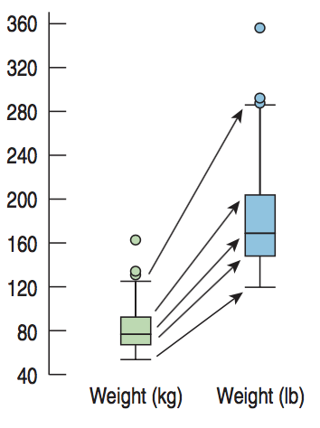
Lecture 04
Shifting and rescaling
Subtract recommended weight: 74 kg
CHOONG-WAN WOO | COCOAN lab | http://cocoanlab.github.io

Slide 12
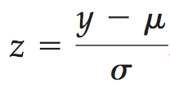
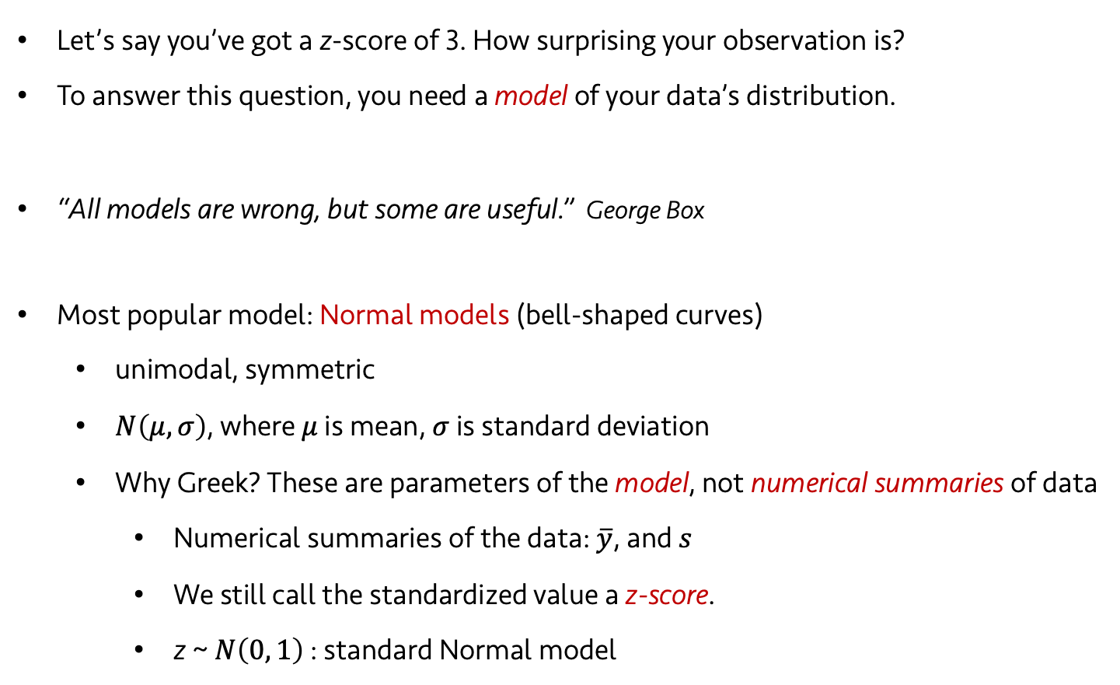
Lecture 04
Normal models: When is a z-score big?
Let’s say you’ve got a z-score of 3. How surprising your observation is?
To answer this question, you need a model of your data’s distribution.
“All models are wrong, but some are useful.” George Box
Most popular model: Normal models (bell-shaped curves)
unimodal, symmetric
$N\left(μ, σ\right)$, where $μ$ is mean, $σ$ is standard deviation
Why Greek? These are parameters of the model, not numerical summaries of data
Numerical summaries of the data: $\overline{y}$, and $s$
We still call the standardized value a z-score.
z ~ $N\left(0, 1\right)$ : standard Normal model
CHOONG-WAN WOO | COCOAN lab | http://cocoanlab.github.io

Slide 13
Lecture 04
Normality assumption
All models make assumptions, which should be carefully examined.
Nearly normal condition (it’s sufficient):
shape: unimodal, symmetric
We can check it with histogram or a normal probability plot.
CHOONG-WAN WOO | COCOAN lab | http://cocoanlab.github.io

Slide 14
Lecture 04
Quiz!
https://forms.gle/sdnQE5VUxiHdfZoTA
CHOONG-WAN WOO | COCOAN lab | http://cocoanlab.github.io

Slide 15
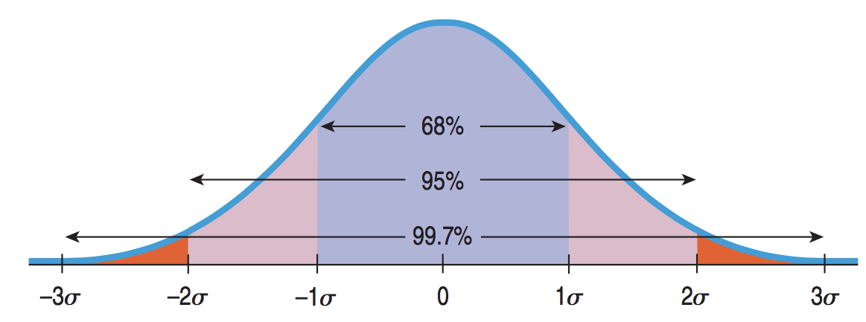
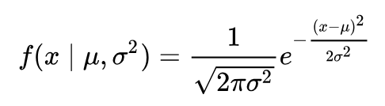
Lecture 04
The 68–95–99.7 Rule
68% of the data fall within 1 standard deviation, 95% within 2 std, 99.7% within 3 std.
z-score = 1 means, you are 84%! Why?
100-(50-68/2) = 84%
CHOONG-WAN WOO | COCOAN lab | http://cocoanlab.github.io

Slide 16
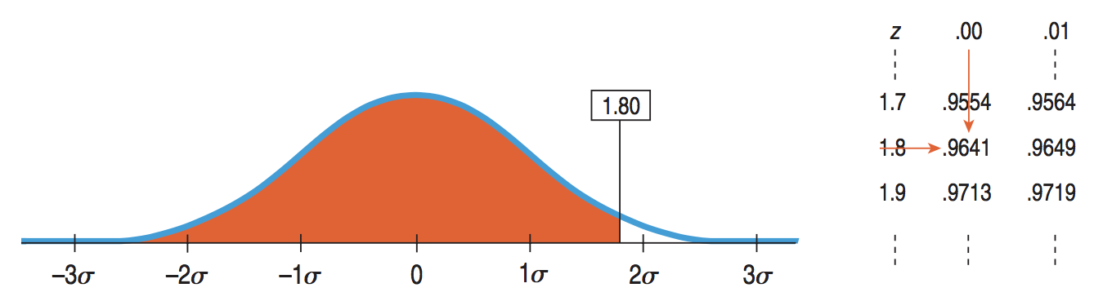
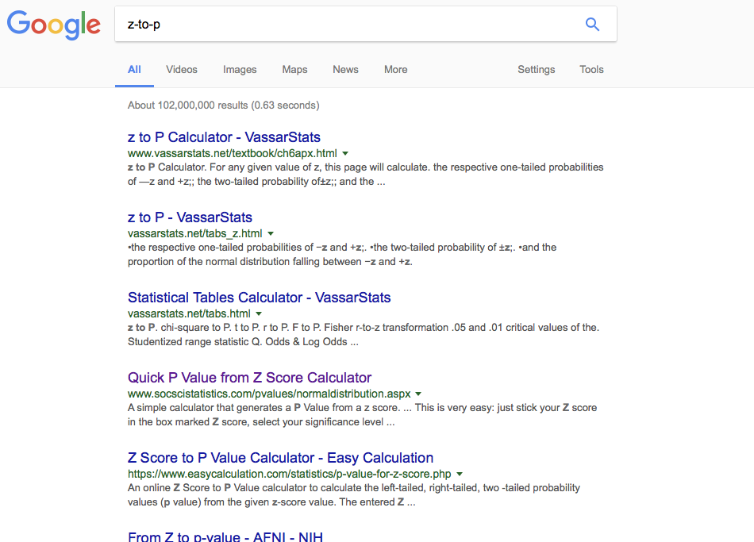
Lecture 04
Finding Normal percentiles
A table of Normal percentiles (Table Z in Appendix D)
Or google it!
p-to-z is same: Table Z again.
CHOONG-WAN WOO | COCOAN lab | http://cocoanlab.github.io

Slide 17
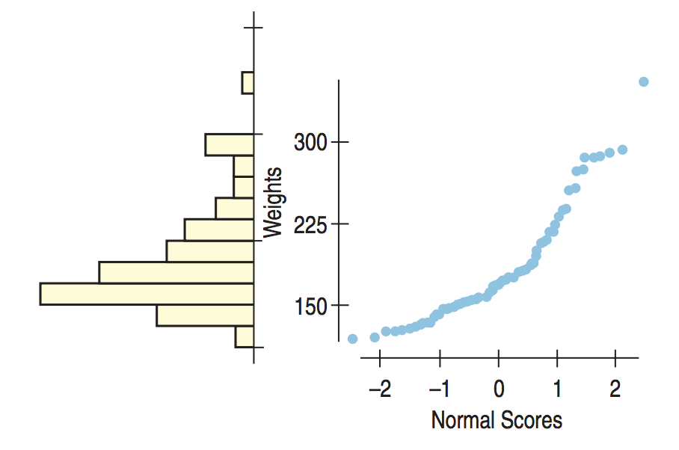
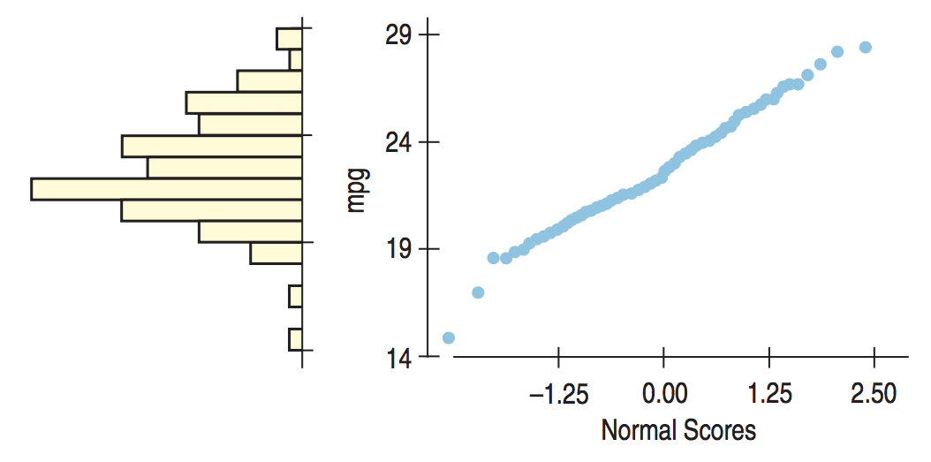
Lecture 04
Normal probability plots
Original value against normal scores (theoretically expected value):
Similar to Q-Q plot (quantile-quantile plot)
symmetric
skewed
CHOONG-WAN WOO | COCOAN lab | http://cocoanlab.github.io

Slide 18
Activity 03
Procedure
Sorting (draw a histogram)
Get percentile
P-to-Z
Make a scatter plot y-axis = Original values x-axis = Normal scores
CHOONG-WAN WOO | COCOAN lab | http://cocoanlab.github.io

Slide 19
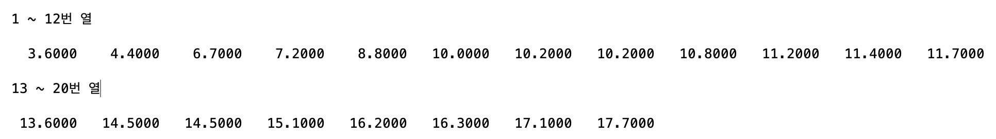
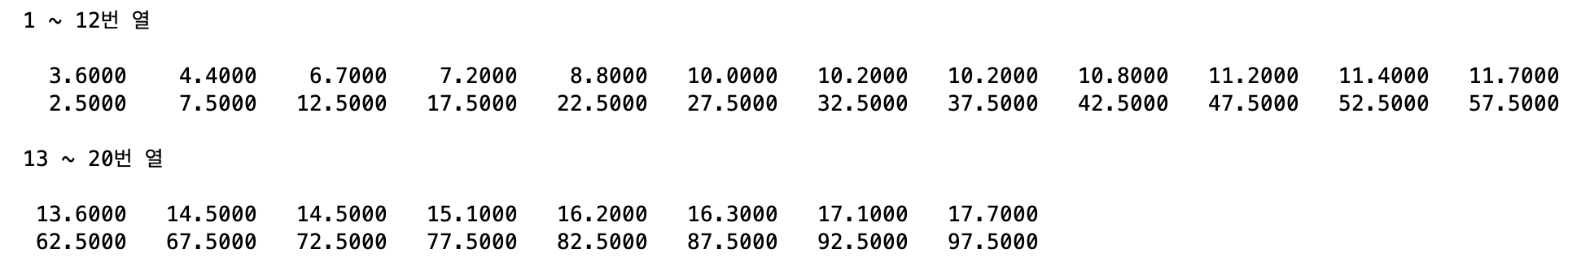
Activity 03
Example
Data
Sorting (draw a histogram)
Get percentile
P-to-Z
Make a scatter plot y-axis = Original values x-axis = Normal scores
1. Sorting
2. Percentile,
If there are N numbers, percentile can be calculated as 100*((1-0.5)/N), 100*((2-0.5)/N), 100*((3-0.5)/N), …, 100*((N-0.5)/N)
Sorted value
Percentile
CHOONG-WAN WOO | COCOAN lab | http://cocoanlab.github.io

Slide 20
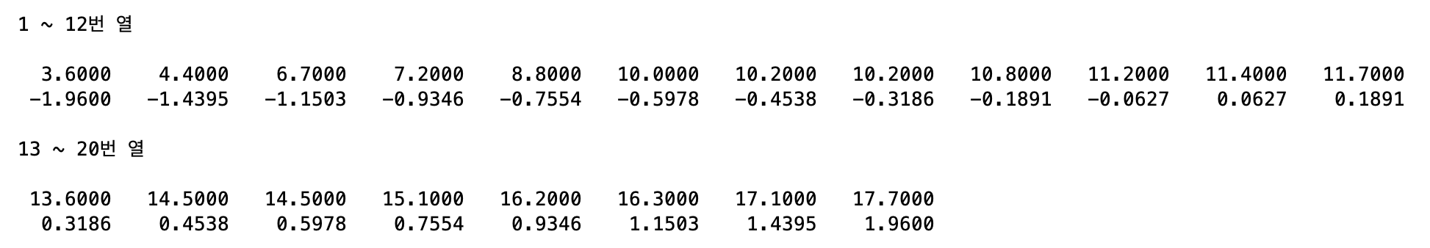
Activity 03
Example
2. Percentile,
If there are N numbers, percentile can be calculated as 100*((1-0.5)/N), 100*((2-0.5)/N), 100*((3-0.5)/N), …, 100*((N-0.5)/N)
Sorting (draw a histogram)
Get percentile
P-to-Z
Make a scatter plot y-axis = Original values x-axis = Normal scores
Sorted value
Percentile
3. P-to-Z
Sorted value
Z-values
CHOONG-WAN WOO | COCOAN lab | http://cocoanlab.github.io

Slide 21
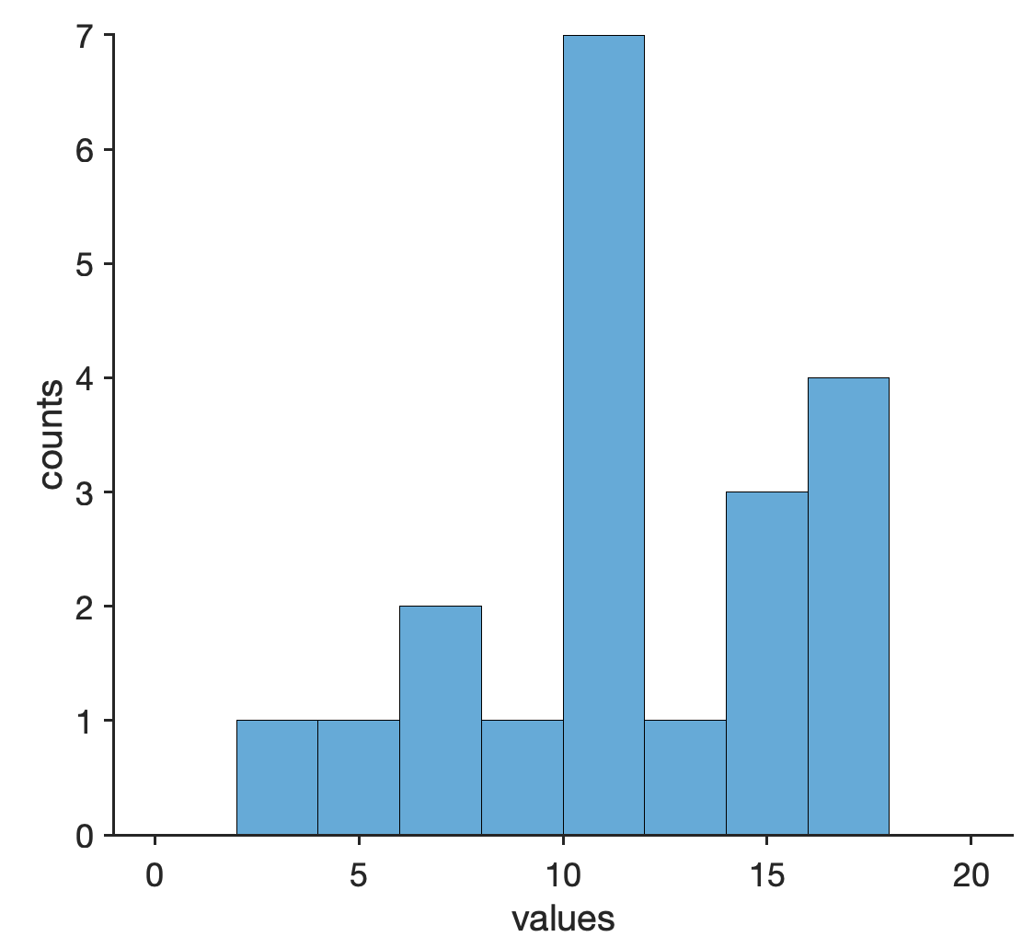
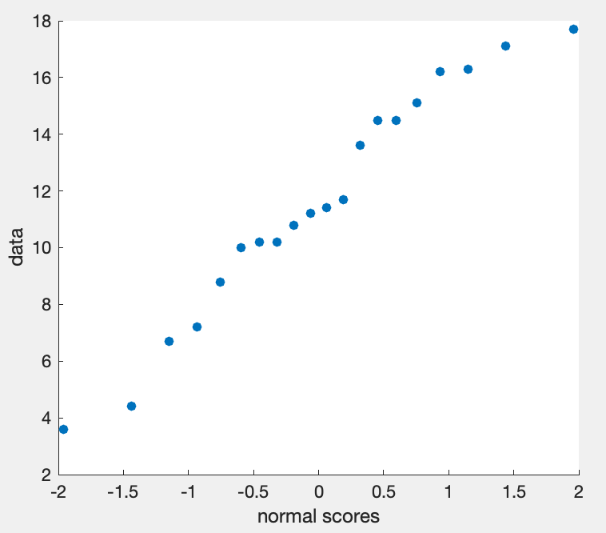
Activity 03
Example
3. P-to-Z
Sorting (draw a histogram)
Get percentile
P-to-Z
Make a scatter plot y-axis = Original values x-axis = Normal scores
Sorted value
Z-values
4. Make a scatter plot (and also histogram)

Slide 22
Lecture 04
Key Points
Chapter 5: Comparing distributions: considerations
Outliers are context dependent
Re-expressing data (log, sqrt)
to improve symmetry
to equalize spread
Timeplots
Moving-averages, smoothing
Chapter 6: Normal model
z-score, shifting and rescaling
Normal model
Normality assumption; unimodal, symmetric
68-95-99.7 Rule
z-to-p, p-to-z
Normal probability plots
CHOONG-WAN WOO | COCOAN lab | http://cocoanlab.github.io

