Slide 1


GBME Probability and Statistics
Activity 06
Activity 06
Bayes theorem and Random variables
CHOONG-WAN WOO | COCOAN lab | http://cocoanlab.github.io

Slide 2
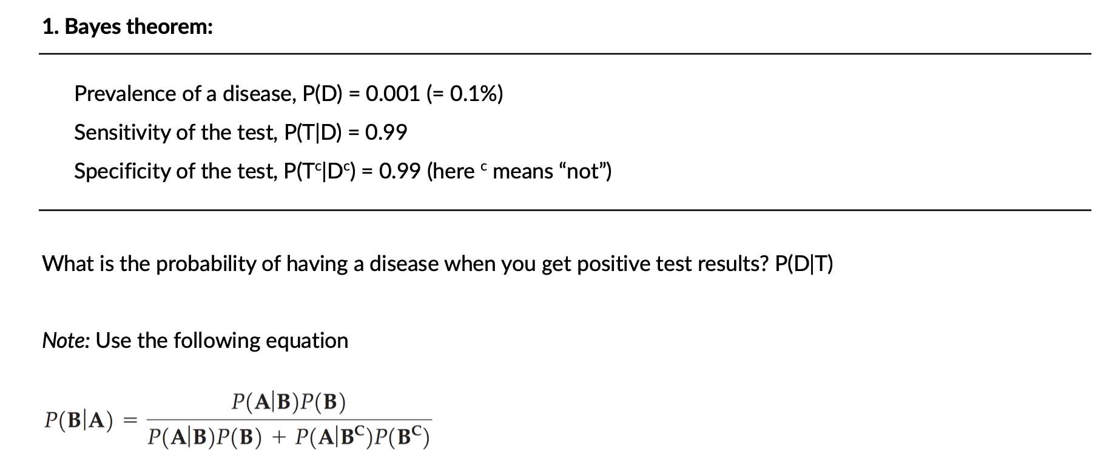
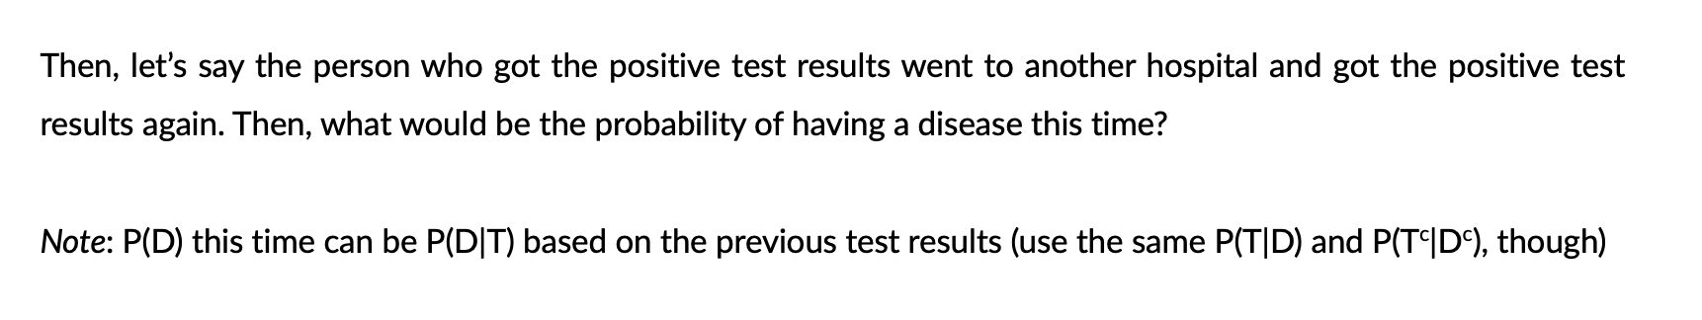
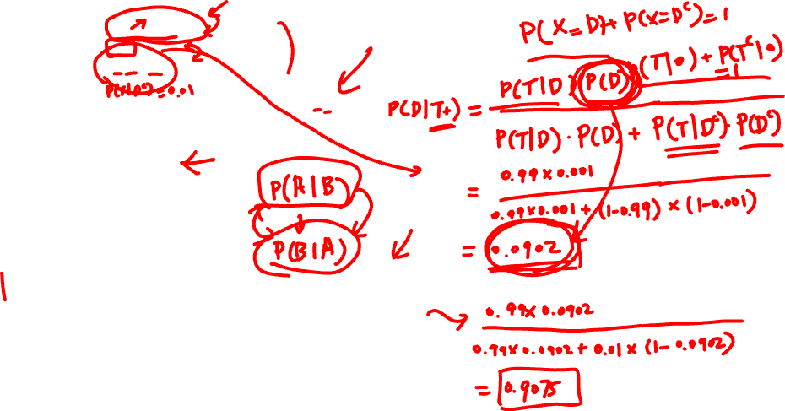
Activity 06
CHOONG-WAN WOO | COCOAN lab | http://cocoanlab.github.io

Slide 3
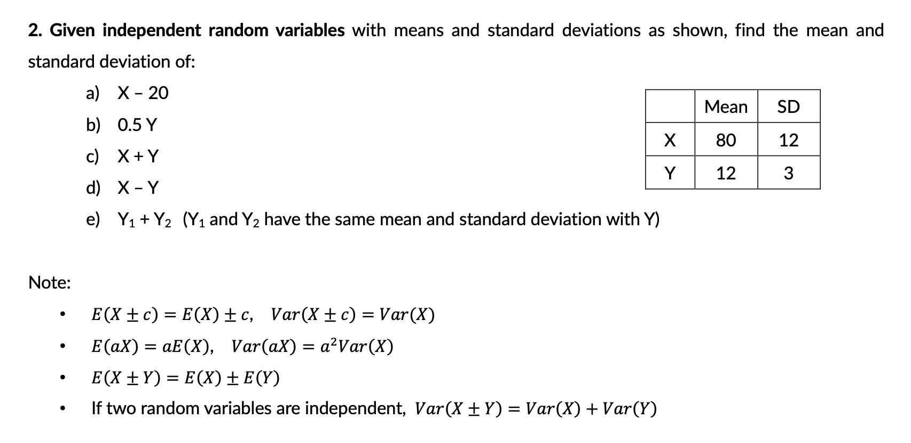
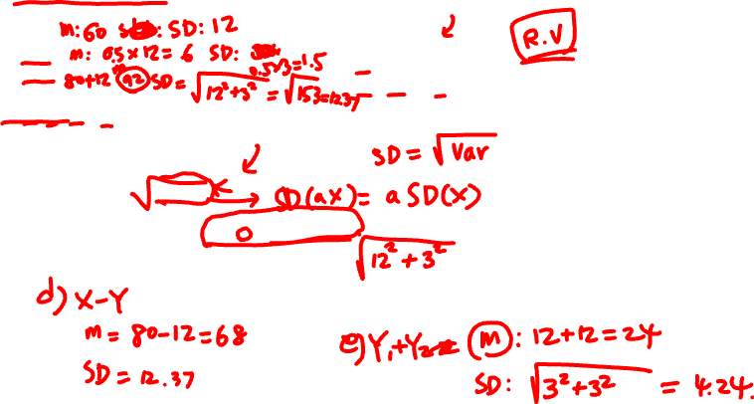
Activity 06
CHOONG-WAN WOO | COCOAN lab | http://cocoanlab.github.io

Slide 4
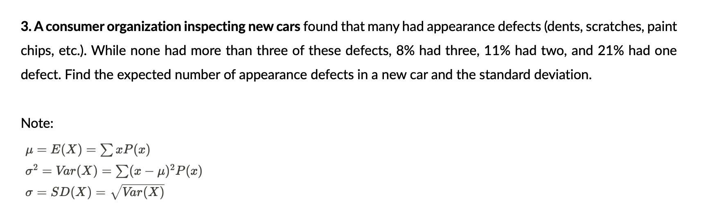
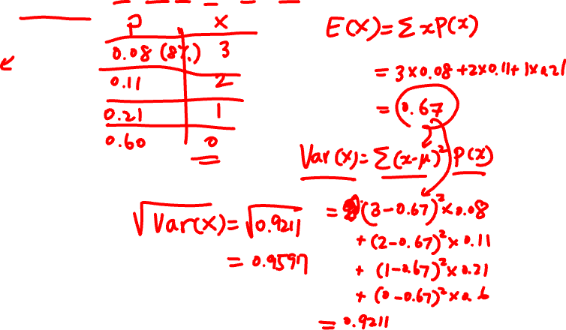
Activity 06
CHOONG-WAN WOO | COCOAN lab | http://cocoanlab.github.io

Slide 5
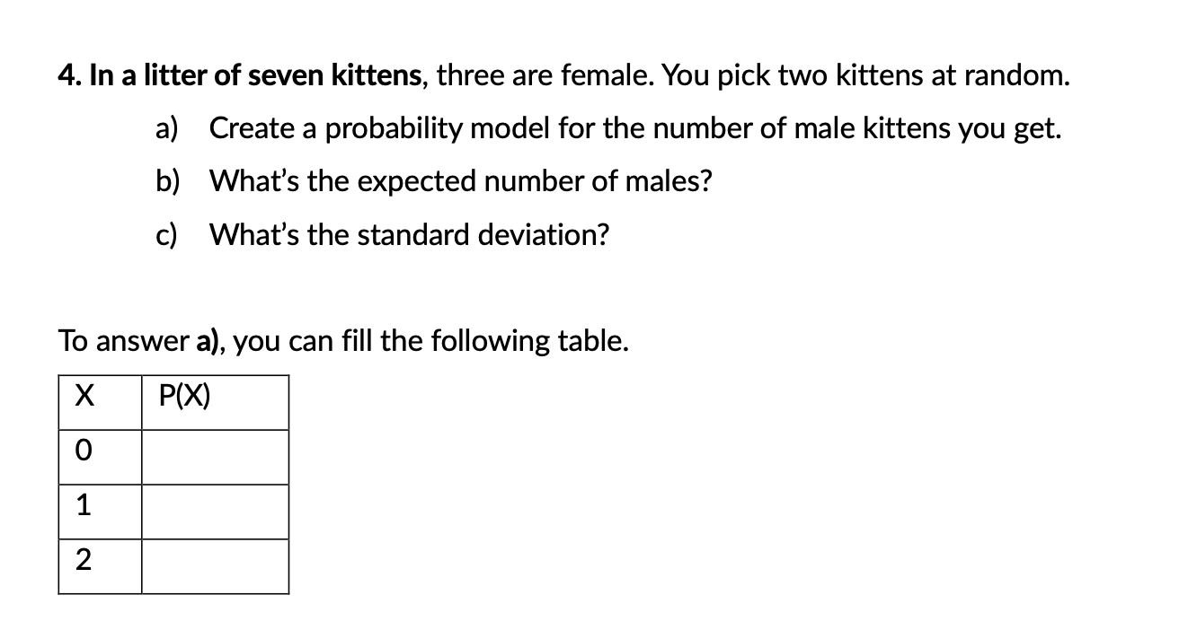
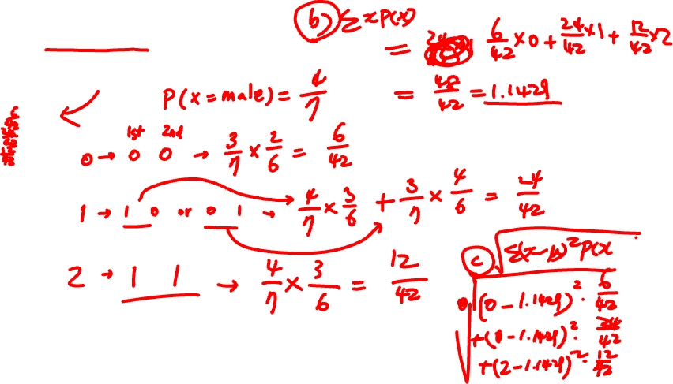
Activity 06
CHOONG-WAN WOO | COCOAN lab | http://cocoanlab.github.io

Slide 6
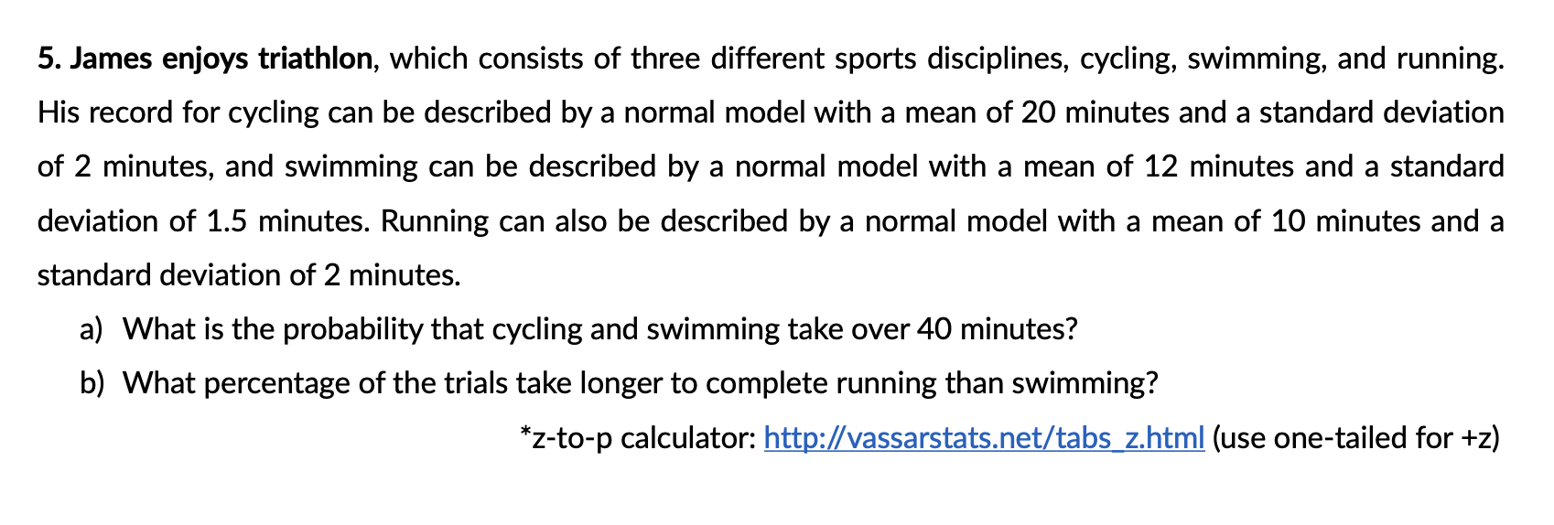
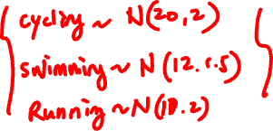
Activity 06
CHOONG-WAN WOO | COCOAN lab | http://cocoanlab.github.io

