Slide 1


GBME Probability and Statistics
Lecture 15
Lecture 15
Confidence interval for proportions
CHOONG-WAN WOO | COCOAN lab | http://cocoanlab.github.io

Slide 2
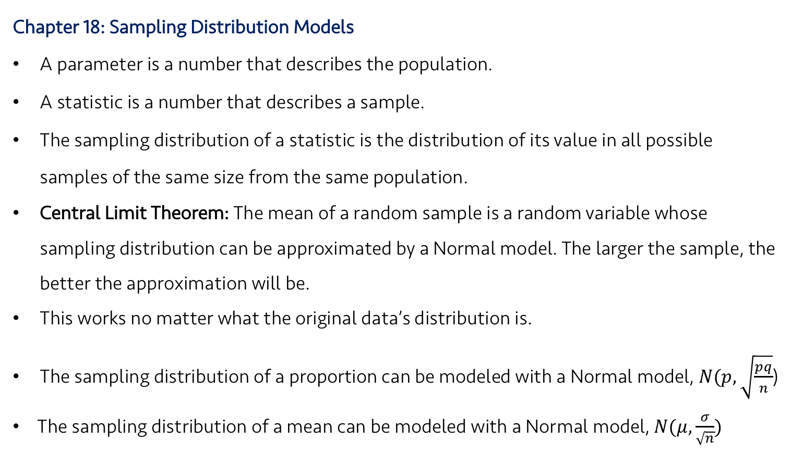
Lecture 15
Review: Key Points
Chapter 18: Sampling Distribution Models
A parameter is a number that describes the population.
A statistic is a number that describes a sample.
The sampling distribution of a statistic is the distribution of its value in all possible samples of the same size from the same population.
Central Limit Theorem: The mean of a random sample is a random variable whose sampling distribution can be approximated by a Normal model. The larger the sample, the better the approximation will be.
This works no matter what the original data’s distribution is.
The sampling distribution of a proportion can be modeled with a Normal model, $N(p,\sqrt{\frac{pq}{n}}$)
The sampling distribution of a mean can be modeled with a Normal model, $N(μ,\frac{σ}{\sqrt{n}})$
CHOONG-WAN WOO | COCOAN lab | http://cocoanlab.github.io

Slide 3
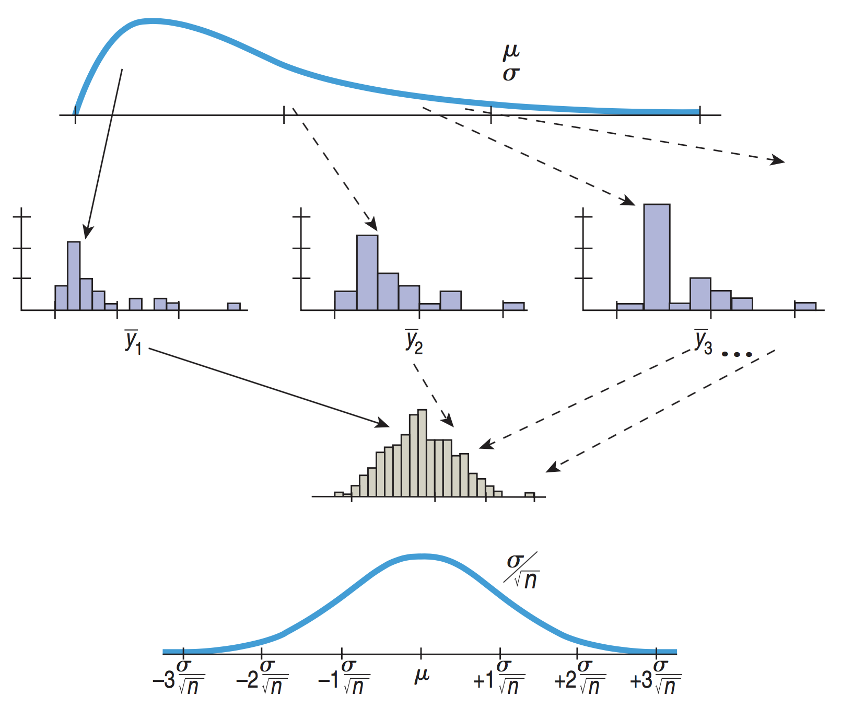
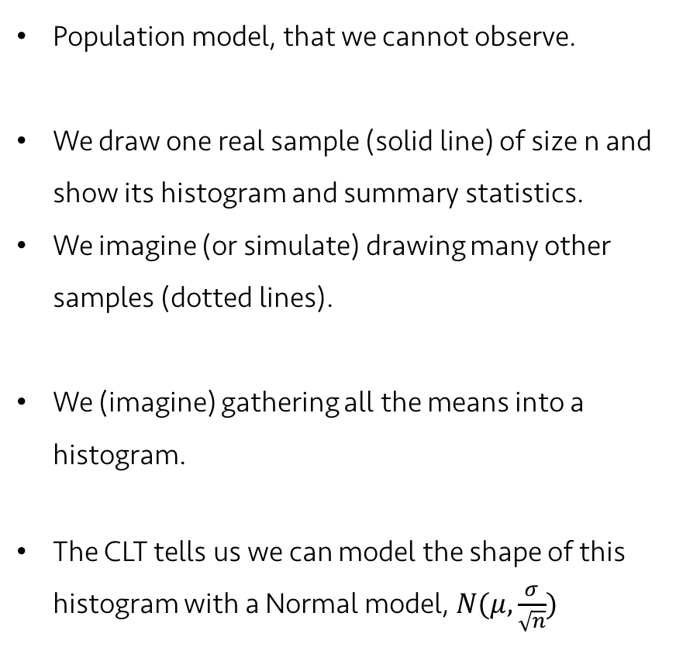
Lecture 15
Let’s revisit what we learned in the last class
Population model, that we cannot observe.
We draw one real sample (solid line) of size n and show its histogram and summary statistics.
We imagine (or simulate) drawing many other samples (dotted lines).
We (imagine) gathering all the means into a histogram.
The CLT tells us we can model the shape of this histogram with a Normal model, $N(μ,\frac{σ}{\sqrt{n}})$
CHOONG-WAN WOO | COCOAN lab | http://cocoanlab.github.io

Slide 4
Lecture 15
But… can we actually know the mean and SD of the sampling distribution?
Population model, that we cannot observe.
We draw one real sample (solid line) of size n and show its histogram and summary statistics.
We imagine (or simulate) drawing many other samples (dotted lines).
We (imagine) gathering all the means into a histogram.
The CLT tells us we can model the shape of this histogram with a Normal model, $N(μ,\frac{σ}{\sqrt{n}})$
No.. Then, what should we do?
To be continued…
CHOONG-WAN WOO | COCOAN lab | http://cocoanlab.github.io

Slide 5
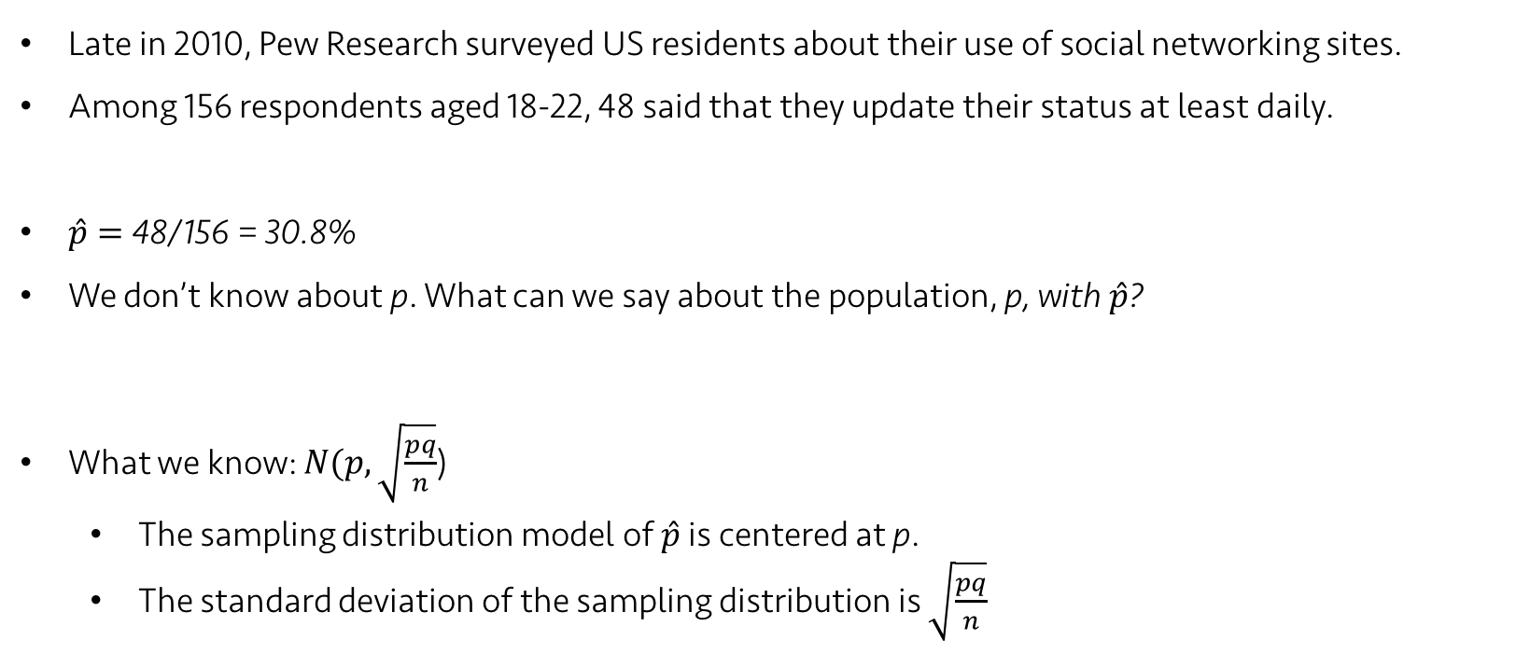
Lecture 15
An example data on “ Facebook use”:
Late in 2010, Pew Research surveyed US residents about their use of social networking sites.
Among 156 respondents aged 18-22, 48 said that they update their status at least daily.
$\hat{p}=$ 48/156 = 30.8%
We don’t know about p. What can we say about the population, p, with $\hat{p}$?
What we know: $N(p,\sqrt{\frac{pq}{n}}$)
The sampling distribution model of $\hat{p}$ is centered at p.
The standard deviation of the sampling distribution is $\sqrt{\frac{pq}{n}}$
CHOONG-WAN WOO | COCOAN lab | http://cocoanlab.github.io

Slide 6
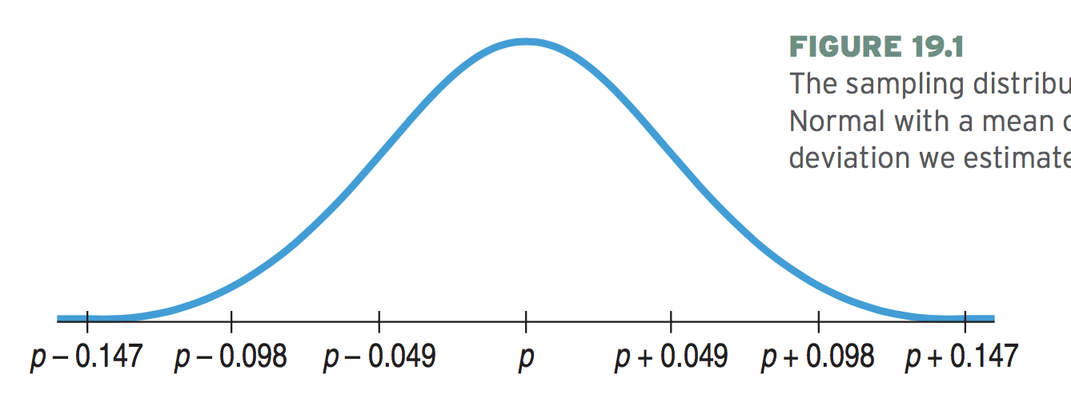
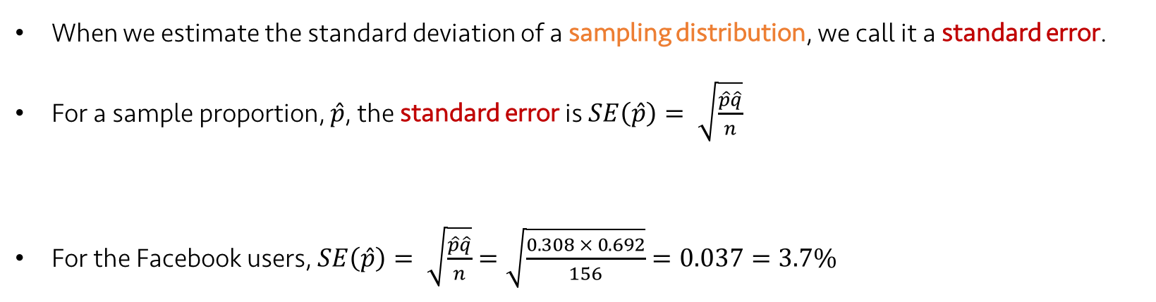
Lecture 15
Standard error
When we estimate the standard deviation of a sampling distribution, we call it a standard error.
For a sample proportion, $\hat{p}$, the standard error is $SE\left(\hat{p}\right)= \sqrt{\frac{\hat{p}\hat{q}}{n}}$
For the Facebook users, $SE\left(\hat{p}\right)= \sqrt{\frac{\hat{p}\hat{q}}{n}}=\sqrt{\frac{0.308 × 0.692}{156}}=0.037=3.7\%$
p-0.111
p-0.074
p-0.037
p
p+0.037
p+0.074
p+0.111
~95%
CHOONG-WAN WOO | COCOAN lab | http://cocoanlab.github.io

Slide 7
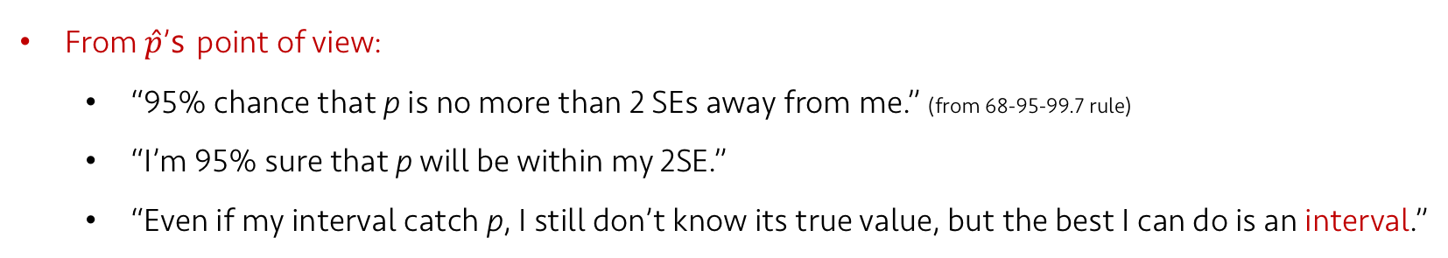

Lecture 15
Confidence Interval
From $\hat{p}$’s point of view:
“95% chance that p is no more than 2 SEs away from me.” (from 68-95-99.7 rule)
“I’m 95% sure that p will be within my 2SE.”
“Even if my interval catch p, I still don’t know its true value, but the best I can do is an interval.”
2SE
= ~95% chance
$$\hat{p}$$
p-0.111
p-0.074
p-0.037
p
p+0.037
p+0.074
p+0.111
~95%
CHOONG-WAN WOO | COCOAN lab | http://cocoanlab.github.io

Slide 8
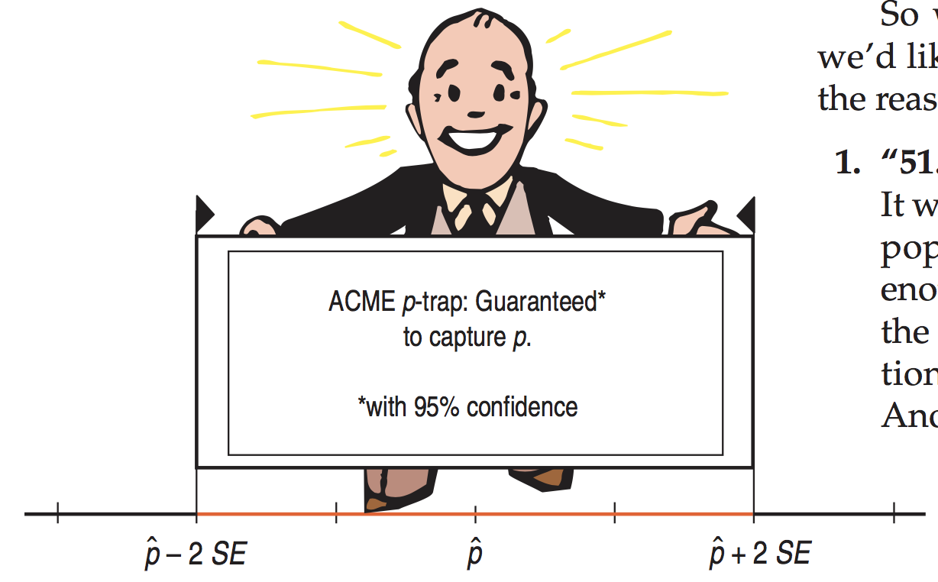
Lecture 15
Confidence Interval
From $\hat{p}$’s point of view:
“95% chance that p is no more than 2 SEs away from me.” (from 68-95-99.7 rule)
“I’m 95% sure that p will be within my 2SE.”
“Even if my interval catch p, I still don’t know its true value, but the best I can do is an interval.”
CHOONG-WAN WOO | COCOAN lab | http://cocoanlab.github.io

Slide 9
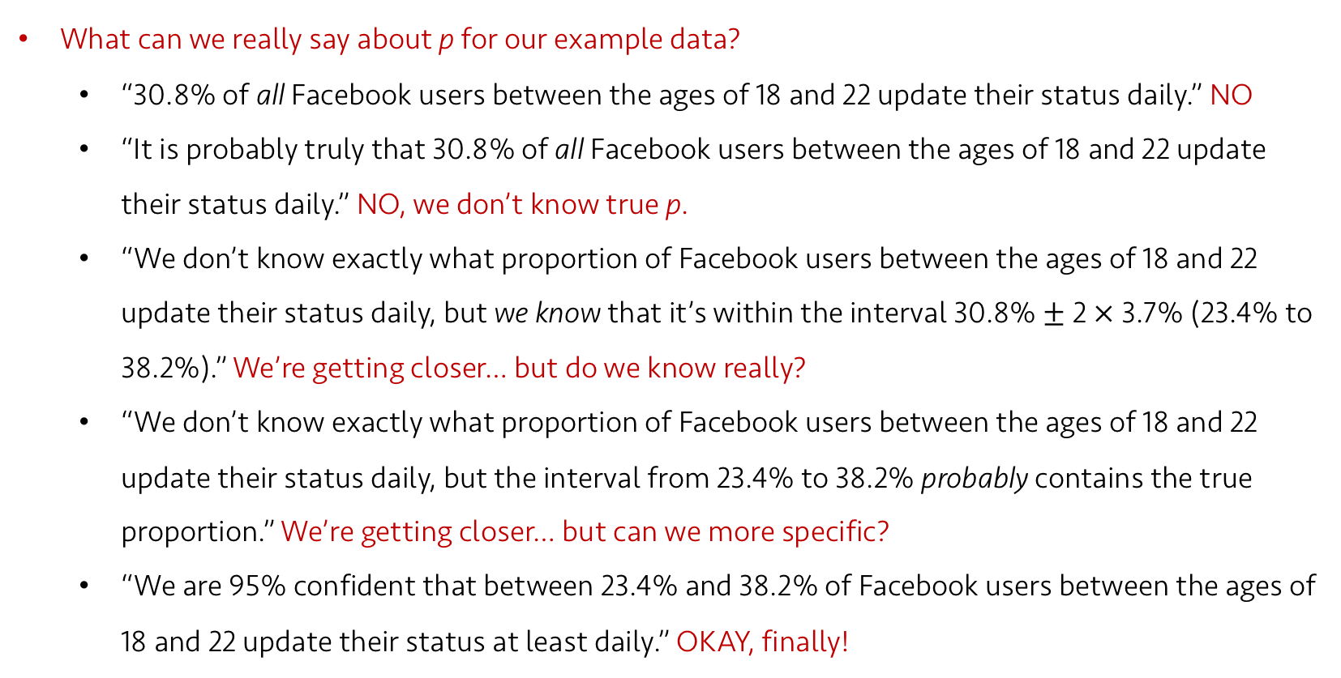
Lecture 15
Confidence Interval
What can we really say about p for our example data?
“30.8% of all Facebook users between the ages of 18 and 22 update their status daily.” NO
“It is probably truly that 30.8% of all Facebook users between the ages of 18 and 22 update their status daily.” NO, we don’t know true p.
“We don’t know exactly what proportion of Facebook users between the ages of 18 and 22 update their status daily, but we know that it’s within the interval 30.8% $±$ 2 $×$ 3.7% (23.4% to 38.2%).” We’re getting closer… but do we know really?
“We don’t know exactly what proportion of Facebook users between the ages of 18 and 22 update their status daily, but the interval from 23.4% to 38.2% probably contains the true proportion.” We’re getting closer… but can we more specific?
“We are 95% confident that between 23.4% and 38.2% of Facebook users between the ages of 18 and 22 update their status at least daily.” OKAY, finally!
CHOONG-WAN WOO | COCOAN lab | http://cocoanlab.github.io

Slide 10
Lecture 15
Confidence Interval
p-0.111
p-0.074
p-0.037
p+0.037
p+0.074
p+0.111
$$\hat{p}$$
CHOONG-WAN WOO | COCOAN lab | http://cocoanlab.github.io

Slide 11
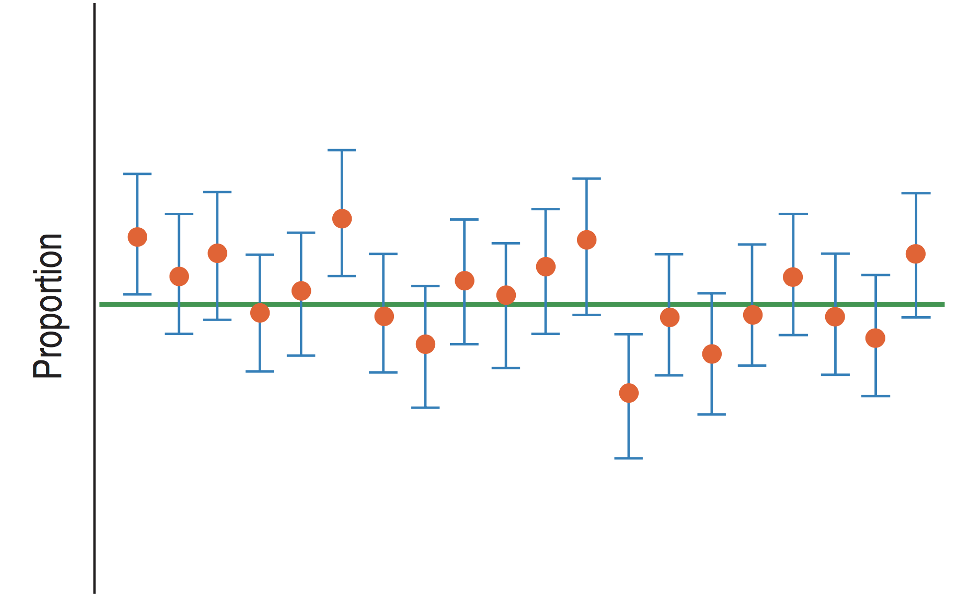
Lecture 15
Confidence Interval
CHOONG-WAN WOO | COCOAN lab | http://cocoanlab.github.io

Slide 12
Lecture 15
Confidence Interval
Each sample proportion can be used to make a confidence interval.
The Central Limit Theorem assures us that (in the long run) 95% of the intervals cover the true value, and only 5% are wrong.
The confidence intervals are random because they are based on random samples.
Our confidence (and our uncertainty) is about the interval, not the true proportion.
CHOONG-WAN WOO | COCOAN lab | http://cocoanlab.github.io

Slide 13
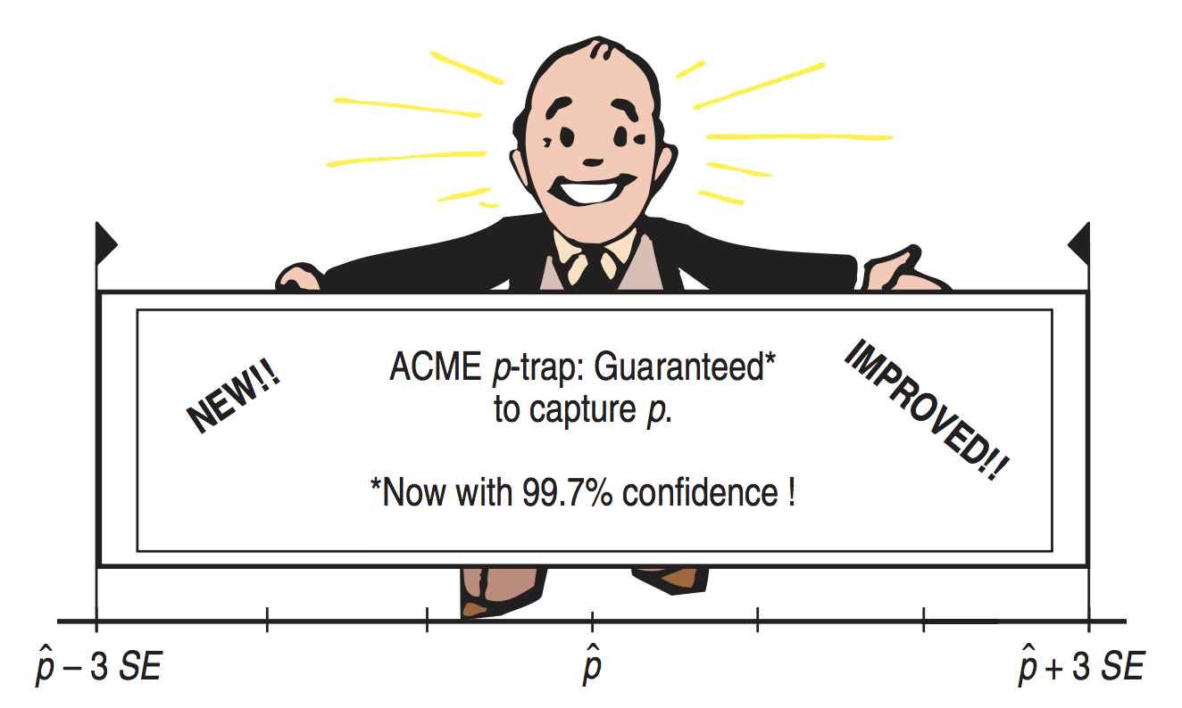
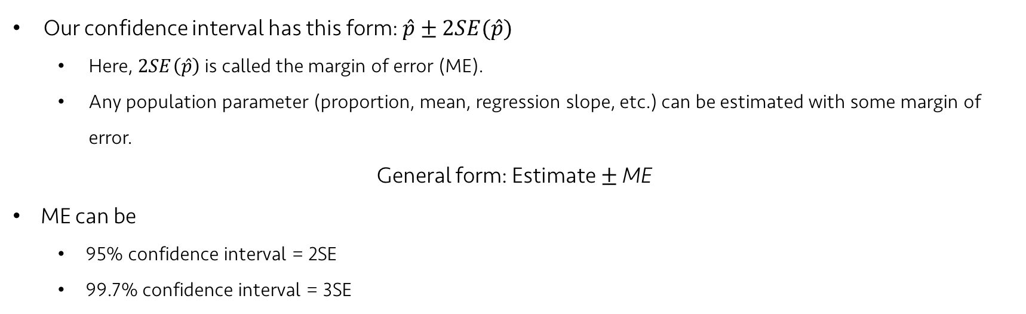
Lecture 15
Certainty vs. Precision
Our confidence interval has this form: $\hat{p}±2SE(\hat{p})$
Here, $2SE\left(\hat{p}\right)$ is called the margin of error (ME).
Any population parameter (proportion, mean, regression slope, etc.) can be estimated with some margin of error.
General form: Estimate $±$ ME
ME can be
95% confidence interval = 2SE
99.7% confidence interval = 3SE
CHOONG-WAN WOO | COCOAN lab | http://cocoanlab.github.io

Slide 14
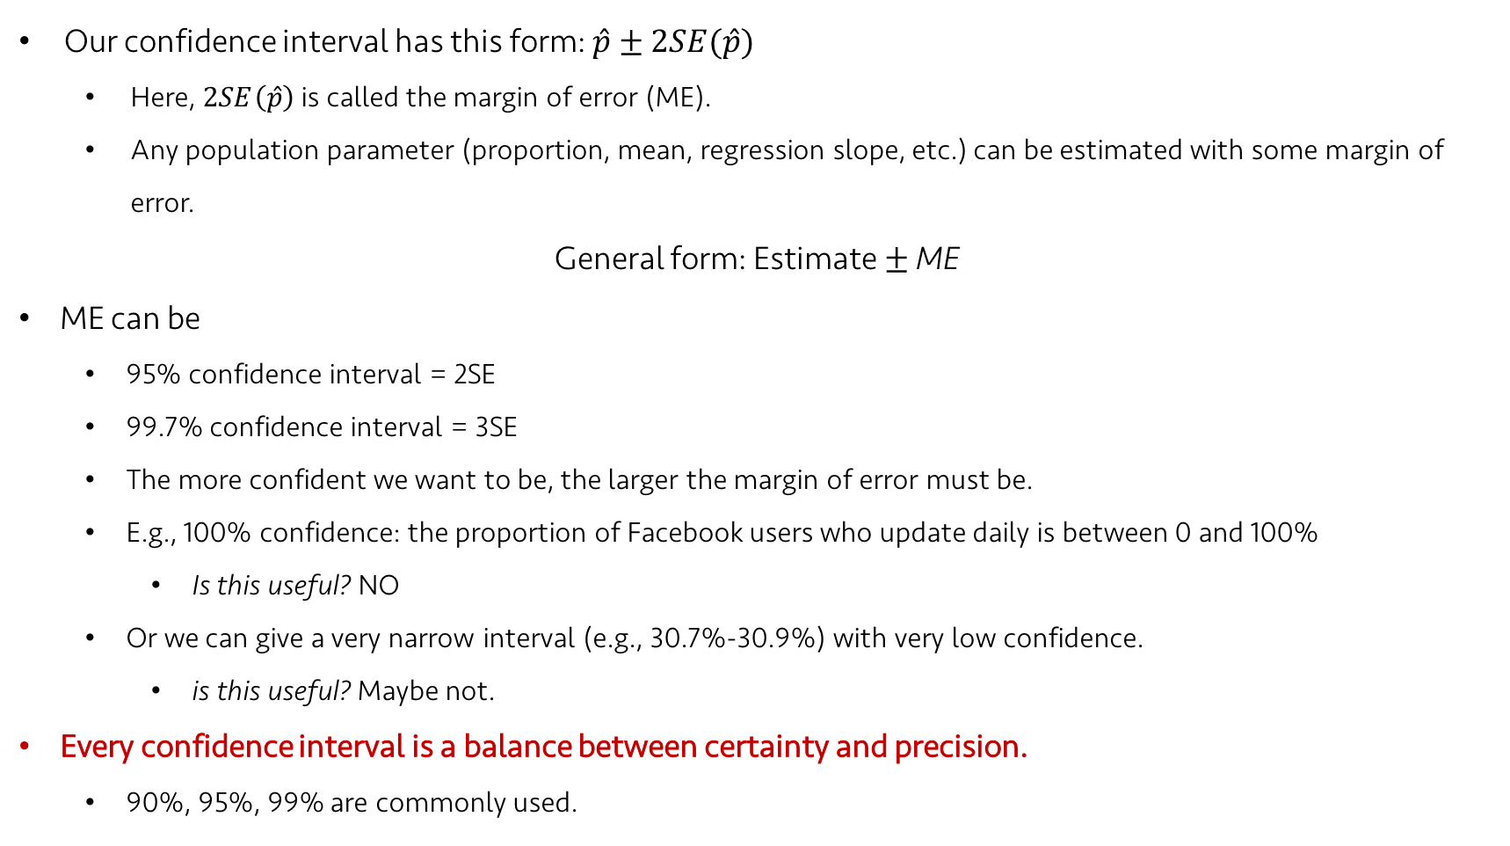
Lecture 15
Certainty vs. Precision
Our confidence interval has this form: $\hat{p}±2SE(\hat{p})$
Here, $2SE\left(\hat{p}\right)$ is called the margin of error (ME).
Any population parameter (proportion, mean, regression slope, etc.) can be estimated with some margin of error.
General form: Estimate $±$ ME
ME can be
95% confidence interval = 2SE
99.7% confidence interval = 3SE
The more confident we want to be, the larger the margin of error must be.
E.g., 100% confidence: the proportion of Facebook users who update daily is between 0 and 100%
Is this useful? NO
Or we can give a very narrow interval (e.g., 30.7%-30.9%) with very low confidence.
is this useful? Maybe not.
Every confidence interval is a balance between certainty and precision.
90%, 95%, 99% are commonly used.

Slide 15
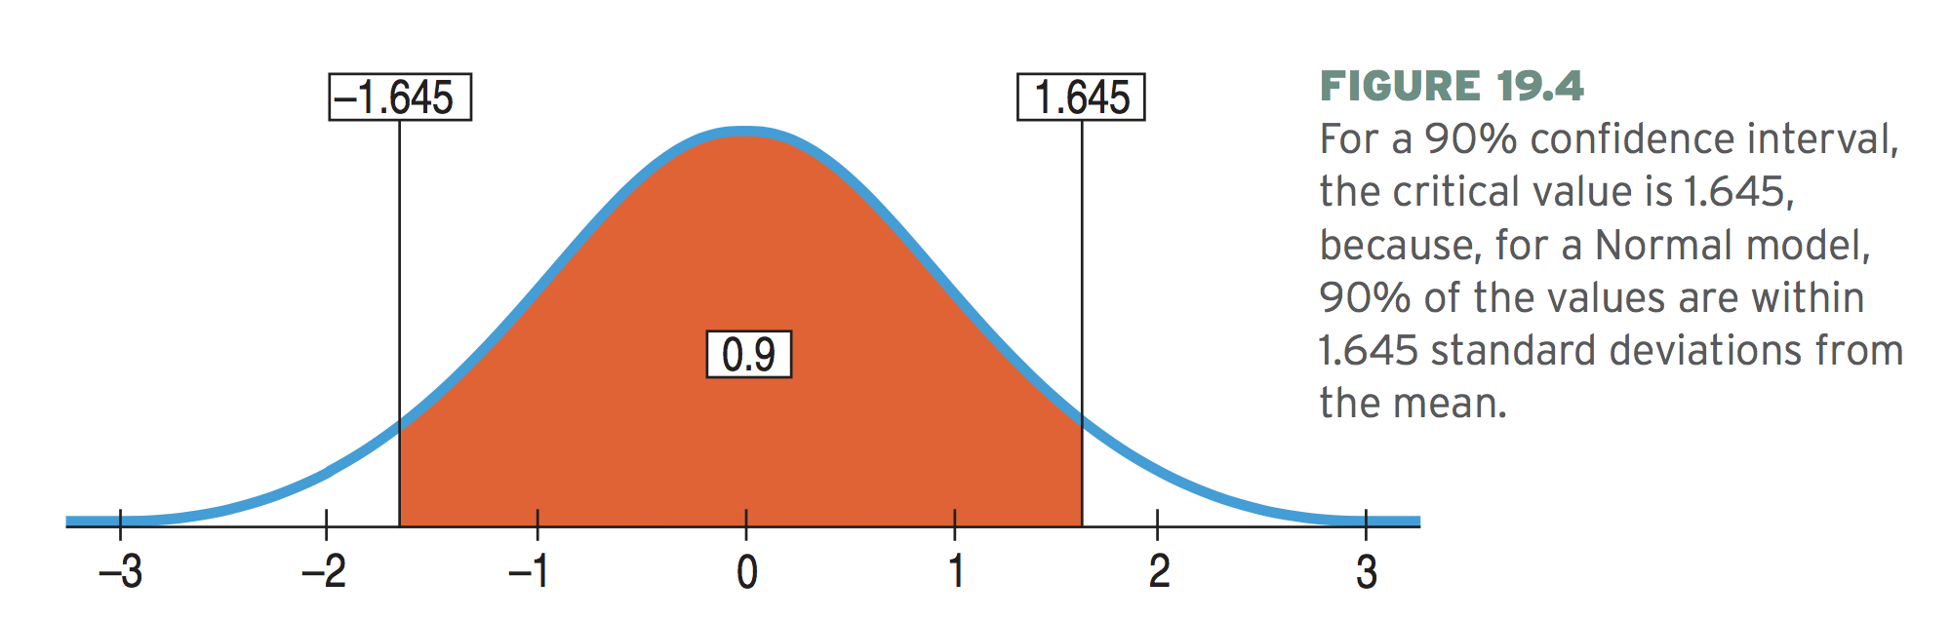
Lecture 15
Critical values
Critical value = the number of SEs (e.g., 2 in 2SEs)
Denoted as z*
For 95% confidence interval, the precise critical value is z* = 1.96 (though we used 2 to make it simple).

Slide 16
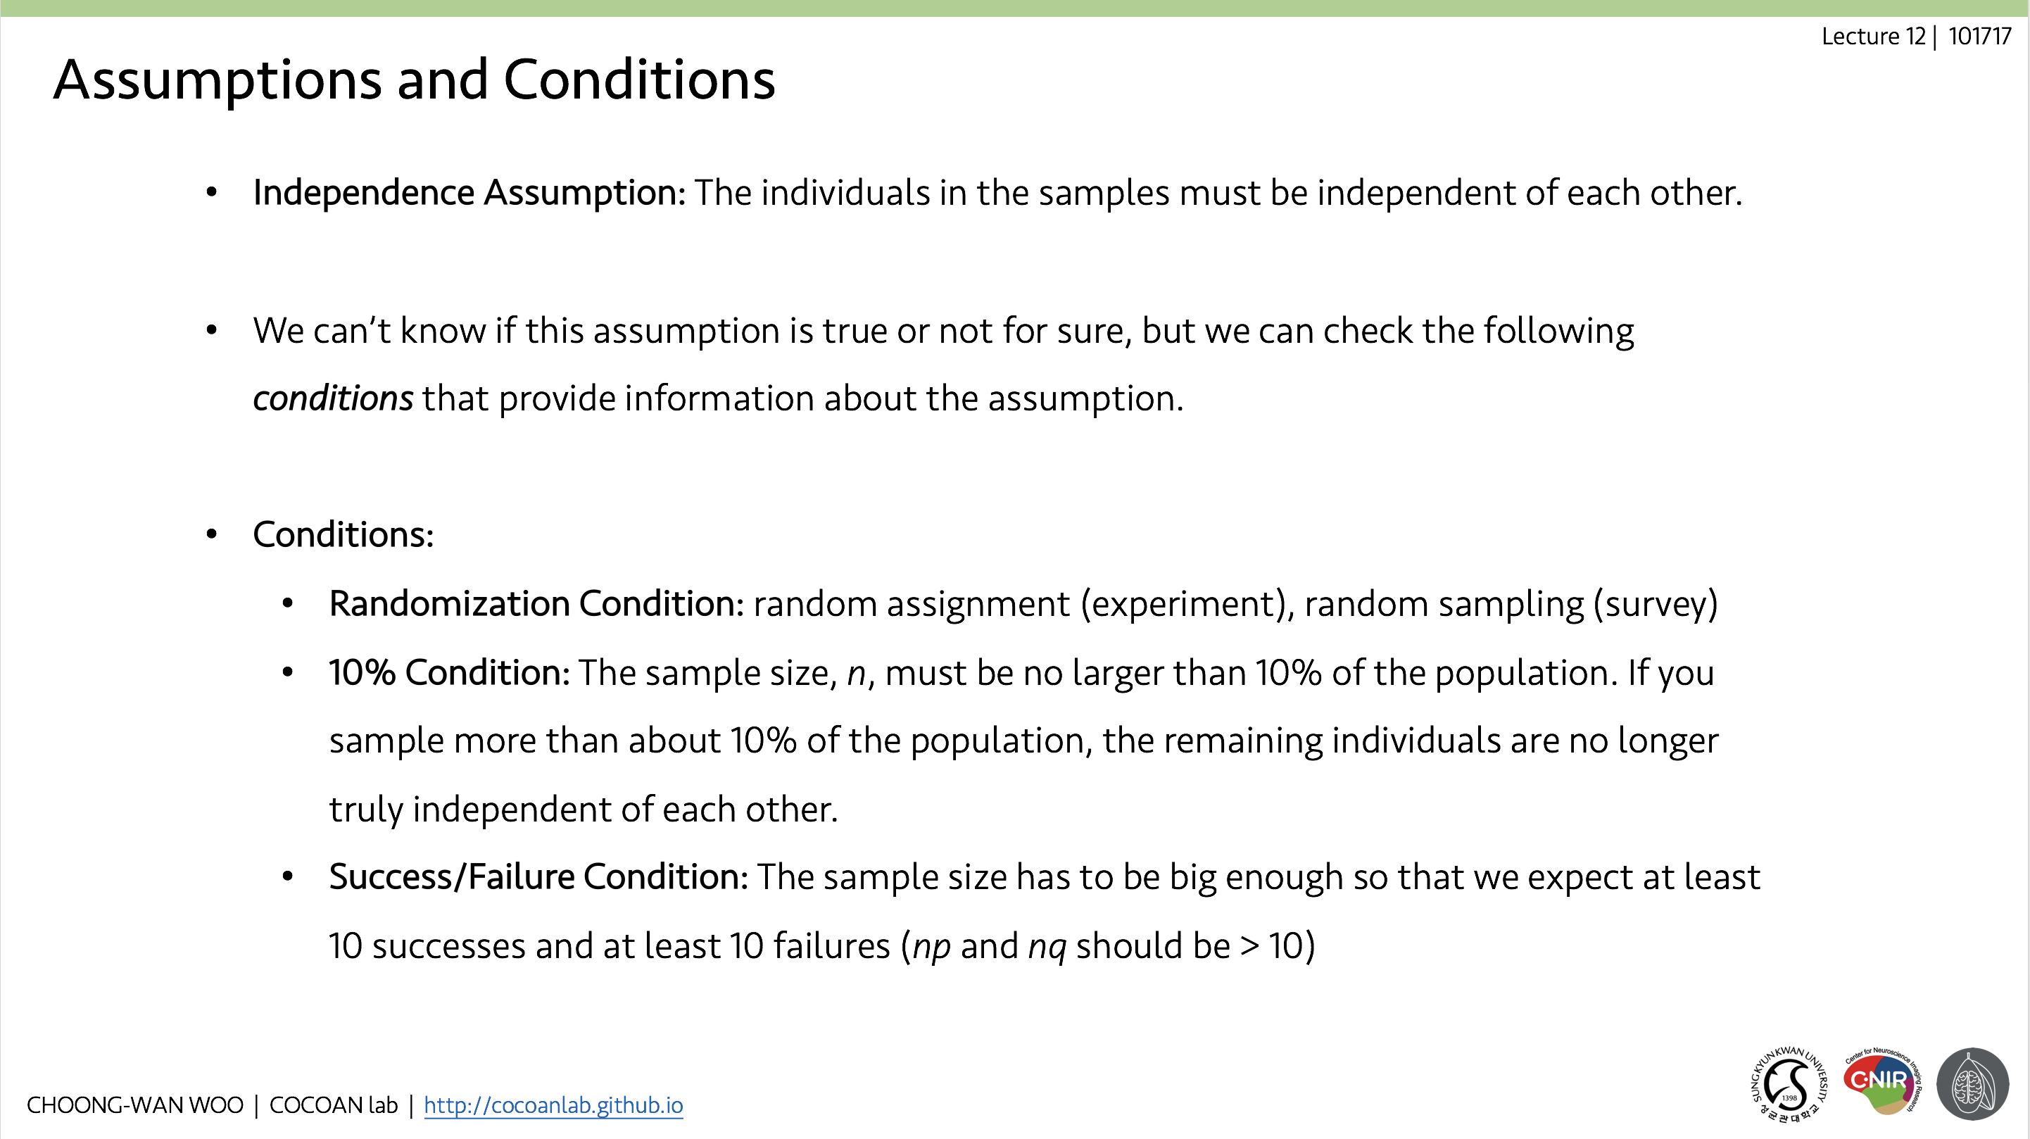
Lecture 15
Assumptions and Conditions

Slide 17
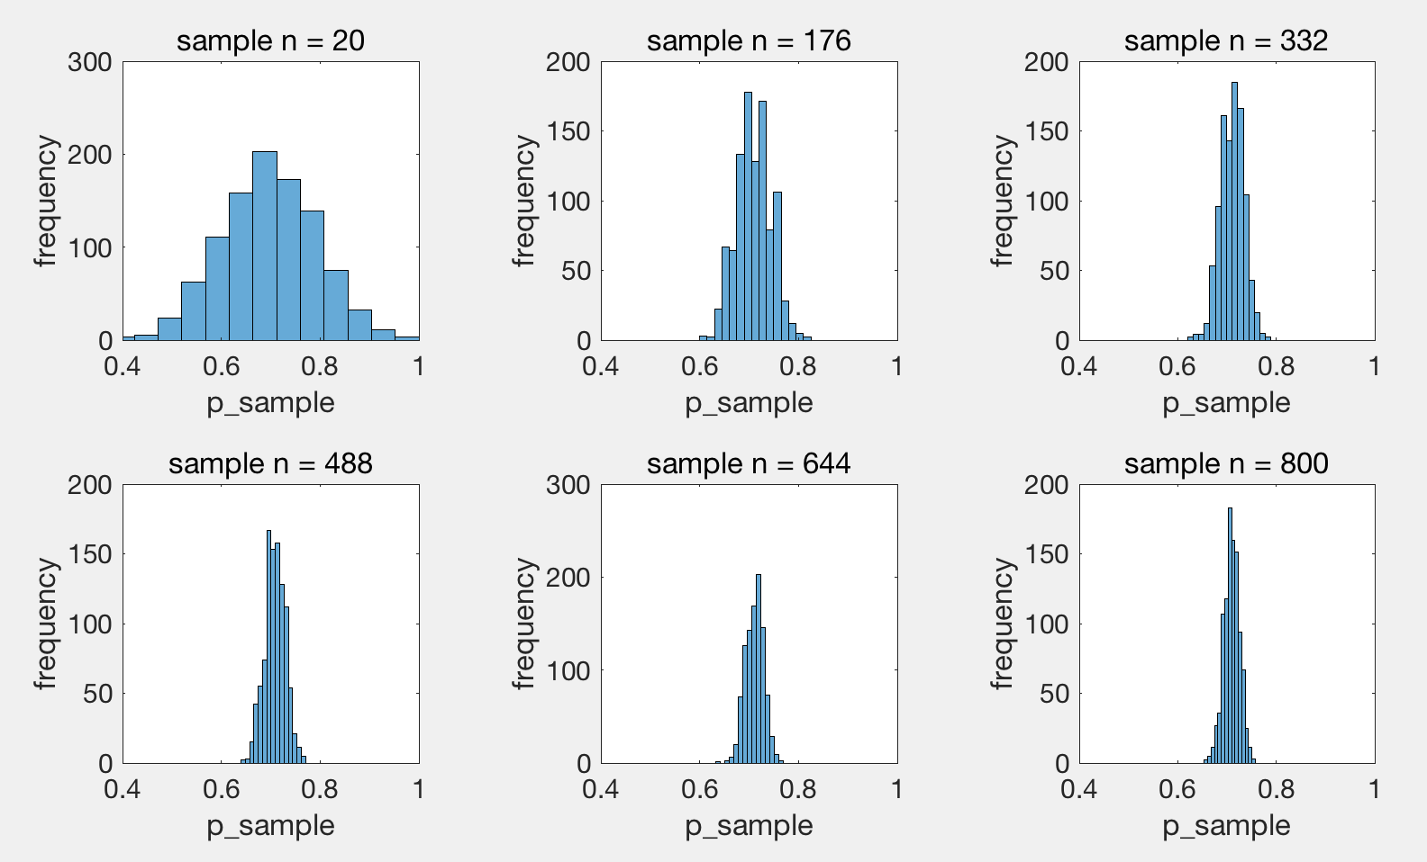

Lecture 15
Choosing your sample size
$ME=z^{∗}\sqrt{\frac{\hat{p}\hat{q}}{n}}$
If we want 3% Margin of error (ME) for 95% confidence (z* = 1.96)
$0.03=1.96 × \sqrt{\frac{\hat{p}\hat{q}}{n}}$
If you don’t know $\hat{p}$, just take its maximum: $\hat{p}=0.5$, then $\hat{p}\hat{q}=0.25$
$\sqrt{n}=\frac{1.96\sqrt{0.5×0.5}}{0.03}≈32.67$
$n≈{\left(32.67\right)}^{2}≈1067.1$
Then, our sample size should be 1068 (rounding up).

Slide 18
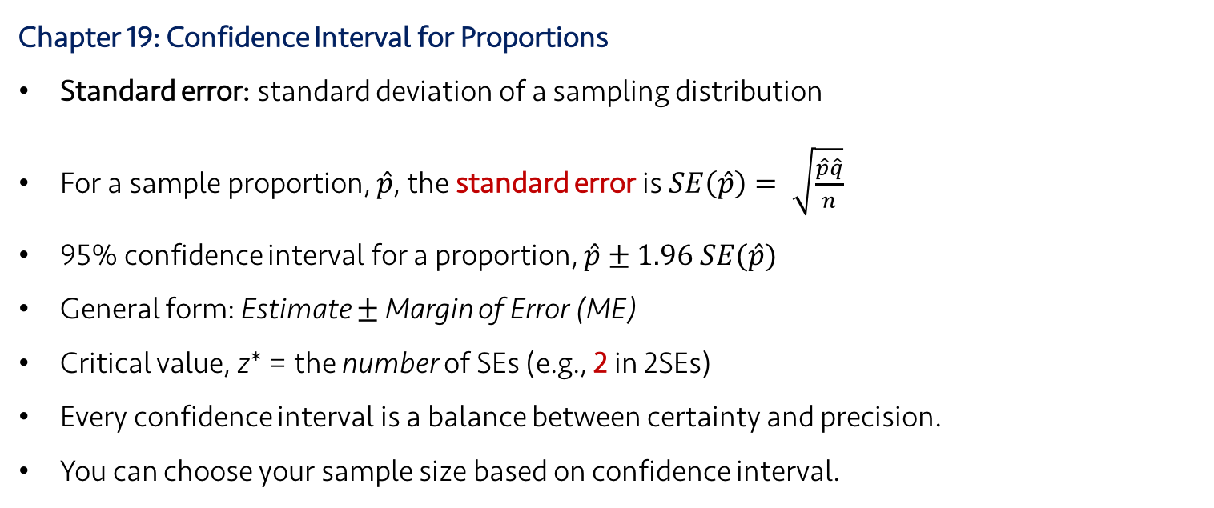
Lecture 15
Key Points
Chapter 19: Confidence Interval for Proportions
Standard error: standard deviation of a sampling distribution
For a sample proportion, $\hat{p}$, the standard error is $SE\left(\hat{p}\right)= \sqrt{\frac{\hat{p}\hat{q}}{n}}$
95% confidence interval for a proportion, $\hat{p}±1.96 SE(\hat{p})$
General form: Estimate $±$ Margin of Error (ME)
Critical value, z* = the number of SEs (e.g., 2 in 2SEs)
Every confidence interval is a balance between certainty and precision.
You can choose your sample size based on confidence interval.
CHOONG-WAN WOO | COCOAN lab | http://cocoanlab.github.io

