Slide 1


GBME Probability and Statistics
Review
Review, Q&A session
CHOONG-WAN WOO | COCOAN lab | http://cocoanlab.github.io

Slide 2
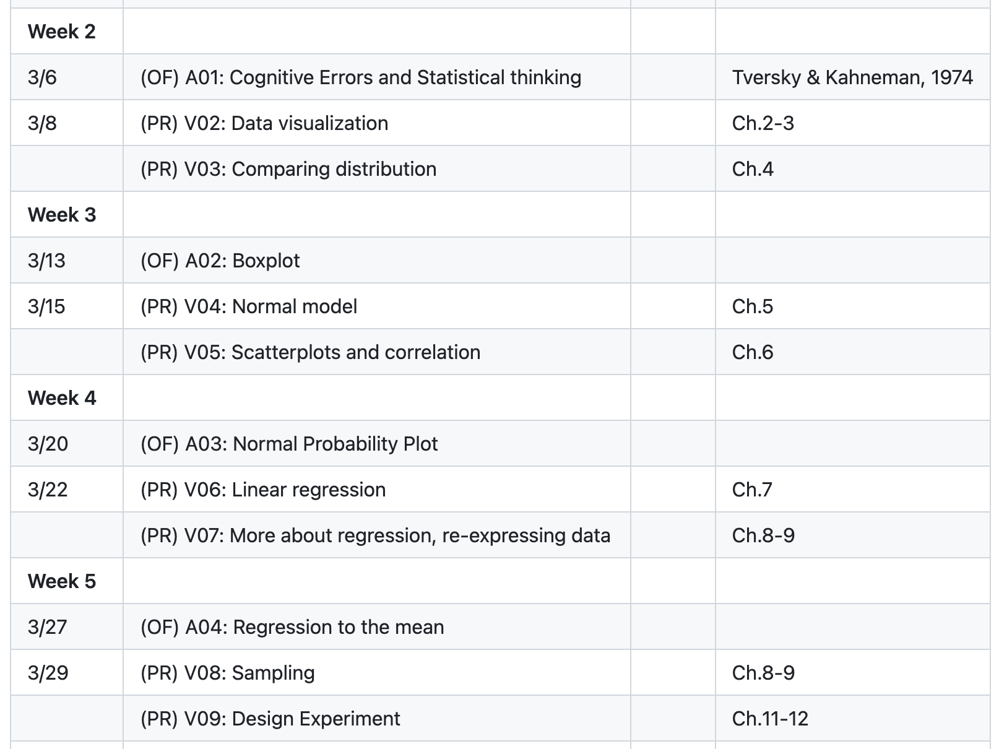
Review
CHOONG-WAN WOO | COCOAN lab | http://cocoanlab.github.io

Slide 3

Review
CHOONG-WAN WOO | COCOAN lab | http://cocoanlab.github.io

