Slide 1


GBME Probability and Statistics
Lecture 10
Lecture 10
Probability
CHOONG-WAN WOO | COCOAN lab | http://cocoanlab.github.io

Slide 2
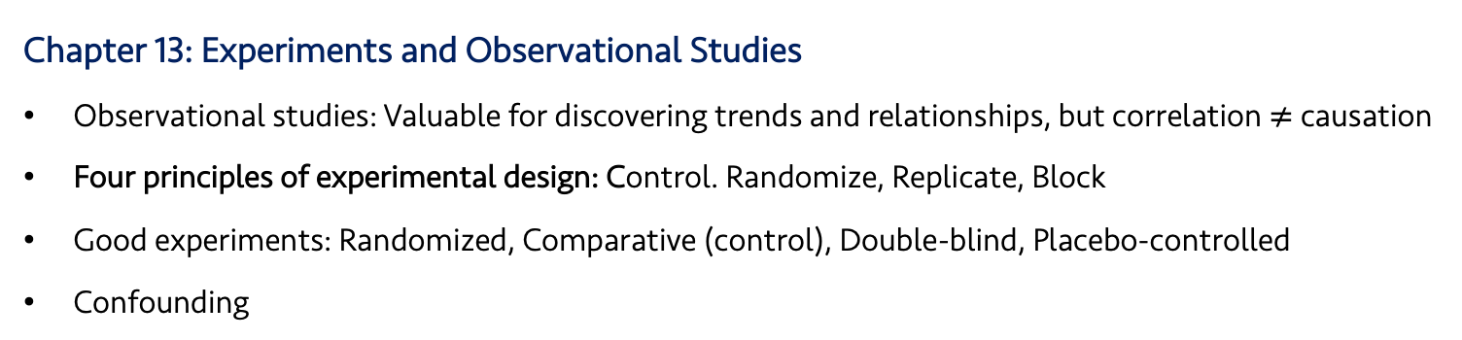
Lecture 10
Review: Key Points
Chapter 11 and 12: Randomness, Sampling
Population parameters vs. sample statistics
Sampling methods:
Simple sampling, stratified sampling, cluster sampling, multistage sampling, systematic sampling
Common mistakes in sampling…
Chapter 13: Experiments and Observational Studies
Observational studies: Valuable for discovering trends and relationships, but correlation $≠$ causation
Four principles of experimental design: Control. Randomize, Replicate, Block
Good experiments: Randomized, Comparative (control), Double-blind, Placebo-controlled
Confounding
CHOONG-WAN WOO | COCOAN lab | http://cocoanlab.github.io

Slide 3
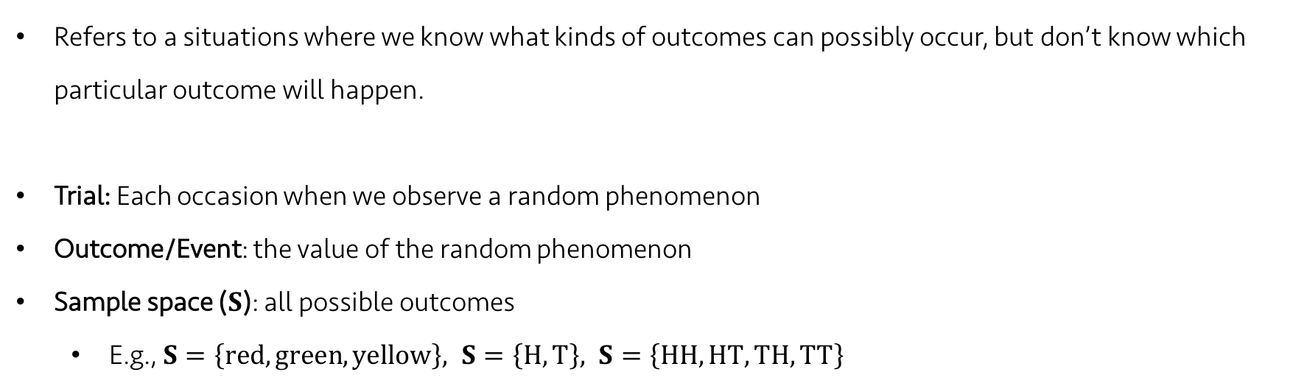
Lecture 10
Random phenomena
Refers to a situations where we know what kinds of outcomes can possibly occur, but don’t know which particular outcome will happen.
Trial: Each occasion when we observe a random phenomenon
Outcome/Event: the value of the random phenomenon
Sample space ($S$): all possible outcomes
E.g., $S=\left\{red, green, yellow\right\}, S=\left\{H, T\right\}, S=\left\{HH, HT, TH, TT\right\}$
CHOONG-WAN WOO | COCOAN lab | http://cocoanlab.github.io

Slide 4
Lecture 10
Law of Large Numbers (LLN)
When we repeat a random process over and over, the proportion of times that an event occurs settle down to one number, which is the probability of the event.
Two key assumption of LLN:
No changes of the random phenomena over the repeats
independence (all the events should be independent): an event doesn’t influence the outcomes of others.
This tells us nothing about “short-run” behavior. And the long run is really long.
Don’t expect the probability tells you a short-term trend of something.
CHOONG-WAN WOO | COCOAN lab | http://cocoanlab.github.io

Slide 5
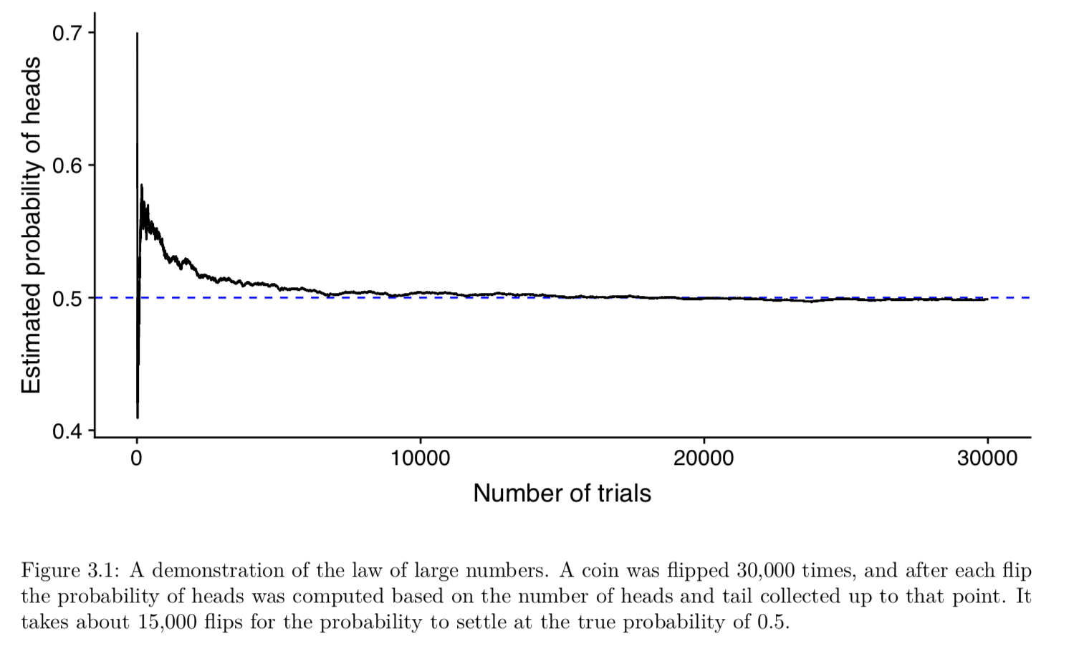

Lecture 10
Law of Large Numbers (LLN)
Highly variable
Many people forget this and overinterpret results from small samples: Law of small numbers (Tversky and Kahneman)
One of the major sources for the recent replication crisis!
https://www.nature.com/collections/prbfkwmwvz
CHOONG-WAN WOO | COCOAN lab | http://cocoanlab.github.io

Slide 6
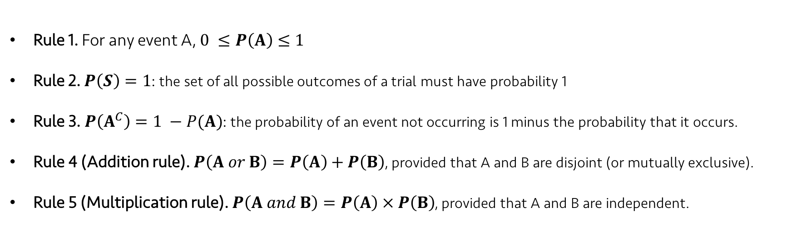
Lecture 10
Rules of formal probability
Rule 1. For any event A, $0 ≤P\left(A\right)≤1$
Rule 2. $P\left(S\right)=1$: the set of all possible outcomes of a trial must have probability 1
Rule 3. $P\left(A^{C}\right)=1 −P(A)$: the probability of an event not occurring is 1 minus the probability that it occurs.
Rule 4 (Addition rule). $P\left(A or B\right)=P\left(A\right)+P\left(B\right)$, provided that A and B are disjoint (or mutually exclusive).
Rule 5 (Multiplication rule). $P\left(A and B\right)=P\left(A\right) × P\left(B\right)$, provided that A and B are independent.
CHOONG-WAN WOO | COCOAN lab | http://cocoanlab.github.io

Slide 7
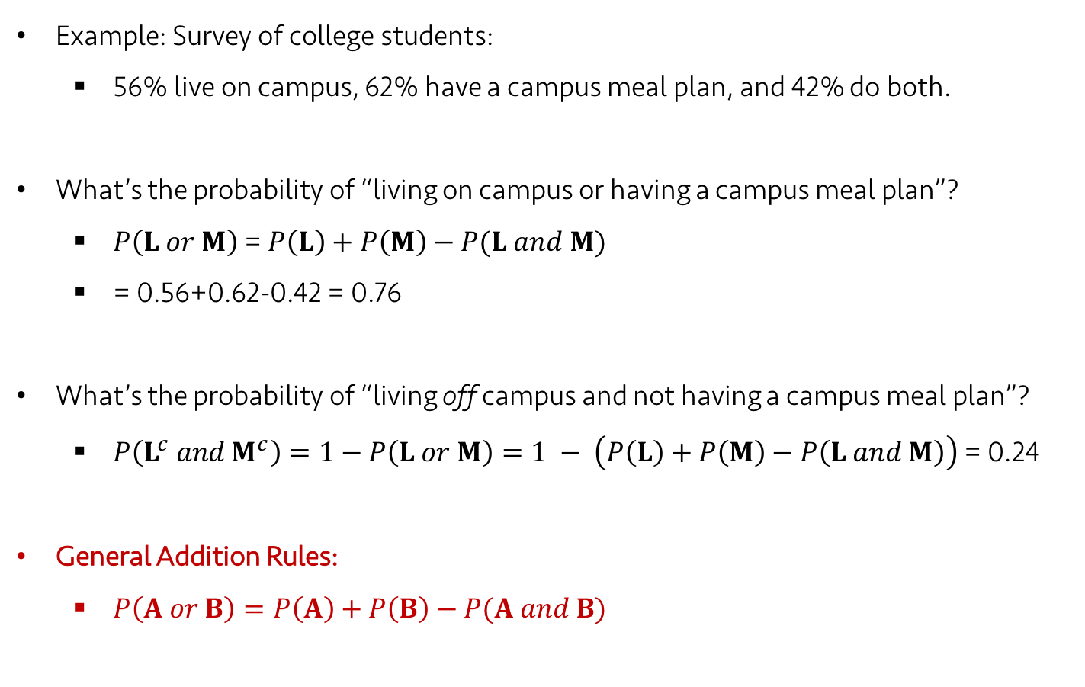
Lecture 10
The General Addition Rules
Example: Survey of college students:
56% live on campus, 62% have a campus meal plan, and 42% do both.
What’s the probability of “living on campus or having a campus meal plan”?
$P\left(L or M\right)$ = $P\left(L\right)+P\left(M\right)−P(L and M)$
= 0.56+0.62-0.42 = 0.76
What’s the probability of “living off campus and not having a campus meal plan”?
$P\left(L^{c} and M^{c}\right)=1−P\left(L or M\right)=1 − \left(P\left(L\right)+P\left(M\right)−P\left(L and M\right)\right)$ = 0.24
General Addition Rules:
$P\left(A or B\right)=P\left(A\right)+P\left(B\right)−P(A and B)$
CHOONG-WAN WOO | COCOAN lab | http://cocoanlab.github.io

Slide 8
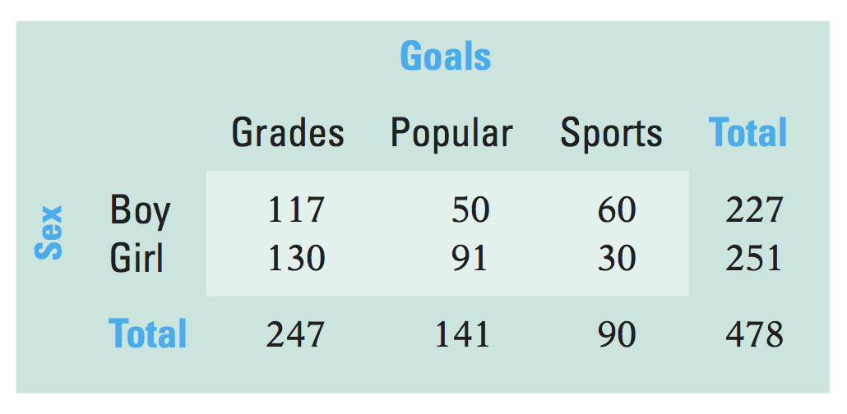
Lecture 10
Conditional Probability
Example: surveyed 478 elementary school students and asked whether their primary goal was to get good grades, to be popular, or to be good at sports.
Contingency table:
P(Sports) = 90/478 = 0.188
P(Girl) = 251/478 = 0.525
P(Sports and Girl) = 30/478 = 0.063
P(Sports | Girl) = Probability of Sports given Girl = 30/251 = 0.120 = P(Sports and Girl) / P(Girl) = (30/478) / (251/478) = 0.063 / 0.525 = 0.120
CHOONG-WAN WOO | COCOAN lab | http://cocoanlab.github.io

Slide 9
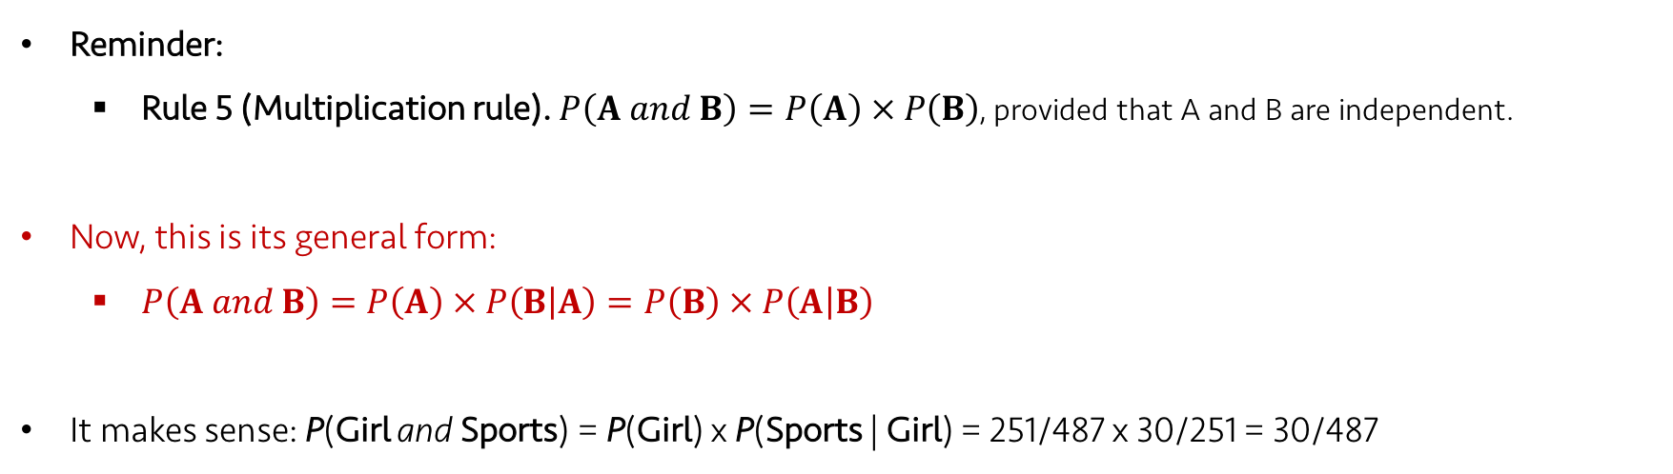
Lecture 10
General Multiplication Rule
Reminder:
Rule 5 (Multiplication rule). $P\left(A and B\right)=P\left(A\right) × P\left(B\right)$, provided that A and B are independent.
Now, this is its general form:
$P\left(A and B\right)=P\left(A\right) × P\left(B | A\right)=P\left(B\right) × P\left(A | B\right)$
It makes sense: P(Girl and Sports) = P(Girl) x P(Sports | Girl) = 251/487 x 30/251 = 30/487
CHOONG-WAN WOO | COCOAN lab | http://cocoanlab.github.io

Slide 10
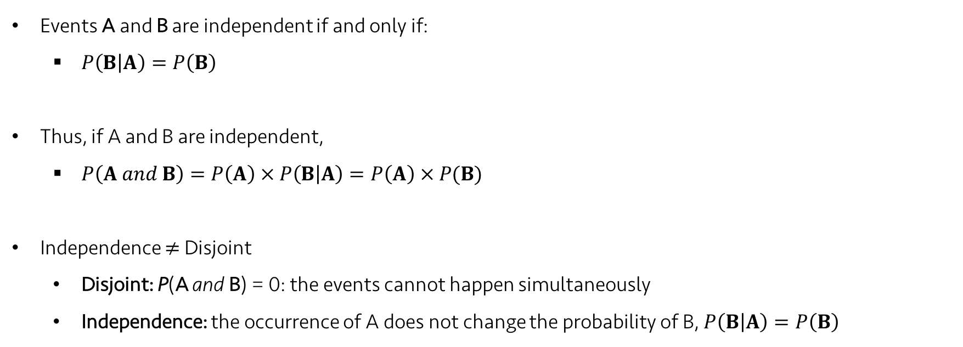
Lecture 10
Independence
Events A and B are independent if and only if:
$P\left(B | A\right)=P\left(B\right)$
Thus, if A and B are independent,
$P\left(A and B\right)=P\left(A\right) × P\left(B | A\right)=P\left(A\right) × P(B)$
Independence $≠$ Disjoint
Disjoint: P(A and B) = 0: the events cannot happen simultaneously
Independence: the occurrence of A does not change the probability of B, $P\left(B | A\right)=P\left(B\right)$
CHOONG-WAN WOO | COCOAN lab | http://cocoanlab.github.io

Slide 11
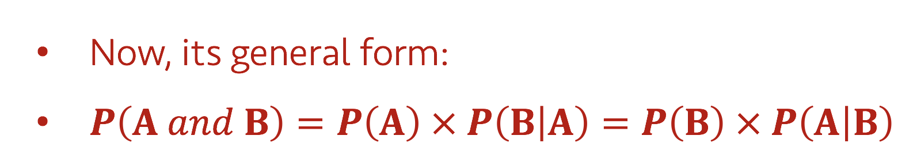
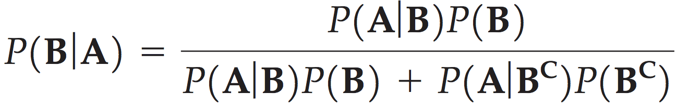
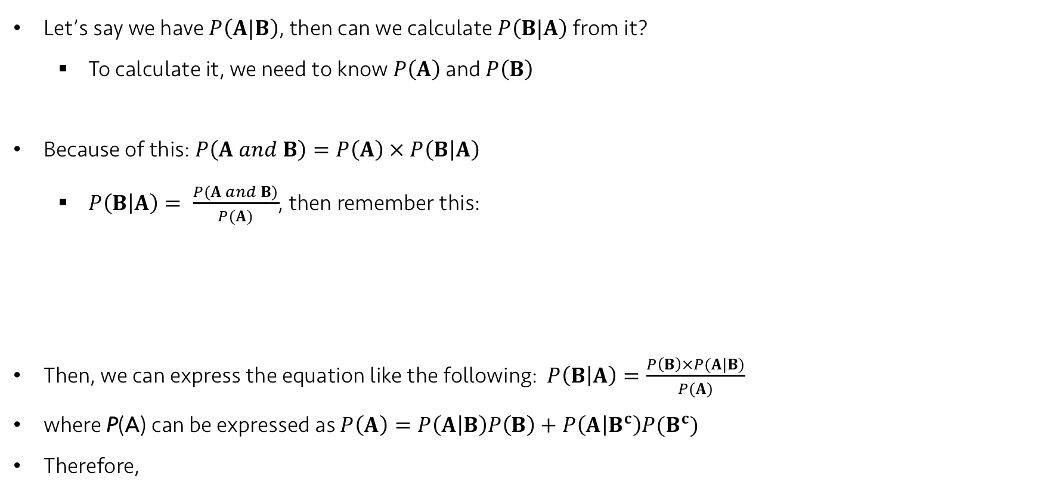
Lecture 10
Reversing the Conditioning and Bayes’ Rule
Let’s say we have $P\left(A|B\right)$, then can we calculate $P\left(B|A\right)$ from it?
To calculate it, we need to know $P\left(A\right)$ and $P\left(B\right)$
Because of this: $P\left(A and B\right)=P\left(A\right) × P\left(B | A\right)$
$P\left(B | A\right)= \frac{P(A and B)}{P(A)}$, then remember this:
Then, we can express the equation like the following: $P\left(B | A\right)=\frac{P\left(B\right)×P(A|B)}{P(A)}$
where P(A) can be expressed as $P\left(A\right)=P\left(A | B\right)P\left(B\right)+P\left(A | B^{c}\right)P(B^{c})$
Therefore,
CHOONG-WAN WOO | COCOAN lab | http://cocoanlab.github.io

Slide 12
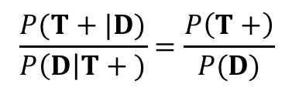
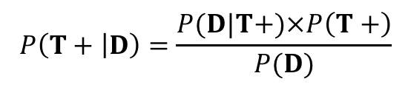
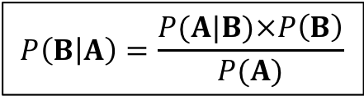
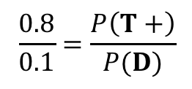
Lecture 10
Practice:
P(test+ | disease) = 0.8
P(disease | test+) = 0.1
How is this possible? In which cases (e.g., what numbers or ratio of P(test+) and P(disease)), can this happen?
$$P\left(B | A\right)=\frac{P(A|B)×P\left(B\right)}{P(A)}$$
$$P\left(T+ | D\right)=\frac{P(D|T+)×P\left(T+\right)}{P(D)}$$
$$\frac{P(T+|D)}{P\left(D\right|T + )}=\frac{P\left(T+\right)}{P(D)}$$
$$\frac{0.8}{0.1}=\frac{P\left(T+\right)}{P(D)}$$
Too many test positive when the disease prevalence is low.. Is this a good test?
CHOONG-WAN WOO | COCOAN lab | http://cocoanlab.github.io

Slide 13
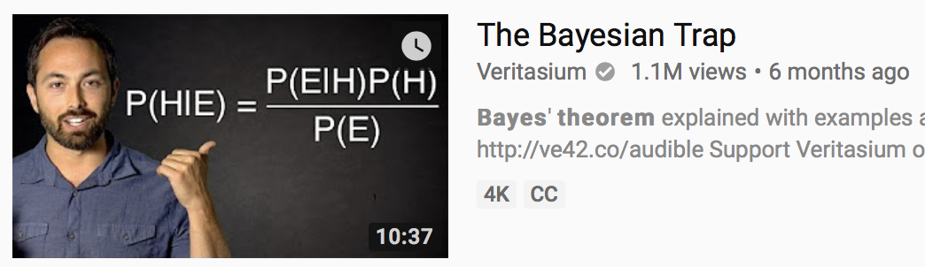
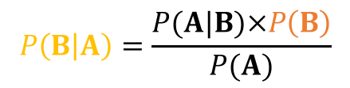
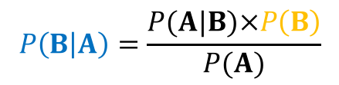
Lecture 10
A good video on Bayes’ theorem
https://www.youtube.com/watch?v=R13BD8qKeTg
First test result came out to be positive:
If the second test results came out to be positive again,
$$P\left(B | A\right)=\frac{P(A|B)×P\left(B\right)}{P(A)}$$
$$P\left(B | A\right)=\frac{P(A|B)×P\left(B\right)}{P(A)}$$
Best P(B): prevalence
Best P(B) this time: P(B|A) from the first test result
Then, P(B|A) becomes much higher than the first time.
CHOONG-WAN WOO | COCOAN lab | http://cocoanlab.github.io

Slide 14
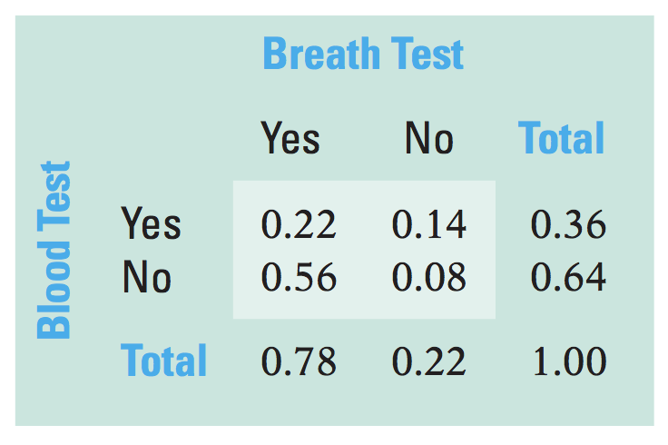
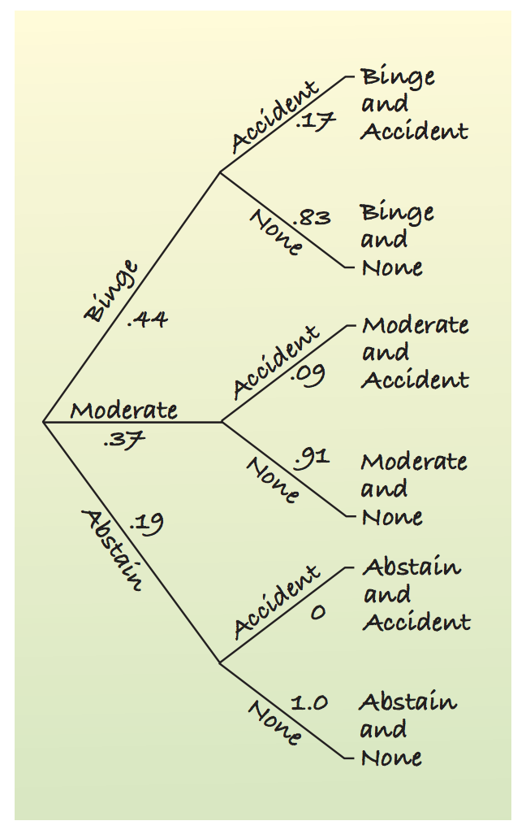
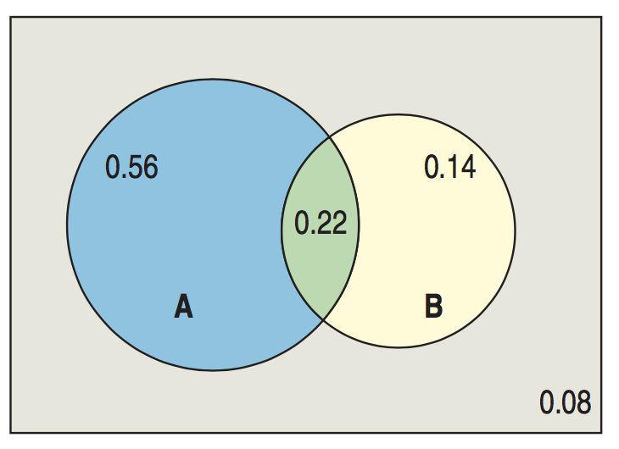
Lecture 10
Picturing Probability
Tables
Venn Diagrams
Trees
CHOONG-WAN WOO | COCOAN lab | http://cocoanlab.github.io

Slide 15
Lecture 10
Visit https://seeing-theory.brown.edu
and run Ch.1 Chance Event and Ch.2 Conditional Probability
CHOONG-WAN WOO | COCOAN lab | http://cocoanlab.github.io

Slide 16
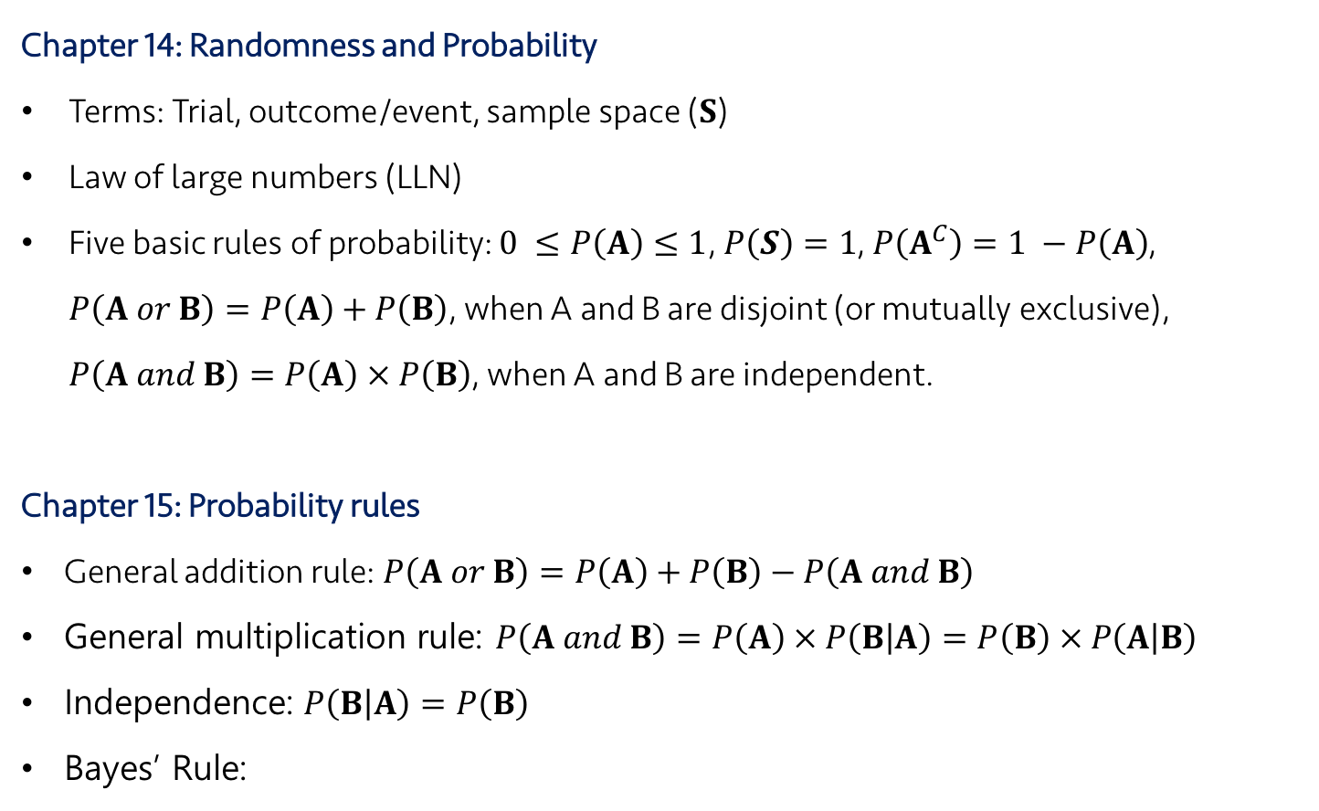
Lecture 10
Key Points
Chapter 14: Randomness and Probability
Terms: Trial, outcome/event, sample space ($S$)
Law of large numbers (LLN)
Five basic rules of probability: $0 ≤P\left(A\right)≤1$, $P\left(S\right)=1$, $P\left(A^{C}\right)=1 −P\left(A\right)$, $P\left(A or B\right)=P\left(A\right)+P\left(B\right)$, when A and B are disjoint (or mutually exclusive), $P\left(A and B\right)=P\left(A\right) × P\left(B\right)$, when A and B are independent.
Chapter 15: Probability rules
General addition rule: $P\left(A or B\right)=P\left(A\right)+P\left(B\right)−P\left(A and B\right)$
General multiplication rule: $P\left(A and B\right)=P\left(A\right) × P\left(B | A\right)=P\left(B\right) × P\left(A | B\right)$
Independence: $P\left(B | A\right)=P\left(B\right)$
Bayes’ Rule:
CHOONG-WAN WOO | COCOAN lab | http://cocoanlab.github.io

