Slide 1


GBME Probability and Statistics
Lecture 11
Lecture 11
Random variables
CHOONG-WAN WOO | COCOAN lab | http://cocoanlab.github.io

Slide 2
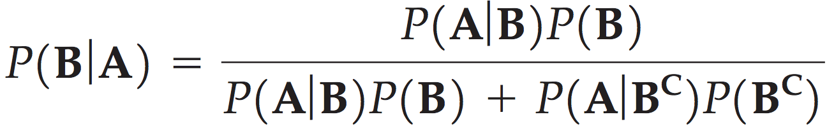
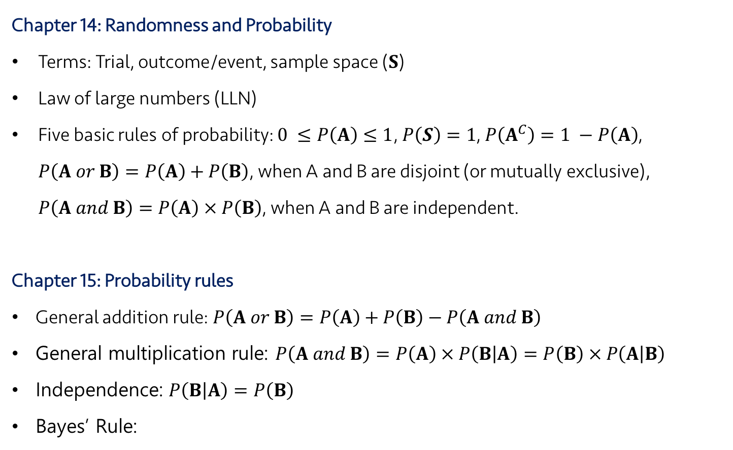
Lecture 11
Review: Key Points
Chapter 14: Randomness and Probability
Terms: Trial, outcome/event, sample space ($S$)
Law of large numbers (LLN)
Five basic rules of probability: $0 ≤P\left(A\right)≤1$, $P\left(S\right)=1$, $P\left(A^{C}\right)=1 −P\left(A\right)$, $P\left(A or B\right)=P\left(A\right)+P\left(B\right)$, when A and B are disjoint (or mutually exclusive), $P\left(A and B\right)=P\left(A\right) × P\left(B\right)$, when A and B are independent.
Chapter 15: Probability rules
General addition rule: $P\left(A or B\right)=P\left(A\right)+P\left(B\right)−P\left(A and B\right)$
General multiplication rule: $P\left(A and B\right)=P\left(A\right) × P\left(B | A\right)=P\left(B\right) × P\left(A | B\right)$
Independence: $P\left(B | A\right)=P\left(B\right)$
Bayes’ Rule:
CHOONG-WAN WOO | COCOAN lab | http://cocoanlab.github.io

Slide 3
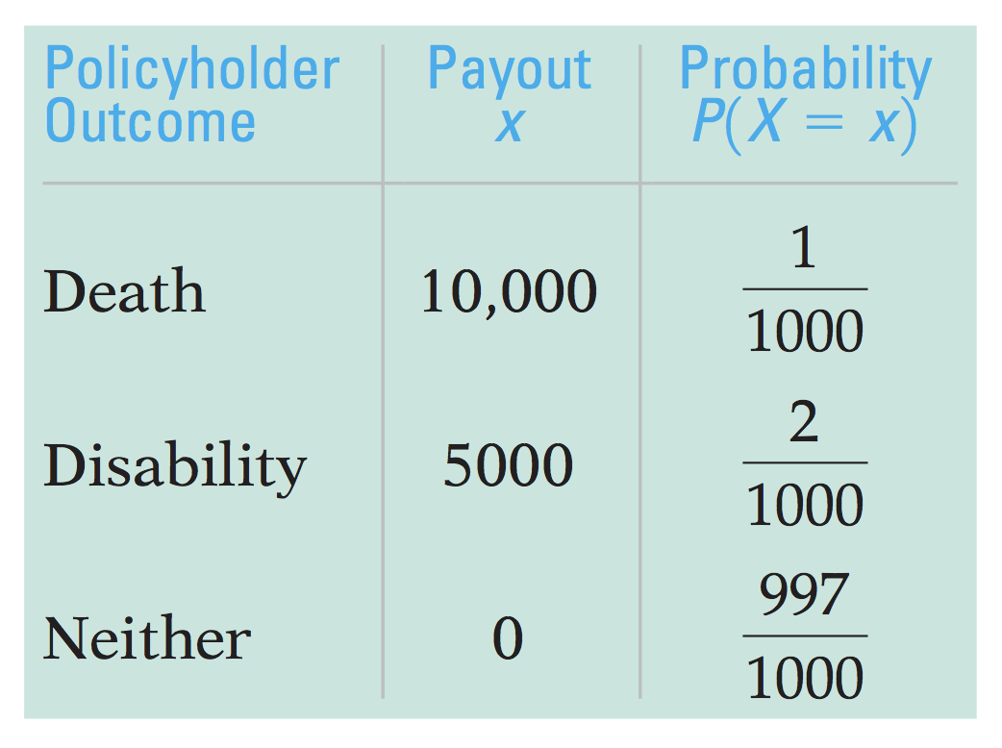
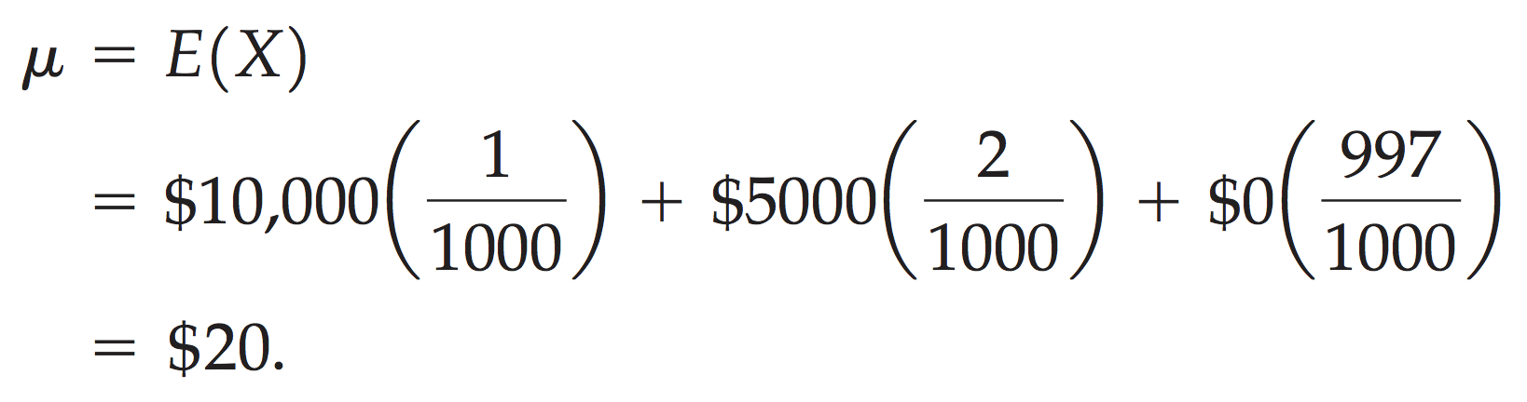
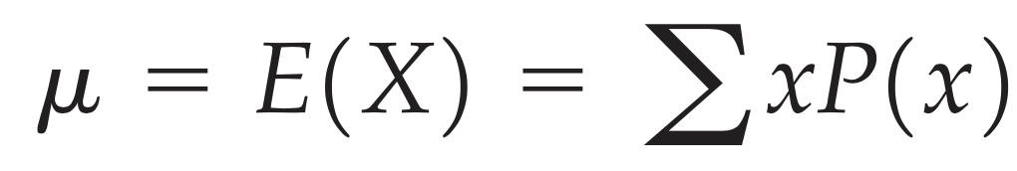
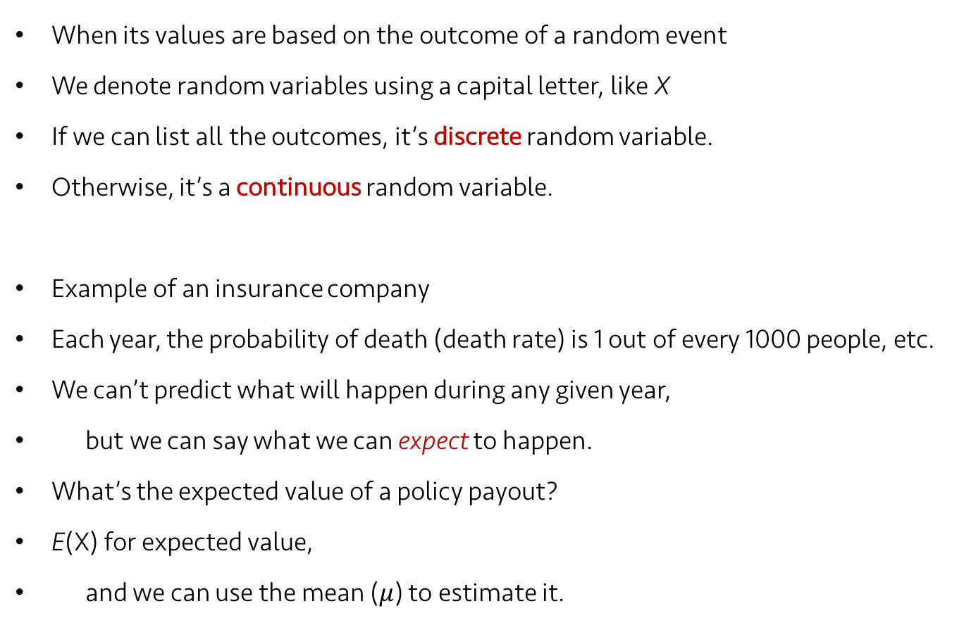
Lecture 11
Random Variables
When its values are based on the outcome of a random event
We denote random variables using a capital letter, like X
If we can list all the outcomes, it’s discrete random variable.
Otherwise, it’s a continuous random variable.
Example of an insurance company
Each year, the probability of death (death rate) is 1 out of every 1000 people, etc.
We can’t predict what will happen during any given year,
but we can say what we can expect to happen.
What’s the expected value of a policy payout?
E(X) for expected value,
and we can use the mean ($μ$) to estimate it.
(for discrete random variables)
CHOONG-WAN WOO | COCOAN lab | http://cocoanlab.github.io

Slide 4

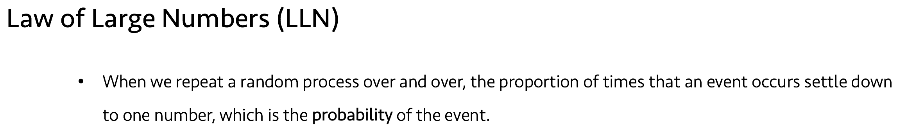
Lecture 11
Is this based on data?
Yes, and no.
Mean for data:
Mean for random variables:
What’s differences?
Probability conveys the information about population.
Remember the law of large numbers.. The probability assumes a large number of repeats.
CHOONG-WAN WOO | COCOAN lab | http://cocoanlab.github.io

Slide 5
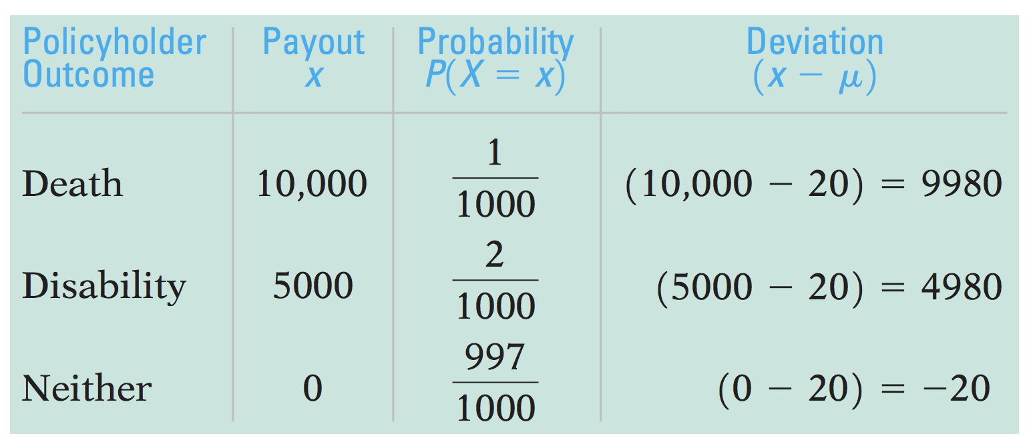
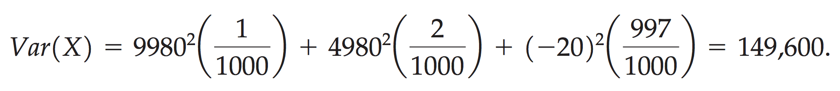
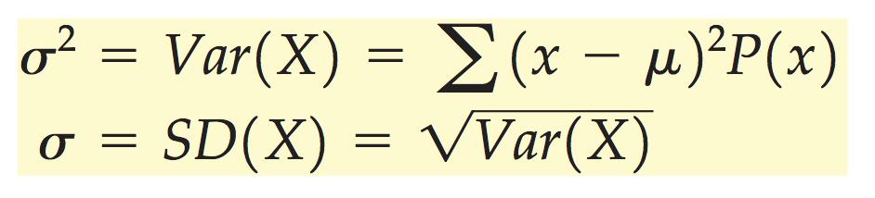
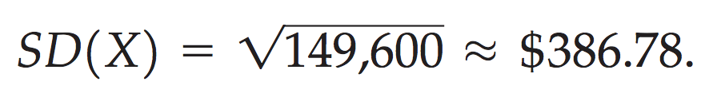
Lecture 11
Spread: Standard deviation
Similar to the data case, we first calculate deviation from the mean and square it.
Example of the insurance company again:
The variance is the expected value of those squared deviations:
Its square root is standard deviation:
CHOONG-WAN WOO | COCOAN lab | http://cocoanlab.github.io

Slide 6
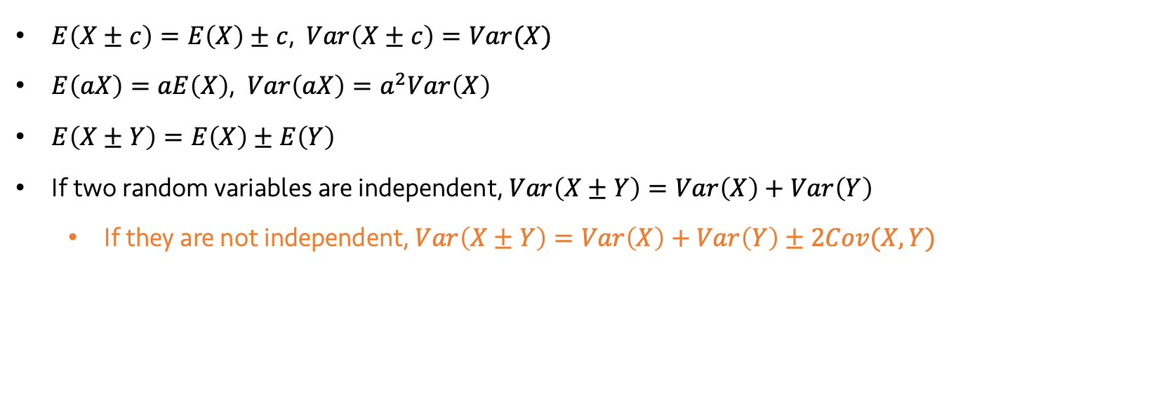
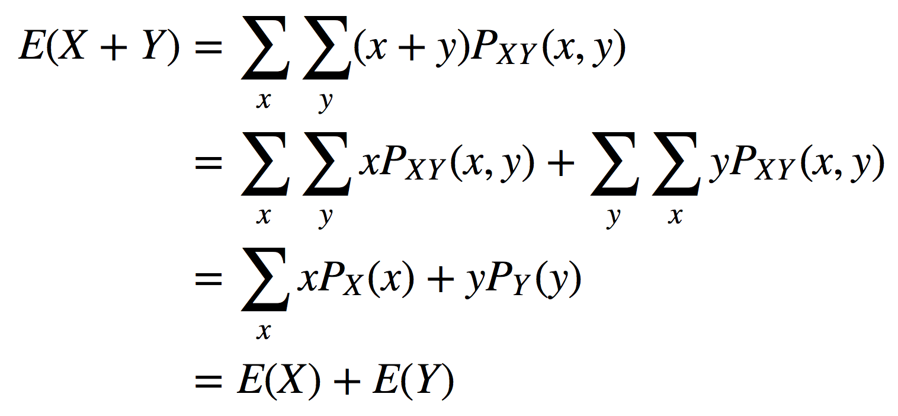


Lecture 11
Shifting and combining random variables
Reminder
$E\left(X±c\right)=E\left(X\right)±c$, $Var\left(X±c\right)=Var(X)$
$E\left(aX\right)=aE\left(X\right)$, $Var\left(aX\right)=a^{2}Var\left(X\right)$
$E\left(X±Y\right)=E\left(X\right)±E\left(Y\right)$
If two random variables are independent, $Var\left(X±Y\right)=Var\left(X\right)+Var\left(Y\right)$
If they are not independent, $Var\left(X±Y\right)=Var\left(X\right)+Var\left(Y\right)±2Cov(X,Y)$
Proof
CHOONG-WAN WOO | COCOAN lab | http://cocoanlab.github.io

Slide 7
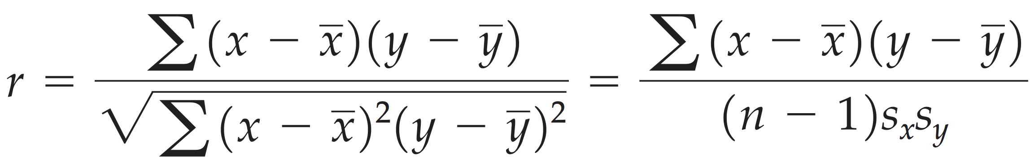
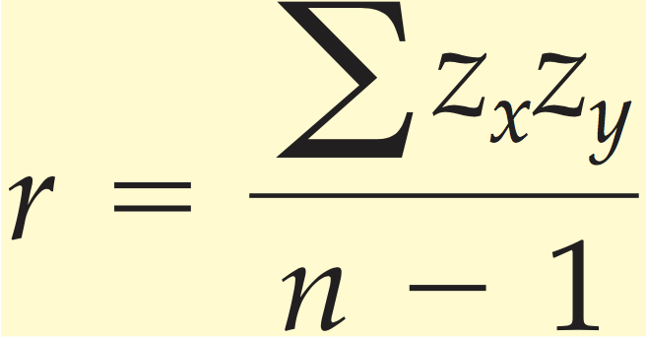
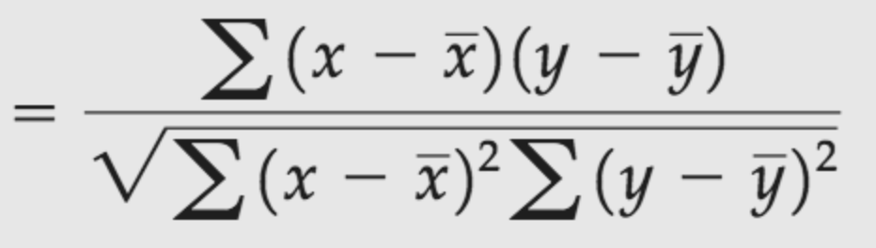
Lecture 11
Covariance and correlation
Remember the correlation between two variables from a previous chapter
Now, correlation between two random variables.
CHOONG-WAN WOO | COCOAN lab | http://cocoanlab.github.io

Slide 8
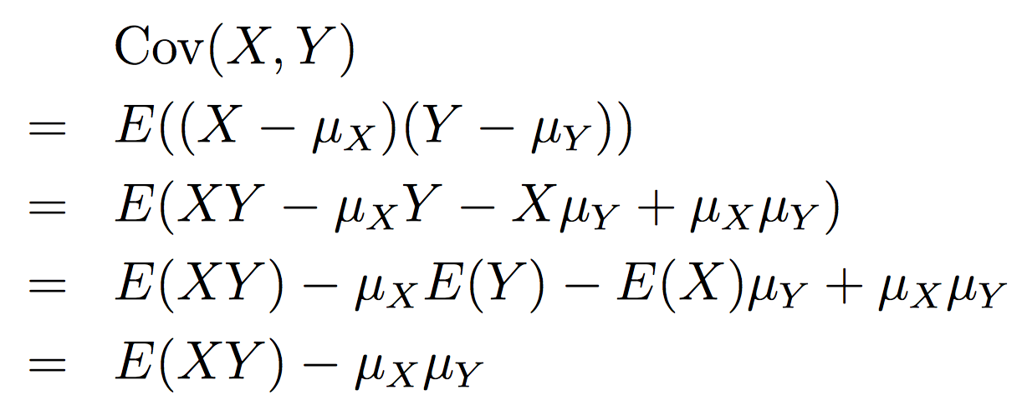
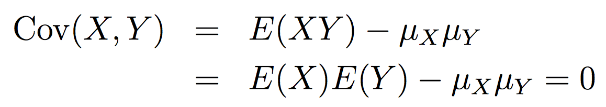
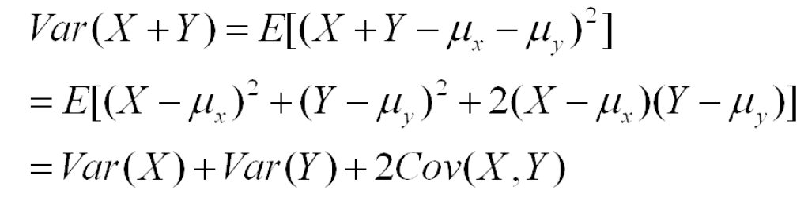
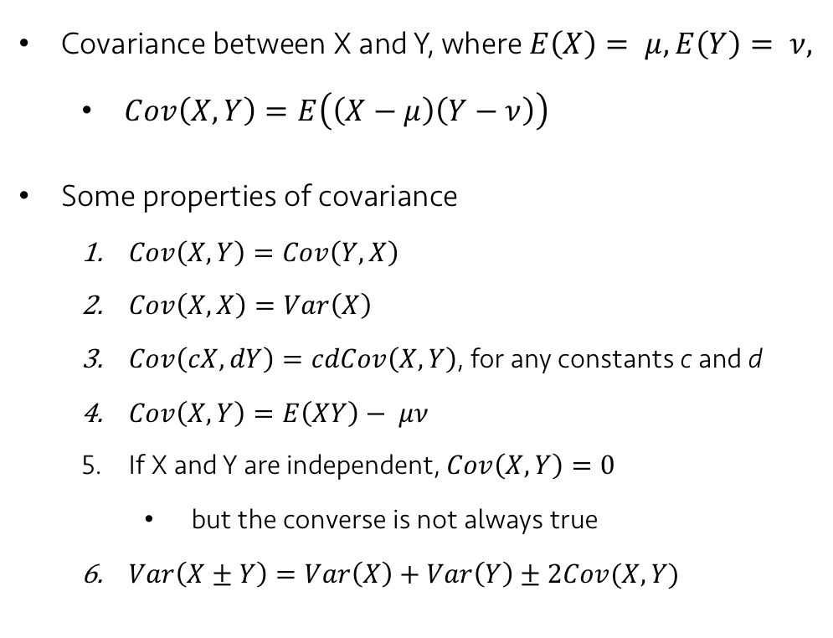
Lecture 11
Covariance and correlation
Proofs
2.
Covariance between X and Y, where $E\left(X\right)= μ, E\left(Y\right)= ν,$
$Cov\left(X,Y\right)=E\left(\left(X−μ\right)\left(Y−ν\right)\right)$
Some properties of covariance
$Cov\left(X,Y\right)=Cov\left(Y,X\right)$
$Cov\left(X,X\right)=Var\left(X\right)$
$Cov\left(cX,dY\right)=cdCov\left(X,Y\right)$, for any constants c and d
$Cov\left(X,Y\right)=E\left(XY\right)− μν$
If X and Y are independent, $Cov\left(X,Y\right)=0$
but the converse is not always true
$Var\left(X±Y\right)=Var\left(X\right)+Var\left(Y\right)±2Cov(X,Y)$
4.
5.
6.
CHOONG-WAN WOO | COCOAN lab | http://cocoanlab.github.io

Slide 9
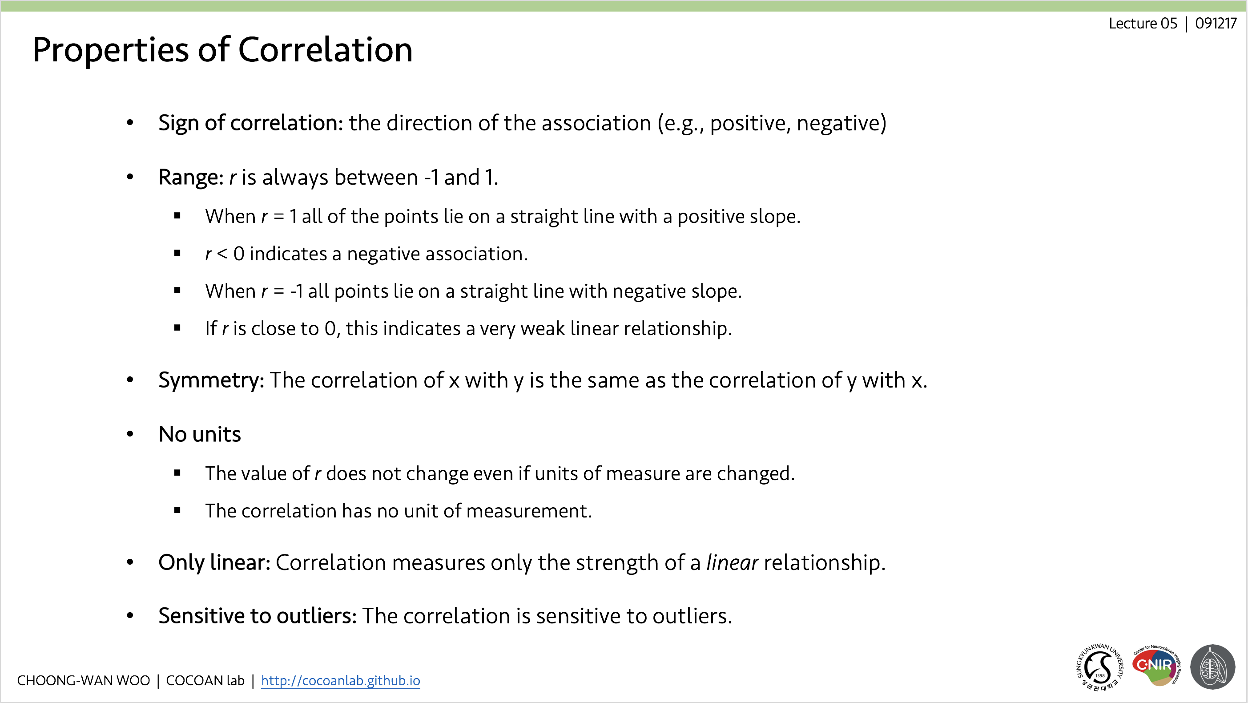

Lecture 11
Covariance and correlation
Correlation:
The properties of the correlation:
$$Corr\left(X,Y\right)= \frac{Cov(X,Y)}{σ_{X}σ_{Y}}$$
CHOONG-WAN WOO | COCOAN lab | http://cocoanlab.github.io

Slide 10

Lecture 11
Key Points
Chapter 16: Random variables
Discrete vs. continuous random variables
Expected values (mean):
Here, probability conveys the information about population assuming a large number of repeats
Spread:
$E\left(X±c\right)=E\left(X\right)±c$, $Var\left(X±c\right)=Var(X)$
$E\left(aX\right)=aE\left(X\right)$, $Var\left(aX\right)=a^{2}Var\left(X\right)$
$E\left(X±Y\right)=E\left(X\right)±E\left(Y\right)$
$Cov\left(X,Y\right)=E\left(\left(X−μ\right)\left(Y−ν\right)\right)$
$Var\left(X±Y\right)=Var\left(X\right)+Var\left(Y\right)±2Cov\left(X,Y\right)$
$Corr\left(X,Y\right)= \frac{Cov(X,Y)}{σ_{X}σ_{Y}}$
CHOONG-WAN WOO | COCOAN lab | http://cocoanlab.github.io

