Slide 1
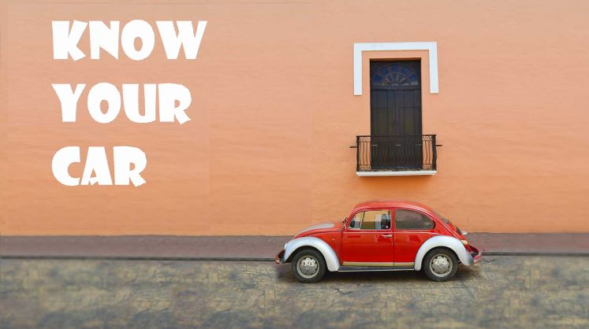

Slide 2

Agenda
Problem Statement
Proposed Solution
Solution Details
Challenges
Data Analysis & Visualization
Conclusion

Slide 3
Problem Statement
As people mostly use the manual process while looking for a car, and it’s not the perfect way they want.
People are not sure what to look, where to look and which one to select?
Testing every car is not possible!
Which car fits my budget?
Unaware of specifics.

Slide 4
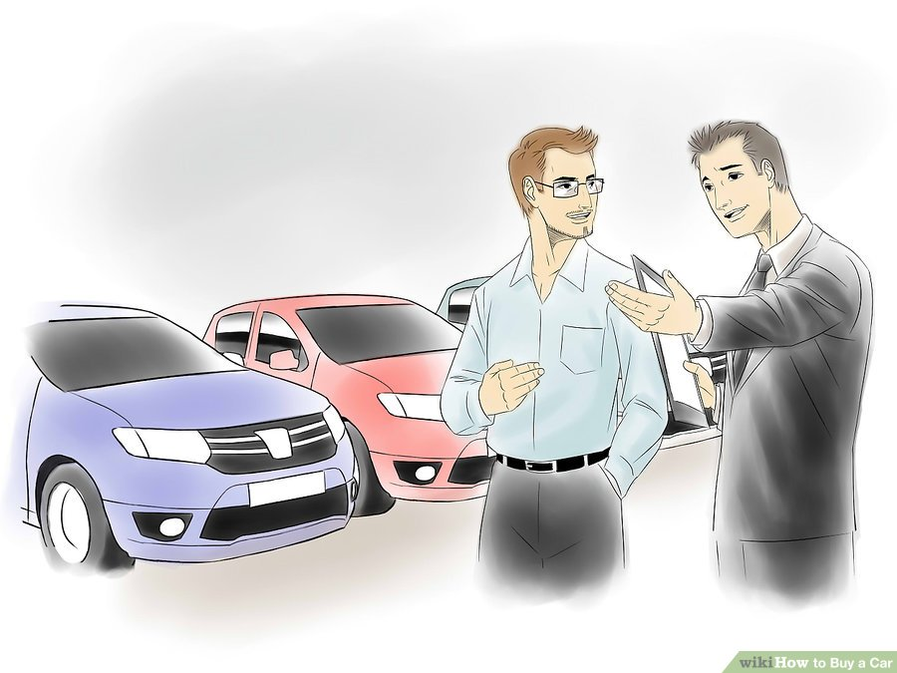
Aim and Objective!
To produce a system that can help user to select/sort any particular car based on initial reviews of people.
To analyse and provide option to the user based on his selection(Manufacturer/ Car Attributes).
To ease customer’s task whenever they want to buy a car.

Slide 5


Slide 6
Edmunds.com
Scaping Reviews
Cleaning
Analysis
Top 10 Brands
Top attributes of top brands
Aspirational Brand

Slide 7
What is Edmunds.com?
Edmunds.com Inc. (stylized as Edmunds) is an American online resource for automotive information. Edmunds give Car Shoppers Alerts and Advice to Help Them Maximize Their Savings.
The Edmunds.com Web site includes prices for new and used vehicles, dealer and inventory listings, a database of national and regional incentives and rebates, vehicle test drive reviews, and tips and advice on all aspects of car purchases and ownership.

Slide 8
Scraping Reviews
We used Selenium for purpose of scrapping, We have to inspect 3 items (user id, date and comment) on our web page and understand how we can extract them.
User id: Inspecting the userid, we can see the highlighted text represents the XML code for user id.
//*[@id=”Comment_5561090"]/div/div[2]/div[1]/span[1]/a[2]
Comment Date: Similar to the user id, we will now inspect the date when the comment was posted.Let’s also see the XPath for the comment date. Again note the unique comment id in the XPath.
//*[@id="Comment_5561090"]/div/div[2]/div[2]/span[1]/a/time
Comments: Lastly, let’s explore how to extract the comments of each user.
Below is the XPath for the user comment —
//*[@id="Comment_5561090"]/div/div[3]/div/div[1]

Slide 9
Cleaning Data
Reviews cleaning is very important task, here we removed punctuation and converted reviews in lower case.
As we are analysing for brands, we have to convert all model names with brands name.
Stop words
Tokenization and Lemmatizing
Counting frequency
Words such as mileage, mpg, Gas, fuel, economy has been mapped to efficiency in order to find most associated attributes for car

Slide 10
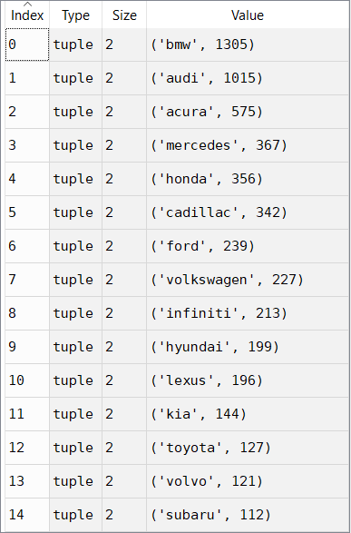
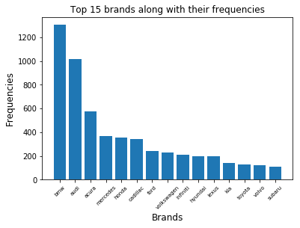
Analysis
Top 15 Brands

Slide 11
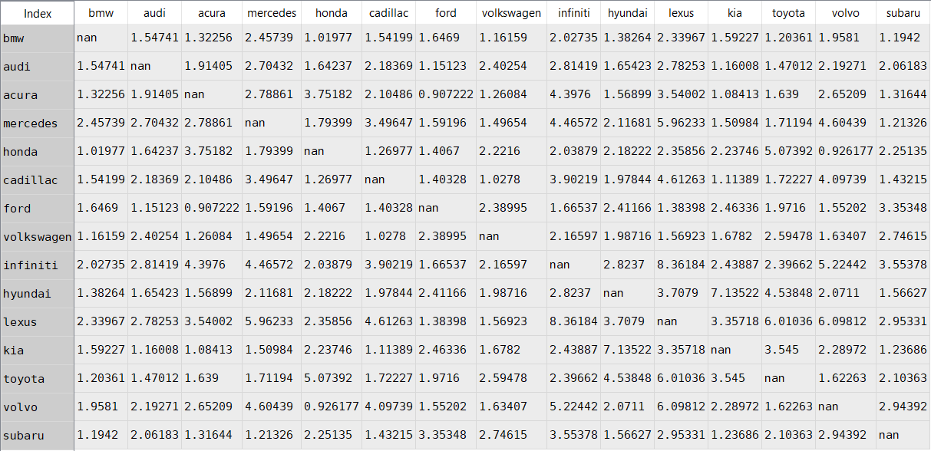
Analysis (Calculate lift ratios for associations between brands)
Top 15 Brands

Slide 12
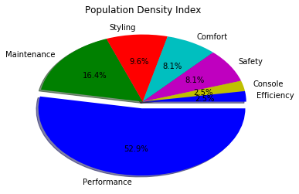
Analysis
Top attributes of top brands

Slide 13
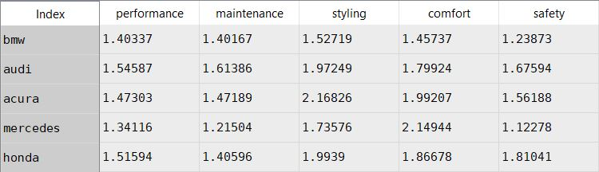
Analysis (Calculate lift ratios for associations between top 5 attributes)
Top attributes of top brands

Slide 14
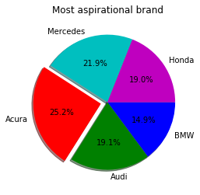
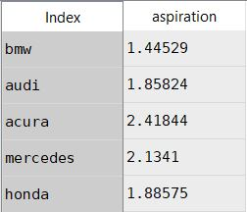
Analysis
Aspirational Brand
Lift Ratio

Slide 15
Observation:
While BMW has claimed that they are the “ultimate driving machine”, is that how people feel on Edmunds?
The association of BMW with performance is lower than that of audi or acura. This shows that probably people don't associate bmw with performance that much.
What is interesting is that people associate BMW more with comfort and styling than performance.
Whereas,
Acura gives comparatively the best result with respect to every attribute.
Hence, Acura could be the most preferred or recommended brand for any person.

Slide 16
Conclusions:
Production Manager:
a.) BMW: While we are marketing BMW as the 'ultimate driving machine' people are not strongly associating BMW with performance. Thus think about improving the quality of engine/materials and maybe see what are the key performance features people are talking about and potentially try to include them in our cars.
b.) Mercedes: While Mercedes is doing a great job at comfort, people think that it is not safer to drive Mercedes. From a product's perspective we could consider including additional high quality safety features to try to alleviate any concerns with the same.

Slide 17
Conclusions:
Marketing:
a.)Audi: For all 5 attributes, it seems like Audi is very closely related to Acura and Honda, and from a marketing perspective, we would want to create more brand differentiation to really uniquely position Audi in the luxury car marketplace.
b.) Honda: For all 5 attributes, it seems like Honda is very closely related to Acura, and from a marketing perspective, we would want to create more brand differentiation to really uniquely position Honda in the luxury car marketplace.
c.)Mercedes: This brands ranks the highest in terms of comfort , but scored the lowest in terms of safety. From a marketing and branding perspective, they are doing a good job of highlighting the comfort and styling of the car, but may want to consider including the vehicle's safety aspects to have a more well-rounded brand image.

