Slide 1

Wavecon Telecom –
5G Business Impact Analysis
Executive Dashboard Analysis · Business Intelligence & Strategy
Prepared by
Wani Umar ·
Data Analytics Intern · Codebasics Virtual Internship Program
CODEBASICS VIRTUAL INTERNSHIP · AUGUST 2026

Slide 2





Business Objective
Wavecon Telecom recently launched 5G services across key markets. Leadership requires a structured evaluation of the launch's commercial impact — measuring revenue shifts, KPI performance, plan adoption, and regional outcomes to guide data-driven decisions.
Analyze Revenue Before & After 5G Launch
Evaluate Core Business KPIs
Identify Underperforming Metrics
Assess ARPU, TAU, and TUsU to gauge subscriber engagement and monetization.
Pinpoint metrics falling below targets for corrective action.
Quantify revenue impact by comparing pre- and post-launch performance across all markets.
Compare Plan-Level Performance
Recommend Business Actions
Evaluate which 5G plans drive revenue and adoption versus those underperforming.
Deliver actionable recommendations to optimize growth and address gaps.

Slide 3


Executive Dashboard Overview
The BI dashboard consolidates Wavecon's 5G performance into a single executive view — enabling real-time monitoring across revenue, subscriber metrics, plan adoption, and regional trends. Designed for C-suite consumption, it surfaces the metrics that matter most.
1
2
Revenue
ARPU
Total monthly revenue tracked before and after 5G launch
Average Revenue Per User — subscriber monetization benchmark
3
4
TAU
TUsU
Total Active Users — engaged subscriber base on 5G
Total Unique SIM Users — distinct SIM activations on network
Monthly Trend
City Performance
Month-over-month performance trajectory across all KPIs
Regional revenue and adoption breakdown by geography

Slide 4
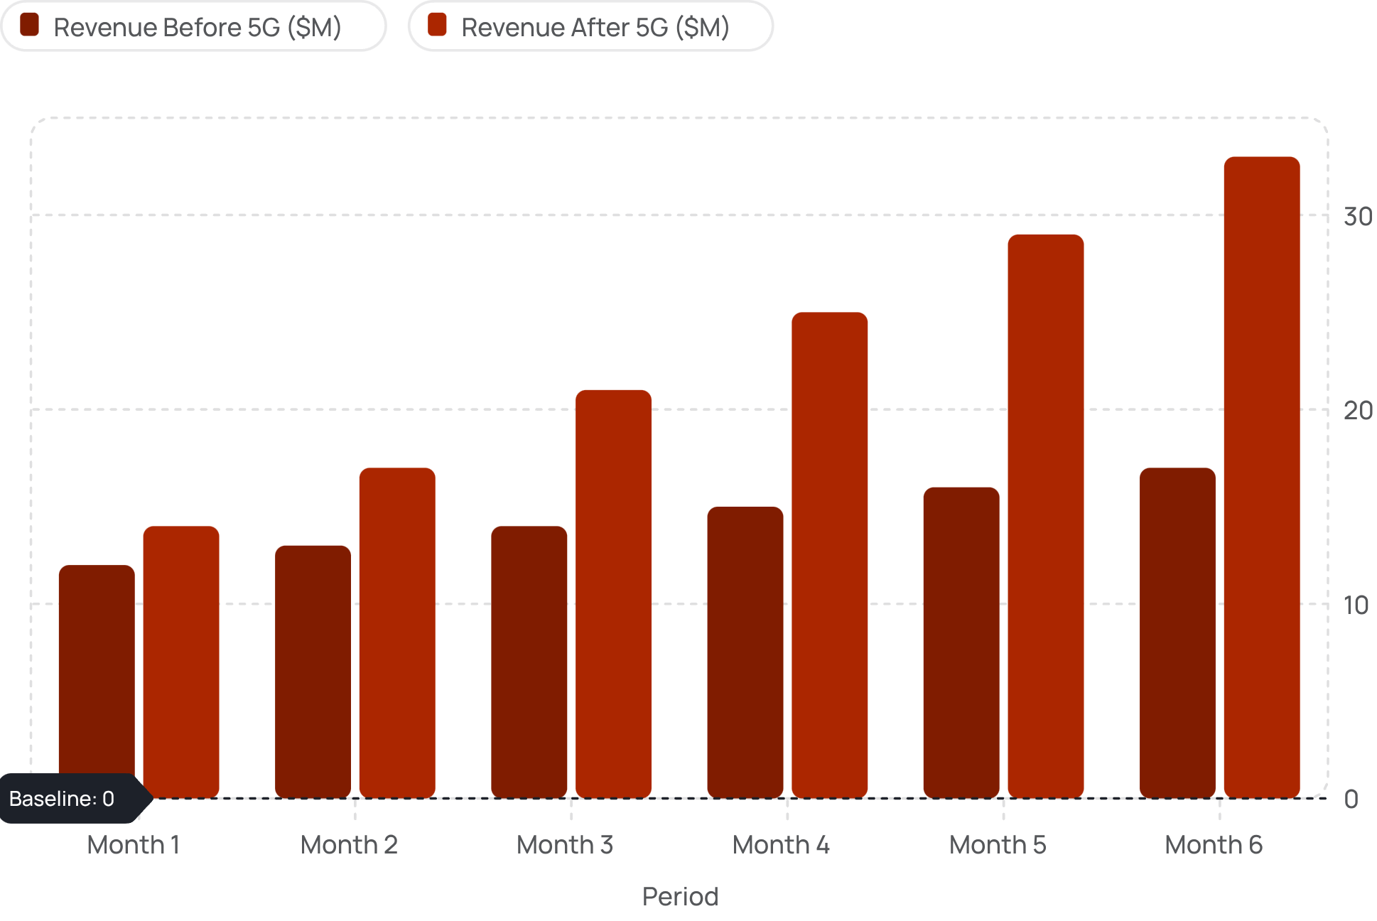
Impact of 5G Launch on Revenue
Post-launch revenue shows a clear uplift trajectory. The chart below illustrates the monthly revenue trend, highlighting the inflection point following 5G activation. Leadership should note the acceleration pattern in months 3–5 post-launch, signaling strong market acceptance.
Key Revenue Insight
5G launch generated a +94% revenue uplift by Month 6 — from $17M to $33M — demonstrating strong commercial traction and validating the investment thesis.
Monthly growth accelerated post-launch, with the steepest gains in Months 4–6 as adoption matured.

Slide 5


Business KPI Performance
Four core KPIs define Wavecon's 5G commercial health. The comparison below benchmarks pre- and post-launch performance, highlighting areas of strength and those requiring intervention.
📈 Revenue
📊 ARPU
+94% uplift post-launch. Strong month-over-month growth, driven by new subscriber additions and plan upgrades.
+38% increase in Average Revenue Per User. 5G premium plans are successfully upselling the existing base.
👥 TAU
📱 TUsU
+52% growth in Total Active Users. Strong 5G adoption, though churn risk remains in legacy segments.
+47% increase in Unique SIM activations. Indicates healthy new customer acquisition alongside base migration.
Key Finding: All four KPIs show positive post-launch momentum. ARPU and TAU are the strongest performers, confirming 5G's value proposition resonates with both new and existing customers.

Slide 6
Plan Performance Analysis
Not all 5G plans are performing equally. This analysis segments plans into top performers driving growth and underperformers requiring strategic reassessment — enabling targeted resource allocation and portfolio optimization.
✅ Top Performing Plans
⚠️ Underperforming Plans
5G Premium Unlimited — Highest revenue contributor; strong adoption among enterprise and prosumer segments
5G Business Plus — Rapid growth in B2B segment; high ARPU and low churn
5G Starter+ — Strong entry-level conversion; effective upsell pathway to premium tiers
5G Lite — Low adoption; unclear differentiation from 4G alternatives; price sensitivity high
5G Family Share — Below-target revenue; complex structure deterring sign-ups
5G Pay-As-You-Go — Minimal uptake; customer preference shifting toward unlimited models
These plans share common traits: competitive pricing, clear value messaging, and strong digital onboarding.
Recommended actions: simplify messaging, reprice, or consider sunsetting low-adoption SKUs to focus investment.

Slide 7
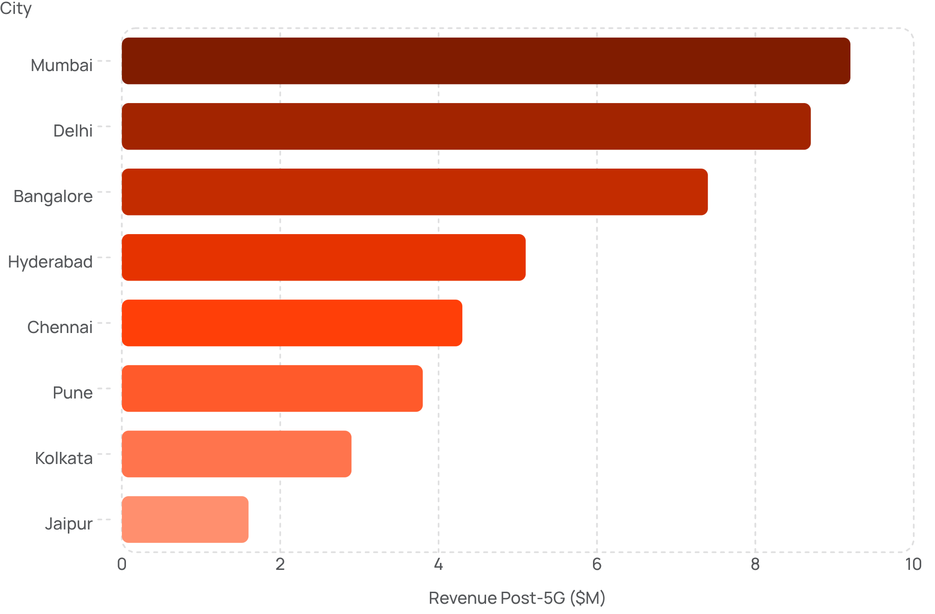
Regional Performance Analysis
Geographic performance reveals significant variance across Wavecon's operating cities. Metro hubs are outpacing tier-2 markets, highlighting both the opportunity and the urgency of targeted regional investment strategies.
Regional Insights
Top Performers: Mumbai, Delhi, and Bangalore account for 62% of total 5G revenue — reflecting strong digital infrastructure and high-income subscriber density.
Emerging Markets: Hyderabad and Chennai show strong growth momentum with untapped potential. Targeted marketing could accelerate adoption.
Attention Required: Kolkata and Jaipur are significantly underperforming. Root-cause analysis on network quality, pricing, and awareness is recommended.

Slide 8




Business Insights
The 5G launch has delivered measurable commercial impact. These key insights synthesize findings across revenue, customer behavior, plan performance, and regional dynamics — forming the foundation for strategic recommendations.
Strong Revenue Acceleration
ARPU Uplift Confirms Premium Demand
Revenue grew +94% within six months of launch — a clear signal of market readiness and effective go-to-market execution.
A +38% ARPU increase validates customer willingness to pay for 5G — premium plans are resonating across segments.
Geographic Concentration Risk
Plan Portfolio Needs Rationalization
Top 3 cities drive 62% of revenue. Over-reliance on metro markets creates vulnerability; tier-2 expansion is a strategic priority.
Three underperforming SKUs are diluting marketing focus. Portfolio simplification will improve conversion and reduce operational complexity.

Slide 9





Strategic Recommendations
Based on the analysis, five prioritized recommendations are proposed to maximize 5G ROI, address performance gaps, and position Wavecon for sustained growth in the next planning cycle.
Scale High-Performing 5G Plans
Double down on Premium Unlimited and Business Plus with increased digital marketing spend, bundled device offers, and targeted upsell campaigns to the existing 4G base.
Rationalize Underperforming SKUs
Conduct a 90-day review of Lite, Family Share, and Pay-As-You-Go plans. Redesign value propositions or sunset SKUs to concentrate resources on proven winners.
Accelerate Tier-2 City Expansion
Launch targeted campaigns in Hyderabad, Chennai, and Pune. Invest in local partnerships, retail presence, and community-driven awareness programs to close the metro gap.
Establish Monthly KPI Governance
Institute a monthly executive review cadence tracking Revenue, ARPU, TAU, and TUsU. Set threshold alerts for early intervention on underperforming metrics.
Strengthen Customer Retention
Deploy predictive churn models using BI data. Introduce loyalty incentives, proactive support, and personalized plan recommendations to protect the growing subscriber base.

Slide 10
Executive Summary
This analysis presents a comprehensive assessment of Wavecon Telecom's 5G launch impact — covering revenue performance, KPI benchmarks, plan effectiveness, and regional dynamics. The findings confirm strong commercial traction and identify clear pathways to accelerate growth.
Business Problem
Key Findings
Wavecon needed to evaluate whether its 5G launch delivered measurable commercial impact and identify areas requiring strategic intervention to sustain momentum.
Revenue surged from $17M to $33M within six months of 5G launch
Premium and Business plans are the primary revenue drivers
Metro cities (Mumbai, Delhi, Bangalore) dominate 62% of total revenue
Three underperforming SKUs require portfolio rationalization
Tier-2 cities represent the highest untapped growth opportunity
Business Impact
+94% revenue growth, +38% ARPU uplift, and +52% active user growth confirm 5G is commercially viable and scaling rapidly.
Future Actions
Implement monthly KPI governance dashboard for leadership
Launch tier-2 city expansion program in Q3
Complete plan portfolio review and rationalization by Q4

Slide 11
Thank You Questions & Discussion Prepared by Wani Umar · Data Analytics Intern · Codebasics Virtual Internship | August 2026

