Slide 1
How to be a teacher of tomorrow?

Slide 2
Teaching is a dynamic profession that requires a unique blend of skills to inspire young minds and create effective learning environments.

Slide 3
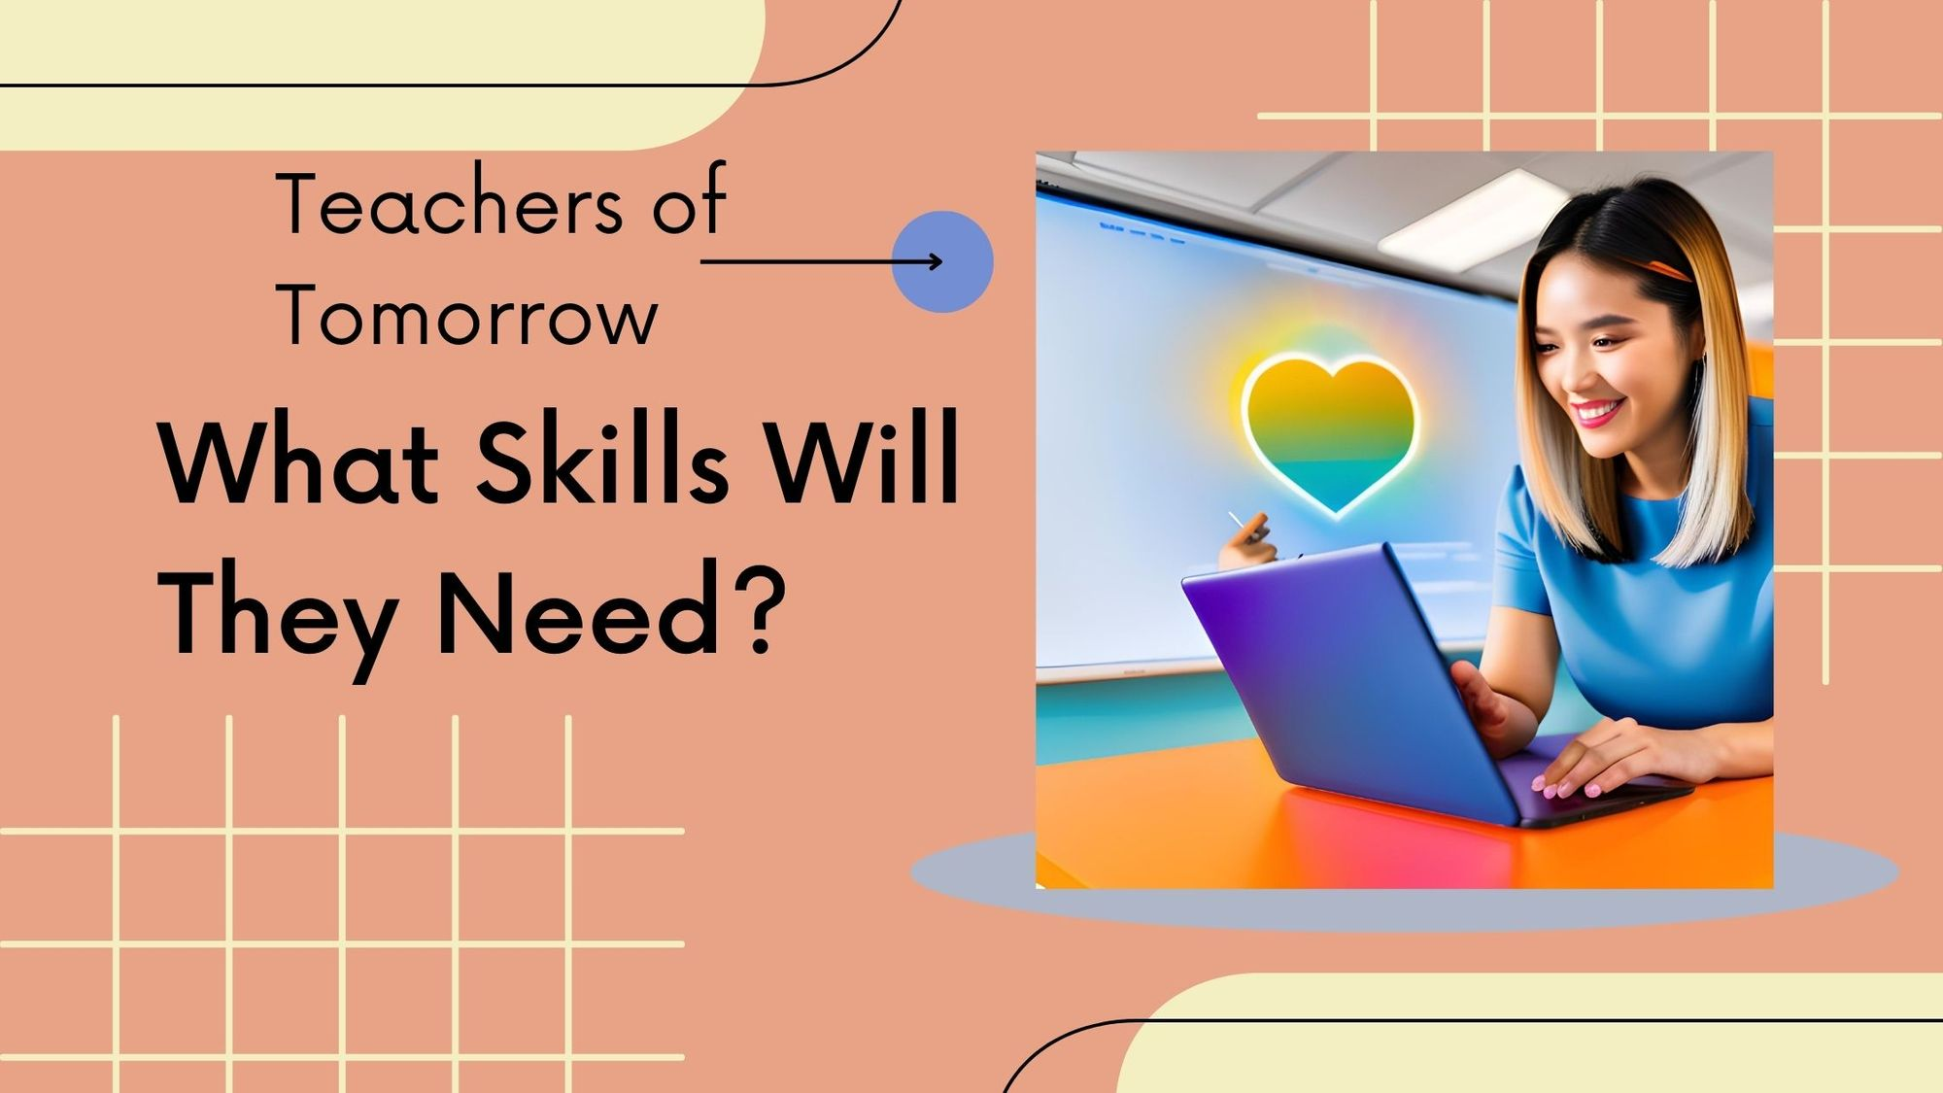
As a teacher, you’re responsible for various tasks within a school, ensuring that your class’s learning runs smoothly.

Slide 4
There are some essential skills:
Communication
Critical Thinking
Patience
Leadership
Organization
Time Management
Teamwork
Listening
Self-Evaluation
Commitment
Classroom Management
Creativity

Slide 5
Becoming a certified teacher usually takes between four to five years. But, if you already hold a bachelor’s degree, you could enroll in an accelerated teacher certification program, become licensed in as little as one year (some programs are longer), and start teaching as quickly as possible. So, yes, with a bachelor’s degree in any subject, you can enroll in a state-approved teaching program. You will be expected to pass the entry requirements, including state exams.

Slide 6
Best teachers of the world are:

Slide 7
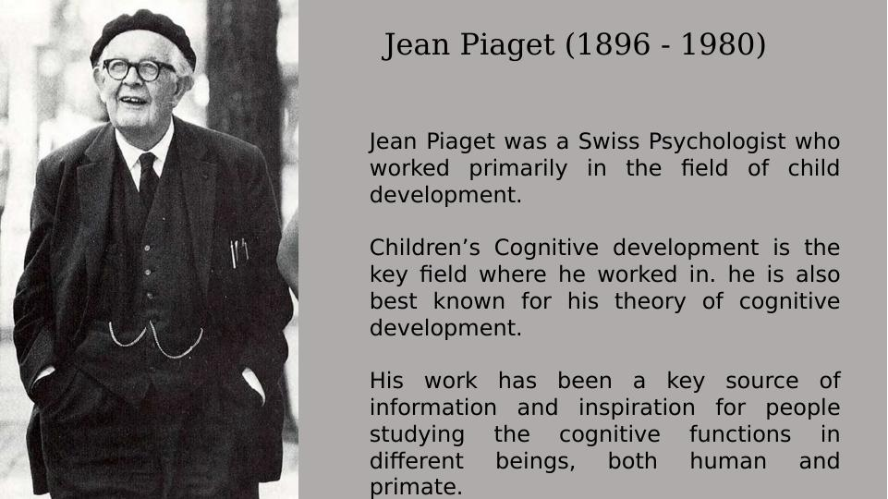

Slide 8
