Slide 1
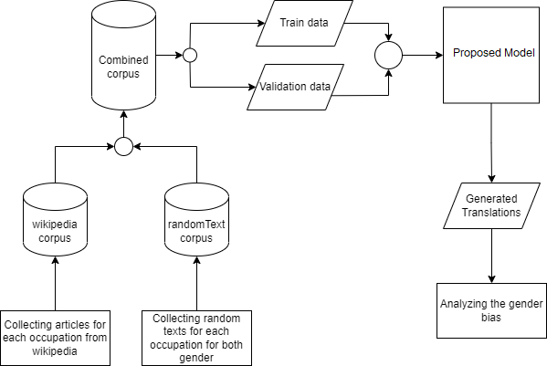
Workflow for The Proposed Model

Slide 2
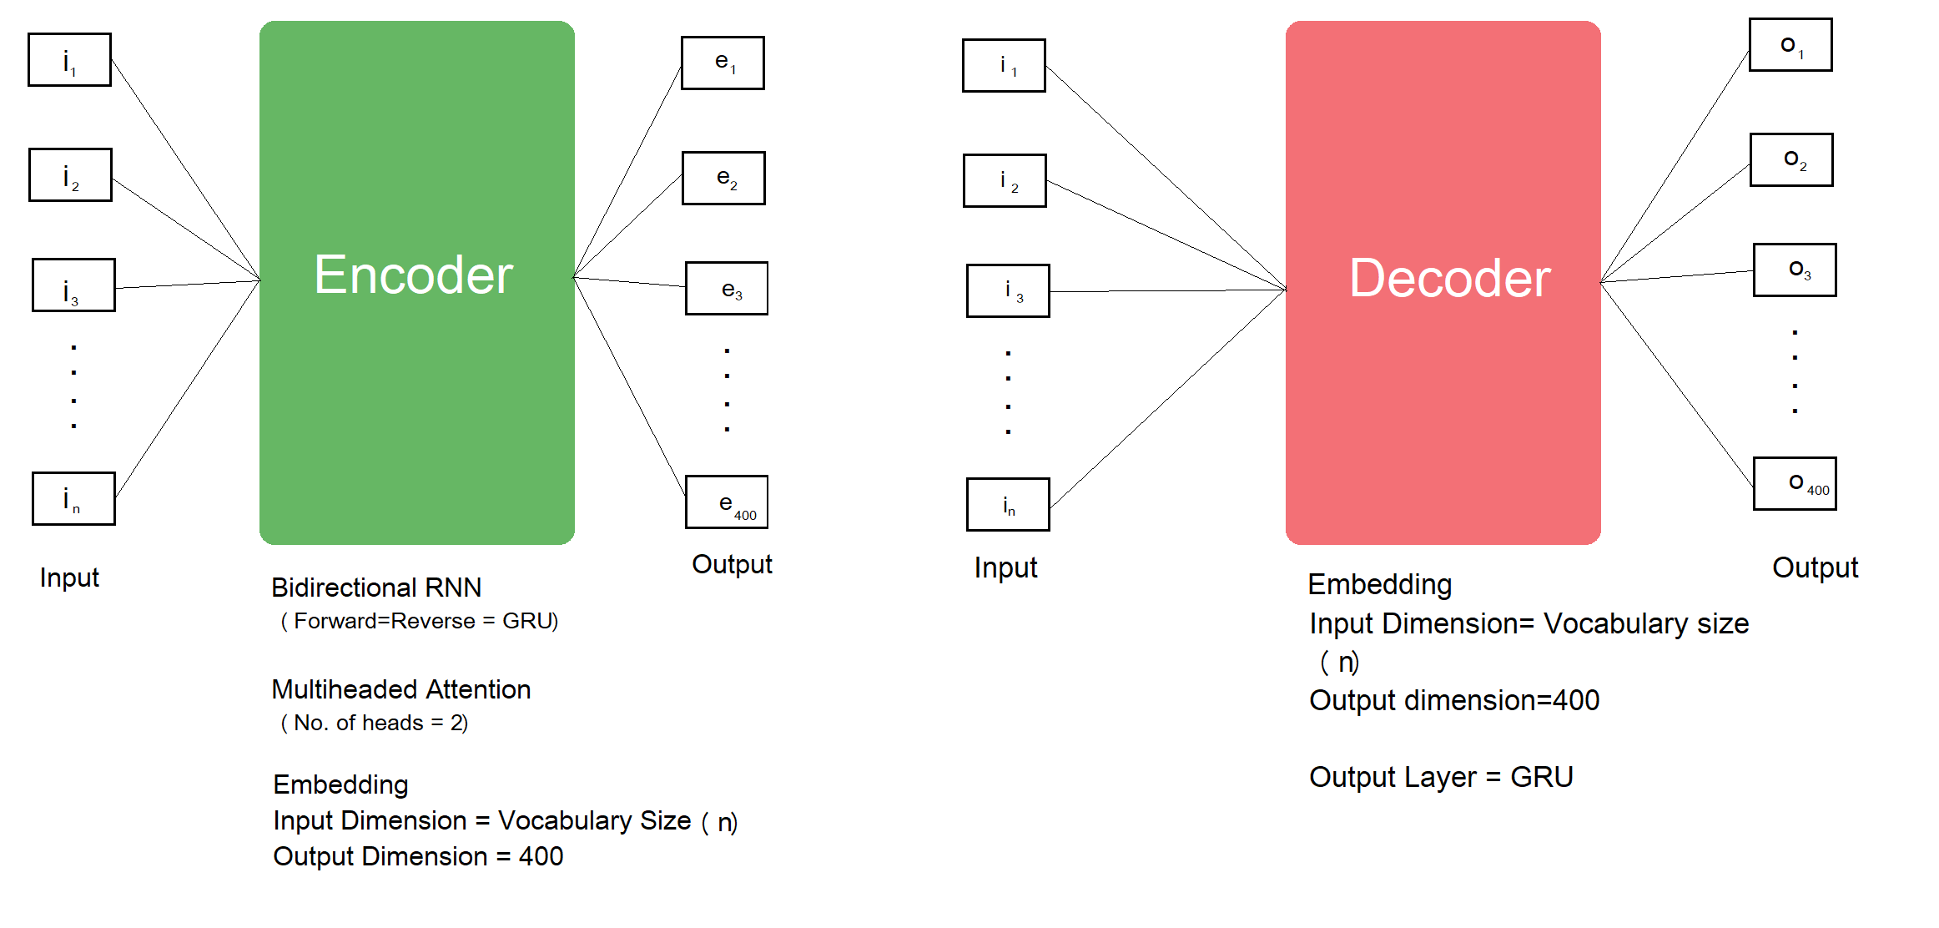
Proposed Model

Slide 3
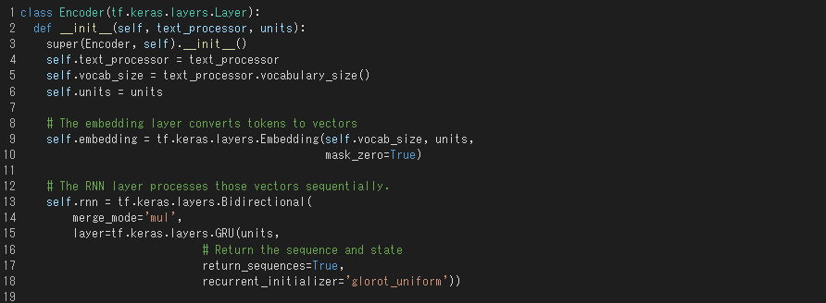
Encoder Architecture

Slide 4
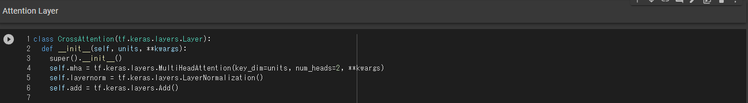
Encoder Architecture

Slide 5
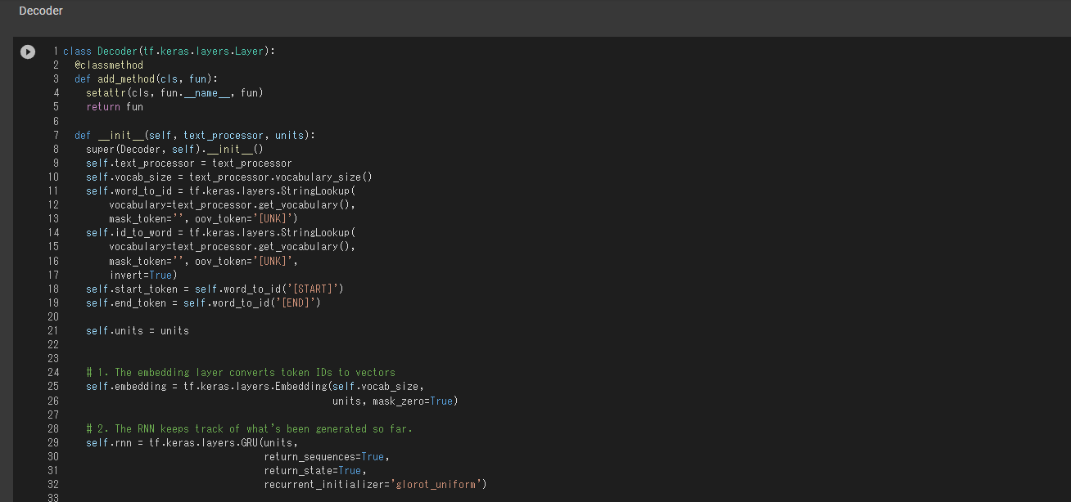
Decoder Architecture

Slide 6
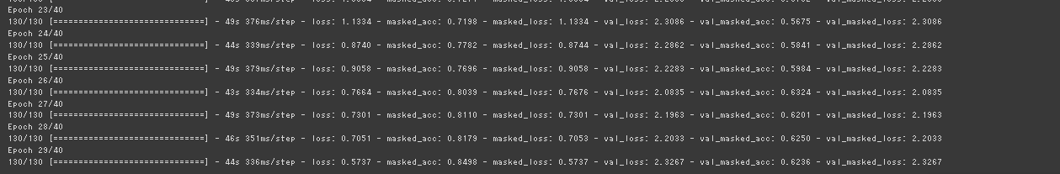
Translation Performance

Slide 7
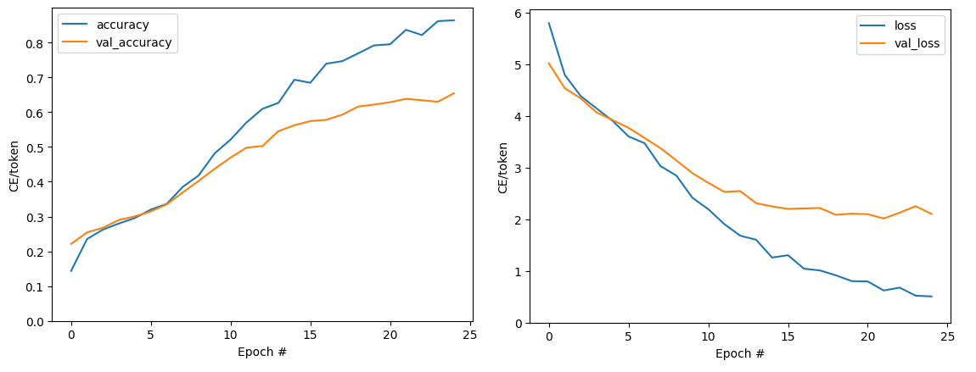
Accuracy and loss

Slide 8
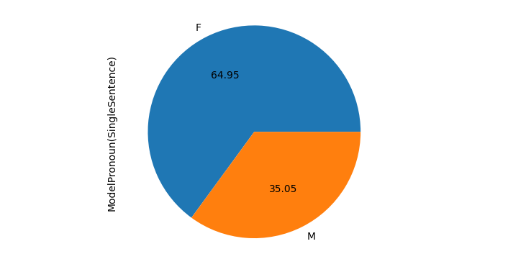
Gender Bias Analysis

