Slide 1
Otomo tool
As far as we know, although this tool has more advantage than Sizmek in some aspects, they also have many defects for us.

Slide 2
Good aspects
Share link more intelligence and fast.
Multiple edits maybe more efficient, for example: render, download, generate preview link.
Speed faster than the Sizmek.

Slide 3
2. Not good enough aspects
Starting to use a new platform need more time.
Couldn’t find the master template demo code on the site, despite they have the ‘help’ page, but it’s difficult to imagine. Even though I email them to ask the master template code, but we haven’t received the file yet.
Only one template is success which hasn’t insert any template code anymore.

Slide 4
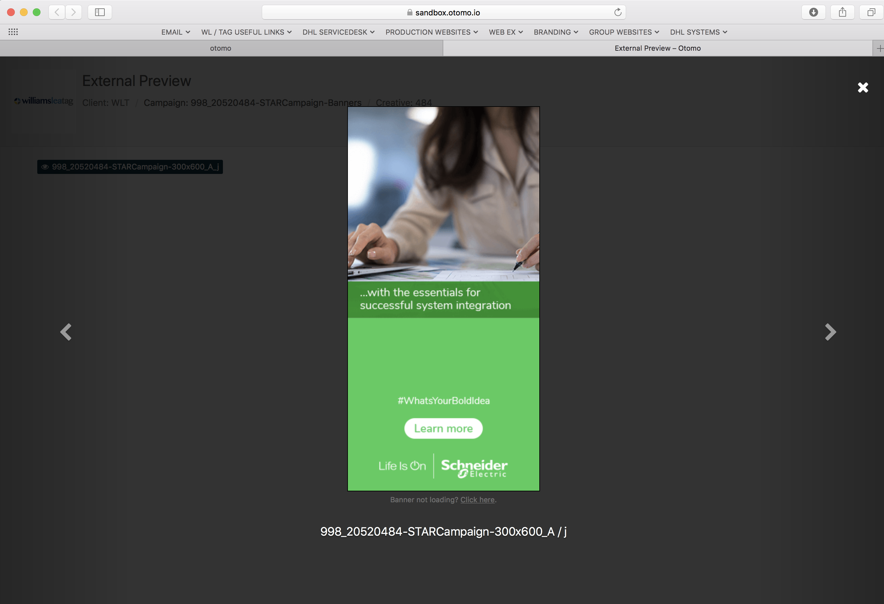

Slide 5
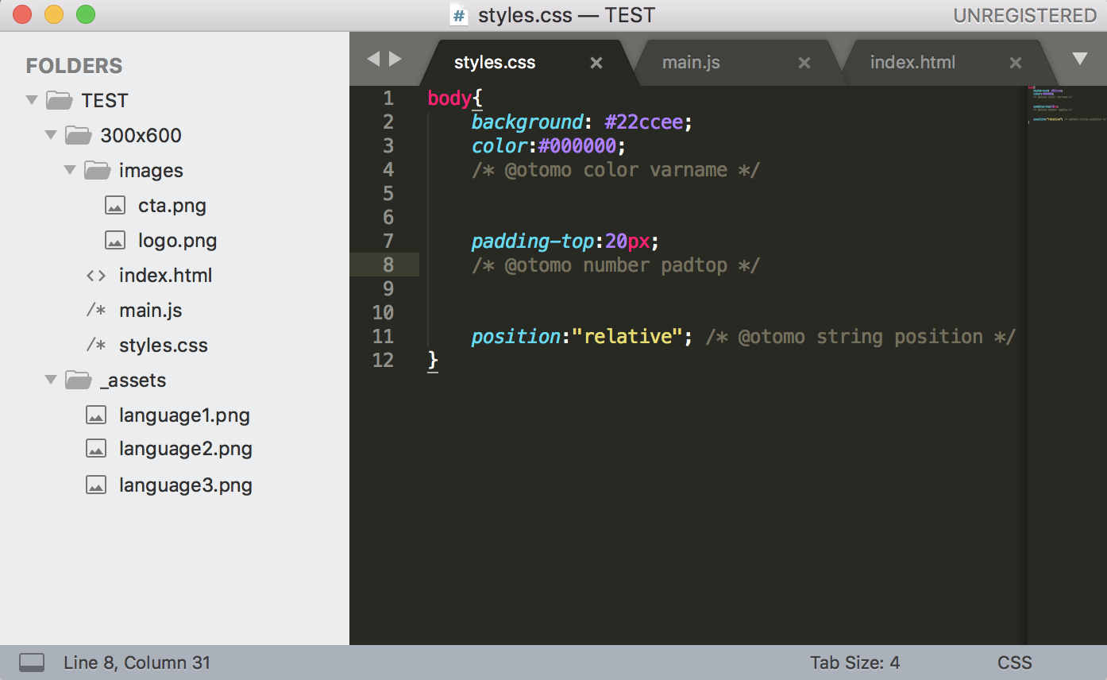
The package doesn’t work very well, although we develop the master according to the ‘help’ document. It has many problems.
Such as rending’s problem:

Slide 6
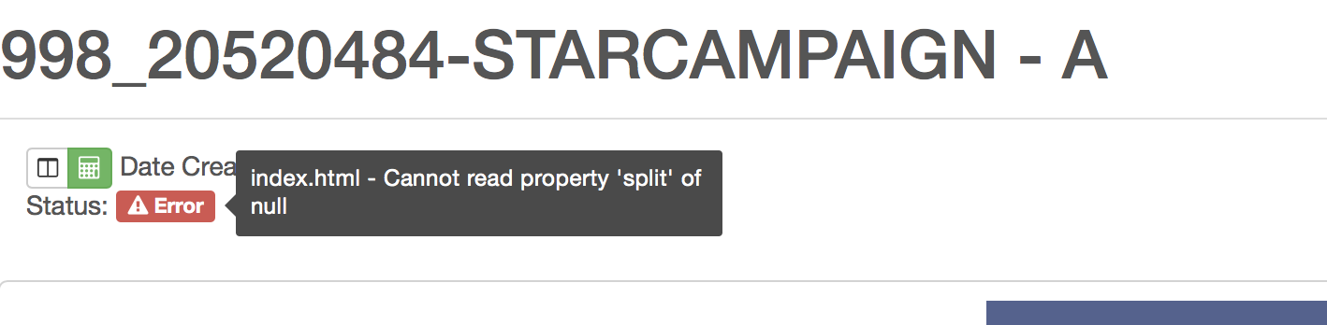
index.html - Cannot read property 'split' of null

Slide 7
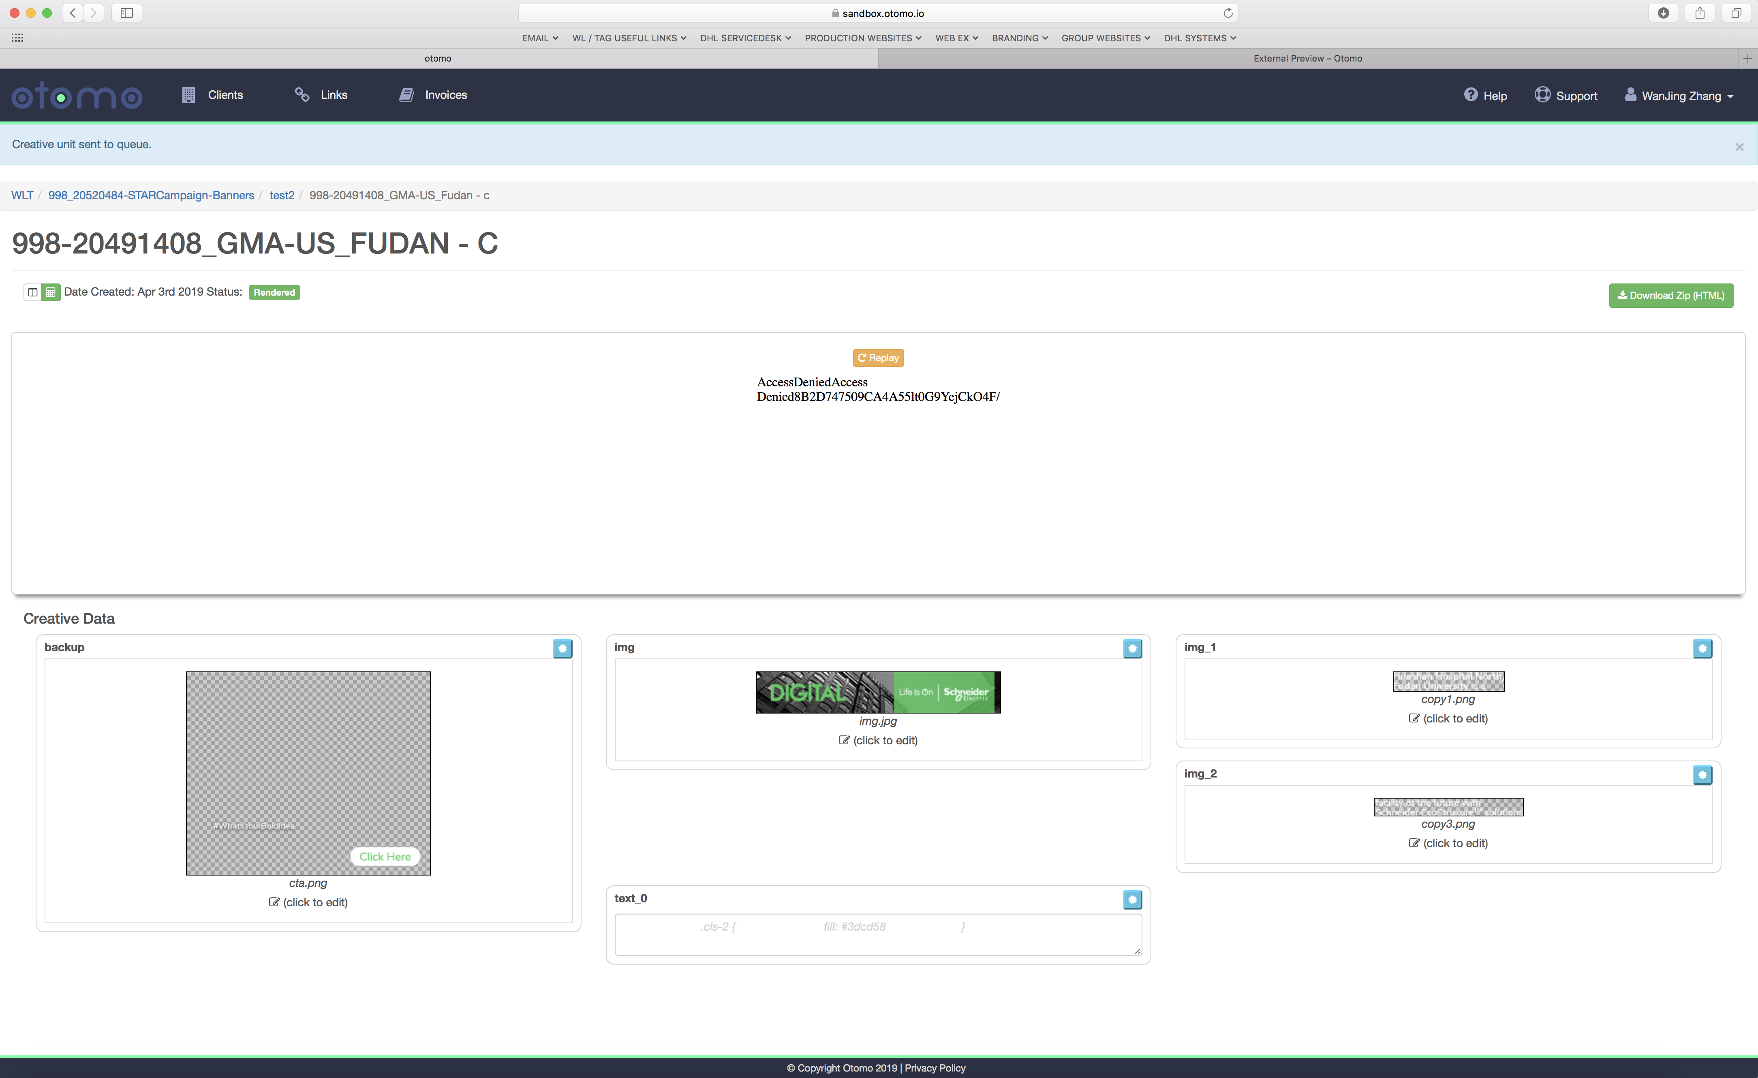
AccessDeniedAccess Denied70BBD6B40446AA9EzGn5dFDqGkM

Slide 8
None debug error give us to fix the bug.
We add the code into the HTML, CSS, JS file, but couldn’t know whether it’s correct or not.

Slide 9
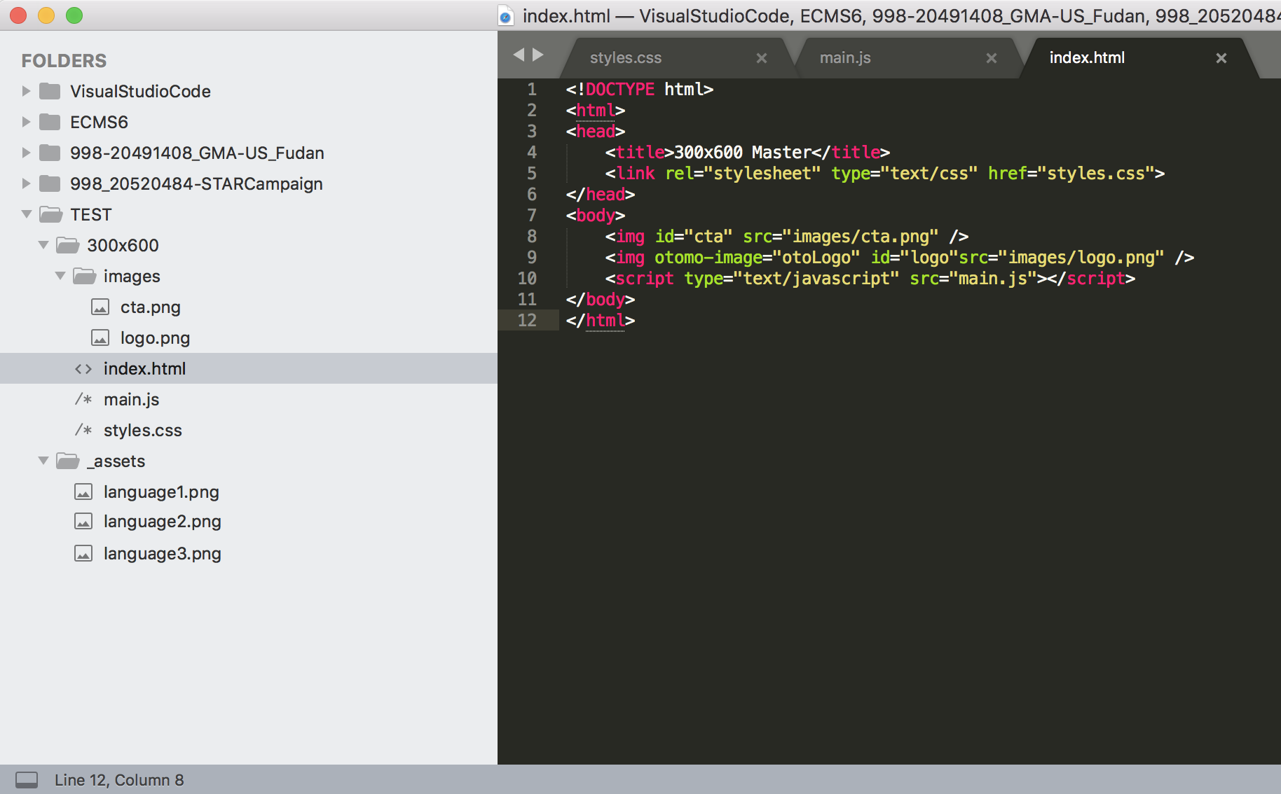

Slide 10
Other important things
1. Speed here in China Load speed is ok in China.
2. Ease of use
Not good enough for ease use.
3. Time saved compared to standard production
I think to make a new template also need time, and we don’t know this tool support the canvas, SVG, CSS background, etc.
4. Possibility to incorporate on Schneider or Richemont
It’s whether available to use is difficult to say, cause we haven’t success render a few of special case on Schneider or Richemont.
5. First we need to do
We need demo code, even if small code snippets will be fine.

