Slide 1
Diabetes Prediction
Problem Statement and Solution Overview

Slide 2
Problem Statement
The goal is to develop a model that can predict whether an individual is likely to develop diabetes based on various health metrics.

Slide 3
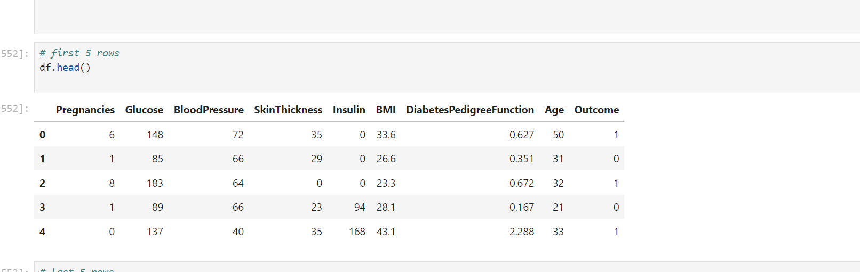
Data Overview
The dataset includes health metrics such as glucose levels, BMI, age, and more. The target variable indicates whether the individual has diabetes.

Slide 4
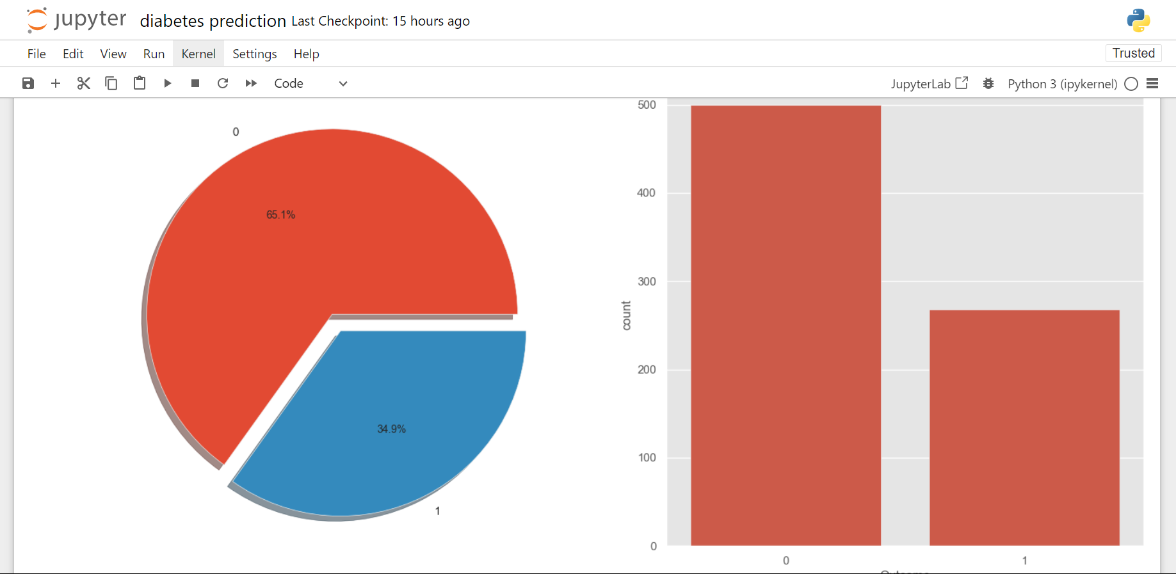
EDA with pie
Data visualization of who has diabetes and who doesn’t 0 for who don’ and 1 has we have a pie chart and a correlation matrix

Slide 5
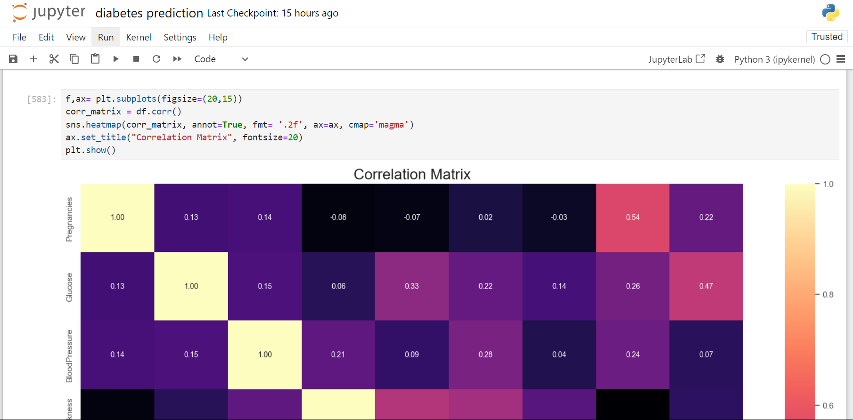
Correlation matrix

Slide 6
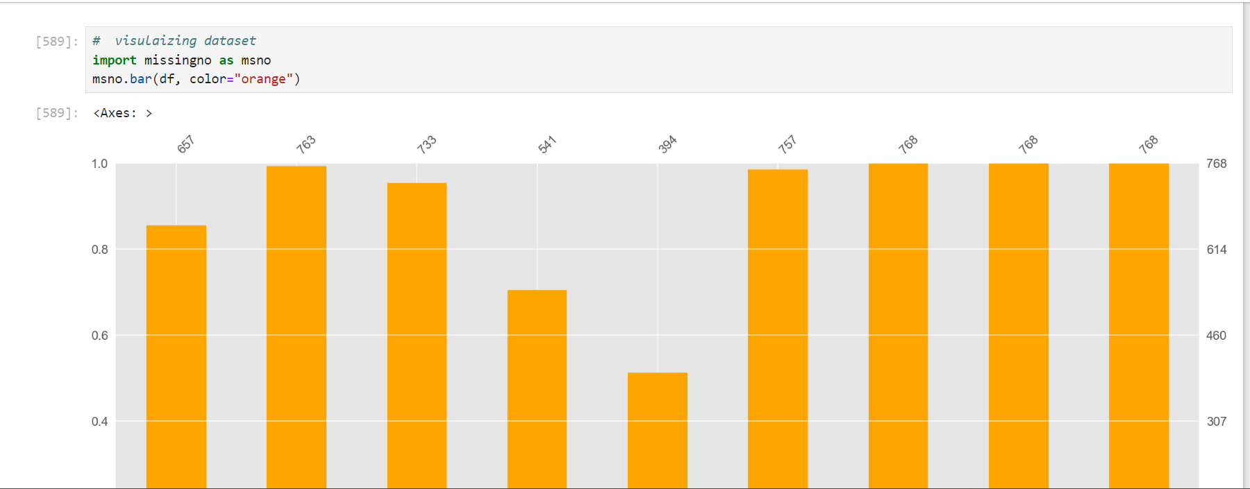
Data preprocessing
first we look at the dataset so as to see which column has the most missing data

Slide 7
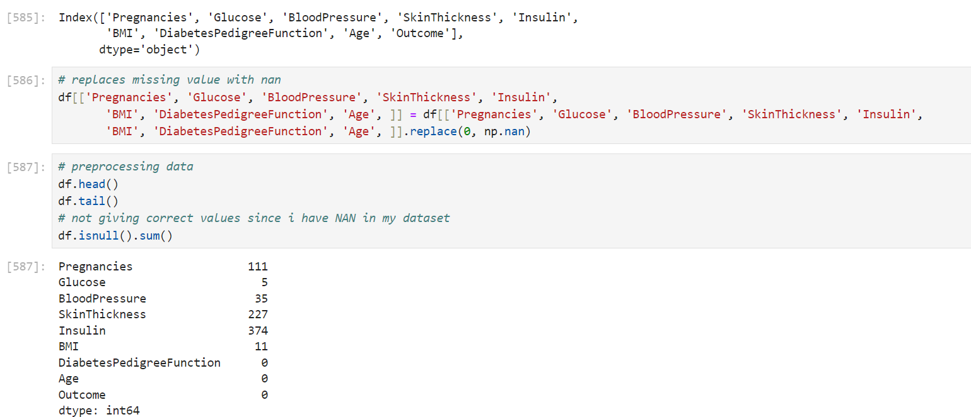
continued
After seeing which columns have missing values we fill them with the median of the column.

Slide 8
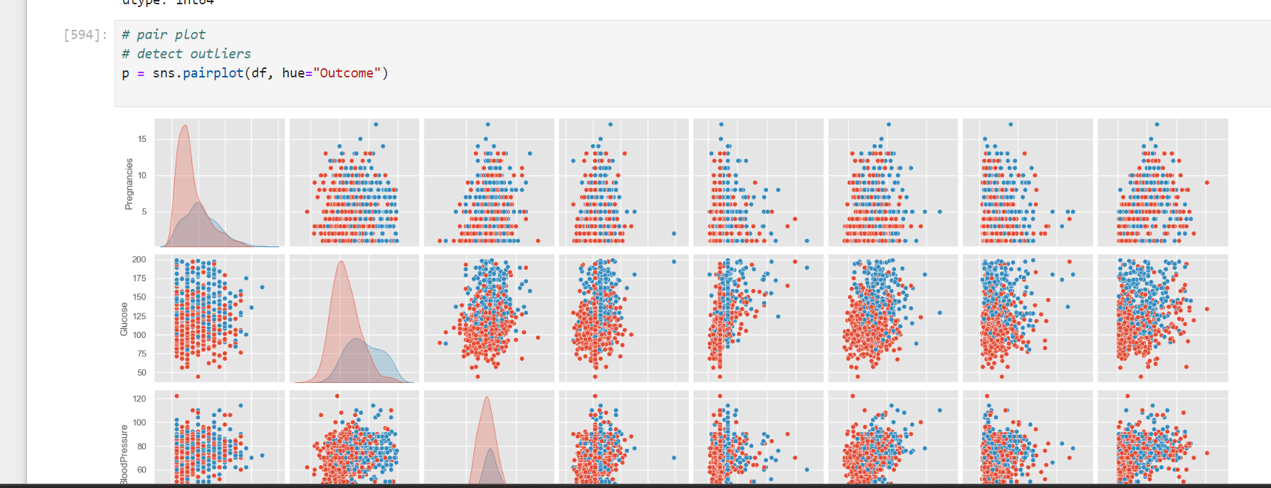
Outliers
Then we find outliers and eliminate them so as to have concise data.

Slide 9
Solution Approach
The solution involves data preprocessing, feature scaling, and training multiple classification models such as Logistic Regression, K-Nearest Neighbors, and Random Forest. The best model is selected based on performance metrics.

Slide 10
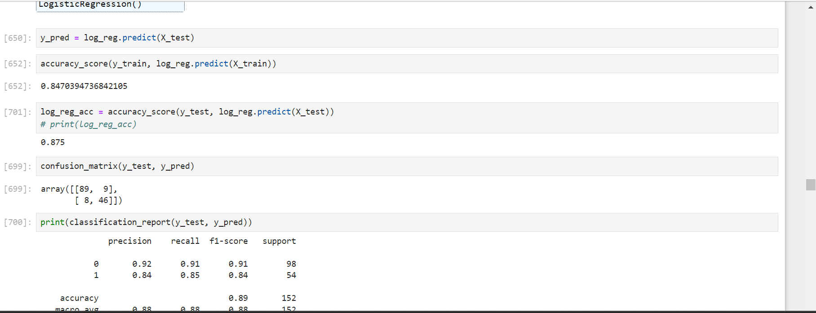
continuation

Slide 11
Model Evaluation
The models are evaluated based on accuracy, ROC-AUC score, and other relevant metrics. The final model is chosen to provide the best balance between accuracy and interpretability.

Slide 12
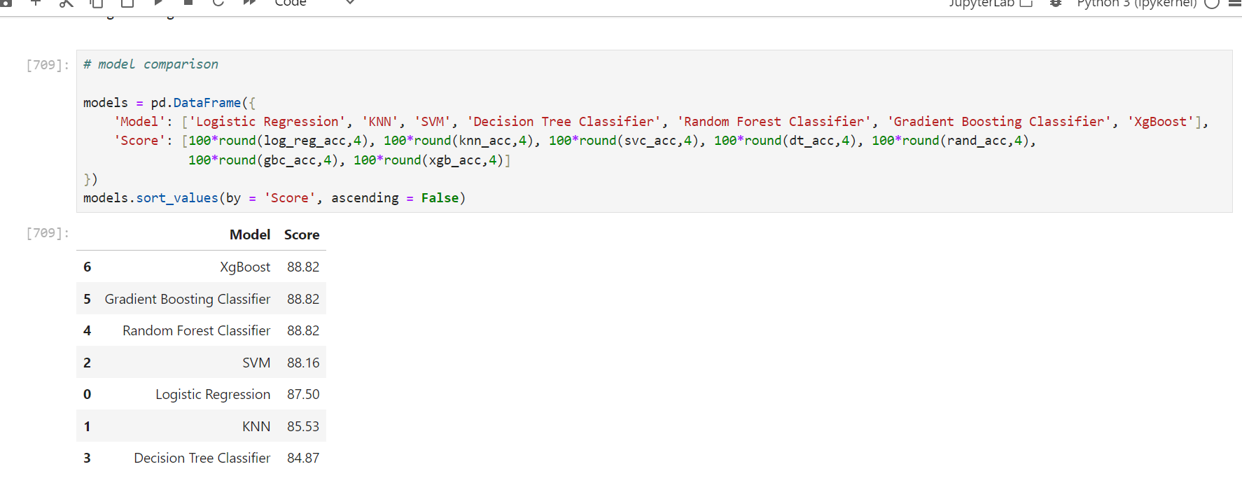
Model evaluation

Slide 13
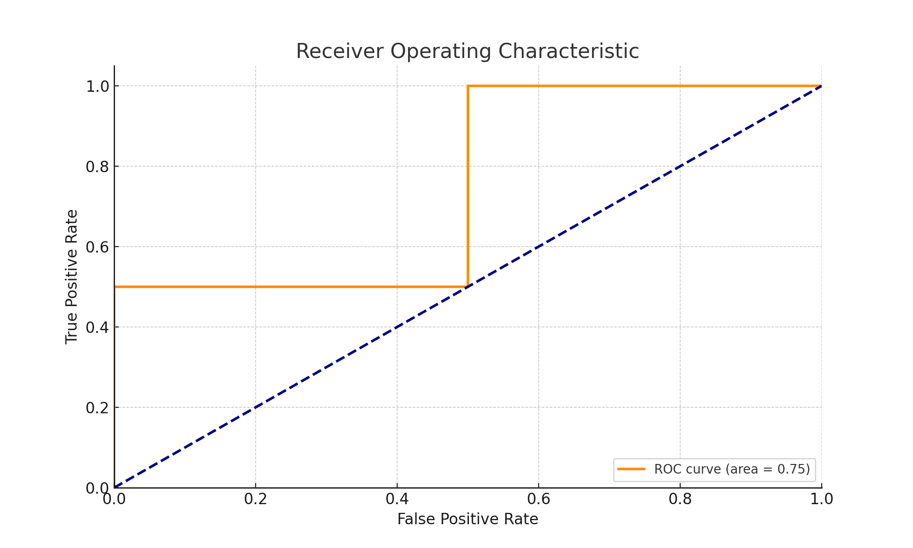
ROC- AUC SCORE DIAGRAM

Slide 14
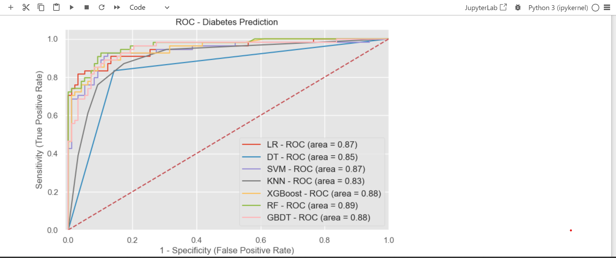
ROC DIABETES PREDICTION

Slide 15
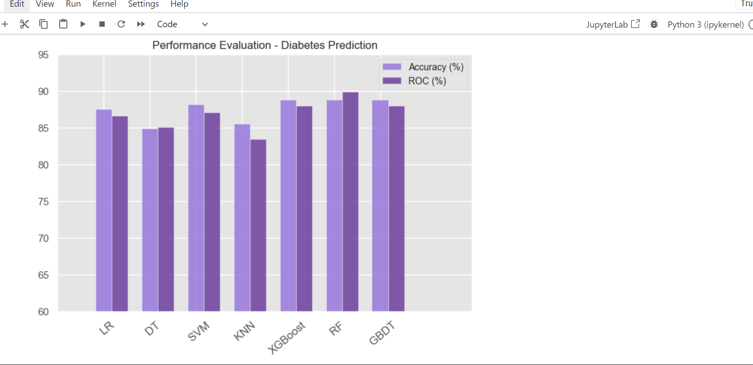
Performance Evaluation

