Slide 1
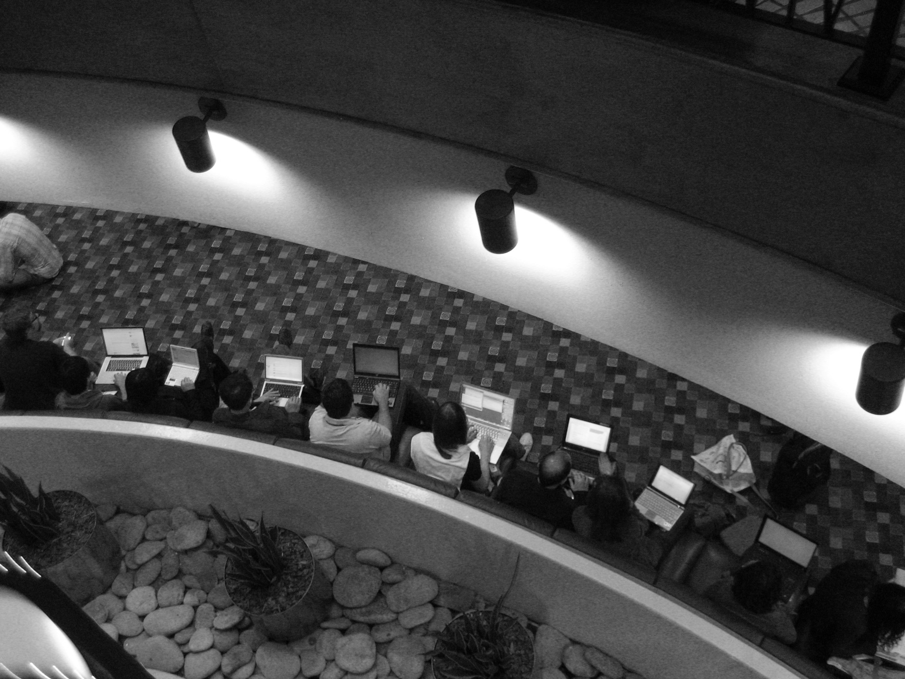
User RESEARCH
Thursday, 9 July 2015

Slide 2
Today’s Plan and Objectives
Part 1: 9:00am – 10:15am
Homework Review.
Why/When User Research? (ProTip?)
Anthropological Grounding
Activity / Break: 10:15am – 10:45am
Part 2: 10:45am – 12:30pm
Methods – Asking or Watching
Quick Usefulness
Take-Home Review Points
Homework

Slide 3
Soo…
the readings:
3 adjectives

Slide 4
Soo…
your homework.

Slide 5
Sam’s UX Pro Tips
Notes:
PLAY VIDEO HERE!
Video: http://www.guardian.co.uk/media/video/2011/jun/22/google-africa-technology-video?intcmp=239
Play: 1:00 - 3:50
This is a clip from a conference called Activate Summit (2011, London)

Slide 6
Constraints are awesome. Critique is not opinion. All UX is knowledge based. For every rule, there is a reason to break it. You are not, and never will be, your user. Users are bad designers, but they know bad design. Expect to be wrong, and embrace it. It depends. Be reflexive. Ideas are easy, good UX is hard.

Slide 7
Constraints are awesome. Critique is not opinion. All UX is knowledge based. For every rule, there is a reason to break it. You are not, and never will be, your user. Users are bad designers, but they know bad design. Expect to be wrong, and embrace it. It depends. Be reflexive. Ideas are easy, good UX is hard.

Slide 8
Constraints are awesome. Critique is not opinion. All UX is knowledge based. For every rule, there is a reason to break it. You are not, and never will be, your user. Users are bad designers, but they know bad design. Expect to be wrong, and embrace it. It depends. Be reflexive. Ideas are easy, good UX is hard.

Slide 9
You are not your user.
So when and how do we study them?

Slide 10
Ask or Watch.
Most user research methods use some form of empirical research method from anthropological or sociological research.
Most methods are modified (hopefully with a rationale and not just because researchers were in a hurry or “knew better”).
Generally is breaks down into asking or watching (or both).
All user studies should be carefully designed, planned, and implemented if you want to be sure you are not reinforcing assumptions, making guesses, or learning the wrong things.

Slide 11
Ask or Watch.
Asking = interviews, surveys, questionnaires, etc.
Watching = ethnography
* Note: both are hard to do really well. :)

Slide 12

Ethnography to HCI
Ethnography is more than just this disciplinary container.
Anthropologists in technology took design out of the laboratory.
Now more than ever, we draw from anthropological traditions.
Notes:
You might wonder: “Why anthropology” or “Why ethnography” ??
Well, anthropology is on that list that we drew from and needed.
Ethnography and anthropologists have been entangled in the growth and trajectory of my field. (Geneveve Bell, Lucy Suchman, etc.)
Sounds absurd, but 1990s it started to really matter. (Salvador, T. with Genevieve Bell and Ken Anderson (1999) in Design Ethnography. Design Management Journal 10(4):35-41.)

Slide 13
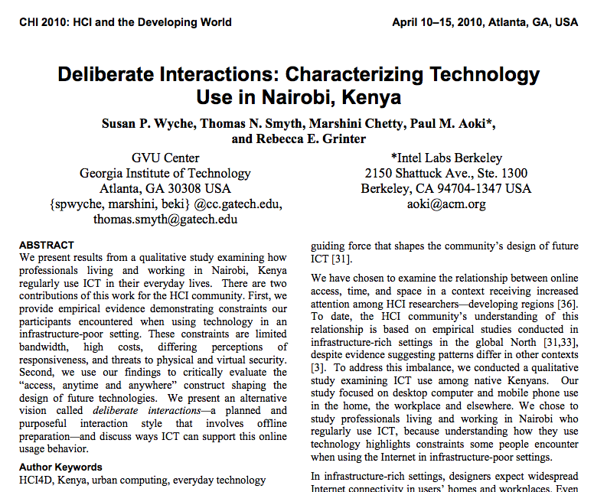
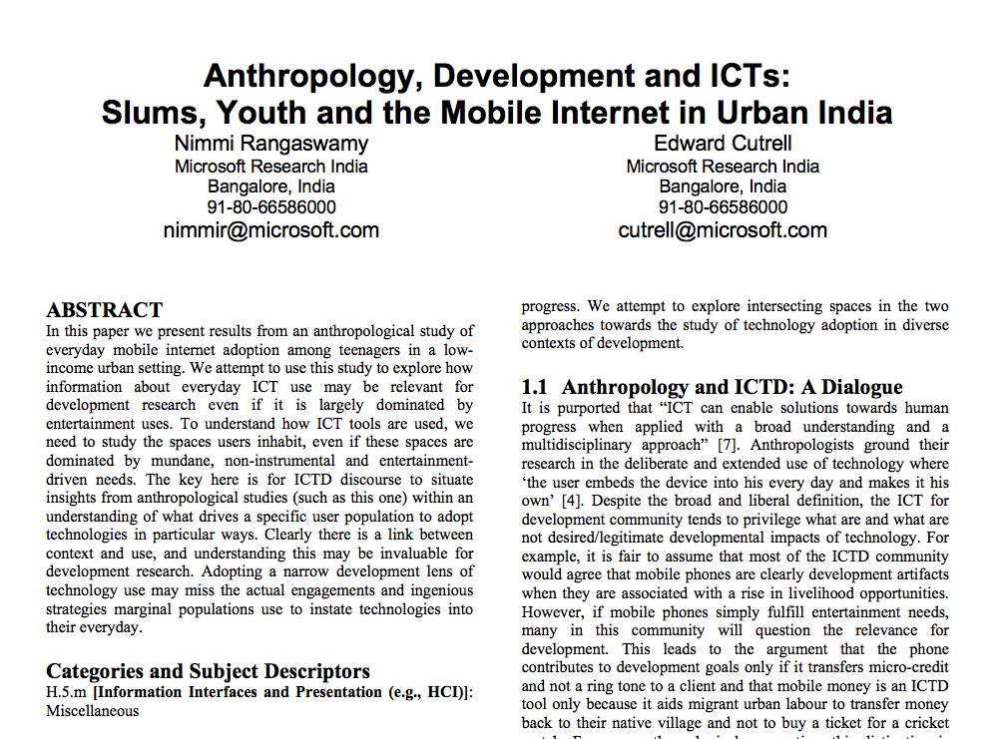

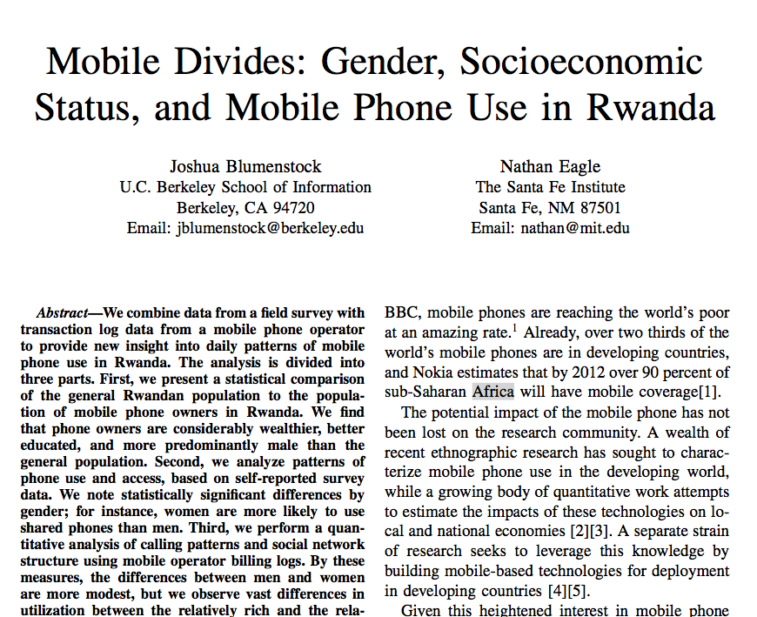
Ethnography (n.)
An ethnographic account collected from field research, written, and published for others to read.
Notes:
That brings me to something we talked about in this class: ethnography can be many things.
Ethnography the noun – An ethnographic account collected from field research, written, and published for others to read.
We make them, and share them with others who are working in our field (to answer GIRL’s question about communication and long term, this is trying to help).
To produce these in technology (with our timelines) in nearly impossible. Story: Angry anthropologists and ICTD 2012 and my workshop.
So, we consume ethnographies produced by others in order to learn, and we go about the business or trying our best to work within our constraints to “do” ethnography.

Slide 14

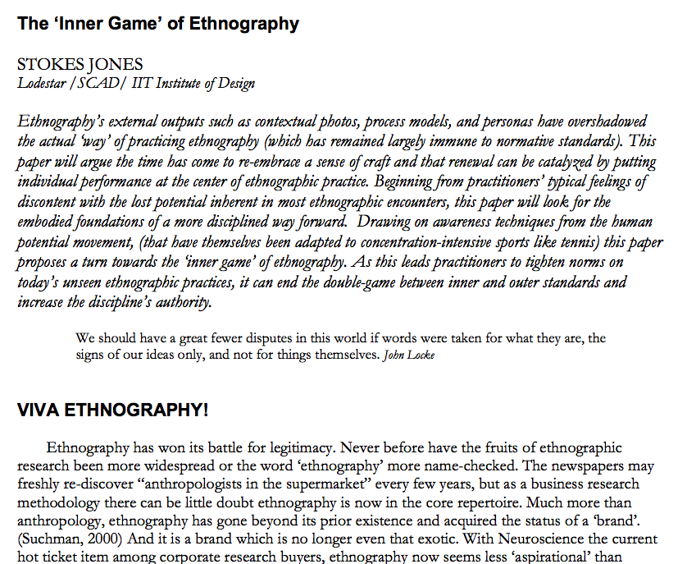
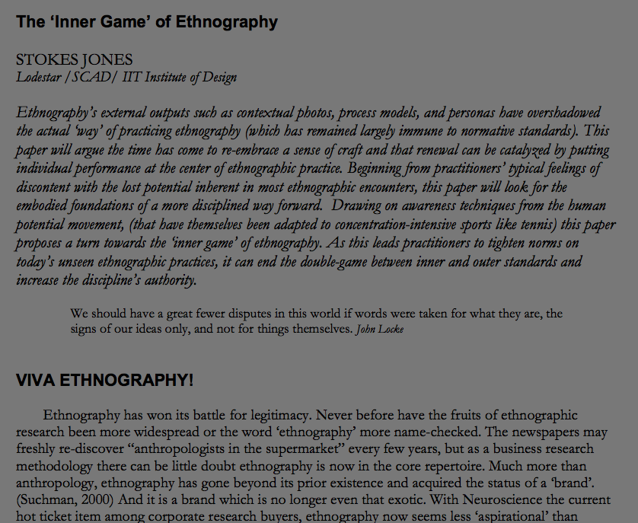
Ethnography (v.)
A method of research; the business of “doing” ethnographic work in the field or to create an ethnography (n.)
Notes:
That brings me to ethnography the verb – the method. This is the part where we go out and do stuff.
Here we have the difference between applied and “real” anthropologists… not a distinction that anyone ever spelled out for me. I fell into it accidentally and realized that it’s a troubled conundrum.
This is where EPIC comes in.
Two QUICK Paper examples

Slide 15
Let’s bring this back to Earth …
Notes:
https://www.youtube.com/watch?v=nV0jY5VgymI

Slide 16
Quick Usefulness
Know when to do it yourself.

Slide 17
Let’s now ask some questions.
Notes:
https://www.youtube.com/watch?v=nV0jY5VgymI

Slide 18
What’s wrong with your questions?
Notes:
https://www.youtube.com/watch?v=nV0jY5VgymI

Slide 19
How to Ask: Tips
Confidentiality is important, communicate it to them.
Choose a comfortable setting for the interview that is free from distractions.
Questions should be worded clearly.
Questions should be asked one at a time.
Question order is important!
Do not ask leading questions.
Avoid biasing responses (be neutral).
o Do not share your hypotheses (if applicable).
o Do not use emotional, loaded or biased language.
o Be careful about what your behavior conveys to participants (e.g., expressions of
surprise, jumping to take notes).

Slide 20
How to Ask: Tips
Avoid questions that can be answered with “yes” or “no” (Ask open ended questions.)
Ask for elaboration. (Probe)
Be careful about the appearance when note taking.
Provide transition between major topics.
Don't lose control of the interview.
The last questions might be to allow respondents to provide any other information they prefer to add and their impressions of the interview
Be careful asking "why" questions.
Do not be a robot!

Slide 21
Quick Usefulness
Career Development… a bit.

Slide 22
Take Homes, What are they?
Why/When User Research? (ProTip?)
Activity
Anthropological Grounding
Methods – Asking or Watching
Questionnaires
Interviews

Slide 23
Homework
ITERATE Questions from Last Week.
Deliverables:
1. Email a revision of the questions you asked last week, with some additional questions added.
2. Write a rationale for an observation study.
Reading.
http://www.nngroup.com/articles/usability-101-introduction-to-usability/
http://www.nngroup.com/articles/how-many-test-users/
Select a Project!
3. Deliverable: Know it next week.

Slide 24
Ask me questions!

