Slide 1


Shri Ramdeobaba College of Engineering & Management, Nagpur
Department of Computer Science & Engineering(AIML)
Session 2024-25
SEMINAR
ON
ML-DRIVEN LEAF DISEASE PREDICTION SYSTEM
Presented By:
Group No:5
Group members:
1) SUJAL TRIVEDI
2) ARYA WANKHADE
3) VINAYAK SAHU
4) AKASH PUROHIT
Guided By:
(Dr.Amit Pimpalkar)

Slide 2
Content
Introduction
Motivation
Literature Survey
Objectives
Proposed Plan of Work(Flow chart, use case diagram)
Technology
Expected Outcome
Summary
Timeline
References

Slide 3
Introduction
Plant diseases pose a major risk to global agriculture and food security, reducing crop yields significantly.
Timely detection is essential to prevent disease spread and limit economic damage to farmers.
Traditional methods rely on slow, expert-driven visual inspections of plants.
Advances in machine learning and image processing offer efficient, automated solutions for disease detection.
Leaves, being highly visible, often show early signs of disease, such as discoloration, wilting, deformation, or spots.

Slide 4
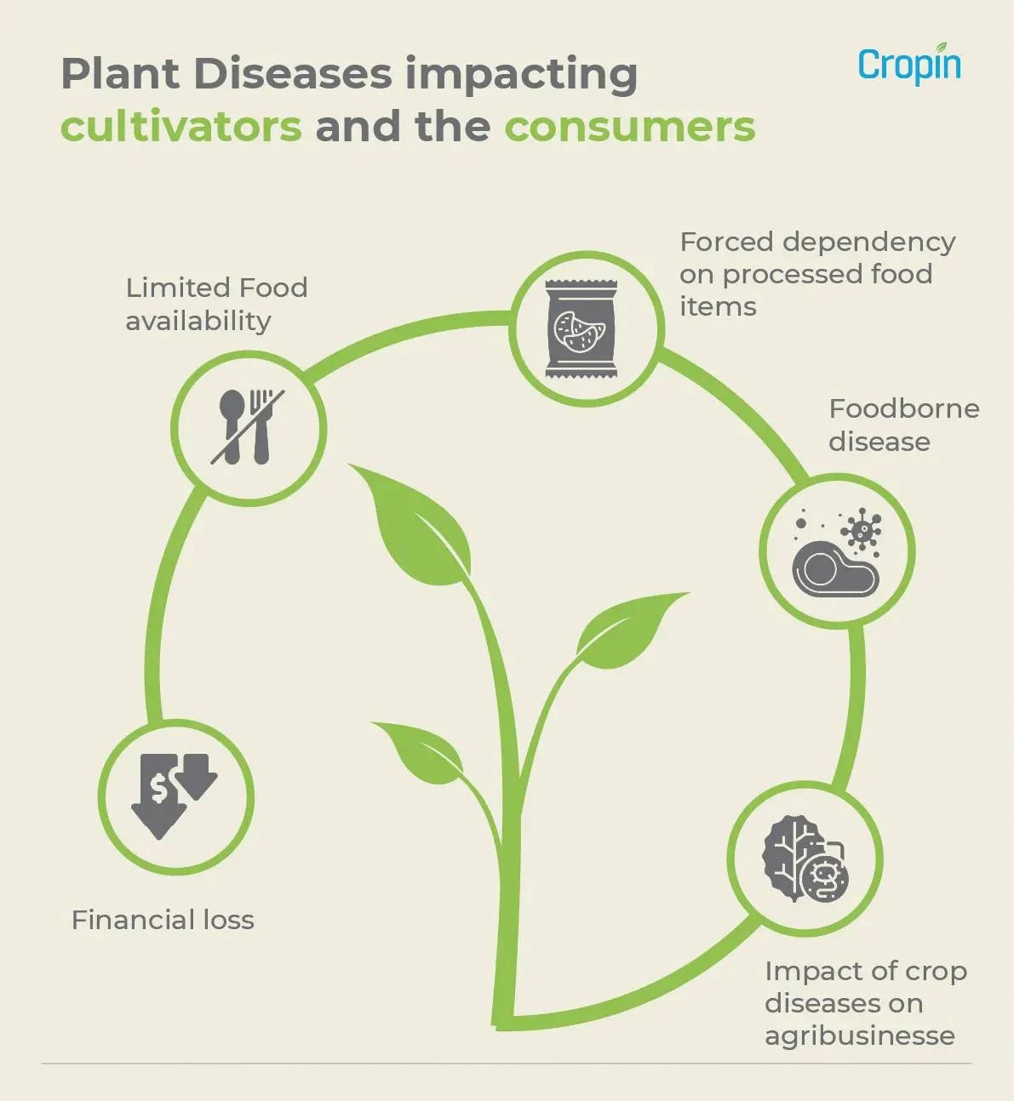
Motivation
Fungal infections account for 10% to 23% of global crop production losses, severely impacting crops like wheat, maize, and potatoes.
Up to 40% of global crop losses are due to plant pests and diseases, affecting staple crops in regions like sub-Saharan Africa and Southeast Asia.
The need is early detection using machine learning reduces crop losses and improves yield in resource-constrained areas.
Machine learning models quickly analyze data to identify diseases, minimizing economic impact and crop losses.

Slide 5
LITERATURE SURVEY​
Ref no. | Year | Approach/Model /Algorithm | Work Done | Source/Dataset | Findings and Accuracy
1 | 2024 | CNN and YOLO models are used for detecting and classifying plant diseases. | Tomato disease detection achieved using a U-Net model. | PlantVillage dataset (50,000 images) | model achieved up to 99.66% accuracy for rice leaf disease detection.
2 | 2024 | SVM, Random Forest, KNN | LDI-NET combines CNN and transformer models with a multi-label method for identifying plant type, disease, and severity. | The AI Challenger dataset, (30,000 images) | LDI-NET achieved 99.42% plant-disease-severity accuracy, outperforming baseline models.
3 | 2024 | The study used CNN, VGG-16, VGG-19, and ResNet-50 models for crop disease prediction. | Experiments were conducted on the PlantVillage dataset. | The PlantVillage dataset. (10,000 images) | ResNet-50 achieved the highest accuracy of 98.98%, outperforming other models like VGG-16 and VGG-19
4 | 2024 | Transfer learning using ConvNets (CNN) | Developed a model using deep learning to predict black pepper leaf diseases. | Dataset containing(1,800 images) | The ResNet-18 model achieved the highest accuracy of 99.67%.
5 | 2023 | Pre-trained Convolutional Neural Networks (CNN) on ImageNet. | Classified diseases using six different CNN models and compared their performances. | PlantVillage dataset(24,304 images) | EfficientNet achieved the highest classification accuracy of 97.5%.

Slide 6
Plants and their Diseases
01
Black_rot
Grape_Esca(Black Measles)
Grape_Leaf_blight
GRAPES
02
Apple_scab
Black_rot
Cedar_apple_rust
APPLE
03
Cercosora_leaf_spot Gray_leaf_spot
common_rust
Northern_leaf_Blight
CORN

Slide 7
Plants and their Diseases
04
Early_blight
Late_blight
POTATO
05
TOMATO
Bacterial_spot
Early_blight
Late_blight
leaf_Mold
leaf_Mold
septoria_leaf_spot
Spider_mites Two
Spotted_spider_mite
Target_spot
mosaic_virus

Slide 8
OBJECTIVES
1
ML Model for Disease Detection
CNN to classify 25 diseases across 5 crops, helping farmers manage crop health.
Efficient Image Processing
Techniques like resizing and normalization for accurate disease detection.
2
3
Real-Time Prediction Interface
Web tool for instant disease diagnosis.

Slide 9




PROPOSED PLAN OF WORK:-
STEP1 :- DATA COLLECTION AND PREPROCESSING
STEP 2 :- MODEL DEVELOPMENT
STEP 3 :-INTEGRATION
STEP 4:- TESTING AND REFINMENT

Slide 10
Basic Flowchart of Disease Detection & Classification
DATA/IMAGE COLLECTION
Resizing
DATA PREPROCESSING
Normalization
CNN
MODEL TRAINING
K-fold cross validation
MODEL TESTING
Web Interface(UI)
MODEL DEPLOYMENT
USER INPUT AND REAL TIME PREDICTION

Slide 11
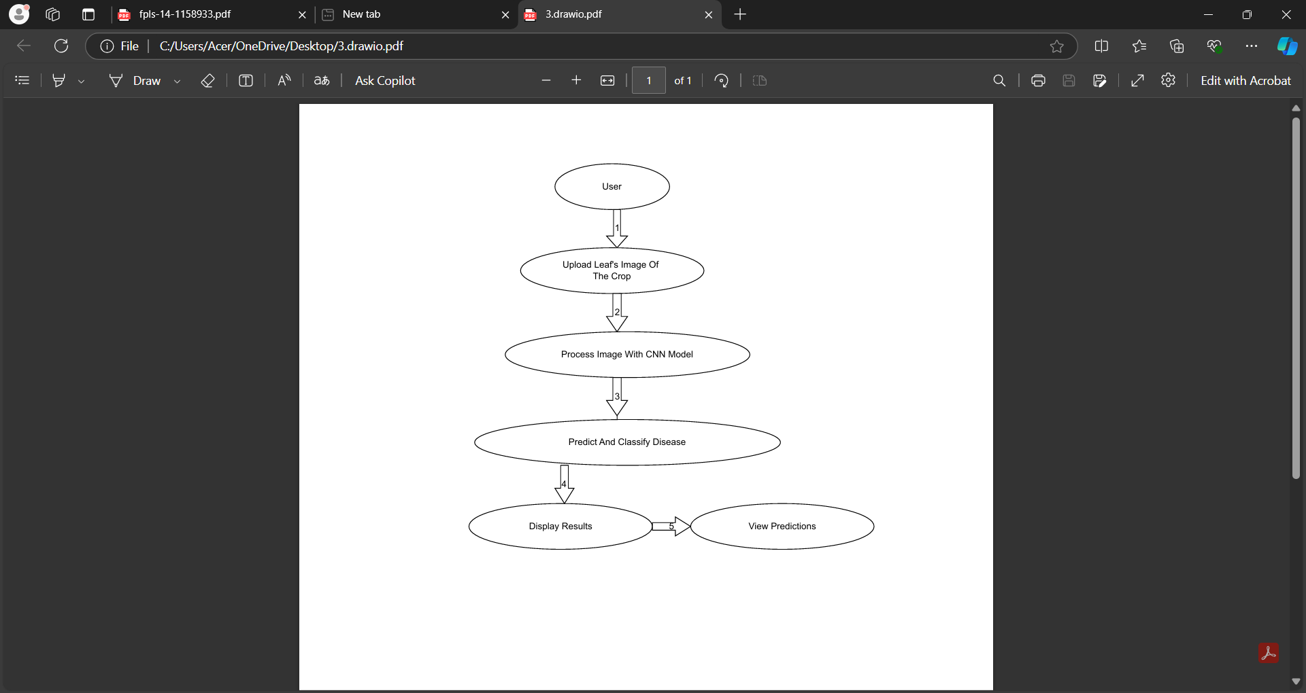
User case Diagram:-
USER CASE DIAGRAM

Slide 12

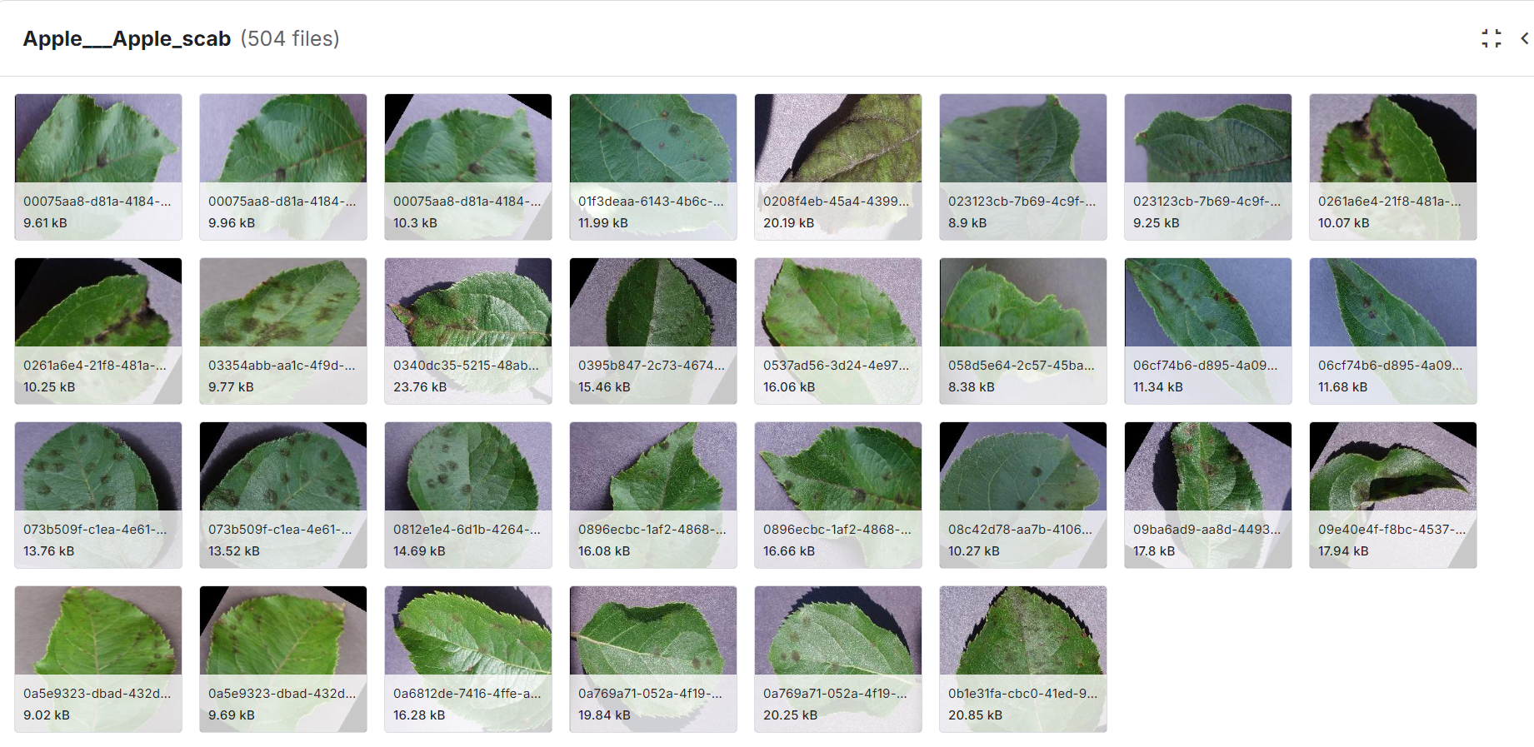
DATASET OVERVIEW
Crop and Disease Count | Total Count (with %)
Apple:-4 | 7771(16.77%)
Tomato:-10 | 18345(39.55%)
Grapes:-4 | 7222(15.59%)
Potato:-3 | 5702(12.30%)
Corn:-4 | 7316(15.79%)
Total:-25 | 46356(100%)
Plant Diseases Dataset:-https://www.kaggle.com/datasets/vipoooool/new-plant-diseases-dataset

Slide 13







Technology
Data manipulation and analysis
Collaboration with team
CNN Model development
Find datasets and test models
Build interactive web applications
CNN Model development

Slide 14
EXPECTED OUTCOME
Accurate
Disease
Detection
Real
Time
Prediction
Scalable
Solutions
Enhanced
Crop
Management

Slide 15
SUMMARY
AI-Powered Disease Detection: Leveraging machine learning (CNN) to accurately identify 25 diseases across 5 crops from images.
Farmer-Centric Tool: A real-time, easy-to-use platform offering farmers rapid crop disease diagnosis.
Precision Agriculture: Providing data-driven insights to optimize crop health, reducing the impact of diseases through timely interventions.
Actionable Recommendations: Offering farmers tailored disease management advice to improve crop health and yield outcomes.

Slide 16
Timeline
Stage:1
Data Collection & Preprocessing
Stage:2
20XX
Model Development
Stage:3
Collected crop disease images.
Preprocessed (resize, normalize, label).
Integration & Interface
Stage:4
Built CNN for image classification.
Used cross-validation for tuning.
Testing & Refinement
Integrated model into Streamlit.
Created user-friendly prediction interface.
Tested on new data.
Improved model accuracy.

Slide 17
REFERENCES
1] Van Klompenburg, T., Kassahun, A., & Catal, C. (2020). Crop yield prediction using machine learning: A systematic literature review. Computers and Electronics in Agriculture, 177*, 105709. https://doi.org/10.1016/j.compag.2020.105709
2] Shoaib, M., Shah, B., EI-Sappagh, S., Ali, A., Ullah, A., Alenezi, F., Gechev, T., Hussain, T., & Ali, F. (2023). An advanced deep learning models-based plant disease detection: A review of recent research. Frontiers in Plant Science, 14, 1158933. https://doi.org/10.3389/fpls.2023.1158933
3] Saleem, M. H., Potgieter, J., & Arif, K. M. (2019). Plant disease detection and classification by deep learning. *Plants, 8*(11), 468.
https://doi.org/10.3390/plants8110468
4] Demilie, W. B. (2024). Plant disease detection and classification techniques: A comparative study of the performances. *Journal of Big Data, 11*(5).
https://doi.org/10.1186/s40537-023-00863-9
5] Mohanty SP, Hughes DP, Salathé M. Using Deep Learning for Image-Based Plant Disease Detection. Front Plant Sci. 2016 Sep 22;7:1419. doi: 10.3389/fpls.2016.01419. PMID: 27713752; PMCID: PMC5032846.
https://doi.org/10.3389%2Ffpls.2016.01419
6] Vasavi, P., Punitha, A., Venkat Narayana Rao, T. (2023). Chili crop disease prediction using machine learning algorithms. Revue d'Intelligence Artificielle, Vol. 37, No. 3, pp. 727-732.
https://doi.org/10.18280/ria.370321

Slide 18
THANK YOU !

