Slide 1
JENKINS ON AWS EC2
Freestyle Project
Build & Verification
A screenshot-based walkthrough: plugin setup, job troubleshooting, and successful builds.
Prepared from the supplied Jenkins screenshots • 12 October 2026
Jenkins Freestyle Job • Step-by-step project documentation
01

Slide 2
JENKINS • AWS EC2
Project workflow
01
Check the queue
02
Finish setup
Identify executor or agent availability issues.
Wait for Jenkins plugin installation to complete.
03
Review the job
04
Run & verify
Open demo-freestyle and verify build steps.
Use Build Now and confirm a green successful result.
Jenkins Freestyle Job • Step-by-step project documentation
02

Slide 3
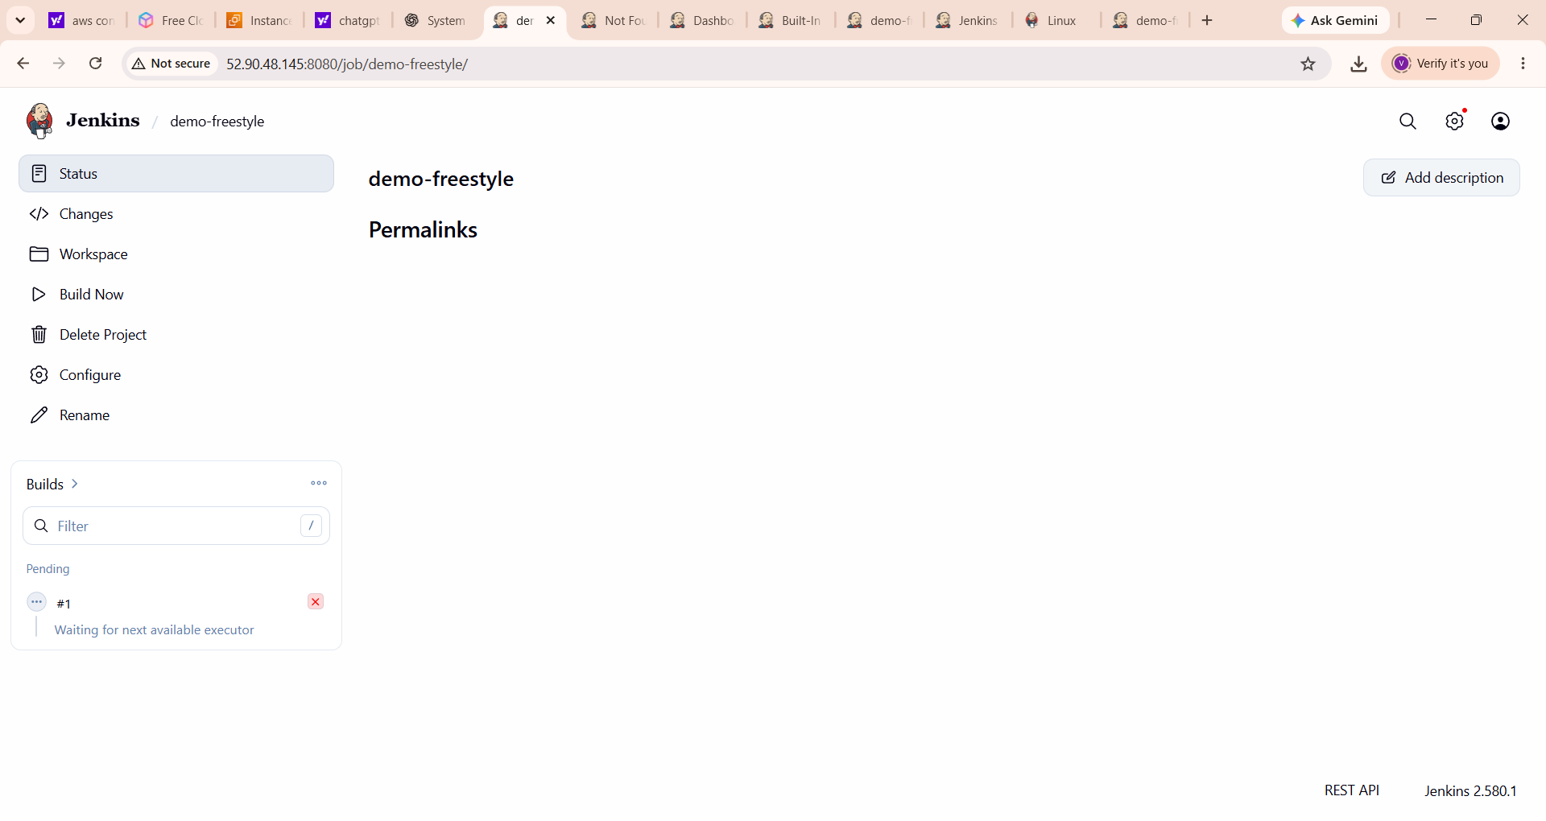
JENKINS • AWS EC2
1. Initial Jenkins Build Queue
The demo-freestyle job was waiting for an available executor. This identified the first issue to troubleshoot.
Jenkins Freestyle Job • Step-by-step project documentation
03

Slide 4
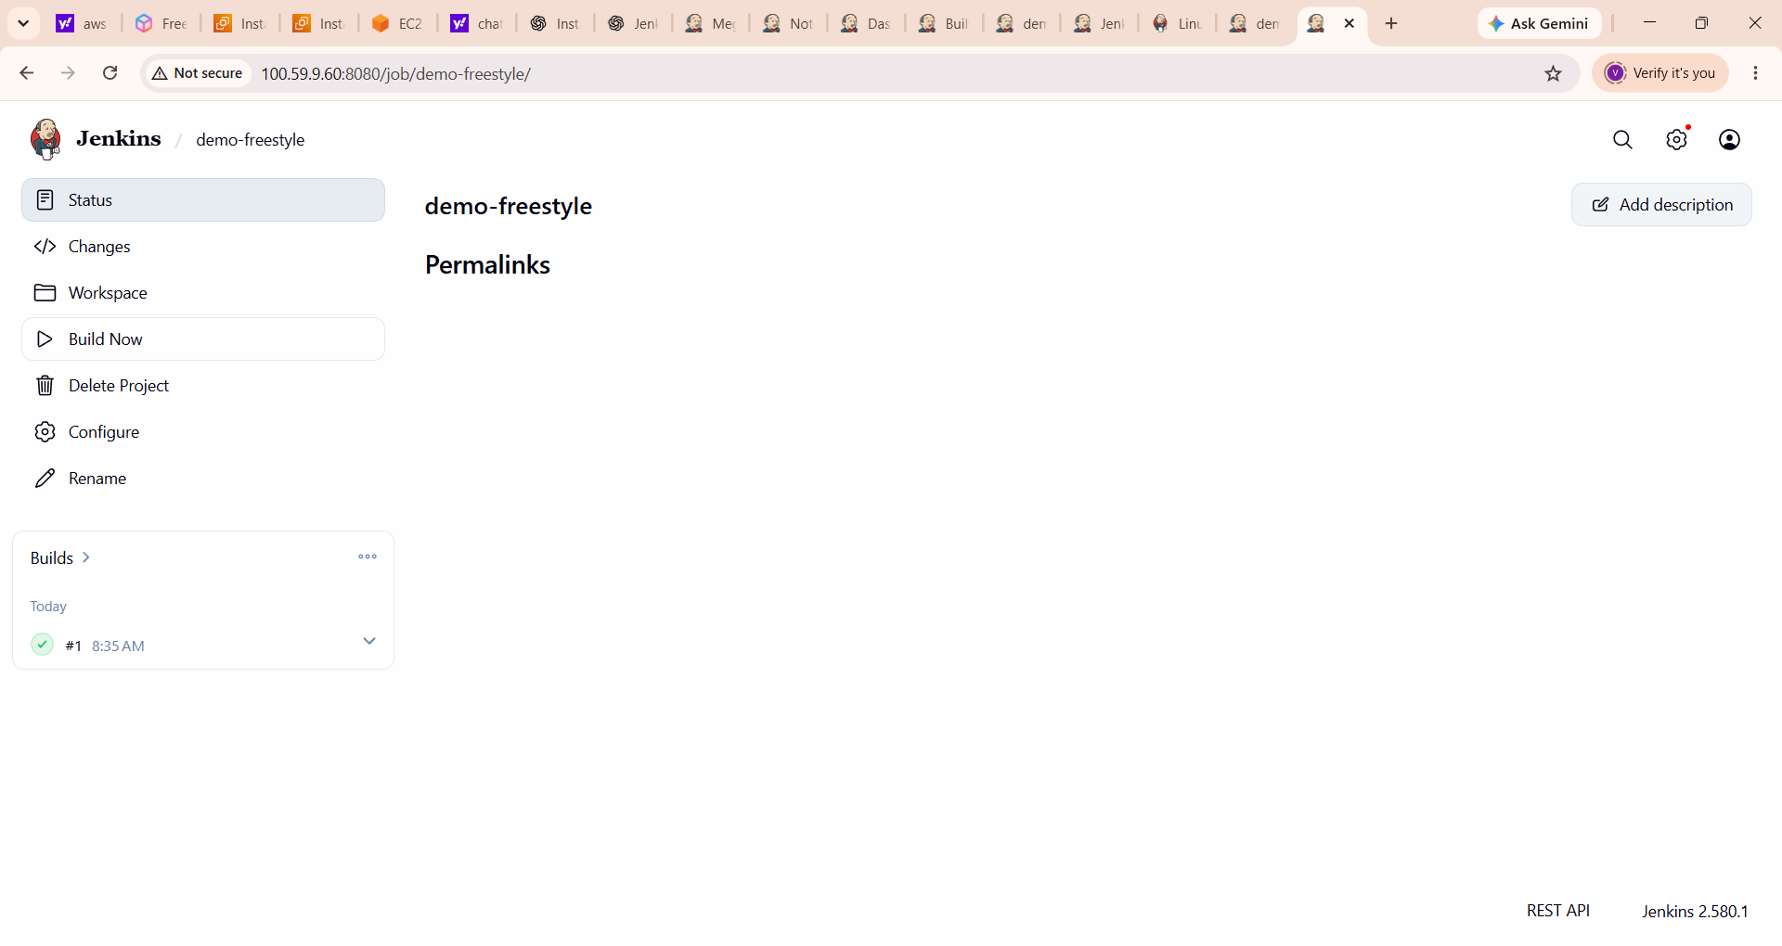
JENKINS • AWS EC2
3. Jenkins Project Page
Return to the demo-freestyle project. Use Configure to review the build steps, then save any corrections before starting a build.
Jenkins Freestyle Job • Step-by-step project documentation
05

Slide 5
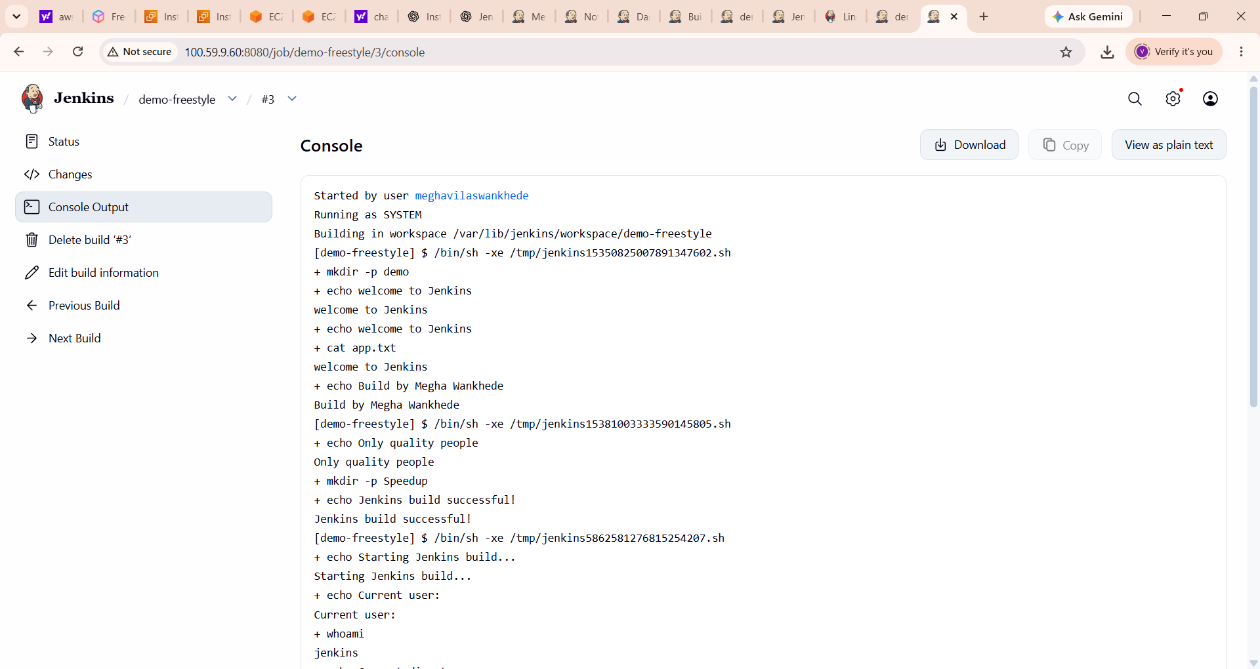
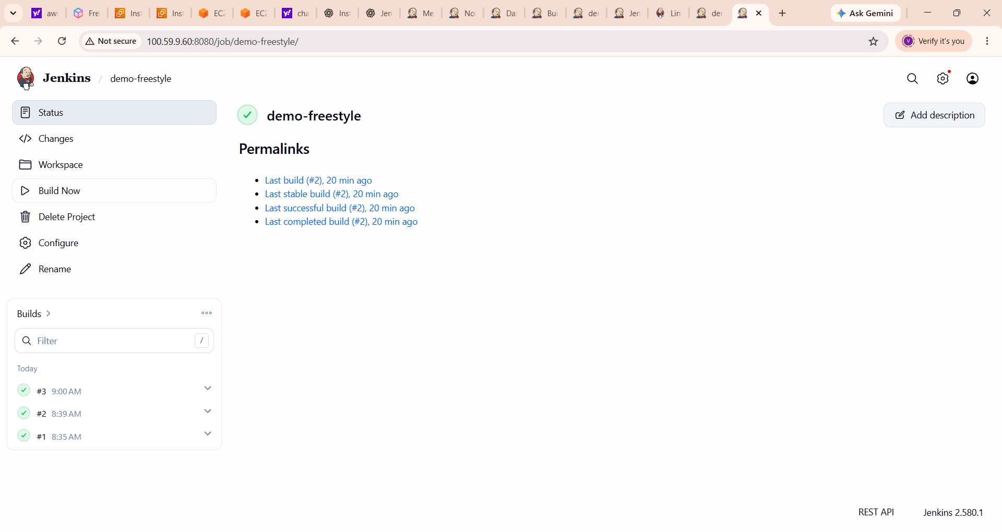
JENKINS • AWS EC2
4. Successful Build History
The green check marks and successful-build links confirm that builds completed successfully. Build #3 is the latest shown in this screenshot.
Jenkins Freestyle Job • Step-by-step project documentation
06

Slide 6
JENKINS • RUNBOOK
Run the next build
1. Open the demo-freestyle job.
2. Select Configure and review the Execute shell step.
3. Save the job configuration.
4. Click Build Now.
5. Open the latest build number → Console Output.
6. Confirm the log ends with: Finished: SUCCESS.
Troubleshooting: if a build stays pending, check Manage Jenkins → Nodes and verify the built-in node is online with an available executor.
Jenkins Freestyle Job • Step-by-step project documentation
07

