Slide 1

Hong Kong
Linux User Group
2012-2013
Prepared and Presented
by Haggen
Released under Creative Commons Attribution 3.0 Hong Kong Licence

Slide 2
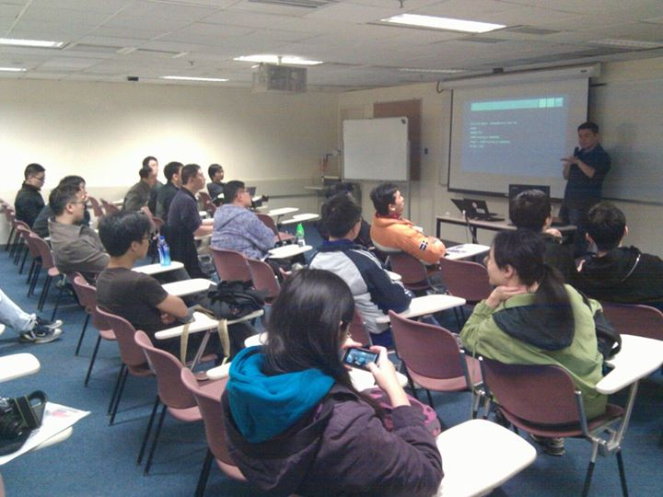
Open Source Workshop
2012: Aug,Oct
2013: Feb,Mar,May,Jun

Slide 3
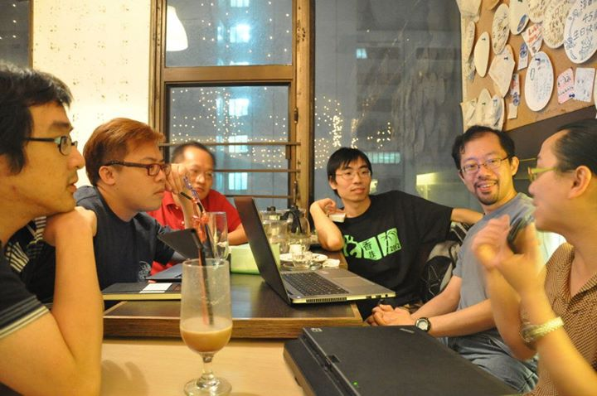
Hacking Thursday
2012: Jul-Dec
2013: Jan-Mar,May

Slide 4
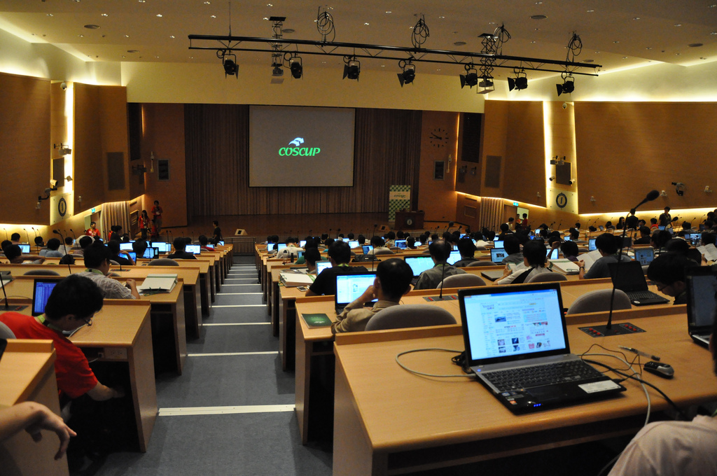
COSCUP Taiwan
2012: Aug

Slide 5
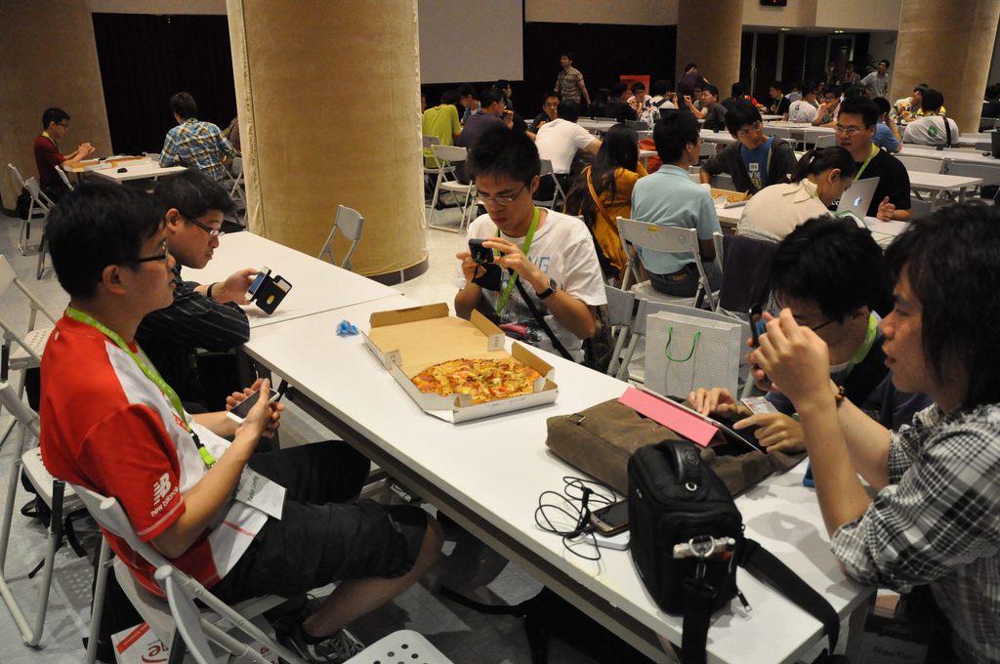
COSCUP Taiwan
2012: Aug

Slide 6
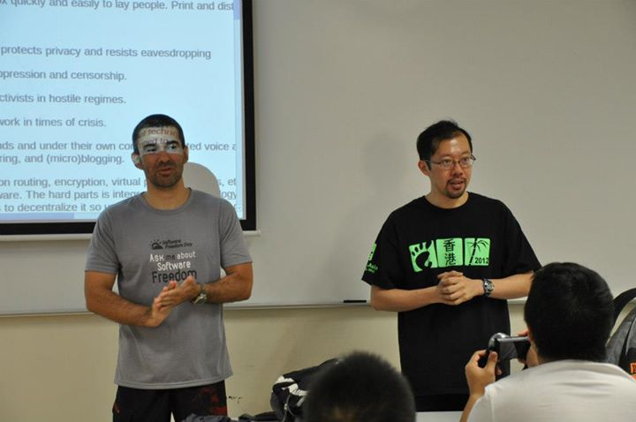
Software Freedom Day
2012: Sep

Slide 7
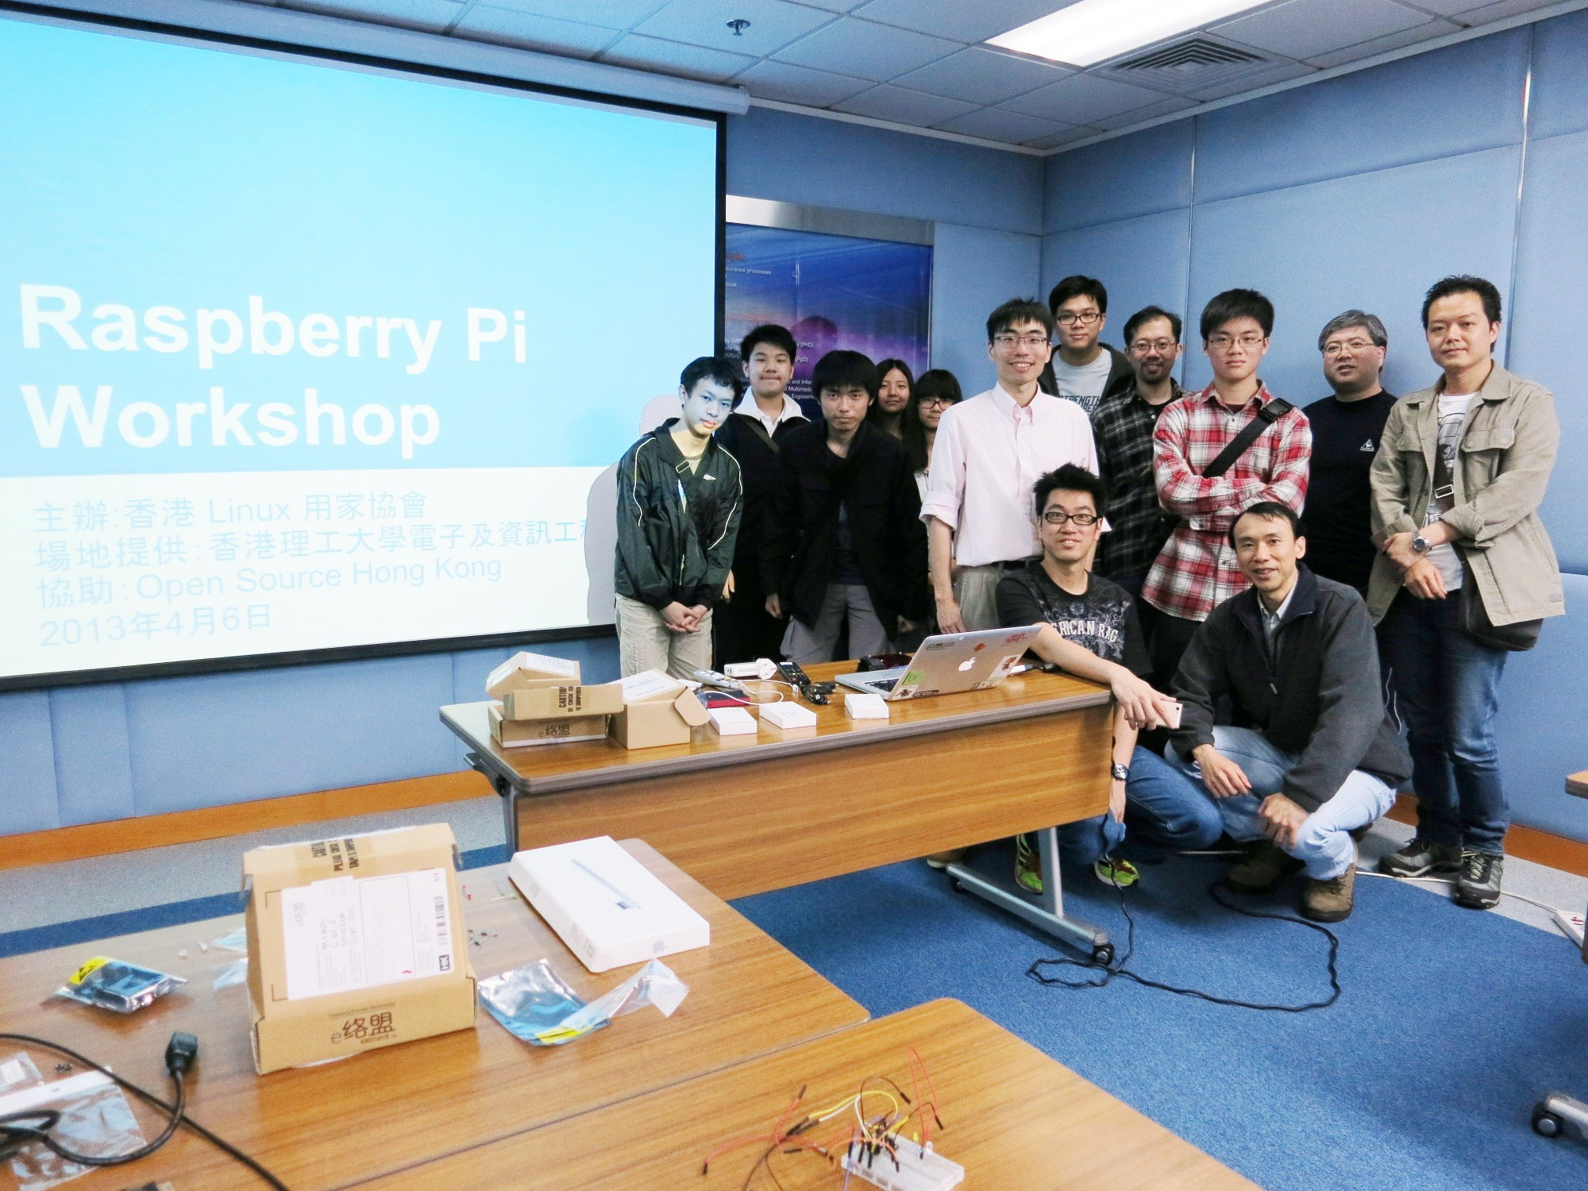
Raspberry Pi
2013: Apr

Slide 8
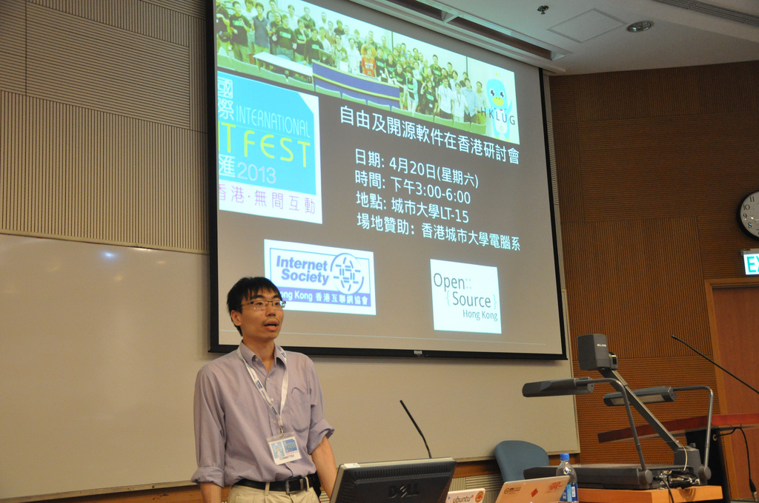
ITFest
2013: Apr

Slide 9
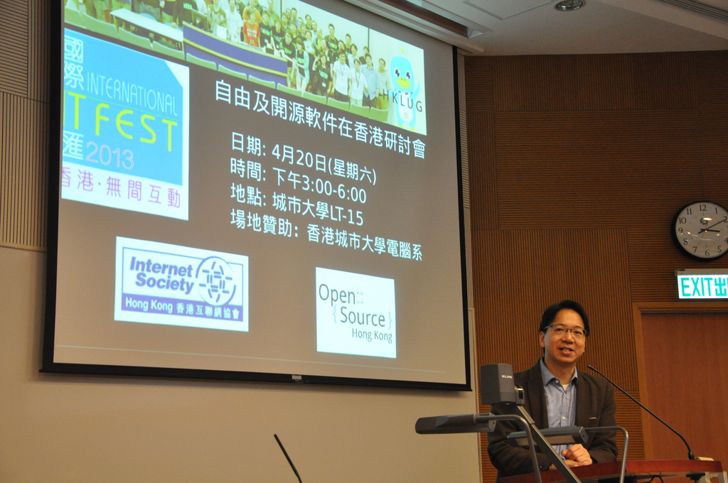
ITFest
2013: Apr

Slide 10
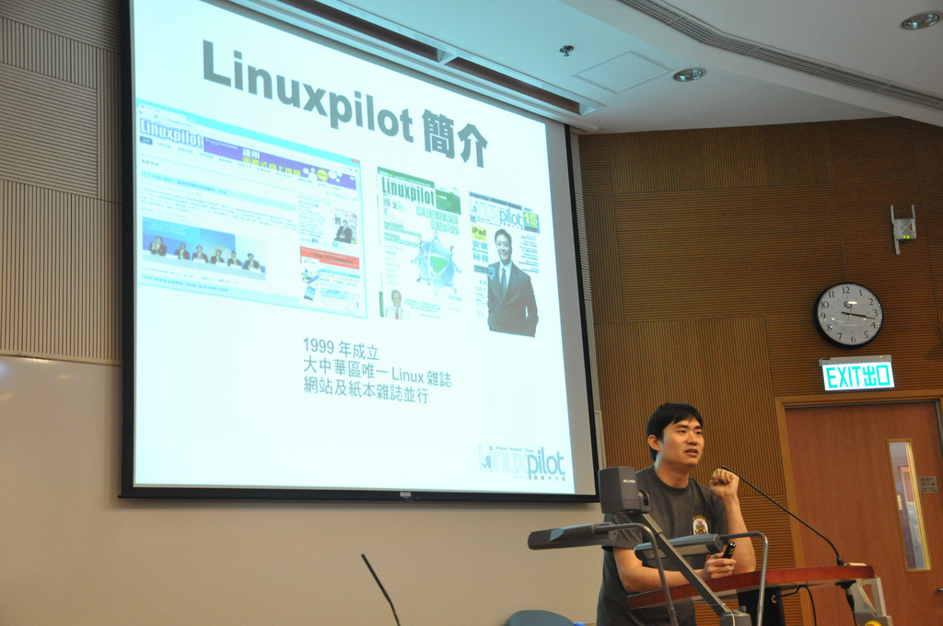
ITFest
2013: Apr

Slide 11
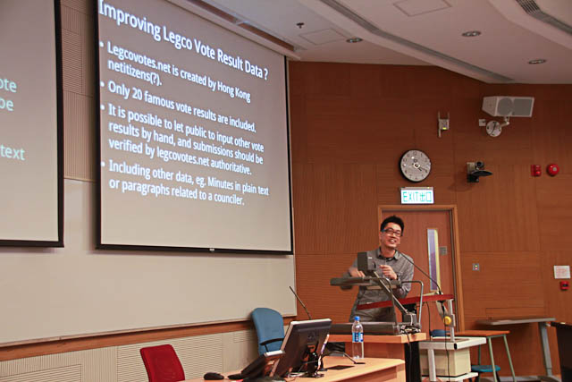
ITFest
2013: Apr

Slide 12
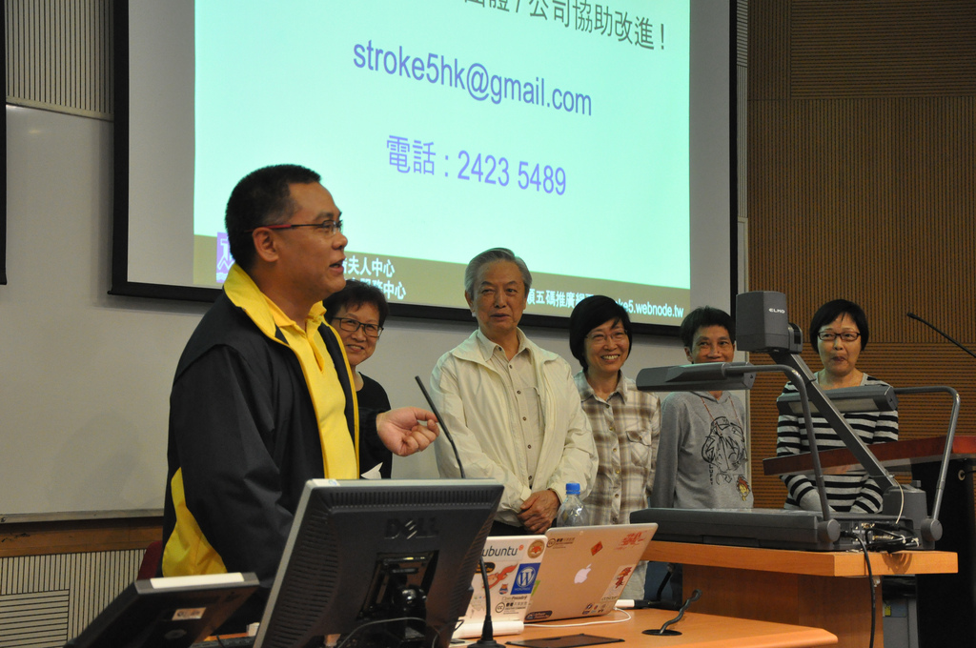
ITFest
2013: Apr

Slide 13
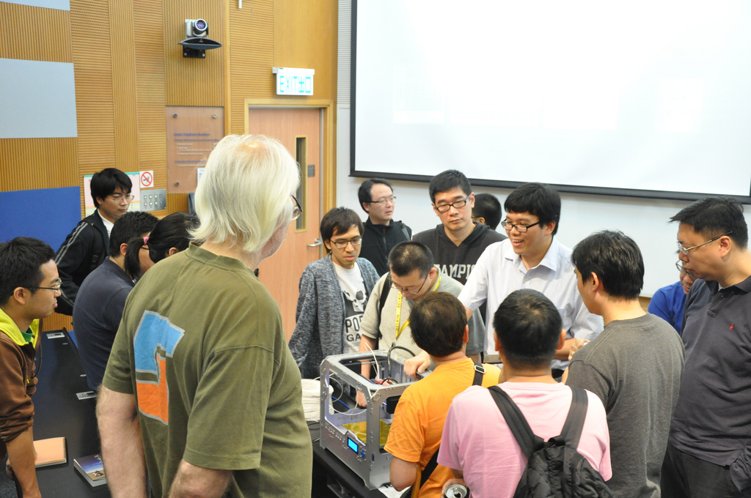
ITFest
2013: Apr

Slide 14
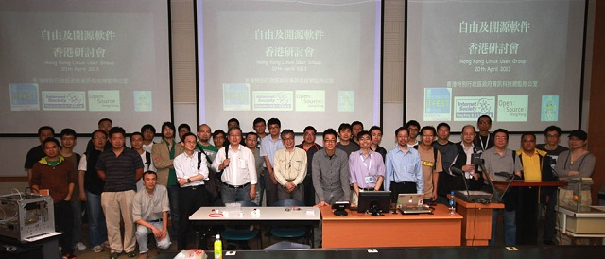
ITFest
2013: Apr

Slide 15
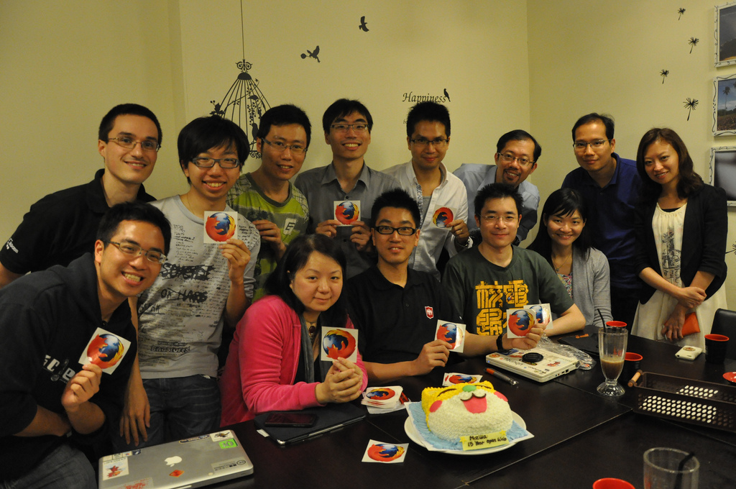
Mozilla 15 Yrs
2013: Apr

Slide 16
What about
the Coming Year?

Slide 17
Photo Credits
All Photos by Sammy Fung
Except ITFest Sammy Fung
and Group Photos from OGCIO
HKLUG Logo designed by Ronald Hung

