Slide 1
Trading Strategy Project
Wan Li
December 15, 2015

Slide 2
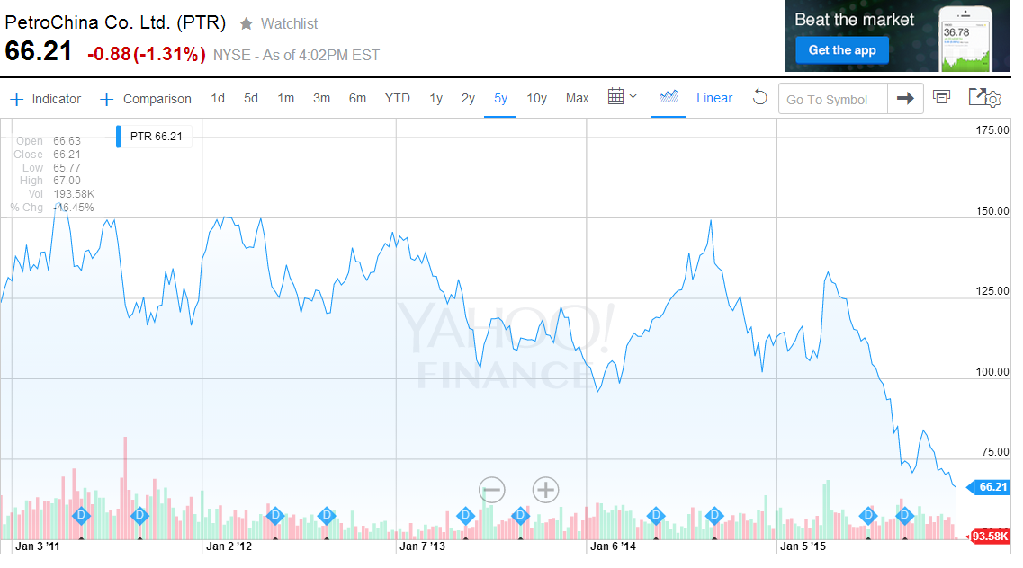
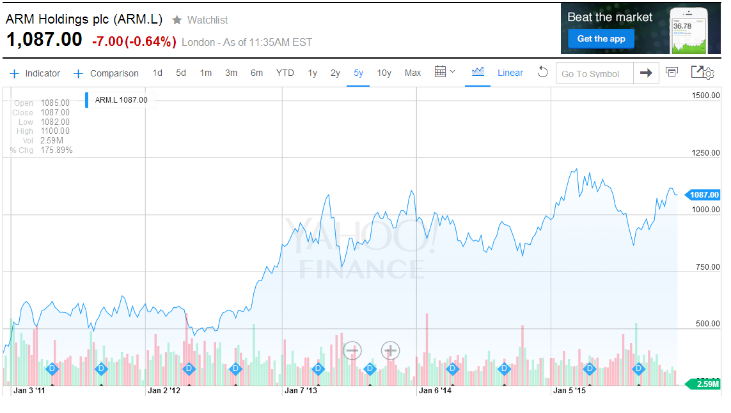
Method Sample: Time period: 5 year - 2010-11-30 to 2015- 11-30 (1259 trading days) Ticker: PTR (PetroChina Co.Ltd - NYSE), ARMA(2,2) model ARM.L (ARM Holding plc -LSE), GARCH(1,1) model Resample method: Bootstrap residuals (500 sample) Strategy: per RSI / MACD indicator 1)buy-sell 2) short-buy to close 3)mixed of buy and short strategy RSI<30, RSI<20, RSI>65,RSI>80; MACD-Signal<0, MACD-Signal>0;

Slide 3
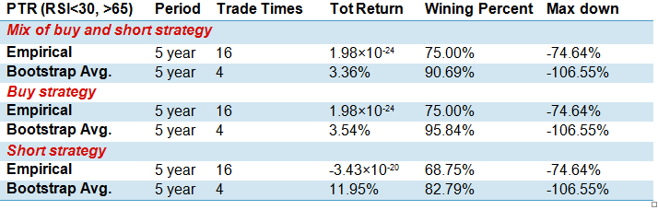
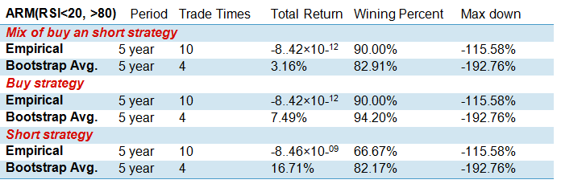
Performance Overview

Slide 4
Possible improved way:
1. Have the MACD indicator worked with other signals together to trade, like RSI and Bollinger bands etc;
2. Have volume covered which is a great information signal.
3. Trading strategy developed also needs to be optimized.
Thanks you for your time !

