Slide 1
TutorsBin
Created By Conssol LLC.

Slide 2
Why Tutorsbin?
There are great number of students with exceptional skills that aren’t being put to use.
An amazing system for student-help is being widely ignored.
There’s a demand for a more modern design philosophy when marketing towards this generation.

Slide 3
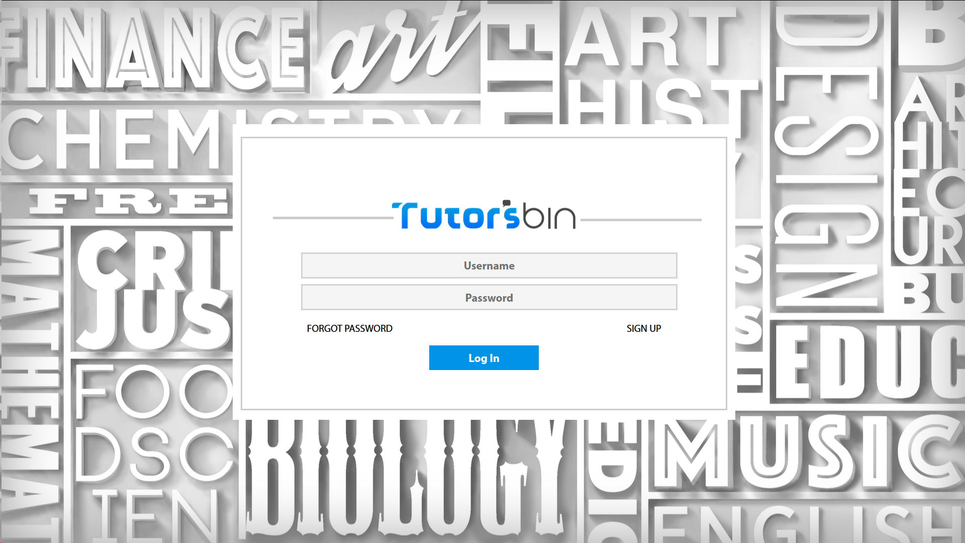
Tutor’s Bin Design Philosophy

Slide 4
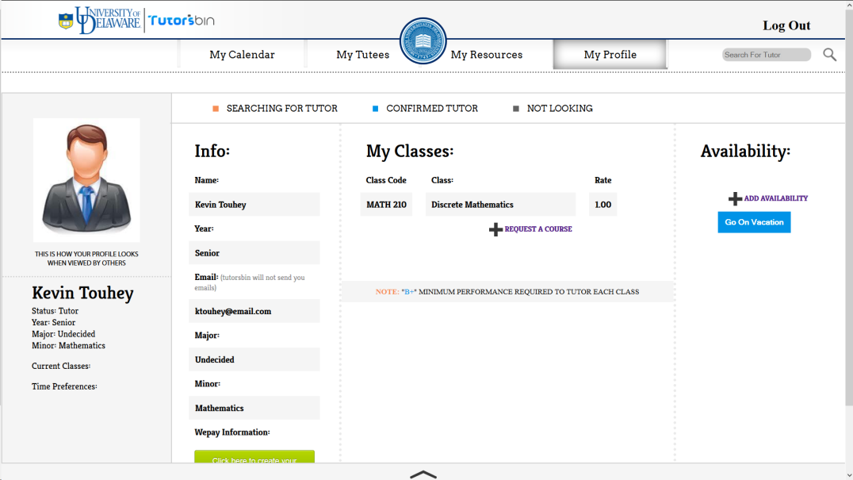
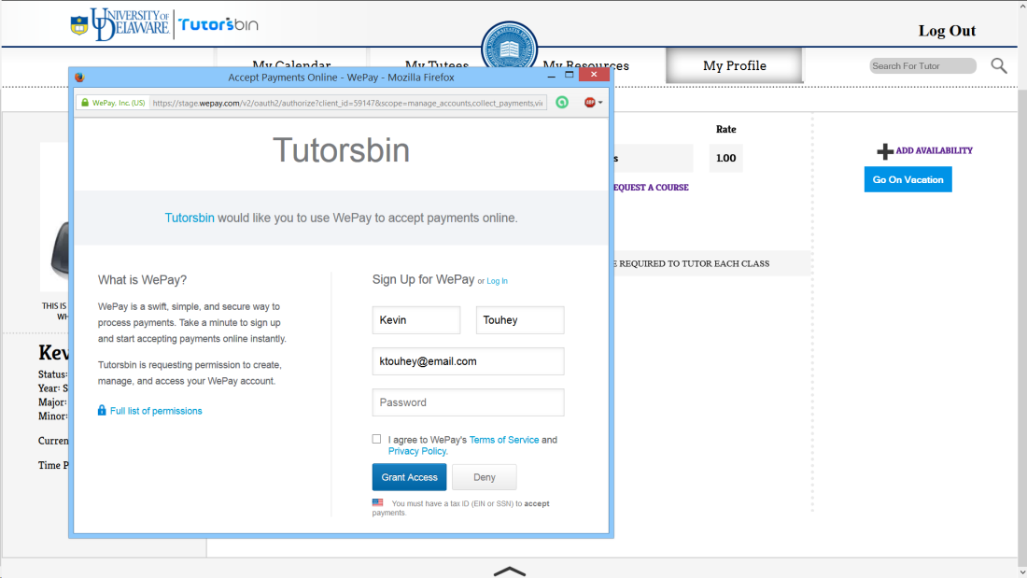
Profile
Sometimes it’s necessary

Slide 5
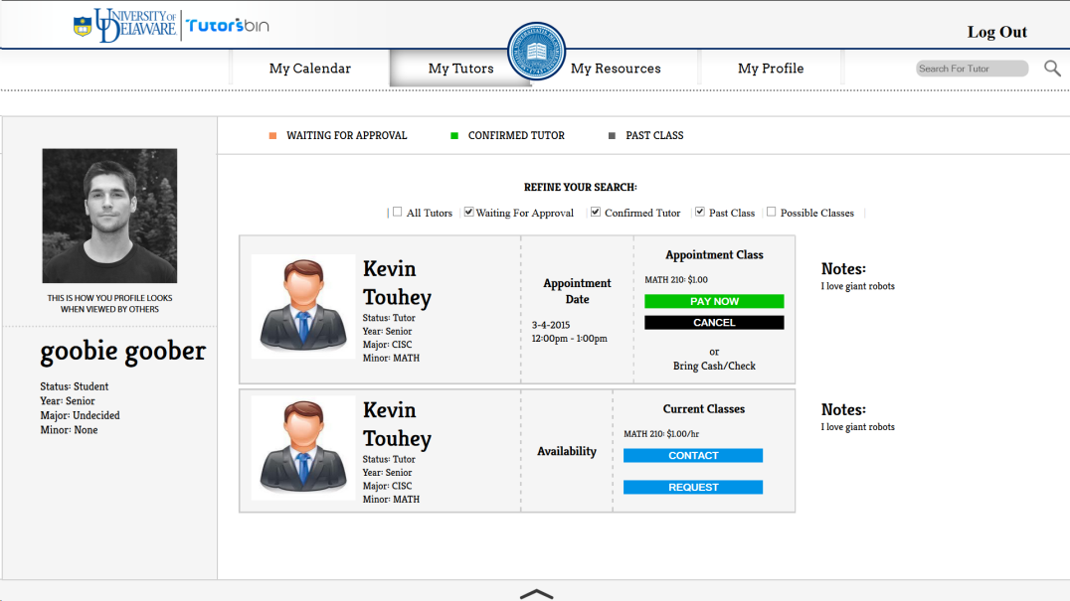
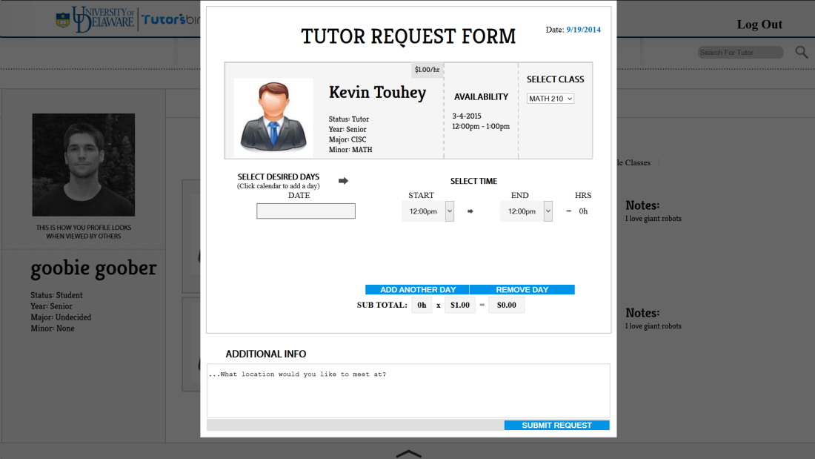
Requesting a Tutor
We want our system to be as easy to use as possible.
When requesting for tutor’s only tutors who have added the same class as you will appear.
The advanced details when making a request shows as much information as possible.
It only takes 1 minute to make a request to a tutor. It is up to the tutor to accept.

Slide 6
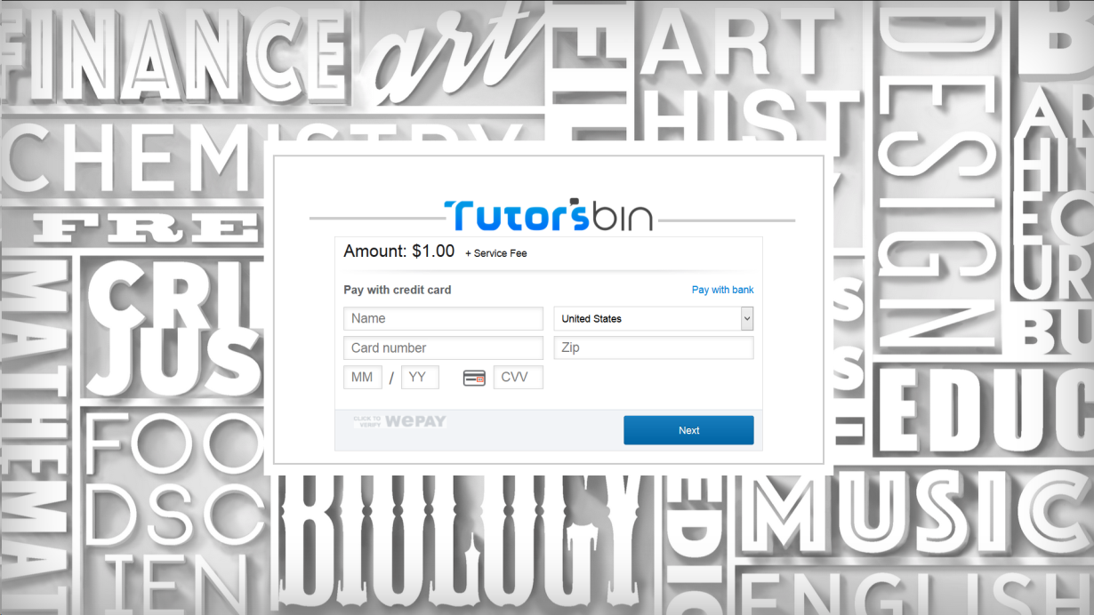
The Payment System
In most programs that offer services, it’s a necessity to have an easy way to pay for that service. Tutorsbin Offers this and:
With no liabilities
Completely integrated
With a backup system

